Slide 1
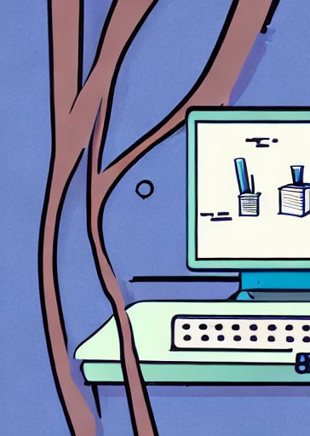
Introduction to AquaticAlgorithms
STEP-UP Internship Program
Summer 2024
Day 1

Slide 2
Outline
AquaticAlgorithms
About me
Program goals
Schedule
Resources:
GitHub
Google Colab
Case Study Overview

Slide 3




About Me: Trevor
AquaticAlgorithms
University of New Mexico
B.S. Civil Engineering with emphasis in Water Resources
Minor in Interdisciplinary Liberal Arts
Extracurriculars:
UNM4Nepal

Slide 4



About Me: Trevor
AquaticAlgorithms
Albuquerque Mid-Region Council of Governments
Bicycle transportation infrastructure
UNM Center for Water & the Environment
Nutrient dynamics in headwater streams
Virginia Tech Institute for Critical Technology & Applied Science
Peatland hydrology & restoration
Brackish Groundwater National Desalination Research Facility
Desalination & saline waste disposal in Southern NM

Slide 5
Program Goals
AquaticAlgorithms
Learn about the complexity of climate, hydrology, and their interactions with the human environment.
Learn about the role of water resource engineers, data science, and environmental modeling in the environmental management.
Become comfortable with basic coding practices and concepts; be able to interpret, run, and write beginner-level Python code.
Gain familiarity with probability and statistics concepts, how they can be used in environmental studies, and how to use code to measure them.
Complete a case study for a student-chosen location of interest, focused on the unique interactions between the hydrology and the human system.

Slide 6
Program Goals
AquaticAlgorithms
Learn about the complexity of climate, hydrology, and their interactions with the human environment.
Learn about the role of water resource engineers, data science, and environmental modeling in the environmental management.
Become comfortable with basic coding practices and concepts; be able to interpret, run, and write beginner-level Python code.
Gain familiarity with probability and statistics concepts, how they can be used in environmental studies, and how to use code to measure them.
Complete a case study for a student-chosen location of interest, focused on the unique interactions between the hydrology and the human system.

Slide 7
Program Goals
AquaticAlgorithms
Learn about the complexity of climate, hydrology, and their interactions with the human environment.
Learn about the role of water resource engineers, data science, and environmental modeling in the environmental management.
Become comfortable with basic coding practices and concepts; be able to interpret, run, and write beginner-level Python code.
Gain familiarity with probability and statistics concepts, how they can be used in environmental studies, and how to use code to measure them.
Complete a case study for a student-chosen location of interest, focused on the unique interactions between the hydrology and the human system.

Slide 8
Program Goals
AquaticAlgorithms
Learn about the complexity of climate, hydrology, and their interactions with the human environment.
Learn about the role of water resource engineers, data science, and environmental modeling in the environmental management.
Become comfortable with basic coding practices and concepts; be able to interpret, run, and write beginner-level Python code.
Gain familiarity with probability and statistics concepts, how they can be used in environmental studies, and how to use code to measure them.
Complete a case study for a student-chosen location of interest, focused on the unique interactions between the hydrology and the human system.

Slide 9
Program Goals
AquaticAlgorithms
Learn about the complexity of climate, hydrology, and their interactions with the human environment.
Learn about the role of water resource engineers, data science, and environmental modeling in the environmental management.
Become comfortable with basic coding practices and concepts; be able to interpret, run, and write beginner-level Python code.
Gain familiarity with probability and statistics concepts, how they can be used in environmental studies, and how to use code to measure them.
Complete a case study for a student-chosen location of interest, focused on the unique interactions between the hydrology and the human system.

Slide 10
Schedule
AquaticAlgorithms
Overview, basic hydrology, intro to Python, and choosing a case study location.
Intelligent piece of paper, what is a model, HYMOD, case study data coding
Sierpinski triangle activity, Into probability and stats, drought detection coding
Modeling basics, case study background research
Future of water resource planning, begin presentations, plotting
Finish case study work, peer presentations

Slide 11
GitHub
AquaticAlgorithms
What is GitHub?
GitHub is a code hosting platform for version control and collaboration. It lets you and others work together on projects from anywhere.

Slide 12





GitHub
AquaticAlgorithms
What is GitHub? Version Control

Slide 13
GitHub
AquaticAlgorithms
What is GitHub? The home-base for this program
https://github.com/TrevorJA/AquaticAlgorithms

Slide 14
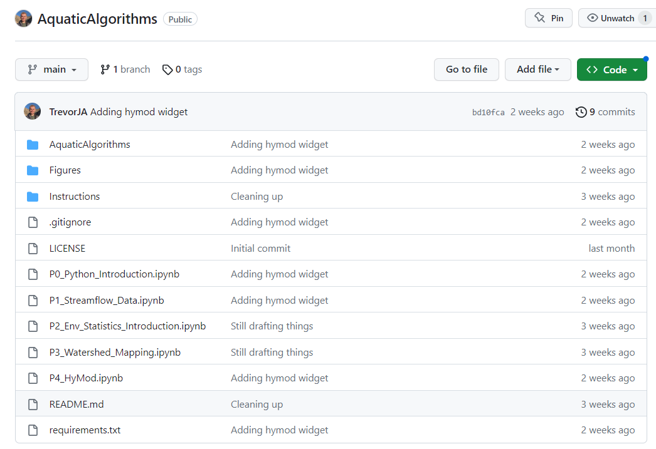
GitHub
AquaticAlgorithms
What is GitHub? The home-base for this program
All files: code, presentations, etc.

Slide 15
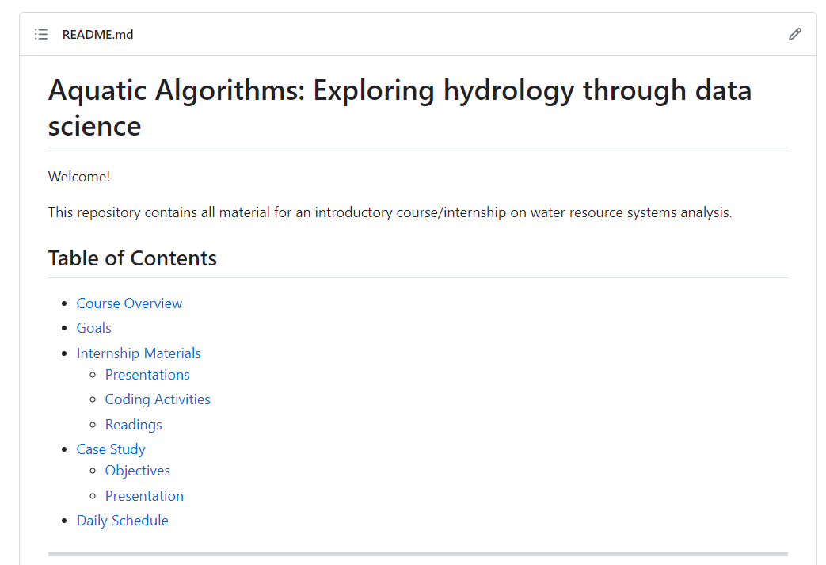
GitHub
AquaticAlgorithms
What is GitHub? The home-base for this program
Program outline, schedule, and resources

Slide 16
GitHub
AquaticAlgorithms
What is GitHub? “Repository”

Slide 17
GitHub
AquaticAlgorithms
What is GitHub? “Repository”
Repositories have files called “README.md”
These are markdown files (.md)
README files give instructions

Slide 18
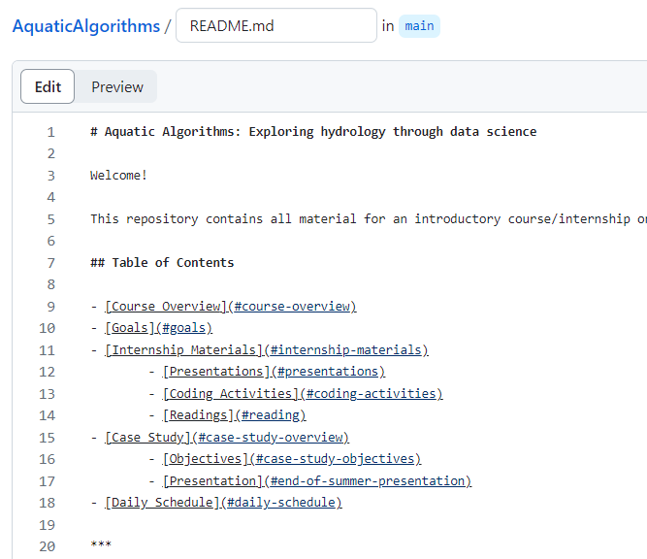
GitHub
AquaticAlgorithms
What is GitHub? “Repository”

Slide 19
Google Colab
AquaticAlgorithms
This is how we are going to do all our coding!

Slide 20
Google Colab
AquaticAlgorithms
This is how we are going to do all our coding!
Benefits:
No need to install Python or any other software
It’s easy to use
Your work can be saved on Google Drive
It’s free

Slide 21
Next Time
AquaticAlgorithms
Let’s talk about hydrology!

