Slide 1
NYC Re-optimization Figure Sequence
Summer 2026

Slide 2
Outline
1.0 Introduction
2.0 Case Study Basin
Figure: Basin map | Operational rules?
3.0 Methods
Figure: Graphical experimental diagram
Figure: DU streamflow parameterization
Results
Figure: Ensemble diagnostic

Slide 3
Methods

Slide 4
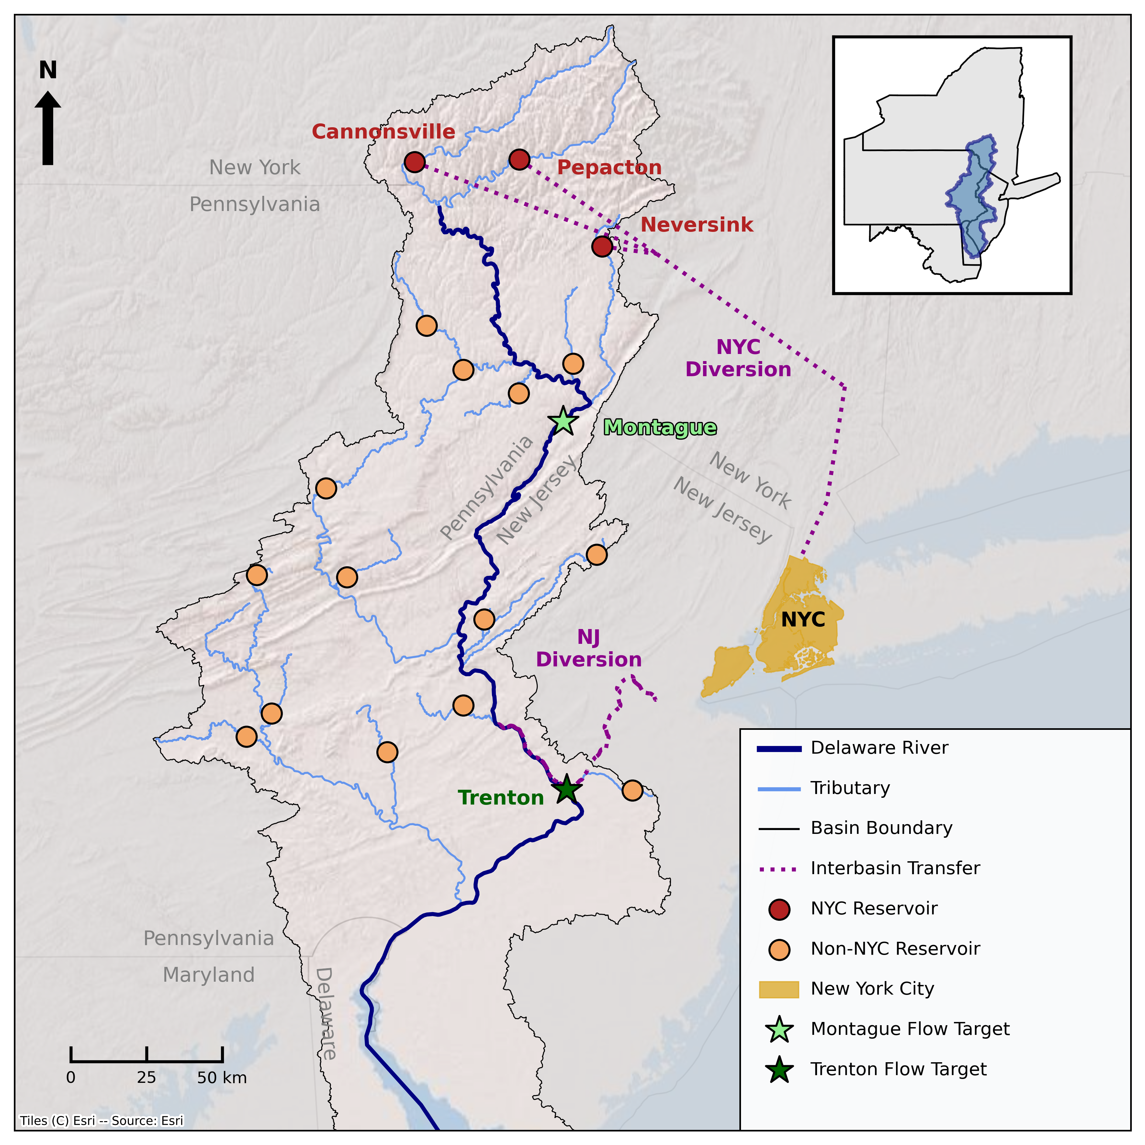
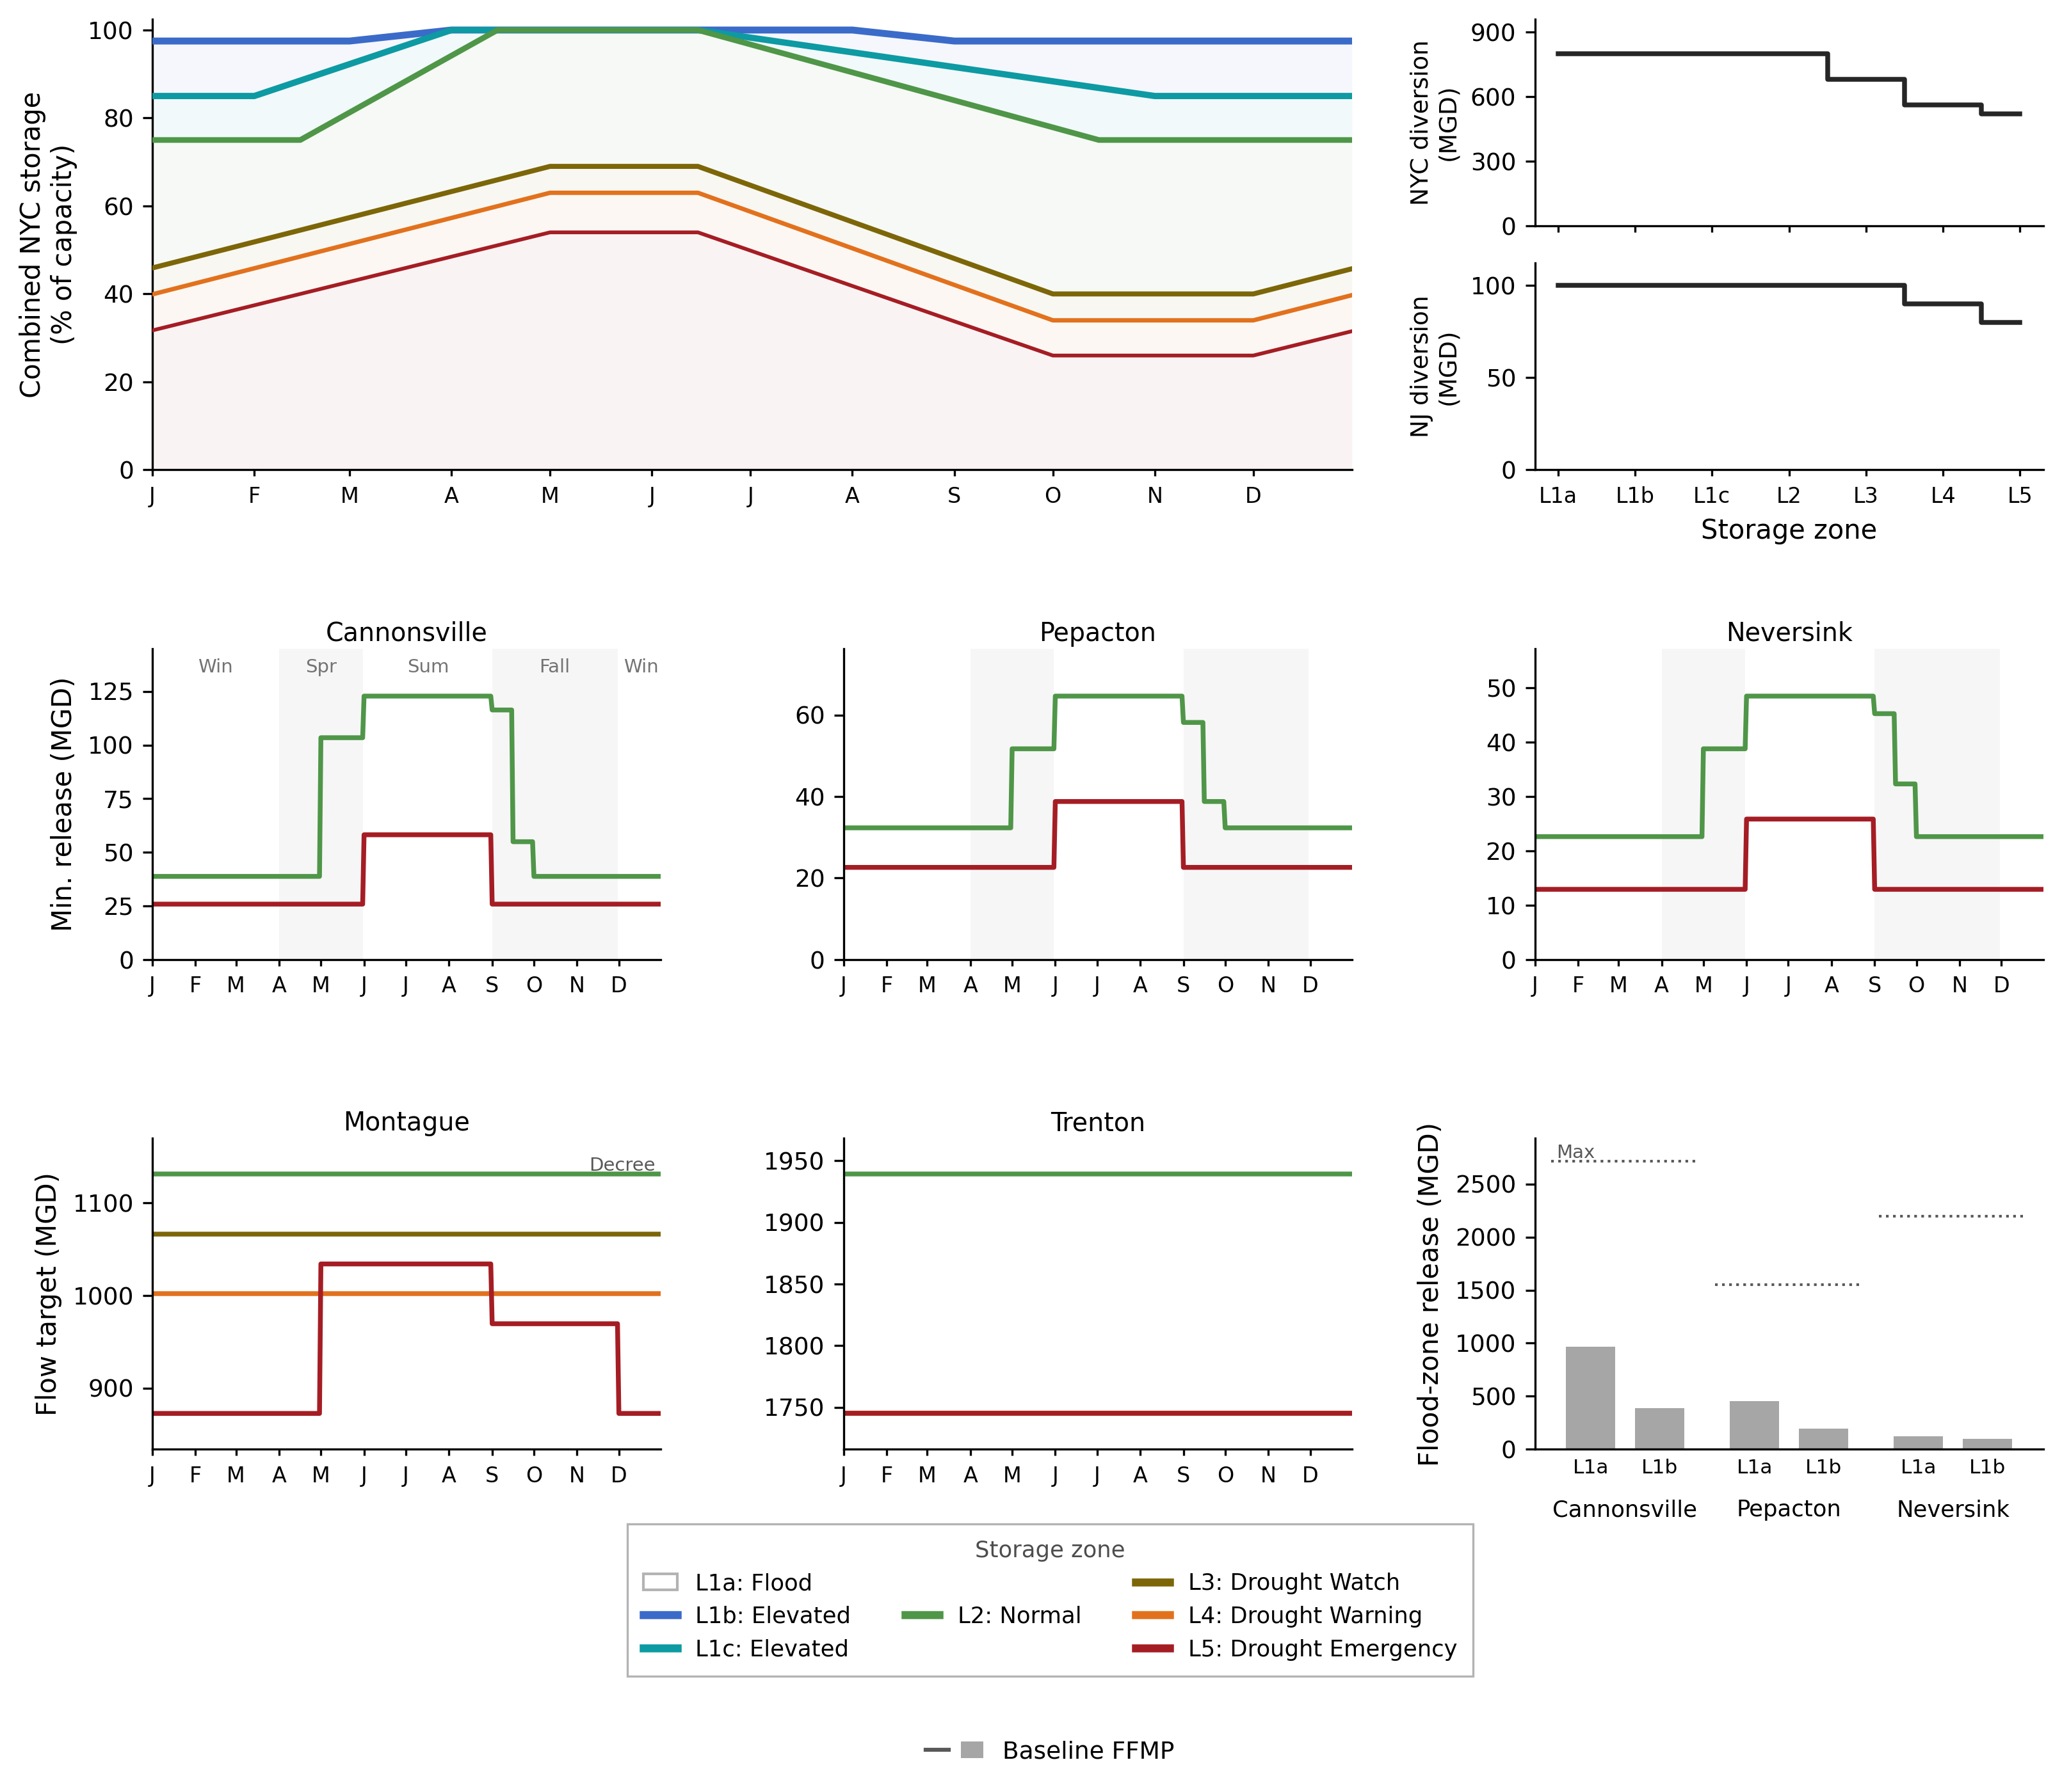
Figure 1: Basin map and operational rules

Slide 5
Figure 2: Graphical Experimental Diagram
Scenario Design
Re-evaluation & Robustness
Optimization
Historical trace (baseline)
Re-evaluation of pareto-approximate solutions across large ensemble of climate change uncertainties
MM-BorgMOEA
Well characterized (probabilistic) ensemble generated from Kirsch-Nowak
Approximate Pareto Front
Approximate Pareto Front
Approximate Pareto Front
Fixed (N-year, NFE) per optimization
5 seeds per run
Multi-criteria satisficing robustness
Regret relative to default FFMP
Multi-metric hazard space filling ensemble, sampled from very large stochastic ensemble
Deeply uncertain hydrologic future ensemble

Slide 6
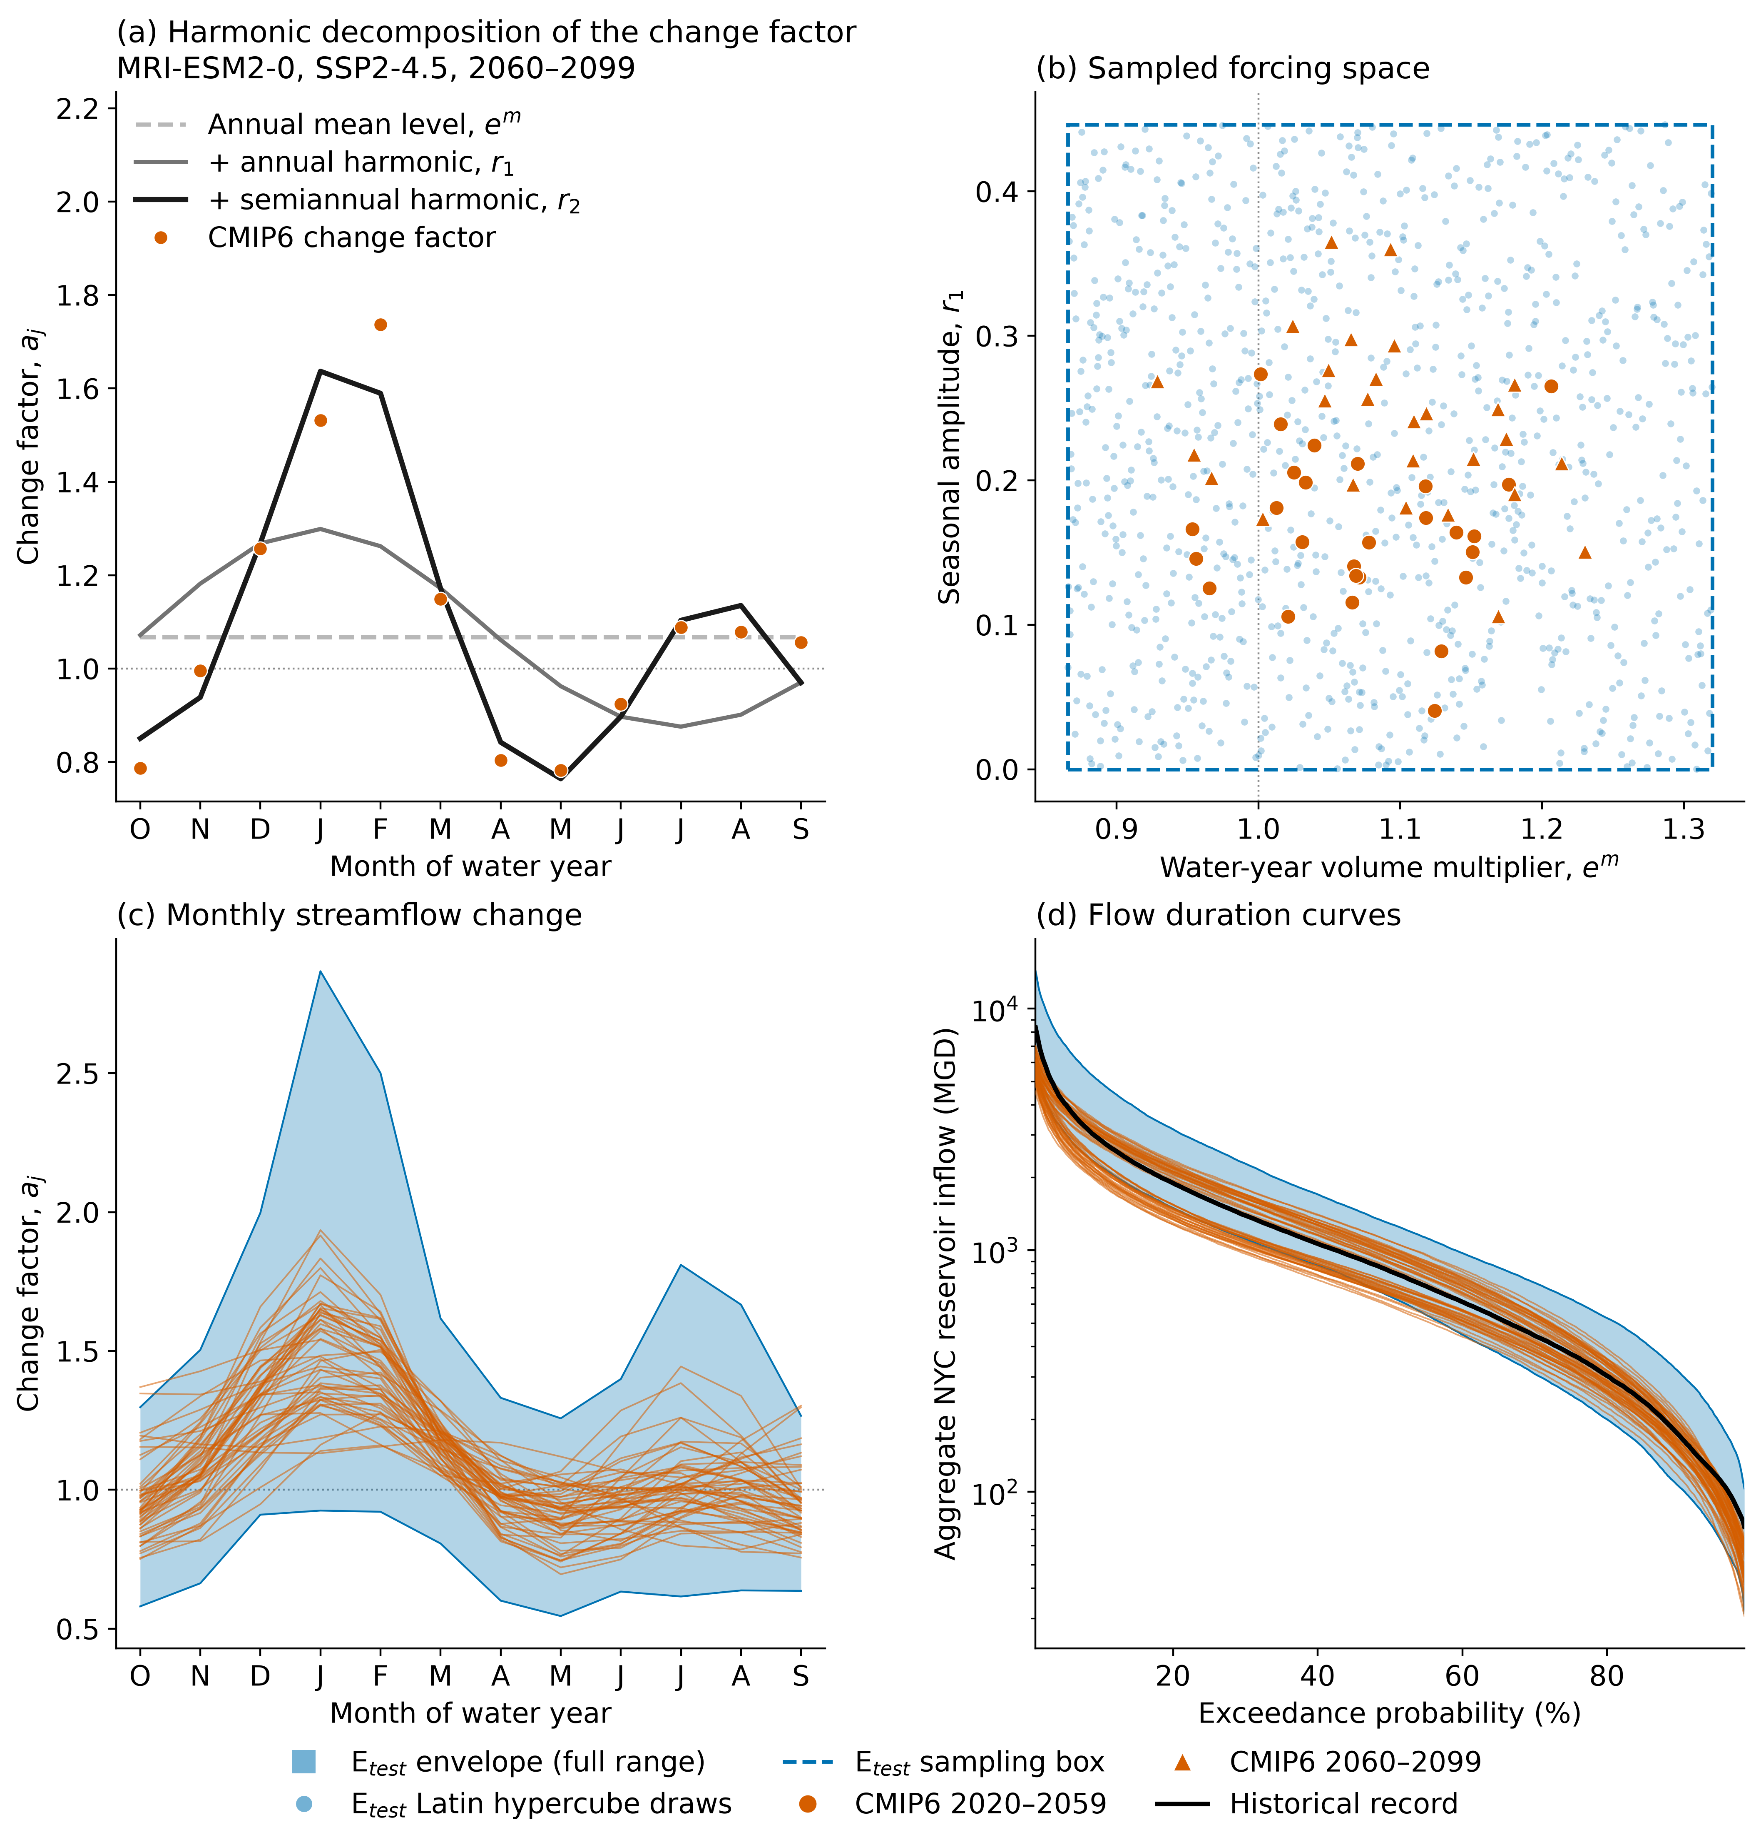
Figure 3: DU streamflow re-evaluation design

Slide 7
Results

Slide 8
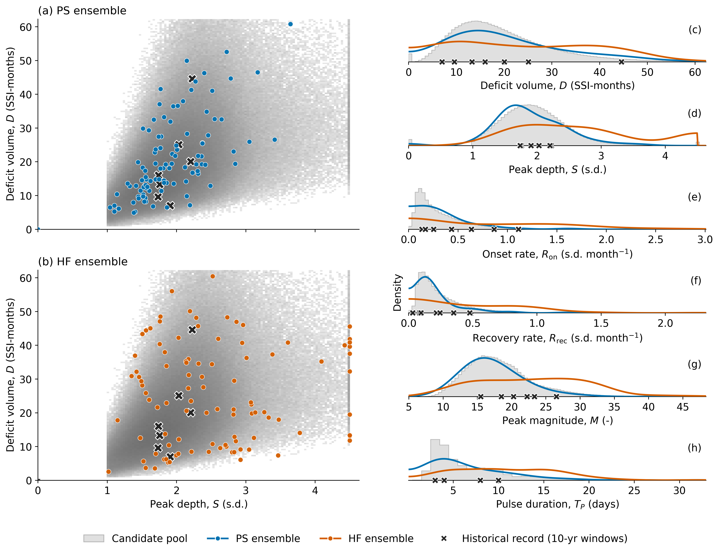
Figure 4: Ensemble diagnostics

Slide 9
Supplemental Material

