Slide 1
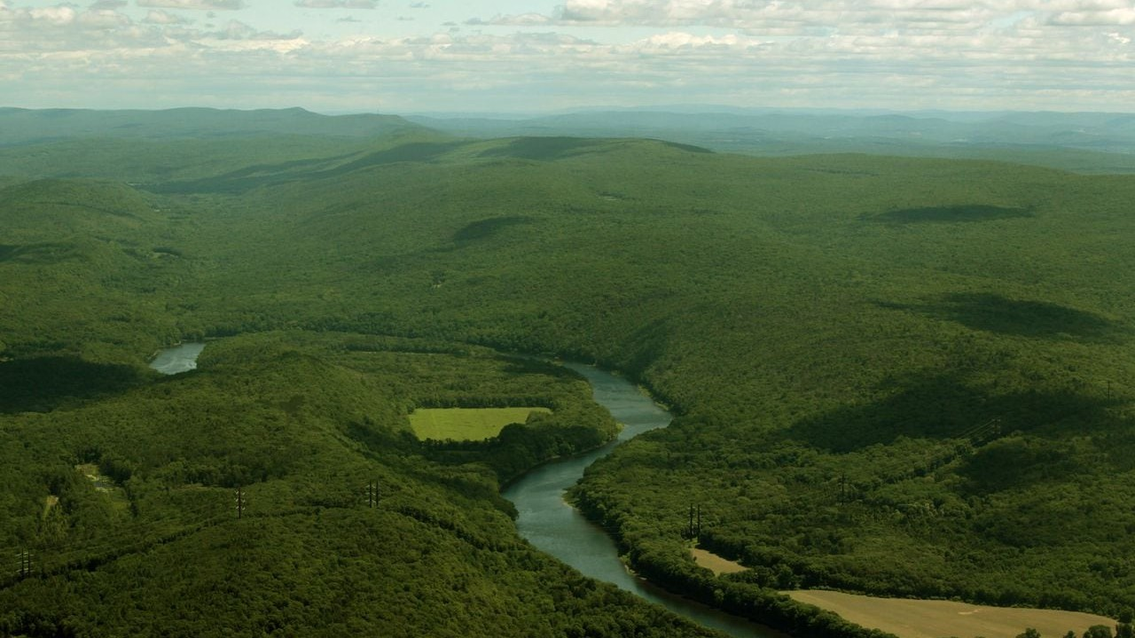
Hazard-Space Scenario Selection for Robust Many-Objective Re-Optimization of New York City’s Delaware Basin Reservoirs
Trevor Amestoy
Reed Research Group,
Cornell University
School of Civil and Environmental Engineering

Slide 2
Content
Introduction
Literature Review
Method & Research Questions
Experimental Design
  Scenario Designs and Hazard Metrics
  Problem Formulation
  Re-evaluation, Robustness and Regret
Preliminary Results
Supplemental
  Streamflow change sampling
  Stochastic ensemble convergence
  Climate change in the search?
  Anvil scaling experiments

Slide 3
Introduction:
Delaware River Basin
Background and Motivation

Slide 4
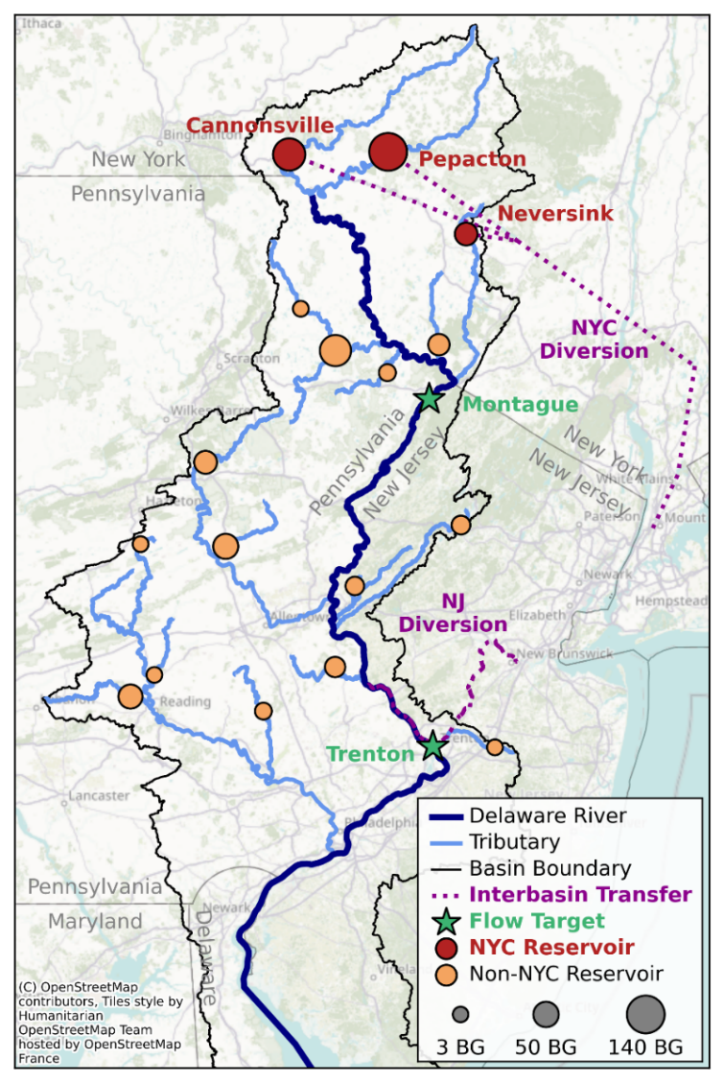



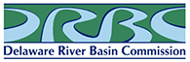
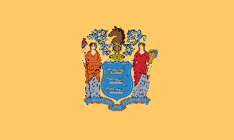



Current Basin Operations
Total population
served by DRB (2020):
14.2 million
Coordinated management is necessary across stakeholders and agencies.

Slide 5
Current Basin Operations
Three NYC reservoirs in the upper DRB support transbasin diversions to New York City:
800 million gallons per day (MGD)

Slide 6
Current Basin Operations
NYC is required to make reservoir releases to support downstream minimum flow targets at:
Montague
(legally required)
The 1954 Supreme Court Decree mandates this release requirement, which is enforced by the Delaware River Master.

Slide 7
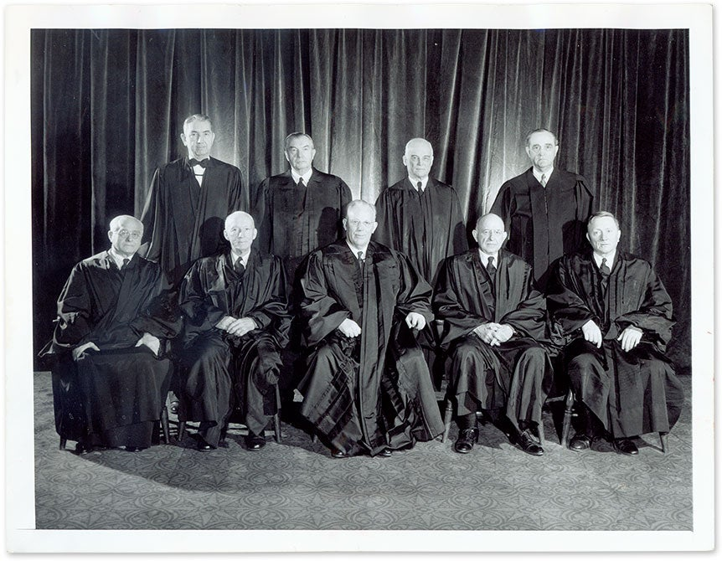
Delaware River Basin: Regulation & Management
1954: U.S. Supreme Court establishes: Max diversions to NYC Min flow target at Montague
Gov. Milestone
1950
1960
1970
1980
1990
2000
2010
2020

Slide 8
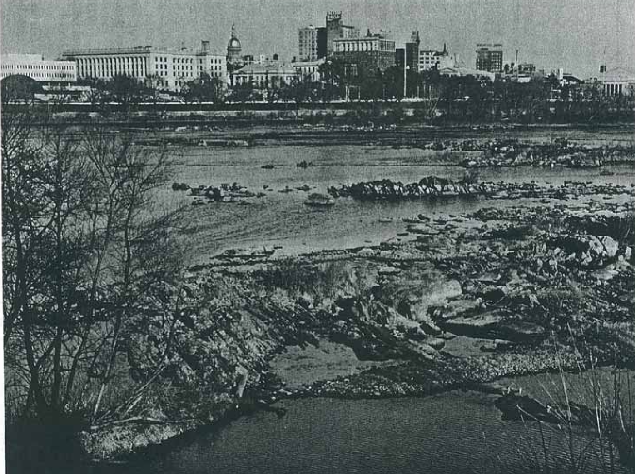
Delaware River Basin: Regulation & Management
1954 Supreme Court: Established NYC requirements: Max diversions NYC is 800MGD Maintain flow target at Montague | 1960s drought of record: Forces NYC to halt releases Raises tensions between states Reveals NYC storage vulnerability | 1980s-2010s: Management policies evolve. Add adaptive flexibility to NYC operations
The limited NYC storage could not support both the NYC diversion and the directed releases to Montague, leading to emergency conditions, Decree violations, and tensions among the Decree Parties (Hogarty, 1970; Kolesar and Serio, 2011; Amestoy et al., 2026).
Gov. Milestone
1950
1960
1970
1980
1990
2000
2010
2020

Slide 9
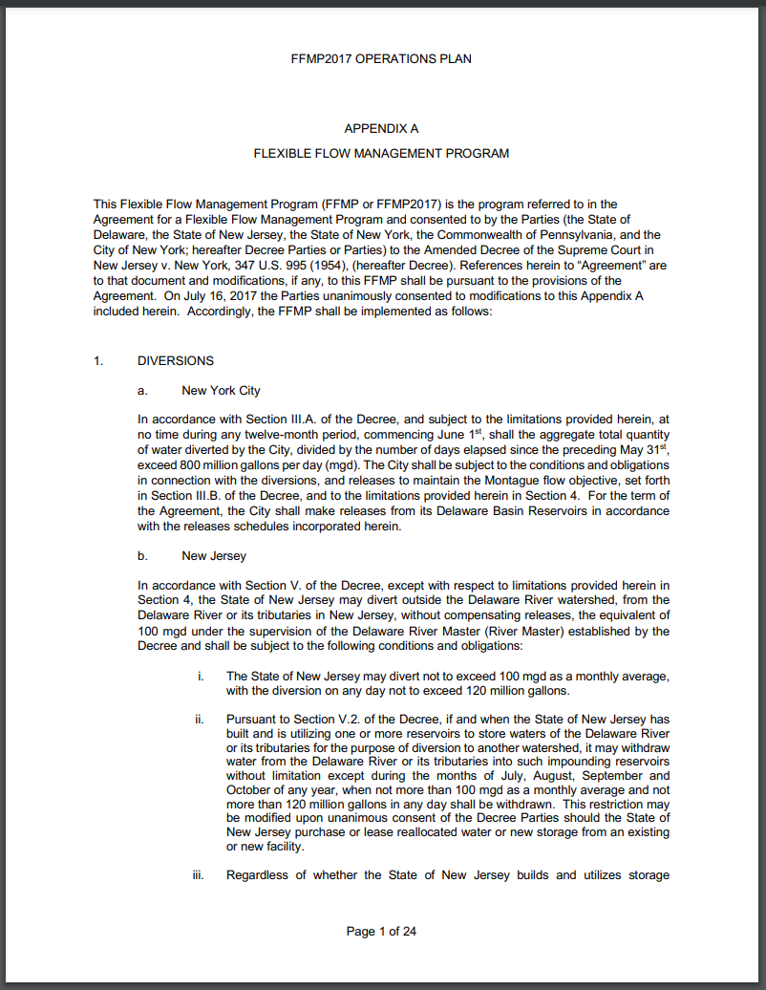
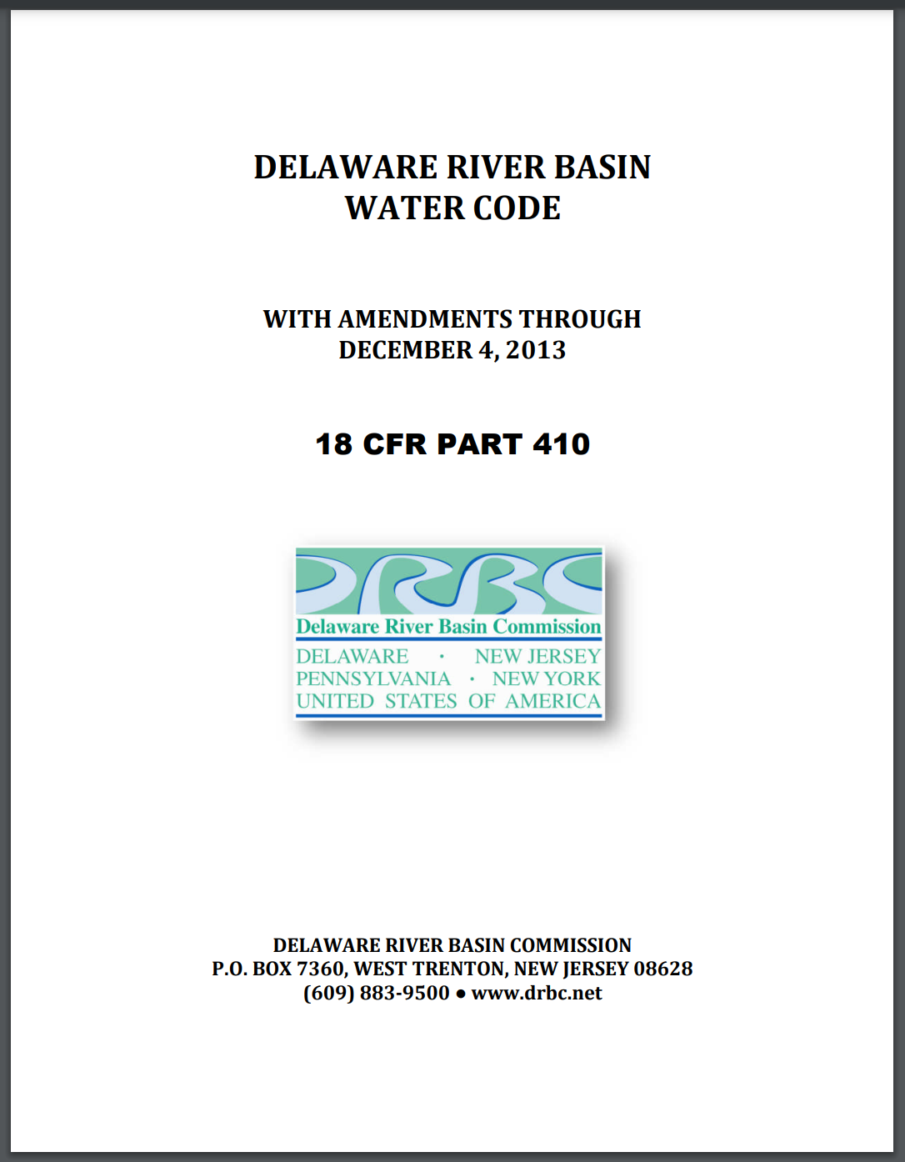
Delaware River Basin: Regulation & Management
1954 Supreme Court: Established NYC requirements: Max diversions NYC is 800MGD Maintain flow target at Montague | 1960s drought of record: Forces NYC to halt releases Raises tensions between states Reveals NYC storage vulnerability | 1980s-2010s: Management policies evolve. Add adaptive flexibility to NYC operations
Gov. Milestone
1950
1960
1970
1980
1990
2000
2010
2020

Slide 10
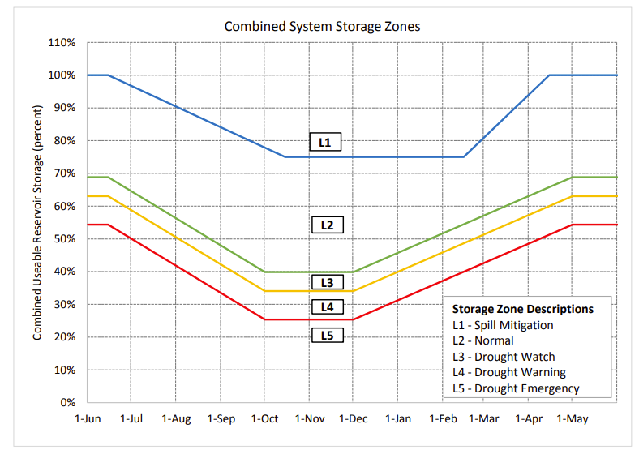
Delaware River Basin: NYC Operations
Overview of the FFMP operating rules
NYC storage zones dictate operating rules
The FFMP is an adaptive policy in which the allowable diversions and the flow targets are reduced in negotiated steps as combined NYC storage declines through successive drought stages
Any change to NYC's Delaware operations requires unanimous consent of the Decree Parties

Slide 11
Delaware River Basin: NYC Operations
Overview of the FFMP operating rules
1954 Decree (unchanged, fixed)
Baseline Minimum Flow Target at Montague
Baseline Max NYC & NJ Diversion Limits
NYC storage zones dictate operating rules
Storage Zone
Determines
NYC (L3-L5) & NJ (L4-L5) diversion reductions
Montague & Trenton flow target reduction (L3-L5)
Conservation Release Schedules
NYC Reservoir Spill Mitigation Releases (L1)

Slide 12
Delaware River Basin: NYC Operations
The FFMP operating rules were developed over decades of negotiation and simulation over the historical record.
To our knowledge, whether alternative operating rules could improve outcomes for multiple stakeholders has not been tested through many-objective optimization.
Nor have alternative rules been tested against hydrologic conditions beyond the historical record.
Overview of the FFMP operating rules
1954 Decree (unchanged, fixed)
Baseline Minimum Flow Target at Montague
Baseline Max NYC & NJ Diversion Limits
NYC storage zones dictate operating rules
NYC (L3-L5) & NJ (L4-L5) diversion reductions
Storage Zone
Determines
Montague & Trenton flow target reduction (L3-L5)
Conservation Release Schedules
NYC Reservoir Spill Mitigation Releases (L1)

Slide 13
Motivation: The Search Ensemble
GRAPHIC?

Slide 14
Motivation: The Search Ensemble
Simulation-based search with MOEAs evaluates operational alternatives and characterizes their trade-offs (Reed et al., 2013; Giuliani et al., 2016).
Each candidate policy is simulated over a fixed ensemble of streamflow realizations, and each objective is a statistic across that ensemble.

Slide 15
Motivation: The Search Ensemble
Hydrologic Scenarios
“Search ensemble”
The resulting trade-offs and Pareto-approximate policies depend on the streamflow conditions the search ensemble contains (Quinn et al., 2017; Giuliani et al., 2021).
Decision Variable Formulation
Optimization Algorithm
Candidate Decision Variables
Objective Scores
Reservoir Simulation Model

Slide 16
Motivation: The Search Ensemble
Search ensembles are commonly sampled independently from a fitted generator (Quinn et al., 2017; Zatarain Salazar et al., 2017).
Little attention has been given to which realizations the search ensemble should contain, or to how that choice affects the robustness of the resulting policies.
Hydrologic Scenarios
“Search ensemble”
Decision Variable Formulation
Optimization Algorithm
Candidate Decision Variables
Objective Scores
Reservoir Simulation Model

Slide 17
Literature Review

Slide 18

Literature Review
Policy search can overfit the sequence of floods and droughts in its training record (Brodeur et al., 2020; Giuliani et al., 2021).
“This approach can overfit the policy parameters to the particular stochastic realizations experienced during the simulation-based optimization, potentially yielding impressive calibration results that can largely degrade when tested on out-of-sample observations.”
- Giuliani et al. (2021)

Slide 19
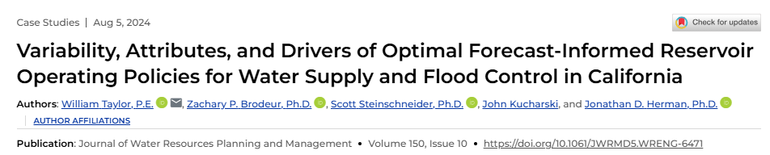
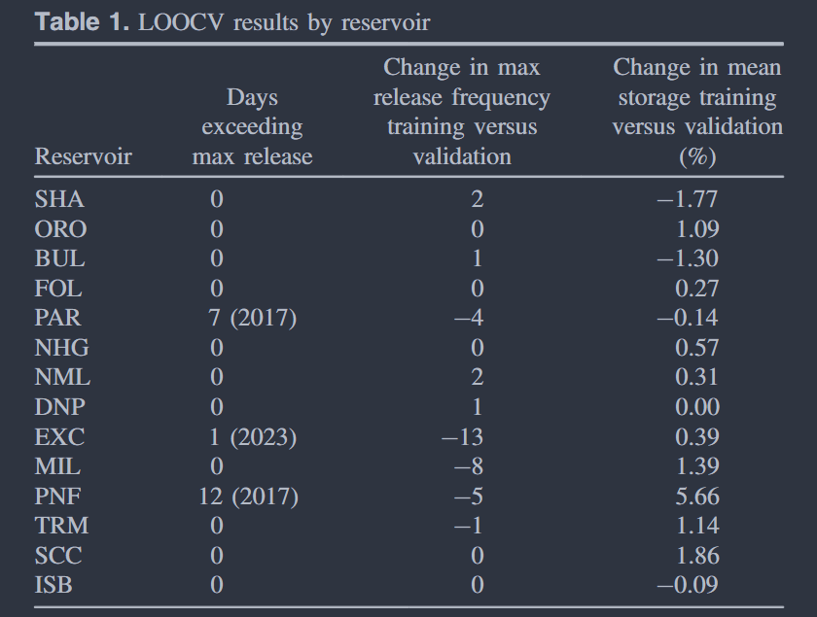
Literature Review
Out-of-sample failures are documented for forecast-informed policies facing floods absent from their training records (Taylor et al., 2024) and for rules developed on the observed record alone (Leitman et al., 2024).
“Under cross-validation, we find that large floods are needed in the training data to avoid overfitting the policy.”
- Taylor et al. (2024)

Slide 20
Literature Review
MORDM searches under one baseline state of the world (SOW), then re-evaluates under deep uncertainty (Kasprzyk et al., 2013).
Baseline SOW
Deeply uncertain SOWs
Search ensemble
Historic Reconstruction
+
Stochastic Generator
Re-evaluation ensemble
CMIP6 model flow change
+
LHS Sampling
+
Stochastic Generator
Policy
Re-evaluation
Later studies moved deeply uncertain SOWs into the search (Watson and Kasprzyk, 2017; Trindade et al., 2017; Eker and Kwakkel, 2018), gaining robustness at six to ten times the function evaluations (Bartholomew and Kwakkel, 2020). This study keeps deep uncertainty out of the search.

Slide 21
Literature Review
Zatarain Salazar et al. (2017) subsampled a large synthetic ensemble by Latin hypercube sampling over the distribution of annual flow, always retaining the wettest and driest realizations.
A single annual statistic does not consider the drought and flood events within each realization.
Mean annual flow
Quantile

Slide 22
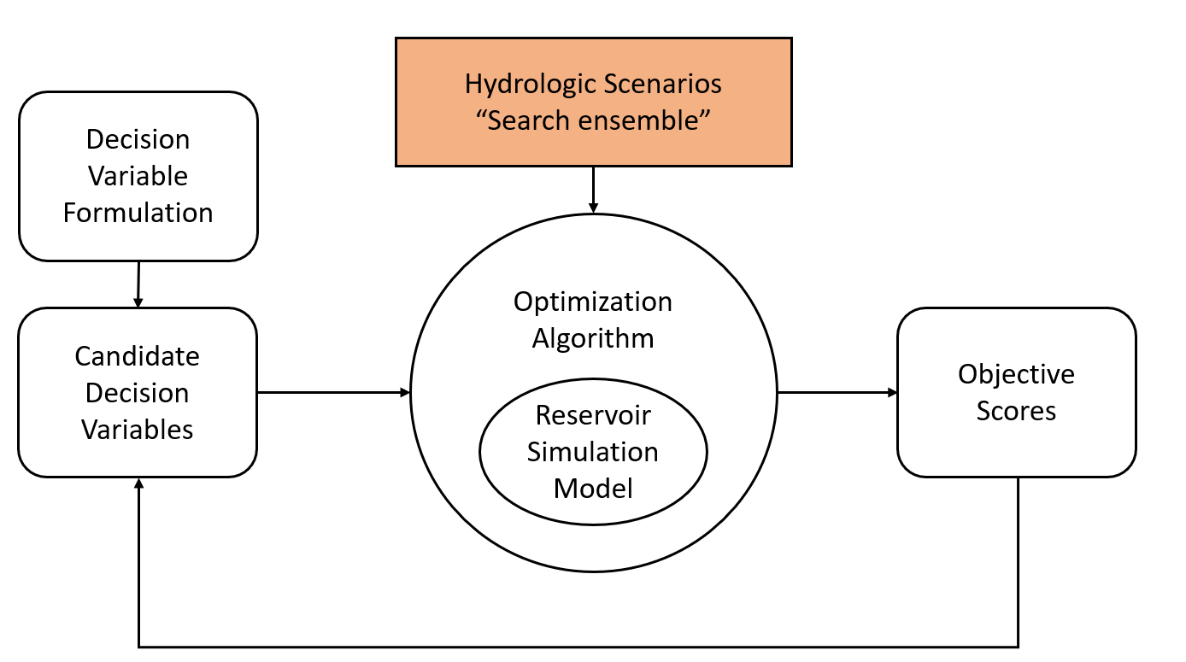
Literature Review
Other methods select decision-relevant subsets by simulating the system's response to each candidate (Hilbers et al., 2019; Cohen et al., 2021).
Selection by simulated
system response
Hydrologic Scenarios
“Search ensemble”
Decision Variable Formulation
Optimization Algorithm
Candidate Decision Variables
Objective Scores
The selected subset is specific to the system model, the objectives, and the policy used to score it, and must be recomputed when any of these change.
Reservoir Simulation Model

Slide 23
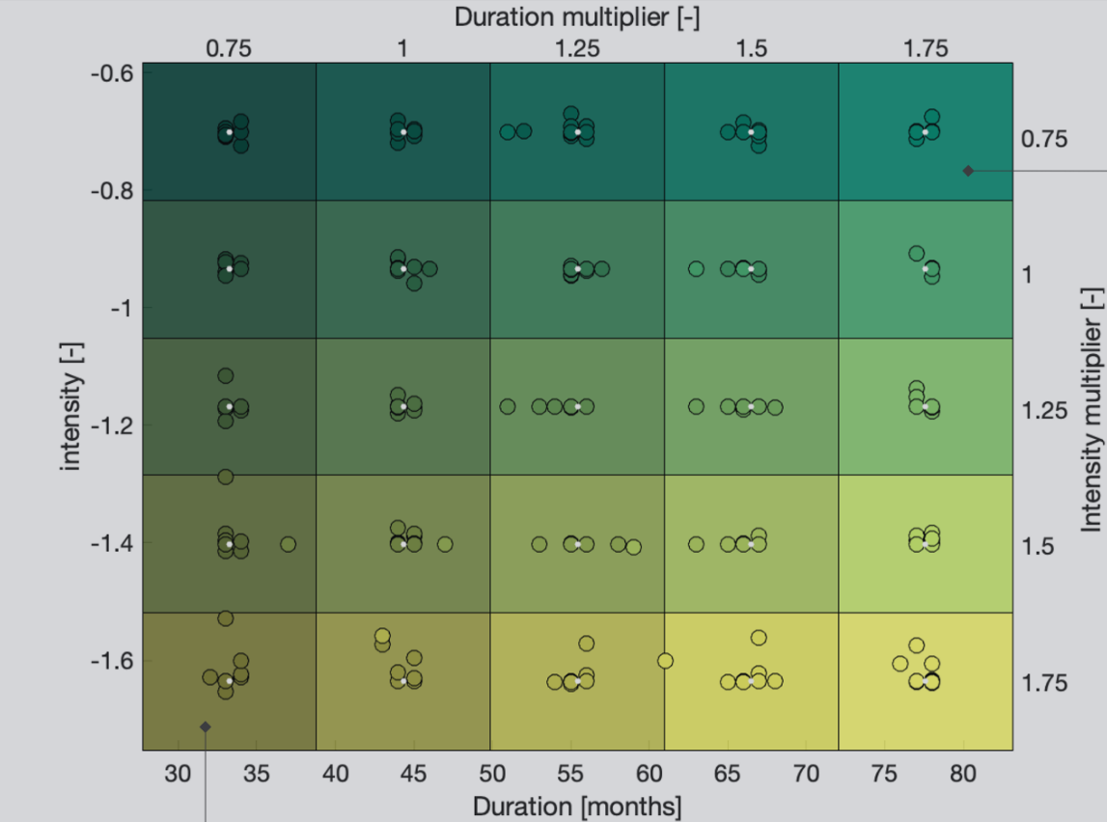
Literature Review
Other methods control hazard content at generation time, e.g., by prescribing drought frequency, intensity, and duration (Herman et al., 2016; Zaniolo et al., 2023, 2024).
Drought characteristics must be specified before generation rather than selected from the generated sequences.

Slide 24
Literature Review
To the best of our knowledge, no study has constructed a search ensemble to span multiple dimensions of emergent drought and flood hazard characterized from the streamflow sequences alone.
No comparison against Monte Carlo sampling from the same generator, matched in ensemble size, realization length, and function-evaluation budget, exists for many-objective policy search on a real water system.

Slide 25
Proposed Method Contribution &
Research Questions

Slide 26
Proposed Method Contribution
Plausible streamflow conditions
Reference streamflow sequence
(e.g., historical flow)
Flow
Time
Stochastic Streamflow Generator
Candidate
ensemble
Hazard Metric 2
Hazard Metric 1

Slide 27
Proposed Method Contribution
Plausible streamflow conditions
Reference streamflow sequence
(e.g., historical flow)
Hazard metrics characterize the drought and flood conditions of each streamflow realization, independently of the water system.
Flow
Time
Stochastic Streamflow Generator
Candidate
ensemble
Six hazard metrics:
Drought magnitude and severity
Drought development and termination rates
Flood peak discharge and pulse duration
Hazard Metric 2
Hazard Metric 1

Slide 28
Proposed Method Contribution
Plausible streamflow conditions
Reference streamflow sequence
(e.g., historical flow)
Flow
Hazard Metric 2
Time
Monte Carlo Sample
Stochastic Streamflow Generator
Candidate
ensemble
Hazard Metric 1
Hazard Metric 2
Hazard Metric 1

Slide 29
Proposed Method Contribution
Plausible streamflow conditions
Reference streamflow sequence
(e.g., historical flow)
Flow
Hazard Metric 2
Time
Monte Carlo Sample
Stochastic Streamflow Generator
Candidate
ensemble
Hazard Metric 1
Hazard Filling Sample
Hazard Metric 2
Hazard Metric 2
Hazard Metric 1
Hazard Metric 1

Slide 30
Proposed Method Contribution
The proposed design selects realizations from a large candidate ensemble so that they cover the range of drought and flood hazard conditions as uniformly as the candidate ensemble permits.
We refer to it as the Hazard Filling (HF) design.
Hypothesis:
Policies found under the HF design will generalize better to unseen, deeply uncertain conditions than policies found under Monte Carlo (MC) sampling.
Monte Carlo (MC)
Hazard Metric 2
Hazard Metric 1
Hazard Filling (HF)
Hazard Metric 2
Hazard Metric 1

Slide 31
Research Questions
Can many-objective search identify changes to the FFMP's operating rules that simultaneously improve outcomes for multiple basin stakeholders without degrading the outcomes of any party relative to the current FFMP policy under the same deeply uncertain future streamflow conditions?

Slide 32
Research Questions
Can many-objective search identify changes to the FFMP's operating rules that simultaneously improve outcomes for multiple basin stakeholders without degrading the outcomes of any party relative to the current FFMP policy under the same deeply uncertain future streamflow conditions?
How does constructing the search ensemble to span the basin's drought and flood hazards, rather than sampling realizations independently from the same generator, affect the robustness and regret of the resulting policies under deeply uncertain future streamflow conditions?

Slide 33
Experimental Design

Slide 34
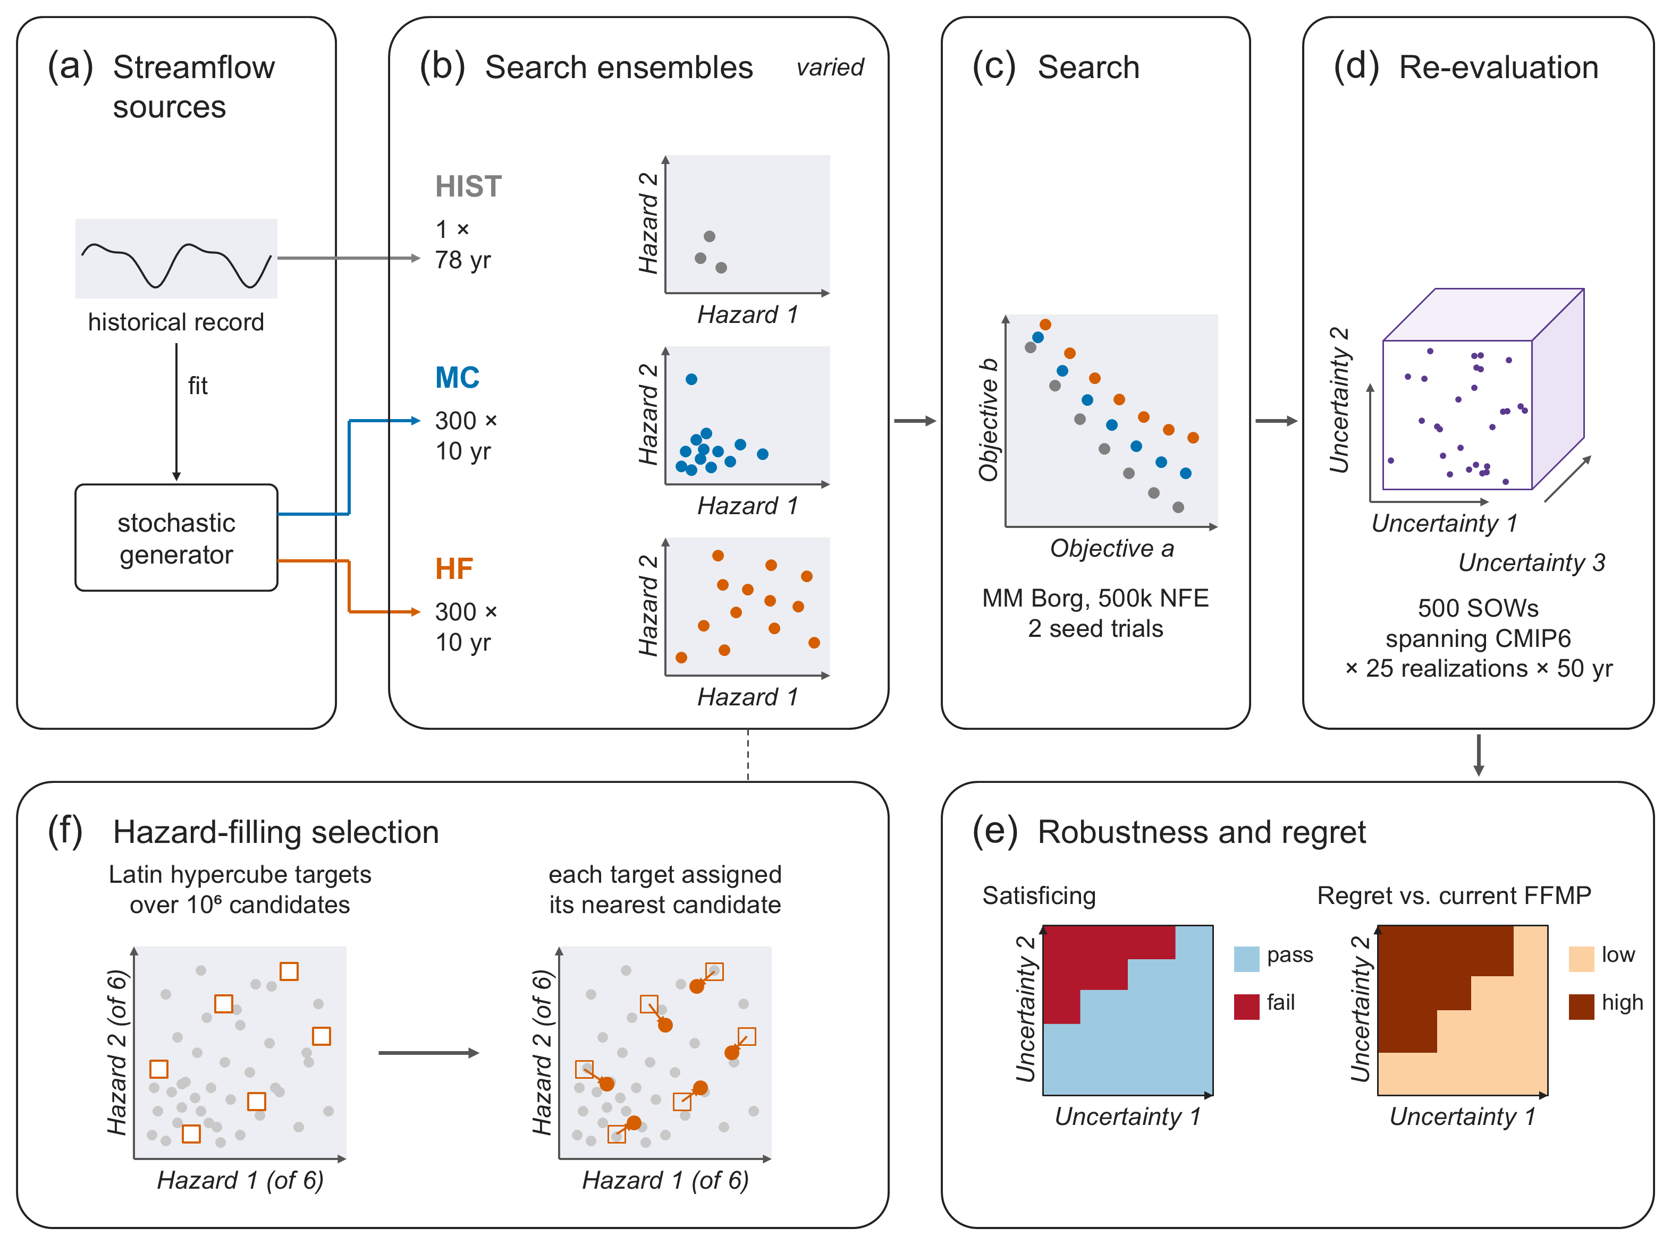
Experimental Design

Slide 35
Experimental Design:
Scenario Designs

Slide 36
Experimental Design: Scenario Designs
Table 1. Scenario designs for the search ensemble
MC and HF share the generator, ensemble size, realization length, and 500,000-NFE search budget, with two seed trials per design.
Design | Construction | Ensemble size (per function evaluation)
Historical (HIST) | Reconstructed 1945–2023 historical record, simulated as one continuous realization | 1 realization × 78 yr
Monte Carlo (MC) | Realizations drawn independently from the stationary stochastic generator | 300 realizations × 10 yr
Hazard Filling (HF) | Proposed design: selected from 10⁶ candidate realizations for uniform coverage of six hazard metrics | 300 realizations × 10 yr
Re-evaluation ensemble | Latin hypercube sample of deeply uncertain streamflow change (CMIP6-informed), with stochastic realizations in each SOW | 500 SOWs × 25 realizations × 50 yr

Slide 37
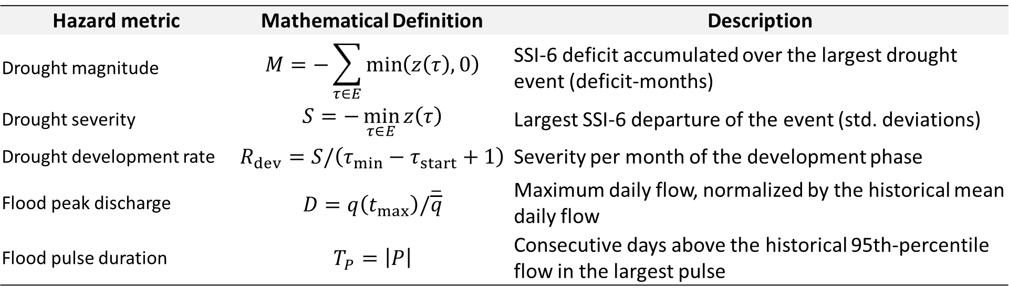
Experimental Design: Hazard Metrics
Table 2. Hazard metrics used to construct the HF ensemble
Computed on aggregate NYC inflow before any simulation, for each realization's largest SSI-6 drought event and largest flood pulse.
Hazard metric | Mathematical Definition | Description
Drought magnitude | $$M=−\sum_{τ∈E}{\min\left(z\left(τ\right),0\right)}$$ | SSI-6 deficit accumulated over the largest drought event (deficit-months)
Drought severity | $$S=−\min_{τ∈E}{z\left(τ\right)}$$ | Largest SSI-6 departure of the event (std. deviations)
Drought development rate | $$R_{dev}=S/\left(τ_{min}−τ_{start}+1\right)$$ | Severity per month of the development phase
Flood peak discharge | $$D=q\left(t_{max}\right)/\overline{\overline{q}}$$ | Maximum daily flow, normalized by the historical mean daily flow
Flood pulse duration | $$T_{P}=\left|P\right|$$ | Consecutive days above the historical 95th-percentile flow in the largest pulse

Slide 38
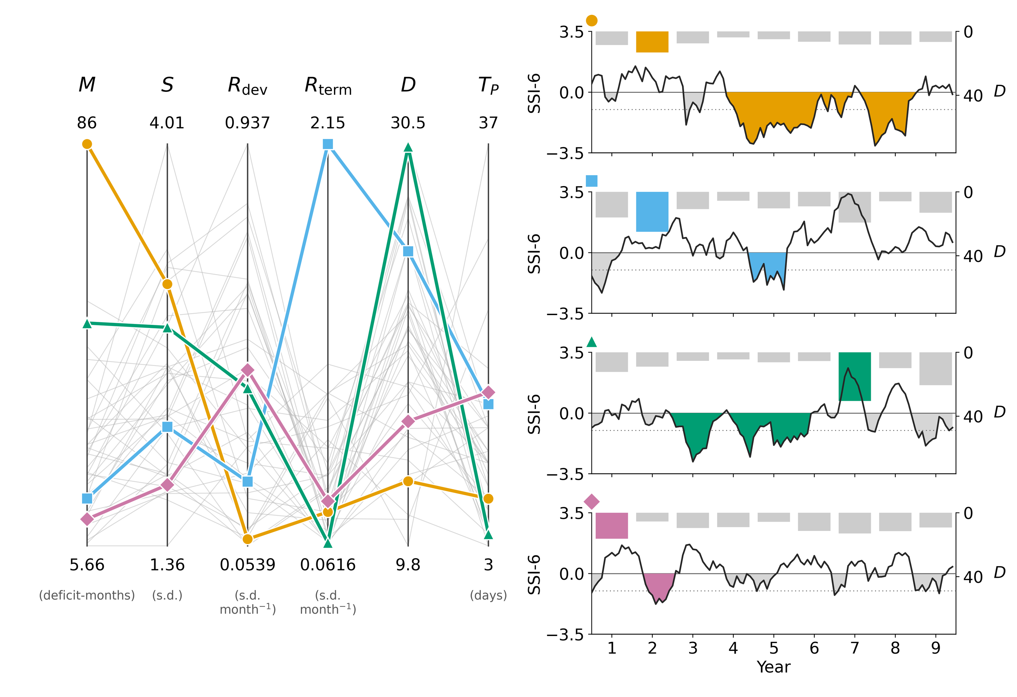
Experimental Design: Hazard Metrics
Each realization is characterized by its largest drought event and its largest flood pulse.
Four example realizations of an HF ensemble

Slide 39
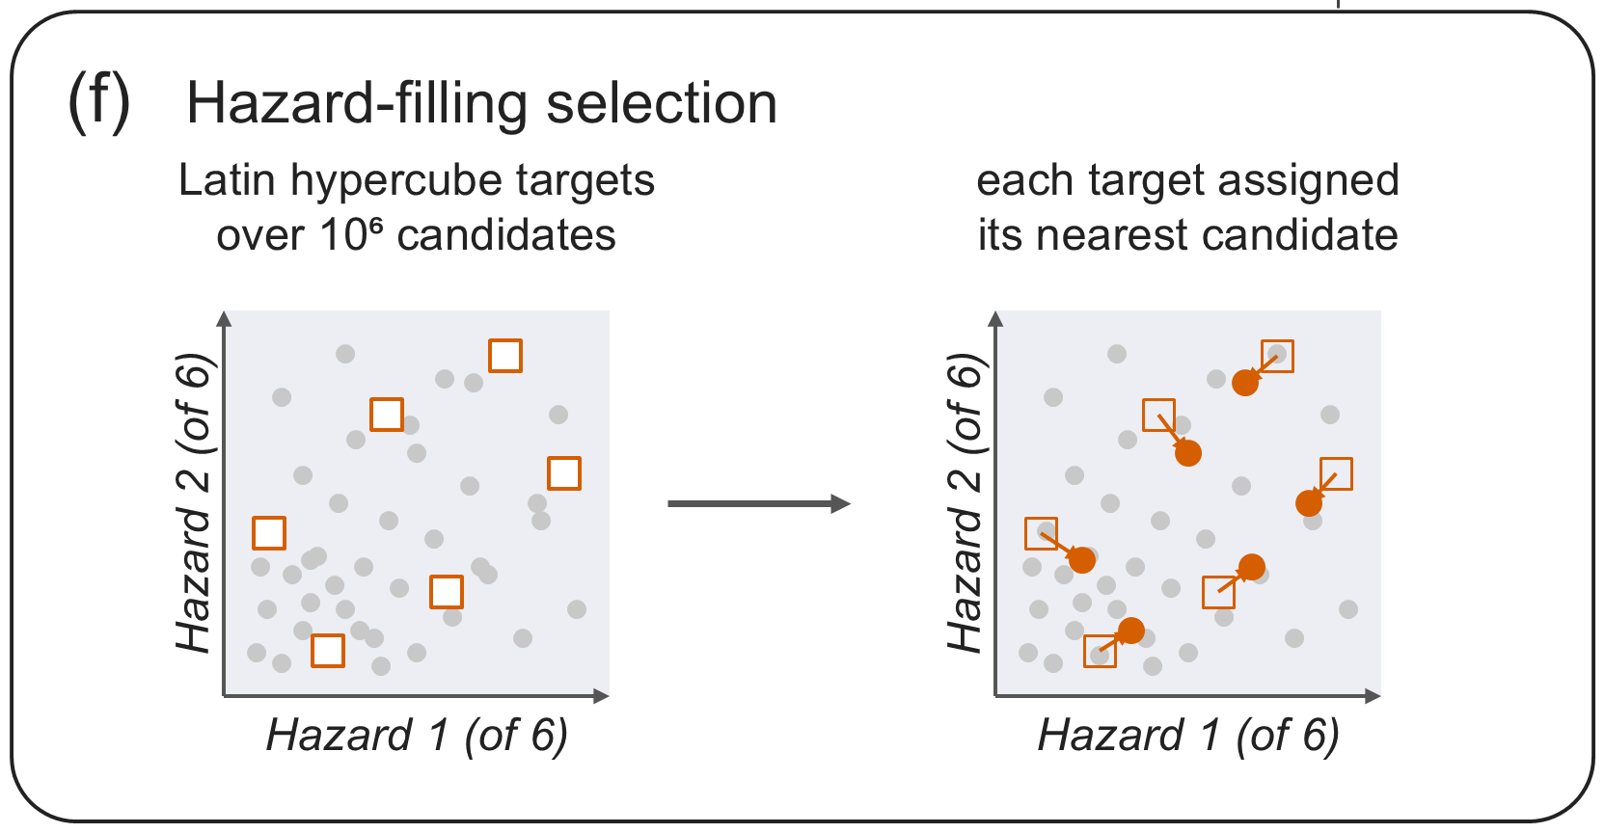
Experimental Design: HF Ensemble Construction
1. Generate 10⁶ candidate realizations with the stationary generator
2. Compute the six hazard metrics for each realization
3. Scale each metric by its 1st and 99th percentiles
4. Draw N = 300 Latin hypercube targets and assign each to the nearest unselected realization

Slide 40
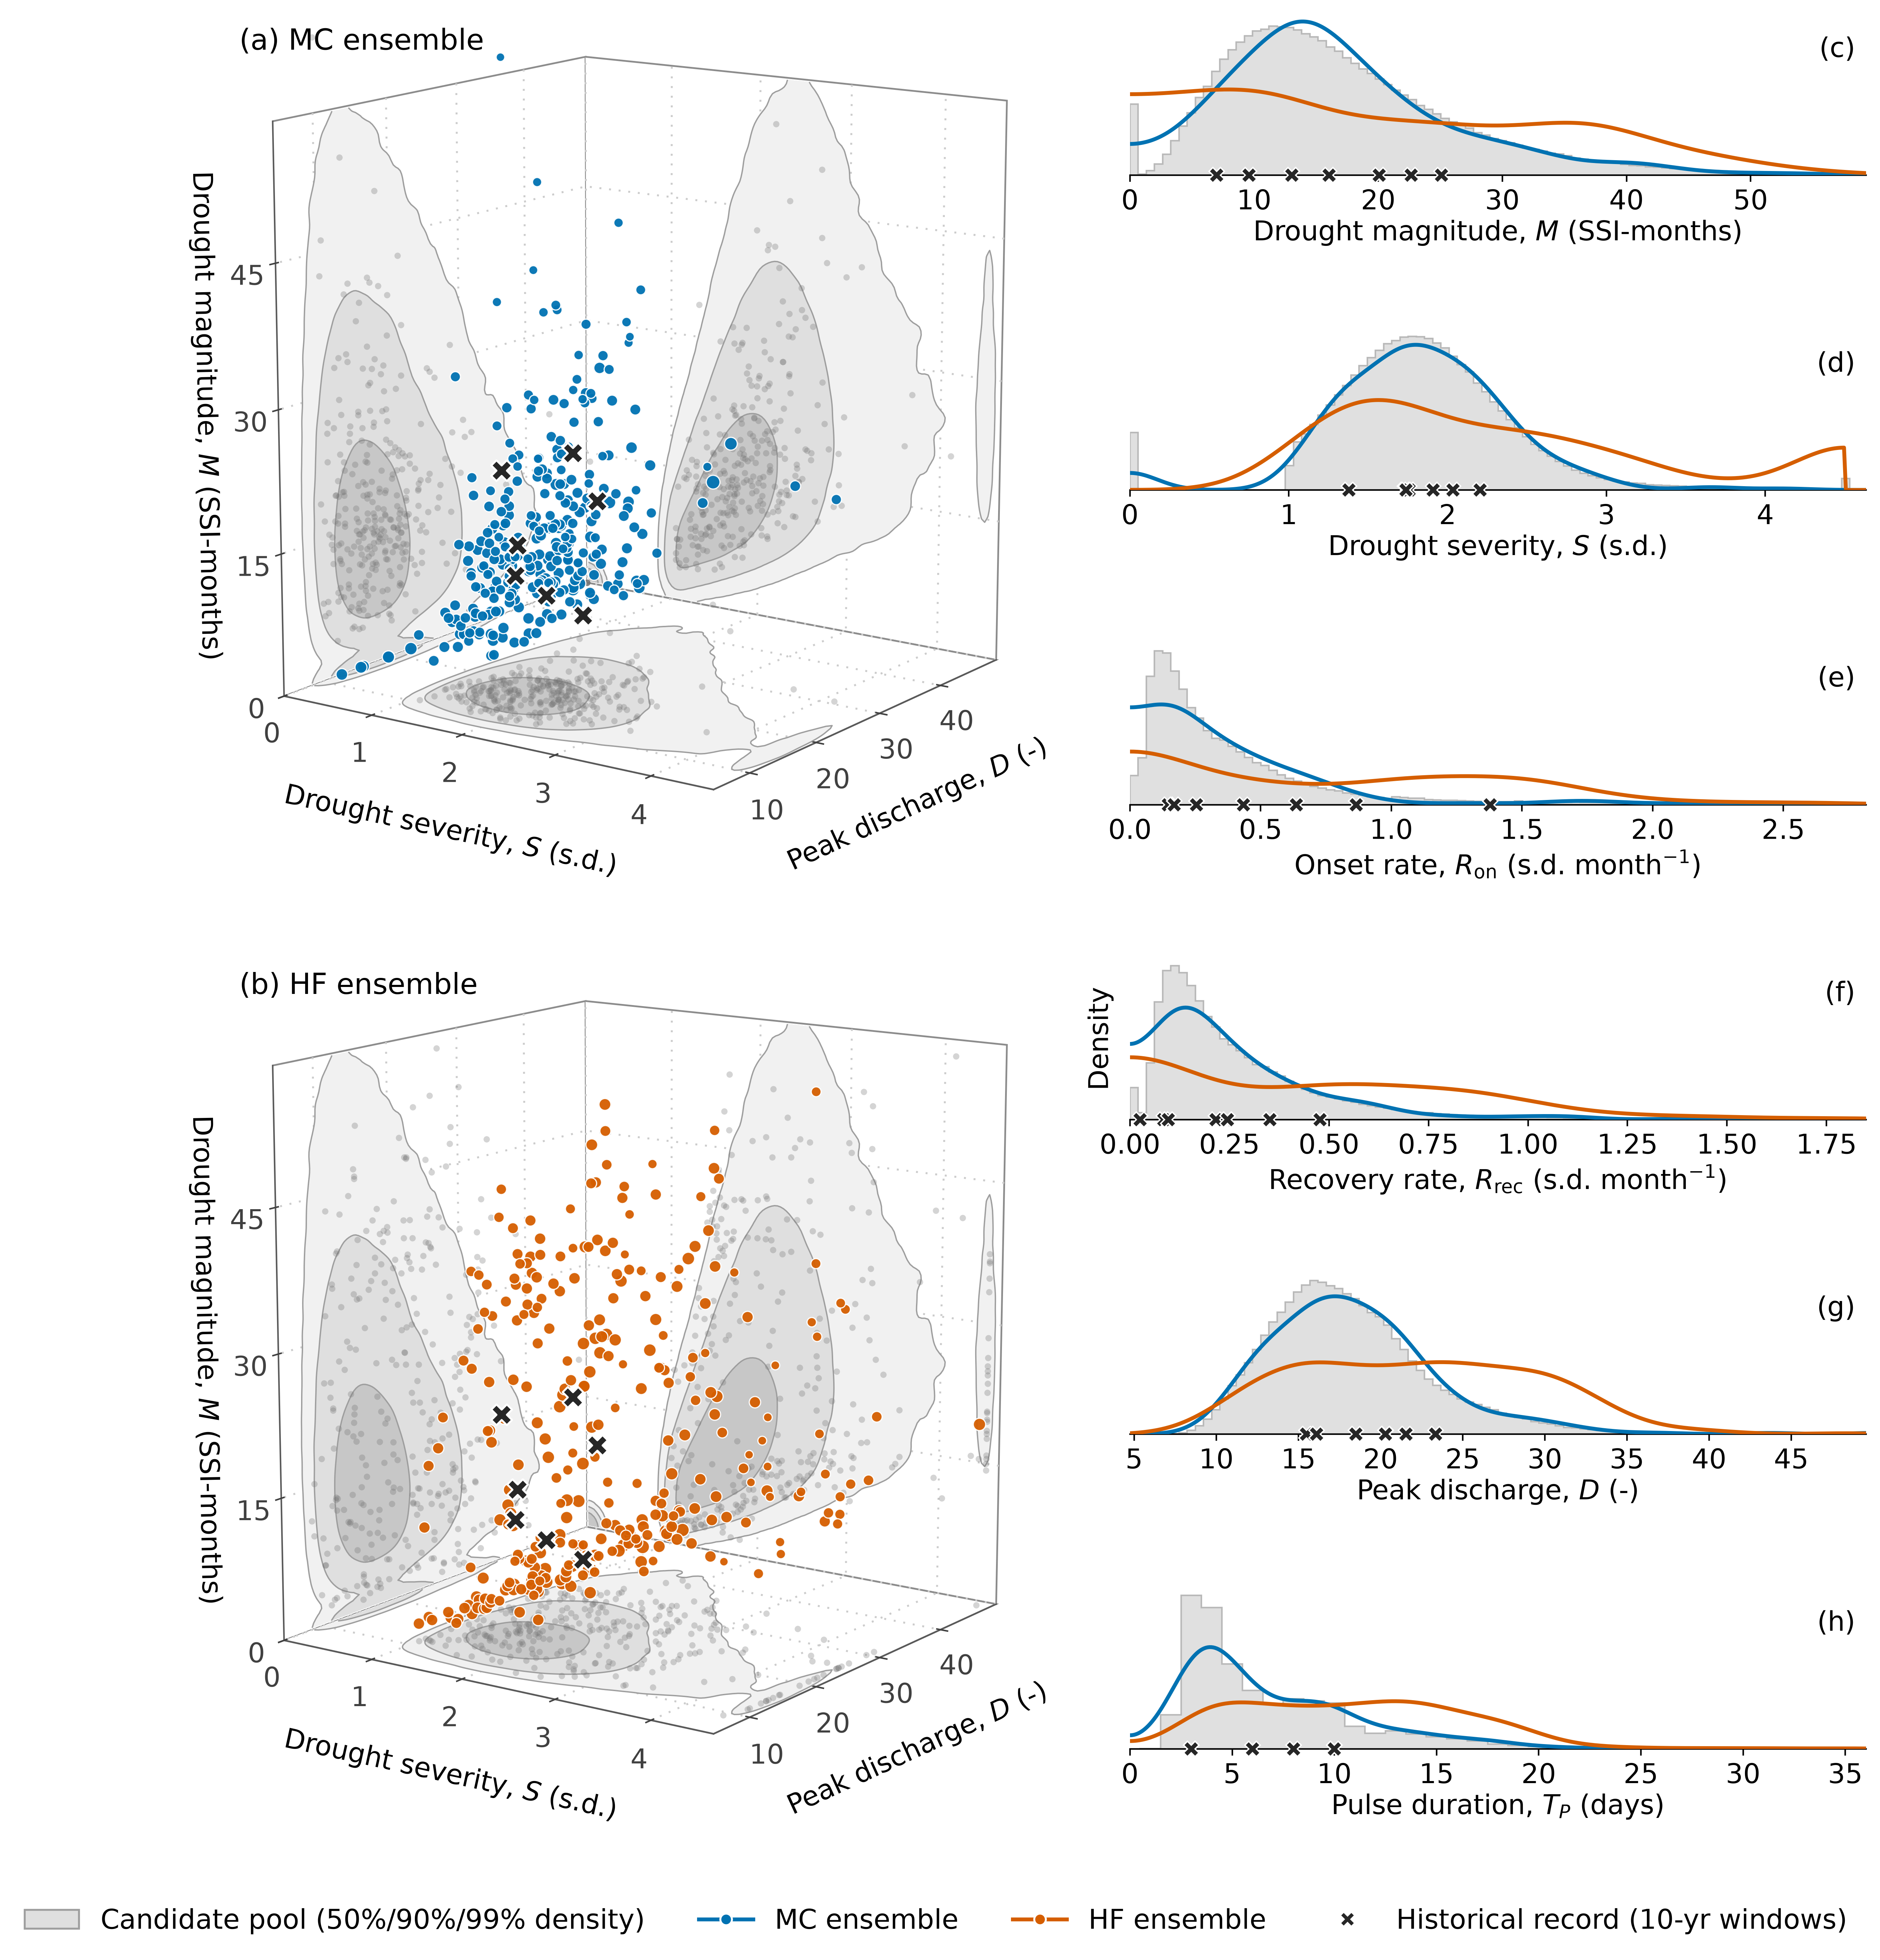
Experimental Design: Hazard Space Coverage

Slide 41
Experimental Design: Hazard Space Coverage
MC concentrates where the candidate ensemble is densest.
HF spreads across the range of every hazard metric.

Slide 42
NYC Reservoir Operations
Problem Formulation

Slide 43
MOEA Problem Formulation: Decision Variables
Fixed constraints and varied operating rules
Fixed by the 1954 Decree and the DRBC Water Code:
Montague 1,750 cfs & Trenton 3,000 cfs flow targets
Preserved in the normal zone. Any change requires unanimous consent of the Decree Parties.
NYC 800 MGD & NJ 100 MGD diversion allocations
The search varies the FFMP operating rules that apply as combined NYC storage declines:
Rule curve placements
Staged diversion and flow-target reductions
Release schedules
Every decision variable is bounded to a limited range around its 2017 FFMP value.

Slide 44
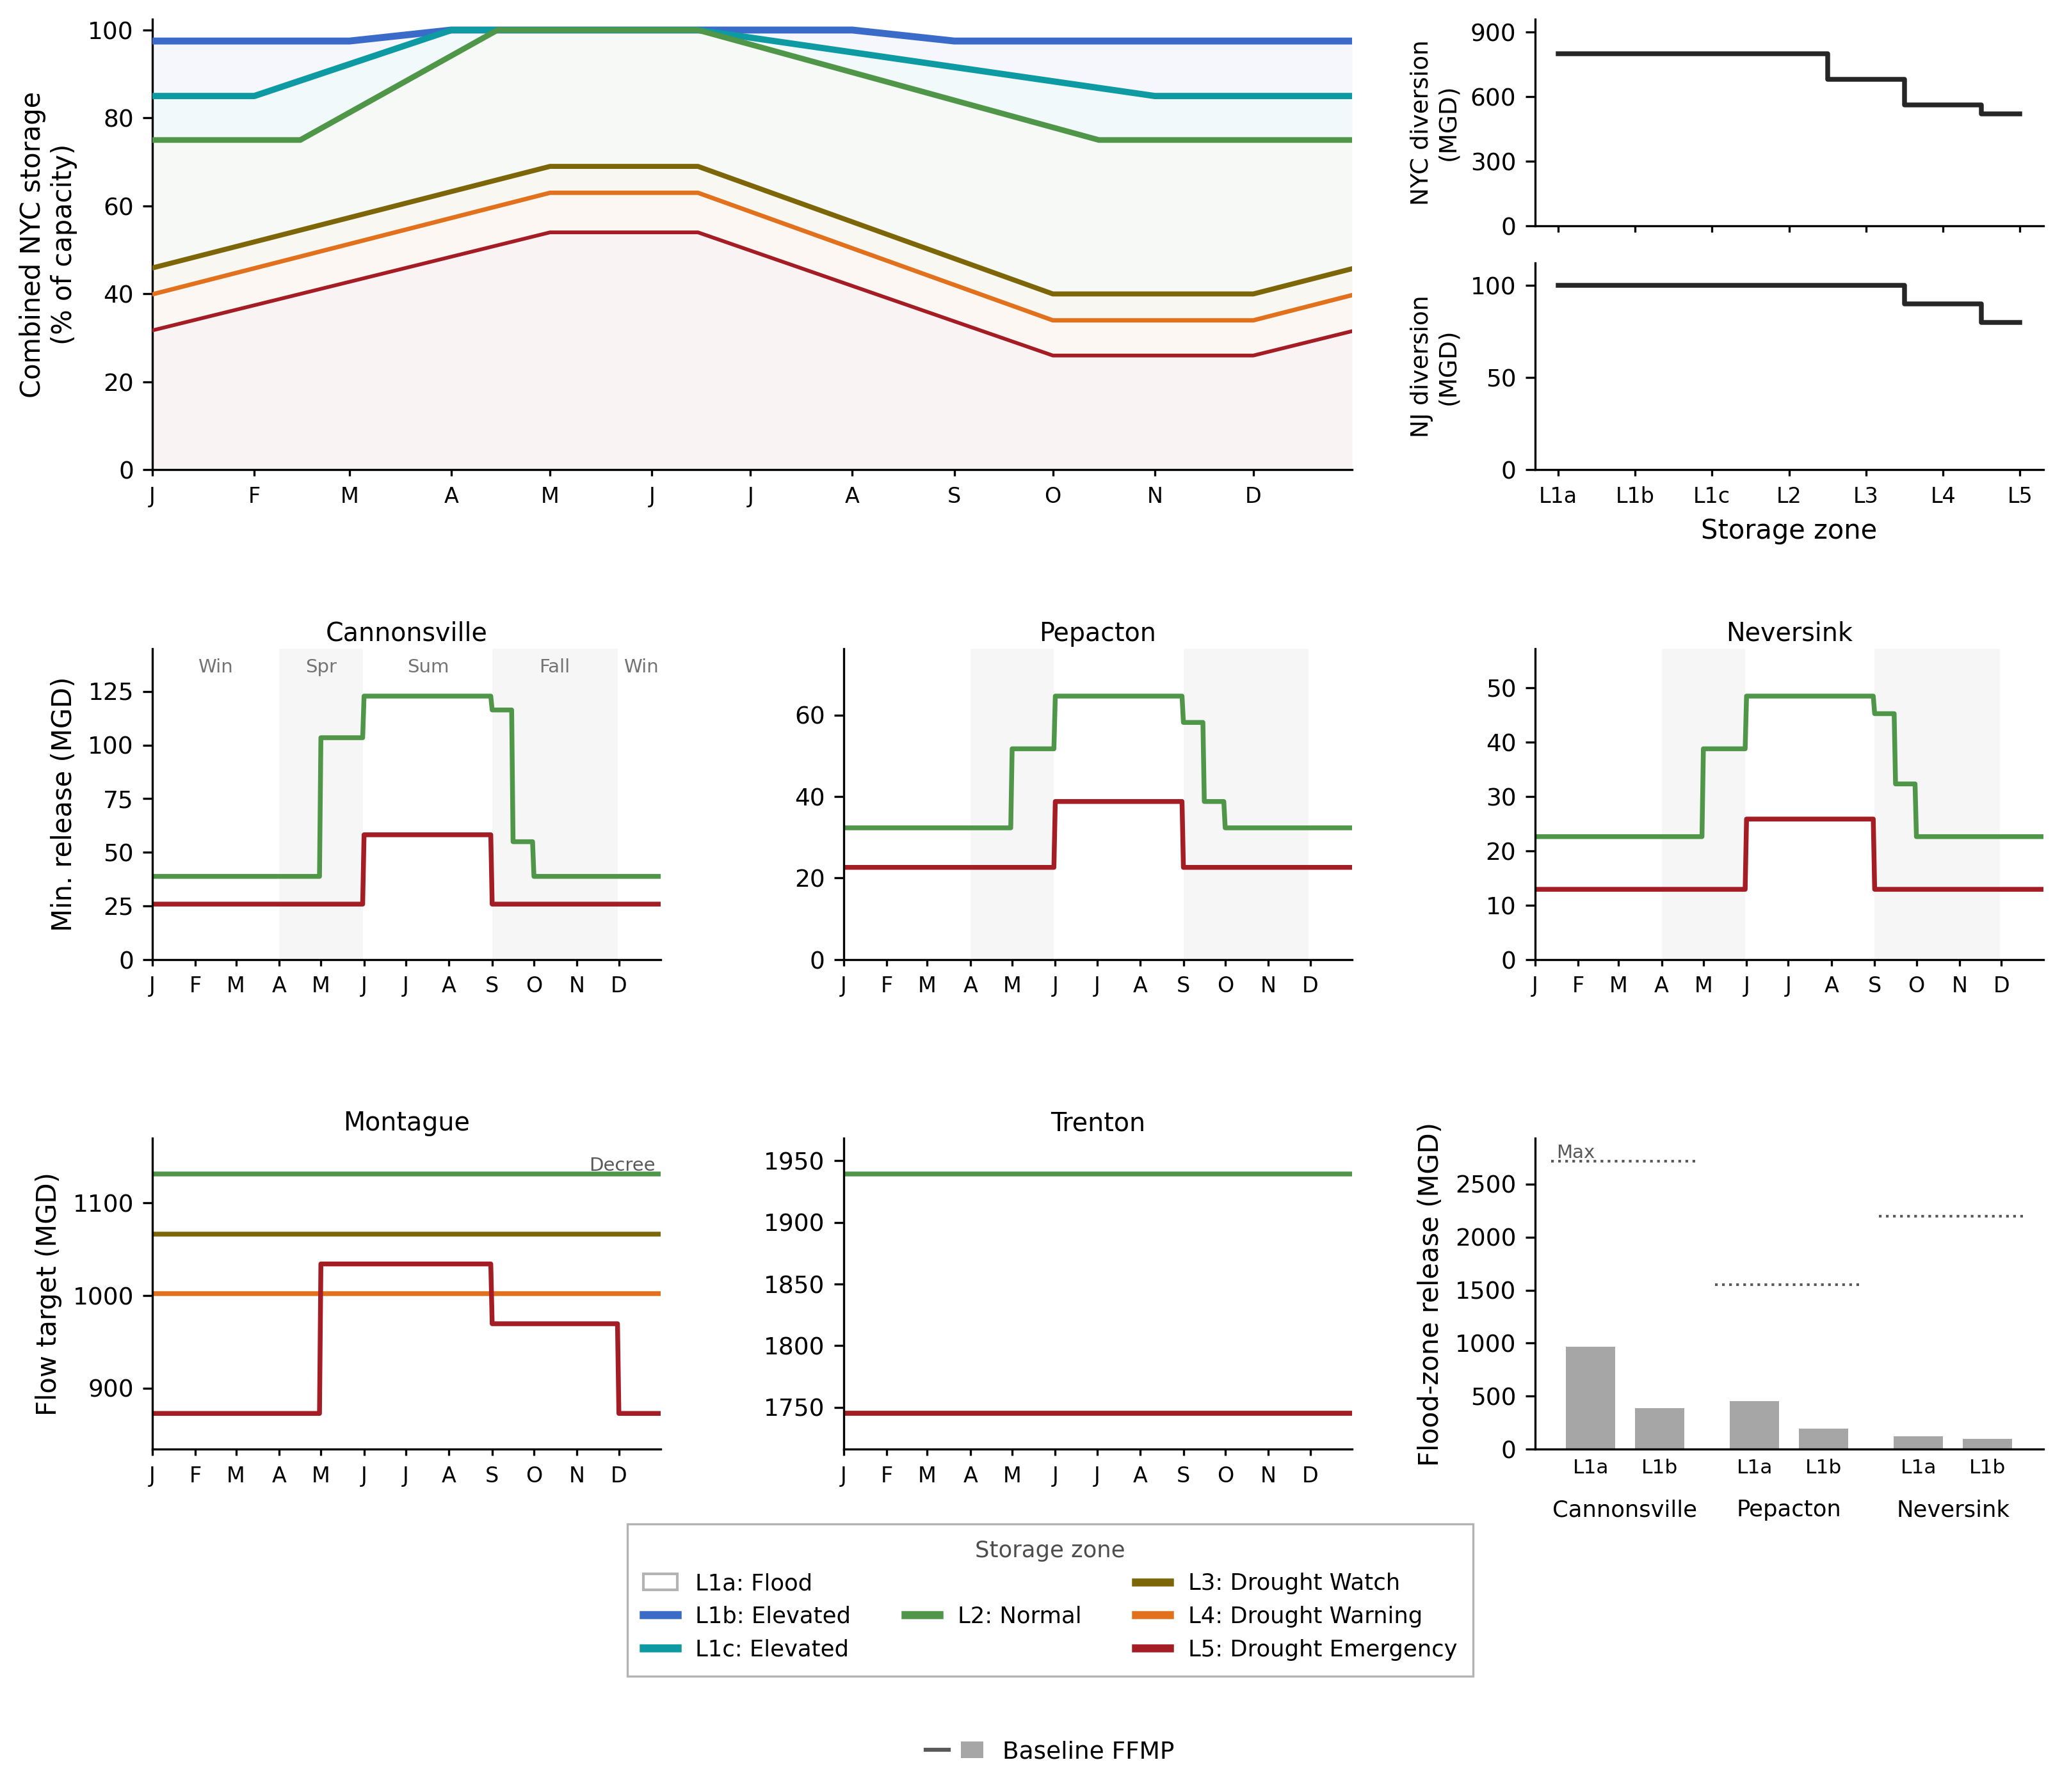
MOEA Problem Formulation: Decision Variables
Overview of the FFMP operating rules
Rule curves
NYC & NJ diversion reductions
Conservation releases
Montague & Trenton flow target reductions
Spill mitigation releases

Slide 45
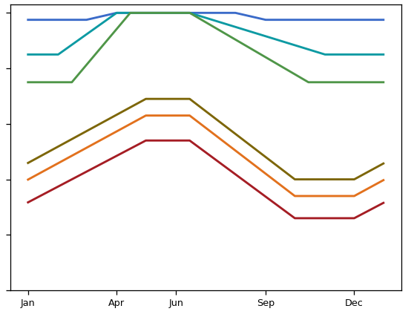
MOEA Problem Formulation: Decision Variables
NYC Reservoir Operational Decision Variables:
Rule Curve Vertical Shifts
Rule Curve Temporal Shifts
One vertical shift per rule curve plateau
One temporal shift per rule curve
Combined NYC Storage
Combined NYC Storage
±10%
±30-days

Slide 46
MOEA Problem Formulation: Decision Variables
NYC Reservoir Operational Decision Variables:
Rule Curve Vertical Shifts
Rule Curve Temporal Shifts
NYC Staged Diversion Reductions
NJ Staged Diversion Reductions
Supreme Court Allocation
near FFMP values
Supreme Court Allocation
near FFMP values

Slide 47
MOEA Problem Formulation: Decision Variables
NYC Reservoir Operational Decision Variables:
Rule Curve Vertical Shifts
Rule Curve Temporal Shifts
NYC Staged Diversion Reductions
NJ Staged Diversion Reductions
Montague & Trenton Flow Target Reductions

Slide 48
MOEA Problem Formulation: Decision Variables
NYC Reservoir Operational Decision Variables:
Rule Curve Vertical Shifts
Rule Curve Temporal Shifts
NYC Staged Diversion Reductions
NJ Staged Diversion Reductions
Montague & Trenton Flow Target Reductions
Spill Mitigation Releases

Slide 49
MOEA Problem Formulation: Decision Variables
NYC Reservoir Operational Decision Variables:
Rule Curve Vertical Shifts
Rule Curve Temporal Shifts
NYC Staged Diversion Reductions
NJ Staged Diversion Reductions
Montague & Trenton Flow Target Reductions
Spill Mitigation Releases
Conservation Release Seasonal Scales

Slide 50
MOEA Problem Formulation: Decision Variables
Table 3. Decision variables (36 total)
Decision variable group (n) | Description | Bounds
Rule curve vertical shifts (9) | Lower plateau of each of the six rule curves and upper plateau of the three drought-stage curves | ±10% of combined capacity
Rule curve temporal shifts (6) | Seasonal timing of each of the six rule curves | ±30 days
Staged NYC & NJ diversion reductions (5) | Reduction of the NYC allowance in each drought stage and of the NJ allowance in Drought Warning and Drought Emergency | Bounded around 2017 FFMP values
Montague & Trenton flow target reductions (6) | Multiplier on the drought-stage reduction of each flow target | 0.65 – 1.15
Spill mitigation releases (6) | Scale on the spill mitigation release of each reservoir in two sub-zones | 0.5 – 1.2/1.35/1.55 (upper sub-zone); 0.5 – 2.0 (lower)
Conservation release seasonal scales (4) | Seasonal multipliers on the conservation release schedules | 0.8 – 2.6

Slide 51
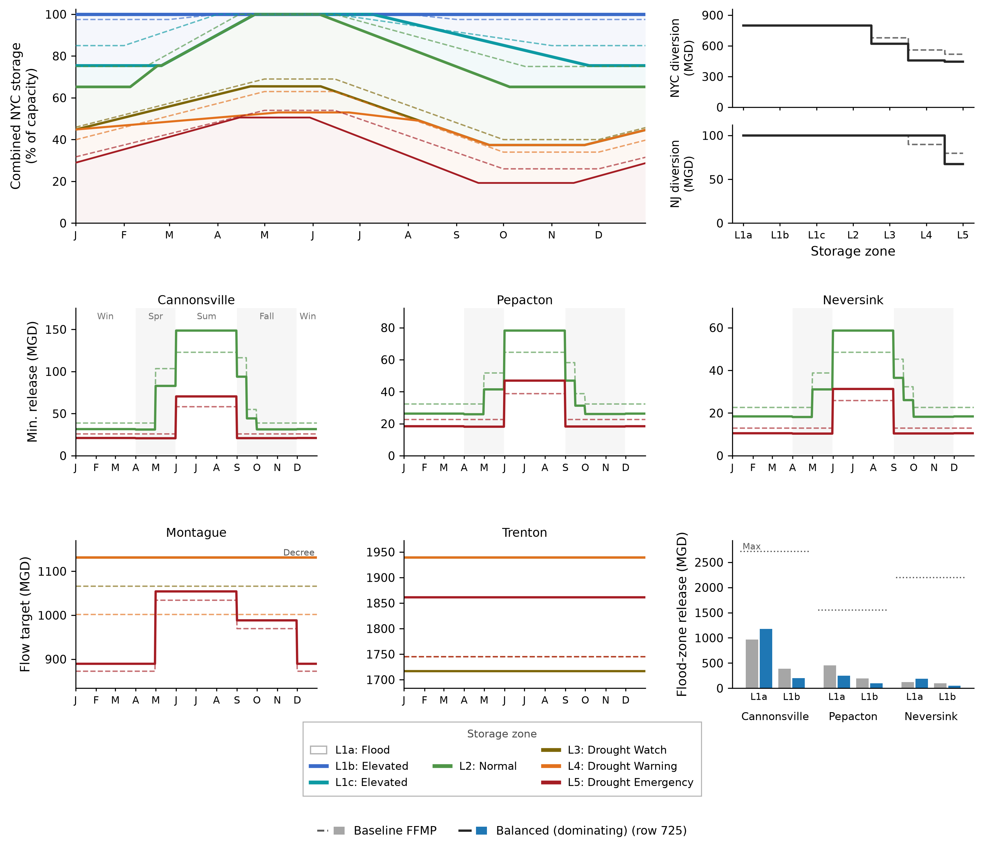
MOEA Problem Formulation: Decision Variables
Example set of decision variables and the resulting operating rules.
Dashed lines = current FFMP
Solid lines = candidate policy

Slide 52
NYC Reservoir Operations
Problem Formulation: Objective Functions

Slide 53
MOEA Problem Formulation: Objective Definitions
Objective definition notes:
Every diversion and flow objective is scored against the obligations of the 1954 Decree and the Water Code, not the FFMP's drought-reduced targets
    A policy's own drought curtailments cannot lower the standard against which it is scored

Slide 54
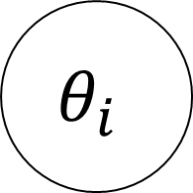
MOEA Problem Formulation: Objective Definitions
Two-stage objective calculation
Year 1
Year 2
…
Year N
Realization 1
$$θ_{i}$$
Realization 2
…
Realization N

Slide 55
MOEA Problem Formulation: Objective Definitions
Two-stage objective calculation
Year 1
Year 2
…
Year N
Each objective is calculated using:
Step 1: Annual metric, Φ
Step 2: Statistic across all ensemble years, Ψ
Realization 1
Realization 2
…
Realization N

Slide 56
MOEA Problem Formulation: Objective Definitions
Table 4. The eight objectives
Objective (preference) | Annual metric, Φ | Across-year statistic, Ψ | Units | ε
NYC diversion reliability (max) | Failure indicator (3 or more failure weeks) | Frequency of non-failure years | fraction of years | 0.05
NYC diversion deficit (min) | CVaR₉₀ of weekly deficit | Worst 1st-percentile year | % of entitlement | 10.0
Montague flow reliability (max) | Failure indicator (3 or more failure weeks) | Frequency of non-failure years | fraction of years | 0.05
Montague flow deficit (min) | CVaR₉₀ of weekly deficit | Worst 1st-percentile year | % of 1,750 cfs target | 10.0
Trenton flow deficit (min) | CVaR₉₀ of weekly deficit | Worst 1st-percentile year | % of 3,000 cfs target | 10.0
Downstream flood exceedance (min) | Annual exceedance of minor flood stage, maximum across three gauges | Mean across years | ft-days/yr | 0.3
NYC minimum storage (max) | Annual minimum daily combined storage | Worst 1st-percentile year | % of capacity | 5.0
NJ diversion reliability (max) | Failure indicator (1 or more failure weeks) | Frequency of non-failure years | fraction of years | 0.05

Slide 57
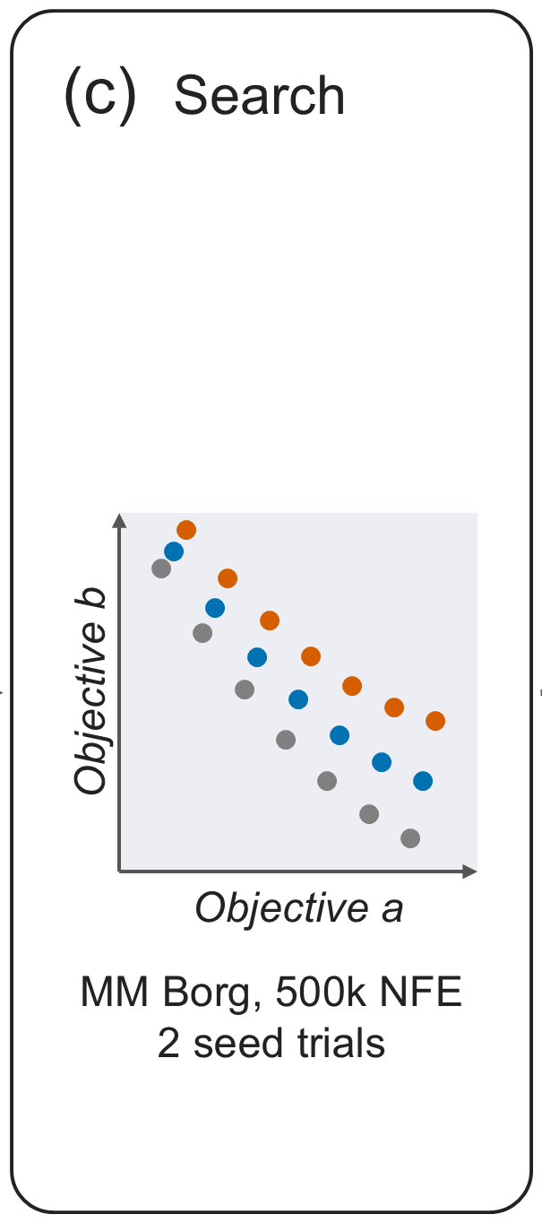
Experimental Design: Search Configuration
MM Borg MOEA with four islands and default parameterization (Hadka and Reed, 2015)
500,000 function evaluations per seed trial
Two random seed trials per scenario design, combined into one Pareto-approximate set
Designs are compared only on the common re-evaluation ensemble

Slide 58
Experimental Design:
Re-evaluation, Robustness and Regret

Slide 59
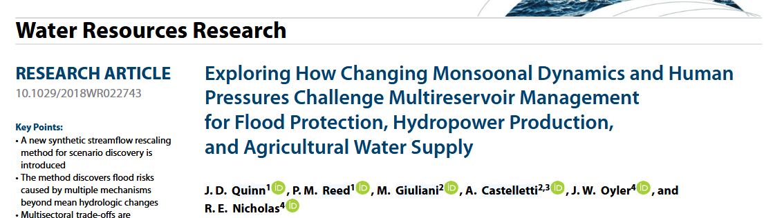
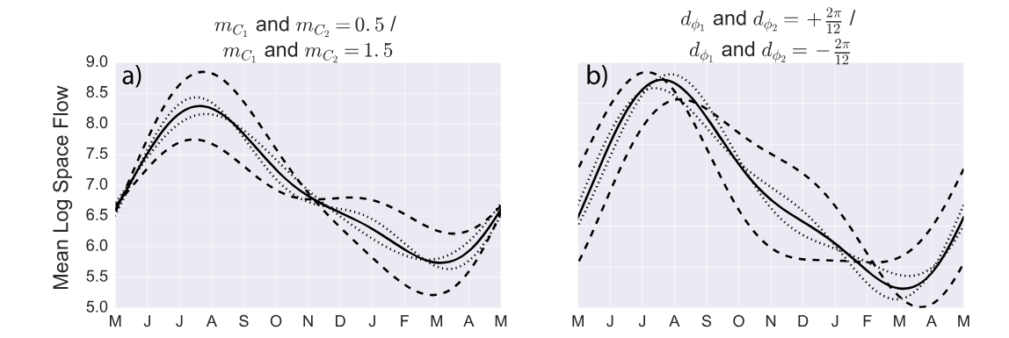
Experimental Design: Re-evaluation under climate change uncertainty
Following the harmonic formulation of Quinn et al. (2018), we parameterize the relative change in monthly streamflow rather than the log-space streamflow.

Slide 60
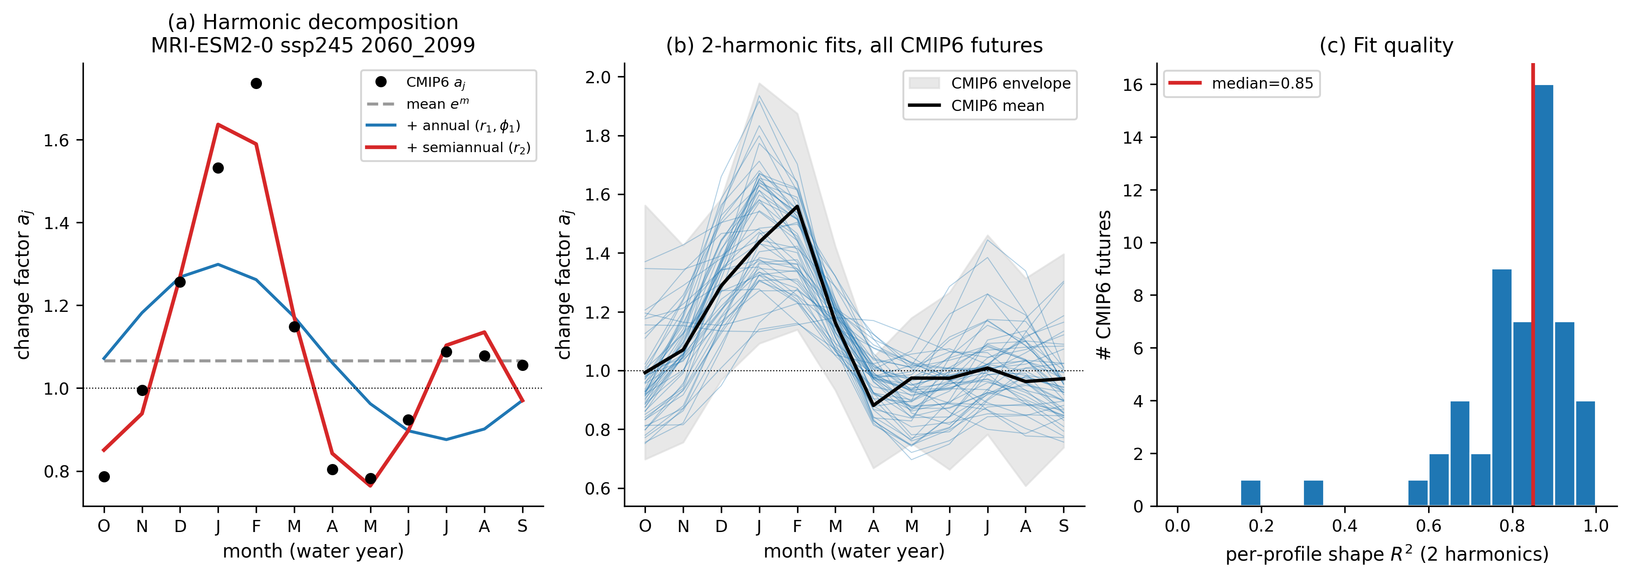
Experimental Design: Re-evaluation under climate change uncertainty
Two harmonics capture the 54 CMIP6 profiles (median R² = 0.85)

Slide 61
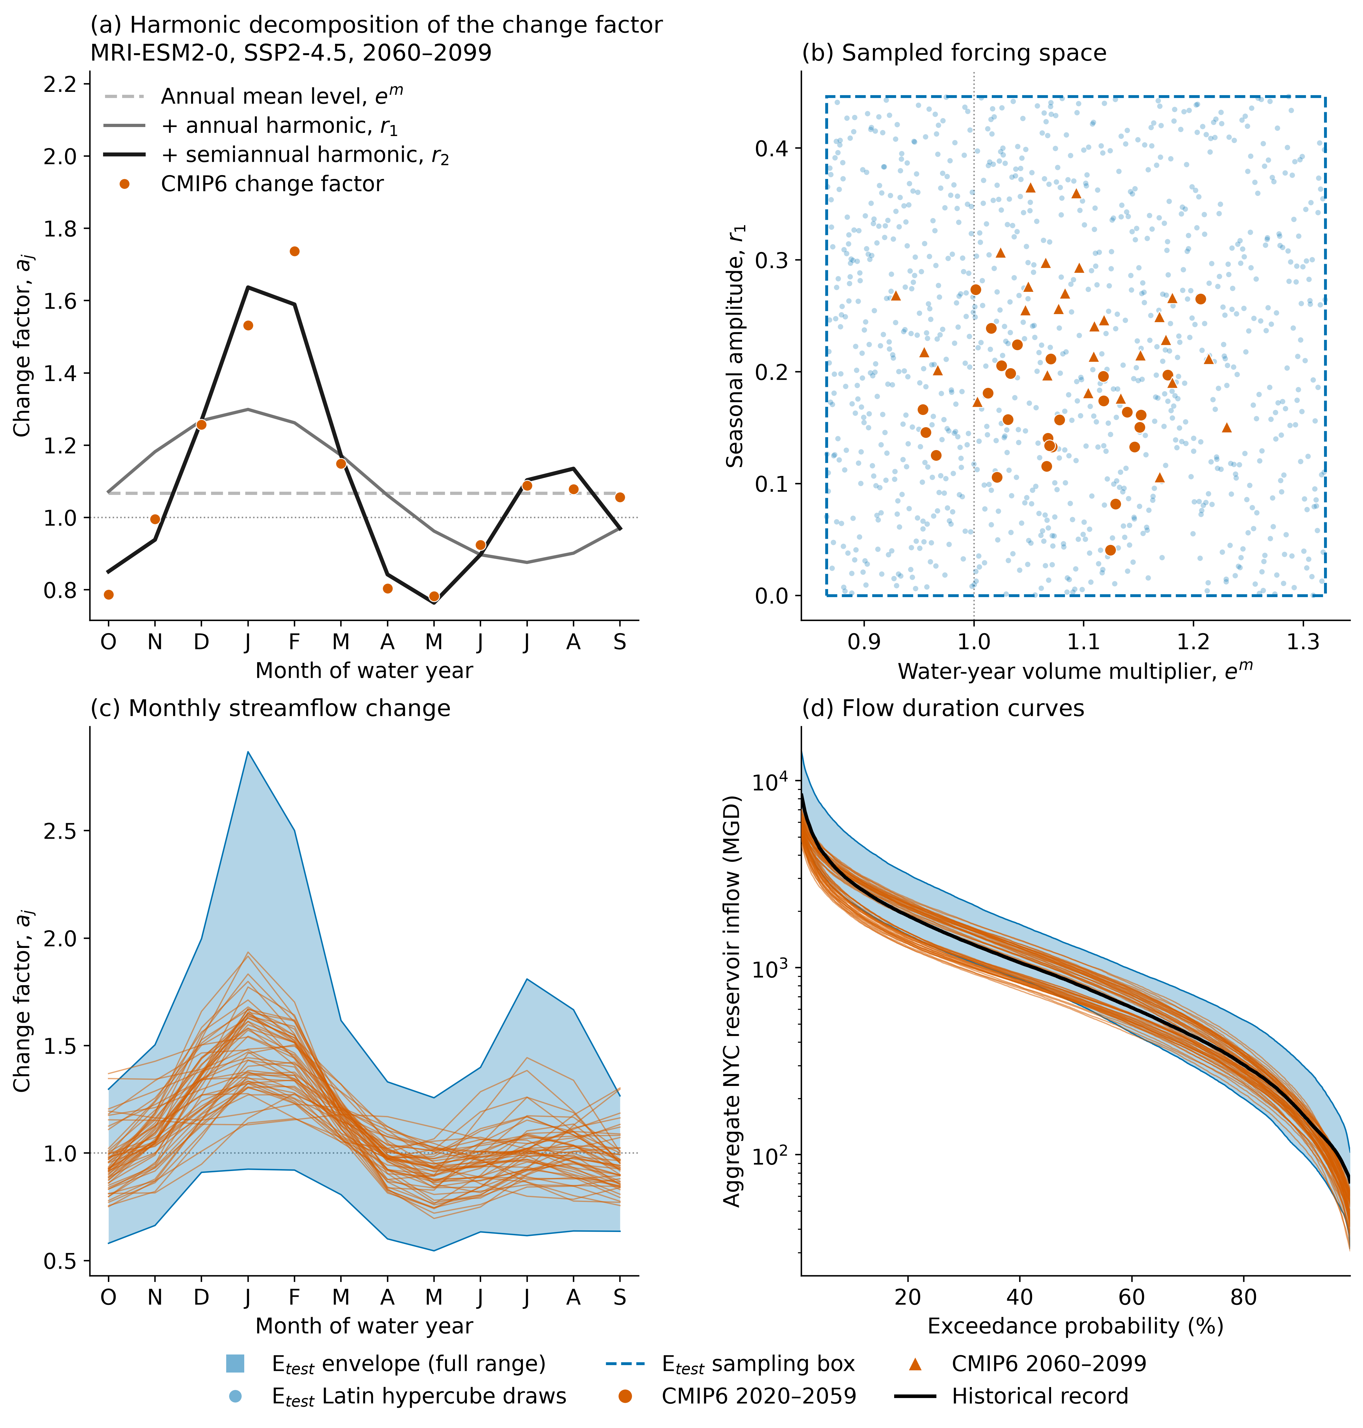
Experimental Design: Re-evaluation under climate change uncertainty
Three harmonic amplitudes span the CMIP6 range widened by one quarter at each end, with the dry bound extended to a 20% reduction in annual flow.
Re-evaluation ensemble:
1,000 SOWs by Latin hypercube sampling, 500 re-evaluated
25 realizations per SOW
50 years per realization

Slide 62
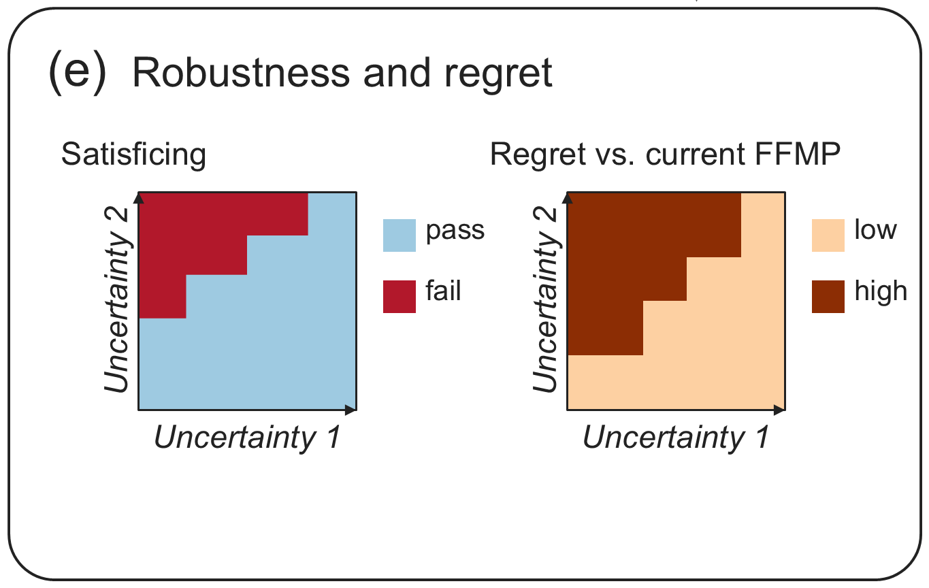
Experimental Design: Robustness and Regret
Satisficing robustness (Starr, 1963)
Fraction of SOWs in which a policy meets every performance criterion
Regret relative to the current FFMP policy
Fraction of SOWs in which no objective is degraded beyond a tolerance
Low regret for every party bears on unanimous consent

Slide 63
NYC Reservoir Re-Operation
Preliminary Results

Slide 64
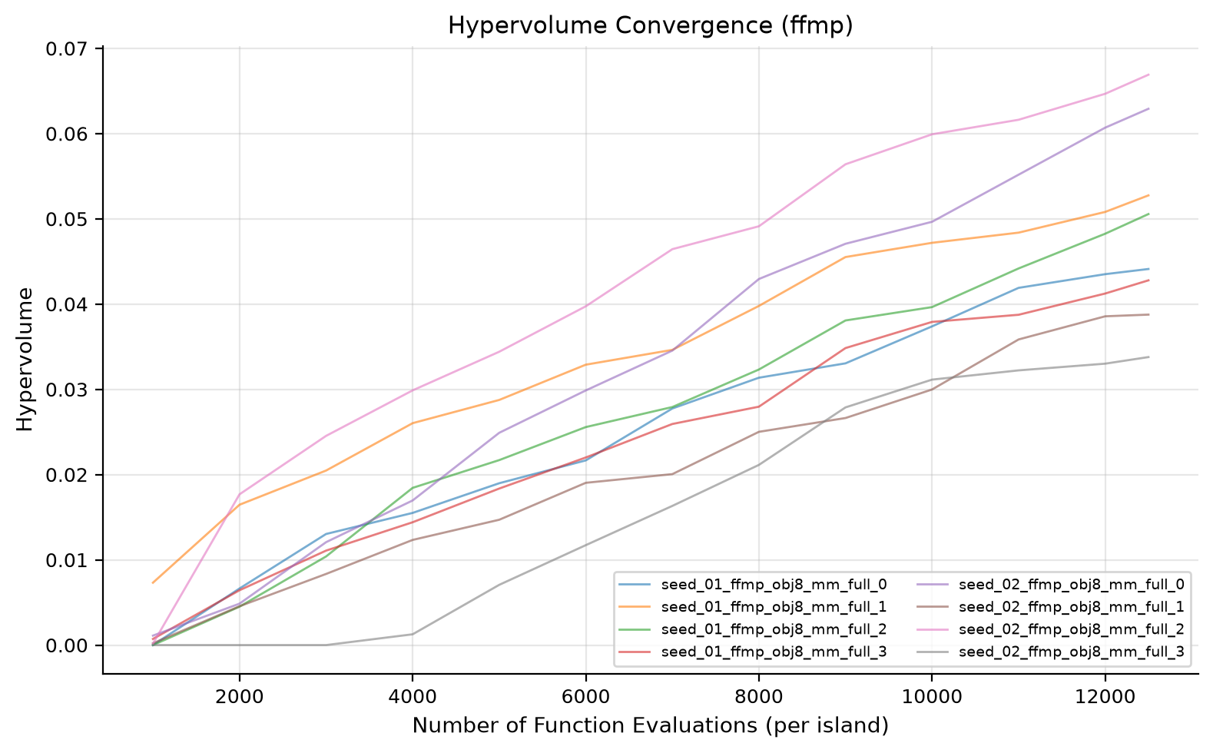
Preliminary Results
Preliminary search:
50k NFE, 2 MM Borg seed trials
HIST design (historical record, 1945–2023)
WARNING: Preliminary results do not converge.

Slide 65
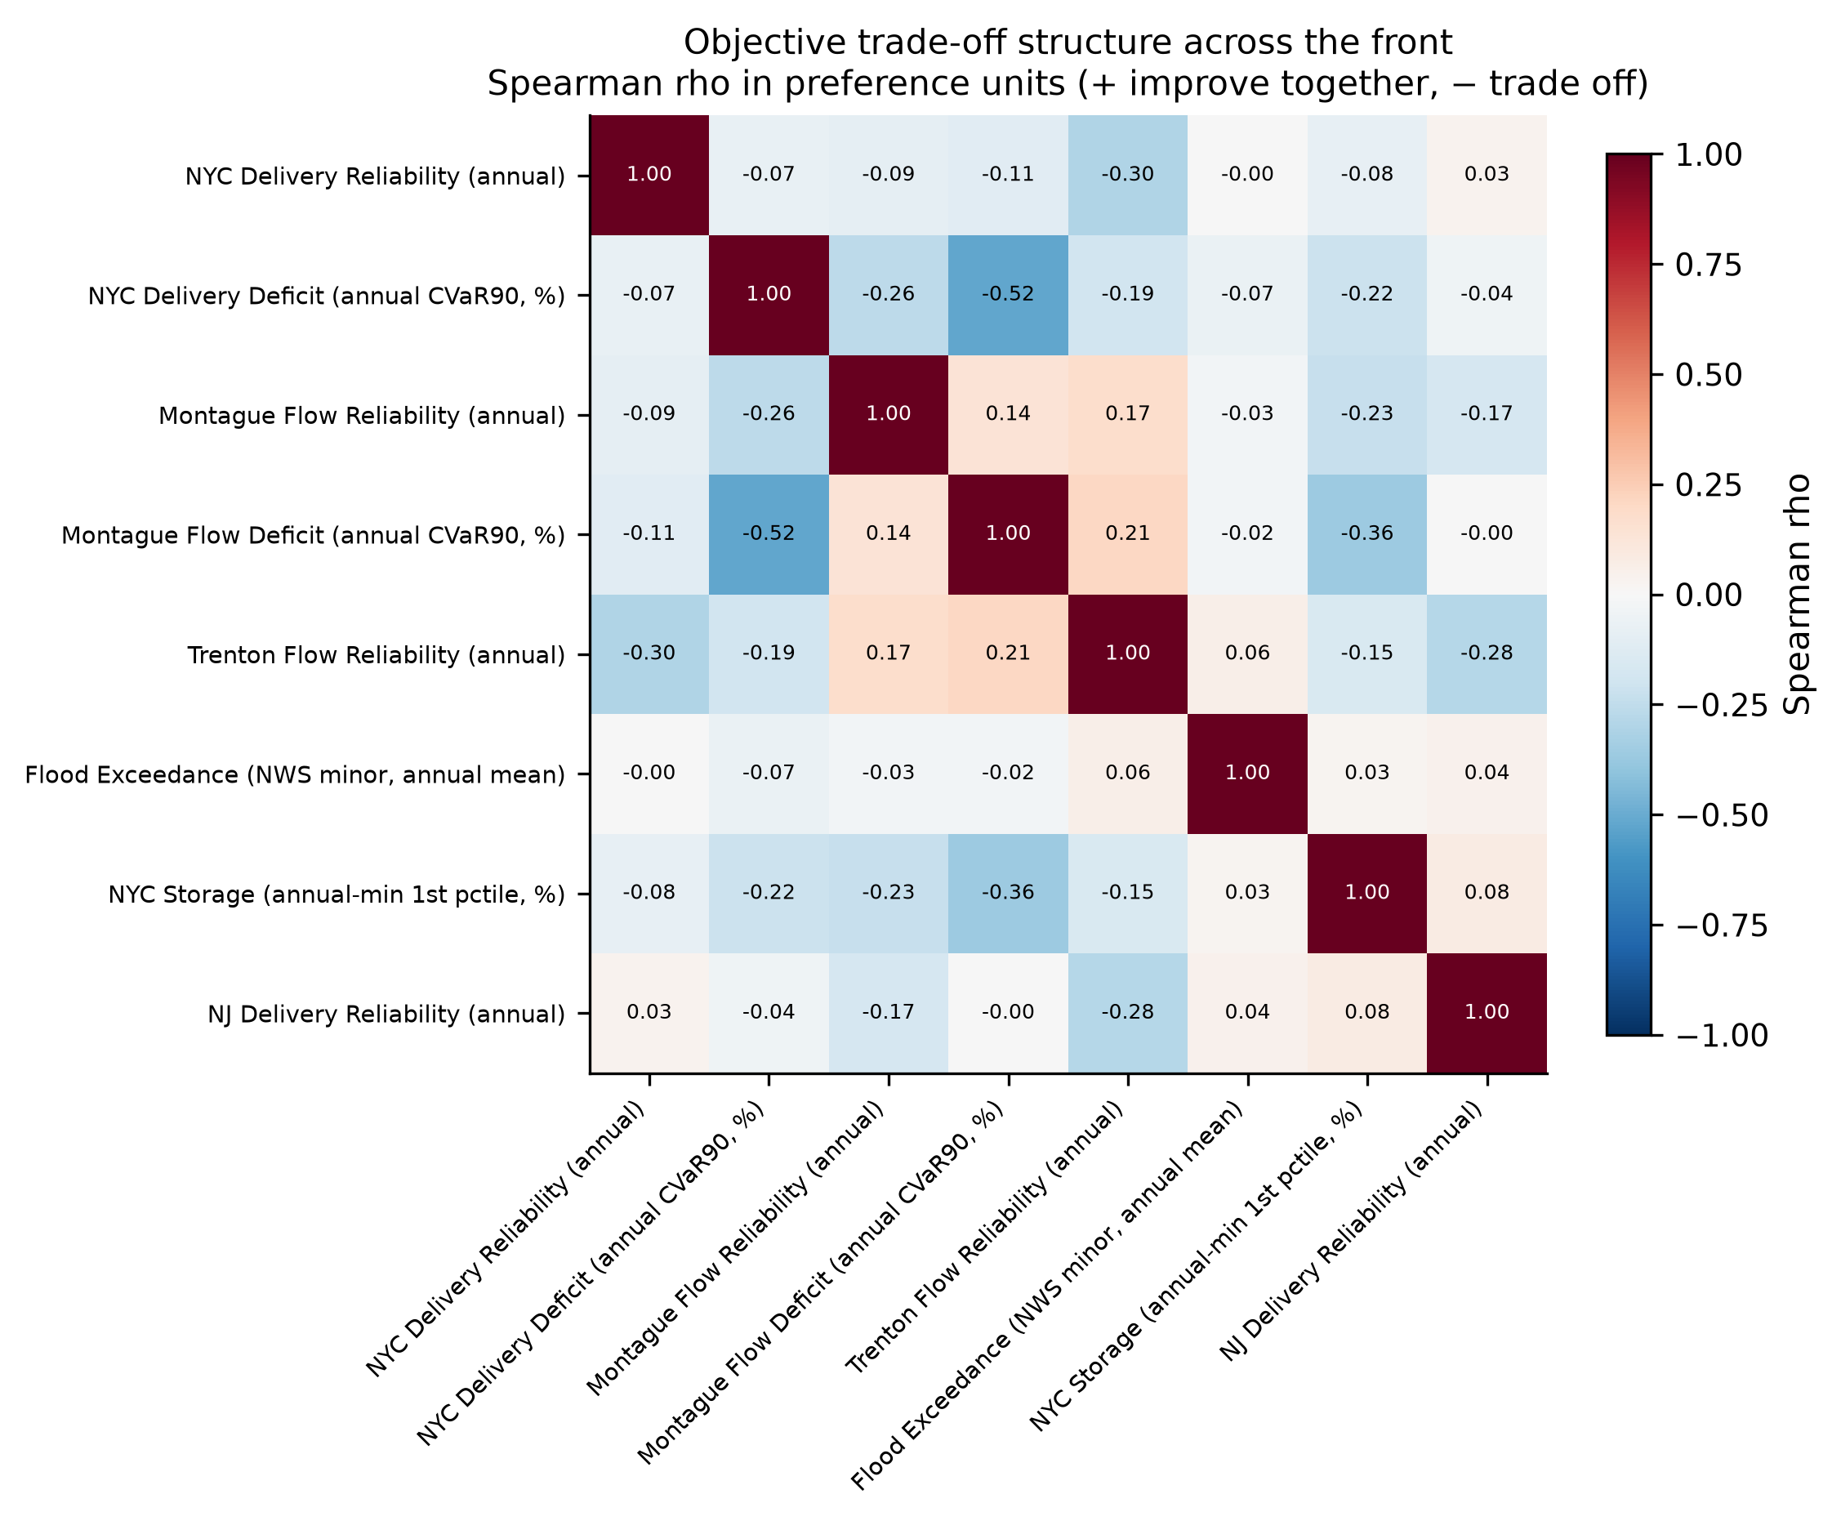
Preliminary Results
There is minimal, and frequently negative, Spearman correlation between objectives.

Slide 66
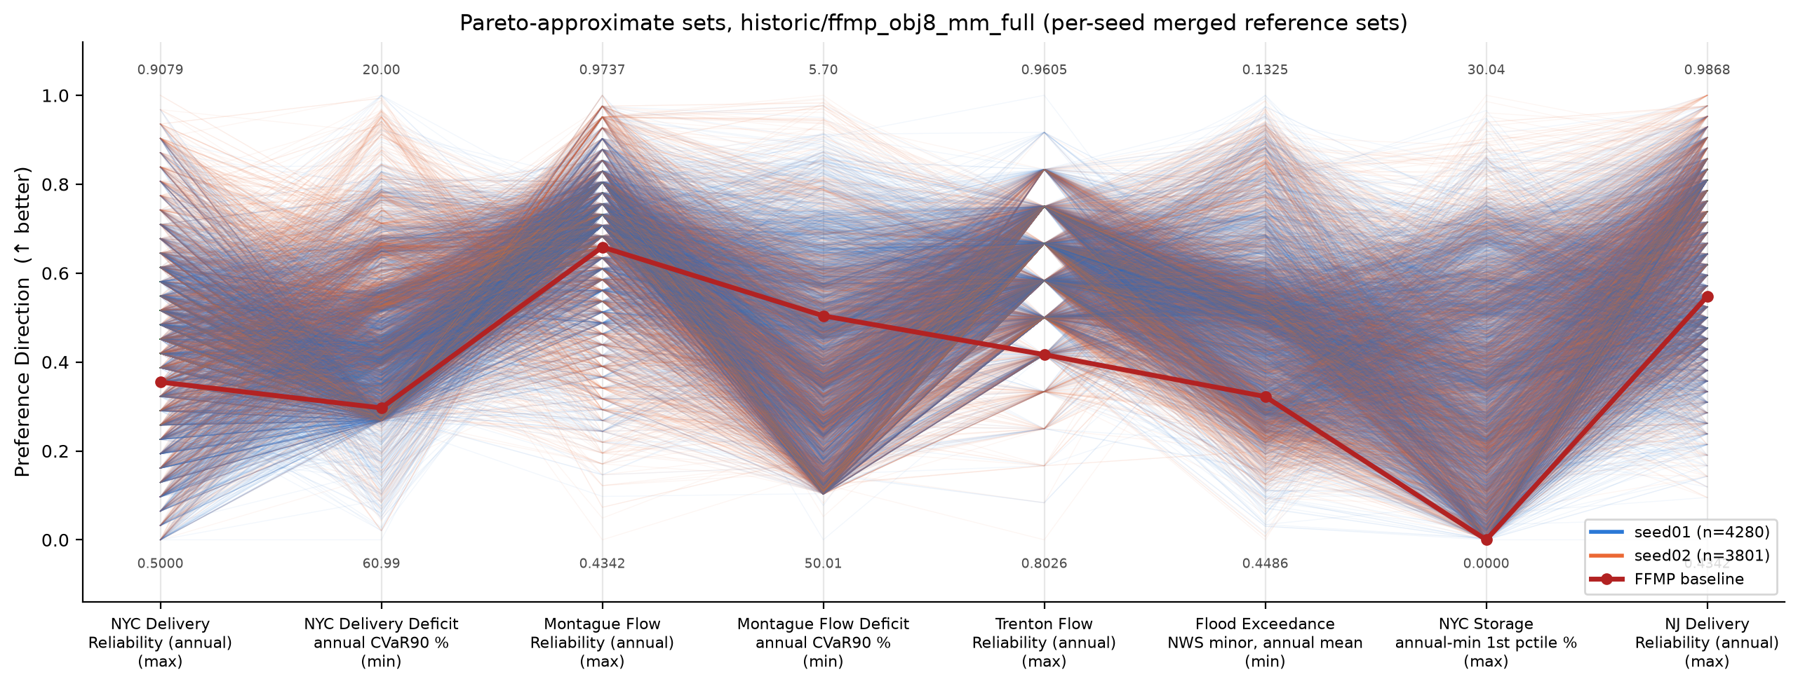
Preliminary Results
1,761 Pareto-approximate policies merged across seeds

Slide 67
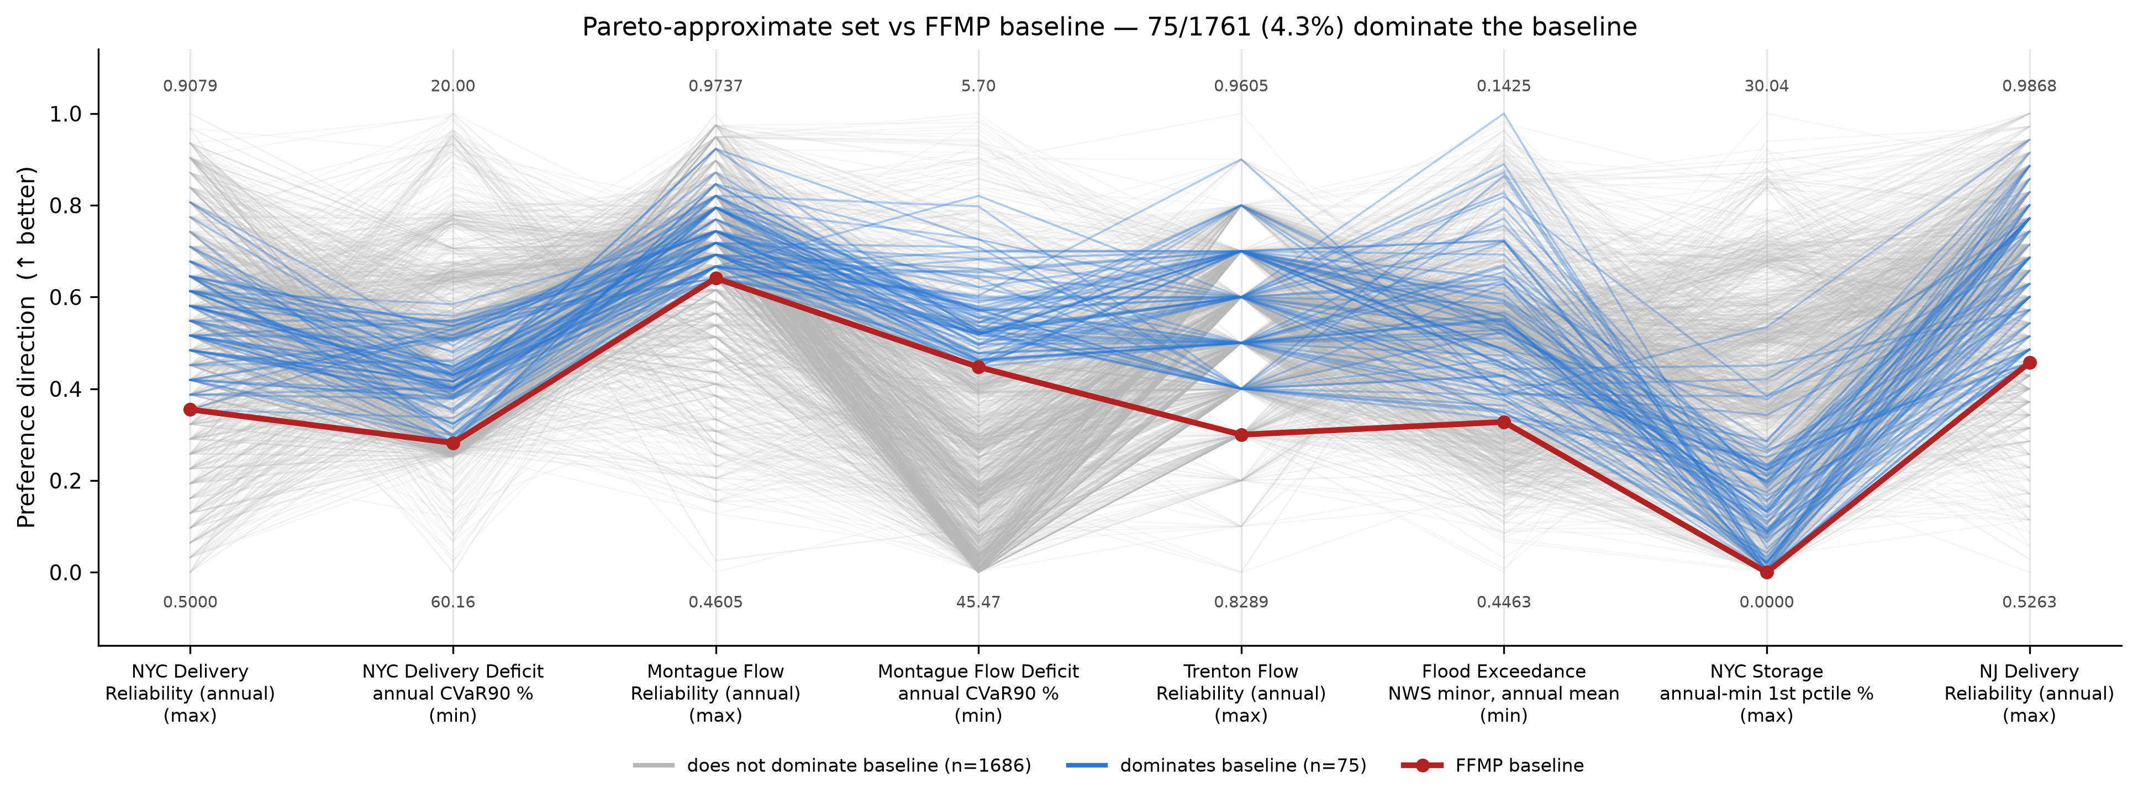
Preliminary Results
75 of 1,761 (4.3%) Pareto-approximate policies dominate the current FFMP on the HIST search ensemble

Slide 68
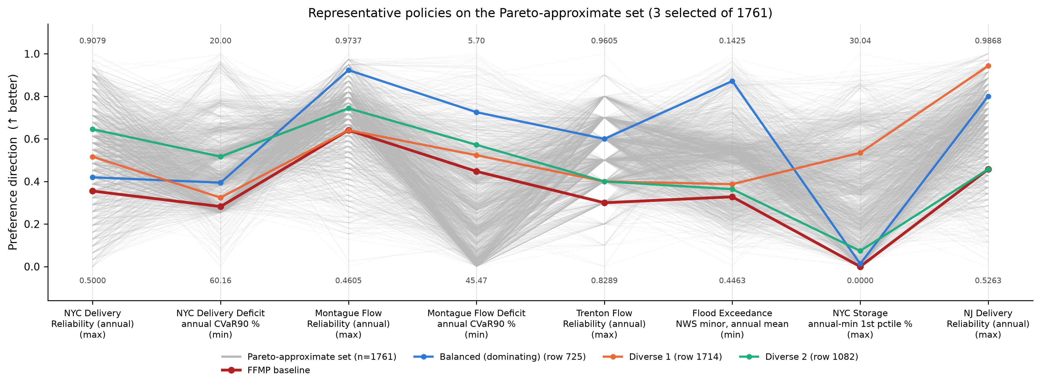
Preliminary Results

Slide 69
Supplemental Information

Slide 70
Supplemental:
Parametric Sampling of Uncertain
Monthly Streamflow Change Factors

Slide 71
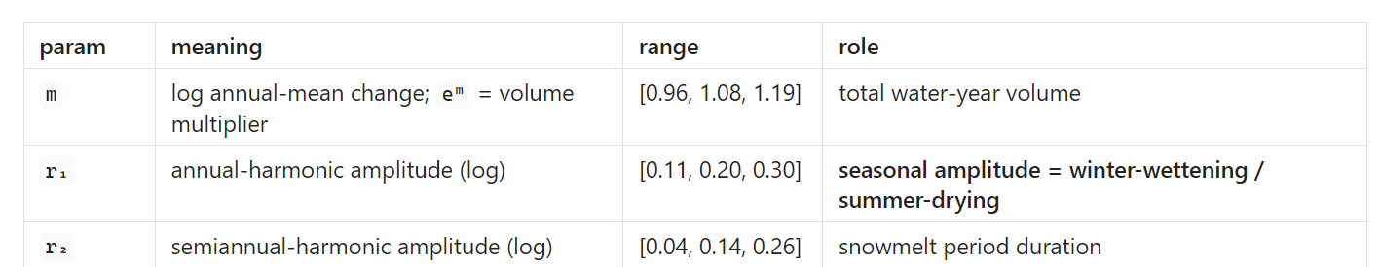
Experimental Design: Re-evaluation under climate change uncertainty
Can a 3 parameter harmonic capture CMIP6 informed monthly flow changes?

Slide 72
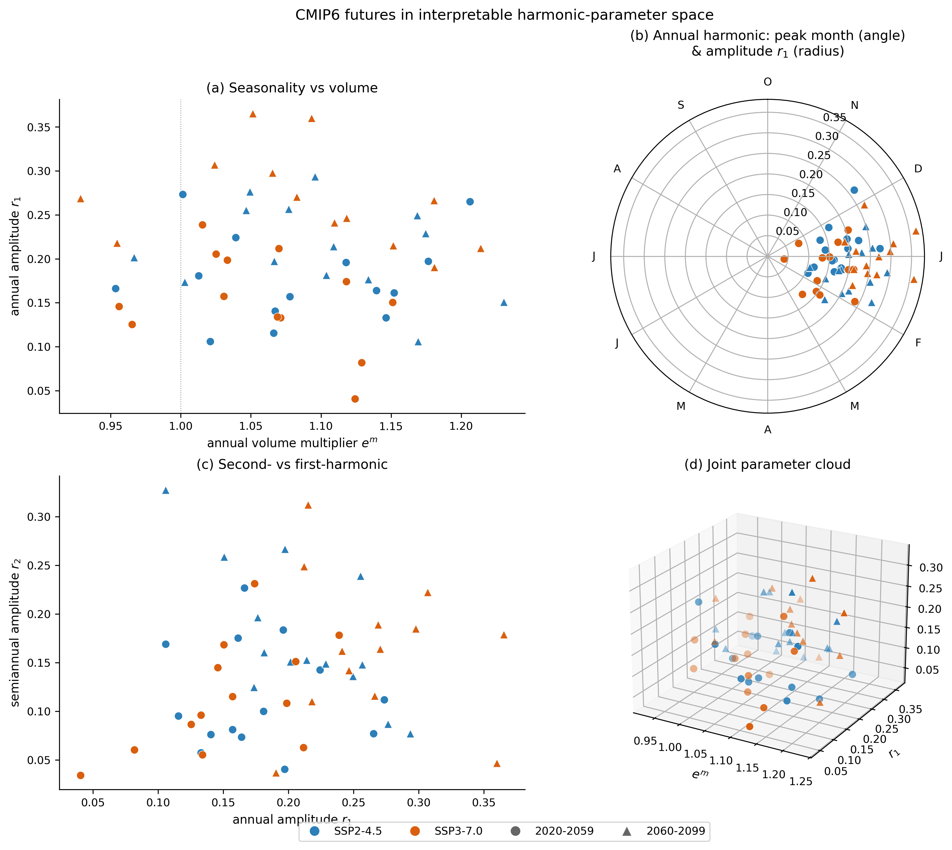
Experimental Design: Re-evaluation under climate change uncertainty
Range & spread of harmonic parameters for all of the CMIP6 streamflow traces (same data as paper 2)
Fit the 3-parameter harmonic to each trace using OLS.

Slide 73
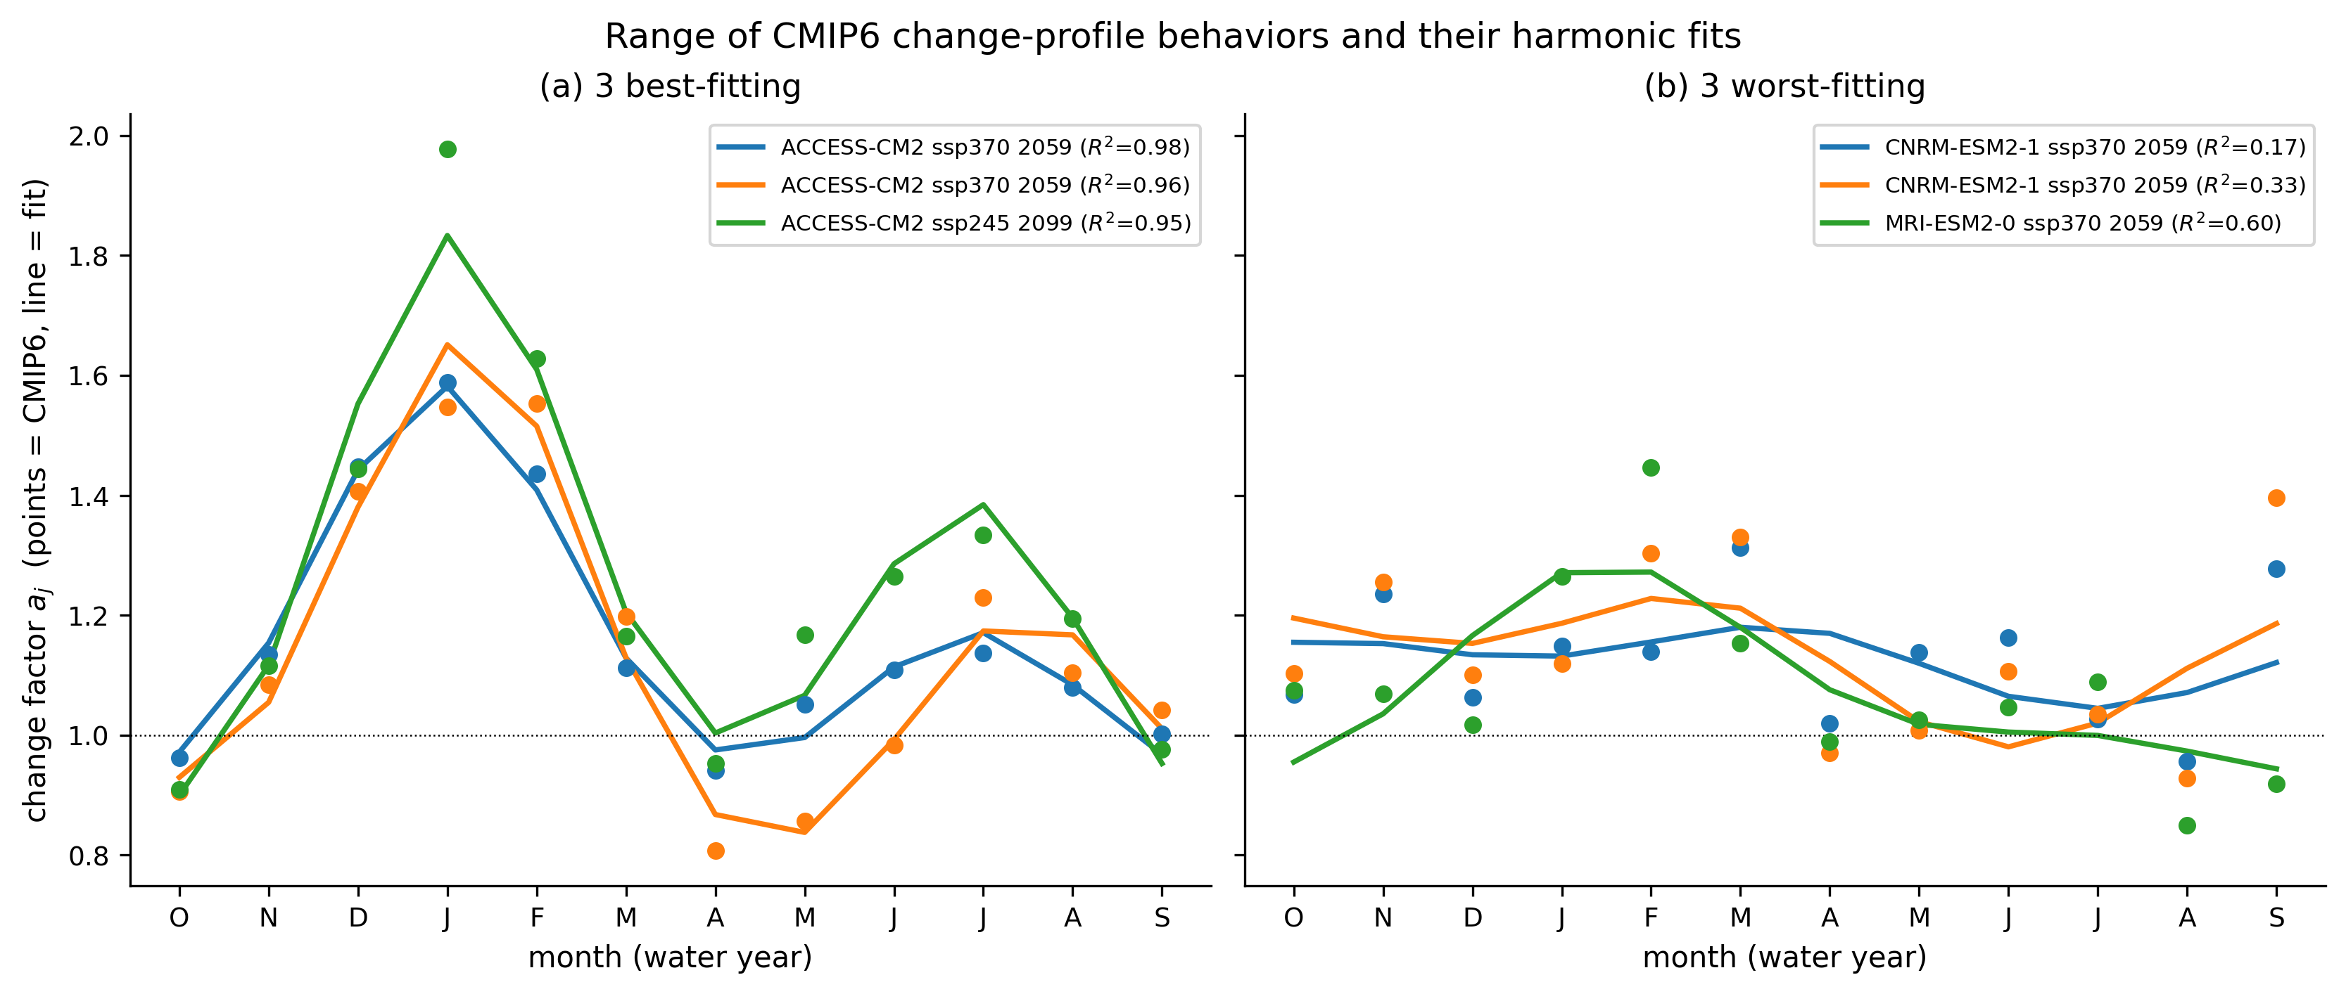
Experimental Design: Re-evaluation under climate change uncertainty

Slide 74
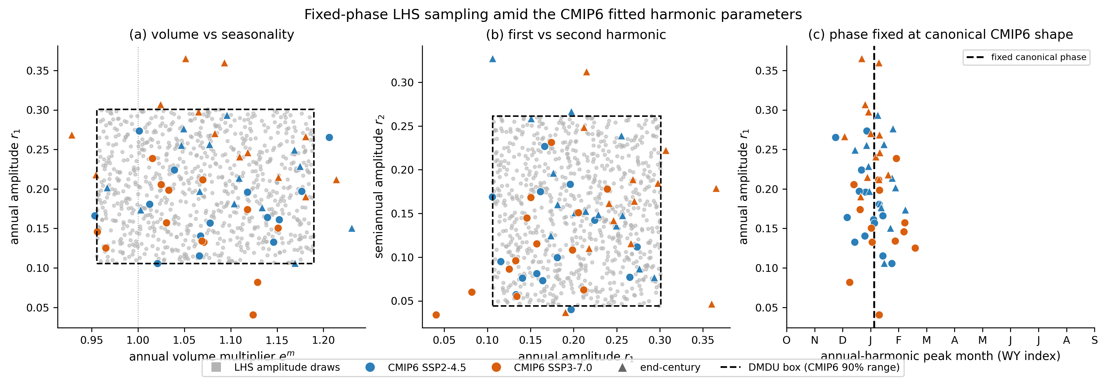
Experimental Design: Re-evaluation under climate change uncertainty
Grey = LHS samples inside the hypercube containing 90% of CMIP6 scenarios
Color markers = fitted parameters from LHS ensemble

Slide 75
Experimental Design: Re-evaluation under climate change uncertainty

Slide 76
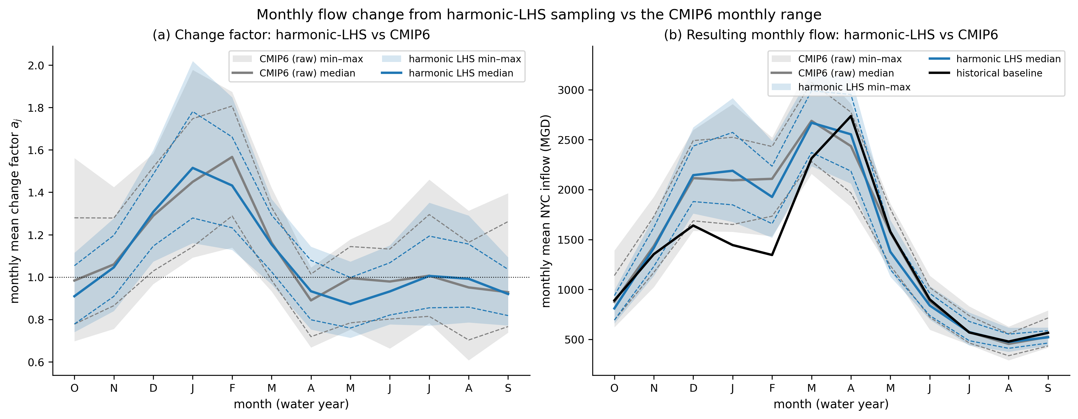
Experimental Design: Re-evaluation under climate change uncertainty

Slide 77
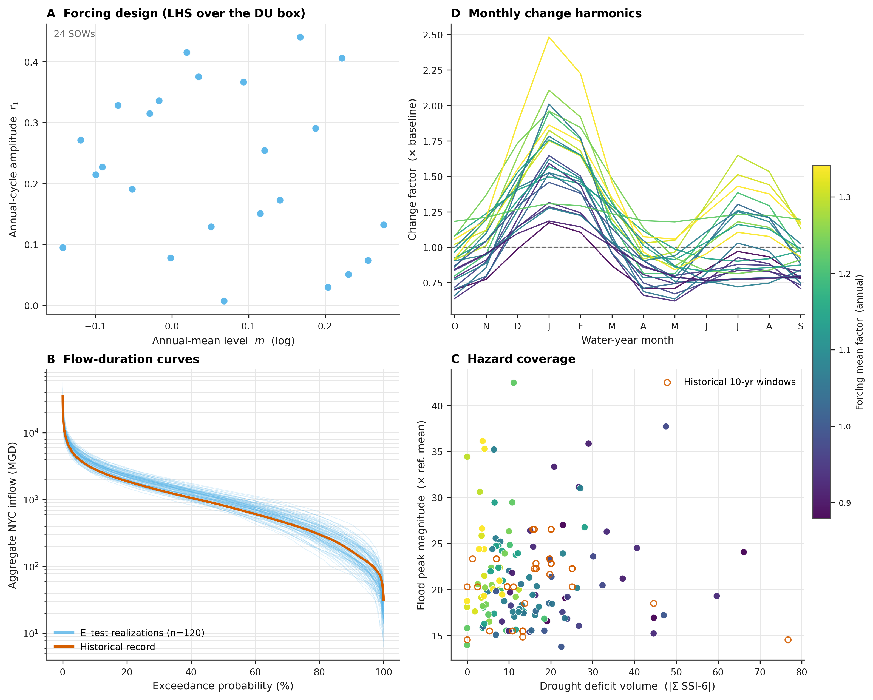
Experimental Design: Re-evaluation under climate change uncertainty

Slide 78
Supplemental:
Stochastic Ensemble Convergence

Slide 79
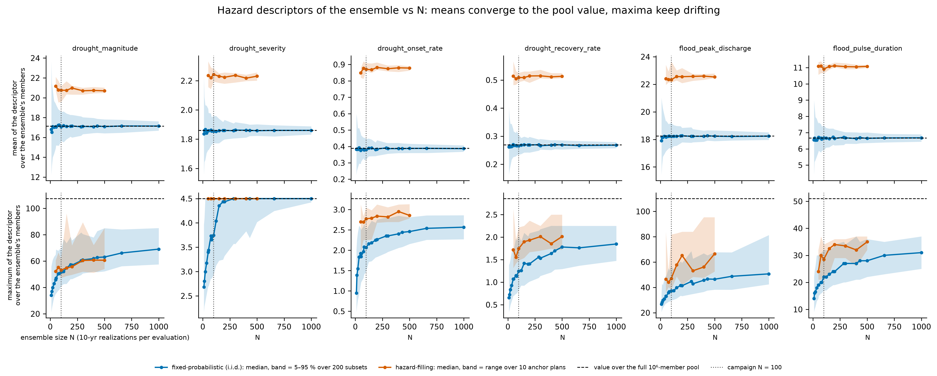
Paper 3 Discussions: How many stochastic realizations, years should be used in each search ensemble and function evaluation?
Top Row = Mean hazard value
Bottom Row = Max hazard value
Blue = Monte Carlo Ensemble
Orange = Hazard Fill Ensemble
Obj score on the Hazard Filling ensemble

Slide 80
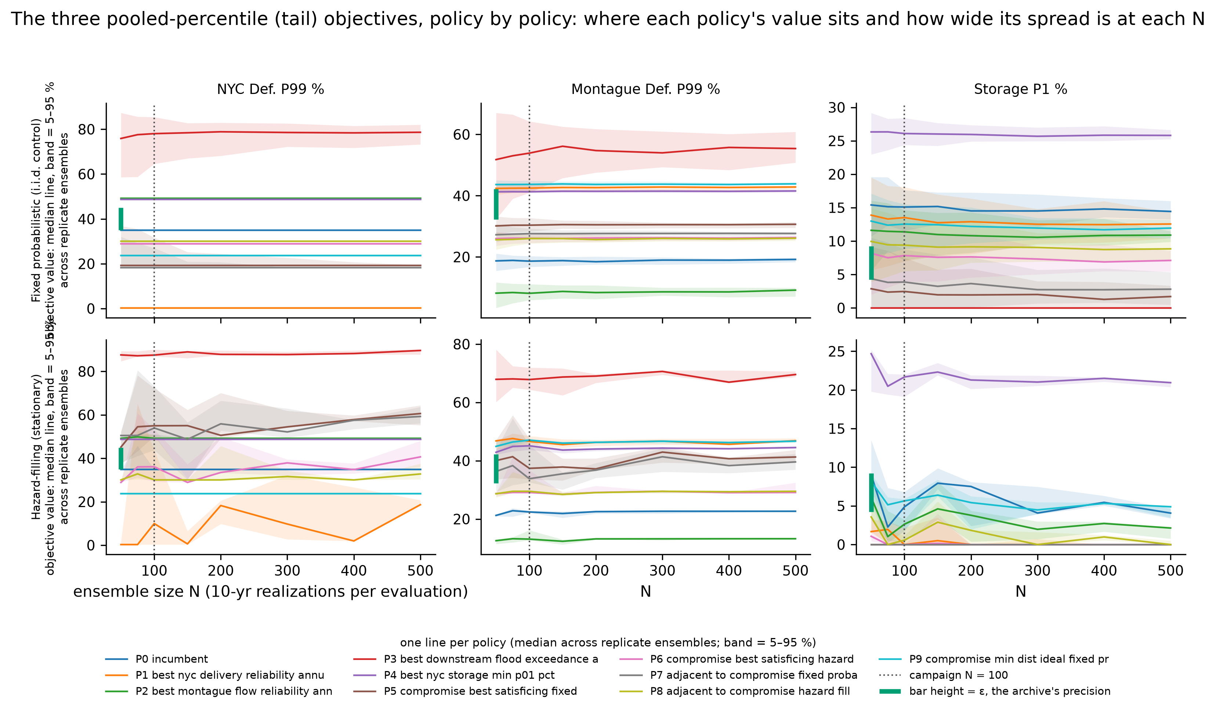
Paper 3 Discussions: How many stochastic realizations, years should be used in each search ensemble and function evaluation?
Obj score on the Monte Carlo ensemble
Obj score on the Hazard Filling ensemble

Slide 81
Supplemental:
Include climate change in the search ensembles?

Slide 82
Paper 3 Discussions
Should we include climate change uncertainty in the hazard-filling ensemble generation?
Attempt to answer this via both:
Practical perspectives
Theoretical perspectives

Slide 83
Paper 3 Discussions: Should we include climate change uncertainty in the hazard-filling ensemble generation?
Practical perspective
Current ensemble generation approach
Hazard Measure 2
i.i.d Monte Carlo Sample
Historic Reconstruction
+
Stochastic Generator
1 Million
10-yr realizations
Hazard Measure 2
Hazard Measure 1
Hazard Measure 1
Actually, the “Monte Carlo” ensemble is generated straight from the generator.
However, it would be technically equivalent to do a i.i.d sample from the large 1M ensemble.

Slide 84
Paper 3 Discussions: Should we include climate change uncertainty in the hazard-filling ensemble generation?
Practical perspective
Current ensemble generation approach
Hazard Measure 2
i.i.d Monte Carlo Sample
Historic Reconstruction
+
Stochastic Generator
1 Million
10-yr realizations
Hazard Measure 2
Hazard Measure 1
Hazard-Filling Sample
Hazard Measure 2
Hazard Measure 1
Hazard Measure 1

Slide 85
Paper 3 Discussions: Should we include climate change uncertainty in the hazard-filling ensemble generation?
Practical perspective
The HF ensemble depends on the hazard space (by design).
Adding climate uncertainty into the generation will only have interpretable/understandable impacts on the resulting HF if there is significant shift in the resulting range of the hazard metrics relative to the stationary baseline.
?
Note:
Since HF design does not preserve the marginal hazard distributions, the change in frequency of flow hazard does not influence the HF ensemble.
Hydro Uncertainty 2
Hazard Measure 2
Hydro Uncertainty 1
Hazard Measure 1

Slide 86
Paper 3 Discussions: Should we include climate change uncertainty in the hazard-filling ensemble generation?
Practical perspective
Historic Reconstruction
+
Stochastic Generator
1 Million
10-yr realizations
Diagnostic test to help understanding:
Compare range/overlap of hazard metrics from:
stationary baseline ensemble used for HF generation
the full LHS re-evaluation ensemble.
Hazard Measure 2
Hazard Measure 1
Hydro Uncertainty 2
Hazard Measure 2
Hydro Uncertainty 1
Hazard Measure 1

Slide 87
Paper 3 Discussions
Sampling scheme for deeply uncertain hydrologic change factors.
Planned full scale ensemble size:
1,000 SOWs (LHS samples)
50 realizations
50 years
Note: For this diagnostic, I calculate hazard metrics for each 10-year period in each realization (matching the HF 10-year periods).
Hazard metrics are designed to be interpretable/meaningful for short periods.

Slide 88
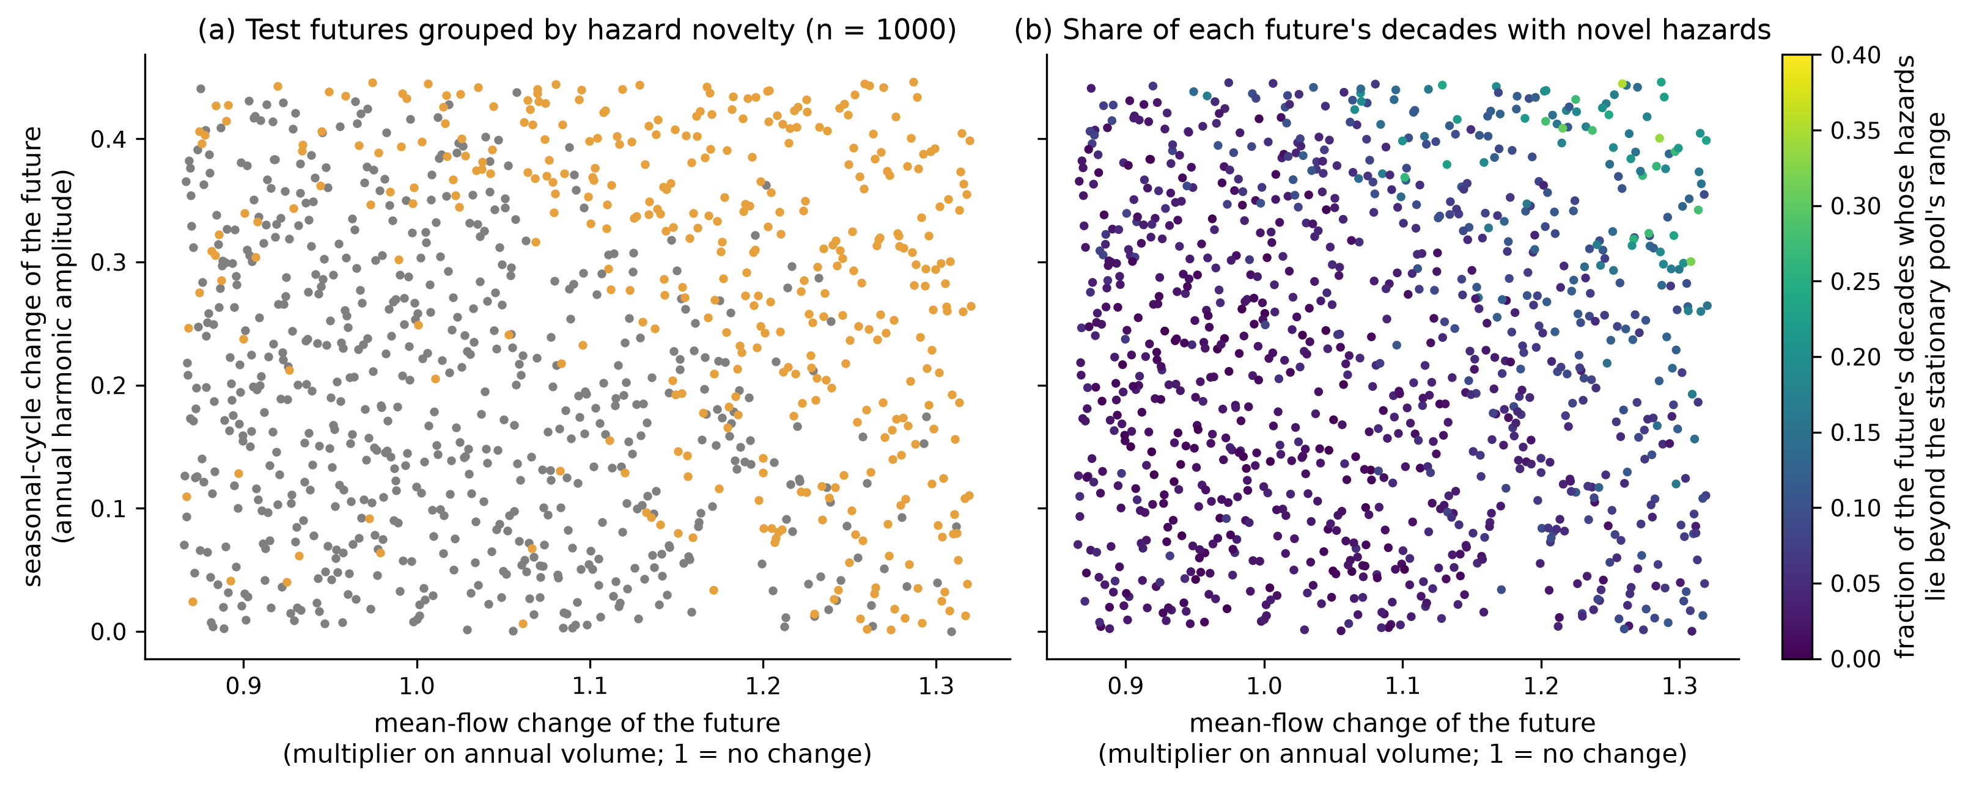
Paper 3 Discussions: Should we include climate change uncertainty in the hazard-filling ensemble generation?
Practical perspective
Each point = 1 streamflow change SOW
Grey: 95% of SOW hazard metrics inside 1M stationary baseline ensemble
Orange: 5-50% of SOW metrics are outside stationary baseline ensemble
Red (0 points): >50% of SOW hazard metrics are outside stationary baseline ensemble

Slide 89
Paper 3 Discussions: Should we include climate change uncertainty in the hazard-filling ensemble generation?
Practical perspective
Stationary baseline is here, zero monthly flow change
Grey: 95% of SOW hazard metrics inside 1M stationary baseline ensemble
Orange: 5-50% of SOW metrics are outside stationary baseline ensemble
Red (0 points): >50% of SOW hazard metrics are outside stationary baseline ensemble

Slide 90
Paper 3 Discussions: Should we include climate change uncertainty in the hazard-filling ensemble generation?
Practical perspective
Only the extreme half of the climate change range results in a significant number of new, unseen hazard conditions (orange).
Grey: 95% of SOW hazard metrics inside 1M stationary baseline ensemble
Orange: 5-50% of SOW metrics are outside stationary baseline ensemble
Red (0 points): >50% of SOW hazard metrics are outside stationary baseline ensemble

Slide 91
Paper 3 Discussions: Should we include climate change uncertainty in the hazard-filling ensemble generation?
Practical perspective
The CMIP6 monthly change profiles cluster around this area of the uncertainty space
Grey: 95% of SOW hazard metrics inside 1M stationary baseline ensemble
Orange: 5-50% of SOW metrics are outside stationary baseline ensemble
Red (0 points): >50% of SOW hazard metrics are outside stationary baseline ensemble

Slide 92
Paper 3 Discussions: Should we include climate change uncertainty in the hazard-filling ensemble generation?
Practical perspective
Similar figure, using a gradient:
Color gradient = Fraction of SOW decades with hazards beyond the stationary baseline ensemble range.
Reiterates prior results.
The most extreme corner of the uncertainty space has ~30% of decades with unseen hazards.
But the vast majority of uncertain SOWs have an overlapping hazard space with the stationary baseline.
Seasonal Amplitude Flow Change Parameter

Slide 93
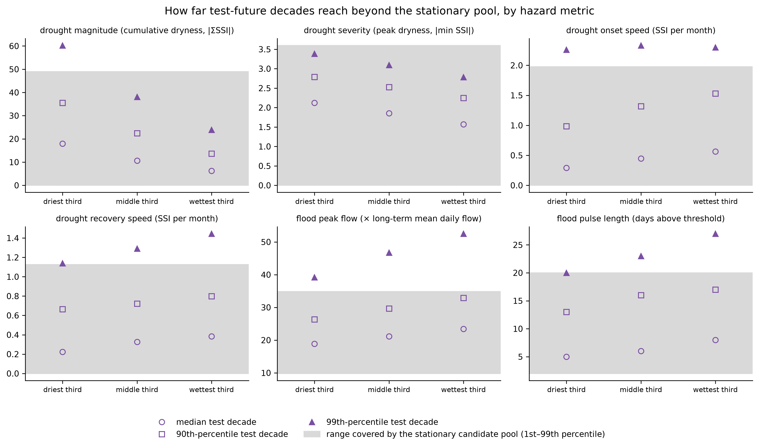
Paper 3 Discussions: Should we include climate change uncertainty in the hazard-filling ensemble generation?
Practical perspective
Alternative visualization, focused on actual hazard metric value ranges.
Grey box = 1M stationary baseline ensemble 1-99% range
Purple markers = Median, 90th and 99th percentile hazard values across SOWs
Each column = 1/3 of the SOWs, ranked by mean annual flow (driest, middle, wettest) chunk of the total uncertainty space.

Slide 94
Paper 3 Discussions: Should we include climate change uncertainty in the hazard-filling ensemble generation?
Practical perspective
Main take-away:
The 90% of flow hazards emerging across the re-evaluation ensemble are within the 1M stationary ensemble range, across all hazard metrics.

Slide 95
Paper 3 Discussions
Should we include climate change uncertainty in the hazard-filling ensemble generation?
Attempt to answer this via both:
Practical perspectives
Theoretical perspectives

Slide 96
Paper 3 Discussions: Should we include climate change uncertainty in the hazard-filling ensemble generation?
Theoretical perspective
“Train”
“Test”
Data used for optimization
Historic Reconstruction
+
Stochastic Generator
Data used for re-evaluation robustness, regret
CMIP6 model flow change
+
LHS Sampling
+
Stochastic Generator
Solution
Re-evaluation

Slide 97
Paper 3 Discussions: Should we include climate change uncertainty in the hazard-filling ensemble generation?
Theoretical perspective
1. Including climate change in the Hazard-Filling (HF) ensemble design will muddle the clean test-train split in the experimental design.
  Reviewers and readers will be familiar with ML-literature on test/train split and will be quick to critique if the HF ensemble has a beneficial bias by seeing the climate scenarios during search.
  Including uncertainty in the search detract from the focus on the contribution of the HF optimization design.

Slide 98
Paper 3 Discussions: Should we include climate change uncertainty in the hazard-filling ensemble generation?
Theoretical perspective
2. The HF approach is a complementary alternative to DU-optimization with the shared goal of improving robustness under uncertainty.
Including uncertainty in the HF search will place within the DU-optimization domain which would be harder to distinguish compared to other studies/approaches.
Instead, we can think about benefits/limits or similarities compared to DU-optimization alternatives. E.g., things to consider:
  Possibly less computationally intensive than DU-opt per each evaluation.
  Rely on well-established historical record + generation rather than
  Avoids making a priori assumptions of uncertain change

Slide 99
Supplemental:
Anvil Scaling Experiments

Slide 100
Anvil Scaling Experiment
Parallelism & Efficiency Levers:
Number of nodes
Number of core per node
Number of MM-Borg islands & workers
Number of realizations per Pywr-DRB simulation (pywr internal parallel)

Slide 101
Anvil Scaling Experiment
Goal: Before committing to large scale MM-Borg optimization, measure (a) how densely we can pack model evaluations on a node and (b) how well MM-Borg's parallelism scales.
Anvil node: 128 cores, 256 GB
Test 1: Efficiency of running K workers on a single node with.
On one node, run K independent copies of the MM-Borg worker evaluation (a 20-realization, 20-year synthetic streamflow ensemble through Pywr-DRB). Each rank times one ‘cold’ + several warm evaluations and records peak memory. Sweeping K reveals when contention or memory becomes the limit.
Test 2: MM-Borg strong scaling.
MM-Borg runs at a fixed budget of 1,280 evaluations, using a short simulation window (~6 s/eval) so runs are cheap. Geometries: 8, 16, 32, 64 workers on one island, plus 2×32 and 4×16 island splits at 64 slots. Two random seeds each. Wall time to finish the fixed budget gives speedup and parallel efficiency.

Slide 102
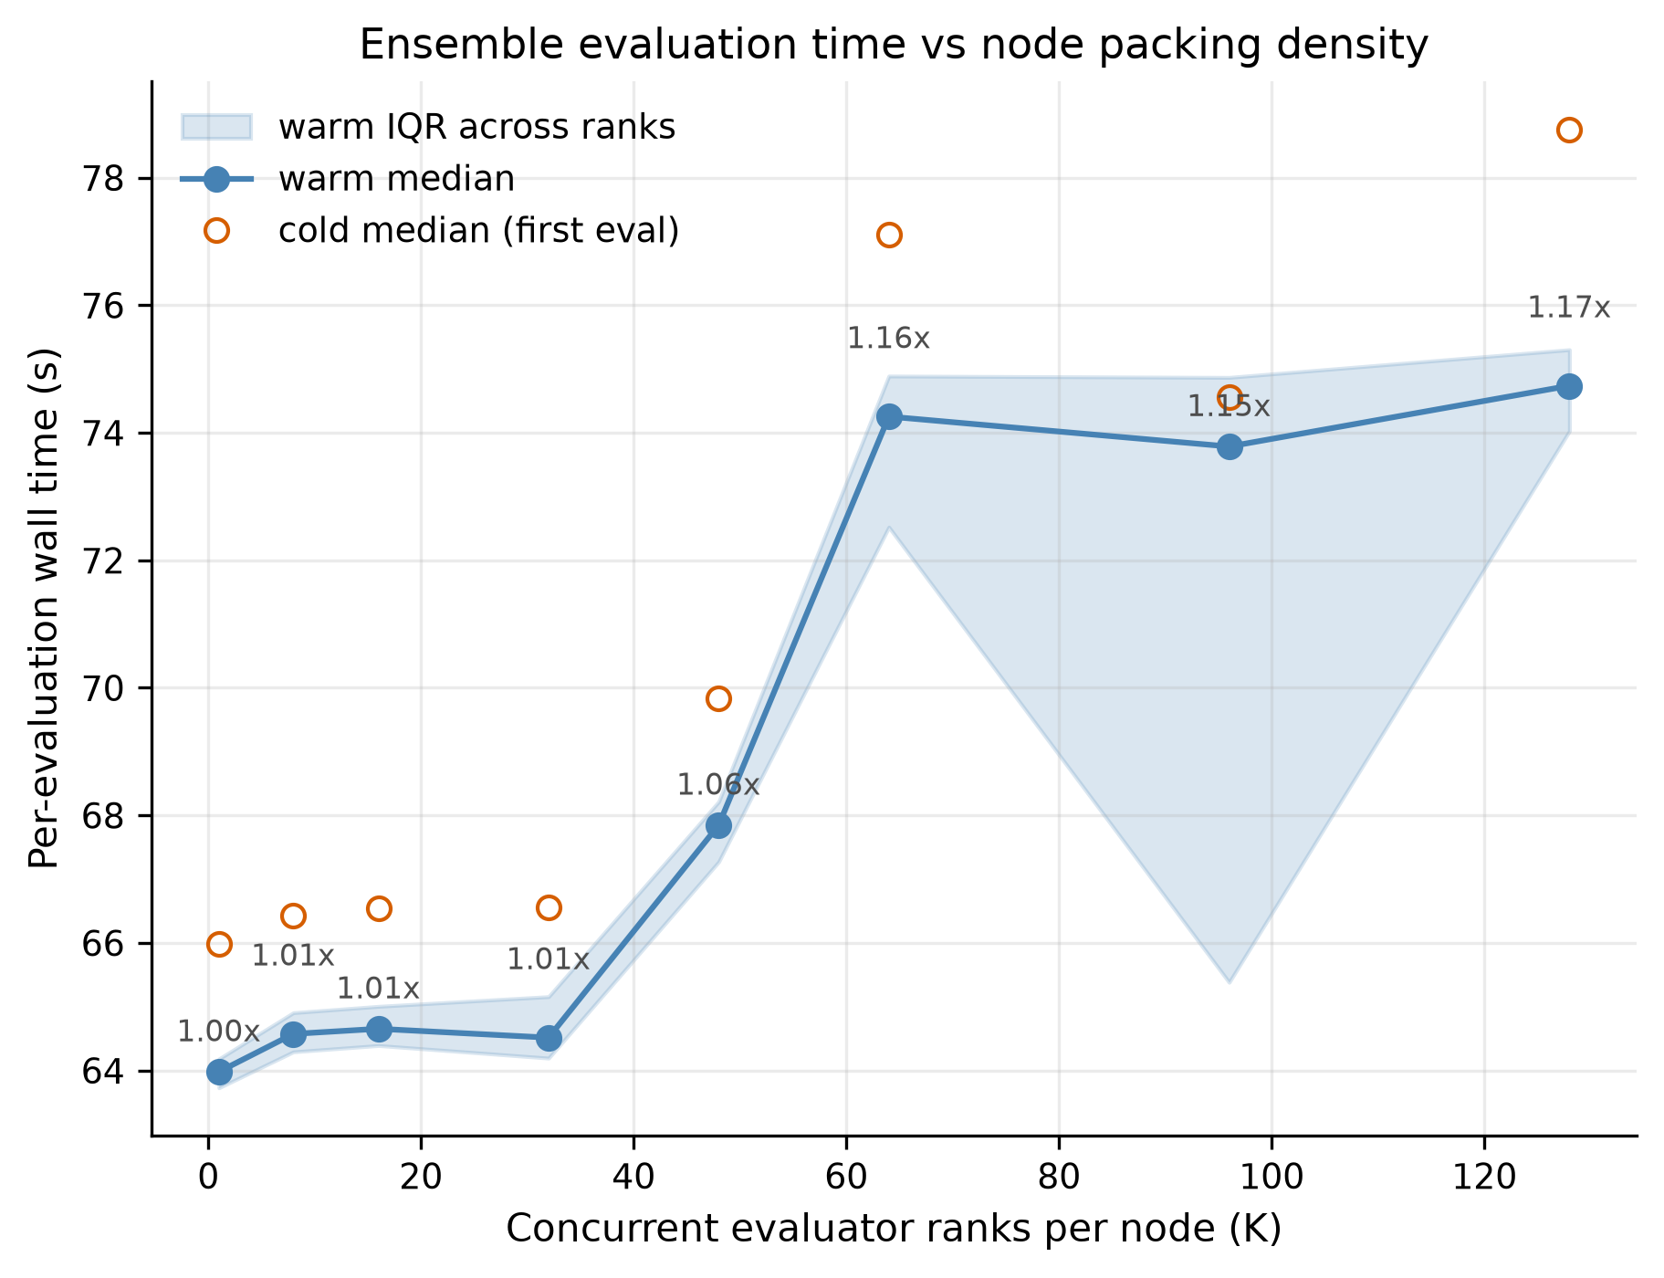
Anvil Scaling Experiments
Run = 20 realizations x 20 years
Run K copies of the evaluation at the same time, K = 1, 8, 16, 32, 48, 64, 96, 128 core.
Every rank times one "cold" evaluation (first one, caches empty) then several "warm" ones, using the exact code path a Borg worker uses.
Question: does crowding more evaluations onto one node make each one slower?

Slide 103
Anvil Scaling Experiments
Run = 20 realizations x 20 years
Packing is nearly free up to K=32 (only 1% slower than running alone), then costs 17% at full density K=128 (64.0 s -> 74.7 s).
However, a 17% per-evaluation penalty is worth it for 128× the parallelism.

Slide 104
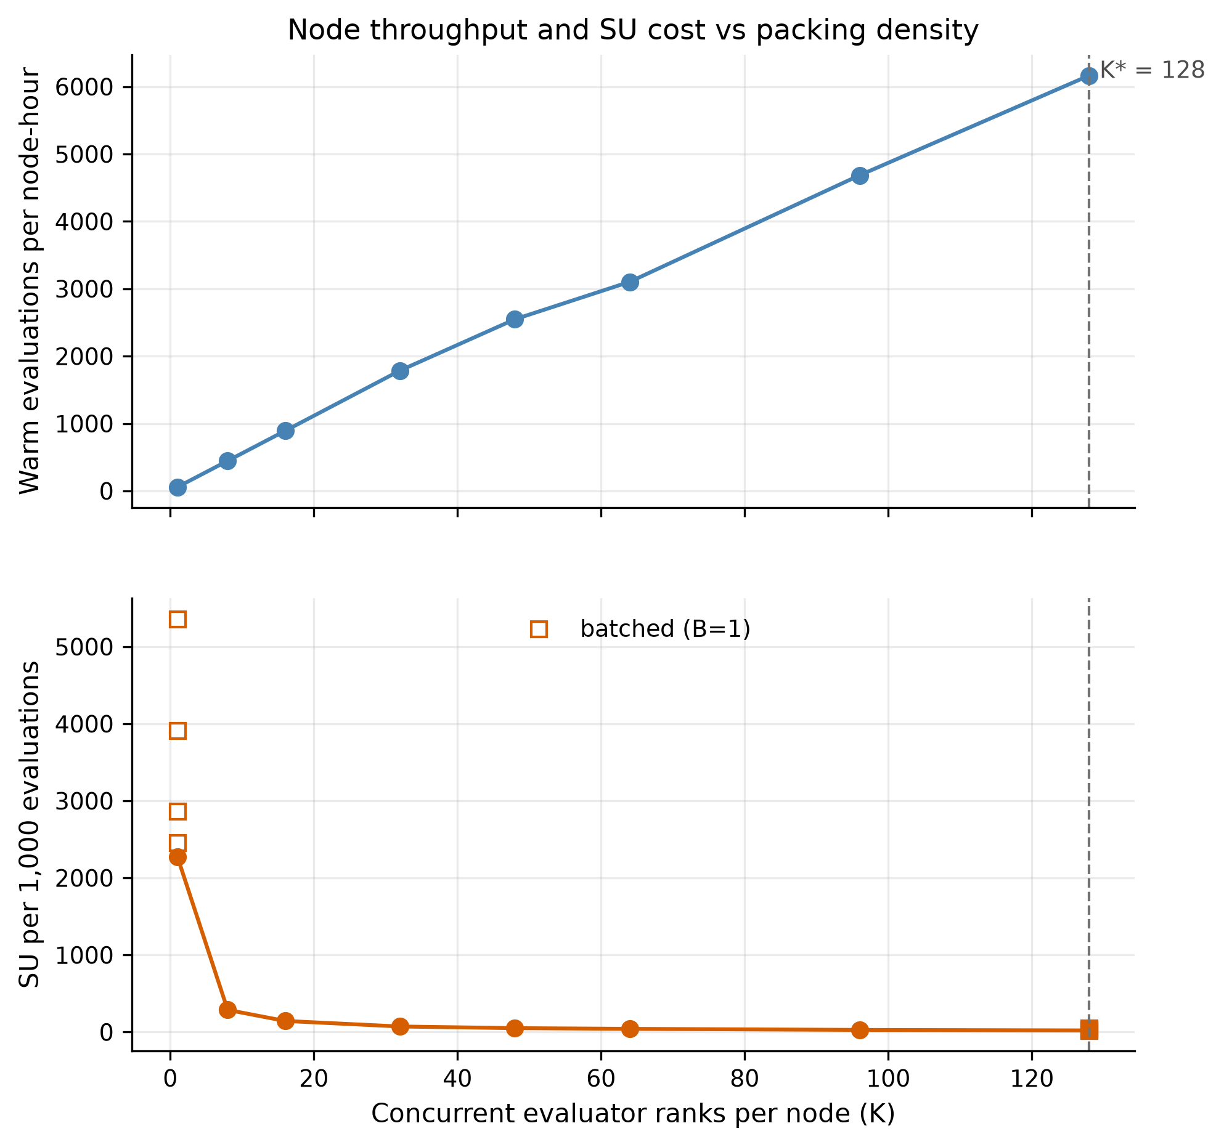
Anvil Scaling Experiments
Run = 20 realizations x 20 years
Top panel: Evaluations completed per node-hour, rising almost linearly with K to a maximum at K=128.
Bottom panel: SUs burned per 1,000 evaluations, decreasing as K rises and flattening out well before K=128 (open squares show the unbatched B=1 case for contrast).

Slide 105
Anvil Scaling Experiments
Run = 20 realizations x 20 years
Take-aways
Top: Throughput scales nearly linearly (56 evals/node-hr at K=1 to 6,166 at K=128), about 110x.
The 17% per-evaluation slowdown never overtakes the parallelism benefit.
Bottom: Cost per 1,000 evaluations drops from 2,275 SU to 21 SU.
Most of the savings arrive by K~=40; beyond that the curve is flat, so K=128 is good but also okay if we need to use less (due to memory)

Slide 106
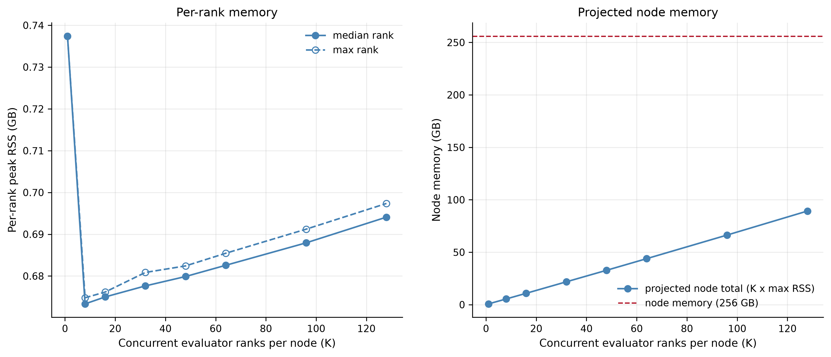
Anvil Scaling Experiments
Run = 20 realizations x 20 years
Left panel: Peak memory used by a single rank across packing densities, for the typical (median) and worst (max) rank memory usage.
Right panel: Total node memory implied by K ranks at the worst-case per-rank footprint, against the 256 GB node limit (red dashed line).

Slide 107
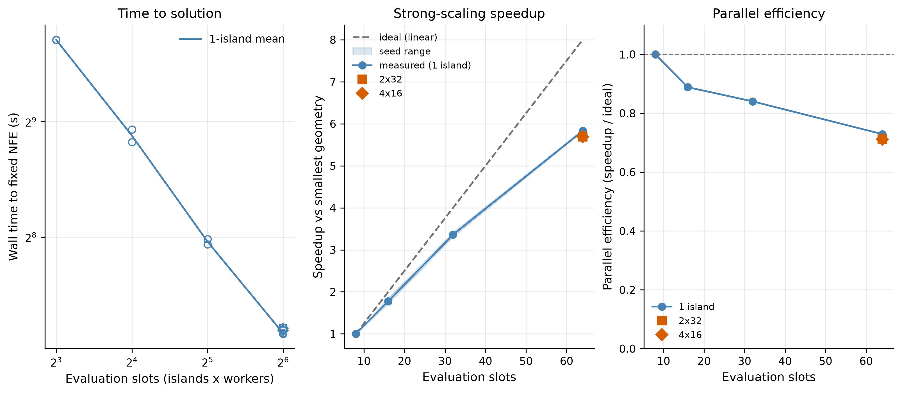
Anvil Scaling Experiments
Short 4 year simulation, 1,280 NFE, 2 random seeds
Left panel: Wall time to finish the fixed evaluation budget as evaluation slots increase from 8 to 64 (log-log).
Middle panel: Speedup relative to the smallest 8-slot run, against the ideal linear line, with the two multi-island geometries overlaid.
Right panel: Parallel efficiency (fraction of ideal speedup retained) as slots increase.

Slide 108
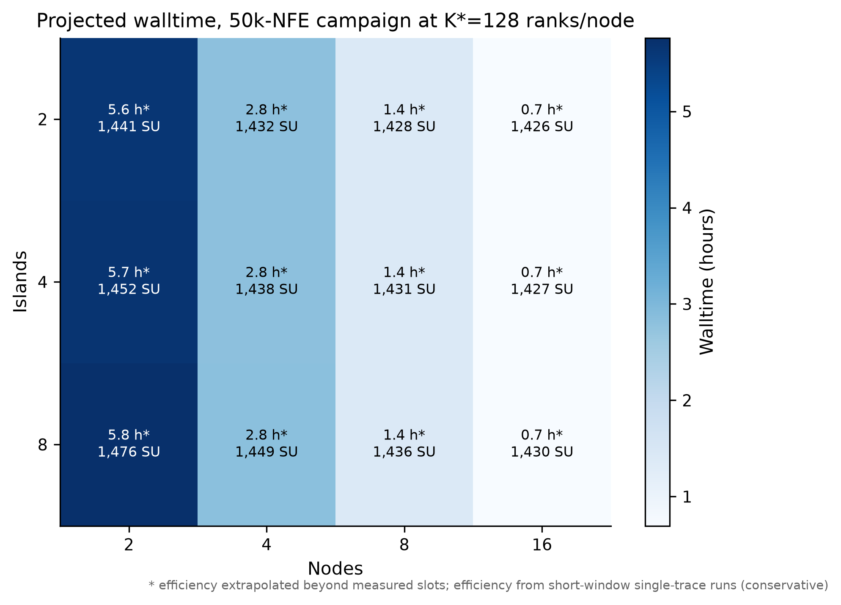
Anvil Scaling Experiments
Projected runtime combines the two measured pieces:
Evalutation runtime pack at K*=128 ranks/node
Borg scaling efficiency (assume 73% parallel efficiency)
For 750k NFE, 16 nodes and 4 islands:
= ~23k SU
= 10.5 hr

Slide 109
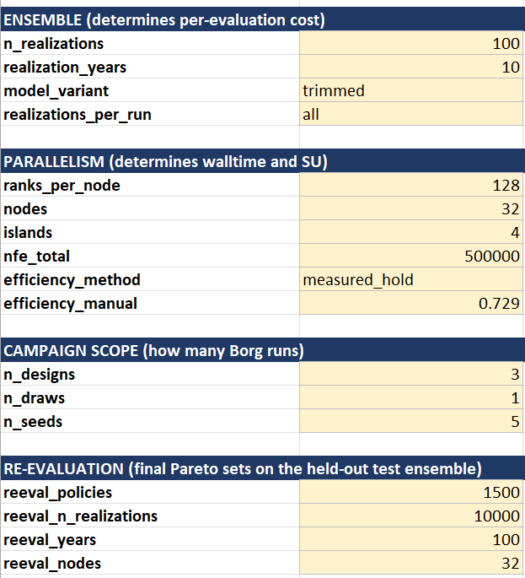
Anvil Scaling Experiment
Setup Anvil allocation calculator (based on Lillian’s advice)
Based on results of runtime & scaling experiments and experimental settings, estimate the total SUs needed for optimizations.
Current scale assumptions:
Optimization
500k NFE
1,000 years per evaluation
3x formulation designs
5x seeds per design
Re-evaluation
1,500 solutions re-evaluated
10,000 realizations x 100 years (1M years) per solution

Slide 110
Anvil Scaling Experiment
Setup Anvil allocation calculator (based on Lillian’s advice)
Saving some budget for re-runs if needed
15 optimizations total:
3 formulations x 5 seeds
Uses ~500 SU of allocation

Slide 111
Anvil Scaling Experiment
Setup Anvil allocation calculator (based on Lillian’s advice)
Wallclock time assuming use of 32 full nodes for each run.
8hr per optimization run/seed
Total = (8x15hr) if all of them are run in serial.

Slide 112
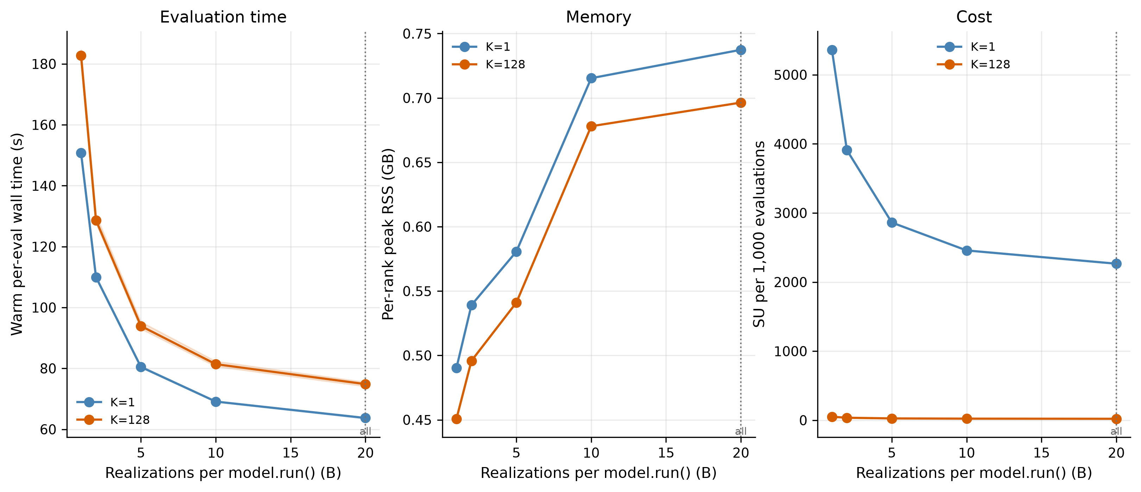
Anvil Scaling Experiments
Run = 20 realizations x 20 years
Left panel: Wall time per evaluation as B increases, for an isolated rank and a fully-packed node.
Middle panel: Peak per-rank memory as B increases.
Right panel: SU cost per 1,000 evaluations as B increases.

Slide 113

Anvil Scaling Experiments

Slide 114

Anvil Scaling Experiments

Slide 115
Archive (possibly delete)

Slide 116
Experimental Design
Scenario Design
Re-evaluation & Robustness
Optimization
Historical trace (baseline)
Re-evaluation of pareto-approximate solutions across large ensemble of climate change uncertainties
MM-BorgMOEA
Well characterized (probabilistic) ensemble generated from Kirsch-Nowak
Approximate Pareto Front
Approximate Pareto Front
Approximate Pareto Front
Fixed (N-year, NFE) per optimization
5 seeds per run
Multi-criteria satisficing robustness
Regret relative to default FFMP
Multi-metric hazard space filling ensemble, sampled from very large stochastic ensemble
Deeply uncertain hydrologic future ensemble

Slide 117
Proposal: Hypothesis
Idea:
Create a space-filling sample of the hazard space, evaluate candidate policies using this deeply uncertain hazard space.
We can then combine this with factorial samples of other deeply uncertain factors.
Hazard Measure 2
X
X
X
Hazard Measure 1
Deeply uncertain with socioeconomic factors

Slide 118
Proposal: Hypothesis
Not a good slide, not good narrative
Input space
generator & climate-forcing parameters θ
Hazard space
drought / low-flow / high-flow metrics per sequence
Outcome space
objective values of a policy under a scenario
generate
simulate
hazard metrics are measured on realized sequences, before any simulation (drought event metrics; flow indices)
so hazard-space ensemble design is a simulation-free, pre-optimization step, reusable across problem formulations

Slide 119

Motivation & Literature Review
Motivation:
4. There can be redundancy in streamflow scenarios resulting from sampling uncertain hydrologic drivers/forcings.
Hydro Uncertainty 2
Hazard Measure 2
Hydro Uncertainty 1
Hazard Measure 1

Slide 120
Motivation & Literature Review
Motivation:
6. There is interest in finding efficient subsamples of the scenario space that produce more robust solutions.
Antecedent | Established | Limitations
Cohen et al. 2021 | training-scenario properties drive out-of-sample robustness | Requires problem-driven regret selection; a preliminary perfect-foresight MOEA run for each scenario
Zaniolo et al. 2023 | drought-type training ensembles change the policies found | Hazard metrics imposed a priori before generation; hazards aren’t emergent
Zatarain Salazar et al. 2017 | search-ensemble size vs fidelity vs cost tradeoffs | Scenario selection relies on 1-dimensional aggregate mean flow CDF sampling
Bonham et al. 2024 | space-filling subsampling + coverage metrics in water resources | Post-hoc robustness ranking, not the search ensemble

Slide 121
Motivation & Literature Review
Common scenario design approaches used in the water resources optimization literature.
Value
Density
Obj B
Uncertain param B
Time
value
Uncertain param A
Obj A
I. Trace-based
Historic series, single traces, design events
II. Distribution-driven
sample an assumed distribution
III. Bottom-up coverage
span a deeply uncertain parameter space
IV. Problem-driven
select by decision relevance

Slide 122
Proposal: Hypothesis
Comparison with relevant and recent publications:
Antecedent | Established | Limitations
Cohen et al. 2021 | training-scenario properties drive out-of-sample robustness | Requires problem-driven regret selection; a preliminary perfect-foresight MOEA run for each scenario
Zaniolo et al. 2023 | drought-type training ensembles change the policies found | Hazard metrics imposed a priori before generation; hazards aren’t emergent
Zatarain Salazar et al. 2017 | search-ensemble size vs fidelity vs cost tradeoffs | Scenario selection relies on 1-dimensional aggregate mean flow CDF sampling
Bonham et al. 2024 | space-filling subsampling + coverage metrics in water resources | Post-hoc robustness ranking, not the search ensemble
No study builds the MOEA search ensemble by space-filling selection in a multi-dimensional hazard space and tests it on a held-out ensemble spanning deep climate uncertainty.

Slide 123


Literature Review
Other studies have focused on selecting a set of ‘diverse’ scenarios, but these approaches have focused on diversity across uncertain exogenous forcing parameters rather than emergent hazard conditions (Carlsen et al., 2016).
Climate Forcing 1
Climate Forcing 2

Slide 124
Preliminary Diagnostic

Slide 125
The Delaware River Basin,
Flexible Flow Management Test Case

Slide 126
Delaware River Basin: Flexible Flow Management Test Case
This section to explain the operational policies in detail.. Skip for now.

Slide 127
Planned Methods

Slide 128
Literature Review
Several studies have moved stressing conditions into the search itself (Watson and Kasprzyk, 2017; Eker and Kwakkel, 2018; Bartholomew and Kwakkel, 2020).
Identification of ‘stressful’
conditions.
Hydrologic Scenarios
“Search ensemble”
Decision Variable Formulation
Optimization Algorithm
Candidate Decision Variables
Objective Scores
However, these methods often depend on a pre-simulated of system’s response under an assumed or random set of operations (Hilbers et al., 2019) or require repeated rounds of re-optimization (Watson and Kasprzyk, 2017; Cohen et al., 2021)
As a result, these selected streamflow scenarios are specific to one problem formulation.
Reservoir Simulation Model

Slide 129
MOEA Problem Formulation: Decision Variables
Overview of the FFMP operational rules
The Supreme Court established:
Minimum Flow Target at Montague
The Court requires unanimous agreement from all DRBC Decree parties to modify these requirements.
Max NYC & NJ Diversion Limits
The Flexible Flow Management Program (FFMP, 2017) was established, via unanimous consent from the Decree parties, to provide flexibility to these requirements during periods of drought to alleviate water stress.
The FFMP recognizes the inherent tension between water diversions and downstream flow targets.
As drought stress increases:
NYC and NJ diversion allocations decrease, leading to municipal supply curtailment
Montague (and Trenton) streamflow targets decrease, leading to downstream environmental and supply risk.

Slide 130
MOEA Problem Formulation: Decision Variables
Table 1. FFMP Decision Variables (36 total)
Decision variable group (n) | Plain-language description | Bounds
NYC drought delivery factors (3) | Fraction of NYC's diversion allowed in each of the three drought stages | FFMP value ± 0.15, clipped at 1.0
NJ drought delivery factors (2) | Fraction of NJ's diversion allowed in the two deepest drought stages | FFMP value ± 0.15, clipped at 1.0
Storage-zone void shifts (6) | Raise/lower the fall–winter low plateau of each storage-zone boundary curve | ±0.10 of capacity (upper zone: +0.025)
Storage-zone refill shifts (3) | Raise/lower the spring refill target of the drought-zone curves only | ±0.10 of capacity
Storage-zone temporal shifts (6) | Slide each zone-boundary curve earlier/later in the year | ±30 days
Flood-release scales (6) | Scale each reservoir's flood-zone spill-mitigation release schedule | 0.5 – 1.2/1.35/1.55 (upper zone); 0.5 – 2.0 (lower zone)
Seasonal minimum-release scales (4) | Scale conservation-zone daily release profiles by FFMP season | 0.8 – 2.6
Flow-target factor scales (6) | Scale Montague/Trenton drought-stage flow-target reductions | 0.65 – 1.15

Slide 131
MOEA Problem Formulation: Objective Definitions
NYC objective definition notes:
Focused on re-optimizing the flexible flow management program (i.e., changes to operations in drought zones) and not the Court mandated NYC & Montague diversions
    As a result, objectives are defined relative to the 1954 Supreme Court mandated requirements
Currently not planning on using salt-front objectives since the SalinityLSTM does not extrapolate well above river mile ~95.

Slide 132
MOEA Problem Formulation: Objective Definitions
Table 2. The Eight Optimization Objectives
Objective (direction) | Mathematical description | Description | Units | ε
NYC delivery reliability (max) | Frequency of years with < 3 failure weeks (delivery ≥ 99% of entitlement) | How often NYC's water supply is satisfied | fraction of years | 0.02
NYC delivery deficit (min) | Worst 1st-percentile year of within-year CVaR₉₀ weekly deficit | Depth of NYC's worst supply shortfalls | % of 800 MGD | 2.0
Montague flow reliability (max) | Frequency of years with < 3 failure weeks (flow ≥ 1,131 MGD) | How often the Decree flow target is met | fraction of years | 0.02
Montague flow deficit (min) | Worst 1st-percentile year of within-year CVaR₉₀ weekly deficit | Depth of the worst Montague flow shortfalls | % of target | 1.5
Trenton flow reliability (max) | Frequency of years with < 1 failure week (flow ≥ 1,939 MGD) | How often the salt-front–repelling flow objective is met | fraction of years | 0.015
Downstream flood exceedance (min) | Mean annual Σ over days of max-across-gauges (stage − NWS minor flood stage)⁺ | Magnitude of downstream flooding above minor flood stage | ft·days/yr | 0.01*
NYC minimum storage (max) | Worst 1st-percentile year of annual minimum daily aggregate storage | How low the reservoirs are drawn down | % of capacity | 5.0
NJ delivery reliability (max) | Frequency of years with < 1 failure week (delivery ≥ 99% of entitlement) | How often NJ's water supply is satisfied | fraction of years | 0.025

