Slide 1
Hazard-Space Scenario Selection for Robust Many-Objective Reservoir Policy Search in the Delaware River Basin
Summer 2026

Slide 2
Content
Motivation & Literature Review
Proposal
Hypothesis
Research Questions
Planned Contributions
Experimental Design
Re-evaluation under climate change uncertainty
MOEA Problem Formulation
Decision Variables
Objectives
Supplemental
Anvil scaling experiments
Parametric sampling of uncertain monthly streamflow changes

Slide 3
Motivation

Slide 4
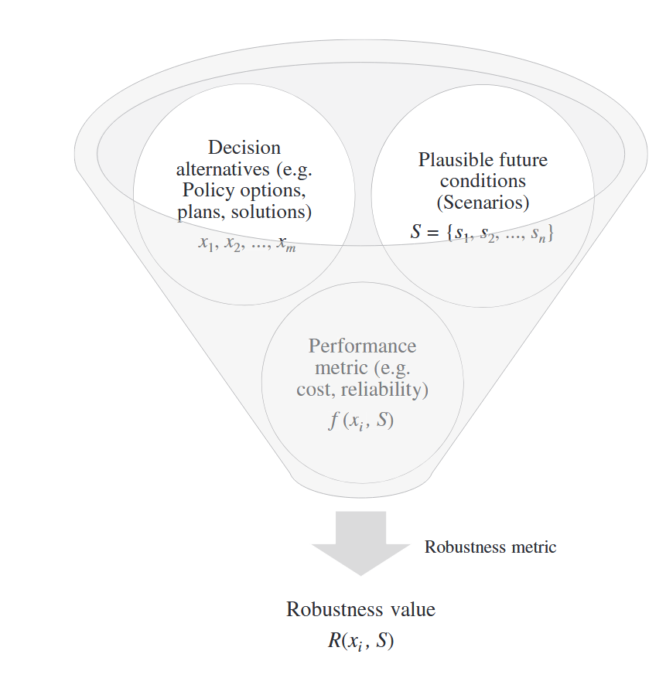
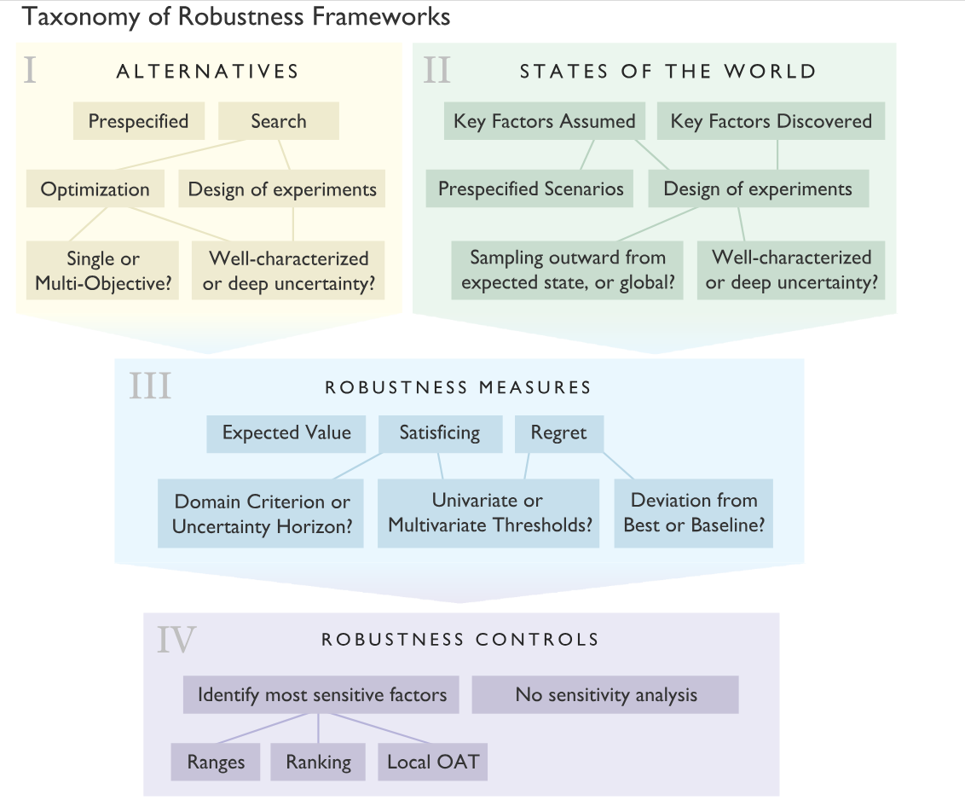
Motivation & Literature Review
Motivation:
0. Scenario design is a key part of robustness frameworks and influences results.

Slide 5
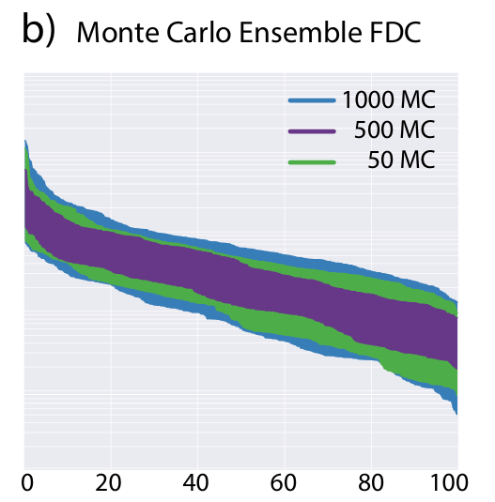
Motivation & Literature Review
Motivation:
1. Large stochastic ensembles of streamflows are necessary for capturing the full range of hydrologic conditions resulting from natural variability.
Figure from Jazmines dissertation

Slide 6
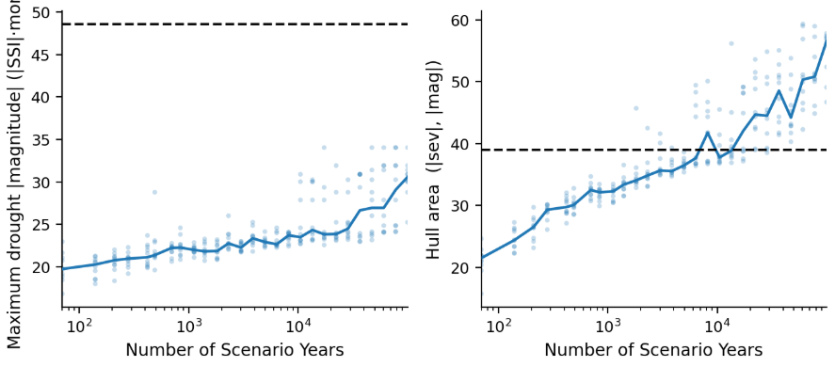
Motivation & Literature Review
Motivation:
Historical period
Historical period
Max drought magnitude
Kirsch-Nowak ensemble of increasing size

Slide 7
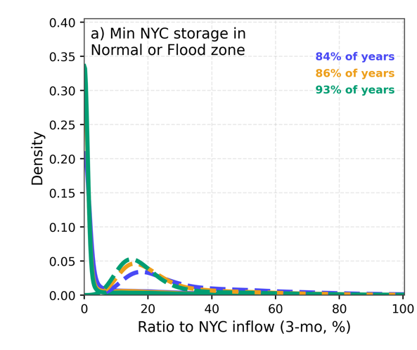
Motivation & Literature Review
Motivation:
3. When using long stochastic sequences much of the simulation period may be low-stress and require simulation/compute time that is not contributing meaningfully to improving solutions.
Eg., in the current stochastic ensembles 84-93% of ensemble years are in Normal conditions.

Slide 8
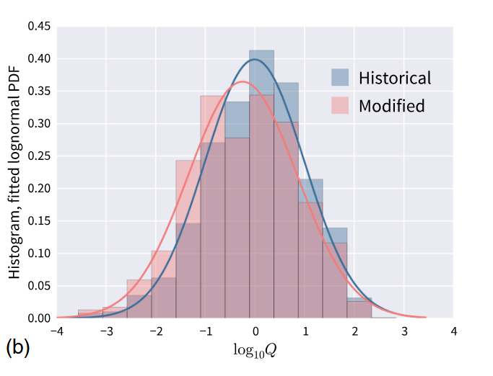
Motivation & Literature Review
Motivation:
4. There can be redundancy in streamflow scenarios resulting from sampling uncertain hydrologic drivers/forcings.
Hydro Uncertainty 2
Hazard Measure 2
Hydro Uncertainty 1
Hazard Measure 1

Slide 9
Motivation & Literature Review
Motivation:
0. Scenario design is a key part of robustness frameworks and influences results.
1. Large stochastic ensembles of streamflows are necessary for capturing the full range of hydrologic conditions resulting from natural variability.
2. Large stochastic ensembles of streamflows are necessary for capturing the full range of hydrologic conditions resulting from natural variability.
3. When using long stochastic sequences much of the simulation period may be low-stress and require simulation/compute time that is not contributing meaningfully to improving solutions.
Eg., in the current stochastic ensembles 84-93% of ensemble years are in Normal conditions.
4. There can be redundancy in streamflow scenarios resulting from sampling uncertain hydrologic drivers/forcings.
5. Rare, extreme drought hazard events drive the most consequential outcomes.

Slide 10
Motivation & Literature Review
Motivation:
6. There is interest in finding efficient subsamples of the scenario space that produce more robust solutions.
Antecedent | Established | Limitations
Cohen et al. 2021 | training-scenario properties drive out-of-sample robustness | Requires problem-driven regret selection; a preliminary perfect-foresight MOEA run for each scenario
Zaniolo et al. 2023 | drought-type training ensembles change the policies found | Hazard metrics imposed a priori before generation; hazards aren’t emergent
Zatarain Salazar et al. 2017 | search-ensemble size vs fidelity vs cost tradeoffs | Scenario selection relies on 1-dimensional aggregate mean flow CDF sampling
Bonham et al. 2024 | space-filling subsampling + coverage metrics in water resources | Post-hoc robustness ranking, not the search ensemble

Slide 11
Motivation & Literature Review
Common scenario design approaches used in the water resources optimization literature.
Value
Density
Obj B
Uncertain param B
Time
value
Uncertain param A
Obj A
I. Trace-based
Historic series, single traces, design events
II. Distribution-driven
sample an assumed distribution
III. Bottom-up coverage
span a deeply uncertain parameter space
IV. Problem-driven
select by decision relevance

Slide 12
Proposal: Hypothesis
Idea:
Create a space-filling sample of the hazard space, evaluate candidate policies using this deeply uncertain hazard space.
Hazard Measure 2
Hazard Measure 2
Hazard Measure 1
Hazard Measure 1

Slide 13
Proposal: Hypothesis
Idea:
Create a space-filling sample of the hazard space, evaluate candidate policies using this deeply uncertain hazard space.
Hazard Measure 2
Hazard Measure 2
Hazard Measure 1
Hazard Measure 1
Hazard Measure 2
Hazard Measure 2
Hazard Measure 1
Hazard Measure 1

Slide 14
Proposal: Hypothesis
Comparison with relevant and recent publications:
Antecedent | Established | Limitations
Cohen et al. 2021 | training-scenario properties drive out-of-sample robustness | Requires problem-driven regret selection; a preliminary perfect-foresight MOEA run for each scenario
Zaniolo et al. 2023 | drought-type training ensembles change the policies found | Hazard metrics imposed a priori before generation; hazards aren’t emergent
Zatarain Salazar et al. 2017 | search-ensemble size vs fidelity vs cost tradeoffs | Scenario selection relies on 1-dimensional aggregate mean flow CDF sampling
Bonham et al. 2024 | space-filling subsampling + coverage metrics in water resources | Post-hoc robustness ranking, not the search ensemble
No study builds the MOEA search ensemble by space-filling selection in a multi-dimensional hazard space and tests it on a held-out ensemble spanning deep climate uncertainty.

Slide 15
Proposal: Hypothesis
Not a good slide, not good narrative
Input space generator & climate-forcing parameters θ
Hazard space drought / low-flow / high-flow metrics per sequence
Outcome space objective values of a policy under a scenario
generate
simulate
hazard metrics are measured on realized sequences, before any simulation (drought event metrics; flow indices)
so hazard-space ensemble design is a simulation-free, pre-optimization step, reusable across problem formulations

Slide 16
NYC Reservoir Operations
Problem Formulation: Decision Variables

Slide 17
MOEA Problem Formulation: Decision Variables
Overview of the FFMP operational rules
The Supreme Court established:
Minimum Flow Target at Montague
The Court requires unanimous agreement from all DRBC Decree parties to modify these requirements.
Max NYC & NJ Diversion Limits
The Flexible Flow Management Program (FFMP, 2017) was established, via unanimous consent from the Decree parties, to provide flexibility to these requirements during periods of drought to alleviate water stress.
The FFMP recognizes the inherent tension between water diversions and downstream flow targets.
As drought stress increases:
NYC and NJ diversion allocations decrease, leading to municipal supply curtailment
Montague (and Trenton) streamflow targets decrease, leading to downstream environmental and supply risk.

Slide 18
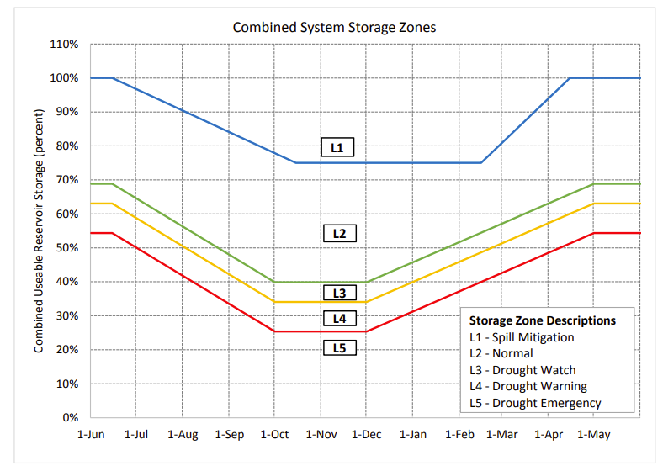
MOEA Problem Formulation: Decision Variables
Overview of the FFMP operational rules
Court Mandated (unchanged, fixed)
Baseline Minimum Flow Target at Montague
Baseline Max NYC & NJ Diversion Limits
NYC storage zones dictate operational rules
Allowable NYC & NJ diversion reduction (L3-L5)
Storage Zone
Determines
Montague & Trenton flow target reduction (L3-L5)
Minimum Daily Reservoir Releases (L3-L5)
NYC Reservoir Spill Mitigation Releases (L1)

Slide 19
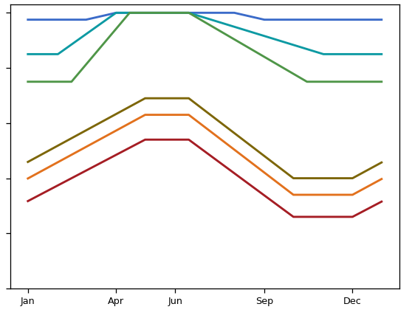
MOEA Problem Formulation: Decision Variables
NYC Reservoir Operational Decision Variables:
Storage Zone Boundary Vertical Shifts
Storage Zone Boundary Temporal Shift
One vertical shift per zone plateau
One temporal shift per zone
Combined NYC Storage
Combined NYC Storage
±10%
±30-days

Slide 20
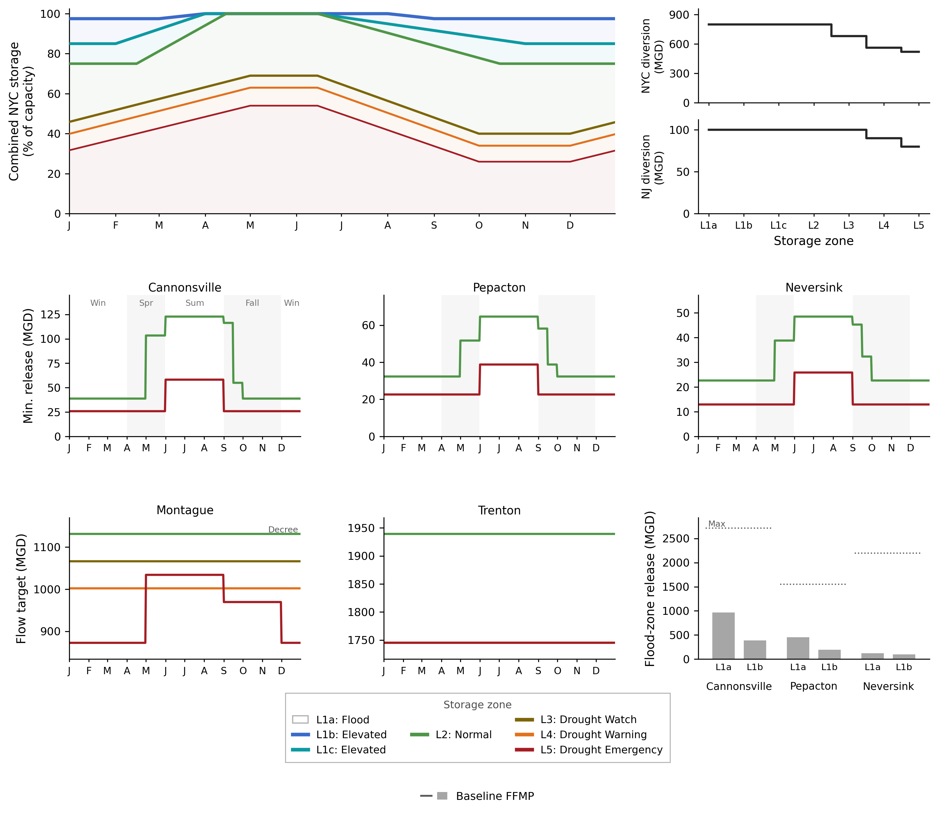
MOEA Problem Formulation: Decision Variables
NYC Reservoir Operational Decision Variables:
Storage Zone Boundary Vertical Shifts
Storage Zone Boundary Temporal Shift
NYC Diversion Reduction Factor
NJ Diversion Reduction Factor
Supreme Court Allocation
±15% FFMP values
Supreme Court Allocation
±15% FFMP values

Slide 21
MOEA Problem Formulation: Decision Variables
NYC Reservoir Operational Decision Variables:
Storage Zone Boundary Vertical Shifts
Storage Zone Boundary Temporal Shift
NYC Diversion Reduction Factor
NJ Diversion Reduction Factor
Montague & Trenton Streamflow Target Reduction Factor

Slide 22
MOEA Problem Formulation: Decision Variables
NYC Reservoir Operational Decision Variables:
Storage Zone Boundary Vertical Shifts
Storage Zone Boundary Temporal Shift
NYC Diversion Reduction Factor
NJ Diversion Reduction Factor
Montague & Trenton Streamflow Target Reduction Factor
Spill Mitigation Releases

Slide 23
MOEA Problem Formulation: Decision Variables
NYC Reservoir Operational Decision Variables:
Storage Zone Boundary Vertical Shifts
Storage Zone Boundary Temporal Shift
NYC Diversion Reduction Factor
NJ Diversion Reduction Factor
Montague & Trenton Streamflow Target Reduction Factor
Spill Mitigation Releases
Minimum Daily Release Scaling Factor

Slide 24
MOEA Problem Formulation: Decision Variables
Table 1. FFMP Decision Variables (36 total)
Decision variable group (n) | Plain-language description | Bounds
NYC drought delivery factors (3) | Fraction of NYC's diversion allowed in each of the three drought stages | FFMP value ± 0.15, clipped at 1.0
NJ drought delivery factors (2) | Fraction of NJ's diversion allowed in the two deepest drought stages | FFMP value ± 0.15, clipped at 1.0
Storage-zone void shifts (6) | Raise/lower the fall–winter low plateau of each storage-zone boundary curve | ±0.10 of capacity (upper zone: +0.025)
Storage-zone refill shifts (3) | Raise/lower the spring refill target of the drought-zone curves only | ±0.10 of capacity
Storage-zone temporal shifts (6) | Slide each zone-boundary curve earlier/later in the year | ±30 days
Flood-release scales (6) | Scale each reservoir's flood-zone spill-mitigation release schedule | 0.5 – 1.2/1.35/1.55 (upper zone); 0.5 – 2.0 (lower zone)
Seasonal minimum-release scales (4) | Scale conservation-zone daily release profiles by FFMP season | 0.8 – 2.6
Flow-target factor scales (6) | Scale Montague/Trenton drought-stage flow-target reductions | 0.65 – 1.15

Slide 25
MOEA Problem Formulation: Decision Variables
Overview of the FFMP operational rules
Storage zones
NYC & NJ allocation reductions
Minimum daily release requirements
Montague & Trenton flow target reductions
Daily releases while in flood zone

Slide 26
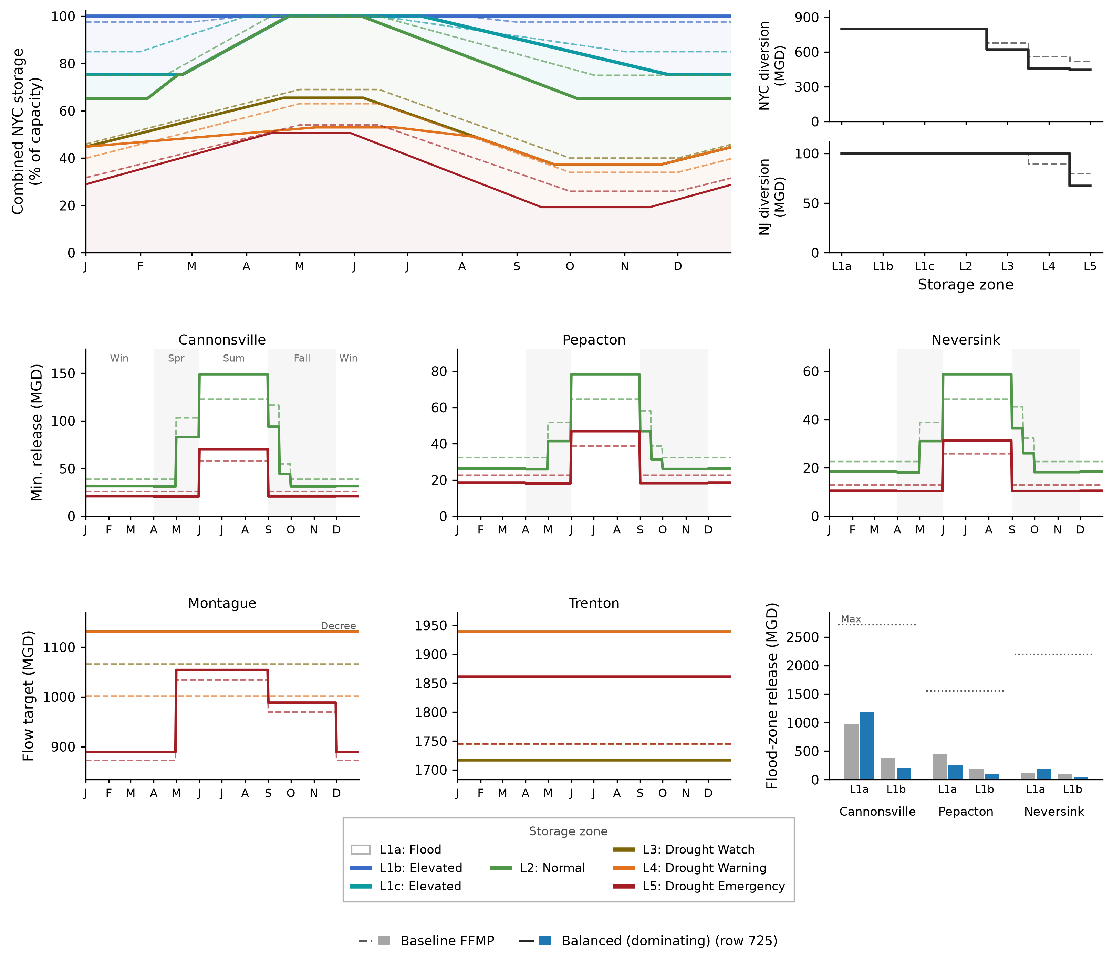
MOEA Problem Formulation: Decision Variables
Example visualizing a custom set of decision variables and the resulting policy rules.
Dashed lines = Default FFMP
Solid lines = Custom operating rules

Slide 27
NYC Reservoir Operations
Problem Formulation: Objective Functions

Slide 28
MOEA Problem Formulation: Objective Definitions
NYC objective definition notes:
Focused on re-optimizing the flexible flow management program (i.e., changes to operations in drought zones) and not the Court mandated NYC & Montague diversions
As a result, objectives are defined relative to the 1954 Supreme Court mandated requirements
Currently not planning on using salt-front objectives since the SalinityLSTM does not extrapolate well above river mile ~95.

Slide 29
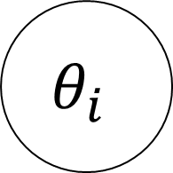
MOEA Problem Formulation: Objective Definitions
Current objective definition set
Year 1
Year 2
…
Year N
Realization 1
$$θ_{i}$$
Realization 2
…
Realization N

Slide 30
MOEA Problem Formulation: Objective Definitions
Current objective definition set
Year 1
Year 2
…
Year N
Each objective is calculated using:
Step 1: Annual metric
Step 2: Aggregation metric across all ensemble years
Realization 1
Realization 2
…
Realization N

Slide 31
MOEA Problem Formulation: Objective Definitions
Table 2. The Eight Optimization Objectives
Objective (direction) | Mathematical description | Description | Units | ε
NYC delivery reliability (max) | Frequency of years with < 3 failure weeks (delivery ≥ 99% of entitlement) | How often NYC's water supply is satisfied | fraction of years | 0.02
NYC delivery deficit (min) | Worst 1st-percentile year of within-year CVaR₉₀ weekly deficit | Depth of NYC's worst supply shortfalls | % of 800 MGD | 2.0
Montague flow reliability (max) | Frequency of years with < 3 failure weeks (flow ≥ 1,131 MGD) | How often the Decree flow target is met | fraction of years | 0.02
Montague flow deficit (min) | Worst 1st-percentile year of within-year CVaR₉₀ weekly deficit | Depth of the worst Montague flow shortfalls | % of target | 1.5
Trenton flow reliability (max) | Frequency of years with < 1 failure week (flow ≥ 1,939 MGD) | How often the salt-front–repelling flow objective is met | fraction of years | 0.015
Downstream flood exceedance (min) | Mean annual Σ over days of max-across-gauges (stage − NWS minor flood stage)⁺ | Magnitude of downstream flooding above minor flood stage | ft·days/yr | 0.01*
NYC minimum storage (max) | Worst 1st-percentile year of annual minimum daily aggregate storage | How low the reservoirs are drawn down | % of capacity | 5.0
NJ delivery reliability (max) | Frequency of years with < 1 failure week (delivery ≥ 99% of entitlement) | How often NJ's water supply is satisfied | fraction of years | 0.025

Slide 32
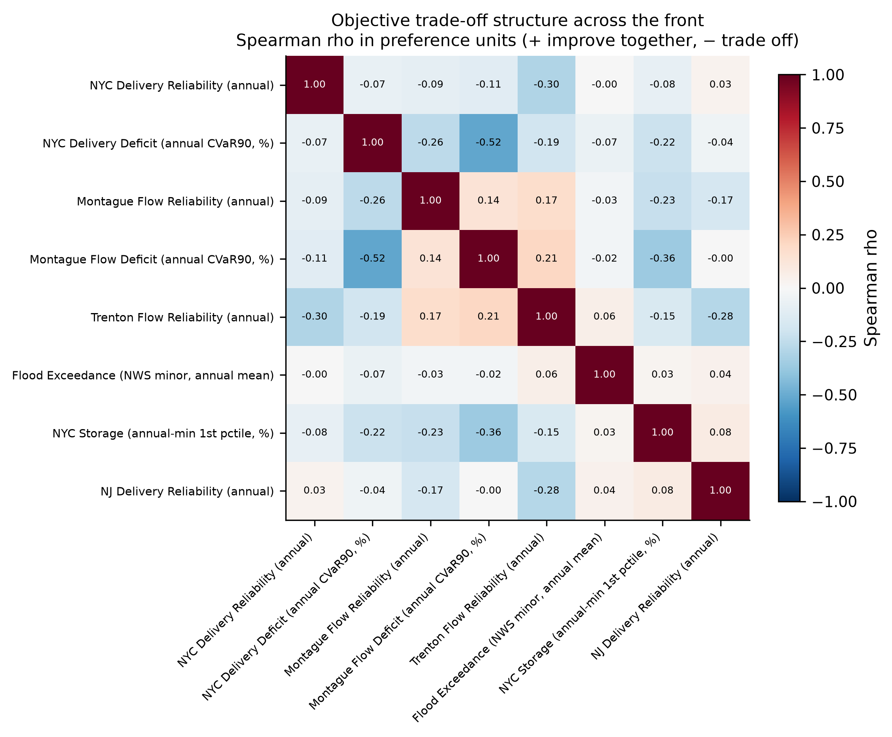
MOEA Problem Formulation: Objective Definitions
There is minimal, and frequently negative, spearman correlation between objectives.

Slide 33
NYC Reservoir Re-Operation
Preliminary Results

Slide 34
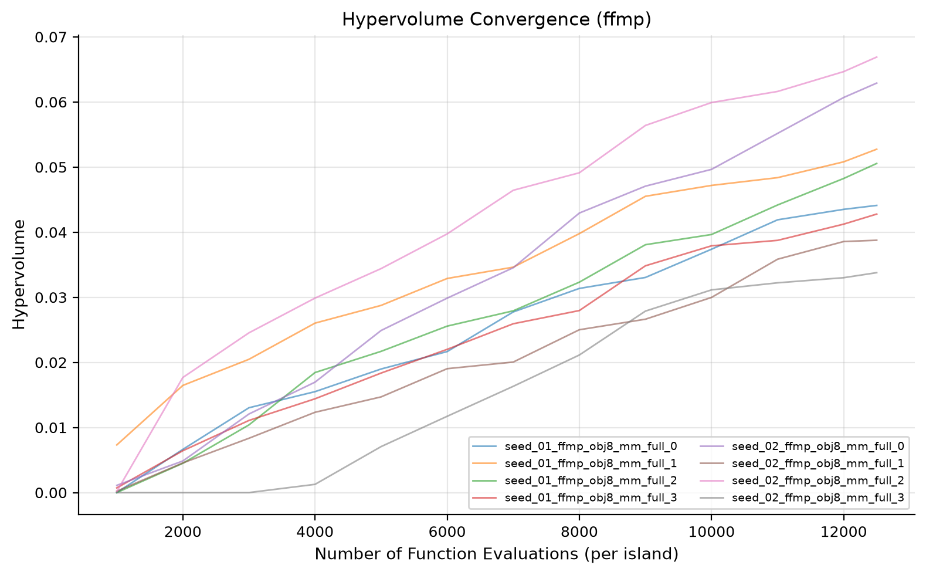
MOEA Problem Formulation: Objective Definitions
Preliminary results are based on:
50k NFE (~2hr runtime)
2x MMBorg seeds
Optimized under historic streamflow scenario (1945-2023)
WARNING: Preliminary results do not converge.

Slide 35
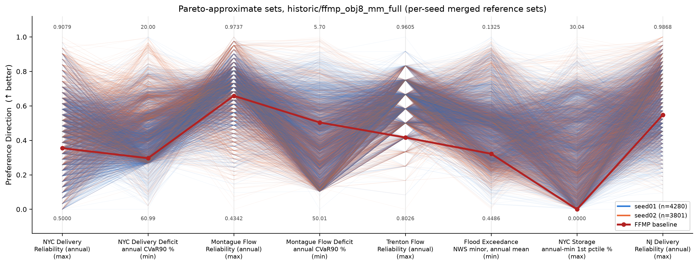
MOEA Problem Formulation: Objective Definitions
1761 pareto-approximate solutions merged across seeds

Slide 36
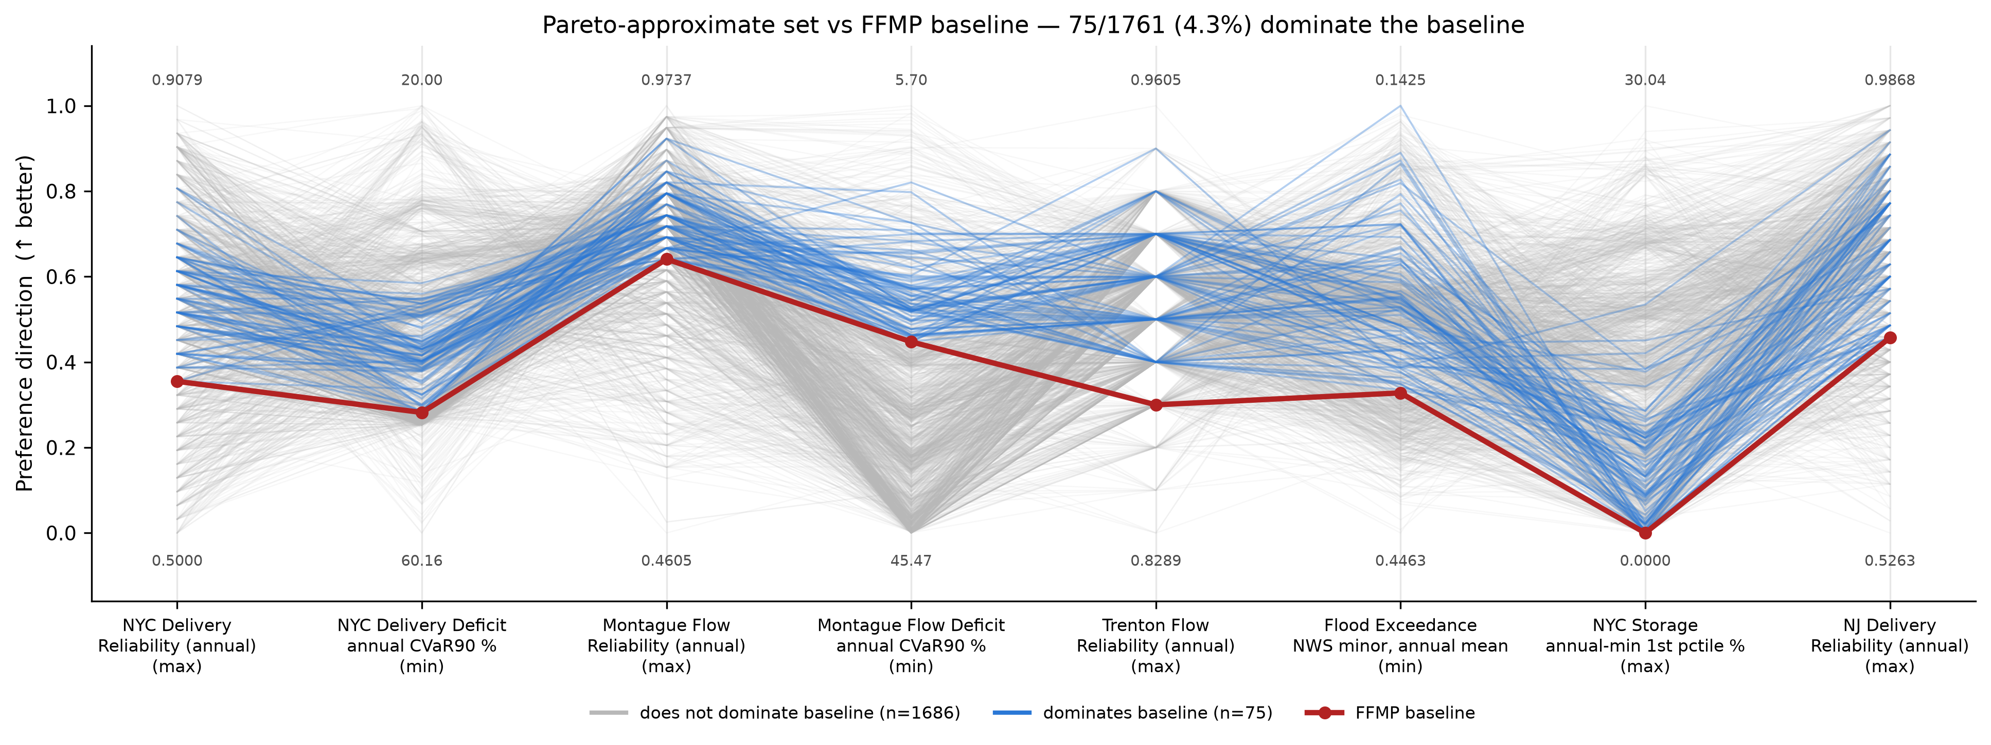
MOEA Problem Formulation: Objective Definitions
75/1761 (4.3%) of pareto-approximate solutions fully dominate the baseline FFMP performance

Slide 37
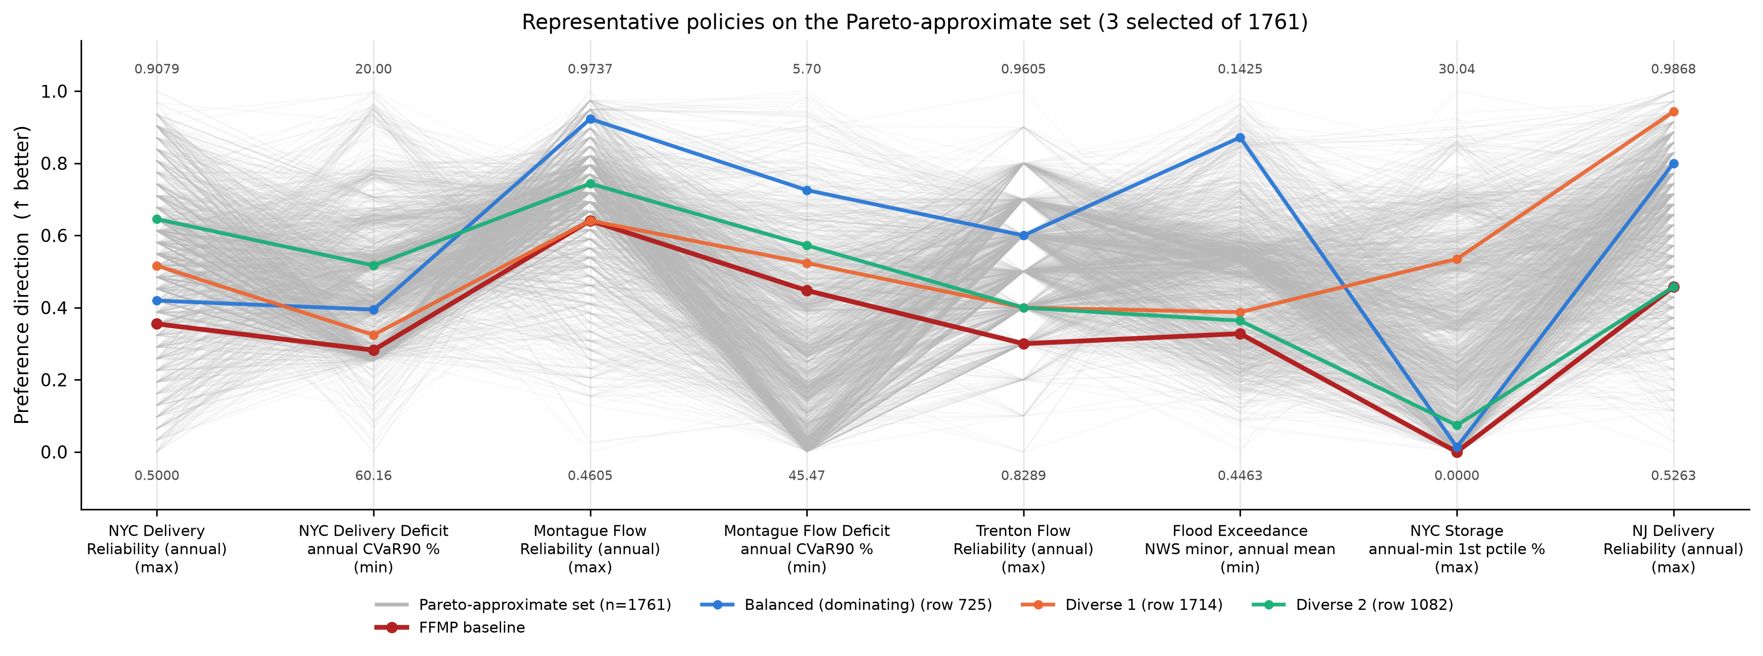
MOEA Problem Formulation: Objective Definitions

Slide 38
Experimental Design

Slide 39
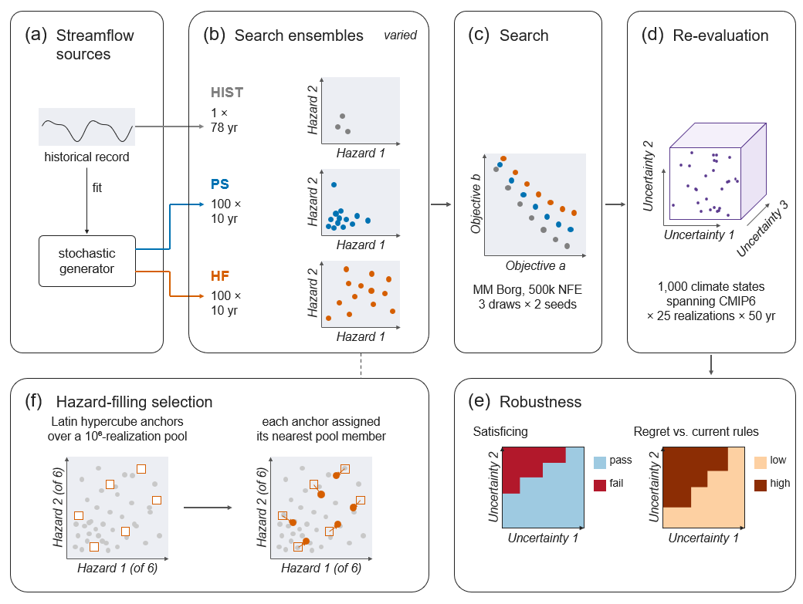
Experimental Design

Slide 40
Experimental Design:
Alternative Scenario Designs

Slide 41
Experimental Design: Optimization Evaluation Scenarios
Table 3. Scenario Designs and Ensemble Sizes
PS and HF share the generator, ensemble size, record length, and 500,000-NFE search budget; K = 3 construction replicates × 2 seeds per design.
Design | Generation Method | Ensemble size (per optimization evaluation)
Historical (HIST) | Observed record simulated as one continuous realization; reference for prevailing practice | 1 realization × 77 yr (77 scenario-years)
Probabilistic Sample (PS) | i.i.d. samples from the stationary Kirsch–Nowak stochastic generator | 100 realizations × 10 yr (1,000 scenario-years)
Hazard Filling (HF) | Proposed design: space-filling selection from a 10⁶-member candidate ensemble for coverage of the hydrologic hazard space | 100 realizations × 10 yr, selected from 10⁶ candidates
Re-evaluation ensemble | Latin hypercube sample of deeply uncertain climate forcings (CMIP6-informed) crossed with stochastic realizations | 1,000 SOWs × 25 realizations × 50 yr (25,000 realizations)

Slide 42
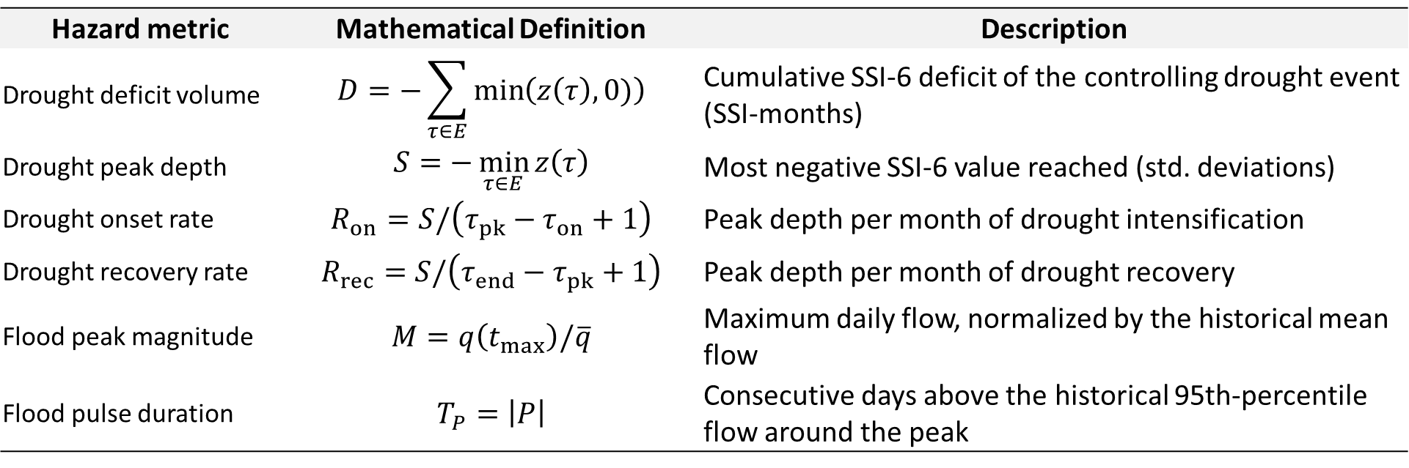
Experimental Design: Optimization Evaluation Scenarios
Table 4. Hydrologic Hazard Metrics for the Hazard-Filling Design
Computed on aggregate NYC reservoir inflow before any simulation; drought events identified by SSI-6 (controlling event = largest deficit volume).
Hazard metric | Mathematical Definition | Description
Drought deficit volume | $$D=−\sum_{τ∈E}{\min\left(z\left(τ\right),0)\right)}$$ | Cumulative SSI-6 deficit of the controlling drought event (SSI-months)
Drought peak depth | $$S=−\min_{τ∈E}{z\left(τ\right)}$$ | Most negative SSI-6 value reached (std. deviations)
Drought onset rate | $$R_{on}=S/\left(τ_{pk}−τ_{on}+1\right)$$ | Peak depth per month of drought intensification
Drought recovery rate | $$R_{rec}=S/\left(τ_{end}−τ_{pk}+1\right)$$ | Peak depth per month of drought recovery
Flood peak magnitude | $$M=q\left(t_{max}\right)/\overline{q}$$ | Maximum daily flow, normalized by the historical mean flow
Flood pulse duration | $$T_{P}=\left|P\right|$$ | Consecutive days above the historical 95th-percentile flow around the peak

Slide 43
Experimental Design:
Re-evaluation under future hydrologic uncertainty

Slide 44
Planned Methods

Slide 45
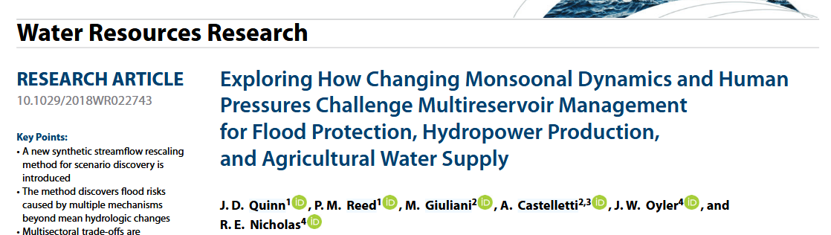
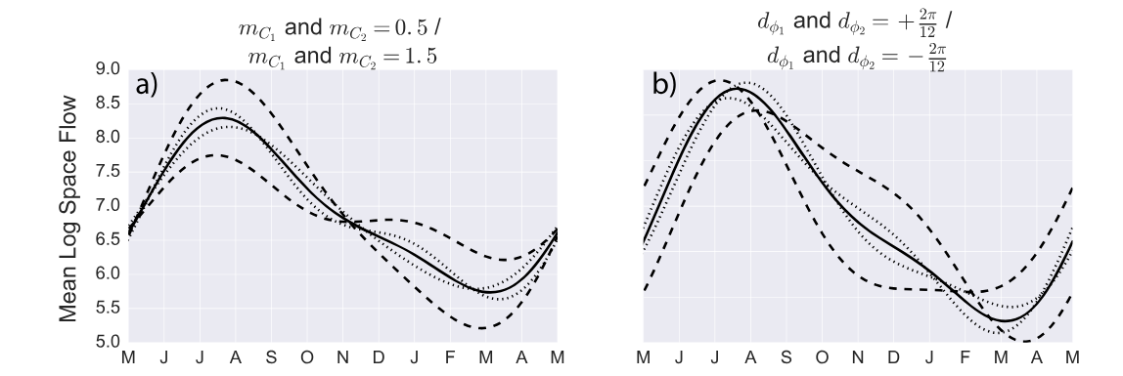
Experimental Design: Re-evaluation under climate change uncertainty
Inspired by parametric harmonic formulation from Quinn et al. (2018).
Instead of parameterizing the log-space streamflow, parameterize the relative change in streamflow

Slide 46
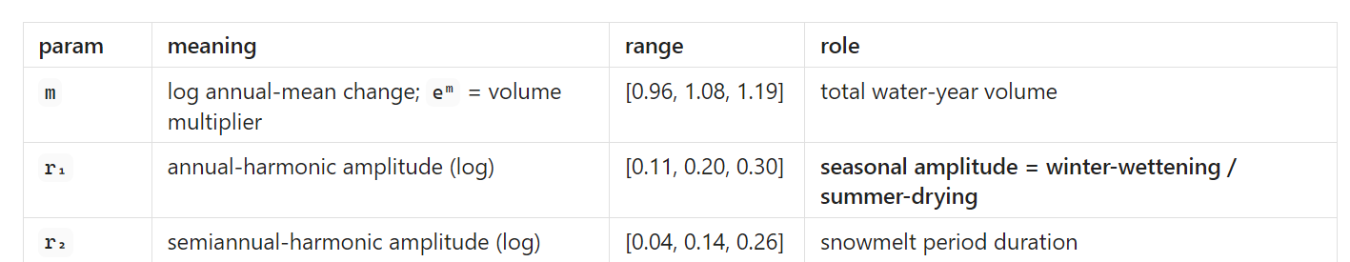
Experimental Design: Re-evaluation under climate change uncertainty
Can a 3 parameter harmonic capture CMIP6 informed monthly flow changes?

Slide 47
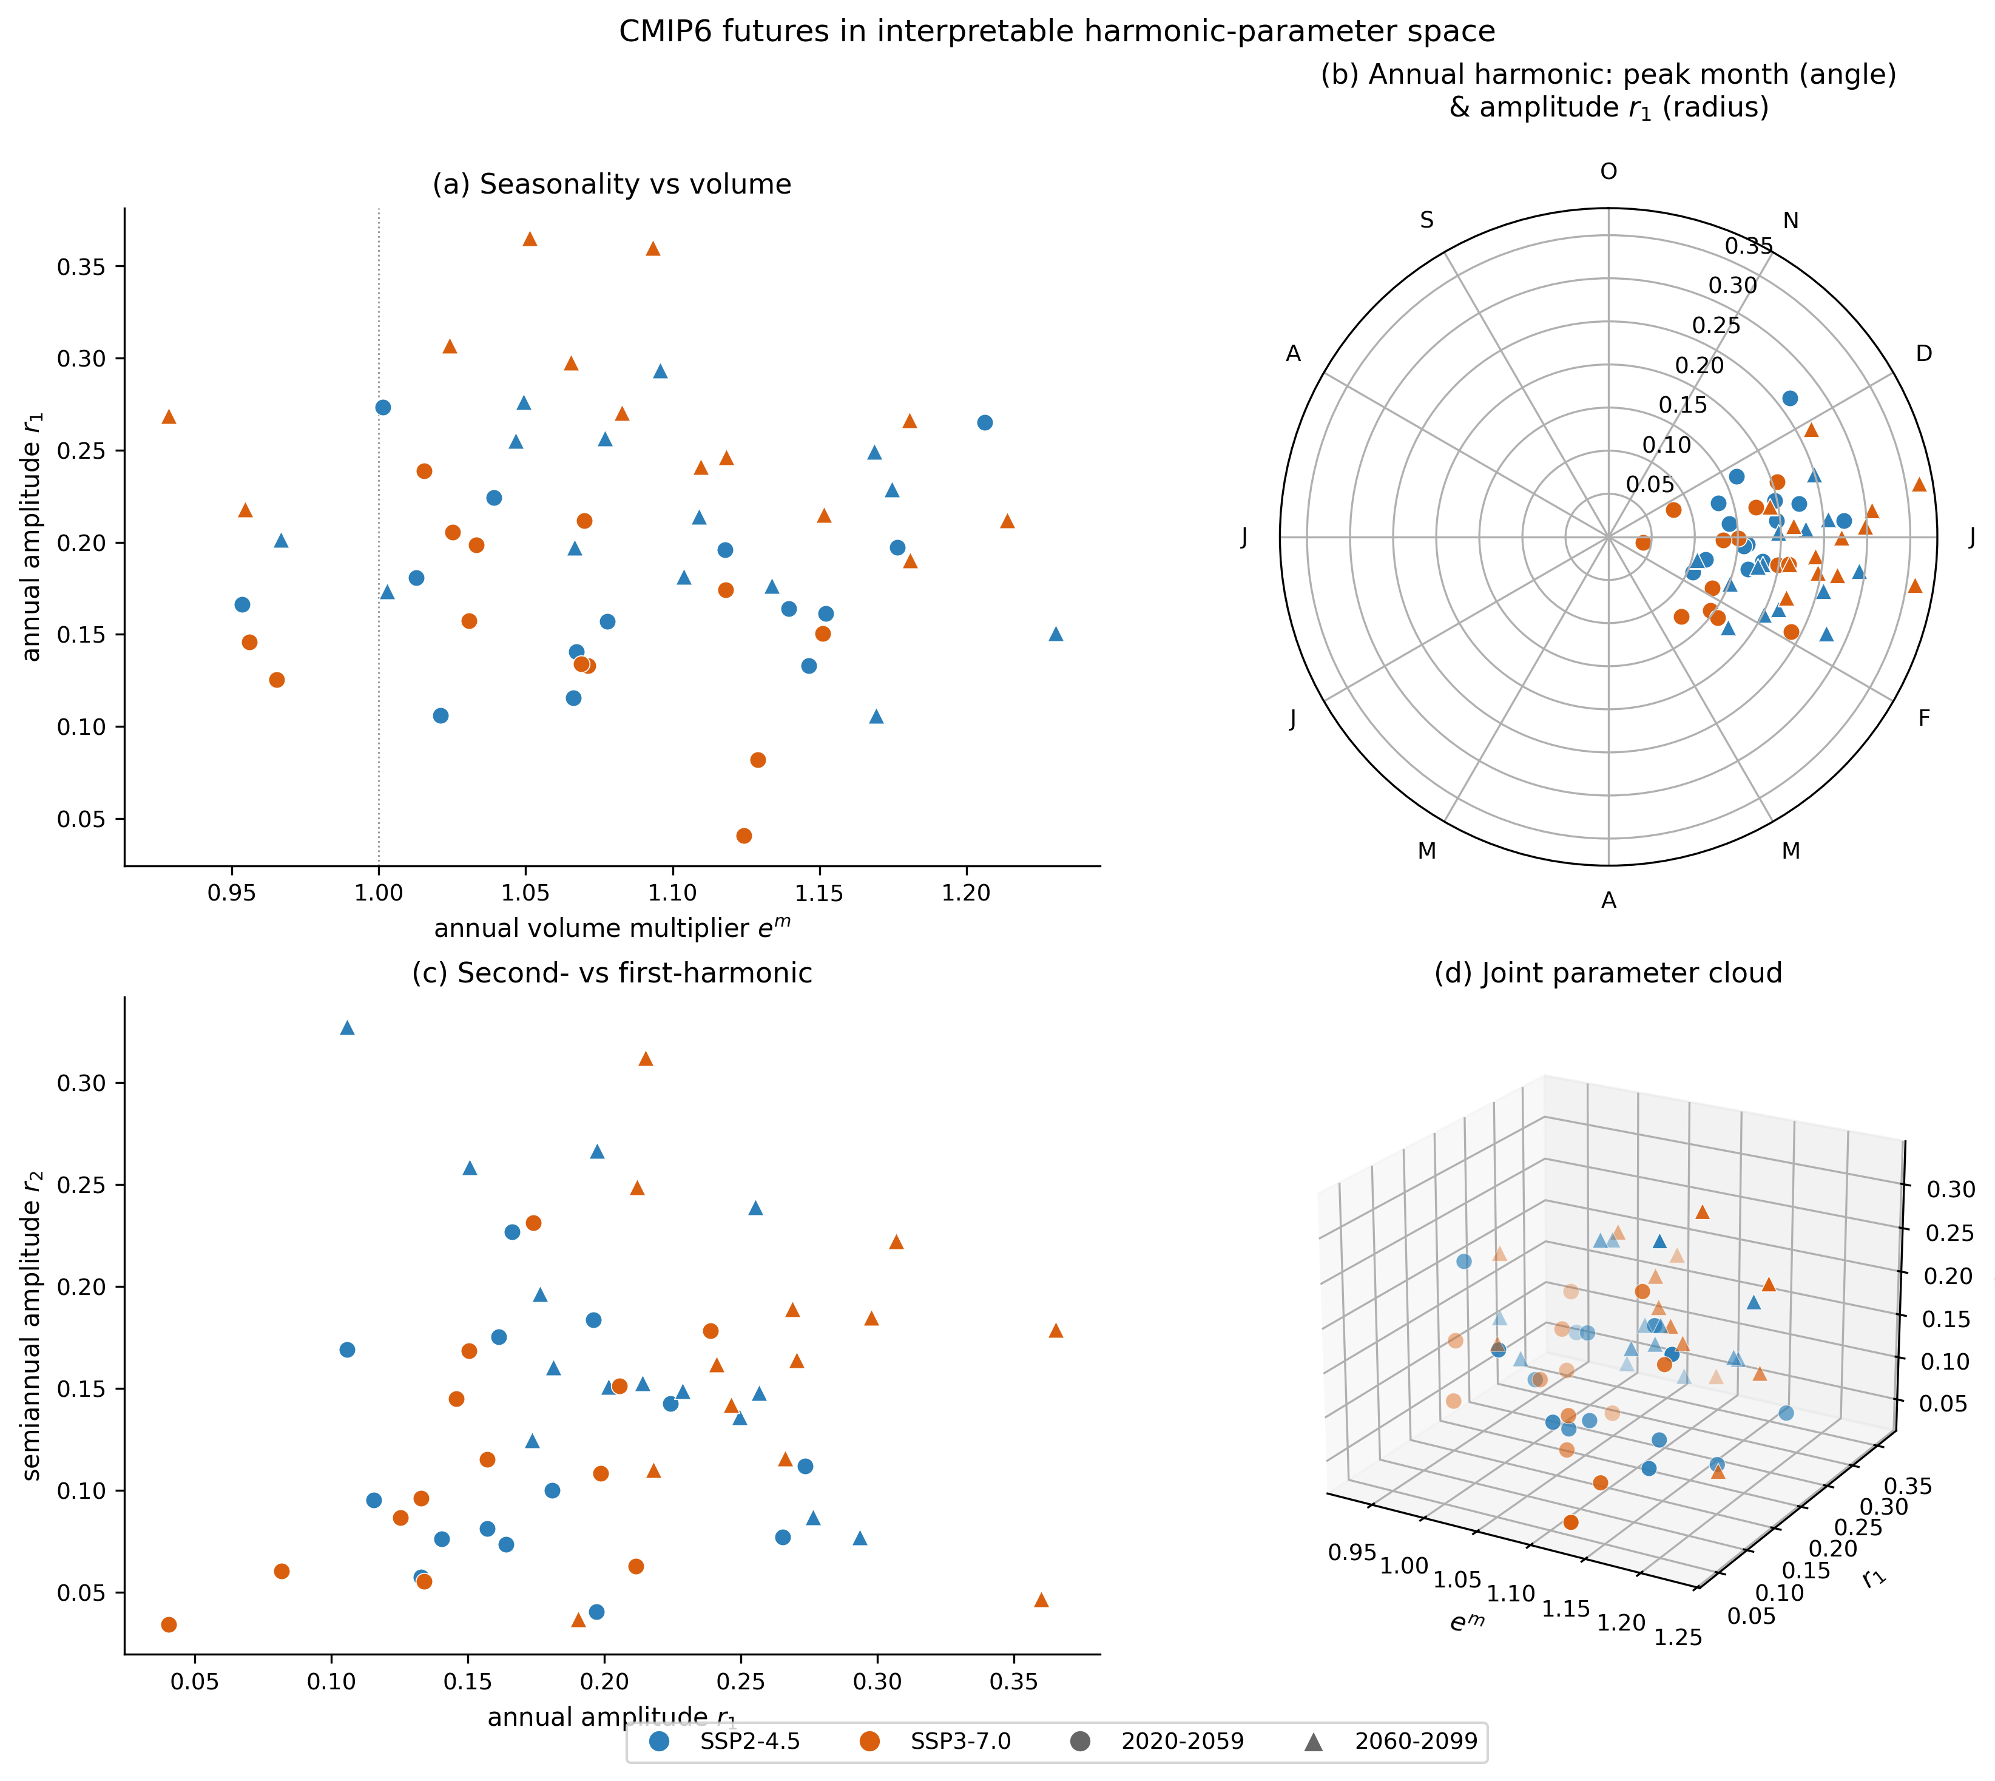
Experimental Design: Re-evaluation under climate change uncertainty
Range & spread of harmonic parameters for all of the CMIP6 streamflow traces (same data as paper 2)
Fit the 3-parameter harmonic to each trace using OLS.

Slide 48
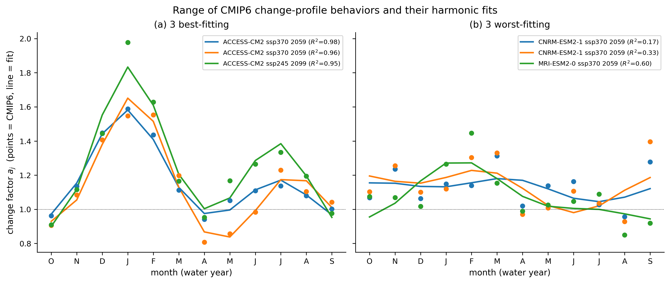
Experimental Design: Re-evaluation under climate change uncertainty

Slide 49
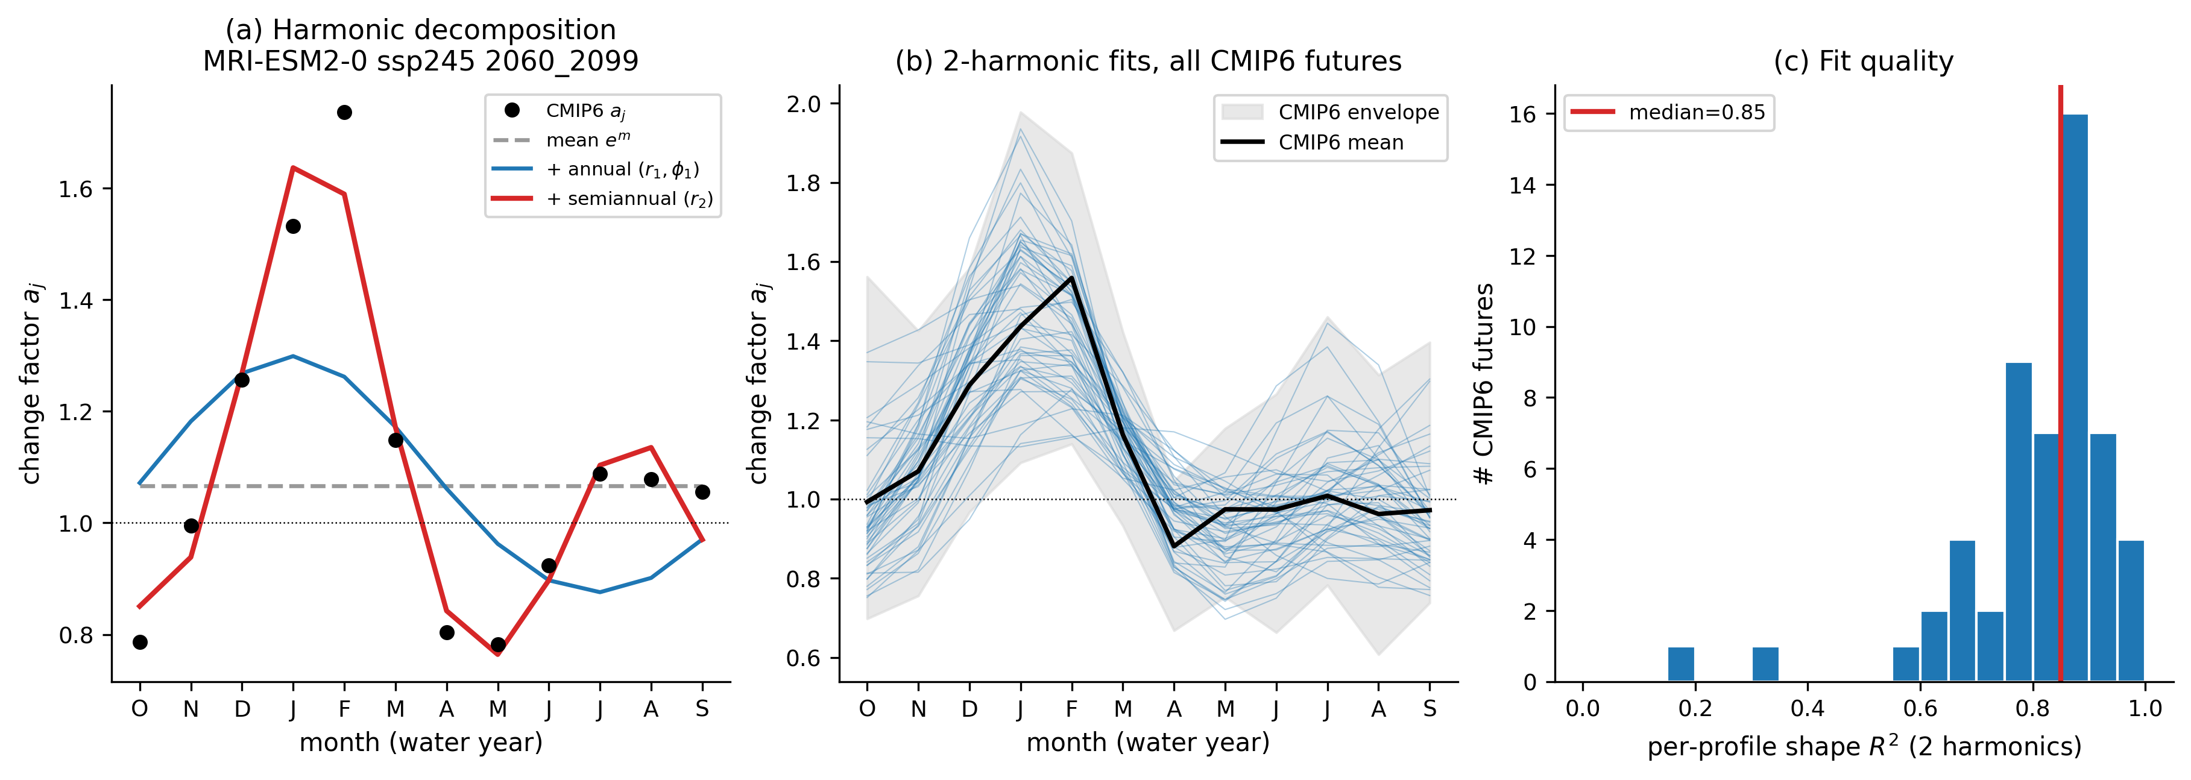
Experimental Design: Re-evaluation under climate change uncertainty

Slide 50
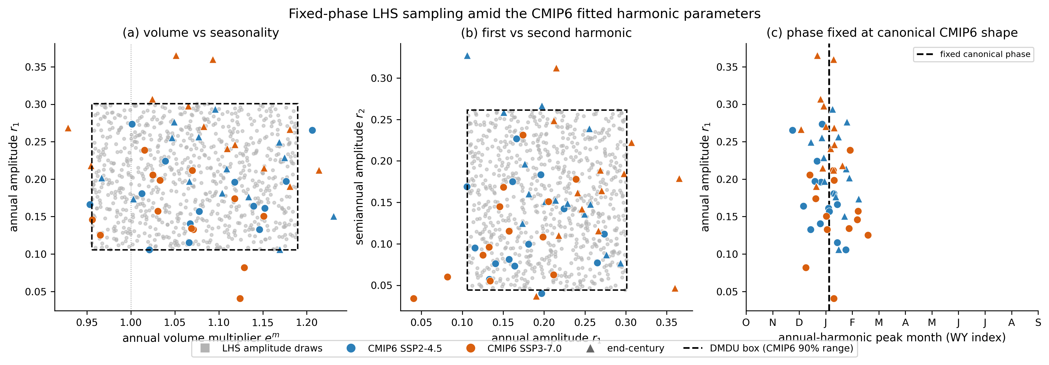
Experimental Design: Re-evaluation under climate change uncertainty
Grey = LHS samples inside the hypercube containing 90% of CMIP6 scenarios
Color markers = fitted parameters from LHS ensemble

Slide 51
Experimental Design: Re-evaluation under climate change uncertainty

Slide 52
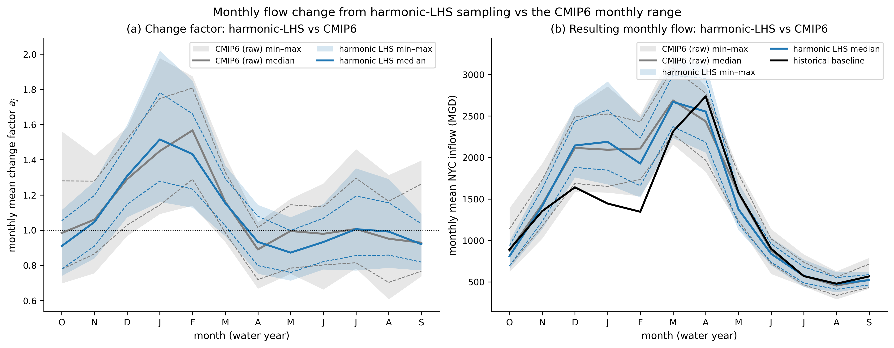
Experimental Design: Re-evaluation under climate change uncertainty

Slide 53
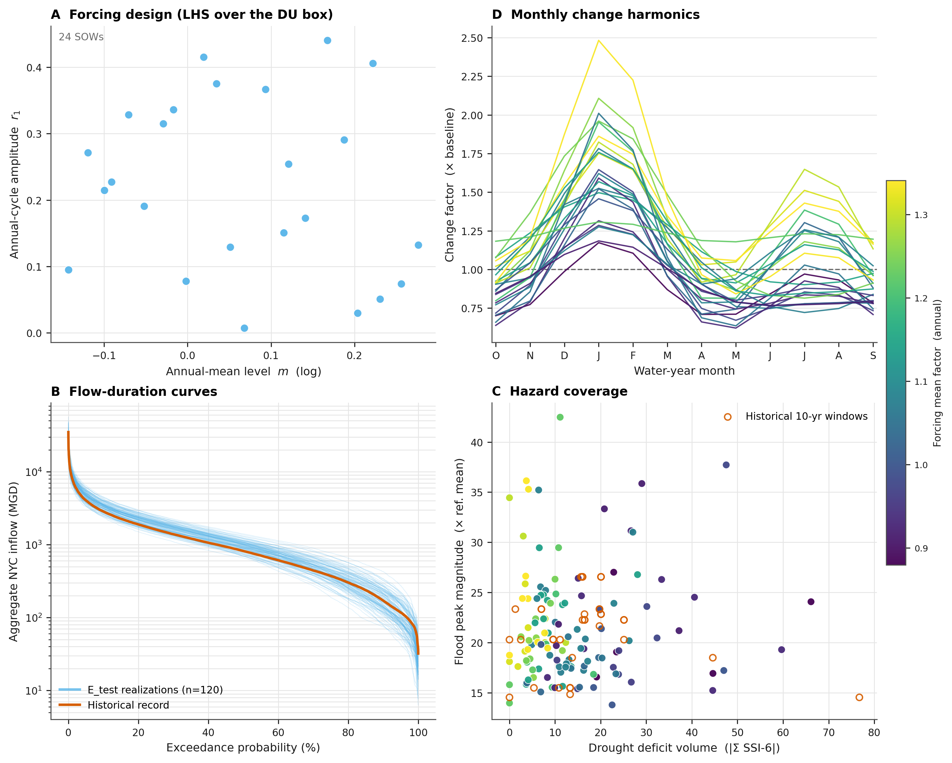
Experimental Design: Re-evaluation under climate change uncertainty

Slide 54
Supplemental

Slide 55
Supplemental:
Parametric Sampling of Uncertain
Monthly Streamflow Change Factors

Slide 56
Supplemental:
Anvil Scaling Experiments

Slide 57
Anvil Scaling Experiment
Parallelism & Efficiency Levers:
Number of nodes
Number of core per node
Number of MM-Borg islands & workers
Number of realizations per Pywr-DRB simulation (pywr internal parallel)

Slide 58
Anvil Scaling Experiment
Goal: Before committing to large scale MM-Borg optimization, measure (a) how densely we can pack model evaluations on a node and (b) how well MM-Borg's parallelism scales.
Anvil node: 128 cores, 256 GB
Test 1: Efficiency of running K workers on a single node with.
On one node, run K independent copies of the MM-Borg worker evaluation (a 20-realization, 20-year synthetic streamflow ensemble through Pywr-DRB). Each rank times one ‘cold’ + several warm evaluations and records peak memory. Sweeping K reveals when contention or memory becomes the limit.
Test 2: MM-Borg strong scaling.
MM-Borg runs at a fixed budget of 1,280 evaluations, using a short simulation window (~6 s/eval) so runs are cheap. Geometries: 8, 16, 32, 64 workers on one island, plus 2×32 and 4×16 island splits at 64 slots. Two random seeds each. Wall time to finish the fixed budget gives speedup and parallel efficiency.

Slide 59
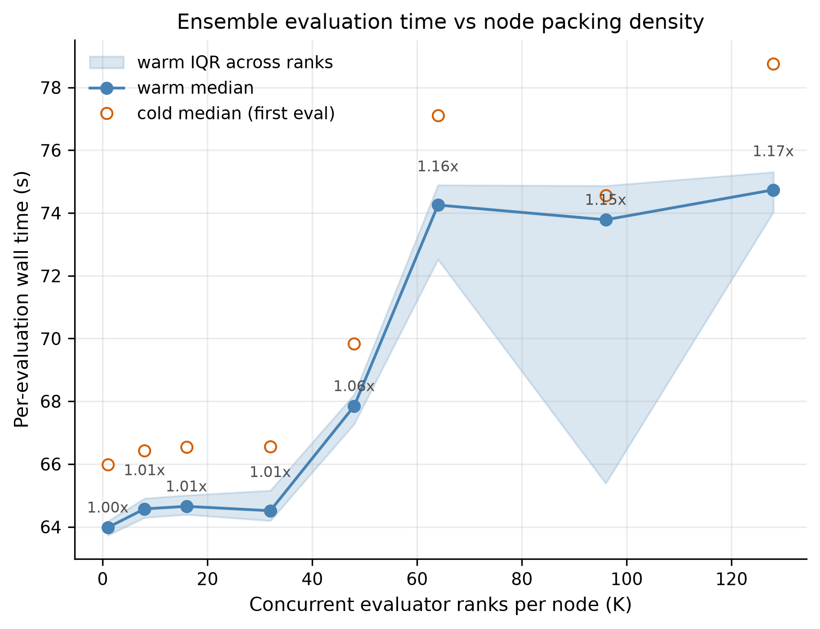
Anvil Scaling Experiments
Run = 20 realizations x 20 years
Run K copies of the evaluation at the same time, K = 1, 8, 16, 32, 48, 64, 96, 128 core.
Every rank times one "cold" evaluation (first one, caches empty) then several "warm" ones, using the exact code path a Borg worker uses.
Question: does crowding more evaluations onto one node make each one slower?

Slide 60
Anvil Scaling Experiments
Run = 20 realizations x 20 years
Packing is nearly free up to K=32 (only 1% slower than running alone), then costs 17% at full density K=128 (64.0 s -> 74.7 s).
However, a 17% per-evaluation penalty is worth it for 128× the parallelism.

Slide 61
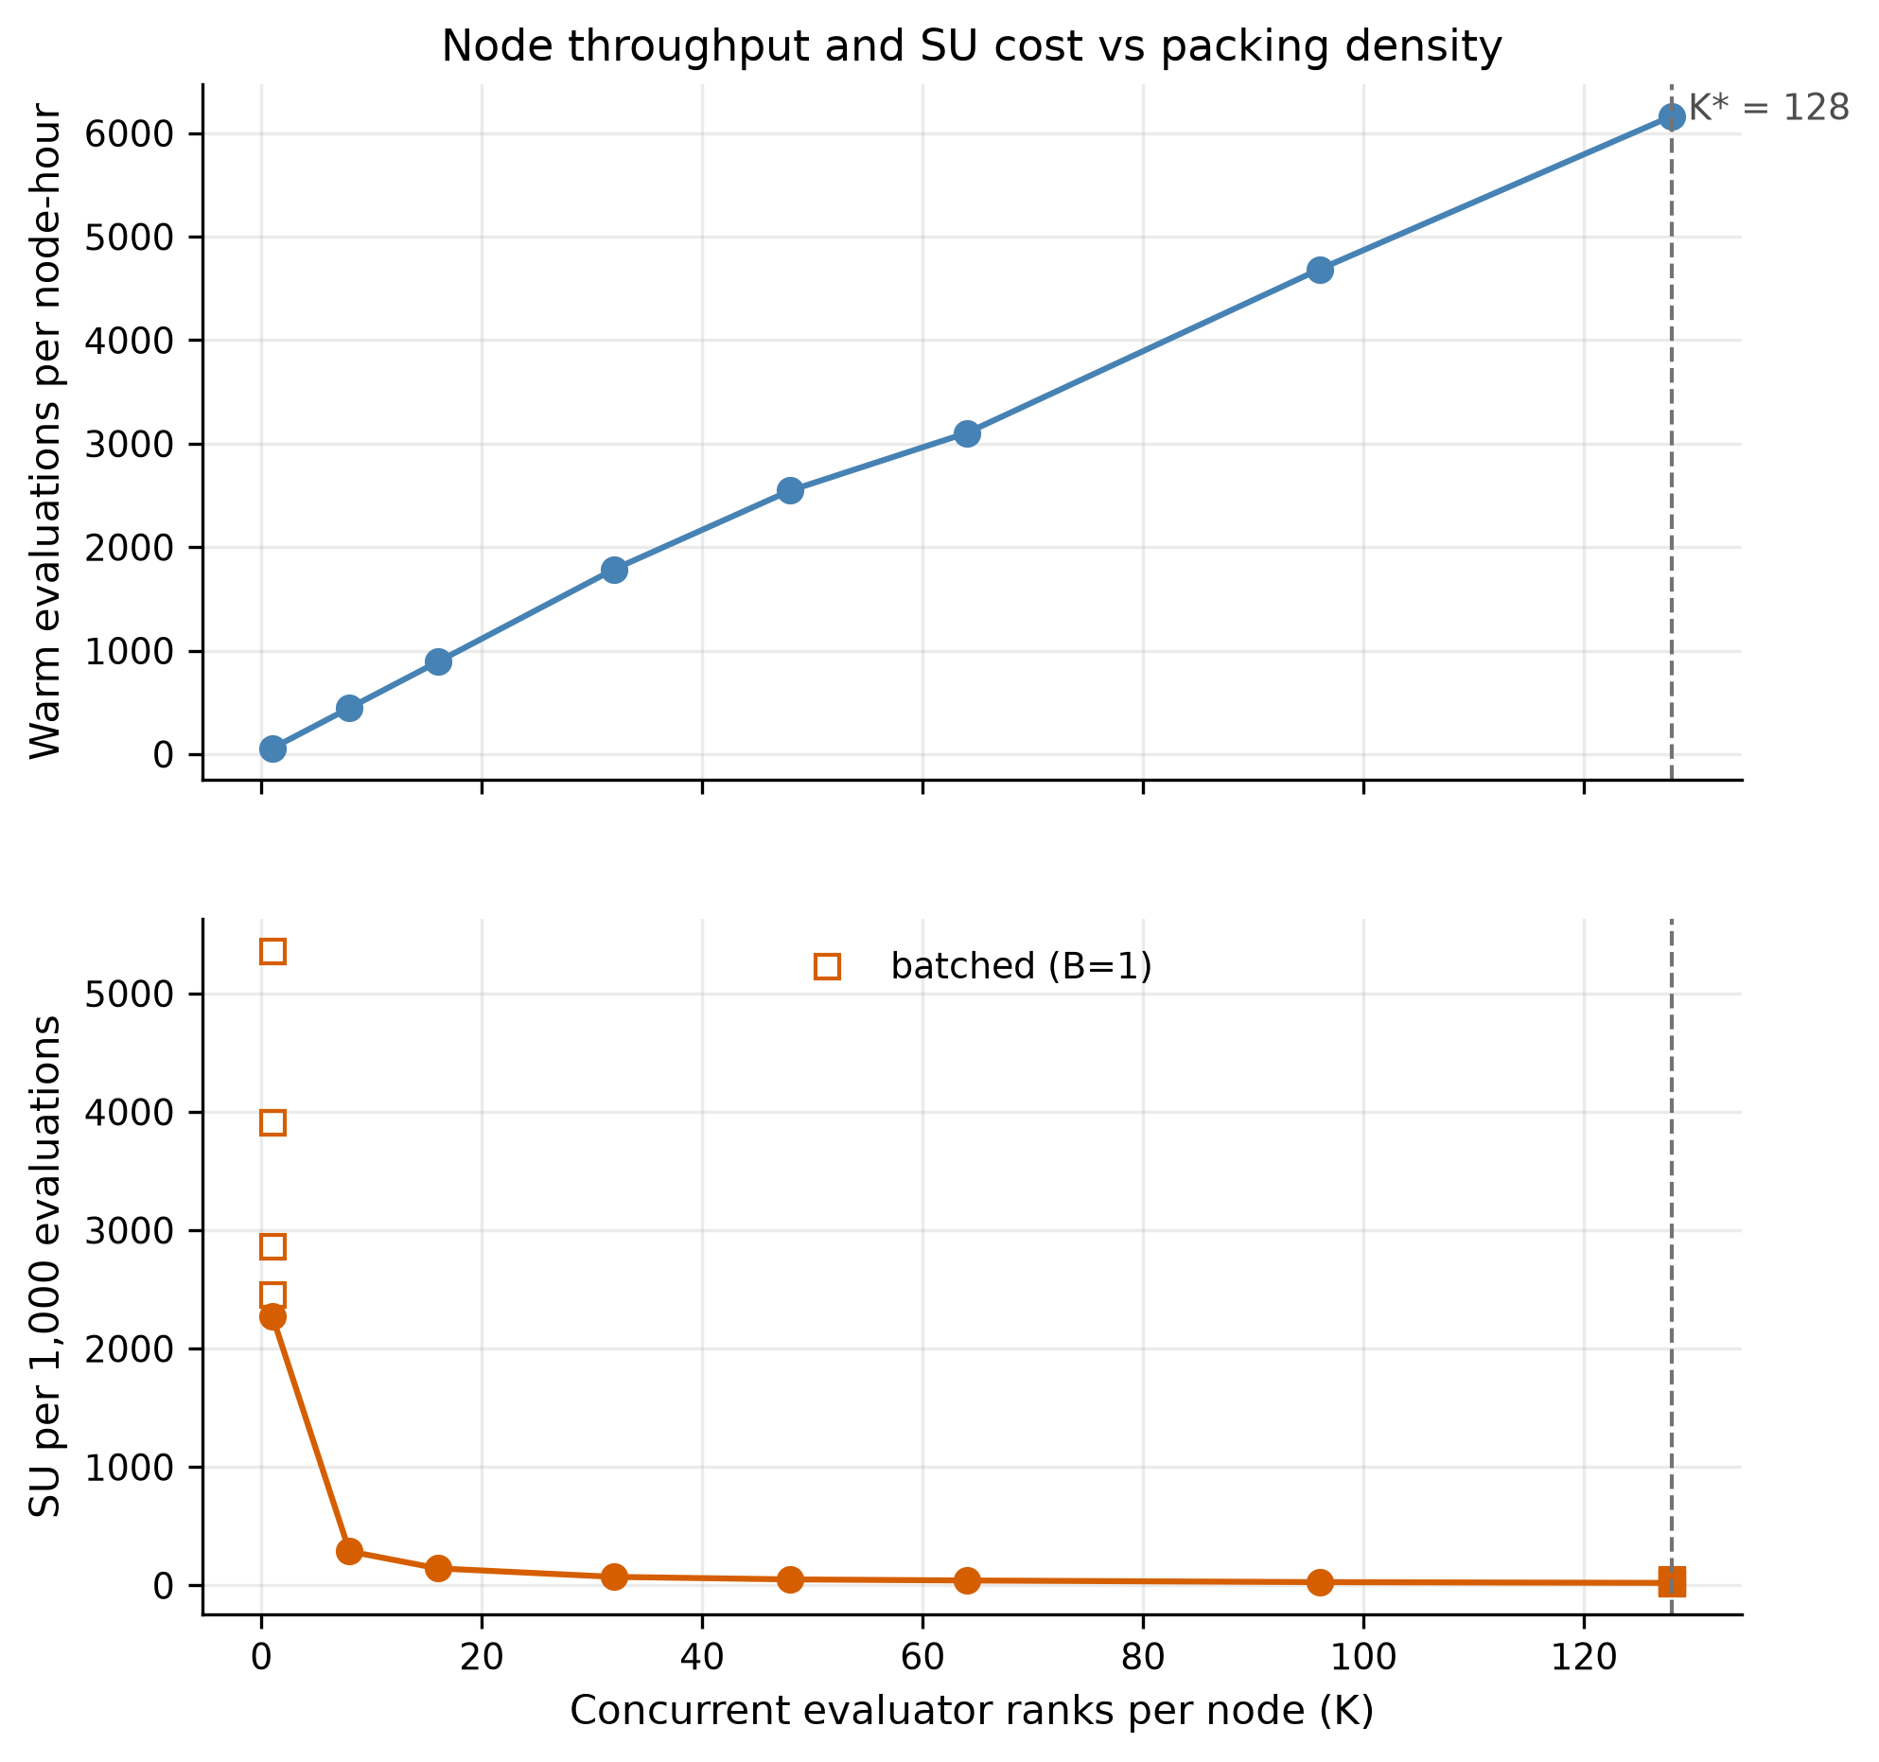
Anvil Scaling Experiments
Run = 20 realizations x 20 years
Top panel: Evaluations completed per node-hour, rising almost linearly with K to a maximum at K=128.
Bottom panel: SUs burned per 1,000 evaluations, decreasing as K rises and flattening out well before K=128 (open squares show the unbatched B=1 case for contrast).

Slide 62
Anvil Scaling Experiments
Run = 20 realizations x 20 years
Take-aways
Top: Throughput scales nearly linearly (56 evals/node-hr at K=1 to 6,166 at K=128), about 110x.
The 17% per-evaluation slowdown never overtakes the parallelism benefit.
Bottom: Cost per 1,000 evaluations drops from 2,275 SU to 21 SU.
Most of the savings arrive by K~=40; beyond that the curve is flat, so K=128 is good but also okay if we need to use less (due to memory)

Slide 63
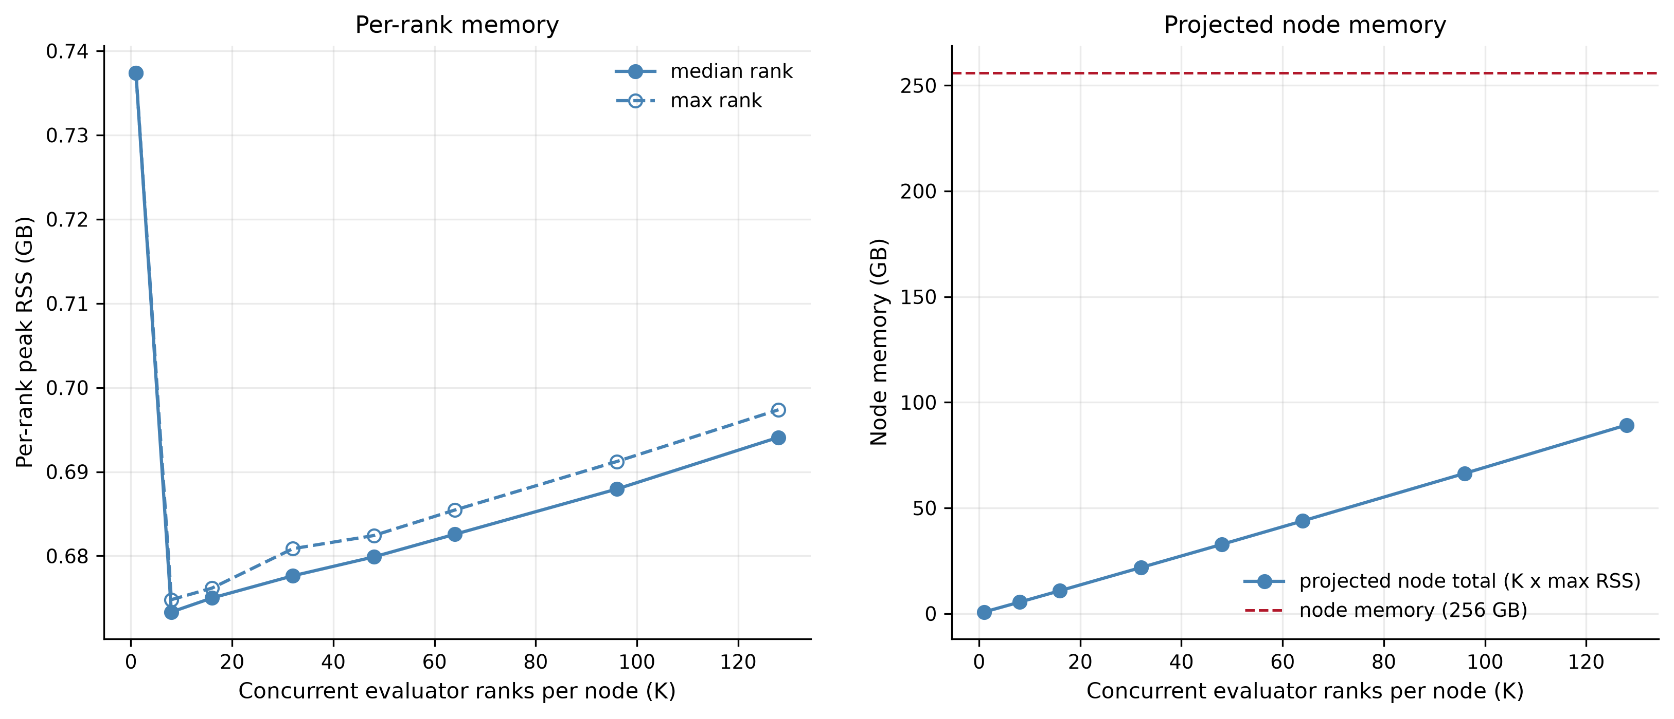
Anvil Scaling Experiments
Run = 20 realizations x 20 years
Left panel: Peak memory used by a single rank across packing densities, for the typical (median) and worst (max) rank memory usage.
Right panel: Total node memory implied by K ranks at the worst-case per-rank footprint, against the 256 GB node limit (red dashed line).

Slide 64
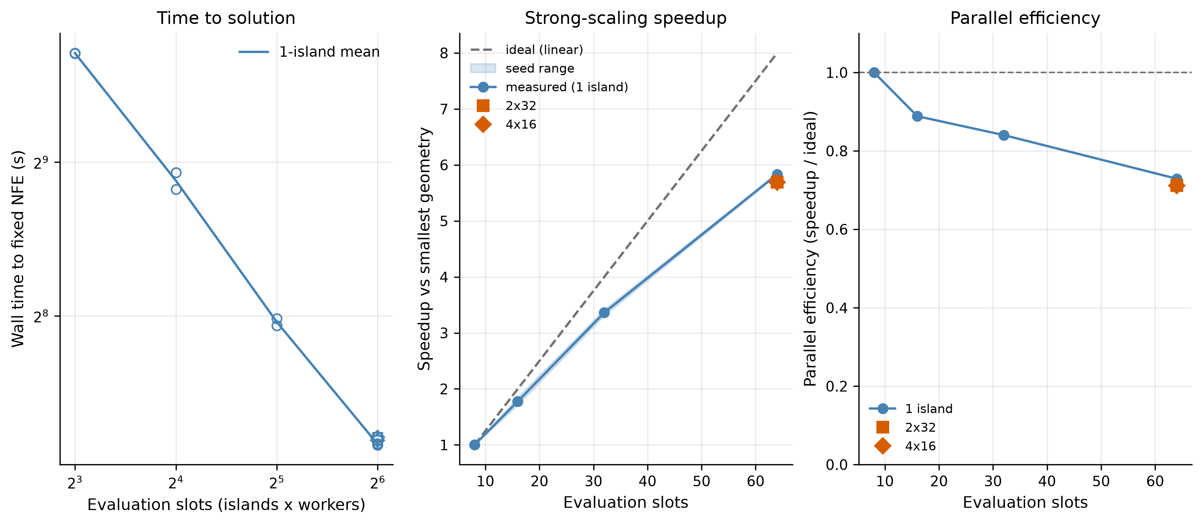
Anvil Scaling Experiments
Short 4 year simulation, 1,280 NFE, 2 random seeds
Left panel: Wall time to finish the fixed evaluation budget as evaluation slots increase from 8 to 64 (log-log).
Middle panel: Speedup relative to the smallest 8-slot run, against the ideal linear line, with the two multi-island geometries overlaid.
Right panel: Parallel efficiency (fraction of ideal speedup retained) as slots increase.

Slide 65
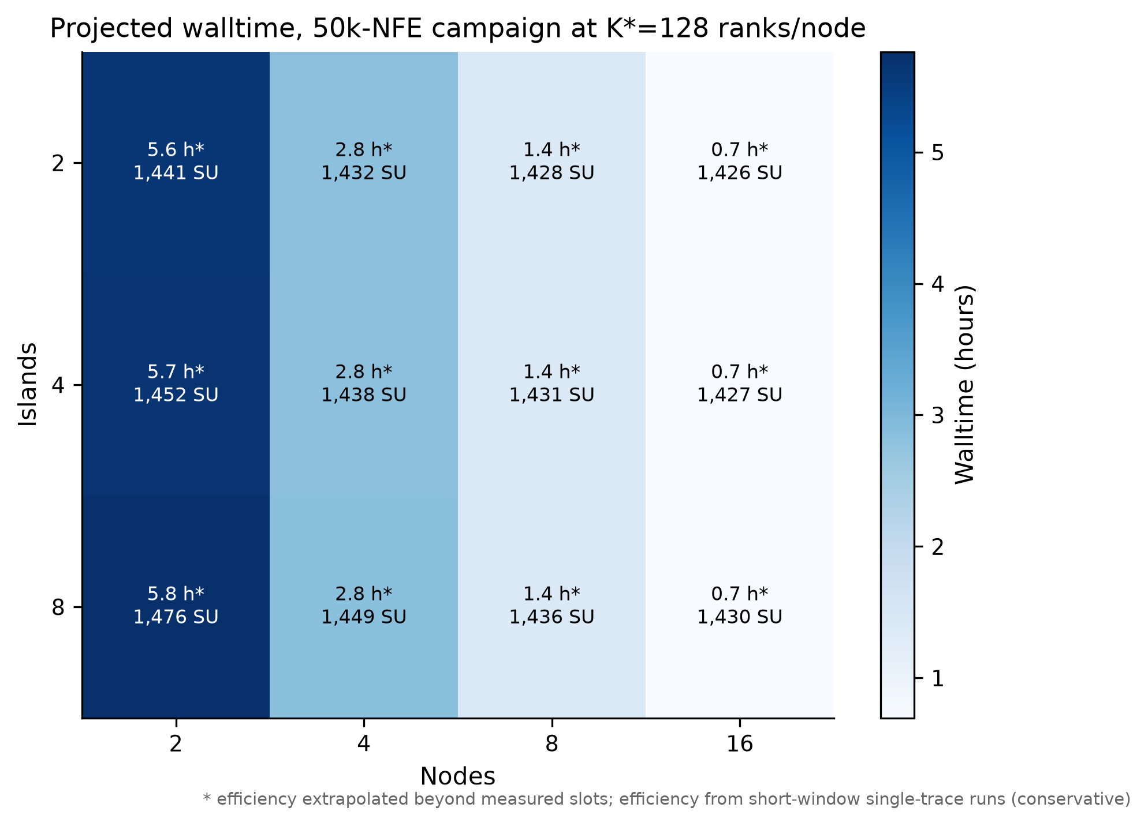
Anvil Scaling Experiments
Projected runtime combines the two measured pieces:
Evalutation runtime pack at K*=128 ranks/node
Borg scaling efficiency (assume 73% parallel efficiency)
For 750k NFE, 16 nodes and 4 islands:
= ~23k SU
= 10.5 hr

Slide 66
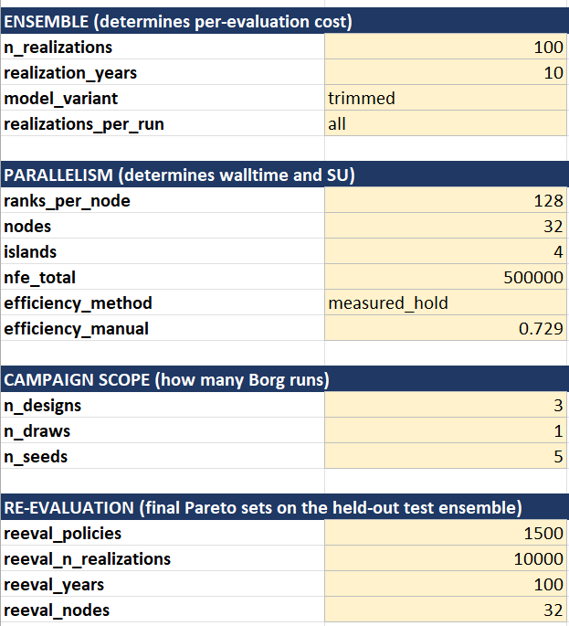
Anvil Scaling Experiment
Setup Anvil allocation calculator (based on Lillian’s advice)
Based on results of runtime & scaling experiments and experimental settings, estimate the total SUs needed for optimizations.
Current scale assumptions:
Optimization
500k NFE
1,000 years per evaluation
3x formulation designs
5x seeds per design
Re-evaluation
1,500 solutions re-evaluated
10,000 realizations x 100 years (1M years) per solution

Slide 67
Anvil Scaling Experiment
Setup Anvil allocation calculator (based on Lillian’s advice)
Saving some budget for re-runs if needed
15 optimizations total:
3 formulations x 5 seeds
Uses ~500 SU of allocation

Slide 68
Anvil Scaling Experiment
Setup Anvil allocation calculator (based on Lillian’s advice)
Wallclock time assuming use of 32 full nodes for each run.
8hr per optimization run/seed
Total = (8x15hr) if all of them are run in serial.

Slide 69
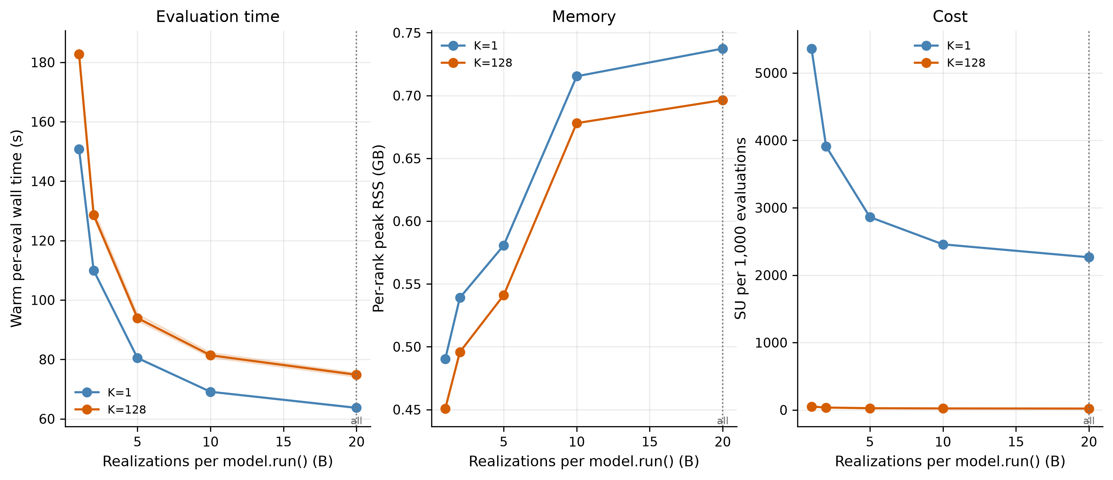
Anvil Scaling Experiments
Run = 20 realizations x 20 years
Left panel: Wall time per evaluation as B increases, for an isolated rank and a fully-packed node.
Middle panel: Peak per-rank memory as B increases.
Right panel: SU cost per 1,000 evaluations as B increases.

Slide 70
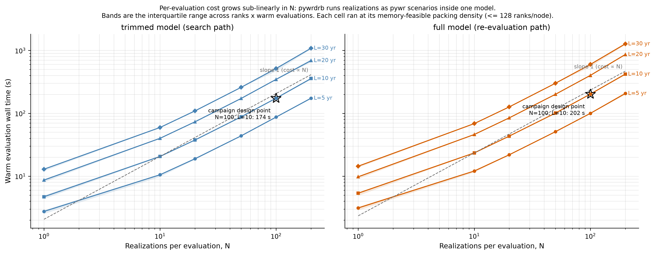
Anvil Scaling Experiments

Slide 71
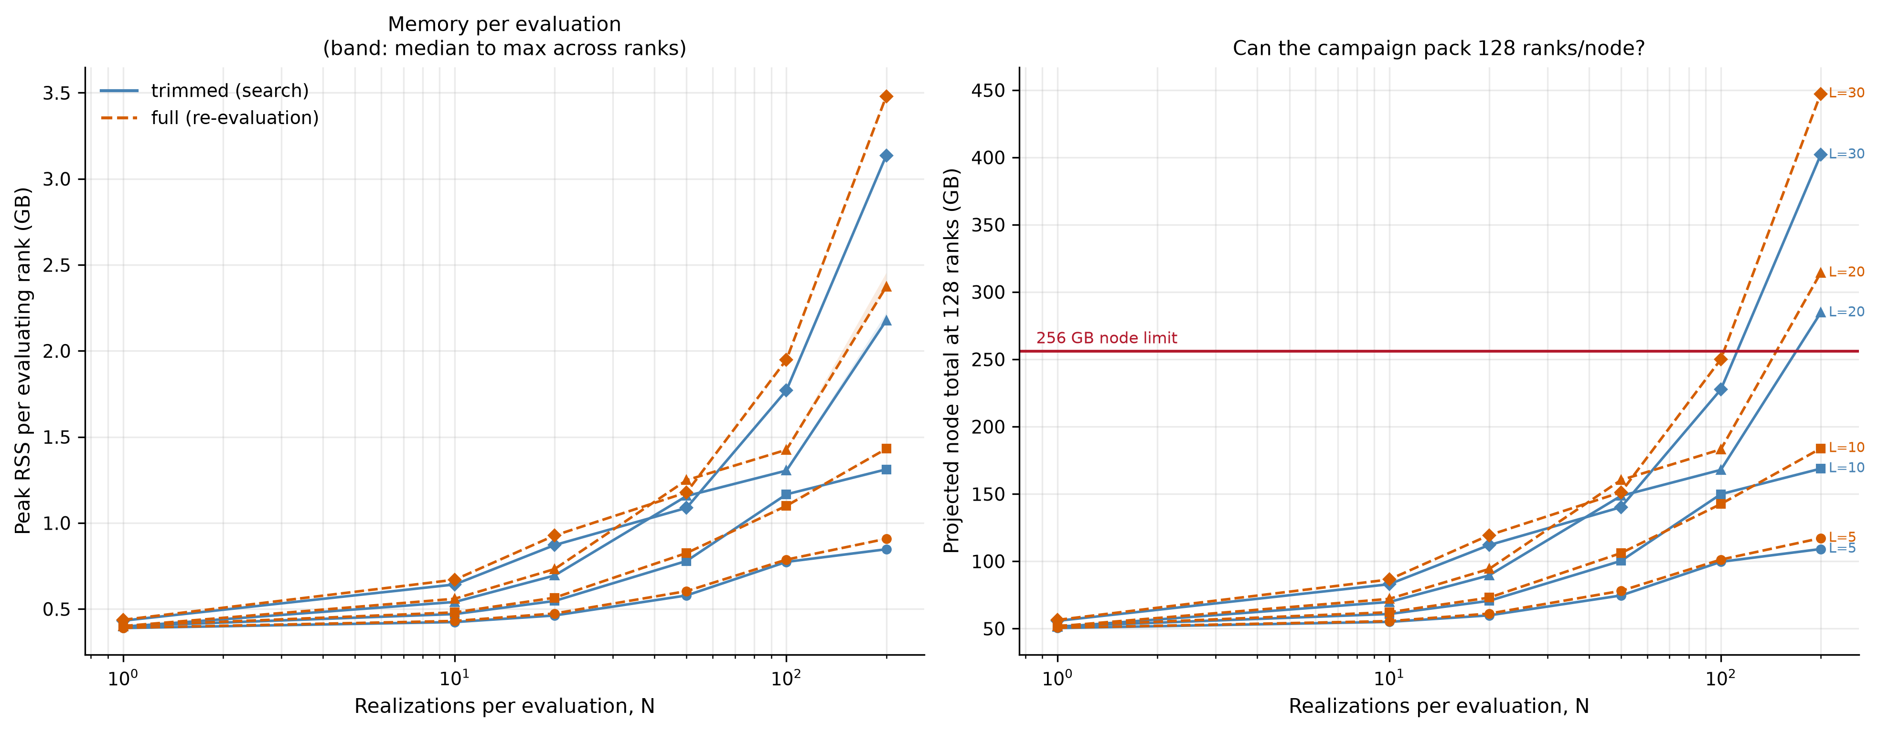
Anvil Scaling Experiments

Slide 72
Archive (possibly delete)

Slide 73
Experimental Design
Scenario Design
Re-evaluation & Robustness
Optimization
Historical trace (baseline)
Re-evaluation of pareto-approximate solutions across large ensemble of climate change uncertainties
MM-BorgMOEA
Well characterized (probabilistic) ensemble generated from Kirsch-Nowak
Approximate Pareto Front
Approximate Pareto Front
Approximate Pareto Front
Fixed (N-year, NFE) per optimization
5 seeds per run
Multi-criteria satisficing robustness
Regret relative to default FFMP
Multi-metric hazard space filling ensemble, sampled from very large stochastic ensemble
Deeply uncertain hydrologic future ensemble

Slide 74
Proposal: Hypothesis
Idea:
Create a space-filling sample of the hazard space, evaluate candidate policies using this deeply uncertain hazard space.
We can then combine this with factorial samples of other deeply uncertain factors.
Hazard Measure 2
X
X
X
Hazard Measure 1
Deeply uncertain with socioeconomic factors

