Slide 1
Hazard-Informed Scenario Design for Many-Objective Reservoir Policy Search
Re-optimizing NYC reservoir operations in the Delaware River Basin under hydrologic uncertainty
Research proposal | Trevor Amestoy Reed Research Group, Cornell University | Summer 2026
Notes:
Working title; alternates: 'Designing the Scenarios We Optimize Over'. Audience: Pat Reed / committee. No results yet; deliverable is scope, gap, and planned experiment.

Slide 2
Contents
Motivation & literature framing
The gap
Proposal
• hypothesis · research questions · contributions
Planned experiment
• three designs, one stationary population · deep uncertainty only in re-evaluation · the controlled contrast · objectives · controls
How designs are compared
• held-out metric set · threshold sweep · mechanism test · threats to validity
Status & open decisions
Supplemental
• objective formulations (7) and notation
• forcing parameterization (CMIP6 harmonic)
• Anvil scaling experiments
• planned manuscript figure sequence
Notes:
Roadmap; supplemental holds reference detail (objectives, forcing, scaling).

Slide 3
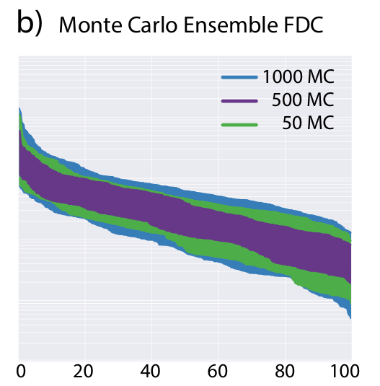
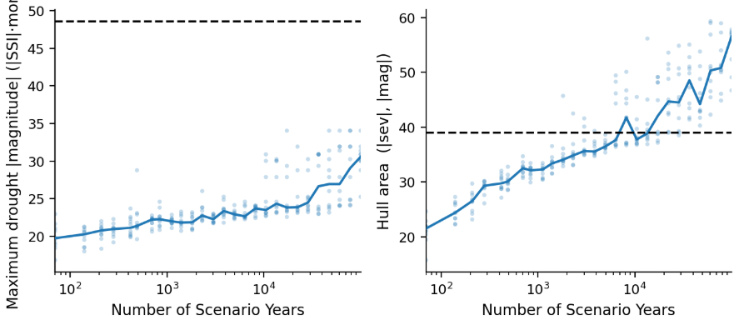
Motivation: the observed record undersamples hazard
New hydrologic extremes keep emerging as stochastic ensembles grow.
• optimizing over one record overfits a single hydrologic history (Brodeur et al. 2020)
• synthetic ensembles are the standard remedy (Kirsch et al. 2013; Herman et al. 2016)
FDC range vs ensemble size
drought extremes and hazard diversity vs scenario-years (this study)
Notes:
Left figure (from Jazmine's dissertation): FDC envelope keeps widening with ensemble size. Right (our DRB Kirsch-Nowak diagnostic): max drought magnitude and hazard hull area still growing past 10^4 scenario-years. TODO before presenting: annotate the dashed reference line and un-truncate the y-axis label in the right panels.

Slide 4
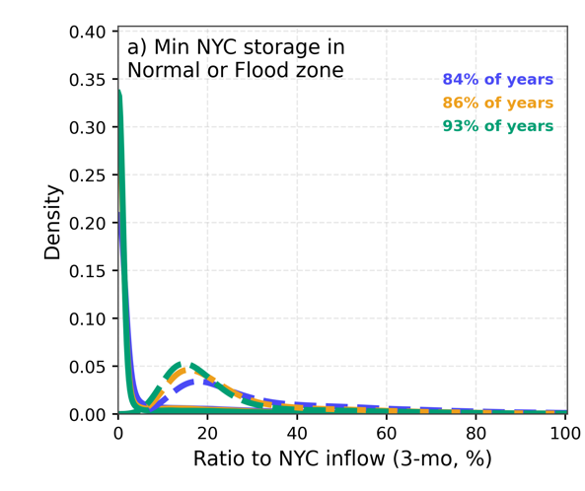
Motivation: most simulated years carry little search signal
84–93% of stochastic-ensemble years sit in Normal / Flood conditions.
• ensemble size trades off directly against evaluation cost in search (Zatarain Salazar et al. 2017)
• supply and drought objectives draw signal only from the rare stress years
• high-flow years are sparse in a complementary way; both motivate designed coverage
share of years whose lowest NYC storage stays in the Normal / Flood FFMP zones, three ensembles (this study)
Notes:
Our current DRB stochastic ensembles: 84-93% of years never leave the Normal/Flood storage zone; simulating them costs the same as stress years but adds little gradient for the supply/drought objectives. If asked: the three legend percentages correspond to the three current stochastic ensemble presets.

Slide 5
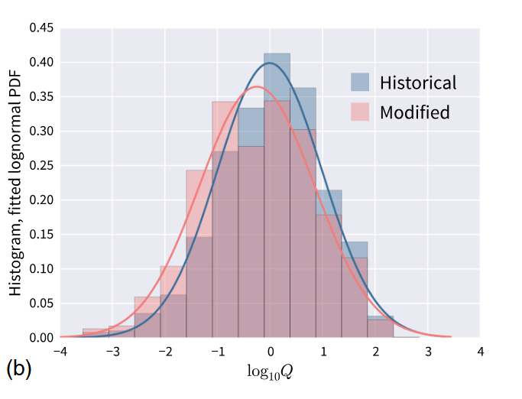
Motivation: input-parameter sampling leaves hazard-space gaps
Distinct generator parameters produce overlapping hazard conditions.
• sampling generator / climate parameters is the prevailing deep-uncertainty design (Quinn et al. 2020; Bartholomew & Kwakkel 2020)
• distinct parameter sets often yield hydrologically redundant realizations (Guo et al. 2018; Quinn et al. 2020)
• preliminary DRB diagnostic: sampling input parameters leaves about 1.3× higher discrepancy (unevenness) in hazard space, surviving input enrichment (this study)
• this motivates controlling coverage directly in hazard space — the point of the proposed selector, not a campaign design of its own
parameter 2
forcing parameter 1
hazard metric 1
modified forcing, similar flows
Notes:
MOTIVATION ONLY: why hazard space is the interesting space to control, not a campaign contrast. Sampling generator/climate parameters (the prevailing deep-uncertainty design) does not control where realizations land in hazard space: the parameter-to-stress mapping is many-to-one. Right figure: a large forcing modification barely moves the flow distribution. Preliminary DRB diagnostic: input-parameter sampling leaves ~1.3x higher discrepancy (unevenness) in hazard space, surviving input-sample enrichment. This motivates selecting directly in hazard space; input-parameter sampling is NOT one of the three campaign designs.

Slide 6
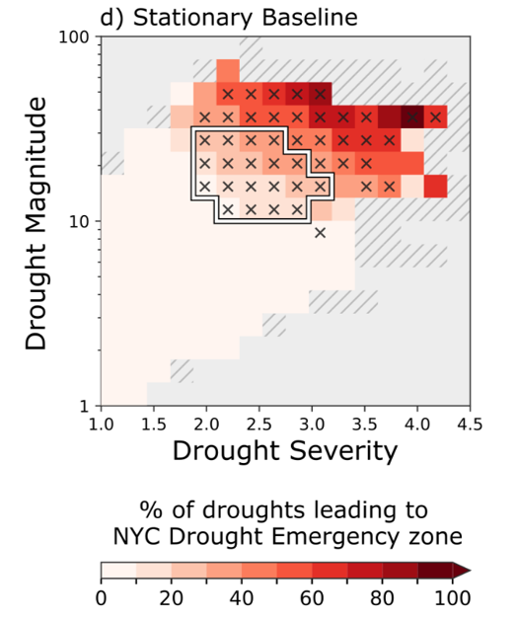
Motivation: rare hazard corners drive consequential outcomes
Consequential failures concentrate in rare, severe drought corners.
• policies only learn from scenarios that contain these events
• high-stress training scenarios matched full-ensemble robustness at about 3× less compute (Cohen et al. 2021)
• training on distinct drought types changes the policies found (Zaniolo et al. 2023)
• Cohen selects scenarios by a perfect-foresight optimization per scenario; we cite the finding, never the machinery
this study: DRB stationary stochastic baseline
Notes:
Figure (ours): fraction of droughts, by severity x magnitude bin, that push NYC into the Drought Emergency zone; consequential outcomes concentrate in rare severe corners. Cohen 2021: high-baseline-regret (stressful) training subsets matched all-scenario training at ~3x less compute -- cited as MOTIVATION only; we never run a perfect-foresight optimization. Zaniolo 2023: policies trained per drought type differ in structure and performance.

Slide 7
How the literature designs scenario sets: four families
Families defined by the criterion of a good scenario set (working taxonomy, after Fairbrother et al. 2022; Brown et al. 2012)
I. Judgment-based
single traces, design events
(Giuliani et al. 2016)
II. Distribution-driven
sample an assumed distribution
(Quinn et al. 2017)
III. Bottom-up coverage
span a condition space
(Brown et al. 2012; Quinn et al. 2020)
IV. Problem-driven
select by decision relevance
(Cohen et al. 2021)
This study: family III coverage, applied in hazard space measured on realized streamflow sequences.
Notes:
Families defined by the criterion of a good scenario set: expert judgment (I), fidelity to a distribution (II), coverage of a condition space (III), relevance to the decision problem (IV). This study sits in family III, coverage-based subset selection, but applies the coverage criterion in hazard space measured on realized sequences. Full taxonomy in the working notes.

Slide 8
Closest antecedents and the gap
Antecedent | Established | Stops short at
Cohen et al. 2021 | training-scenario properties drive out-of-sample robustness | problem-driven regret selection; a perfect-foresight run per scenario; 97 GCM traces
Bonham et al. 2024 | space-filling subsampling + coverage metrics in water resources | post-hoc robustness ranking, not the search ensemble
Zaniolo et al. 2023 | drought-type training ensembles change the policies found | imposed at generation; four discrete types
Zatarain Salazar et al. 2017 | search-ensemble size vs fidelity vs cost tradeoff | one-dimensional flow-magnitude stratification
Gap. No study builds the MOEA search ensemble by space-filling selection in a multi-dimensional hazard space, at candidate-pool scale (10⁵–10⁶ sequences), and tests it on a held-out ensemble spanning deep climate uncertainty.
Cohen et al. (2021) showed composition matters; the new element is the scalable, simulation-free construction and its held-out test.
Notes:
The honest gap statement. Cohen 2021 already showed composition matters (cited as motivation, never as a metric we compute); each antecedent stops short on one axis: problem-driven vs simulation-free selection (Cohen), post-hoc vs search-phase (Bonham), generation control vs selection from realized sequences (Zaniolo), 1-D vs multi-dimensional (Zatarain Salazar). 'Genuinely held-out' contrasts with Cohen's complementary-halves testing.

Slide 9
Terminology: three spaces
Input space generator & climate-forcing parameters θ
Hazard space drought / low-flow / high-flow metrics per sequence
Outcome space objective values of a policy under a scenario
generate
simulate
• hazard coordinates are measured on realized sequences, before any simulation (drought event metrics per run theory, Yevjevich 1967; SSI, Vicente-Serrano et al. 2012; flow indices, Richter et al. 1996)
• so hazard-space ensemble design is a simulation-free, pre-optimization step, reusable across problem formulations
Notes:
Load-bearing vocabulary. Hazard space: drought event metrics (SSI run theory), low/high-flow indices, measured on each realized sequence before any simulation. Because coordinates exist pre-simulation, hazard-space ensemble design is simulation-free and reusable across formulations; that is what separates it from family IV problem-driven selection, which needs an optimization per scenario.

Slide 10
Proposed design: hazard-filling search ensembles
θ is a knob on the generator. Hazard is not — it is emergent, measured after the fact.
• input-parameter designs generate to their design points: LHS alone, nothing to snap to
• hazard-space design must select from a finite candidate pool of 10⁵–10⁶ short (10-yr) i.i.d. realizations, which the design generates and owns
• selector: LHS anchors in ABSOLUTE, range-scaled hazard space, snapped to the nearest unused pool member — deliberately over-represents the severe corners; deterministic, no tuning
• the nearest-neighbour step is intrinsic to hazard-space design, not an approximation of something better; the asymmetry is part of the argument
• the shift toward the severe corners is the deliberate intervention RQ1 tests; the single comparison point is the held-out, deeply uncertain re-evaluation on E_test
candidate pool (own, i.i.d., ~10⁶)
search ensemble (N = 100)
LHS anchors + nearest-neighbour snap
metric 2
metric 2
hazard metric 1
hazard metric 1
Notes:
THE central conceptual slide. You cannot generate a realization with prescribed hazard coordinates -- hazard is an emergent property of a realized flow sequence, not a knob on the generator. Forcing parameters theta ARE a knob. So input-space designs GENERATE TO their design points (LHS alone, nothing to snap to) while hazard-space designs must SELECT FROM a finite candidate pool (LHS anchors + nearest-neighbour snap). That asymmetry is intrinsic, not an implementation shortcut, and it is why hazard-filling is the only design that needs a pool. The hazard-filling design owns its i.i.d. candidate pool; nothing is shared. The selector fills ABSOLUTE, range-scaled hazard space, deliberately over-representing the severe corners.

Slide 11
Hypothesis & planned contributions
Hypothesis. Search ensembles that fill hazard space produce Pareto-approximate policies that are more robust under held-out re-evaluation than probabilistic (i.i.d.) sampling from the same stochastic generator, at equal N, equal L and equal NFE.
Planned contributions
• first budget-controlled comparison of scenario designs, with an exact statistical control (fixed_probabilistic) for the hazard-filling claim, judged on a genuinely held-out, deeply uncertain re-evaluation
• scalable, simulation-free, coverage-designed search-ensemble construction (hazard-filling), selecting in absolute hazard space over its own i.i.d. pool
• design-ranking stability under threshold stringency — the sweep nobody in this lineage has run
• evidence on FFMP re-optimization and a variable-resolution rule structure
Notes:
Falsifiable hypothesis; contribution 1 stands even under a null result. Positioning vs Cohen 2021: they showed composition matters; we contribute the scalable, simulation-free, coverage-designed construction, an exact statistical control (fixed_probabilistic), and a genuinely held-out deep-uncertainty test.

Slide 12
Testbed: NYC reservoirs in the Delaware River Basin
• Cannonsville, Pepacton and Neversink supply about half of NYC's water; the 1954 Supreme Court Decree caps the diversion at 800 MGD
• the Decree also sets minimum-flow targets at Montague and Trenton, protecting New Jersey and Philadelphia (salinity repulsion)
• operations follow the Flexible Flow Management Program (FFMP): storage-zone-based releases with drought step-downs; its 24 rule parameters are the decision variables re-optimized here
• simulated with Pywr-DRB, an open-source daily water-availability model of the basin (Hamilton et al. 2024)
Cannonsville
Pepacton
Neversink
NYC diversion ≤ 800 MGD
Delaware mainstem
Montague target 1,750 cfs
Trenton target 3,000 cfs
Notes:
One context slide so the objectives and RQ2/RQ3 are interpretable to non-DRB readers: three NYC Delaware reservoirs, the 1954 Supreme Court Decree quantities (diversion cap, Montague and Trenton flow targets), and the FFMP acronym expanded. All simulation in Pywr-DRB.

Slide 13
Research questions
RQ1 (core). Does building the search ensemble by hazard-space coverage, rather than i.i.d. sampling from the same generator, change re-evaluated robustness?
• held-out, deeply uncertain re-evaluation of the resulting Pareto-approximate policies; the single controlled contrast is fixed_probabilistic vs hazard_filling
RQ2. Can FFMP re-optimization improve NYC / basin outcomes?
• supply reliability · Decree flow targets · flooding · storage resilience; judged against the current FFMP policy re-evaluated on the same test ensemble
RQ3. Does a variable-resolution FFMP rule structure help?
• ffmp_N redraws the storage-zone discretization with N zone levels (8, 10, 12) vs the standard 24-parameter FFMP; nesting within the design campaign open (SU budget)
Notes:
RQ1 drives the experimental design; RQ2/RQ3 answered by the same campaign.

Slide 14
The planned experiment
one stationary population Kirsch–Nowak fit to the record (no climate perturbation)
each design generates its own realizations from its own namespaced seed stream
deep uncertainty enters only in E_test (stage 4)
1 GENERATE
2 BUILD
historic*
fixed prob.
hazard-fill
no design subsamples a shared pool; only hazard-filling needs a pool, and it owns its candidate pool + hazard image
3 SEARCH
independent MM-Borg searches per design N = 100 × L = 10 yr, equal NFE; K draws × S seeds
Pareto-approximate sets (per design)
4 EVALUATE
common held-out E_test (DU-forced) LHS over CMIP6 forcing box × realizations; never searched
multivariate satisficing (primary) + secondary metrics; nondominated sets recomputed for all designs
*historic = observed record, prevailing-practice reference (N = 1; cannot be size-matched); the current FFMP policy is also re-evaluated on the test ensemble as the RQ2 baseline
Notes:
Diagram style follows staged method figures (Bonham et al. 2024 Fig. 1; Cohen et al. 2021 Fig. 3). ONE stationary population (Kirsch-Nowak fit to the record, no climate perturbation). KEY POINT of stage 1: there is NO shared pool. Every design generates its own realizations from its own namespaced seed stream, so no two designs ever share a realization. Only hazard_filling needs a pool, and it owns it. Deep uncertainty enters ONLY in stage 4 (E_test), which spans a CMIP6-forced envelope no search ensemble contains, making re-evaluation a generalization test. Stage 3: identical N, L and NFE for both matched designs. Stage 4: one common held-out evaluation; search-time values are never compared across designs.

Slide 15
Scenario designs compared (RQ1)
Population | Design | Construction of the search ensemble | Precedent
stationary | historic | the observed record as one continuous trace (N = 1) | Giuliani et al. 2016; Herman et al. 2020
stationary | fixed_probabilistic | N × L realizations generated i.i.d.; frozen across the search | Quinn et al. 2017; Zatarain Salazar et al. 2017
stationary | hazard_filling | LHS + nearest-neighbour snap in ABSOLUTE hazard space, over its own i.i.d. stationary pool | proposed
• each design generates its own realizations from its own seed stream; no design is subsampled from a shared pool
• the two matched designs run at N = 100, L = 10 yr, equal NFE; fixed_probabilistic is the exact statistical control for hazard_filling
• historic is an unmatched prevailing-practice reference; deep uncertainty enters only in the held-out E_test
Notes:
The three campaign designs, from src/scenario_designs.py. ONE stationary population (Kirsch-Nowak fit to the record, no climate perturbation). Each design is built by its own published recipe from its own seed stream. fixed_probabilistic is the EXACT statistical control for hazard_filling (a uniform random size-N subset of an i.i.d. pool = N fresh i.i.d. draws), so the pair differs only in the selection rule. historic is the unmatched prevailing-practice reference (N = 1). Deep uncertainty lives only in E_test. resampled_probabilistic, input_stratified, and a DU-forced hazard_filling variant are out of the campaign (future work at most).

Slide 16
The exact statistical control
fixed_probabilistic is the exact statistical control for hazard_filling.
• same generator, same stationary population, same N, same L, same NFE — only the selection rule differs
• so any difference in re-evaluated robustness is attributable to the selection rule alone; this is the Eker & Kwakkel (2018) null benchmark upgraded to hazard space, a real system, and draw-based replication
• deep uncertainty enters only in E_test, which spans a CMIP6-forced envelope no search ensemble contains — so re-evaluation is a generalization test to conditions never seen in search
The exact control. A uniform random size-N subset of an i.i.d. pool is distributionally identical to N fresh i.i.d. draws. That is what makes fixed_probabilistic the exact statistical control for hazard_filling: they differ only in the selection rule applied to the same population law. It requires the pool to be sampled i.i.d., never by LHS — enforced by an invariant test, because nothing else would fail if it were broken.
Notes:
The single controlled contrast rests on an exact statistical control. A uniform random size-N subset of an i.i.d. pool is distributionally identical to N fresh i.i.d. draws, so fixed_probabilistic is the EXACT control for hazard_filling: same generator, population, N, L, NFE, only the selection rule differs. This requires the pool to be sampled i.i.d. (never by LHS), enforced by an invariant test. Deep uncertainty enters only in E_test, which spans a CMIP6-forced envelope no search ensemble contains, making re-evaluation a generalization test to conditions never seen in search. This upgrades the Eker & Kwakkel (2018) null benchmark (diversity selection did not beat random) to hazard space, a real system, and draw-based replication.

Slide 17
The controlled contrast
fixed_probabilistic N i.i.d. draws from the generator, frozen
only the selection RULE differs
hazard_filling LHS + snap in absolute hazard space
Does hazard coverage beat random sampling?
• the contrast holds N = 100, L = 10 yr and NFE fixed; only the rule that selects the N realizations changes
• because the candidate pool is i.i.d., fixed_probabilistic is the exact statistical control — a uniform random size-N subset equals N fresh draws
• historic (prevailing-practice anchor, N = 1) sits outside the matched contrast; deep uncertainty enters only at re-evaluation (E_test)
Notes:
The experimental core, in one picture. ONE controlled contrast: fixed_probabilistic -> hazard_filling. Same stationary generator, same population, same N = 100, same L = 10 yr, same NFE; only the selection RULE differs (i.i.d. sampling vs absolute hazard-space filling). Because the pool is i.i.d., fixed_probabilistic is the exact statistical control. historic is the unmatched prevailing-practice reference. RQ1: does hazard coverage beat random sampling?

Slide 18
The candidate pool (and where the forcing box lives)
stationary Kirsch–Nowak fit to the record (no perturbation)
i.i.d. sampling (never LHS)
one i.i.d. candidate pool (hazard_filling selects N = 100 from it)
• hazard_filling owns its pool; the pool is re-drawn on every ensemble draw, so a draw re-rolls everything that is random about building the ensemble
• the pool is sampled i.i.d., never by LHS — a random subset of an LHS design is not i.i.d., which would silently void the exact control (enforced by an invariant test)
• only the hazard image + seeds are stored; any realization regenerates deterministically on demand (hundreds of GB avoided)
• seed domains are disjoint across designs, draws, and the test ensemble, so no two ever share a realization
• the CMIP6 harmonic forcing box (m, r₁, r₂; amplitudes sampled, phases fixed, Quinn et al. 2018) is not a search design — it is the envelope for the held-out E_test (Kirsch et al. 2013; Nowak et al. 2010)
• historical interannual persistence is retained by the generator; claims scoped accordingly
Notes:
How the stationary candidate pool is built. The pool is sampled i.i.d., NEVER by LHS -- a random subset of an LHS design is not i.i.d., which would silently void the exact control. The pool is re-drawn on every ensemble draw: generating the pool IS part of hazard_filling's construction, so pinning it would make hazard-filling look more stable by construction. Storage: only hazard image + seeds persisted; realizations regenerate deterministically. The CMIP6 harmonic forcing box is NOT a search design; it is the envelope for the held-out E_test (shown later). Caveat: historical interannual persistence retained; claims scoped accordingly.

Slide 19
Hazard axes & the hazard-filling selector
• candidate axes: SSI-6 drought-event metrics (deficit volume, duration, peak depth, onset and recovery rate) and peaks-over-threshold flood metrics (peak magnitude, pulse duration, rise rate), computed per sequence
• redundancy screen retains 3–4 low-collinearity axes, balanced across the dry and wet concepts (|ρ| ≥ 0.7 clustering, Olden & Poff 2003)
• selector: range-scale each axis to [0,1] by its pool min-max (ABSOLUTE space), draw N Latin-hypercube anchors, snap each to the nearest unused pool member. Deterministic given the anchor seed; no annealing, no tuning
• absolute-space filling deliberately over-represents the severe corners relative to their pool frequency — the distribution shift RQ1 tests (a rank-space ECDF variant is a non-campaign sensitivity only)
• coverage stats (L2-star discrepancy, MST, snap distance) are build-QC / method verification that the intervention was administered at strength, reported against a random design at the same (N, m) — not a comparison result
hollow = LHS anchor; filled = snapped pool member
hazard axis 2
hazard axis 1 (absolute, range-scaled space)
Notes:
Selector: range-scale each hazard axis to [0,1] by its pool min-max (ABSOLUTE space, NOT empirical-CDF / rank space), draw N Latin-hypercube anchors, snap each to the nearest not-yet-selected pool member. Deterministic given the anchor seed. NO simulated annealing, no tuning, no discrepancy objective. Absolute-space filling deliberately OVER-REPRESENTS the severe (rare) hazard corners relative to their pool frequency -- that is the genuine distribution shift under study. Because the selector does not minimize a discrepancy objective, L2-star discrepancy / MST / snap distance are BUILD-QC that the intervention was administered at strength (vs a random design at the same N, m), NOT a comparison result. Axes chosen by a redundancy screen on the production pool's hazard image. A rank-space ECDF variant is a non-campaign sensitivity only.

Slide 20
Objectives: seven, spanning basin stakeholders
 | Objective | Temporal metric (single trace) | Dir
1 | NYC delivery reliability | fraction of weeks delivery ≥ 99% of Decree-capped demand | max
2 | NYC delivery deficit | CVaR₉₀ of weekly deficit (% of 800 MGD) | min
3 | Montague flow reliability | fraction of weeks ≥ 1,750 cfs Decree target | max
4 | Montague flow deficit | CVaR₉₀ of weekly deficit (% of target) | min
5 | Trenton flow reliability | fraction of weeks ≥ Decree target | max
6 | Downstream flood days | days any tail gauge ≥ NWS minor flood stage | min
7 | NYC storage resilience | 5th percentile of daily storage (% capacity) | max
• goalposts are the static 1954 Decree quantities, never the live FFMP step-down targets
• reliability, tail and count forms follow Hashimoto et al. (1982), Rockafellar & Uryasev (2000), Quinn et al. (2017); formulations in supplement
Notes:
Static 1954 Decree goalposts, never the live FFMP step-down targets (a policy must not lower its own goalpost). Stable tail/count forms replace worst-case extremes. Trenton stands in for the salt front (physically redundant target, cleaner signal). Full formulations and rationale per objective in supplement.

Slide 21
Scoring a policy on an ensemble: two-layer aggregation
N
stage 1: annual metric per (realization × year) unit
stage 2: unit operator over pooled N·L unit-years
fᵢ
L water-years
• reliability objectives: frequency of non-failure years (Zeff et al. 2014; Trindade et al. 2017; Gold et al. 2023)
• deficit / storage objectives: worst 1st-percentile unit-year (Quinn et al. 2017, 2018)
• flood days: mean annual count, P99 variant registered (Quinn et al. 2017)
• identical scheme and unit denominator across designs (two-layer vocabulary, Hamilton et al. 2022); failure criteria and ε from the sensitivity experiment
Notes:
How a (realizations x time) simulation becomes one scalar per objective during ensemble search. Stage 1: annual metric on every (realization x water-year) unit. Stage 2: per-objective operator over the pooled N*L unit-years. Every operator follows published search-time practice (WaterPaths-lineage frequency; Quinn's percentile over annual units). Identical scheme and unit denominator for every ensemble design; historic keeps single-trace metrics. Failure criteria and epsilons from the sensitivity experiment (in progress).

Slide 22
Controls for a fair comparison
N = 100 and L = 10 yr for every matched design → 1,000 scenario-years per evaluation, at equal NFE.
• because N and L are common, per-evaluation cost, warm-up, scenario-years and wall-clock are identical — equal-NFE and equal-scenario-years coincide. One budget condition, no arms, no confound between composition and search effort
• the common (N, L) is required, not convenient: if L differed across designs, the selection rule would be confounded with record length
• N is bounded below by the fill requirement — at m = 4 hazard axes, N = 100 gives ~3.2 points per dimension (~4.6 at m = 3), the smallest defensible fill. This is why long records are not viable: at a fixed per-evaluation budget L = 50 forces N ≈ 20, and space-filling in 4-D with 20 points is noise
• NFE = 500,000 per search is a target (revisable once initial searches reveal convergence; the runtime archive keeps intermediate NFE so a lower budget can be justified after the fact)
• replication (targets): K = 3 ensemble draws × S = 2 seeds per matched design (historic K = 1); revisable from a pilot minimum-detectable-effect calc. A draw = the construction re-run from scratch with a fresh seed, including its pool, and is the unit of analysis (effective n ≈ K)
• search-time objective values are never compared across designs; convergence is a per-design diagnostic only
Notes:
The budget control is a CONSEQUENCE of the sizing choice, not something imposed. Because N and L are common to every matched design, per-evaluation cost, warm-up, scenario-years and wall-clock are identical, so equal-NFE and equal-scenario-years coincide: ONE budget condition, no arms, no composition-vs-search-effort confound. A common (N, L) is REQUIRED, not convenient: with different L the selection rule would be confounded with record length. N is bounded below by the fill requirement. Replication: a draw re-rolls EVERYTHING, including the pool -- otherwise a hazard-filling draw would vary only its anchor plan while a fixed_probabilistic draw re-rolls its whole sample, and hazard-filling would look more stable by construction.

Slide 23
Comparison metrics: the held-out metric set
Primary: multivariate satisficing (Starr 1962 domain criterion) — the fraction of test realizations in which a policy meets ALL criteria jointly. The realization is the unit.
• the standard robustness unit of the Herman (2014, 2015) / Trindade (2017) / Gold (2022, 2023) lineage; converges at 50–300 scenarios (Bonham et al. 2024)
• run-level endpoint (pre-specified): the max satisficing fraction attained in a run's re-evaluated set, with a leave-one-out reference-set correction and robustness-space hypervolume as bounding co-reports
• secondary, all free from the same persisted cube: univariate satisficing; Laplace / mean and maximin (risk-neutral and risk-averse anchors — a single robustness family is never sufficient, Herman et al. 2015; McPhail et al. 2018); improvement over the status quo (shortfall vs the current FFMP policy on the same test ensemble — the only fixed-reference regret-type quantity, design-independent, needs no optimization, Kasprzyk et al. 2013)
• attainability screen (free): which test realizations no policy from any design can win — separating *this design searched badly* from *this scenario is impossible for anyone* (Shavazipour et al. 2021 found 23% unwinnable)
• ranking agreement via Kendall's τ_b, computed across the design rankings
Deliberately excluded. Regret — Cohen et al. (2021) baseline regret needs a perfect-foresight MOEA run per scenario (97 optimizations, ~3,233 CPU-h) and does not scale to a 10⁵–10⁶ pool; regret-from-best is set-relative and design-coupled (dropping one design changes every other design's score) and never converges on a tail objective (Bonham et al. 2024). No perfect-foresight optimization appears anywhere in this study.
Pooled-reference-set hypervolume across designs — contributor bias, cardinality asymmetry, and noise-induced spurious dominance (a noisier design is flattered). Reference sets are built per design; cross-design comparison is re-evaluation only (Zatarain Salazar et al. 2017, §5.3).
Notes:
The finalized metric set (src/robustness.py). PRIMARY: multivariate Starr (1962) domain criterion -- realization-level, the standard unit of the Herman/Trindade/Gold lineage, and it converges at 50-300 scenarios (Bonham 2024). Everything else is FREE from the same persisted (solution x realization x objective) cube. Three deliberate exclusions, each with a reason a reviewer will accept. NO perfect-foresight optimization appears anywhere in the study.

Slide 24
Satisficing thresholds are conventions, so we sweep them
Rank agreement across scenario designs degrades as the criterion tightens (Quinn et al. 2020).
• nobody in this lineage derives a threshold: Zeff et al. (2014) elicited them, and every later number descends by convention and drifts without stated reason (worst-case cost 5% → 10%; restriction frequency 20% → 10%; reliability 99% → 98.5% because nothing met 99%)
• so the design effect is largest at the conservative end, and a single fixed threshold could manufacture or hide the entire result
• we anchor each criterion on a Decree / FFMP goalpost where one exists, and sweep the rest across a stringency grid
• the reported quantity is whether the design ranking — not the robustness value — is threshold-invariant (Kendall's τ_b vs the default): a main-text figure, not a robustness check
• free: the persisted (solution × realization × objective) cube is re-scored offline; nothing is re-simulated
hazard-fill
robustness
criterion stringency →
conceptual: rankings diverge at the tight end; τ_b of the design ranking reported at every grid point
Notes:
A MAIN-TEXT figure, not a robustness check. Quinn et al. 2020: robustness-rank agreement ACROSS scenario designs degrades as the satisficing criterion becomes more stringent -- 'the more conservative one wants to be in finding robust policies, the harder it is to choose this consistently across experimental designs.' So the design effect is largest at the conservative end and a single fixed threshold could manufacture or hide the entire result. We sweep a stringency grid and ask whether the DESIGN RANKING is threshold-invariant. Free: the raw cube is re-scored offline, no re-simulation. Nobody in this lineage has done this.

Slide 25
Scenario discovery in hazard space: the mechanism test
If hazard-filling works, its policies should fail where the design under-covered.
under-covered region
• boosted trees (Gold et al. 2022, 2023 configuration) fit to each design's held-out failure realizations, labelled by the joint satisficing criterion, in hazard space
• this is the falsifiable prediction of the coverage claim, and strictly stronger than a correlational coverage → robustness association
• caveat, stated up front: the raw coverage-deficit → failure AUC is inflated by geometry (nearest-neighbour distance grows toward the manifold boundary), so the verdict is read off AUC minus a random-ensemble null, never raw AUC
• correlated hazard axes destabilize factor importances (Quinn et al. 2020), so the axes are redundancy-screened before this is run
hazard axis 2
failures
hazard axis 1
Notes:
Scenario discovery in HAZARD space is the MECHANISM TEST, not decoration. Boosted trees (Gold 2022/2023 configuration) on each design's held-out failures, labelled by the joint satisficing criterion, in hazard space. The falsifiable prediction: if hazard-filling works, its policies should fail in the hazard region that the design UNDER-COVERED. Caveat to state up front: the raw coverage-deficit -> failure AUC is inflated by GEOMETRY -- nearest-neighbour distance grows toward the manifold boundary -- so the verdict is read off AUC minus a random-ensemble null, never raw AUC.

Slide 26
Threats to validity, named before a reviewer names them
Eker & Kwakkel (2018) is a null result
• diversity-based scenario selection did not beat random selection. Our fixed_probabilistic vs hazard_filling contrast is that benchmark. Differentiators: their diversity is in *outcome* space on the Lake Problem (little scenario-to-outcome leverage), ours is in absolute hazard space on a real system; and our statistic has far more power (K draws × S seeds, the draw as the unit of analysis, vs counting solutions above a group median)
Giuliani & Castelletti (2016): search-measure mismatch is a one-directional penalty
• policies designed under one aggregation rule and scored under another are dominated (their Fig. 4). Hazard-filling searches under a distorted measure and is scored under the test measure, so Giuliani predicts it will be penalized. That is the null this study must beat
Bartholomew & Kwakkel (2020) wrote the objection already
• selecting scenarios from a chosen region “intrinsically biases subsequent results towards solutions that do well in this region … no a-priori reason to assume [they] might not be vulnerable in a different way.” Our answer: the distortion is deliberate, stated and coverage-motivated; held-out re-evaluation corrects evaluation bias; selection bias is not corrected, and is precisely what the experiment measures
Degeneracy
• a metric can be stable, optimizable and still perverse (Huang et al. 2025: a deviation metric is minimized by being uniformly terrible), so raw performance distributions are co-reported with every robustness number
Notes:
Name them before a reviewer does. Eker & Kwakkel 2018 is a NULL RESULT and our fixed_probabilistic -> hazard_filling contrast IS that benchmark. Giuliani & Castelletti 2016 Fig. 4 predicts hazard-filling will be PENALIZED for search-measure mismatch -- that is the null this study must beat, and we say so. Bartholomew & Kwakkel 2020 already wrote the reviewer's objection: selection bias is NOT corrected by held-out re-evaluation, and it is precisely what the experiment measures.

Slide 27
Evaluation: one common held-out test ensemble
Pareto set: historic
Pareto set: fixed prob.
E_test, held-out (DU-forced) LHS over the CMIP6 forcing box × realizations spans a forced envelope no search ensemble contains
multivariate satisficing (primary) + Laplace · maximin · vs status quo + attainability screen
Pareto set: hazard-fill
baseline: current FFMP
• E_test is the sole carrier of deep uncertainty — search is stationary, so re-evaluation is a generalization test to conditions never seen in search; E_test is structurally distinct from both designs and favours neither
• no robustness number is an expectation — a satisficing fraction over E_test is a coverage-weighted count; the comparison is valid because E_test is identical across designs, not because it is probability-faithful (Quinn et al. 2020)
• E_test is LHS, not i.i.d., and never the source of any search ensemble; seed domains are disjoint by construction. Optional 2nd construction (multi-site HMM) tests ranking stability across generator families
Notes:
Single point of cross-design comparison, and the SOLE carrier of deep uncertainty. E_test is an LHS over the CMIP6 harmonic forcing box crossed with many realizations per point -- LHS, NOT i.i.d. -- spanning a forced envelope no search ensemble contains. So re-evaluation is a GENERALIZATION test to conditions never seen in search, and E_test is structurally distinct from both designs (it favours neither). No robustness number is an expectation: a satisficing fraction over E_test is a coverage-weighted count over a designed exploration of the deeply uncertain box; the comparison is valid because E_test is identical across designs, not because it is probability-faithful. An optional 2nd construction (multi-site HMM) would test ranking stability across generator families. Nondominated sets recomputed from re-evaluated values for all designs alike.

Slide 28
Status & open decisions
Built & verified
• end-to-end pipeline at test scale
• per-design generation, disjoint seed domains
• deterministic pools + on-demand regeneration
• hazard-filling selector (LHS + nearest-neighbour, absolute space) wired
• Anvil scaling experiment running
Next
• production candidate pools, then the axis screen, then the sensitivity experiments, then the campaign
Open, input requested
• coverage adequacy at m ≈ 4, N = 100 — uniform filling is sparse; must be demonstrated against a random-design null, not asserted (the biggest methodological risk)
• NFE (target, revisable); K / S replication targets
• pool size P; the hazard-axis set (post-screen)
• E_test sizing; thresholds / ε; whether to stand up the optional 2nd (HMM) E_test
• which design carries the RQ3 variable-resolution (ffmp_N) sweep
Notes:
Left: verified as of July 2026. Right: open decisions in priority order, where committee input is most valuable. SU table lands when the Anvil scaling experiment finishes.

Slide 29
Supplemental
Notes:
Supplemental divider.

Slide 30
Notation: building blocks
shortfall: (gap)₊ = max(gap, 0)
unit-year = one water year (Oct 1–Sep 30); an L-yr record scores L−1 unit-years
CVaR₉₀(series) = mean of the worst 10% of weekly values
P₉₉ / P₀₁(units) = worst / 1st-percentile unit-year
• flows / demands in MGD; storage in MG; first 365 days (warm-up) dropped
• Decree goalposts: NYC 800 MGD; Montague 1,131.05 MGD (1,750 cfs); Trenton 1,938.95 MGD; NYC capacity 270,837 MG
• every objective is two-layer — an annual metric per unit-year, then a unit operator over the pooled unit-years. The SAME function for every design (historic = 1 record × 76 unit-years; ensembles = N × (L−1)), so only the scenario set varies
Notes:
Plain-language building blocks for the objective slides.

Slide 31
Objective 1: NYC delivery reliability (higher is better)
entitlement: Eₜ = min(demandₜ, allowanceₜ) [allowance = running-avg bank]
failing week: Σ delivery < 99% × Σ E failure-year: ≥ k failing weeks (k = 1)
f₁ = (unit-years without failure) ÷ (total unit-years)
• the Decree caps the running AVERAGE diversion, not any single day — demand is never clipped at a flat 800 MGD, and a spike is owed whenever prior under-use has banked the allowance for it
• the bank accrues 800 − delivery per day (reset Jun 1) at the STATIC Decree right, so a policy's own drought step-downs cannot lower its own goalpost
• failure-year frequency is the citable search-time satisficing operator (Zeff et al. 2014; Trindade et al. 2017)
• re-evaluation metric: whole-record weekly reliability, per realization
Notes:
Annual failure-year frequency vs the running-average entitlement; same objective for every design.

Slide 32
Objective 2: NYC delivery deficit (lower is better)
weekly deficit = (E − delivery)₊ ÷ 800 MGD × 100%
annual metric = CVaR₉₀ of that unit-year's weekly deficits
f₂ = P₉₉ across pooled unit-years (worst 1st-percentile unit-year)
• magnitude of shortfalls below the running-average entitlement E, not just their frequency; scaled to the fixed 800 MGD right
• the tail average is far stabler than the single worst week (Rockafellar & Uryasev 2000; Quinn et al. 2017)
• re-evaluation metric: whole-record CVaR₉₀, per realization
Notes:
Within-year CVaR90, then worst-1%-unit-year across the pool.

Slide 33
Objective 3: Montague flow reliability (higher is better)
failing week: mean flow < 1,131.05 MGD [1,750 cfs]
f₃ = (unit-years with < k failing weeks) ÷ (total unit-years)
• vs the fixed Decree target, never the live FFMP step-down target
• won't reach 100%: FFMP drought rules cut releases below target by design, keeping the signal continuous
• failure-year frequency (Zeff et al. 2014; Trindade et al. 2017)
• re-evaluation metric: whole-record weekly reliability, per realization
Notes:
Annual failure-year frequency vs static Decree target.

Slide 34
Objective 4: Montague flow deficit (lower is better)
weekly deficit = (1,131.05 − flow)₊ ÷ 1,131.05 × 100%
annual metric = CVaR₉₀ of that unit-year's weekly deficits
f₄ = P₉₉ across pooled unit-years
• depth of target misses in the bad weeks, as % of target
• Montague flow is storm-dominated, so the single worst week is mostly exogenous noise; use the tail average (Quinn et al. 2017)
• re-evaluation metric: whole-record CVaR₉₀, per realization
Notes:
Within-year CVaR90, then worst-1%-unit-year.

Slide 35
Objective 5: Trenton flow reliability (higher is better)
failing week: mean flow < 1,938.95 MGD
f₅ = (unit-years with < k failing weeks) ÷ (total unit-years)
• lower-basin / NJ obligation; direct representation of a co-equal Decree party (Trindade et al. 2017; Hadjimichael et al. 2020)
• replaces the salt-front objective: physically redundant target, cleaner signal in drought
• re-evaluation metric: whole-record weekly reliability, per realization
Notes:
Trenton reliability replacing salt front.

Slide 36
Objective 6: Downstream flood days (lower is better)
annual metric = days any tail gauge ≥ NWS minor flood stage, per unit-year
f₆ = mean across pooled unit-years (expected annual flood days)
gauges: Hale Eddy, Fishs Eddy, Bridgeville
• tail gauges respond to release decisions, so flooding here is attributable to operations
• count-over-threshold avoids the expected-damage trap (Quinn et al. 2017); a P₉₉ variant is registered because an expectation can mask floods
• re-evaluation metric: whole-record flood-day count, per realization
Notes:
Expected annual flood days at minor stage.

Slide 37
Objective 7: NYC storage resilience (higher is better)
storage% = combined NYC storage ÷ 270,837 MG × 100%
annual metric = that unit-year's minimum daily storage%
f₇ = P₀₁ across pooled unit-years (1st-percentile unit-year)
• how depleted the system routinely runs; a low percentile is stabler than the single-day minimum, which one event dominates (Quinn et al. 2017)
• re-evaluation metric: whole-record P₅ of daily storage%, per realization
Notes:
Annual minimum storage, then P01 across the pool.

Slide 38
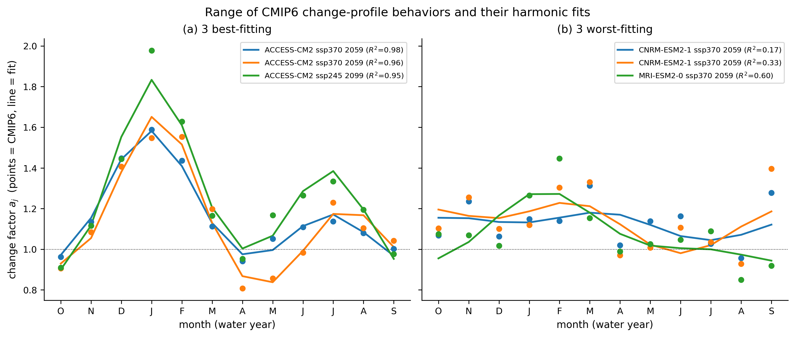
Supplemental: fixed-phase harmonic fits to CMIP6 (E_test forcing)
• sampled axes: volume m · seasonal amplitude r₁ · shoulder shape r₂; phases fixed at the canonical CMIP6 shape (Quinn et al. 2018). This parameterization defines the held-out E_test forcing envelope, not a search design
Notes:
Each CMIP6 (GCM x SSP x period) run gives a 12-month change-factor profile; the log profile is decomposed into a low-order harmonic with phases FIXED at the canonical CMIP6 seasonal shape; only amplitudes sampled. Left: best fits; right: worst (flat profiles, low R2 but small amplitude, harmless).

Slide 39
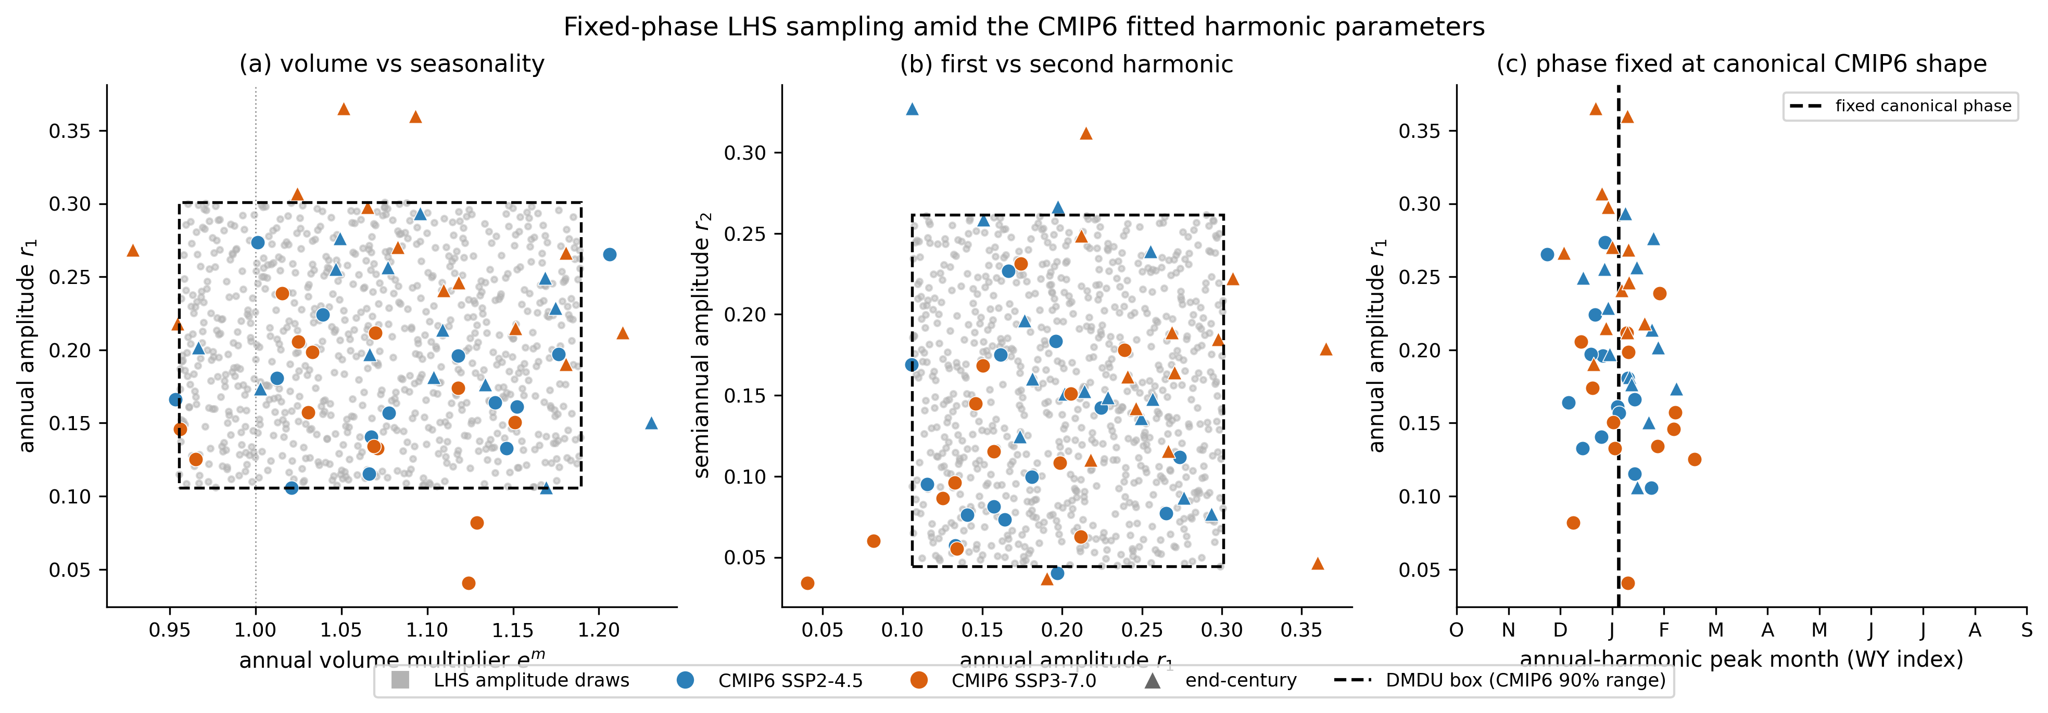
Supplemental: the CMIP6 90% amplitude envelope (E_test)
• the E_test forcing envelope: deeply uncertain magnitude combinations the GCMs did not jointly produce, with a physically plausible seasonal shape; sampled by LHS to build E_test
Notes:
The DMDU box = empirical 90% range of the CMIP6 fitted parameters (markers). This box is the forcing envelope for the held-out E_test: E_test is an LHS over this box crossed with realizations. It is NOT a search design (search is stationary; no input_stratified design). Panel c: phase held at the canonical winter peak.

Slide 40
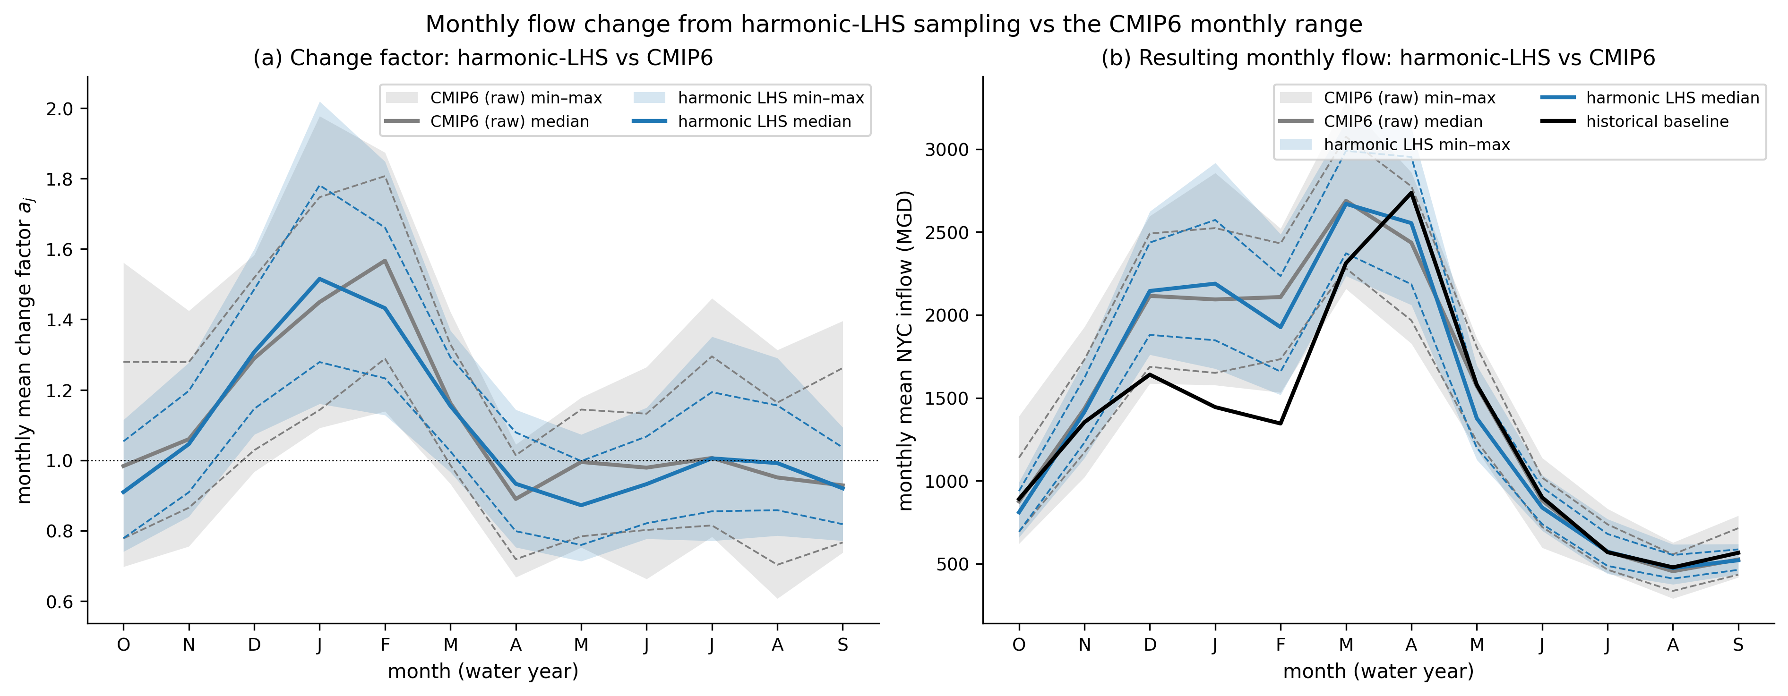
Supplemental: sampled forcing spans the CMIP6 monthly range
Notes:
Sanity check: the sampled change factors and the resulting monthly NYC inflows span the raw CMIP6 monthly range.

Slide 41
Supplemental: Anvil scaling & measured cost surface
Parallelism levers
• nodes · cores per node · MM-Borg islands · workers per island · realizations per simulation
Measured cost (Anvil)
• 173.8 s per evaluation (N = 100, L = 10, trimmed model); full model 1.16×
• ~33,300 SU per 500k-NFE search; full campaign ~415,000 of the 750,000-SU allocation; re-evaluation nearly free
• packing sweep + Borg strong scaling set the production parallel geometry
Notes:
Scaling experiment run on Anvil; sets production parallel geometry and the SU budget that gates campaign scope. Measured cost surface: 173.8 s/eval at N=100, L=10 on the trimmed model; full model 1.16x; ~33,300 SU per 500k-NFE search; full campaign ~415,000 of the 750,000-SU allocation; re-evaluation nearly free.

Slide 42
Planned Manuscript Figure Sequence
(conceptual; details set after the sensitivity experiments)
Notes:
Conceptual figure sequence for the manuscript: guides narrative and the processing/metrics to build. Inspired by the figure sequences of Cohen et al. 2021 (Figs. 2-6), Trindade et al. 2017 (Figs. 5-8), Bonham et al. 2024 (Fig. 1). Details finalized after the sensitivity experiments.

Slide 43
Planned figure sequence (conceptual)
• Fig. 1 System & experiment: the NYC-DRB testbed and the four-stage comparison workflow.
• Fig. 2 Search ensembles in hazard space: what each of the three designs samples from the stationary population.
• Fig. 3 Robustness by design: held-out multivariate satisficing per design and objective (RQ1 headline).
• Fig. 4 Threshold sweep: design robustness vs criterion stringency, with τ_b of the design ranking (the credibility figure).
• Fig. 5 The controlled contrast: fixed_probabilistic vs hazard_filling robustness, with historic as reference.
• Fig. 6 Policy differences: do designs change the policies, not just the scores (RQ1).
• Fig. 7 Mechanism test: failure rate vs coverage deficit, against the random-ensemble null (RQ1).
• Fig. 8 Re-optimized vs current FFMP: objective gains and drought behavior (RQ2).
• Fig. 9 Rule resolution: robustness vs FFMP zone count, ffmp_N (RQ3).
Notes:
One-line map of the planned figures. Figs 1-2 methods; 3-7 RQ1 (headline, threshold stringency, the controlled contrast, policy differences, mechanism); 8 RQ2; 9 RQ3. There is no robustness-vs-regret figure (regret is not computed) and no budget-interaction figure (there is one budget condition). Leave-one-out reference-set hypervolume stays in the supplement, per Zatarain Salazar 2017. Three designs, one stationary population.

Slide 44
Planned Fig. 1: system & experimental design
• shows: the NYC-DRB system (reservoirs, diversion, Decree targets) and the four-stage comparison workflow in one methods figure
• role: orients the reader; every results figure refers back to its stages
style cue: staged workflow figures of Bonham et al. 2024 (Fig. 1) and Cohen et al. 2021 (Fig. 3).
conceptual mockup
(a) system
(b) workflow
Notes:
Panel (a): basin schematic (could be a proper map). Panel (b): the 4-stage GENERATE/BUILD/SEARCH/EVALUATE workflow. Processing needs: none beyond existing diagrams.

Slide 45
Planned Fig. 2: search ensembles in hazard space
• shows: each of the three designs' realized search ensembles over the stationary population's hazard cloud, with coverage statistics (L2-star discrepancy, MST edge spread)
• comparison: what each design actually samples; the visual case for random sampling vs hazard coverage
• role: makes the design tangible before any outcome is shown
processing: hazard image per design draw; discrepancy + spread vs a random design at the same (N, m).
conceptual mockup
historic
fixed prob.
hazard-fill
Notes:
Small multiples, one per design, over the SINGLE stationary population's hazard cloud (there is no shared pool, but all designs share the one population's support). Historic shown as its own trace marker. Processing: hazard coordinates for every staged search ensemble; coverage metrics per draw, reported against the random-design expectation.

Slide 46
Planned Fig. 3: held-out robustness by design (RQ1 headline)
• shows: distributions of re-evaluated multivariate satisficing per design, over K draws × S seeds; univariate panels alongside
• comparison: the RQ1 verdict, with draw-level spread separating design effect from sampling noise
• co-reported: the raw performance distribution of the same objectives (the degeneracy check)
style cue: Cohen et al. 2021 Fig. 5; Gold et al. 2023 Fig. 5 for the co-reported distributions.
conceptual mockup
one panel per objective (7 small multiples)
satisficing
hist
fixp
hz-fill
Notes:
Boxplots (or CDFs) of satisficing robustness per design; hazard-filling highlighted. Processing: per-draw robustness table (design x draw x seed x objective) from the persisted re-eval cube; mixed-effects variance components with the draw as the unit.

Slide 47
Planned Fig. 4: design robustness vs threshold stringency (RQ1)
• shows: each design's held-out robustness across a grid of satisficing criteria, plus Kendall's τ_b of the design ranking vs the default threshold
• comparison: is the design ranking threshold-invariant, or does it flip at the conservative end (Quinn et al. 2020)?
• role: the credibility figure — a single fixed threshold could manufacture or hide the entire result
processing: `threshold_spectrum` re-scores the persisted cube offline; no re-simulation.
conceptual mockup
robustness
hazard-fill
criterion stringency →
(b) τ_b of the design ranking
Notes:
Panel (a): robustness vs stringency, one line per design; hazard-filling accented. Panel (b): tau_b of the design ranking vs the default threshold, across the same grid, with the stability band annotated. Replaces the deleted robustness-vs-regret figure: regret is not computed anywhere in this study.

Slide 48
Planned Fig. 5: the controlled contrast (RQ1)
• shows: re-evaluated robustness distributions for the single contrast fixed_probabilistic vs hazard_filling, with historic as a reference marker
• comparison: the selection-rule effect, read directly — same generator, population, N, L, NFE; only the rule differs
• role: makes the exact-control argument visible rather than asserted
processing: the same per-draw robustness table as Fig. 3, arranged by the contrast.
conceptual mockup
fixed prob.
only the selection RULE differs
hazard-fill
historic shown as a reference line
Notes:
Two stacked robustness distributions: fixed_probabilistic (top) and hazard_filling (bottom), the vertical contrast annotated 'only the selection RULE differs'. historic drawn as a reference line. Replaces the deleted 2x2 population-by-selection and budget-interaction figures: there is one stationary population and one budget condition.

Slide 49
Planned Fig. 6: do designs find different policies? (RQ1)
• shows: re-evaluated objective tradeoffs as parallel coordinates, policies colored by design; compromise policies highlighted
• comparison: composition can move values more than rankings (McPhail et al. 2020); do designs change the decisions, not just the scores?
style cue: Trindade et al. 2017 Fig. 6 (robustness parallel coordinates with highlighted compromises).
conceptual mockup
colored: compromise policies by design
f1
f2
f3
f4
f5
f6
f7
Notes:
Parallel coordinates over the 7 re-evaluated objectives; gray cloud = all policies, colored bundles by design, thick lines = per-design compromise policies. A companion DV-space version (decision-variable ranges per design, Trindade Fig. 8 style) may go in supplement. Processing: re-evaluated objective matrix + archived decision variables per design.

Slide 50
Planned Fig. 7: mechanism test: failure vs coverage deficit (RQ1)
• shows: per design, the held-out failure rate as a function of hazard-space coverage deficit, against a random-ensemble null
• comparison: the falsifiable prediction — hazard-filling's policies should fail in the region its own design under-covered
• caveat drawn on the figure: raw AUC is inflated by geometry, so the verdict is AUC minus the null, never raw AUC
processing: boosted-tree scenario discovery in hazard space (Gold et al. 2022, 2023 configuration); null from random ensembles at the same (N, m).
conceptual mockup
hazard-fill
failure rate
random null
hazard-space coverage deficit →
Notes:
Panel (a): failure rate vs coverage deficit, one curve per design, with the random-ensemble null shaded. Panel (b): AUC minus null, per design, with a CI. Replaces the old coverage-vs-robustness scatter, which was correlational; this is the mechanism test.

Slide 51
Planned Fig. 8: re-optimized vs current FFMP (RQ2)
• shows: (a) objective-by-objective change vs the current FFMP baseline on the test ensemble; (b) storage / Montague flow through a drought-of-record-scale event
• comparison: Pareto-approximate policies vs the status-quo baseline — the same fixed external reference used by the improvement-over-status-quo metric
processing: baseline FFMP re-evaluation (workflow step 05); event extraction from test scenarios; policy simulation traces.
conceptual mockup
(a) change vs FFMP
(b) drought event
f1
f2
f3
f4
f5
f6
f7
storage: current (rust) vs re-optimized
Notes:
Panel (a): horizontal bars of change vs baseline per objective (improvement right). Panel (b): time series through a severe drought, current FFMP vs a compromise re-optimized policy, drought window shaded. Processing: current-FFMP run on E_test; trace storage for selected policies and events.

Slide 52
Planned Fig. 9: rule resolution, ffmp_N (RQ3)
• shows: re-evaluated robustness vs FFMP storage-zone resolution N, including the 24-parameter standard
• comparison: is added rule resolution worth its larger search space?
processing: the ffmp_N campaign runs; same re-evaluation post-processing as RQ1. Per-design (never pooled) reference sets if a search metric is shown.
conceptual mockup
held-out satisficing, per rule resolution
satisficing
8
10
12
std
FFMP storage-zone resolution
Notes:
Dot-line plot: x = rule resolution (8, 10, 12, standard), y = re-evaluated satisficing. Any MOEA search metric (hypervolume) is a WITHIN-design convergence diagnostic only, per Zatarain Salazar 2017; it is not a cross-design yardstick. Processing: ffmp_N sweep under the chosen design(s), re-evaluated on E_test.

