Slide 1
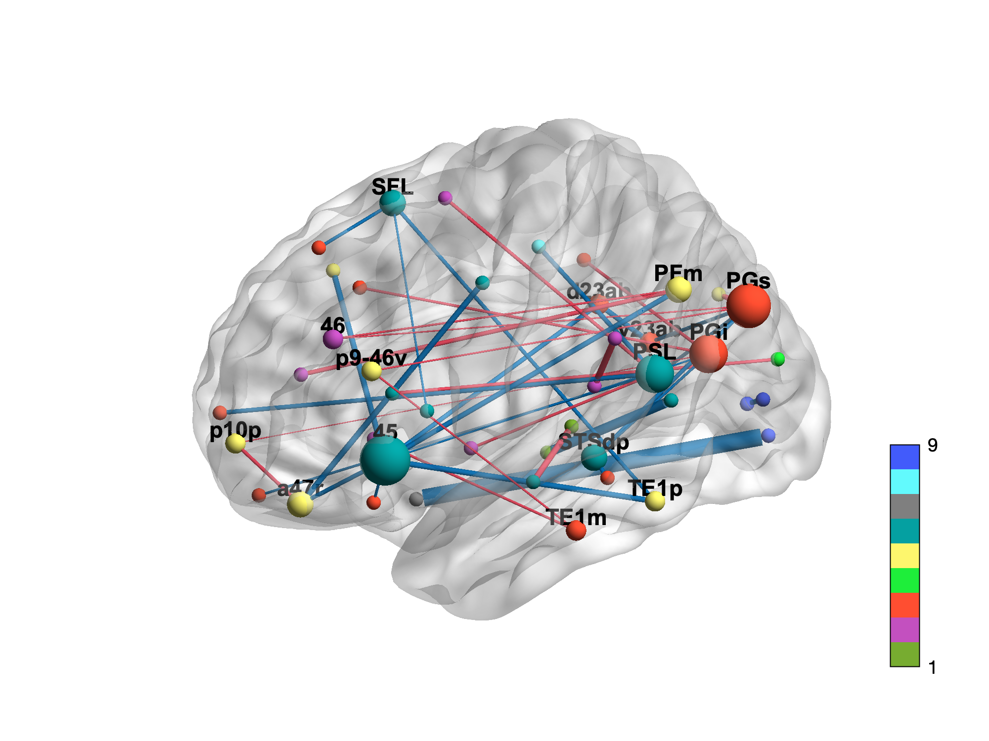
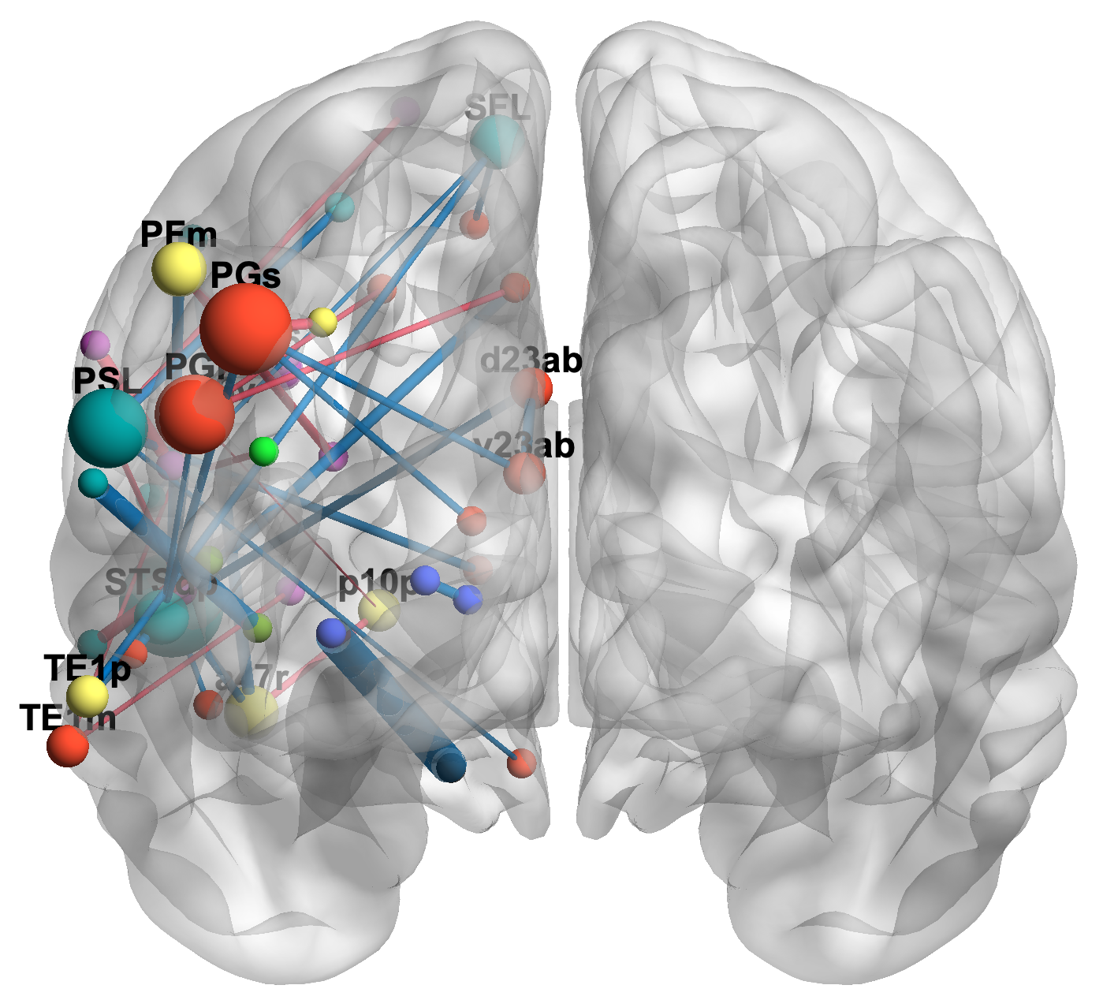
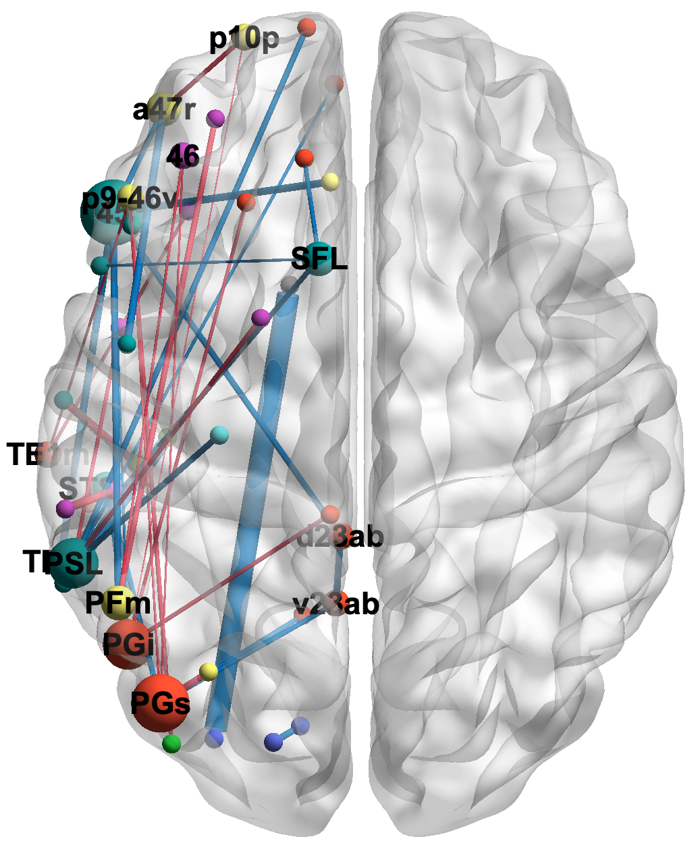
Networks
Auditory
Cingulo-Opercular
Default
Dorsal Attention
Frontoparietal
Language
Orbito-Affective
Somatomotor
Visual
Degree
Edge strength
Edge sign
0.05
Positive
1
0.27
Negative
7
Notes:
t

