Slide 1
Queues
Presentation for use with the textbook Data Structures and Algorithms in Java, 6th edition, by M. T. Goodrich, R. Tamassia, and M. H. Goldwasser, Wiley, 2014

Slide 2
The Queue ADT
The Queue ADT stores arbitrary objects
Insertions and deletions follow the first-in first-out scheme
Insertions are at the rear of the queue and removals are at the front of the queue
Main queue operations:
enqueue(object): inserts an element at the end of the queue
object dequeue(): removes and returns the element at the front of the queue
Auxiliary queue operations:
object first(): returns the element at the front without removing it
integer size(): returns the number of elements stored
boolean isEmpty(): indicates whether no elements are stored
Boundary cases:
Attempting the execution of dequeue or first on an empty queue returns null

Slide 3
Example
Operation Output Q
enqueue(5) – (5)
enqueue(3) – (5, 3)
dequeue() 5 (3)
enqueue(7) – (3, 7)
dequeue() 3 (7)
first() 7 (7)
dequeue() 7 ()
dequeue() null ()
isEmpty() true ()
enqueue(9) – (9)
enqueue(7) – (9, 7)
size() 2 (9, 7)
enqueue(3) – (9, 7, 3)
enqueue(5) – (9, 7, 3, 5)
dequeue() 9 (7, 3, 5)

Slide 4
Applications of Queues
Direct applications
Waiting lists, bureaucracy
Access to shared resources (e.g., printer)
Multiprogramming
Indirect applications
Auxiliary data structure for algorithms
Component of other data structures

Slide 5
Array-based Queue
Use an array of size N in a circular fashion
Two variables keep track of the front and size
f index of the front element
sz number of stored elements
When the queue has fewer than N elements, array location r = (f + sz) mod N is the first empty slot past the rear of the queue
normal configuration
Q
0
1
2
f
r
wrapped-around configuration
Q
0
1
2
r
f

Slide 6
Queue Operations
We use the modulo operator (remainder of division)
Algorithm size()
return sz
Algorithm isEmpty()
return (sz == 0)
Q
0
1
2
f
r
Q
0
1
2
r
f

Slide 7
Queue Operations (cont.)
Operation enqueue throws an exception if the array is full
This exception is implementation-dependent
Algorithm enqueue(o)
if size() = N − 1 then
throw IllegalStateException
else
r ← (f + sz) mod N
Q[r] ← o
sz ← (sz + 1)
Q
0
1
2
f
r
Q
0
1
2
r
f

Slide 8
Queue Operations (cont.)
Note that operation dequeue returns null if the queue is empty
Algorithm dequeue()
if isEmpty() then
return null
else
o ← Q[f]
f ← (f + 1) mod N
sz ← (sz − 1)
return o
Q
0
1
2
f
r
Q
0
1
2
r
f

Slide 9
Queue Interface in Java
Java interface corresponding to our Queue ADT
Assumes that first() and dequeue() return null if queue is empty
public interface Queue<E> {
int size();
boolean isEmpty();
E first();
void enqueue(E e);
E dequeue(); }

Slide 10
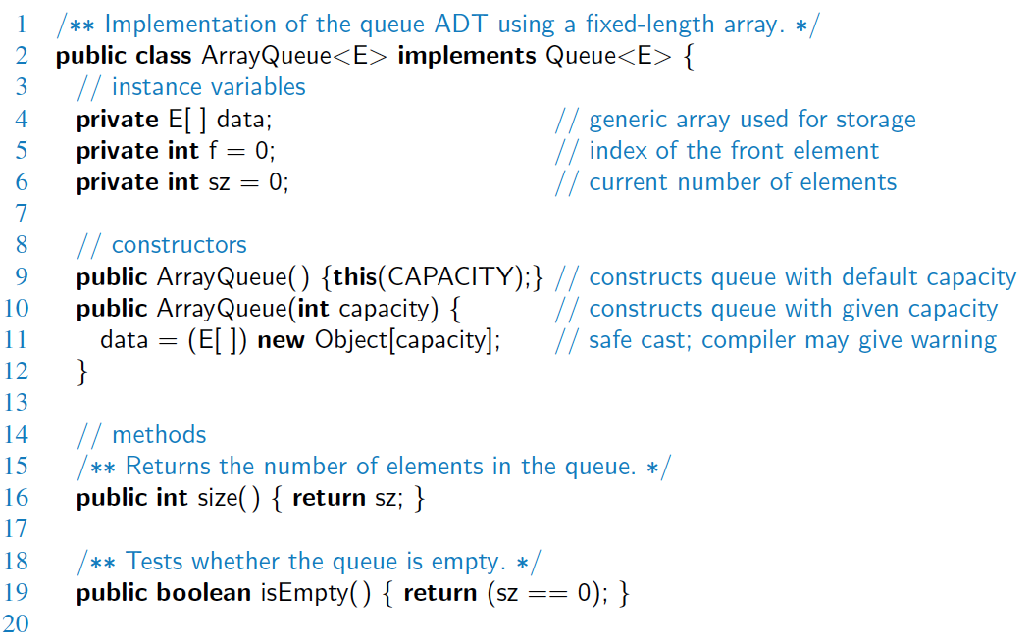
Array-based Implementation

Slide 11
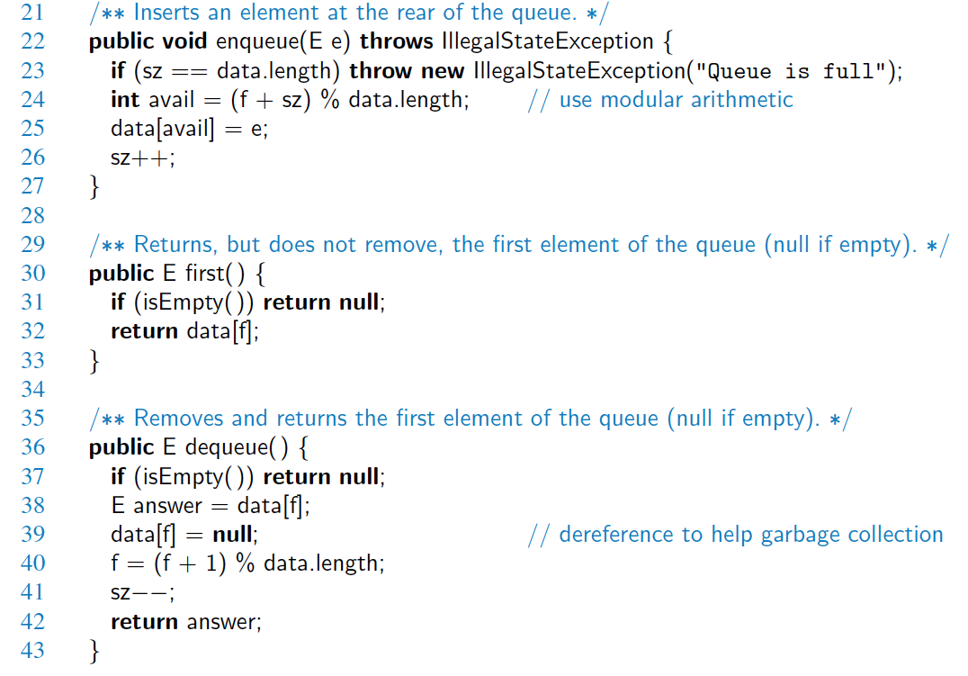
Array-based Implementation (2)

Slide 12
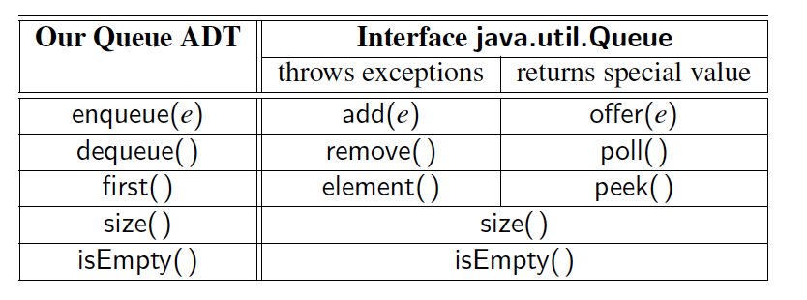
Comparison to java.util.Queue
Our Queue methods and corresponding methods of java.util.Queue:

Slide 13
Application: Round Robin Schedulers
We can implement a round robin scheduler using a queue Q by repeatedly performing the following steps:
e = Q.dequeue()
Service element e
Q.enqueue(e)
Queue
Dequeue
Enqueue
Shared Service

