Slide 1
Trees
Presentation for use with the textbook Data Structures and Algorithms in Java, 6th edition, by M. T. Goodrich, R. Tamassia, and M. H. Goldwasser, Wiley, 2014
Mammal
Dog
Pig
Cat

Slide 2
What is a Tree
In computer science, a tree is an abstract model of a hierarchical structure
A tree consists of nodes with a parent-child relation
Applications:
Organization charts
File systems
Programming environments
Computers”R”Us
Sales
Manufacturing
R&D
US
International
Laptops
Desktops
Europe
Asia
Canada

Slide 3
Tree Terminology
Root: node without parent (A)
Internal node: node with at least one child (A, B, C, F)
External node (a.k.a. leaf ): node without children (E, I, J, K, G, H, D)
Ancestors of a node: parent, grandparent, grand-grandparent, etc.
Depth of a node: number of ancestors
Height of a tree: maximum depth of any node (3)
Descendant of a node: child, grandchild, grand-grandchild, etc.
Subtree: tree consisting of a node and its descendants
A
subtree
B
C
D
E
F
G
H
I
J
K

Slide 4
Tree ADT
We use positions to abstract nodes
Generic methods:
integer size()
boolean isEmpty()
Iterator iterator()
Iterable positions()
Accessor methods:
position root()
position parent(p)
Iterable children(p)
Integer numChildren(p)
Query methods:
boolean isInternal(p)
boolean isExternal(p)
boolean isRoot(p)
Additional update methods may be defined by data structures implementing the Tree ADT

Slide 5
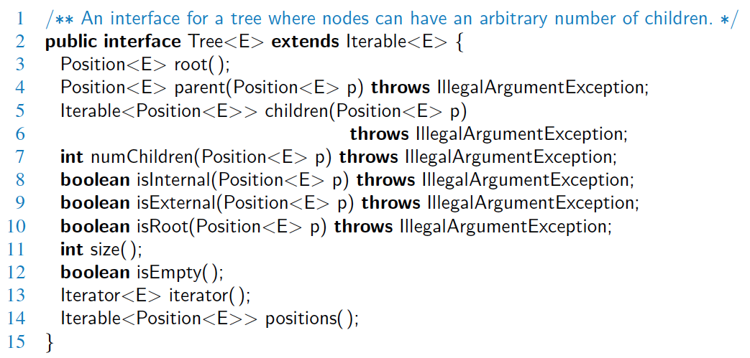
Java Interface
Methods for a Tree interface:

Slide 6
Preorder Traversal
A traversal visits the nodes of a tree in a systematic manner
In a preorder traversal, a node is visited before its descendants
Application: print a structured document
Algorithm preOrder(v)
visit(v)
for each child w of v
preorder (w)
1
Make Money Fast!
2
5
9
1. Motivations
2. Methods
References
3
4
6
7
8
1.1 Greed
1.2 Avidity
2.1 Stock Fraud
2.2 Ponzi Scheme
2.3 Bank Robbery

Slide 7
Postorder Traversal
In a postorder traversal, a node is visited after its descendants
Application: compute space used by files in a directory and its subdirectories
Algorithm postOrder(v)
for each child w of v
postOrder (w)
visit(v)
9
cs16/
8
3
7
homeworks/
programs/
todo.txt 1K
1
2
4
5
6
h1c.doc 3K
h1nc.doc 2K
DDR.java 10K
Stocks.java 25K
Robot.java 20K

Slide 8
Binary Trees
A binary tree is a tree with the following properties:
Each internal node has at most two children (exactly two for proper binary trees)
The children of a node are an ordered pair
We call the children of an internal node left child and right child
Alternative recursive definition: a binary tree is either
a tree consisting of a single node, or
a tree whose root has an ordered pair of children, each of which is a binary tree
Applications:
arithmetic expressions
decision processes
searching
A
B
C
D
E
F
G
H
I

Slide 9
Arithmetic Expression Tree
Binary tree associated with an arithmetic expression
internal nodes: operators
external nodes: operands
Example: arithmetic expression tree for the expression (2 × (a − 1) + (3 × b))
+
×
×
2
−
3
b
a
1

Slide 10
Decision Tree
Binary tree associated with a decision process
internal nodes: questions with yes/no answer
external nodes: decisions
Example: dining decision
Want a fast meal?
Yes
No
How about coffee?
On expense account?
Yes
No
Yes
No
Starbucks
Chipotle
Gracie’s
Café Paragon

Slide 11
Properties of Proper Binary Trees
Notation
n number of nodes
e number of external nodes
i number of internal nodes
h height
Properties:
e = i + 1
n = 2e − 1
h ≤ i
h ≤ (n − 1)/2
e ≤ 2^{h}
h ≥ log₂ e
h ≥ log₂ (n + 1) − 1

Slide 12
BinaryTree ADT
The BinaryTree ADT extends the Tree ADT, i.e., it inherits all the methods of the Tree ADT
Additional methods:
position left(p)
position right(p)
position sibling(p)
The above methods return null when there is no left, right, or sibling of p, respectively
Update methods may be defined by data structures implementing the BinaryTree ADT

Slide 13
Inorder Traversal
In an inorder traversal a node is visited after its left subtree and before its right subtree
Application: draw a binary tree
x(v) = inorder rank of v
y(v) = depth of v
Algorithm inOrder(v)
if left (v) ≠ null
inOrder (left (v))
visit(v)
if right(v) ≠ null
inOrder (right (v))
6
2
8
1
4
7
9
3
5

Slide 14
Print Arithmetic Expressions
Specialization of an inorder traversal
print operand or operator when visiting node
print “(“ before traversing left subtree
print “)“ after traversing right subtree
Algorithm printExpression(v)
if left (v) ≠ null print(“(’’)
inOrder (left(v))
print(v.element ())
if right(v) ≠ null
inOrder (right(v))
print (“)’’)
+
×
×
2
−
3
b
((2 × (a − 1)) + (3 × b))
a
1

Slide 15
Evaluate Arithmetic Expressions
Specialization of a postorder traversal
recursive method returning the value of a subtree
when visiting an internal node, combine the values of the subtrees
Algorithm evalExpr(v)
if isExternal (v)
return v.element ()
else
x ← evalExpr(left(v))
y ← evalExpr(right(v))
◊ ← operator stored at v
return x ◊ y
+
×
×
2
−
3
2
5
1

Slide 16
Euler Tour Traversal
Generic traversal of a binary tree
Includes a special cases the preorder, postorder and inorder traversals
Walk around the tree and visit each node three times:
on the left (preorder)
from below (inorder)
on the right (postorder)
+
L
×
R
×
B
2
−
3
2
5
1

Slide 17
Linked Structure for Trees
A node is represented by an object storing
Element
Parent node
Sequence of children nodes
Node objects implement the Position ADT
∅
B
∅
∅
A
D
F
B
A
D
F
C
E
∅
∅
C
E

Slide 18
Linked Structure for Binary Trees
A node is represented by an object storing
Element
Parent node
Left child node
Right child node
Node objects implement the Position ADT
∅
B
∅
∅
B
A
D
A
D
∅
∅
∅
∅
C
E
C
E

Slide 19
Array-Based Representation of Binary Trees
Nodes are stored in an array A
0
A
A
B
D
…
G
H
…
1
2
0
1
2
9
10
B
D
Node v is stored at A[rank(v)]
rank(root) = 0
if node is the left child of parent(node), rank(node) = 2 ⋅ rank(parent(node)) + 1
if node is the right child of parent(node), rank(node) = 2 ⋅ rank(parent(node)) + 2
3
4
5
6
E
F
C
J
9
10
G
H

