Slide 1
Adaptable Priority Queues
Presentation for use with the textbook Data Structures and Algorithms in Java, 6th edition, by M. T. Goodrich, R. Tamassia, and M. H. Goldwasser, Wiley, 2014
3
a
5
g
4
e

Slide 2
Entry and Priority Queue ADTs
An entry stores a (key, value) pair
Entry ADT methods:
getKey(): returns the key associated with this entry
getValue(): returns the value paired with the key associated with this entry
Priority Queue ADT:
insert(k, x) inserts an entry with key k and value x
removeMin() removes and returns the entry with smallest key
min() returns, but does not remove, an entry with smallest key
size(), isEmpty()

Slide 3

Example
Online trading system where orders to purchase and sell a stock are stored in two priority queues (one for sell orders and one for buy orders) as (p,s) entries:
The key, p, of an order is the price
The value, s, for an entry is the number of shares
A buy order (p,s) is executed when a sell order (p’,s’) with price p’<p is added (the execution is complete if s’>s)
A sell order (p,s) is executed when a buy order (p’,s’) with price p’>p is added (the execution is complete if s’>s)
What if someone wishes to cancel their order before it executes?
What if someone wishes to update the price or number of shares for their order?

Slide 4
Methods of the Adaptable Priority Queue ADT
remove(e): Remove from P and return entry e.
replaceKey(e,k): Replace with k and return the key of entry e of P; an error condition occurs if k is invalid (that is, k cannot be compared with other keys).
replaceValue(e,v): Replace with v and return the value of entry e of P.

Slide 5
Example
Operation Output P
insert(5,A) e₁ (5,A)
insert(3,B) e₂ (3,B),(5,A)
insert(7,C) e₃ (3,B),(5,A),(7,C)
min() e₂ (3,B),(5,A),(7,C)
key(e₂) 3 (3,B),(5,A),(7,C)
remove(e₁) e₁ (3,B),(7,C)
replaceKey(e₂,9) 3 (7,C),(9,B)
replaceValue(e₃,D) C (7,D),(9,B)
remove(e₂) e₂ (7,D)

Slide 6
Locating Entries
In order to implement the operations remove(e), replaceKey(e,k), and replaceValue(e,v), we need fast ways of locating an entry e in a priority queue.
We can always just search the entire data structure to find an entry e, but there are better ways for locating entries.

Slide 7
Location-Aware Entries
A location-aware entry identifies and tracks the location of its (key, value) object within a data structure
Intuitive notion:
Coat claim check
Valet claim ticket
Reservation number
Main idea:
Since entries are created and returned from the data structure itself, it can return location-aware entries, thereby making future updates easier

Slide 8
List Implementation
A location-aware list entry is an object storing
key
value
position (or rank) of the item in the list
In turn, the position (or array cell) stores the entry
Back pointers (or ranks) are updated during swaps
header
nodes/positions
trailer
2
c
4
c
5
c
8
c
entries

Slide 9
Heap Implementation
A location-aware heap entry is an object storing
key
value
position of the entry in the underlying heap
In turn, each heap position stores an entry
Back pointers are updated during entry swaps
2
d
4
a
6
b
8
g
5
e
9
c

Slide 10
Performance
Improved times thanks to location-aware entries are highlighted in red
Method Unsorted List Sorted List Heap
size, isEmpty O(1) O(1) O(1)
insert O(1) O(n) O(log n)
min O(n) O(1) O(1)
removeMin O(n) O(1) O(log n)
remove O(1) O(1) O(log n)
replaceKey O(1) O(n) O(log n)
replaceValue O(1) O(1) O(1)

Slide 11
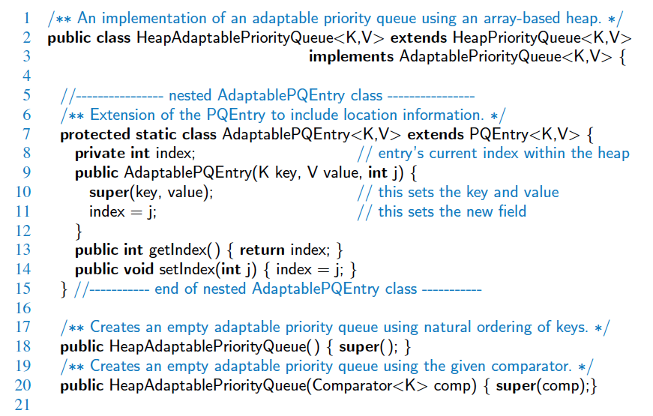
Java Implementation

Slide 12
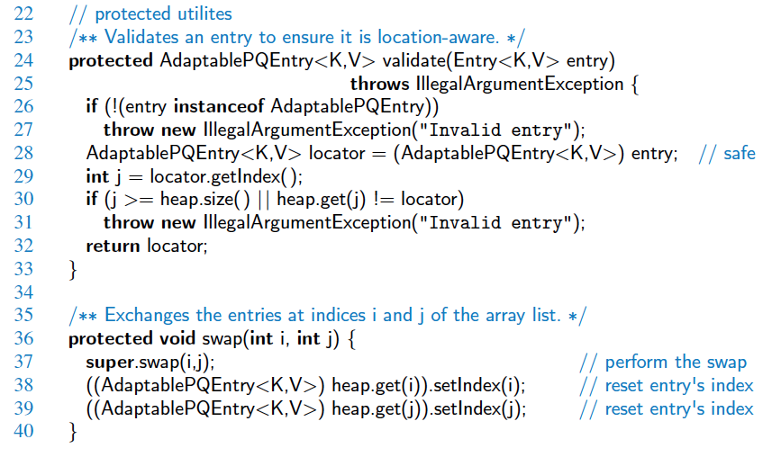
Java Implementation, 2

Slide 13
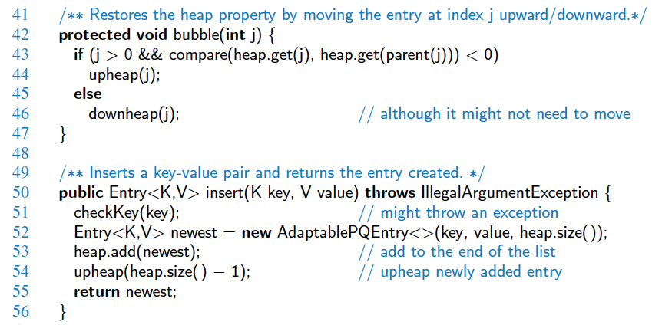
Java Implementation, 3

Slide 14
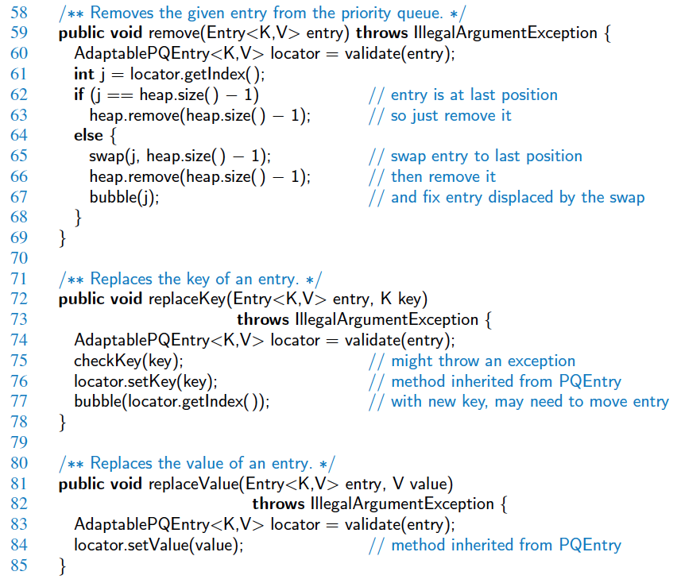
Java Implementation, 4

