Slide 1
Heaps
Presentation for use with the textbook Data Structures and Algorithms in Java, 6th edition, by M. T. Goodrich, R. Tamassia, and M. H. Goldwasser, Wiley, 2014
2
5
6
9
7

Slide 2
Recall Priority Queue ADT
A priority queue stores a collection of entries
Each entry is a pair (key, value)
Main methods of the Priority Queue ADT
insert(k, v) inserts an entry with key k and value v
removeMin() removes and returns the entry with smallest key
Additional methods
min() returns, but does not remove, an entry with smallest key
size(), isEmpty()
Applications:
Standby flyers
Auctions
Stock market

Slide 3

Recall PQ Sorting
We use a priority queue
Insert the elements with a series of insert operations
Remove the elements in sorted order with a series of removeMin operations
The running time depends on the priority queue implementation:
Unsorted sequence gives selection-sort: O(n²) time
Sorted sequence gives insertion-sort: O(n²) time
Can we do better?
Algorithm PQ-Sort(S, C)
Input sequence S, comparator C for the elements of S
Output sequence S sorted in increasing order according to C
P ← priority queue with comparator C
while ¬S.isEmpty ()
e ← S.remove (S. first ())
P.insert (e, e)
while ¬P.isEmpty()
e ← P.removeMin().getKey()
S.addLast(e)

Slide 4
Heaps
A heap is a binary tree storing keys at its nodes and satisfying the following properties:
Heap-Order: for every internal node v other than the root, key(v) ≥ key(parent(v))
Complete Binary Tree: let h be the height of the heap
for i = 0, … , h − 1, there are 2^{i} nodes of depth i
at depth h − 1, the internal nodes are to the left of the external nodes
The last node of a heap is the rightmost node of maximum depth
2
5
6
9
7
last node

Slide 5
Height of a Heap
Theorem: A heap storing n keys has height O(log n)
Proof: (we apply the complete binary tree property)
Let h be the height of a heap storing n keys
Since there are 2^{i} keys at depth i = 0, … , h − 1 and at least one key at depth h, we have n ≥ 1 + 2 + 4 + … + 2^{h−1} + 1
Thus, n ≥ 2^{h} , i.e., h ≤ log n
depth
keys
0
1
1
2
h−1
2^{h−1}
h
1

Slide 6
Heaps and Priority Queues
We can use a heap to implement a priority queue
We store a (key, element) item at each internal node
We keep track of the position of the last node
(2, Sue)
(5, Pat)
(6, Mark)
(9, Jeff)
(7, Anna)

Slide 7
Insertion into a Heap
Method insertItem of the priority queue ADT corresponds to the insertion of a key k to the heap
The insertion algorithm consists of three steps
Find the insertion node z (the new last node)
Store k at z
Restore the heap-order property (discussed next)
2
5
z
6
9
7
insertion node
2
5
6
z
9
7
1

Slide 8
Upheap
After the insertion of a new key k, the heap-order property may be violated
Algorithm upheap restores the heap-order property by swapping k along an upward path from the insertion node
Upheap terminates when the key k reaches the root or a node whose parent has a key smaller than or equal to k
Since a heap has height O(log n), upheap runs in O(log n) time
2
1
5
1
5
2
z
z
9
7
6
9
7
6

Slide 9
Removal from a Heap
Method removeMin of the priority queue ADT corresponds to the removal of the root key from the heap
The removal algorithm consists of three steps
Replace the root key with the key of the last node w
Remove w
Restore the heap-order property (discussed next)
2
5
6
w
9
7
last node
7
5
w
6
9
new last node

Slide 10
Downheap
After replacing the root key with the key k of the last node, the heap-order property may be violated
Algorithm downheap restores the heap-order property by swapping key k along a downward path from the root
Upheap terminates when key k reaches a leaf or a node whose children have keys greater than or equal to k
Since a heap has height O(log n), downheap runs in O(log n) time
7
5
5
w
6
7
w
6
9
9

Slide 11
Updating the Last Node
The insertion node can be found by traversing a path of O(log n) nodes
Go up until a left child or the root is reached
If a left child is reached, go to the right child
Go down left until a leaf is reached
Similar algorithm for updating the last node after a removal

Slide 12
Heap-Sort
Consider a priority queue with n items implemented by means of a heap
the space used is O(n)
methods insert and removeMin take O(log n) time
methods size, isEmpty, and min take time O(1) time
Using a heap-based priority queue, we can sort a sequence of n elements in O(n log n) time
The resulting algorithm is called heap-sort
Heap-sort is much faster than quadratic sorting algorithms, such as insertion-sort and selection-sort

Slide 13
Array-based Heap Implementation
We can represent a heap with n keys by means of an array of length n
For the node at rank i
the left child is at rank 2i + 1
the right child is at rank 2i + 2
Links between nodes are not explicitly stored
Operation add corresponds to inserting at rank n + 1
Operation remove_min corresponds to removing at rank n
Yields in-place heap-sort
2
5
6
9
7
2
5
6
9
7
0
1
2
3
4

Slide 14
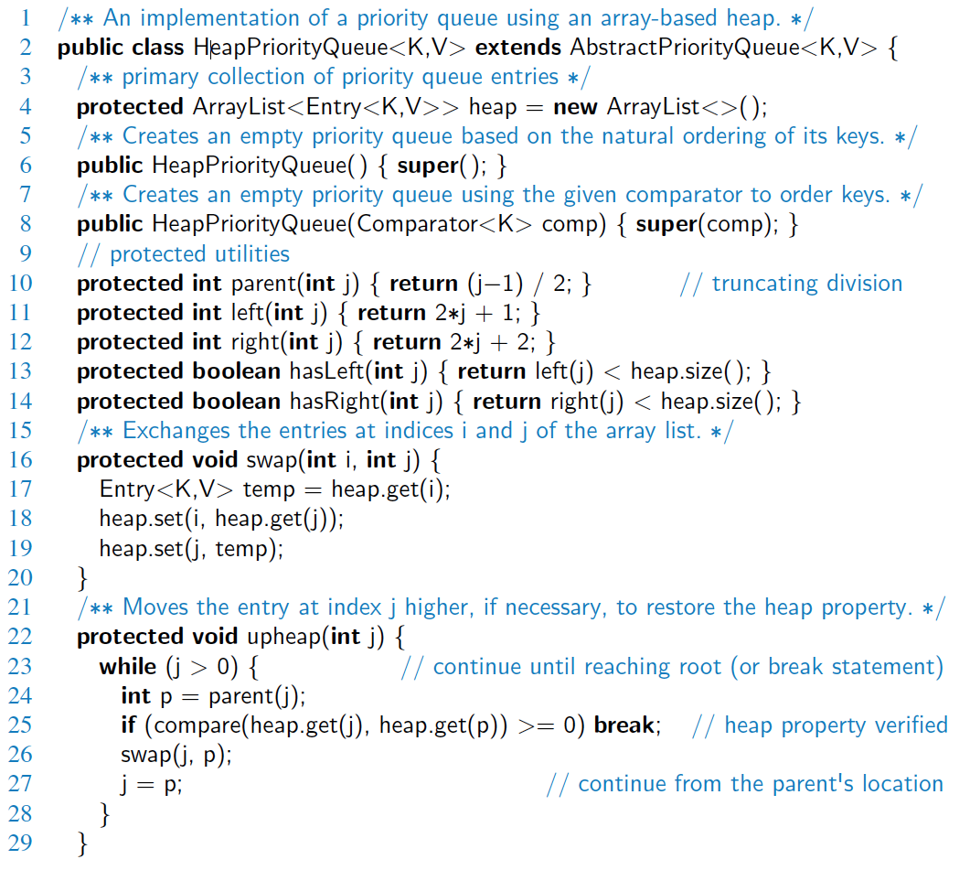
Java Implementation

Slide 15
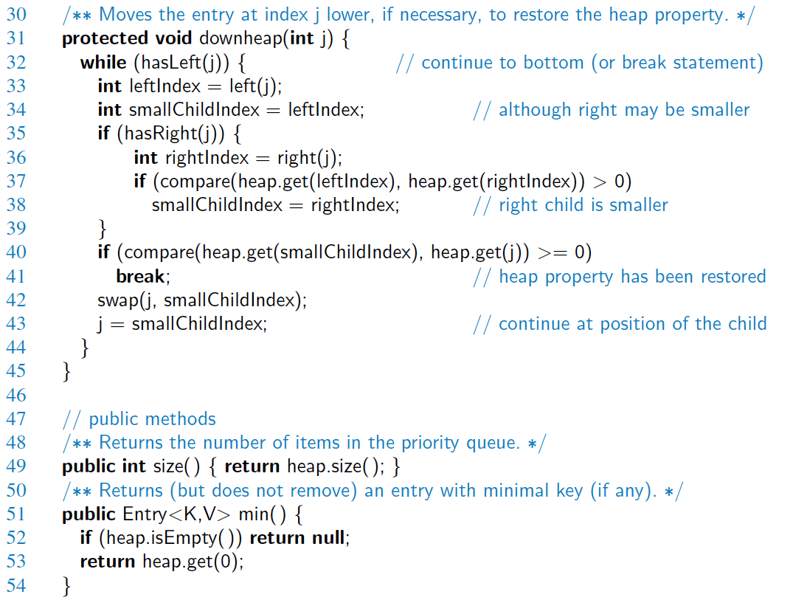
Java Implementation, 2

Slide 16
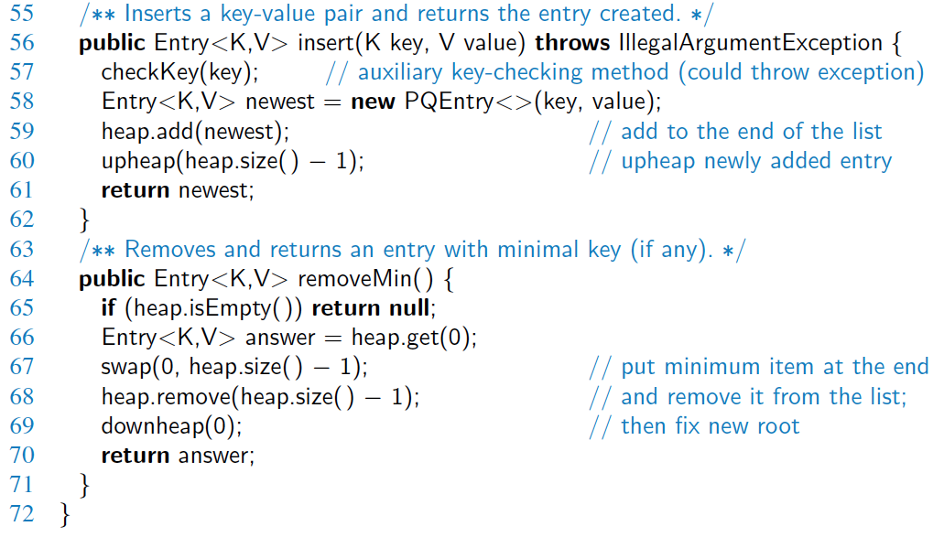
Java Implementation, 3

Slide 17
Merging Two Heaps
We are given two two heaps and a key k
We create a new heap with the root node storing k and with the two heaps as subtrees
We perform downheap to restore the heap-order property
3
2
8
5
4
6
7
3
2
8
5
4
6
2
3
4
8
5
7
6

Slide 18
Bottom-up Heap Construction
We can construct a heap storing n given keys in using a bottom-up construction with log n phases
In phase i, pairs of heaps with 2^{i} −1 keys are merged into heaps with 2^{i+1}−1 keys
2^{i} −1
2^{i} −1
2^{i+1}−1

Slide 19
Example
16
15
4
12
6
7
23
20
25
5
11
27
16
15
4
12
6
7
23
20

Slide 20
Example (contd.)
25
5
11
27
16
15
4
12
6
9
23
20
15
4
6
23
16
25
5
12
11
9
27
20

Slide 21
Example (contd.)
7
8
15
4
6
23
16
25
5
12
11
9
27
20
4
6
15
5
8
23
16
25
7
12
11
9
27
20

Slide 22
Example (end)
10
4
6
15
5
8
23
16
25
7
12
11
9
27
20
4
5
6
15
7
8
23
16
25
10
12
11
9
27
20

Slide 23
Analysis
We visualize the worst-case time of a downheap with a proxy path that goes first right and then repeatedly goes left until the bottom of the heap (this path may differ from the actual downheap path)
Since each node is traversed by at most two proxy paths, the total number of nodes of the proxy paths is O(n)
Thus, bottom-up heap construction runs in O(n) time
Bottom-up heap construction is faster than n successive insertions and speeds up the first phase of heap-sort

