Slide 1
Hash Tables
Presentation for use with the textbook Data Structures and Algorithms in Java, 6th edition, by M. T. Goodrich, R. Tamassia, and M. H. Goldwasser, Wiley, 2014
0
∅
1
025-612-0001
2
981-101-0002
3
∅
4
451-229-0004

Slide 2

Recall the Map ADT
get(k): if the map M has an entry with key k, return its associated value; else, return null
put(k, v): insert entry (k, v) into the map M; if key k is not already in M, then return null; else, return old value associated with k
remove(k): if the map M has an entry with key k, remove it from M and return its associated value; else, return null
size(), isEmpty()
entrySet(): return an iterable collection of the entries in M
keySet(): return an iterable collection of the keys in M
values(): return an iterator of the values in M

Slide 3

Intuitive Notion of a Map
Intuitively, a map M supports the abstraction of using keys as indices with a syntax such as M[k].
As a mental warm-up, consider a restricted setting in which a map with n items uses keys that are known to be integers in a range from 0 to N − 1, for some N ≥ n.

Slide 4
More General Kinds of Keys
But what should we do if our keys are not integers in the range from 0 to N – 1?
Use a hash function to map general keys to corresponding indices in a table.
For instance, the last four digits of a Social Security number.
0
∅
1
025-612-0001
2
981-101-0002
3
∅
4
451-229-0004
…

Slide 5
Hash Functions and Hash Tables
A hash function h maps keys of a given type to integers in a fixed interval [0, N − 1]
Example: h(x) = x mod N is a hash function for integer keys
The integer h(x) is called the hash value of key x
A hash table for a given key type consists of
Hash function h
Array (called table) of size N
When implementing a map with a hash table, the goal is to store item (k, o) at index i = h(k)

Slide 6
Example
We design a hash table for a map storing entries as (SSN, Name), where SSN (social security number) is a nine-digit positive integer
Our hash table uses an array of size N = 10,000 and the hash function h(x) = last four digits of x
0
∅
1
025-612-0001
2
981-101-0002
3
∅
4
451-229-0004
…
9997
∅
9998
200-751-9998
9999
∅

Slide 7
Hash Functions
A hash function is usually specified as the composition of two functions:
Hash code: h₁: keys → integers
Compression function: h₂: integers → [0, N − 1]
The hash code is applied first, and the compression function is applied next on the result, i.e., h(x) = h₂(h₁(x))
The goal of the hash function is to “disperse” the keys in an apparently random way

Slide 8
Hash Codes
Memory address:
We reinterpret the memory address of the key object as an integer (default hash code of all Java objects)
Good in general, except for numeric and string keys
Integer cast:
We reinterpret the bits of the key as an integer
Suitable for keys of length less than or equal to the number of bits of the integer type (e.g., byte, short, int and float in Java)
Component sum:
We partition the bits of the key into components of fixed length (e.g., 16 or 32 bits) and we sum the components (ignoring overflows)
Suitable for numeric keys of fixed length greater than or equal to the number of bits of the integer type (e.g., long and double in Java)

Slide 9
Hash Codes (cont.)
Polynomial accumulation:
We partition the bits of the key into a sequence of components of fixed length (e.g., 8, 16 or 32 bits) a₀ a₁ … a_{n−1}
We evaluate the polynomial
p(z) = a₀ + a₁ z + a₂ z² + … … + a_{n−1}z^{n−1}
at a fixed value z, ignoring overflows
Especially suitable for strings (e.g., the choice z = 33 gives at most 6 collisions on a set of 50,000 English words)
Polynomial p(z) can be evaluated in O(n) time using Horner’s rule:
The following polynomials are successively computed, each from the previous one in O(1) time
p₀(z) = a_{n−1}
p_{i} (z) = a_{n−i−1} + zp_{i−1}(z) (i = 1, 2, …, n −1)
We have p(z) = p_{n−1}(z)

Slide 10
Compression Functions
Division:
h₂ (y) = y mod N
The size N of the hash table is usually chosen to be a prime
The reason has to do with number theory and is beyond the scope of this course
Multiply, Add and Divide (MAD):
h₂ (y) = (ay + b) mod N
a and b are nonnegative integers such that a mod N ≠ 0
Otherwise, every integer would map to the same value b

Slide 11
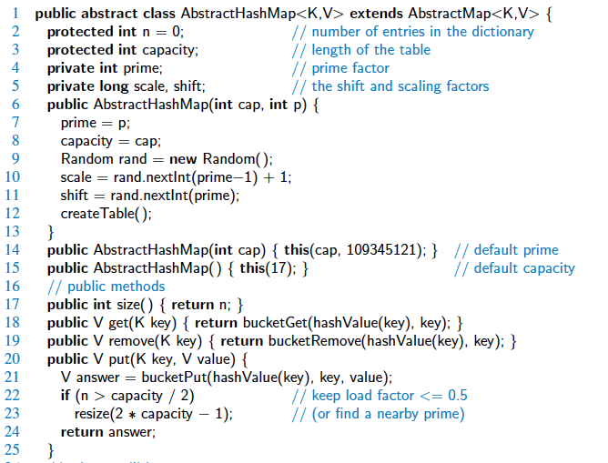
Abstract Hash Map in Java

Slide 12
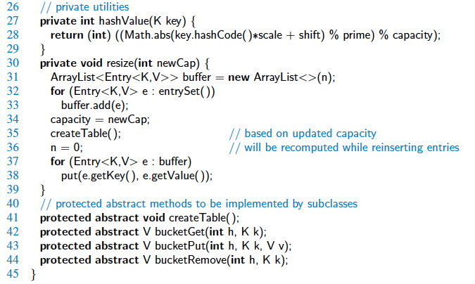
Abstract Hash Map in Java, 2

Slide 13
Collision Handling
Collisions occur when different elements are mapped to the same cell
Separate Chaining: let each cell in the table point to a linked list of entries that map there
0
∅
1
025-612-0001
2
∅
3
∅
4
451-229-0004
981-101-0004
Separate chaining is simple, but requires additional memory outside the table

Slide 14
Map with Separate Chaining
Delegate operations to a list-based map at each cell:
Algorithm get(k):
return A[h(k)].get(k)
Algorithm put(k,v):
t = A[h(k)].put(k,v)
if t = null then {k is a new key}
n = n + 1
return t
Algorithm remove(k):
t = A[h(k)].remove(k)
if t ≠ null then {k was found}
n = n - 1
return t

Slide 15
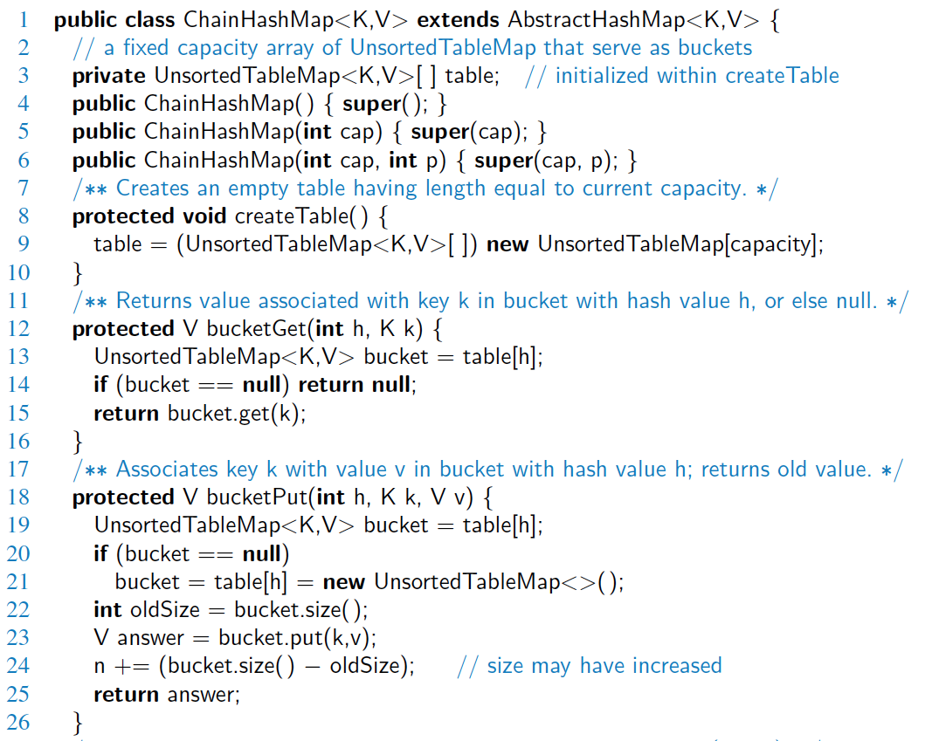
Hash Table with Chaining

Slide 16
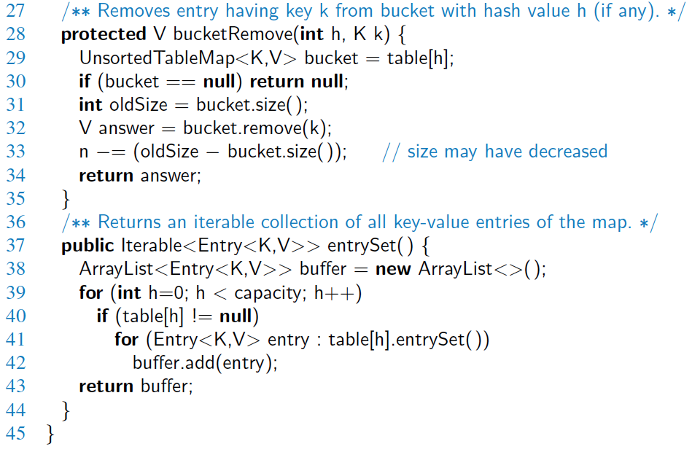
Hash Table with Chaining, 2

Slide 17
Linear Probing
Open addressing: the colliding item is placed in a different cell of the table
Linear probing: handles collisions by placing the colliding item in the next (circularly) available table cell
Each table cell inspected is referred to as a “probe”
Colliding items lump together, causing future collisions to cause a longer sequence of probes
Example:
h(x) = x mod 13
Insert keys 18, 41, 22, 44, 59, 32, 31, 73, in this order
0
1
2
3
4
5
6
7
8
9
10
11
12
41
18
44
59
32
22
31
73
0
1
2
3
4
5
6
7
8
9
10
11
12

Slide 18
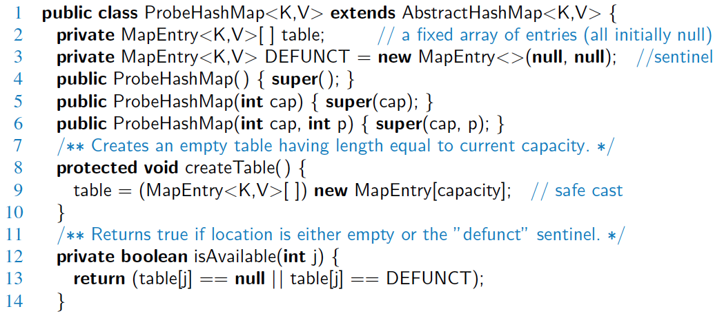
Probe Hash Map in Java

Slide 19
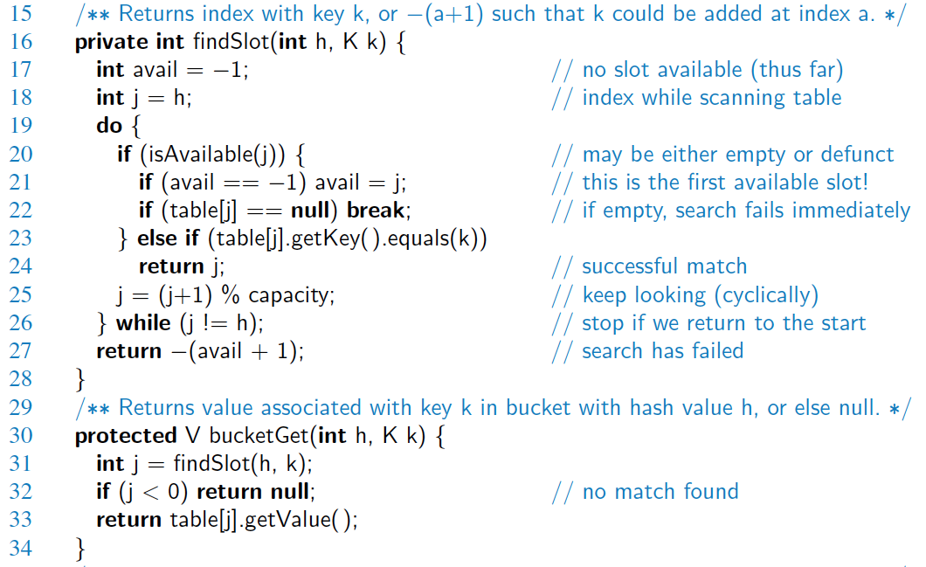
Probe Hash Map in Java, 2

Slide 20
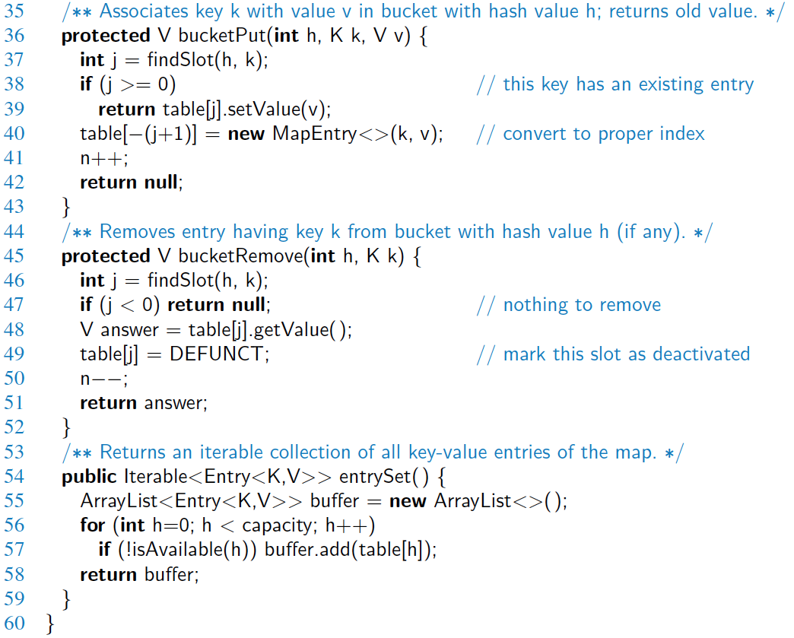
Probe Hash Map in Java, 3

Slide 21
Double Hashing
Double hashing uses a secondary hash function d(k) and handles collisions by placing an item in the first available cell of the series (i + jd(k)) mod N for j = 0, 1, … , N − 1
The secondary hash function d(k) cannot have zero values
The table size N must be a prime to allow probing of all the cells
Common choice of compression function for the secondary hash function:
d₂(k) = q − k mod q
where
q < N
q is a prime
The possible values for d₂(k) are 1, 2, … , q

Slide 22
Example of Double Hashing
Consider a hash table storing integer keys that handles collision with double hashing
N = 13
h(k) = k mod 13
d(k) = 7 − k mod 7
Insert keys 18, 41, 22, 44, 59, 32, 31, 73, in this order
0
1
2
3
4
5
6
7
8
9
10
11
12
31
41
18
32
59
73
22
44
0
1
2
3
4
5
6
7
8
9
10
11
12

Slide 23
Performance of Hashing
In the worst case, searches, insertions and removals on a hash table take O(n) time
The worst case occurs when all the keys inserted into the map collide
The load factor α = n/N affects the performance of a hash table
Assuming that the hash values are like random numbers, it can be shown that the expected number of probes for an insertion with open addressing is 1 / (1 − α)
The expected running time of all the dictionary ADT operations in a hash table is O(1)
In practice, hashing is very fast provided the load factor is not close to 100%
Applications of hash tables:
small databases
compilers
browser caches

