Slide 1
Merge Sort
Presentation for use with the textbook Data Structures and Algorithms in Java, 6th edition, by M. T. Goodrich, R. Tamassia, and M. H. Goldwasser, Wiley, 2014
7 2 ⏐ 9 4 → 2 4 7 9
7 ⏐ 2 → 2 7
9 ⏐ 4 → 4 9
7 → 7
2 → 2
9 → 9
4 → 4

Slide 2
Divide-and-Conquer
Divide-and conquer is a general algorithm design paradigm:
Divide: divide the input data S in two disjoint subsets S₁ and S₂
Recur: solve the subproblems associated with S₁ and S₂
Conquer: combine the solutions for S₁ and S₂ into a solution for S
The base case for the recursion are subproblems of size 0 or 1
Merge-sort is a sorting algorithm based on the divide-and-conquer paradigm
Like heap-sort
It has O(n log n) running time
Unlike heap-sort
It does not use an auxiliary priority queue
It accesses data in a sequential manner (suitable to sort data on a disk)

Slide 3
Merge-Sort
Merge-sort on an input sequence S with n elements consists of three steps:
Divide: partition S into two sequences S₁ and S₂ of about n/2 elements each
Recur: recursively sort S₁ and S₂
Conquer: merge S₁ and S₂ into a unique sorted sequence
Algorithm mergeSort(S)
Input sequence S with n elements
Output sequence S sorted
according to C
if S.size() > 1
(S₁, S₂) ← partition(S, n/2)
mergeSort(S₁)
mergeSort(S₂)
S ← merge(S₁, S₂)

Slide 4
Merging Two Sorted Sequences
The conquer step of merge-sort consists of merging two sorted sequences A and B into a sorted sequence S containing the union of the elements of A and B
Merging two sorted sequences, each with n/2 elements and implemented by means of a doubly linked list, takes O(n) time
Algorithm merge(A, B)
Input sequences A and B with n/2 elements each
Output sorted sequence of A ∪ B
S ← empty sequence
while ¬A.isEmpty() ∧ ¬B.isEmpty()
if A.first().element() < B.first().element()
S.addLast(A.remove(A.first()))
else
S.addLast(B.remove(B.first()))
while ¬A.isEmpty() S.addLast(A.remove(A.first()))
while ¬B.isEmpty() S.addLast(B.remove(B.first()))
return S

Slide 5
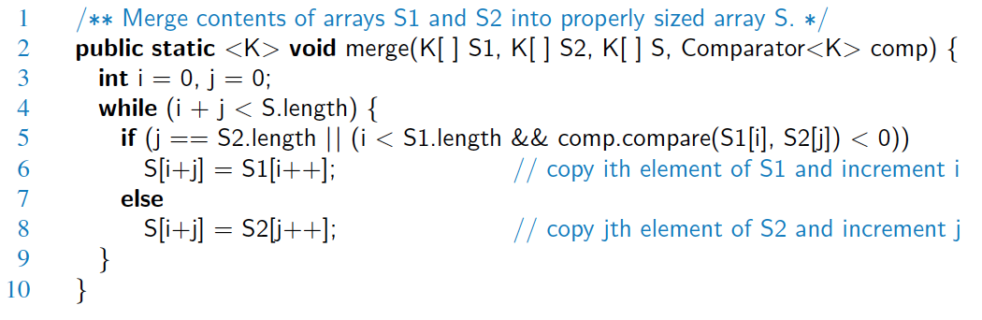
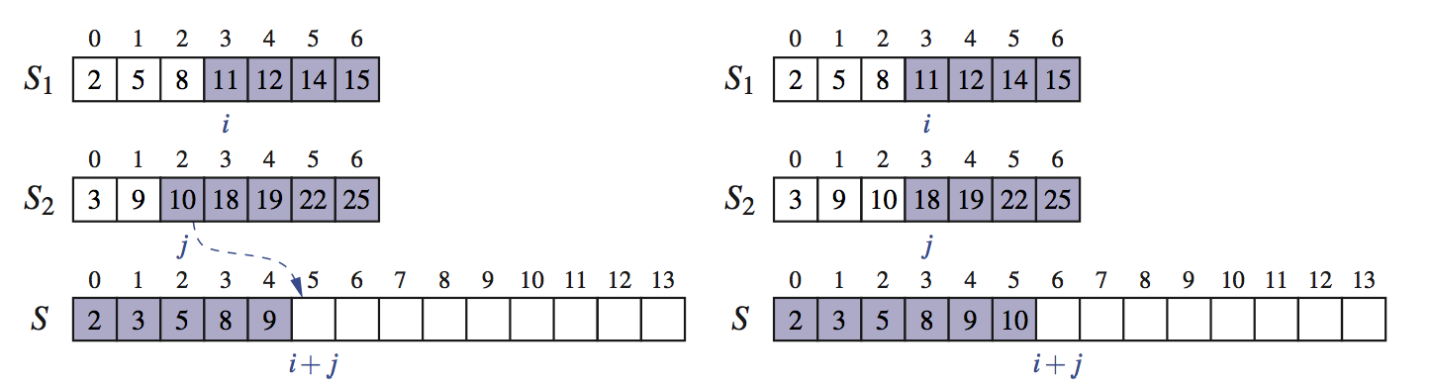
Java Merge Implementation

Slide 6
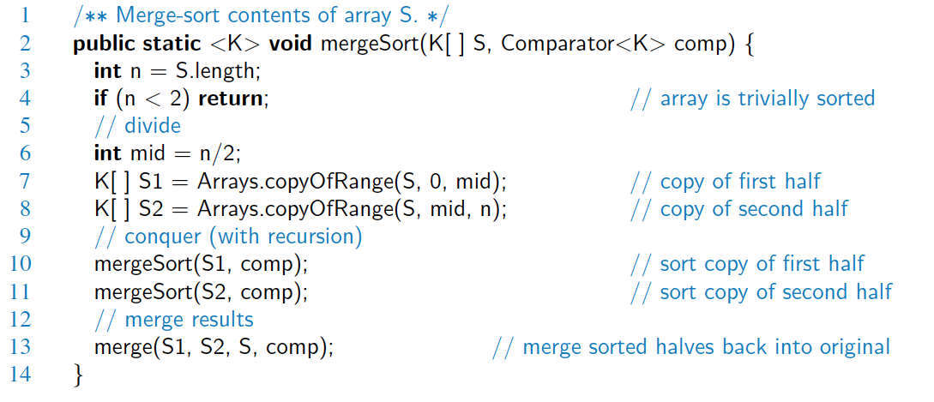
Java Merge-Sort Implementation

Slide 7
Merge-Sort Tree
An execution of merge-sort is depicted by a binary tree
each node represents a recursive call of merge-sort and stores
unsorted sequence before the execution and its partition
sorted sequence at the end of the execution
the root is the initial call
the leaves are calls on subsequences of size 0 or 1
7 2 ⏐ 9 4 → 2 4 7 9
7 ⏐ 2 → 2 7
9 ⏐ 4 → 4 9
7 → 7
2 → 2
9 → 9
4 → 4

Slide 8
Execution Example
Partition
7 2 9 4 ⏐ 3 8 6 1 → 1 2 3 4 6 7 8 9
7 2 9 4 → 2 4 7 9
3 8 6 1 → 1 3 8 6
7 2 → 2 7
9 4 → 4 9
3 8 → 3 8
6 1 → 1 6
7 → 7
2 → 2
9 → 9
4 → 4
3 → 3
8 → 8
6 → 6
1 → 1

Slide 9
Execution Example (cont.)
Recursive call, partition
7 2 9 4 ⏐ 3 8 6 1 → 1 2 3 4 6 7 8 9
7 2 ⏐ 9 4 → 2 4 7 9
3 8 6 1 → 1 3 8 6
7 2 → 2 7
9 4 → 4 9
3 8 → 3 8
6 1 → 1 6
7 → 7
2 → 2
9 → 9
4 → 4
3 → 3
8 → 8
6 → 6
1 → 1

Slide 10
Execution Example (cont.)
Recursive call, partition
7 2 9 4 ⏐ 3 8 6 1 → 1 2 3 4 6 7 8 9
7 2 ⏐ 9 4 → 2 4 7 9
3 8 6 1 → 1 3 8 6
7 ⏐ 2 → 2 7
9 4 → 4 9
3 8 → 3 8
6 1 → 1 6
7 → 7
2 → 2
9 → 9
4 → 4
3 → 3
8 → 8
6 → 6
1 → 1

Slide 11
Execution Example (cont.)
Recursive call, base case
7 2 9 4 ⏐ 3 8 6 1 → 1 2 3 4 6 7 8 9
7 2 ⏐ 9 4 → 2 4 7 9
3 8 6 1 → 1 3 8 6
7 ⏐ 2 → 2 7
9 4 → 4 9
3 8 → 3 8
6 1 → 1 6
7 → 7
2 → 2
9 → 9
4 → 4
3 → 3
8 → 8
6 → 6
1 → 1

Slide 12
Execution Example (cont.)
Recursive call, base case
7 2 9 4 ⏐ 3 8 6 1 → 1 2 3 4 6 7 8 9
7 2 ⏐ 9 4 → 2 4 7 9
3 8 6 1 → 1 3 8 6
7 ⏐ 2 → 2 7
9 4 → 4 9
3 8 → 3 8
6 1 → 1 6
7 → 7
2 → 2
9 → 9
4 → 4
3 → 3
8 → 8
6 → 6
1 → 1

Slide 13
Execution Example (cont.)
Merge
7 2 9 4 ⏐ 3 8 6 1 → 1 2 3 4 6 7 8 9
7 2 ⏐ 9 4 → 2 4 7 9
3 8 6 1 → 1 3 8 6
7 ⏐ 2 → 2 7
9 4 → 4 9
3 8 → 3 8
6 1 → 1 6
7 → 7
2 → 2
9 → 9
4 → 4
3 → 3
8 → 8
6 → 6
1 → 1

Slide 14
Execution Example (cont.)
Recursive call, …, base case, merge
7 2 9 4 ⏐ 3 8 6 1 → 1 2 3 4 6 7 8 9
7 2 ⏐ 9 4 → 2 4 7 9
3 8 6 1 → 1 3 8 6
7 ⏐ 2 → 2 7
9 4 → 4 9
3 8 → 3 8
6 1 → 1 6
7 → 7
2 → 2
9 → 9
4 → 4
3 → 3
8 → 8
6 → 6
1 → 1

Slide 15
Execution Example (cont.)
Merge
7 2 9 4 ⏐ 3 8 6 1 → 1 2 3 4 6 7 8 9
7 2 ⏐ 9 4 → 2 4 7 9
3 8 6 1 → 1 3 8 6
7 ⏐ 2 → 2 7
9 4 → 4 9
3 8 → 3 8
6 1 → 1 6
7 → 7
2 → 2
9 → 9
4 → 4
3 → 3
8 → 8
6 → 6
1 → 1

Slide 16
Execution Example (cont.)
Recursive call, …, merge, merge
7 2 9 4 ⏐ 3 8 6 1 → 1 2 3 4 6 7 8 9
7 2 ⏐ 9 4 → 2 4 7 9
3 8 6 1 → 1 3 6 8
7 ⏐ 2 → 2 7
9 4 → 4 9
3 8 → 3 8
6 1 → 1 6
7 → 7
2 → 2
9 → 9
4 → 4
3 → 3
8 → 8
6 → 6
1 → 1

Slide 17
Execution Example (cont.)
Merge
7 2 9 4 ⏐ 3 8 6 1 → 1 2 3 4 6 7 8 9
7 2 ⏐ 9 4 → 2 4 7 9
3 8 6 1 → 1 3 6 8
7 ⏐ 2 → 2 7
9 4 → 4 9
3 8 → 3 8
6 1 → 1 6
7 → 7
2 → 2
9 → 9
4 → 4
3 → 3
8 → 8
6 → 6
1 → 1

Slide 18
Analysis of Merge-Sort
The height h of the merge-sort tree is O(log n)
at each recursive call we divide in half the sequence,
The overall amount or work done at the nodes of depth i is O(n)
we partition and merge 2^{i} sequences of size n/2^{i}
we make 2^{i+1} recursive calls
Thus, the total running time of merge-sort is O(n log n)
depth | #seqs | size
0 | 1 | n
1 | 2 | n/2
i | 2^{i} | n/2^{i}
… | … | …

Slide 19
Summary of Sorting Algorithms
Algorithm | Time | Notes
selection-sort | O(n²) | slow in-place for small data sets (< 1K)
insertion-sort | O(n²) | slow in-place for small data sets (< 1K)
heap-sort | O(n log n) | fast in-place for large data sets (1K — 1M)
merge-sort | O(n log n) | fast sequential data access for huge data sets (> 1M)

