Slide 1

Data Science Capstone: Final Project
Trevor McCormick

Slide 2



Proposal:
I am going to be using data from data.gov in order to predict how often people are leaving their homes
This will be done by moving the data through many applications for cleaning, storage, visualization, analysis, and modeling
Most of the project will be done in Python using the Pandas package
The storage method will be SQLite
Data visualization will be done in Power BI due to it connecting with SQLite
Finally, everything goes back into Python for the analysis and modelling
The end goal is to make a useful and working predictive analysis program

Slide 3
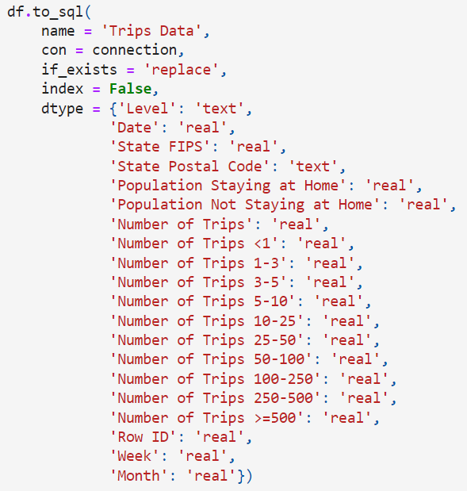
Data Collection and Storage:
Original data was imported into Python from data.gov
In Python, I converted the data to a Pandas data frame
This data frame was then imported to SQLite using the Python code shown to the right
An add-on called DB-Browser enabled the SQLite data to be viewed and analyzed

Slide 4
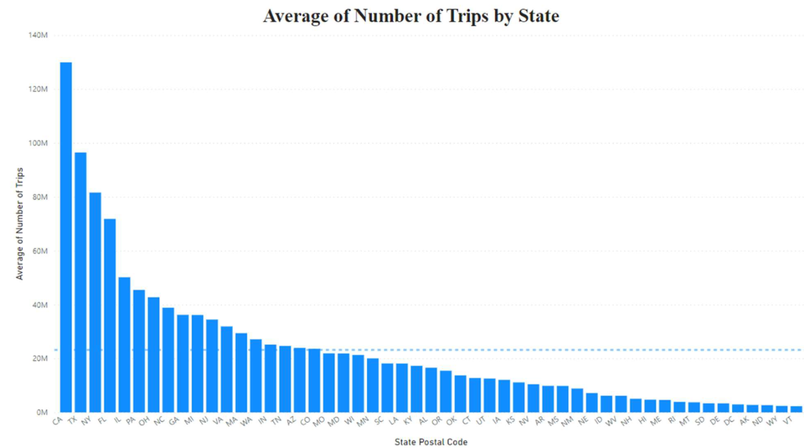
Exploratory Data Analysis:
The EDA was completed using both Python (with packages) and Power BI
Due to the large size of the dataset and Python having trouble loading visualizations, most visuals were generated using Power BI
SQLite was simple to connect to Power BI for the most part, which made the whole process much smoother
From the EDA I concluded that the data has:
45,267 Rows
20 Columns
0% Missing Data

Slide 5
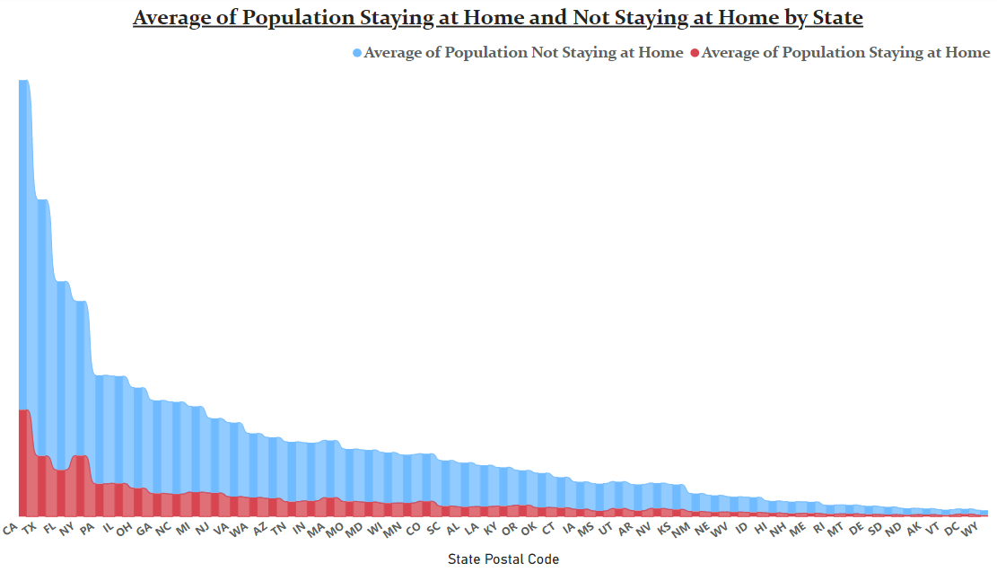
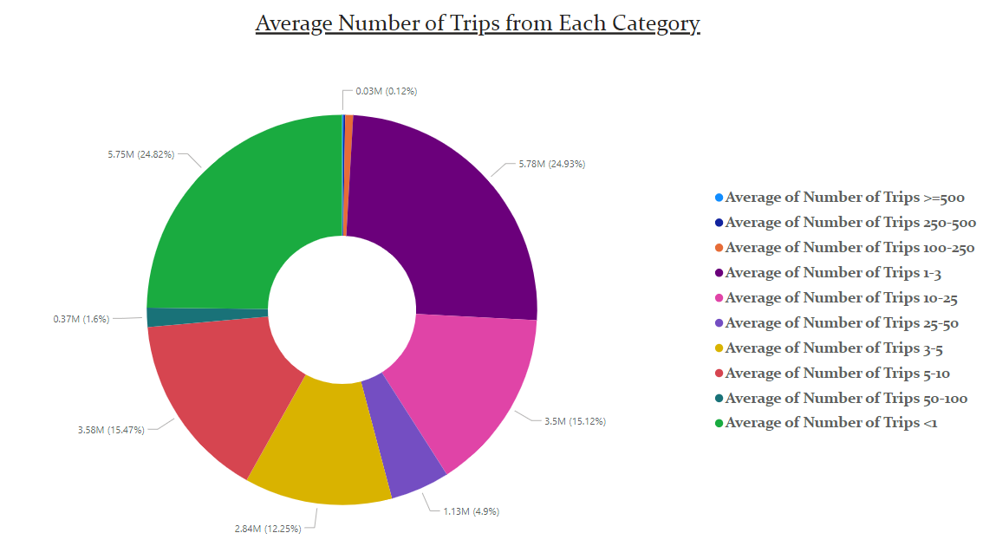
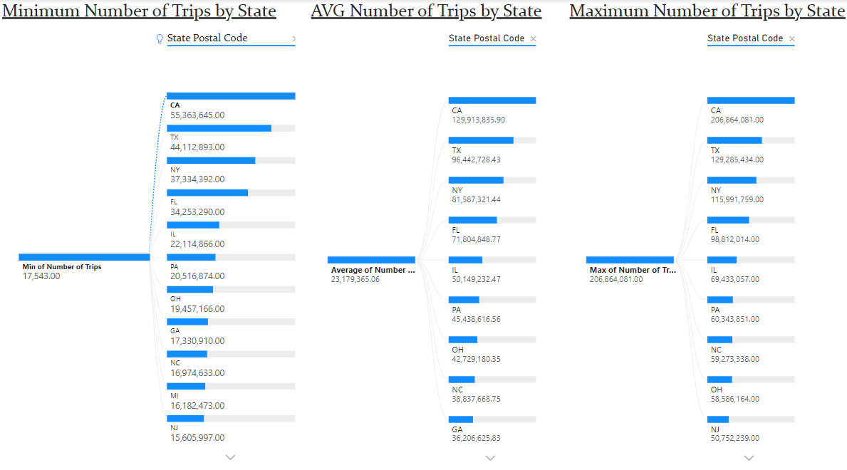
Data Dashboard:
Once SQLite was connected to Power BI, creating the dashboard was a fairly simple process

Slide 6
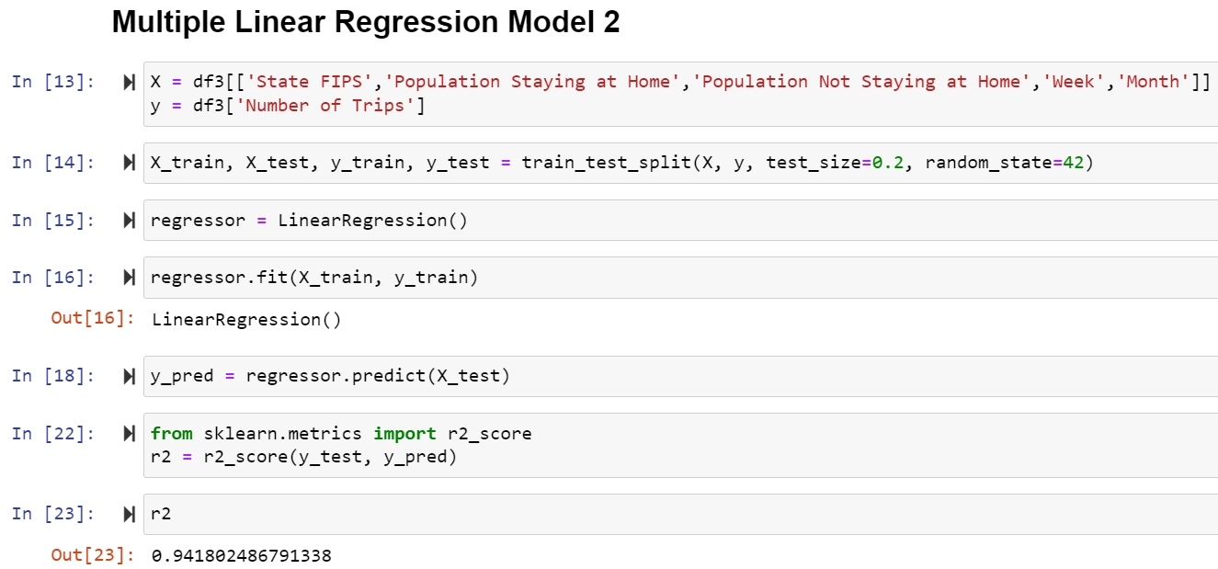
Final System:
Random Forest and Multiple Linear Regression were used as the final predictive models for this dataset
The Random Forest Model yielded a predictive score of 98%
The Multiple Linear Regression Model yielded a predictive score of 94%
Given that the score for the Random Forest Model is almost suspiciously high, I believe that the Regression Model is the best fit for this dataset

Slide 7
Reflection:
In the future, pick a dataset that you know will work well with your project goals
Prepare for each step before you get to it. This will help streamline the entire process and make each step more efficient
Take time to make sure every step is working and correct
Use the tools that work best with your project
Using Python, SQLite, and Power BI were excellent for what I wanted to do with this project
Once your goals are laid out, pick the applications that are best for you

Slide 8
Summary:
Used the Trips dataset from data.gov in order to predict when and how often people are leaving their homes
Python and Pandas used for initial cleaning and preparation
SQLite used for data storage, imported using Python
Visualized using Power BI graphs and charts
Python and Pandas used again for both the EDA and the final predictive modeling
Random Forest and Multiple Linear Regression were the predictive models used for the final result

Slide 9

Questions:

