Slide 1
ON THE EFFICACY OF LARGE LANGUAGE MODELS AS MODELS OF COMPUTATION
08.30.2023
SE-691-682
Sebastian Just, Frank Ottey, Greg Morgan, Trevor Pawlewicz

Slide 2
Introduction
LANGUAGE MODELS AS MODELS OF COMPUTATION

Slide 3
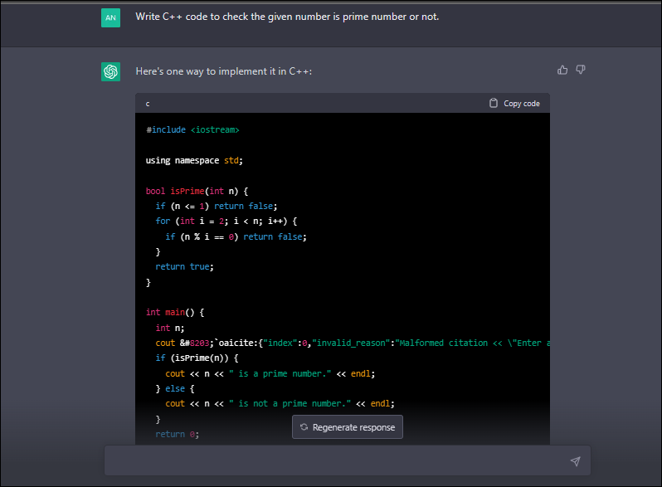
Language Models as Programmers
Language models as models of computation
As autoregressive LLMs based on the transformer architecture have increased in capability, expectations around their efficacy at modeling real-world phenomenon
The transformer architecture itself has proven a valuable architecture for domain-based sequence-to-sequence modeling – See OpenAI's Whisper model for an example in the ASR domain
Our original thought: Could we apply language modeling techniques (autoregressive LLMs, transformer architecture) to computational modeling?
Original title: “Evaluating the efficacy of multi-task attention networks in detecting vulnerabilities in WASM byte code”
Specifically, can LLM's be used to intuit understanding around what Web Assembly byte code does and means?

Slide 4
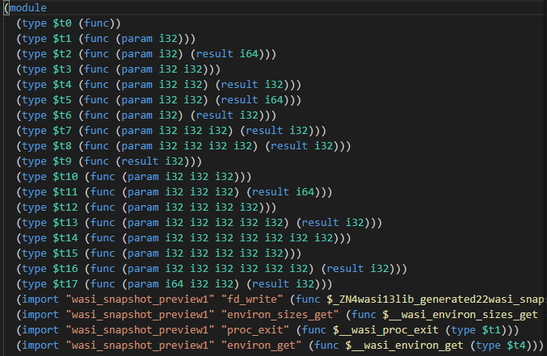
What is Web Assembly?
LANGUAGE MODELS AS MODELS OF COMPUTATION
Web Assembly bytecode is a byte code format similar to JVM bytecode that can be run by a variety of VM implementations, both on a server or in a sandboxed browser
As a bytecode format it is platform agnostic
It is a popular target for performance-sensitive web-application code that might need to run on the client-side.
Because WASM bytecode is run on the client-side – (in a user's browser) there is an inherent risk / required amount of trust from the user to run the code.
Web Assembly is growing to become an isomorphic platform target: the Web Assembly System Interface (WASI) specification defines a runtime for server-side WebAssembly

Slide 5
Why use LLMs for Bytecode Analysis?
LLM's have shown initial promise at generating and evaluating code.
Analysis of code is generally performed either statically or dynamically
Static analysis tends to have less reliable coverage while dynamic analysis tends to be non-performant. (Compiler Analysis vs. Valgrind, Sanitizers)
Dynamic analysis requires running code, which, if the code is untrusted / malicious is already problematic
Use LLMs to analyze bytecode fragments before execution by the VM?

Slide 6
Similar / Prior Work
LANGUAGE MODELS AS MODELS OF COMPUTATION
"Deep Neural Networks for Malicious JavaScript Detection Using Bytecode Sequences," 2020 International Joint Conference on Neural Networks (IJCNN), Glasgow, UK, 2020, pp. 1-8, doi: 10.1109/IJCNN48605.2020.9207134.)
https://ieeexplore.ieee.org/document/9207134
Compiled V8 bytecode vs. WASM bytecode
Linked functions included in VM compilation
V8 bytecode then encoded via word2vec, featurized and used in a classifier

Slide 7
A Contemporary Adaptation
LANGUAGE MODELS AS MODELS OF COMPUTATION
Instead of operating on V8 bytecode, which is specific to Chrome's V8 Javascript engine, start with WASM bytecode, which is platform-agnostic
Instead of using word2vec, utilize modern auto-regressive LLMs (ChatGPT, Llama etc.) to perform bytecode encoding.
Follow similar experiments with featurization and classification
Present evaluation / results
Use-case: As more performance-sensitive code may be required to run client-side for privacy and security reasons, there is a need to have tools to automatically verify the transmitted code as non-malicious

Slide 8
Challenges
Language Models vs. Models of Computation

Slide 9
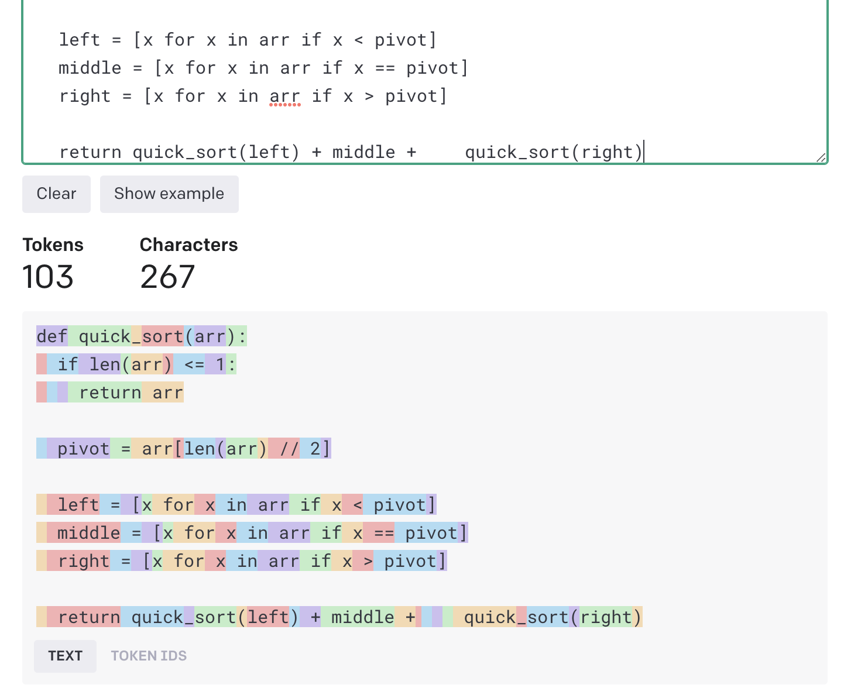
Key Finding: Tokenization is Everything
LANGUAGE MODELS VS. MODELS OF COMPUTATION
Tokenization greatly changes model output
Tokenization greatly changes model performance
Tokenization is contextual
Tokenization is only as good as the input training data
Obscure input sequences will be harder to tokenize and harder to get quality output from.
Notes:
Determining what tokens to feed into the model greatly changes the output of the model – as such the tokenization step, which occurs before any model inference has a higher degree of importance than what you do after tokenization
The reason tokenization is contextual because the same character can be parsed as separate tokens depending on context (i.e. whitespace in Python code snippets tokenized by ChatGPT)
Autoregressive models have specific tokenizer models that are trained during the model generation process – these tokenizers are only as good as the corpus of input data that they have been trained on
A lack of high-quality samples of accurate language tokenization will lead to low-quality tokenizers, which will lead to difficulty in the model being able to parse the semantic meaning from inputs

Slide 10
Computation is not Autoregressive
LANGUAGE MODELS VS. MODELS OF COMPUTATION
LLM's are trained in an auto-regressive style
Computation models are not auto-regressive
Token mis-predictions / inaccurate predictions are more likely to produce poor quality results (Computation is stricter / less expressive than language)
Notes:
Autoregressive - ; to predict the next token in a sequence based on previous tokens in a sequence
; the more imperative / lower-level the model of computation (programming language) the more likely syntactic regularity and localized source context is more important
For an example of computation not being auto-regressive – given an arbitrary function signature – how do you know how to fill in the function? What if you don't have the function name correct?

Slide 11
The Limits of Transfer Learning and Dataset Availability
LANGUAGE MODELS VS. MODELS OF COMPUTATION
Tokenizer had little experience with WASM sequences.
Transfer learning options limited due to dataset availability
Ability to load / run models impacted by computational availability
Notes:
In order to improve model performance for any given task, the tokenizer and model must have had sufficient training data to parse the input
In our case, there was not enough WASM bytecode "out in the wild" to leverage as a good source of input data to attempt improving existing tokenizers in 10 weeks

Slide 12
Evaluating the Divergence of Language and Computation?
LANGUAGE MODELS VS. MODELS OF COMPUTATION
How effective are LLM's at being "programmers" in the small case?
How effective are LLM's at translating a given computation between languages?
To what extent are LLMs simply understanding the semantic meaning of the tokens vs. understanding computation?
How effective are LLM's at understanding computation given the changing context of language?

Slide 13
Evaluating LLMs with WebAssembly
Assessing LLM's current ability to generate and interpret WebAssembly Text Code

Slide 14
Can LLM's generate WebAssembly Text (WAT) given sample C++ code? Can LLM's interpret WebAssembly Text (WAT) and generate equivalent C++ code?
WebAssembly Translation
Methodology:
We evaluated ChatGPT 3.5 using basic C++ programs and their compiled WAT representation:
Sum of Two Integers
Fibonacci
Factorial
Is Integer a Prime Number
Ask ChatGPT 3.5 to perform code translation using the following prompts:
Can you translate this C++ to WebAssembly text? <C++ code>
Can you translate this WebAssembly text to C++? <WAT code>
Compile and Run the resulting code
Using WasmFiddle to compile and run C++
Using WasmExplorer to compile and run WAT
Evaluation Criteria:
Readable: Does the code generate look reasonable to the human eye?
Compilable: Does the code compile?
Runnable: Does the code run?
Usable: Does the generated code actually work as expected and give us the right answers?

Slide 15
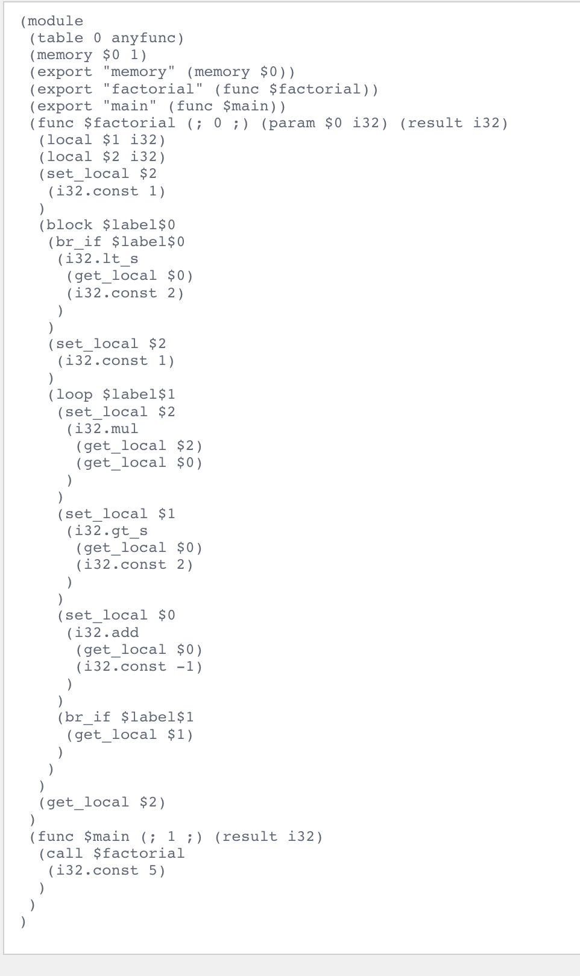
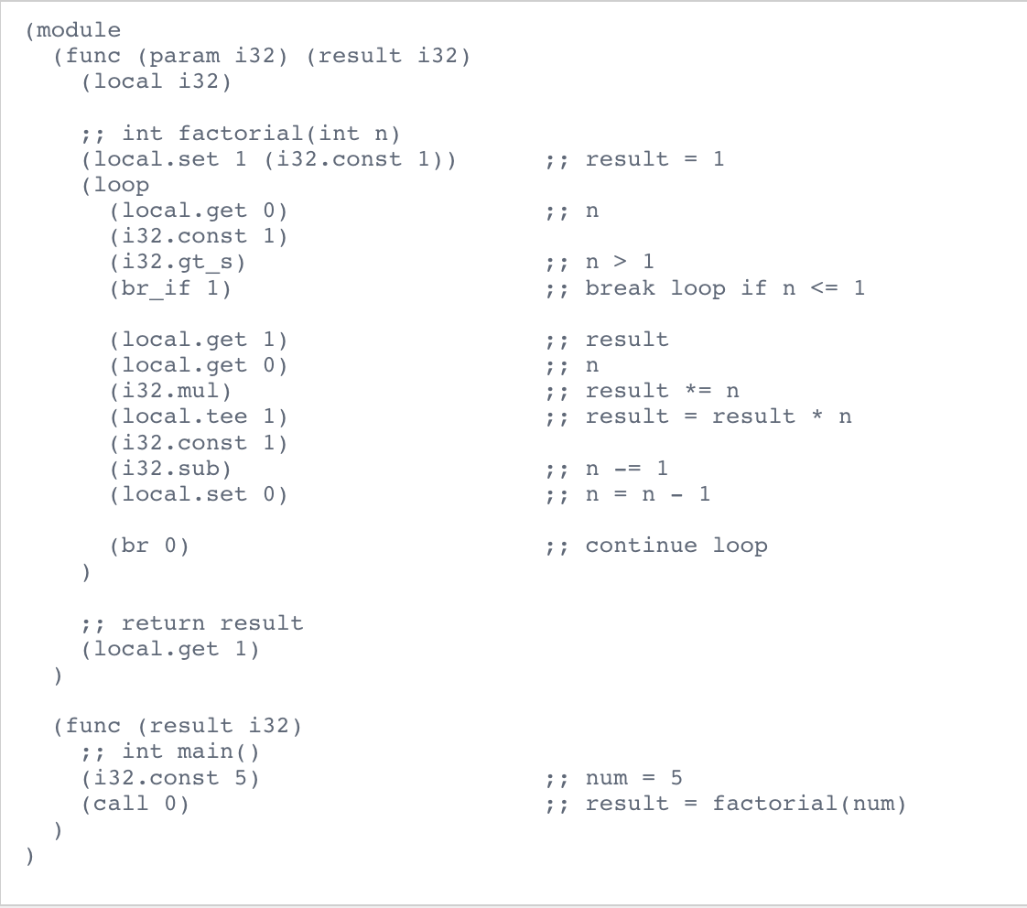
Sample – Factorial (C++ to WAT)
Actual WebAssembly
WebAssembly Translation
Chat GPT Output

Slide 16
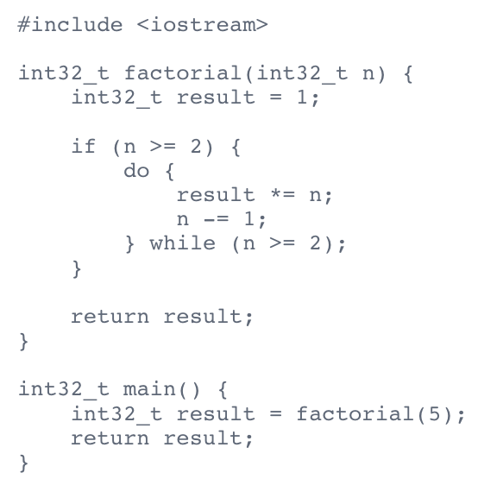
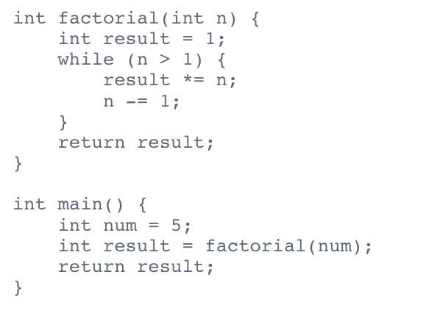
Sample – Factorial (WAT to C++)
WebAssembly Translation
Chat GPT Output
Actual C++

Slide 17
Results
WebAssembly Translation
Function (ChatGPT Output) | Readable | Compilable | Runnable | Usable
Sum Two Ints WAT | Yes | Yes | Yes | Yes
Sum Two Ints C++ | Yes | Yes | Yes | Yes
Factorial WAT | Yes | No | No | No
Factorial C++ | Yes | Yes | Yes | Yes
Fibonacci WAT | Yes | Yes | Yes | Yes
Fibonacci C++ | Yes | Yes | Yes | No
IsPrime WAT | Yes | No | No | No
IsPrime C++ | Yes | Yes | Yes | No
Common Errors:
C++ -> WAT: Parsing Error "wasm text error: parsing wasm text at 4:6"
WAT -> C++: Unexpected Output – IsPrime gave 2 as a response where 0 or 1 are expected outputs

Slide 18
Findings (C++ to WAT)
WebAssembly Translation
Analyzing our Results:
Most errors were compiler/syntax errors
Suggests that ChatGPT needs improvement in working with WAT syntax
WAT code output that did compile gave us the expected output
Suggests that ChatGPT could translate the semantic meaning of the code to WAT but struggled more with the syntax
Future Work:
Recent research from Rémi Louf et all [1] suggests that regex guided generation can greatly reduce syntax errors
Guided generation using a WebAssembly Grammer or Compiler assisted fine tuning could see improvements
Exposing an LLM to more WebAssembly code which is syntactically correct and compiles
[1] Eliminating hallucinations (fast!) in Large Language ModelswithFinite State Machines (Rémi Louf, Phoebe Klett, and Dan Simpson 2023)

Slide 19
Findings (WAT to C++)
Webassembly TRanslation
Analyzing our Results:
Code generated was able to compile
Suggests ChatGPT better at generating C++ than WAT
Understands the Syntax and Grammar of C++
Code generated wrong output
Core logic in WAT confusing ChatGPT
Doesn't understand the Semantic meaning of WAT
Resulting Question:
Is ChatGPT using key words in the WAT such as "Factorial" or "Fibonacci" or does it have a deeper understanding of the logic and language structure?

Slide 20
Evaluating LLMs with Python
Assessing LLM's current ability to interpret Python Code

Slide 21
Approach Does an LLM understand the code or is it just recognizing the (English) keywords?
Evaluating LLMs with Python
Analyze well-known algorithms
Bubble-Sort, Quick-Sort, Reverse String, LCS
Implement
Let ChatGPT 3.5 analyze it
“What does code do? ```<actual code>```
Obscure code
4 iterations
Goto #3
Obscure code layers
Must have no impact on the algorithm
Inlined by the compiler
Replace all methods and variables names
Remove meaning from names
Re-phrase conditions etc. with lambdas
Remove meaning from “well known” checks
Replace built-in function
Replace ie. len() as “well known” pivot points
Add dead code
Empty loops

Slide 22
Sample Quick-Sort
Evaluating LLMs with Python
def foo(bar):
if fuzz(bar) <= 1:
return bar
z = ""
for i in range(0, 10):
z = z + str(i)
aa = lambda a,b: a>b
bb = lambda a,b: a<b
cc = lambda a,b: a == b
a = bar[len(bar) // 2]
for i in range(0, 10):
z = z + str(a)
b = [x for x in bar if bb(x, a)]
for i in range(0, 10):
z = z + str(b)
c = [x for x in bar if cc(x, a)]
for i in range(0, 10):
z = z + str(c)
def fuzz(foo):
bar = 0
for _ in foo:
bar += 1
return bar
def foo(bar):
if fuzz(bar) <= 1:
return bar
aa = lambda a,b: a>b
bb = lambda a,b: a<b
cc = lambda a,b: a == b
a = bar[len(bar) // 2]
b = [x for x in bar if bb(x, a)]
c = [x for x in bar if cc(x, a)]
d = [x for x in bar if aa(x, a)]
return foo(b) + c + foo(d)
def floo(bar):
if len(bar) <= 1:
return bar
a = bar[len(bar) // 2]
b = [x for x in bar if x < a]
c = [x for x in bar if x == a]
d = [x for x in bar if x > a]
return floo(b) + c + floo(d)
def foo(bar):
if len(bar) <= 1:
return bar
aa = lambda a,b: a>b
bb = lambda a,b: a<b
cc = lambda a,b: a == b
a = bar[len(bar) // 2]
b = [x for x in bar if bb(x, a)]
c = [x for x in bar if cc(x, a)]
d = [x for x in bar if aa(x, a)]
return foo(b) + c + foo(d)
def quick_sort(arr):
if len(arr) <= 1:
return arr
pivot = arr[len(arr) // 2]
left = [x for x in arr if x < pivot]
middle = [x for x in arr if x == pivot]
right = [x for x in arr if x > pivot]
return quick_sort(left) + middle + quick_sort(right)
Recursive implementation
Foobar’ed
Lambda’ed
len() ’ed
No-op’ed

Slide 23
Findings
Evaluating LLMs with Python
Modification | Quick-Sort | Bubble-Sort | Reverse String | LCS
None | algorithm recognized | algorithm recognized | algorithm recognized | algorithm recognized
Foobar’ed | algorithm recognized | algorithm recognized | algorithm recognized | algorithm recognized
Lambda’ed | purpose recognized | purpose recognized | algorithm recognized | algorithm recognized
len() ’ed | purpose recognized | not recognized | purpose recognized | algorithm recognized
No-op’ed | not recognized | not recognized | not recognized | not recognized
Renaming has no impact
“Inline”-Lambda usage for conditions has impact
Replacing built-in functions (len()) has impact
“Dead” code has significant impact
Algorithm detection via statistical distribution of tokens
Reuse of token (ie. variable names) causes significant false statements about the code
LLM has no concept of scope

Slide 24
CONCLUSIONS
Next steps

Slide 25
Evaluating the Divergence of Language and Computation?
LANGUAGE MODELS VS. MODELS OF COMPUTATION
How effective are LLM's at being "programmers" in the small case?
It depends... Sometimes fairly effective to not very effective...
How effective are LLM's at translating a given computation between languages?
It depends – level of abstraction and complexity of computation are key factors regarding the ability to perform this task
To what extent are LLMs simply understanding the semantic meaning of the tokens vs. understanding computation?
Token replacement in common languages does not seem to affect computation reasoning (haven't explored the effect in less common languages)
How effective are LLM's at understanding computation given the changing context of language?
This is dependent on the complexity of the computation and the target language

Slide 26
Thank you

Slide 27
Adapting Sequence Encoding
LANGUAGE MODELS vs. MODELS OF COMPUTATION
In Rozi, Kim, Ozawa, (see earlier) word2vec was used to encode the compiled V8 bytecode into embedded sequences.
First thought was to simply pass the raw bytecode sequence as a bytestring to LLMs to encode as sequences
Problem – there were no clear delineations between semantic bytecode boundaries
Next approach utilized the textual representation of the bytecode fragments – this is closer to what others (Ashizawa, Yanai, Cruz, Okamura) [1]
This presented its own problems – limited context-length of LLMs – bytecode was "wordy"
Eth2Vec: Learning Contract-Wide Code Representations for Vulnerability Detection on Ethereum Smart Contracts

Slide 28
Challenges
Adapting to transformers / LLMs
Environmental Impact / Resources
Natural Language Processing (NLP) technologies, including large language models like transformers, have shown remarkable advancements in various applications. However, they also come with environmental and resource-related challenges that need to be addressed.
Addressing these hurdles, a combination of technological innovation, efficient training methods, industry collaboration, and ethical considerations to ensure a more sustainable approach to language-related technologies.
Notes:
As an example, for any Information and Communication Technology (ICT) service, there are at least four sources of CO2 equivalent emission sources that should be taken into account to assess the environmental impact of computational experiments: 1/ production of hardware equipment: router, PC, server; 2/idle use of the hardware; 3/ dynamic use of the hardware; and 4/ end of life of equipment

