Slide 1
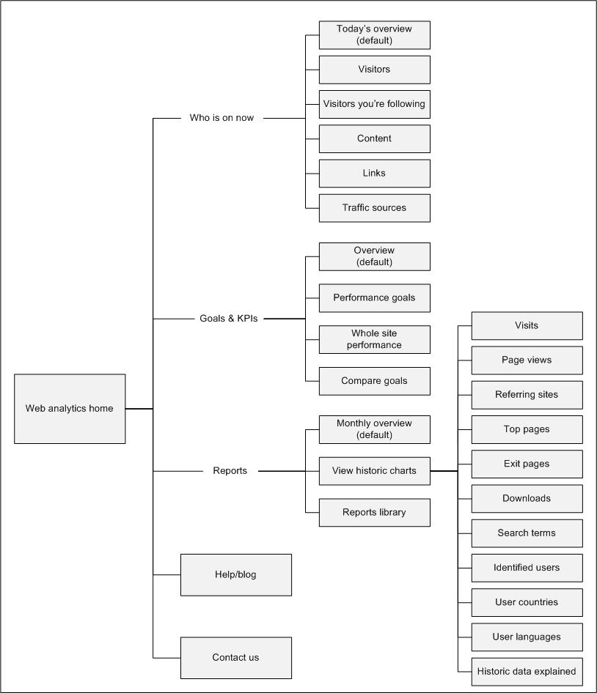
Sitemap – Web analytics

Slide 2
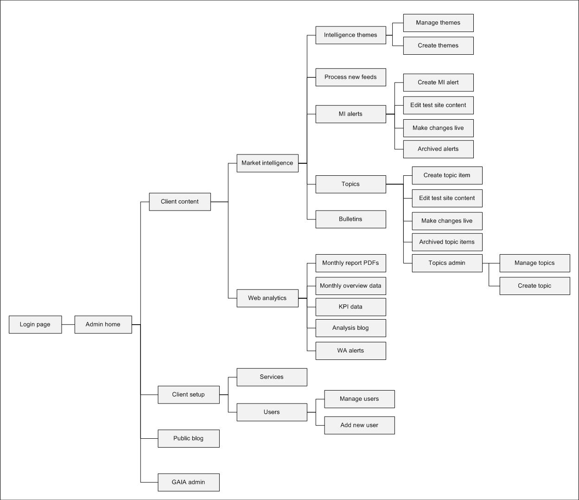
Sitemap – Administration site

Slide 3
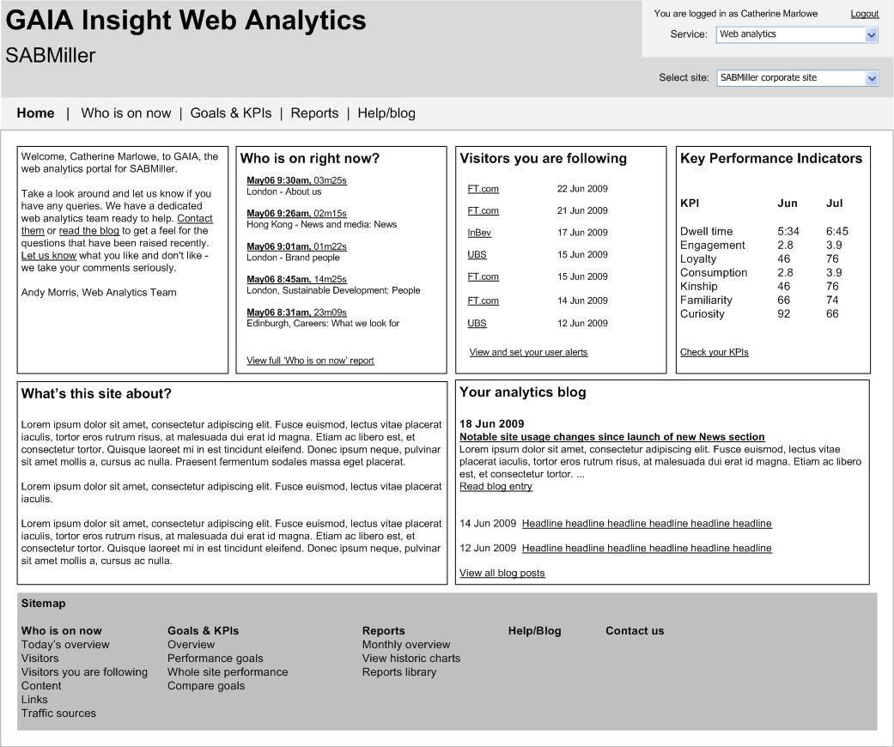
Web analytics - Home

Slide 4
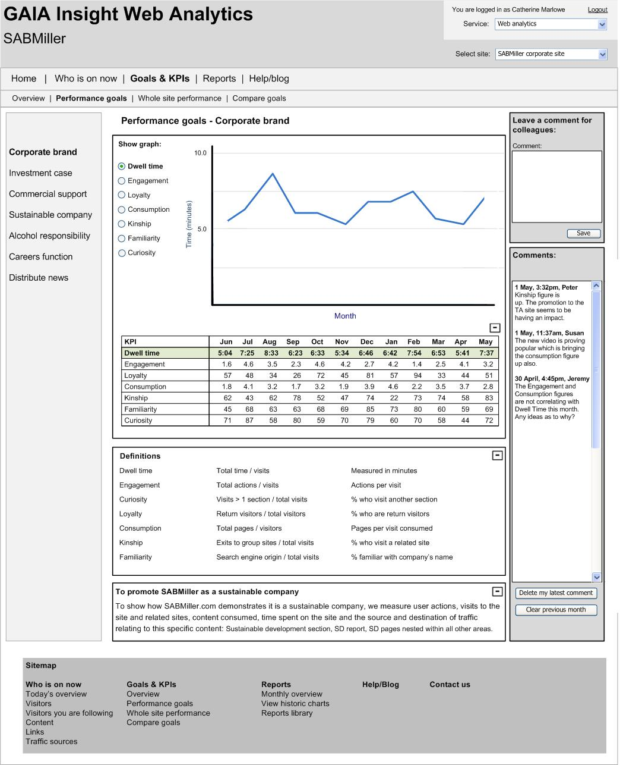
Sitemap – Web analytics – Goals – Goal performance

Slide 5
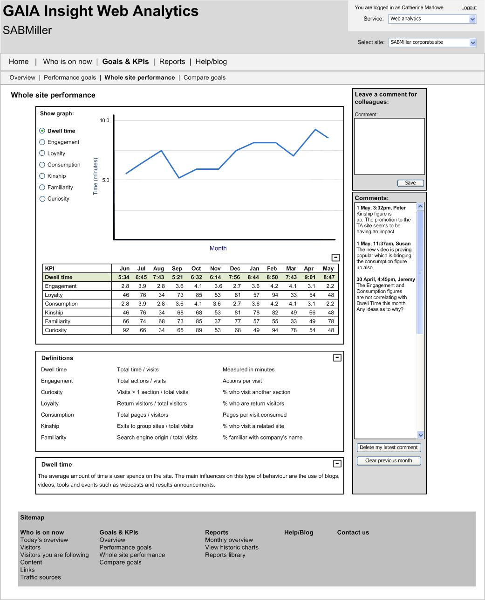
Sitemap – Web analytics – Goals – Site performance

Slide 6
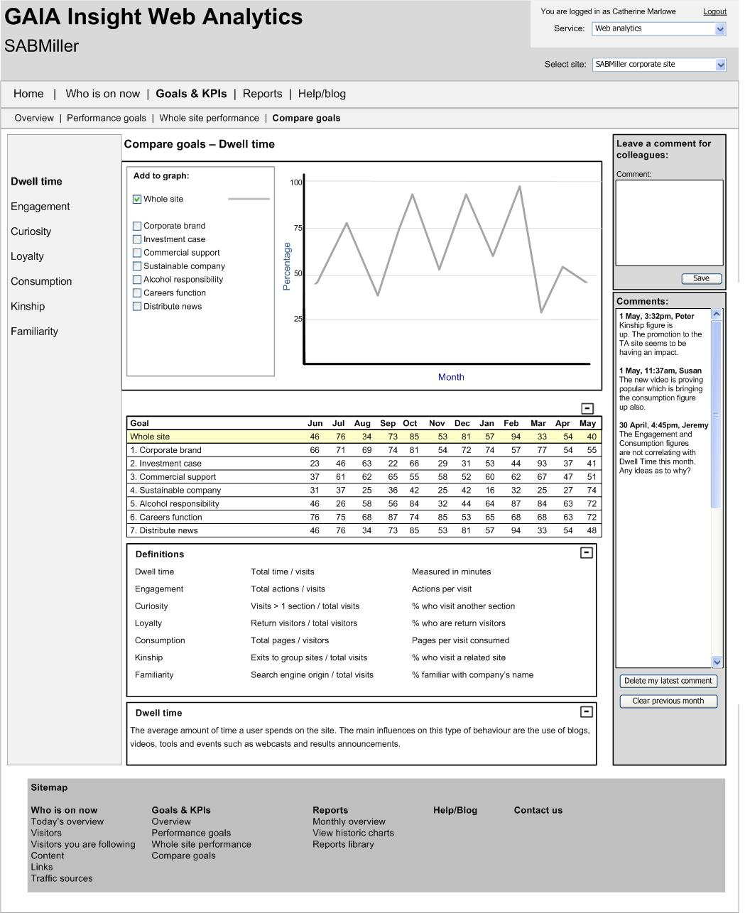
Sitemap – Web analytics – Goals – Compare

Slide 7
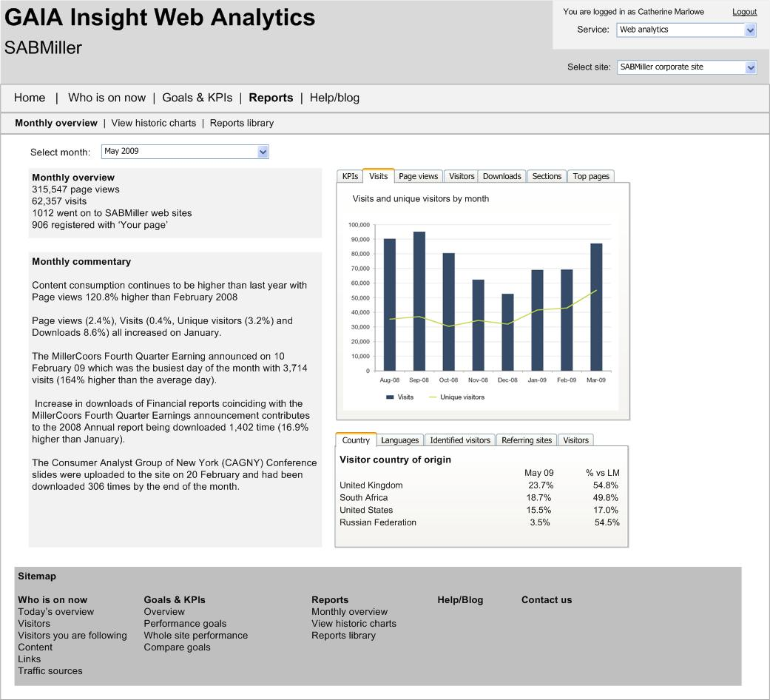
Sitemap – Web analytics – Reports – Monthly overview

Slide 8
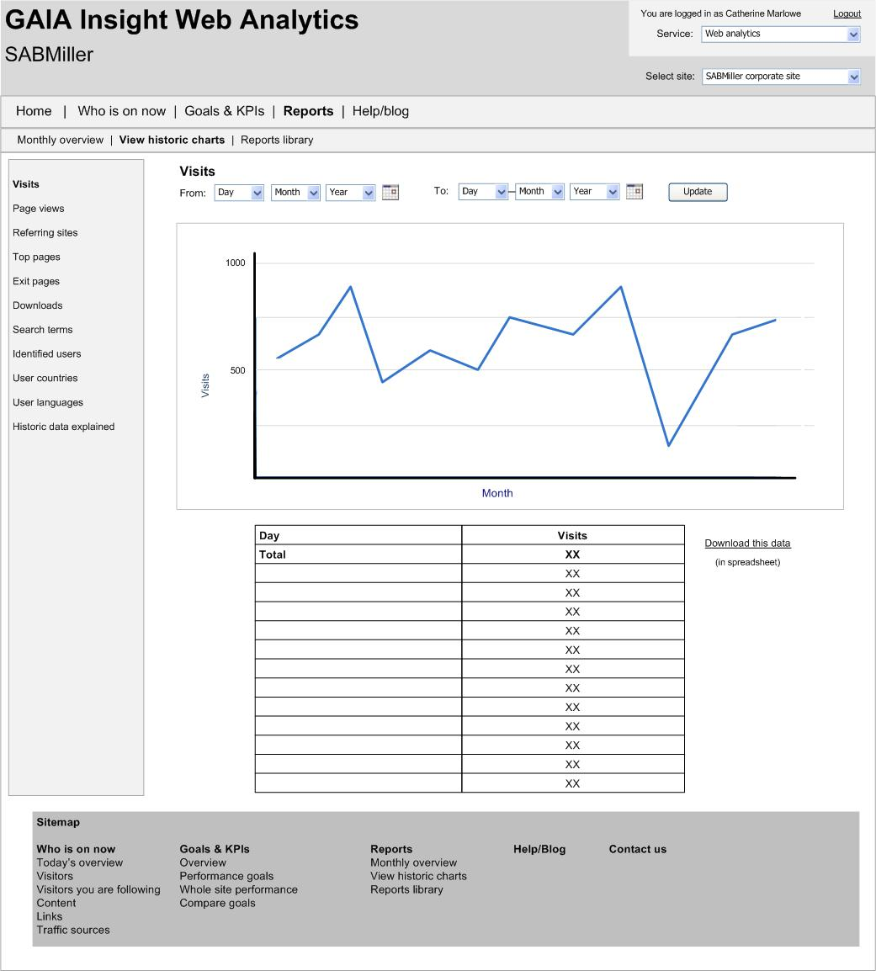
Sitemap – Web analytics – Reports – Historic charts (vertical graph)
Vertical graph used for:
* Visits
* Page views

Slide 9
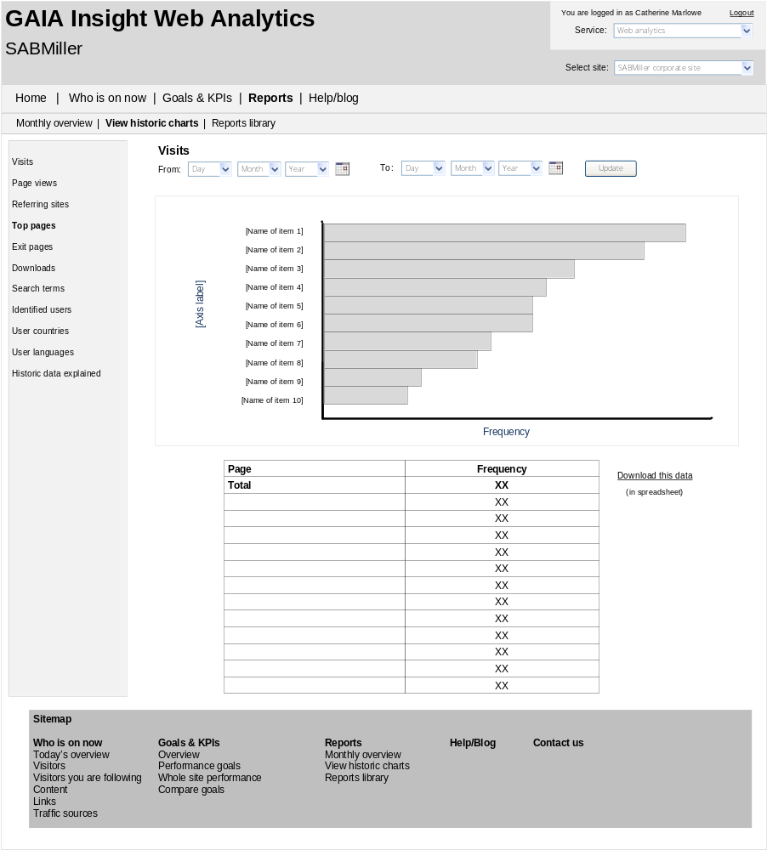
Sitemap – Web analytics – Reports – Historic charts (horizontal graph)
Horizontal graph used for:
Top pages
Referring sites
Search terms
Identified users
Countries
Languages

