Slide 1



Attention-Guided Automatic Swara Identification in Indian Classical Flute Melodies
Thesis by | Supervised by
Akash Datta Roni; Reg. 2020331550 Misbah Al Mamun; Reg. 2020331553 | Md Abu Naser Mojumder Assistant Professor, Head of Department Department of Computer Science & Engineering

Slide 2

Hypothesis
Background: Indian classical flute music relies on Swara (the 7 basic notes: Sa, Re, Ga, Ma, Pa, Dha, Ni) and Raga
The Problem: Swaras in continuous melodies have flute transitions and are not clearly separable in waveforms, making identification difficult for beginners.
Research Hypothesis: Implementing an Attention-guided Convolutional Neural Network (CNN) on Mel-Frequency Cepstral Coefficients (MFCC) will effectively isolate and accurately identify individual Swaras from continuous, overlapping Indian classical flute recordings.
02

Slide 3
Novelty
Literature Review
Domain Specificity
  Unlike Western instruments with discrete notes, this research directly tackles the continuous, non-separable note transitions unique to the Indian Classical Flute.
Custom Dataset Construction
  Creating a specialized dataset capturing both isolated flute swaras and complex continuous sequences.
Attention-Driven Focus
  Innovatively applies an Attention mechanism specifically to weigh steady-state pitches over transitional noise in fluid ragas.
Computational Approaches for Indian Classical Music
Identifies strengths, limitations, and future research gaps.
Author: Singh & Biswas (2020)
Raga Recognition Using Deep Learning
Spectrogram + deep learning approach for raga detection.
Achieved 98.98% accuracy on CompMusic dataset (10 ragas).
Author: Shah, Jagtap, Talekar & Gawande (2021)
Sequence‑to‑Sequence Piano Transcription with Transformers
Encoder‑decoder Transformer for audio‑to‑MIDI transcription.
Simplifies AMT by modeling audio + symbolic dependencies.
Author: Hawthorne, Simon, Swavely, Manilow & Engel (2019)
03

Slide 4
Objectives of the Study
To develop an automatic Swara identification system for continuous flute ragas
Accurately extract spectral characteristics (MFCCs) from audio signals
Design and train a hybrid CNN + Attention model for 7-way classification (7 Swaras)
To explore and evaluate different audio segmentation techniques for flute note transcribing
04

Slide 5
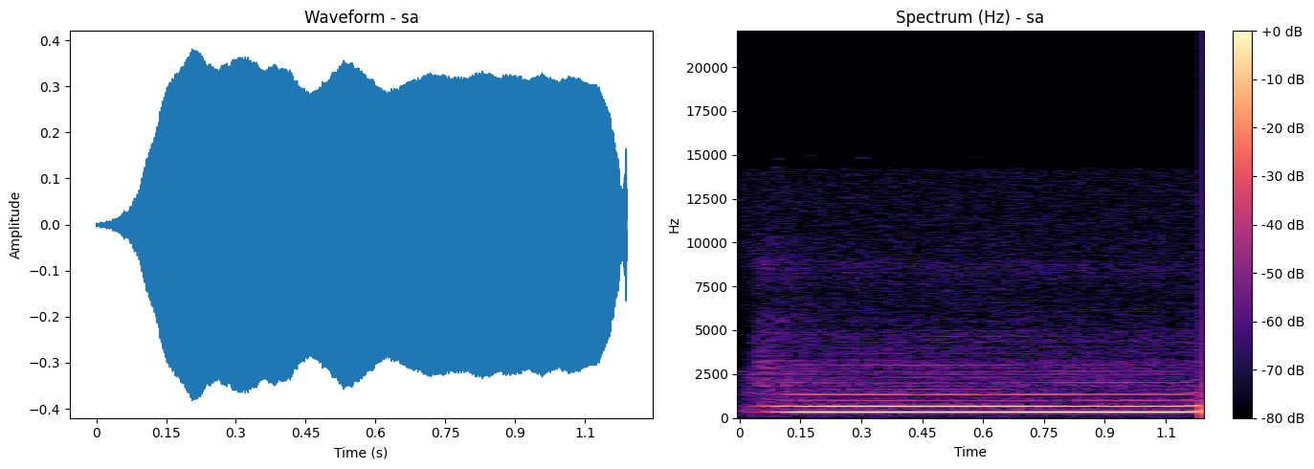
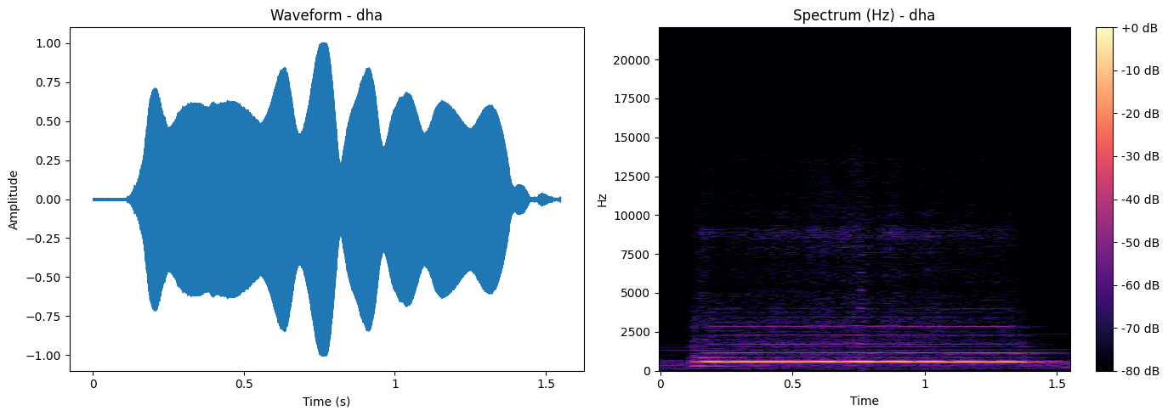

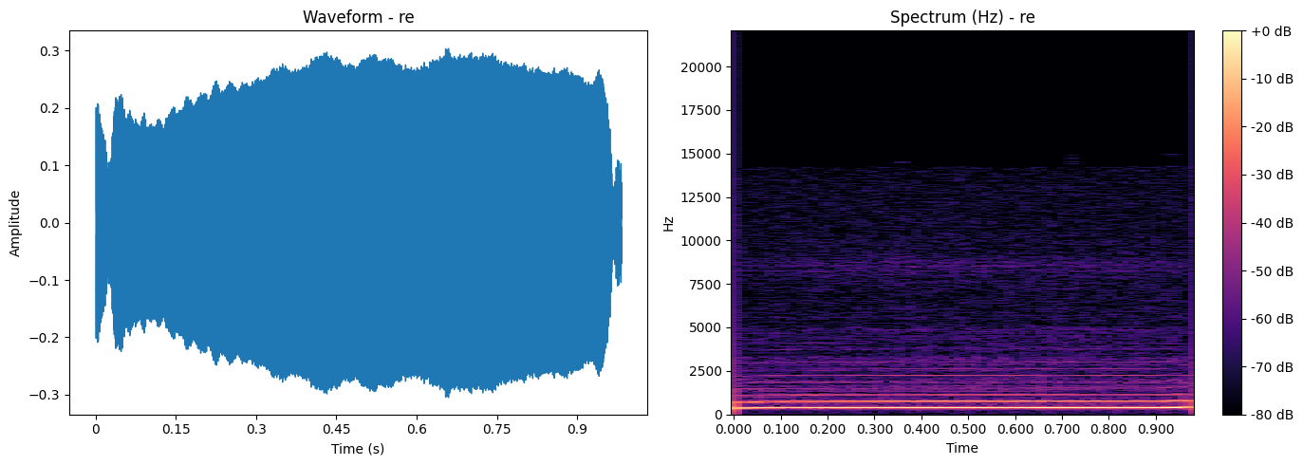
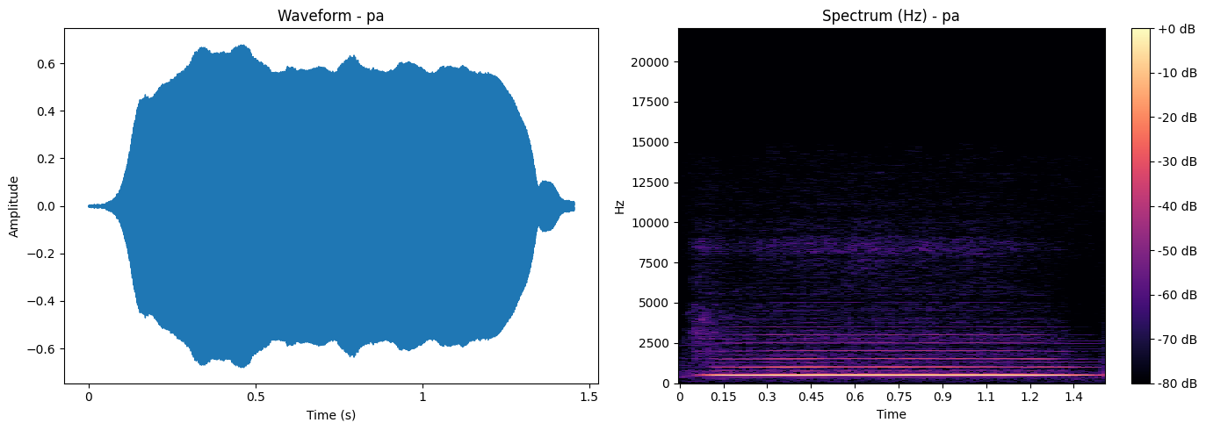
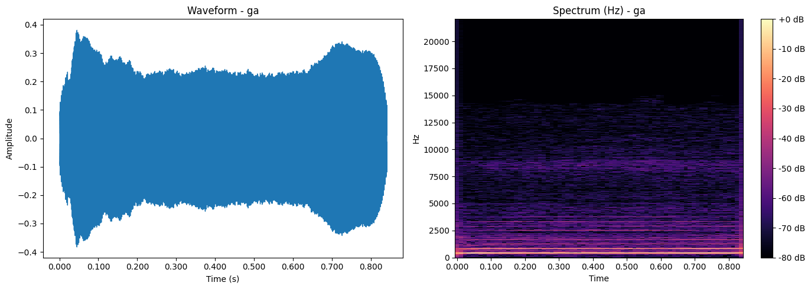
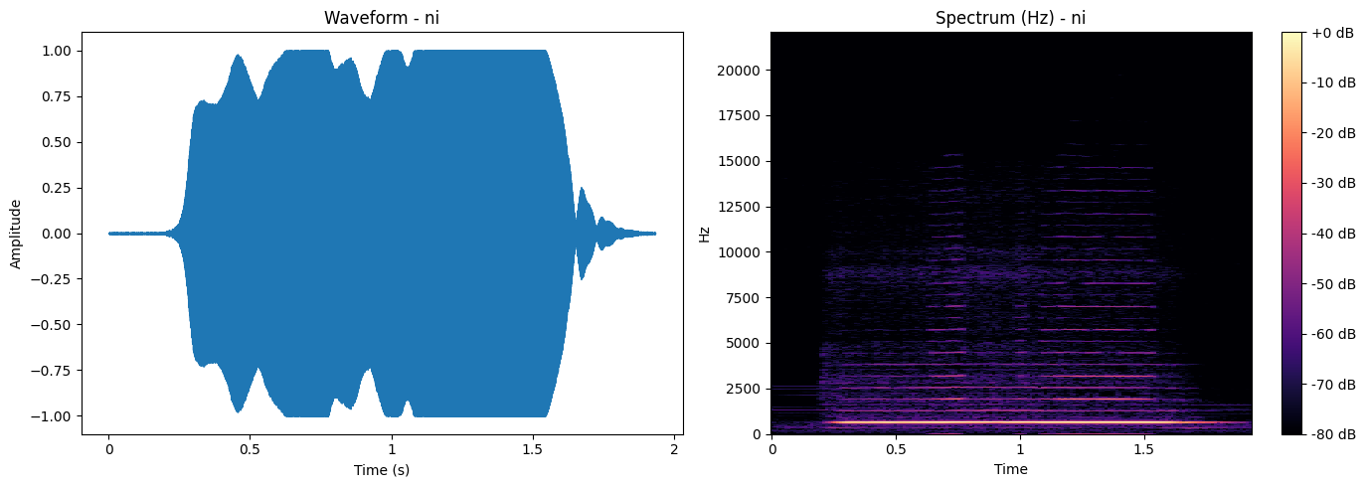
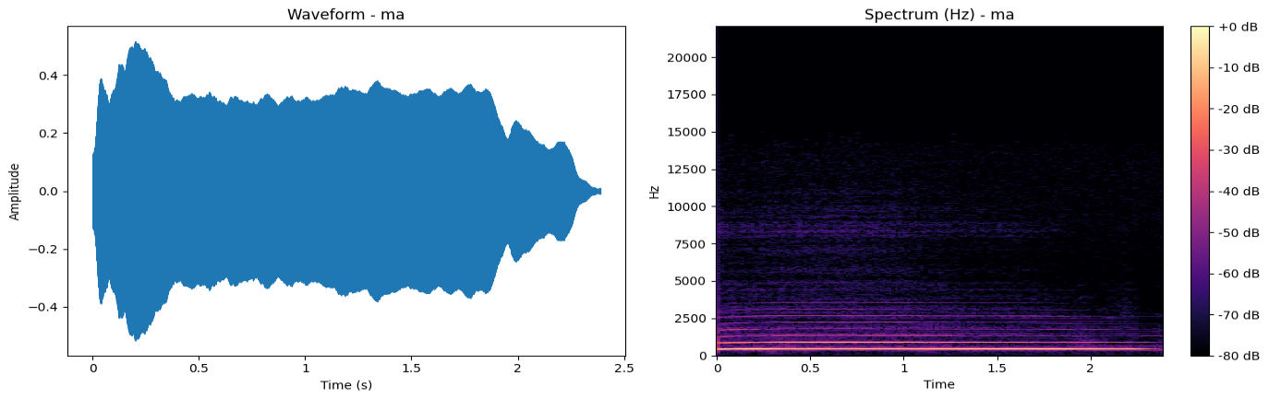
Swaras
Sa
Pa
Re
Dha
Ga
Ni
Ma
05

Slide 6
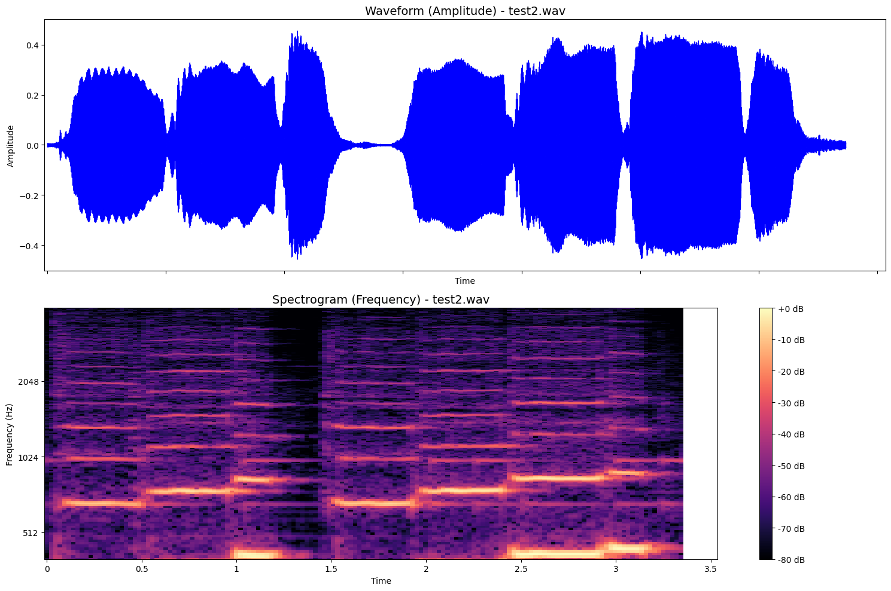
Time and Frequency Analysis of Melody Signals
Swara sequence:
  Sa → Re → Ga → Sa → Re → Ga → Ma
Raga signals have continuous note transitions
Swaras are not clearly separable in waveform/spectrogram
Requires automatic identification approach
06

Slide 7
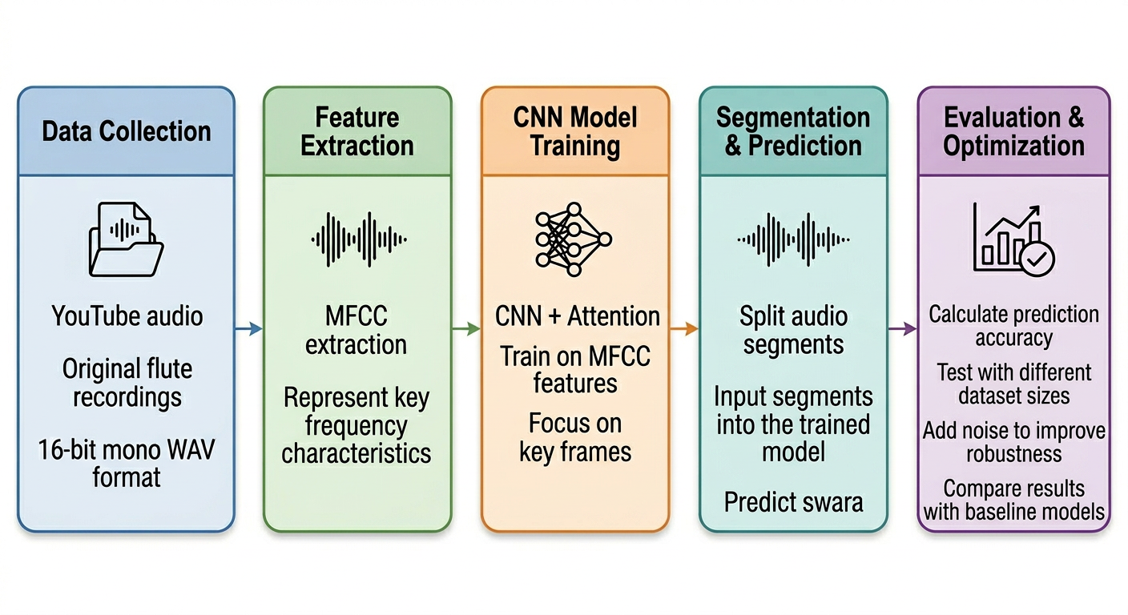
Our proposed methodology
07

Slide 8
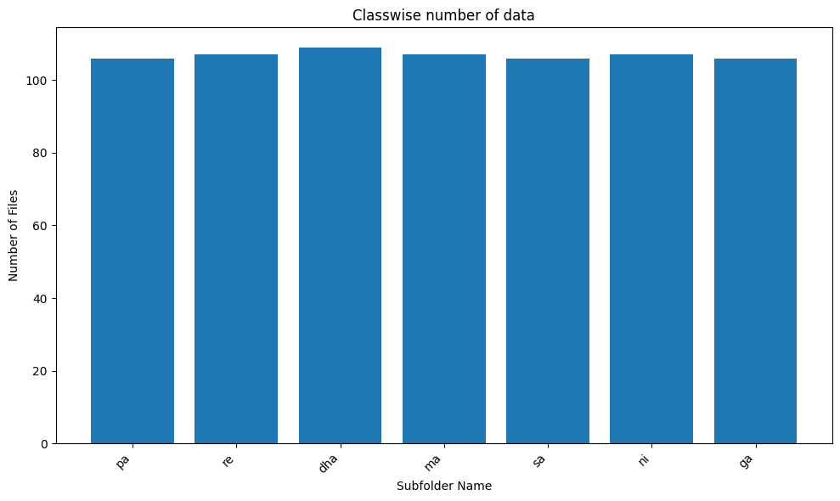


Work Completed So Far
Data Collection :
  Collected around 105 audio samples per swara class, totaling 735 recordings
  Test dataset includes 102 different mixtures of continuous audio recordings
Model Training:
  Trained our CNN + Attention model on the MFCC representations of the audio.
    The obtained results are as follows:
    Accuracy: 0.9271
    Precision: 0.9432
    Recall: 0.9271
    F1 Score: 0.9306
08

Slide 9
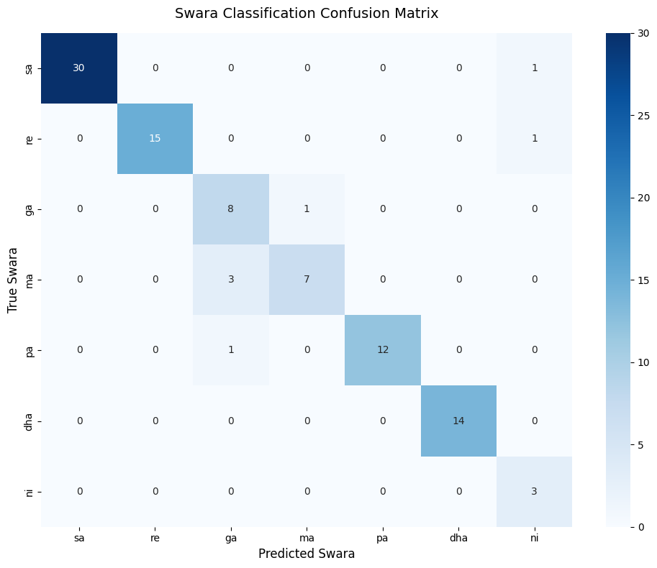
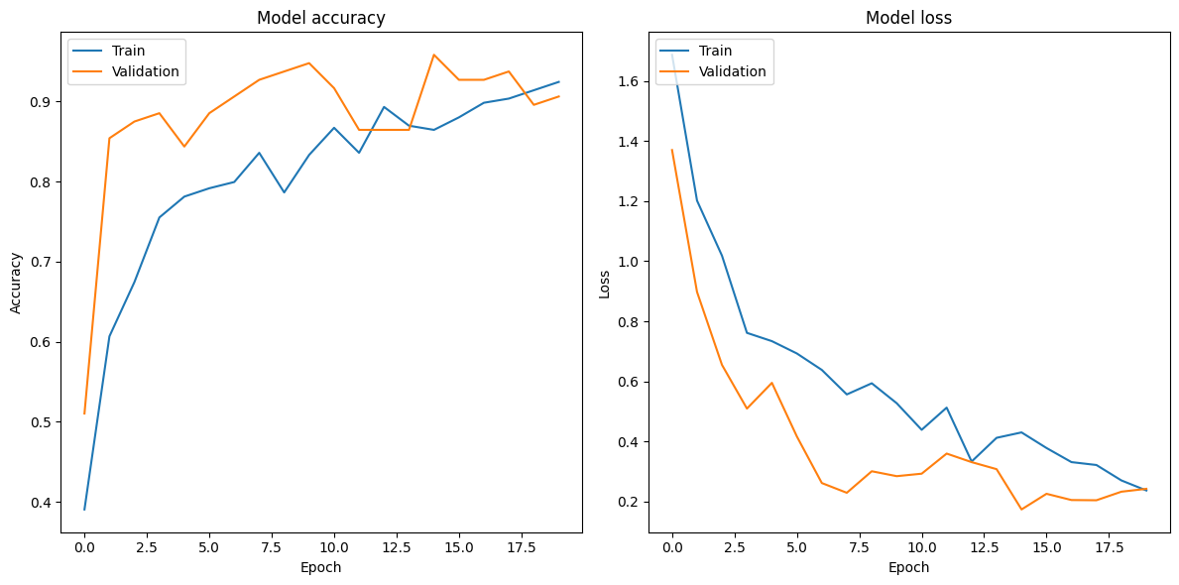
Our model Training Pipeline
Feature Extraction (MFCC): Transforms audio into 2D spectral images (100 time frames × 40 features) at a 22,050 Hz sampling rate.
Architecture (CNN + Attention): CNN extracts local harmonic patterns; Attention isolates steady pitches from noise. Softmax classifies 7 categories (7 Swaras).
Training Protocol: Optimized via Adam and Sparse Categorical Cross-entropy loss over 20 Epochs with a batch size of 32. Integrates 100 extracted noise snippets (0.1s) for robustness. Dataset split ratio was 80:10:10 for train test validation.
09

Slide 10



Remaining Work
  Develop an optimized method for segmenting continuous audio recordings accurately
  Evaluate the trained CNN + Attention model on the test dataset
  Refine dataset size and composition based on evaluation results to improve performance and robustness.
10

Slide 11
Proposed Methods for Segmentation
Sliding Window
Segment audio into fixed-length overlapping frames for model prediction.
MF + RCNN on Synthetic Data
Train a Mel-frequency + RCNN model using synthetic swara sequences for segmentation.
Change Point Detection (CPD)
Detect transitions between swaras based on statistical changes in the signal using kernel methods.
SSL via Wav2Vec 2.0
Leverage pretrained models to learn meaningful audio representations without labeled data.
11

Slide 12
References
Swara, https://en.wikipedia.org/wiki/Svara
CNN, LeCun, Y., Bottou, L., Bengio, Y., & Haffner, P. “Gradient-based learning applied to document recognition.” Proceedings of the IEEE, 86(11), 2278–2324, 1998.
MFCC — Davis, S., & Mermelstein, P. "Comparison of parametric representations for monosyllabic word recognition in continuously spoken sentences." IEEE Transactions on Acoustics, Speech, and Signal Processing, 28(4), 357–366, 1980.
Attention — Vaswani, A., Shazeer, N., Parmar, N., et al. "Attention Is All You Need." NeurIPS, 2017.
Deep learning — Goodfellow, I., Bengio, Y., & Courville, A. Deep Learning. MIT Press, 2016.
Yeshwant Singh, and Anupam Biswas. In Advances in Speech and Music Technology: Computational Aspects and Applications, Signal and Communication Technology. Springer, 2023. https://doi.org/10.1007/978-3-031-18444-4_5
Devansh P. Shah, Nikhil M. Jagtap, Prathmesh T. Talekar, and Kiran Gawande. In Raga Recognition in Indian Classical Music using Deep Learning (EvoMUSART 2021), Lecture Notes in Computer Science, vol. 12693. Springer, 2021. https://doi.org/10.1007/978-3-030-72914-1_17
Yu-Te Wu, Berlin Chen, and Li Su. IEEE/ACM Transactions on Audio, Speech, and Language Processing 28 (2020): 2796–2809. https://doi.org/10.1109/TASLP.2020.3030482
Qi Wang, Mingkuan Liu, Changchun Bao, and Maoshen Jia. IEEE/ACM Transactions on Audio, Speech, and Language Processing 32 (2024): 3492–3505. https://doi.org/10.1109/TASLP.2024.3419441
Ruimin Wu, Xianke Wang, Yuqing Li, Wei Xu, and Wenqing Cheng. In ICASSP 2024 – IEEE International Conference on Acoustics, Speech and Signal Processing, 1256–1260, 2024.
Rachel M. Bittner, Juan José Bosch, David Rubinstein, Gabriel Meseguer-Brocal, and Sebastian Ewert. arXiv preprint (2022). https://doi.org/10.48550/arXiv.2203.09893
Eelco van der Wel, and Karen Ullrich. In Proceedings of the 18th International Society for Music Information Retrieval Conference (ISMIR 2017), 731–737. https://doi.org/10.5281/zenodo.1415664
Rui Pedro Paiva, Teresa Mendes, and Amílcar Cardoso. Journal of New Music Research 37, no. 4 (2008): 297–314. https://doi.org/10.1080/09298210802549748
Tim Beyer, and Angela Dai. arXiv preprint (2024). https://doi.org/10.48550/arXiv.2410.00210
Antonio Ríos-Vila, Jorge Calvo-Zaragoza, and Thierry Paquet. In Document Analysis and Recognition – ICDAR 2024. https://doi.org/10.1007/978-3-031-70552-6_2 ; https://doi.org/10.48550/arXiv.2402.07596
12

Slide 13
THANK
YOU
Any Question?

