Slide 1
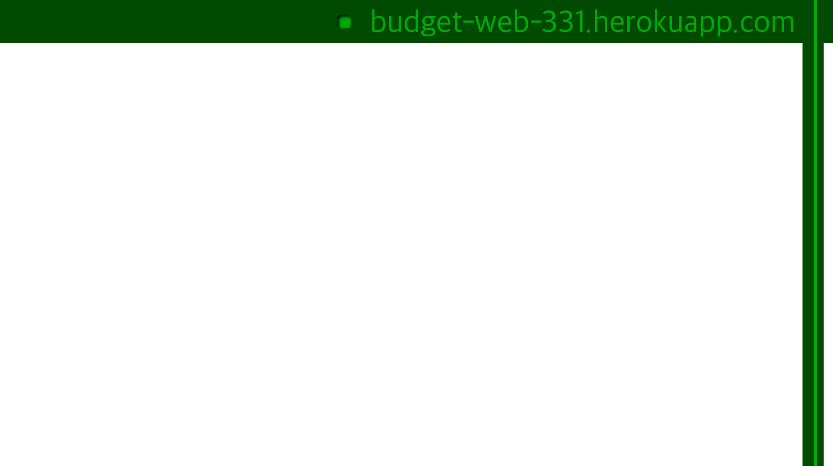

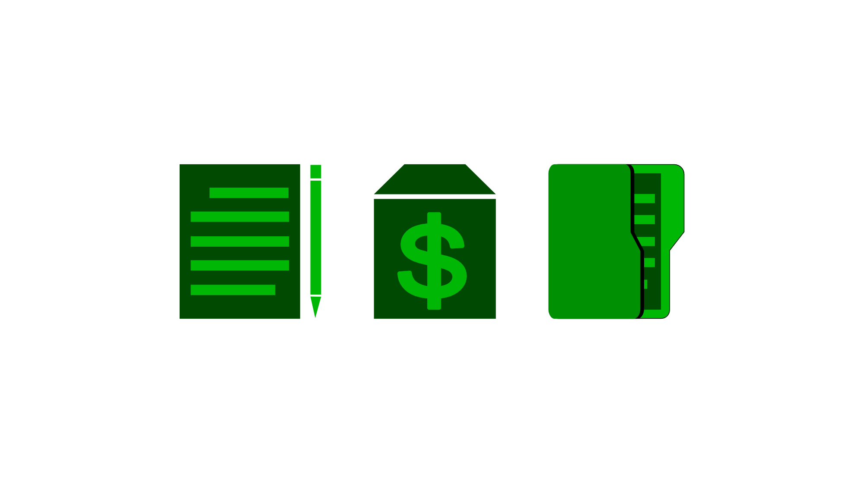
Budget-X
Trey Popp & Garrett Turner

Slide 2
Goal
We wanted to provide a with a simpler way to manage your projects financially.
Budget-X offers the ability to create projects, invite members, and log user purchases.
Eliminating the task of tracking receipts.
Notes:
EGEN 310 - we were required to spend money on parts for a RC car that we were designing in the class. The general method of tracking purchases that groups used was a google docs file, which is prone to error and could lead to different people having to spend more than others in the group. This project would be a solution to that.
Eliminates the task of tracking receipts by putting all of the purchases people have made on a single screen that everyone has access to

Slide 3
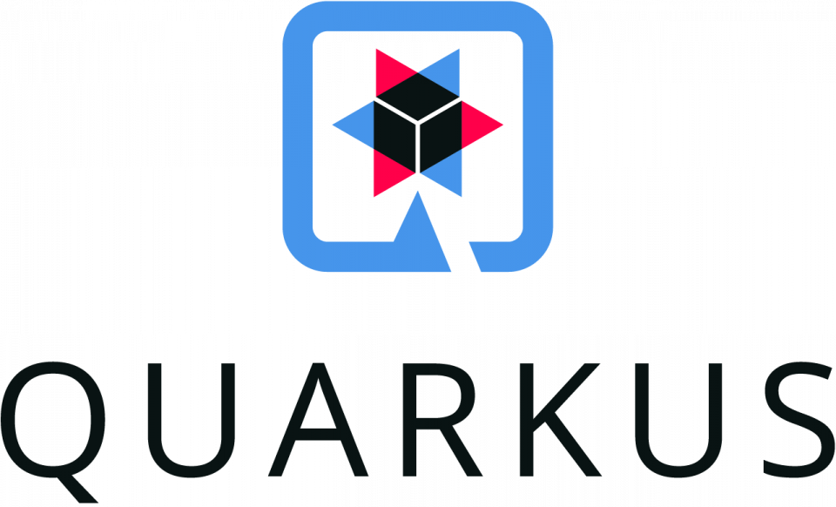


CORE Technologies
The technologies we used can be divided into three main levels:
The database
The api
The application level

Slide 4
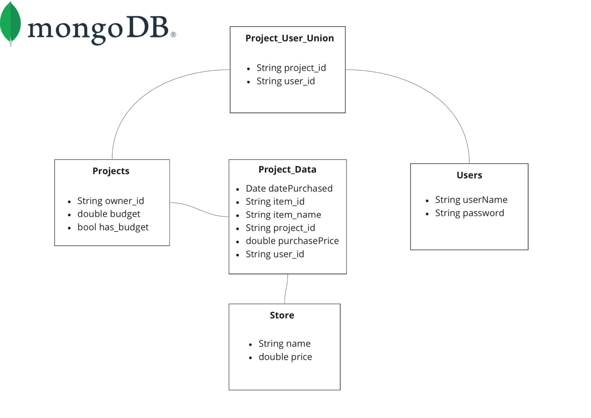

Slide 5
The API Layer
Quarkus:
Panache
Object Relational Mapper
Communicates with mongodb
Rest-Easy-Reactive
Handles endpoints (GET, POST, DELETE)
Jackson Serialization
Converts models to and from JSON
(Java Framework)
Notes:
Quarkus is a java framework and has many different modules, these were some of the main ones we used:
Panache - provides methods to create, update, and remove records, perform basic queries, and define and execute your own queries

Slide 6

Flutter
Riverpod (State management)
Chopper (Handling API calls)
Beamer (Routing)
(Coded in Dart)

Slide 7
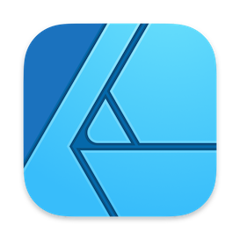
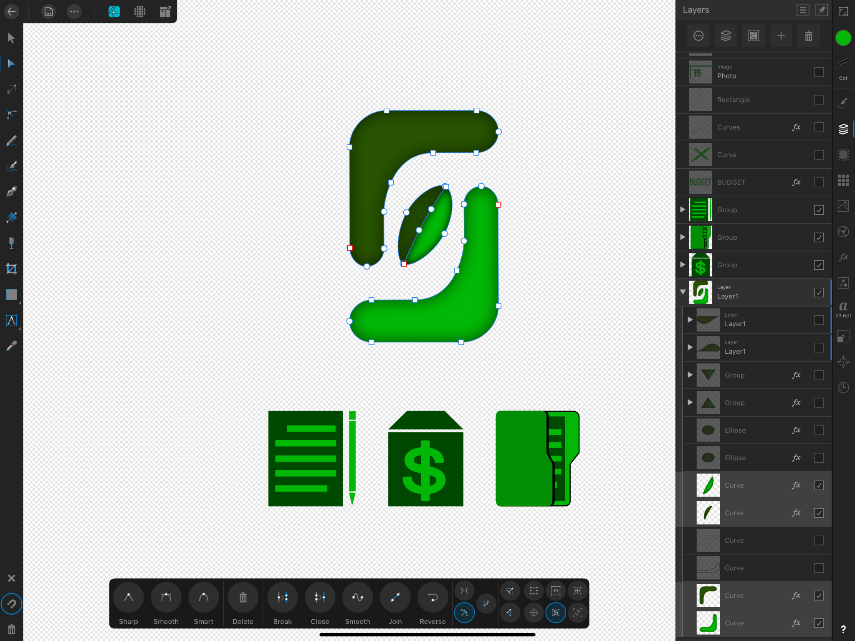

AFFINITY DESIGNER

Slide 8

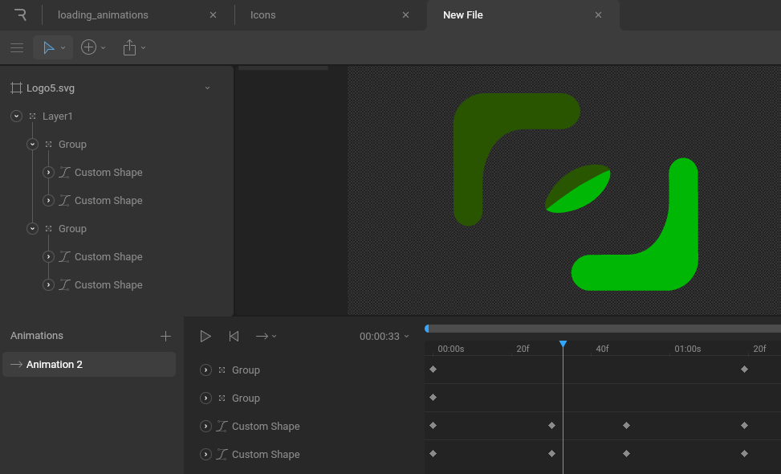
https://rive.app

Slide 9
Contributions
We handled majority of the work as a team (vs splitting up the work) to account for the learning curve with these unfamiliar libraries.

Slide 10
What We Learned
Got experience with many different technologies
MongoDB
Quarkus
Flutter
Tying these technologies together to create a functional web app

Slide 11
What Worked
Quarkus made making the api very easy
Chopper: Code generation for api calls (http requests)

Slide 12
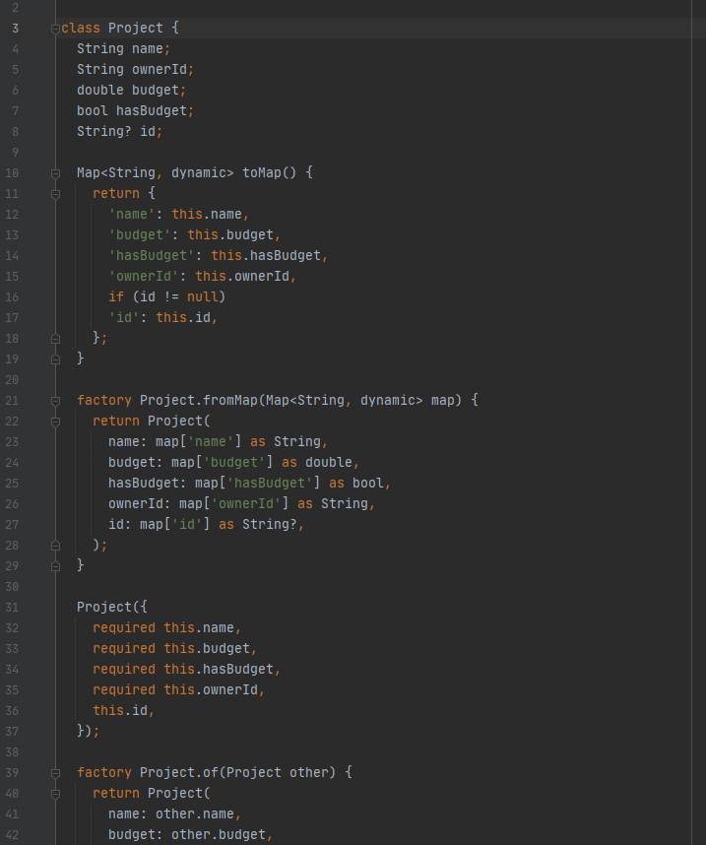
What Didn’t Work
Usability of technologies
Tall learning curve
Notes:
Flutter and dart

Slide 13



Communication
Github
Discord
Text
Notes:
Only in a group of two so it was very cut and dry what needed done
Didn’t need to use a scrum board or other similar collaboration tool

Slide 14
If We Were to do This Project Again
Implement more security features
Create a better UI
Add more features to the web app
Switch to a relational db, (mysql) for schema immutability.. In Mongo, schema can’t change after the table is created
Relational db is faster

Slide 15
Demo
http://budget-web-331.herokuapp.com/

