Slide 1
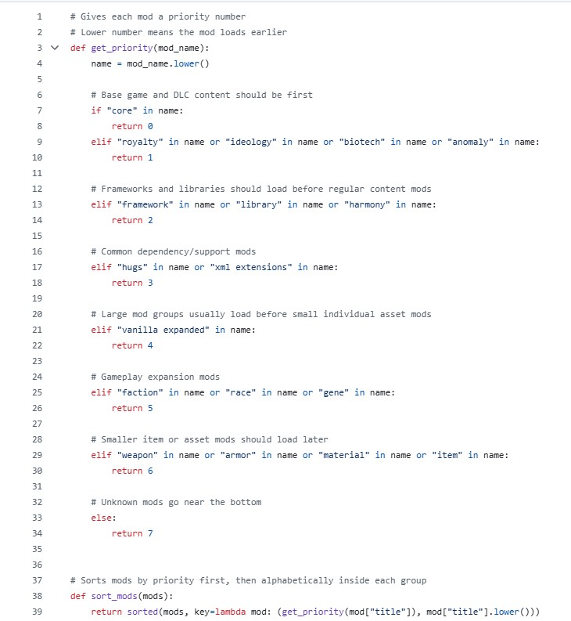



Project: ModSortOrder
This Project is being developed by the sole dev: Trey Runner
Most premade mod collections are already sorted into the order they need to be to work optimally- but this isn’t always the case!
Here is an example of a well-designed collection (AKA Mod packs) used by many modders around the world. With the high priority load order items higher in the queue than those that depend on it. IE; Framework comes before dependencies.
My code receives the ID of a collection by your input- even one that is freshly created by you- and sorts the mods within into 7 different categories based on priority. This is particularly useful for amateur mod pack developers and those that have never modified one before. This does not directly alter the collection but produces a guide with load order so you can manually alter to fit the requirements.

