Slide 1
Driveline Open Biomechanics Project
Trey Chase

Slide 2
Introduction/Goals
Analyze pitching data provided by Driveline to find a quantitative link between mechanics and velocity
All pitches are fastballs in this study
Data from pitchers obtained by motion capture equipment and force plates
Data is pre-cleaned by Driveline
Pitchers vary in level from high school to MLB (most are college)
Draw conclusions to streamline mechanical adjustments

Slide 3
Research Questions
Predict fastball velocity from the mechanical metrics provided
Split data into train and test splits
Step-wise regression algorithm
Determine the five most significant movements linked with velocity
Draw the terms in the model with the most statistically significant coefficients

Slide 4
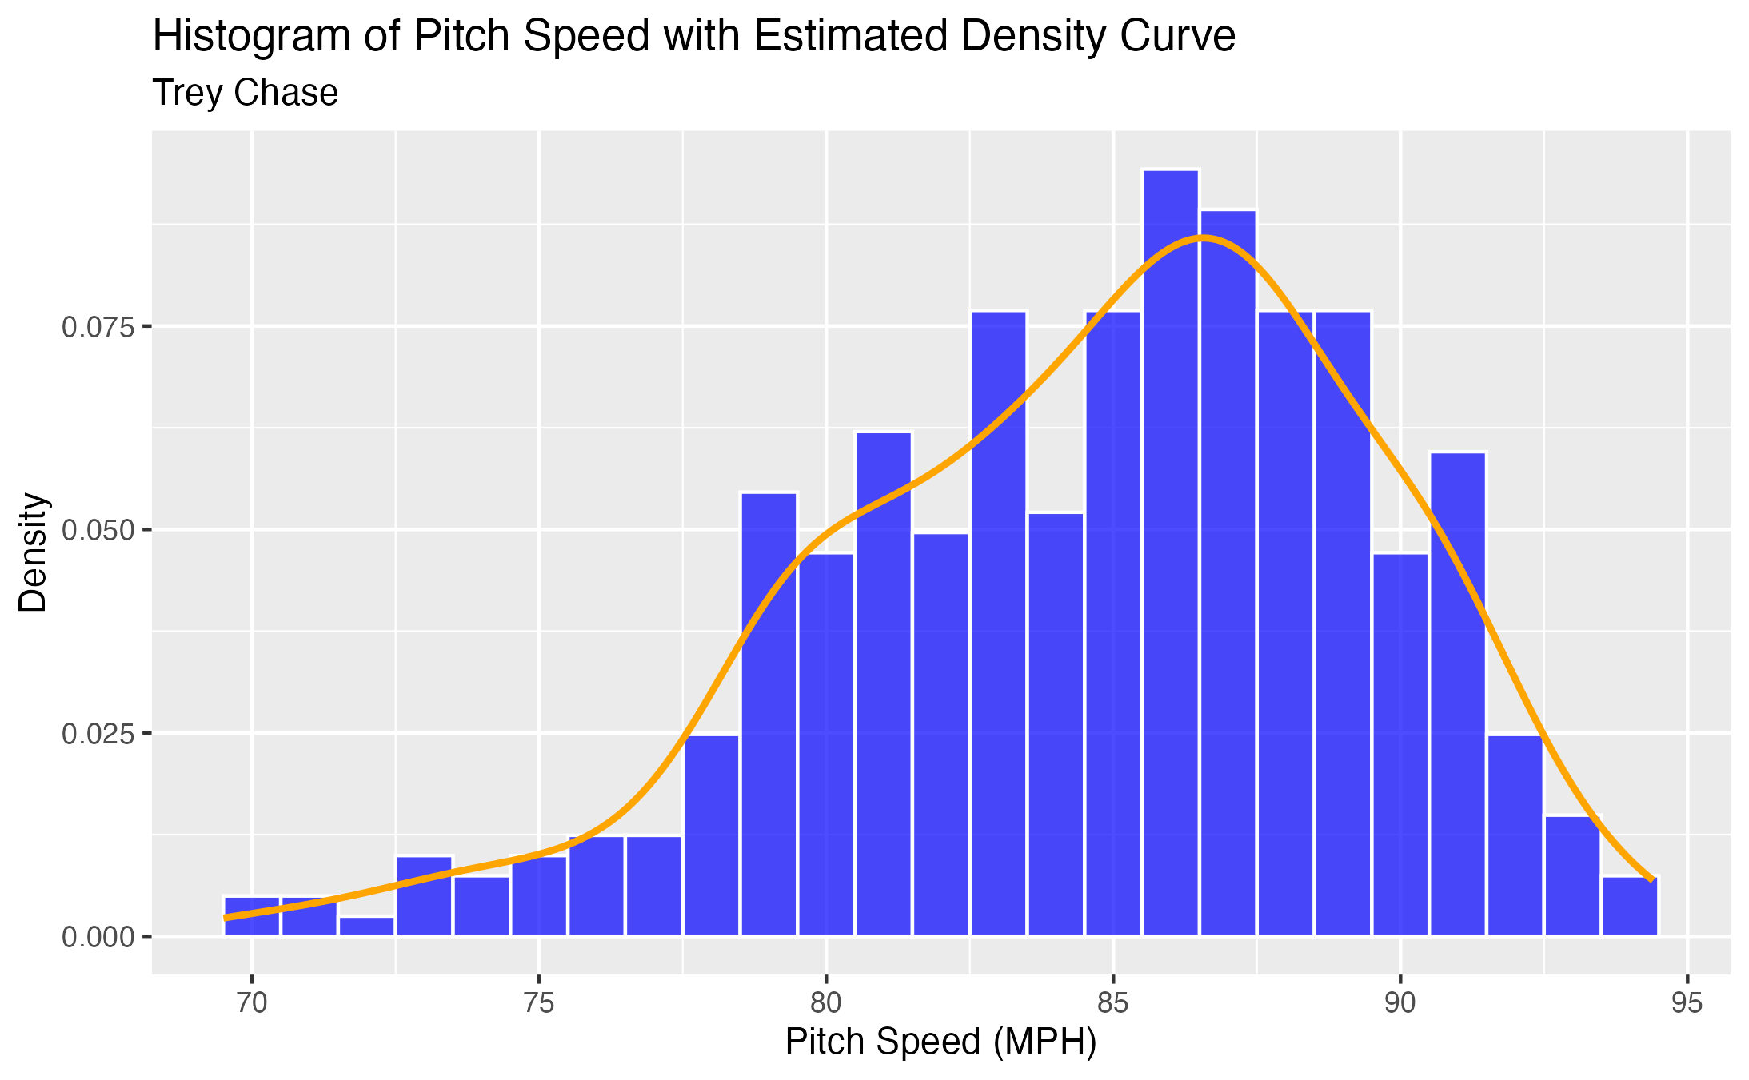
Pitch Speed Distribution
Distribution is skewed left
Approximately normal

Slide 5
Assumptions
Multicollinearity
The explanatory variables cannot be highly correlated with one another
Use Variance Inflation Factor (VIF)
Heteroscedasticity
The variance of errors is roughly constant
Residuals should be normally distributed

Slide 6
Model Selection
Linear Regression
Step-wise algorithm
At each step, multiple models are created by dropping a variable
Models are compared
One with the lowest prediction error moves to the next step

Slide 7
Assumptions

Slide 8
Model Performance

Slide 9
Visualizations

Slide 10
Data Visualization

Slide 11
Five Most Important Features

