Slide 1
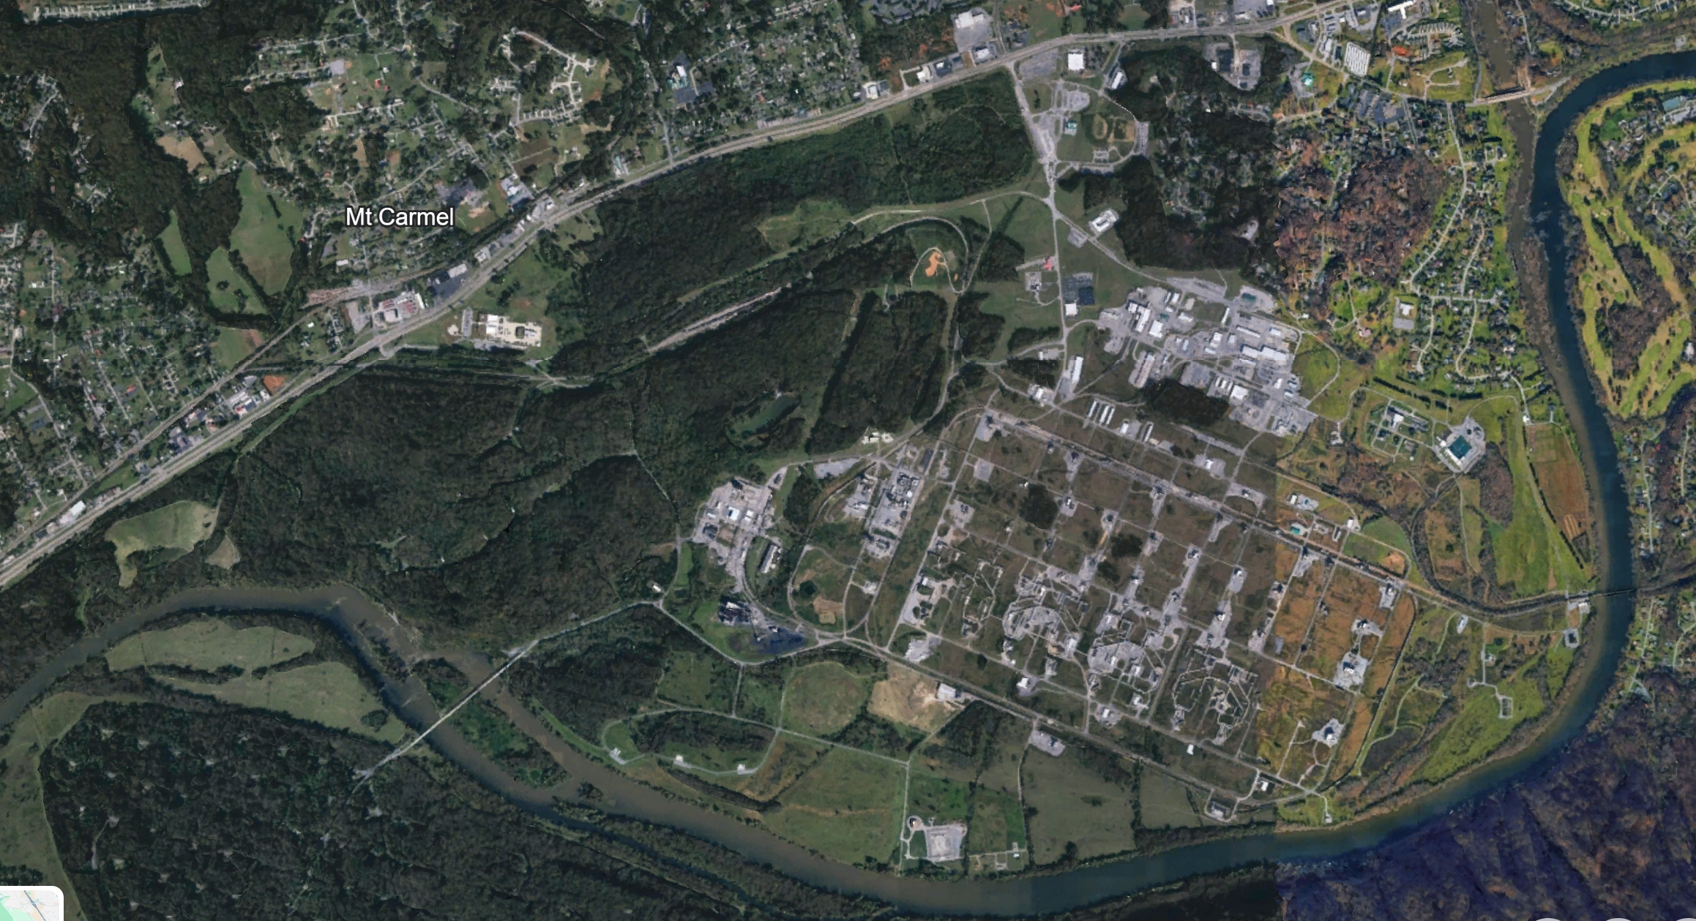
US-11W
NAI
3001 – ICP
3002 – Main Gate Access Point
3003 – Critical Infrastructure – 1
3004 – Railway / Pipeline Access
3005 – Critical Infrastructure – 2
3006 – Railway / ASP Access Point
3007 – Waterway Access Point
3008 – Bridge
3009 – Railway Switch / Access Point
3010 – US-11W
NAI 3002
NAI 3001
NAI 3009
NAI 3006
NAI 3003
US-11W
NAI 3004
NAI 3008
NAI 3005
NAI 3007
N

Slide 2
US-11W
TNSG | TNNG 3 / 3
S
US-11W
P
TNNG | TNSG 3 / 3
P
P
N

Slide 3
US-11W
TNSG | TNNG 3 / 3
S
US-11W
P
TNNG | TNSG 3 / 3
P
P
N

Slide 4
US-11W
NAI 3002
TNSG | TNNG 3 / 3
NAI 3001
S
NAI 3009
NAI 3006
NAI 3003
US-11W
P
US-11W
NAI 3004
TNNG | TNSG 3 / 3
NAI 3005
NAI 3008
P
NAI 3007
P
N

