Slide 1


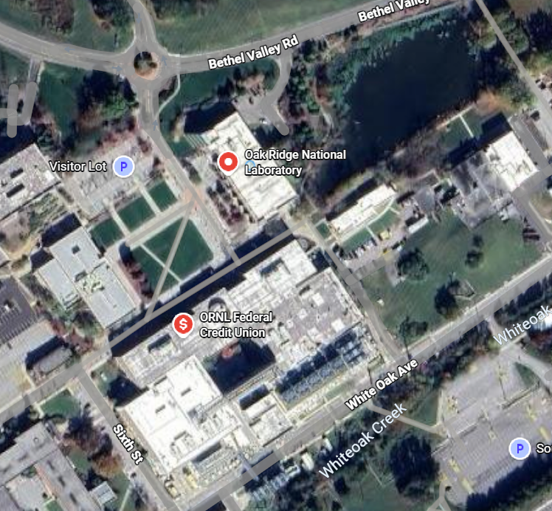
Cyber WG
Scenario:
Cyber event targeting eagle-i.doe.gov impacts TEMA operations. During incident response, UTK is discovered to be a secondary target.
Triggers/Artificialities/Simulation:
Participants | Onsite | Remote
ORNL Cyber Division | 10 | 0
Eagle-I Sys admins | 3 | 0
TEMA | 1 | 1
UTK | 0 | 1
TN Guard | 5 | 5
State Guard | 3 | 2
Timeline: 14May2026
See slide “TNMAN 2026 Basic Scenario”
POC & Location Information:
ORNL – Matt Lindsey (404) 245 – 1123, lindseymg@ornl.gov, ORNL SOC w/ Teams Link
UTK – Brian Gard (865) 974 – 9347, bgard1@utk.edu, UTK EOC joined via Teams Link
TEMA – David West (865) 719 – 2233, David.l.west@tn.gov, ORNL SOC
ARNG – CW4 Richard Allen, (615) 478-1159, richard.d.allen56.mil@army.mil
State Guard – CW4 Michael Simpson, (615) 243 – 4703, michael.simpson@tnstateguard.org
Objectives:
1 - Coms between ORNL and TEMA surrounding Eagle-I outage.
2 - LMR interop exercise/radio checks for communication outage.
3 – State EOC intel sharing with UTK of IOCs/TTPs.
4 - IR tabletop exercise with ORNL/UTK.
Logistics & Resources:
Food/Water: Provided per individual units
Lodging: Provided per individual units
Role Players: Documented in Participants Section.
Comms: Subject to TNNG: P: ; A: ; C: ; E:
Admin: Provided per individual units.
Medical: Provided per individual units.

Slide 2
TNMAN 2026 Basic Scenario
Starting Scenario – ORNL Eagle-I service is targeted by a cyber attack.
0800 EST, Eagle-I system admins notice strange activity, and report to ORNL DCO of a potential cyber event.
0830 EST, ORNL DCO formally declares an incident.
0930 EST, TEMA is notified of derogated service to Eagle-I.
0945 EST, known IOCs are shared to state EOC.
1000 EST, UTK staff detects suspicious activity matching IOCs provided by ORNL.
1030 EST, UTK IMT/EOC responds to cyber attack and impacts of campus wide infrastructure outage. – UTK/ORNL attempts to determine joint staff list.
1130 EST, ORNL localized cell tower outage. TEMA notified via VoIP/email.
1140 EST, Eagle-I goes down entirely. TEMA is notified of Eagle-I outage.
1200 EST, ORNL requests radios from onsite EOC and coordinates channels with TEMA.
1205 EST, ORNL is offered training awareness kit (TAK) to coordinate response.
1215 EST, runner sent to pickup radios arrive.
1245 EST, ORNL achieves eradication and containment of cyber event.
1300 EST, Eagle-I service is partially restored.
1400 EST, UTK reports partially restored continuity of operations.
Injects
1 – Eagle-I goes down entirely
2 – After ORNL provides IOCs, UTK detects suspicious activity on their network.
3 – Localized cell tower outage, ORNL EOC brings out radios.

Slide 3
Assumptions and Background Conditions
Outside of the scope of this scenario itself, but we are assuming that federal communications are restored via ECN.
We will be simulating IJC3, FBI, and ORNL communications on ORNL’s side.
ORNL will schedule a training session of team awareness kits (TAK) @CW4 Simpson.
Once notified, UTK will follow their own response plan and generate their own injects for the remainder of the exercise.
ORNL radios are initially only locally effective.

Slide 4
Deliverables
ORNL – Sharpen technical details with Eagle-I admins for tabletop cyber event.
UTK – Bring internal MSEL with internal cyber response actions.
TEMA – Review plans/procedures with lead on how communications and resources will work between ORNL, UTK, etc.
TN/State Guard – Planning session for participation in this event.

Slide 5
Lead Planners
UNCLASSIFIED
TN National Guard
2LT Gabriel Sussman
J3/7 DOMS Training Officer
gabriel.f.sussman.mil@army.mil
615-313-0562
MAJ Trint Callison
Deputy J3/5/7
trinity.r.callison.mil@army.mil
615-417-9811
MAJ Kristin Crandall
Plans and Operations Officer, DOMS
kristin.k.crandall.mil@army.mil
615-313-3107
LTC Dallas Clements
Deputy J3/Director of Military Support
dallas.c.clements.mil@army.mil
615-313-0881
TEMA
Ryan Scwartz
Exercise Program Manager
Ryan.Schwartz@tn.gov
615-557-7360
Tatiana DiSalvo
Exercise Specialist
Tatiana.DiSalvo@tn.gov
615-626-8321
Matt Heckard
Assistant Director
Matthew.Heckard@tn.gov
615-939-0505
Todd Jones
East Region Director
Todd.Jones@tn.gov
865-599-0035
UNCLASSIFIED

