Slide 1
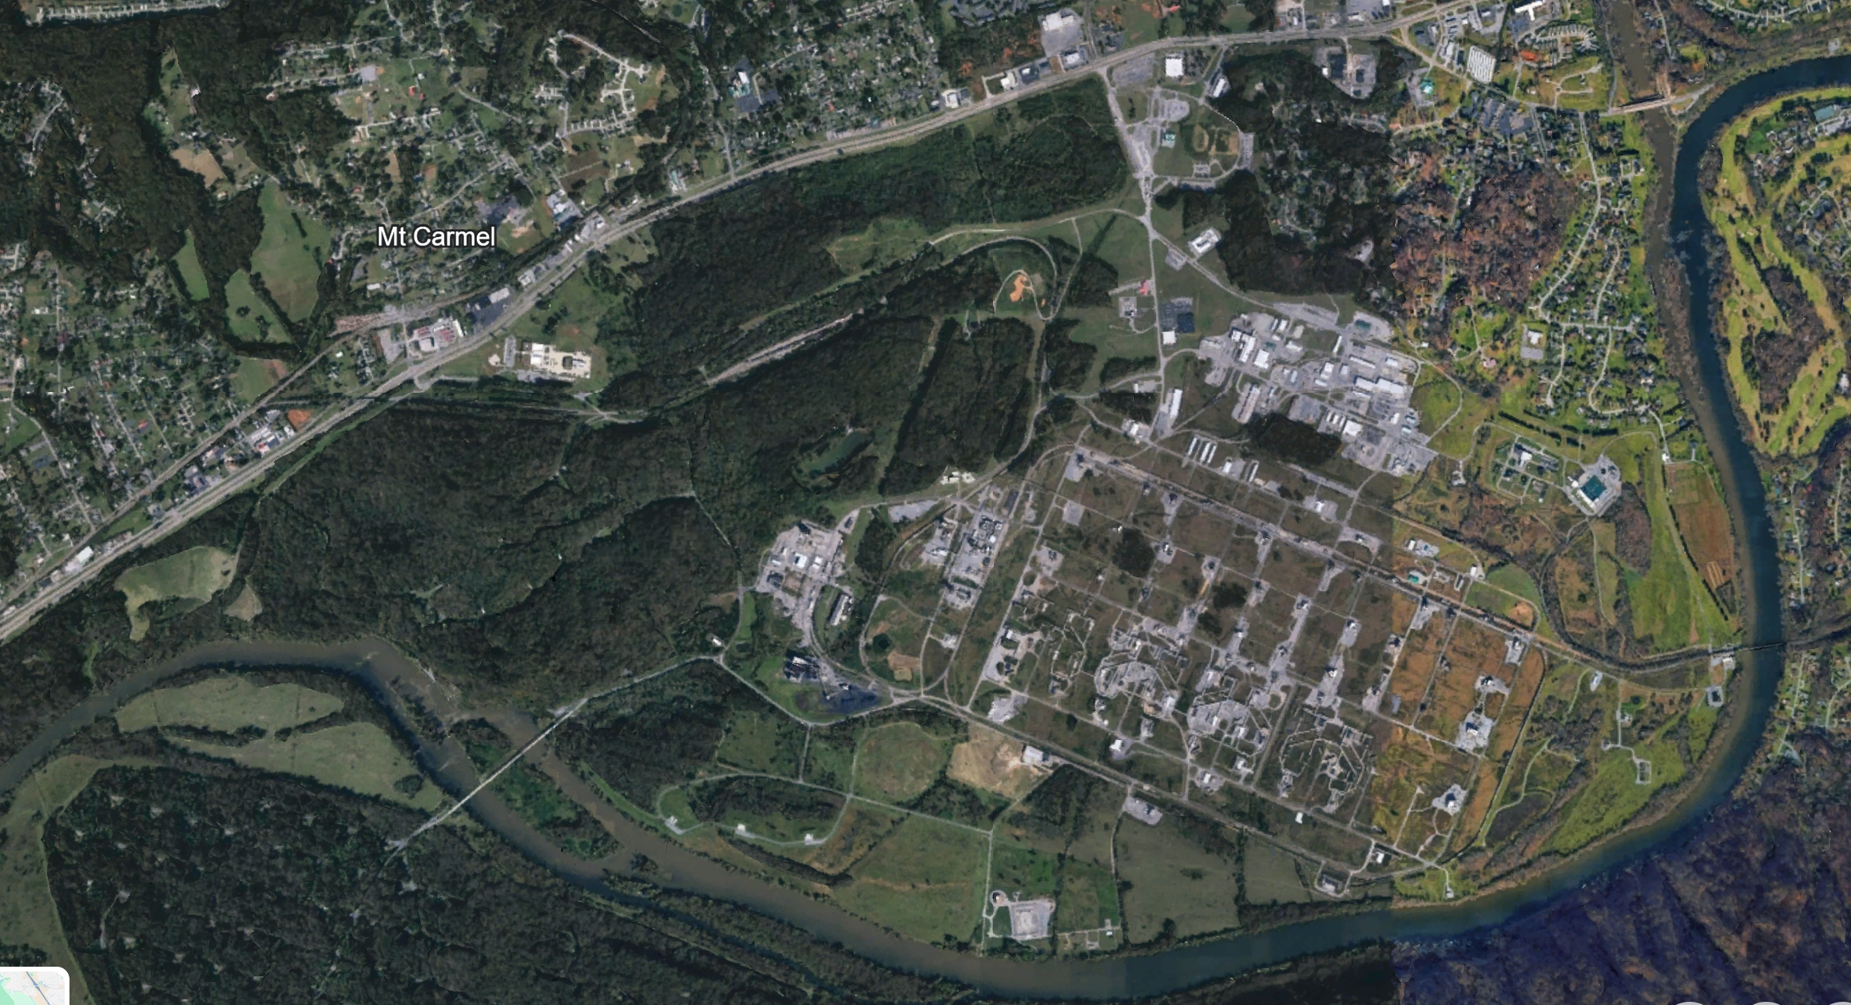
US-11W
NAI
3001 – ICP
3002 – Main Gate Access Point
3003 – Critical Infrastructure – 1
3004 – Railway / Pipeline Access
3005 – Critical Infrastructure – 2
3006 – Railway / ASP Access Point
3007 – Waterway Access Point
3008 – Bridge
3009 – Railway Switch / Access Point
3010 – US-11W
NAI 3002
NAI 3001
NAI 3009
NAI 3006
NAI 3003
US-11W
NAI 3004
NAI 3008
NAI 3005
NAI 3007
N

Slide 2
US-11W
SECFOR Patrol Ops
TNSG 3 / 3 | TNNG
S
~ 2700 m
~ 2200 m
US-11W
P
TNNG | TNSG 3 / 3
P
~ 2200 m
~ 2200 m
P
N

Slide 3
US-11W
sUAS Ops
NAI 3002
NO-GO Line
US-11W
NAI 3008

Slide 4
US-11W
NAI
3001 – ICP
3002 – Main Gate Access Point
3003 – Critical Infrastructure – 1
3004 – Railway / Pipeline Access
3005 – Critical Infrastructure – 2
3006 – Railway / ASP Access Point
3007 – Waterway Access Point
3008 – Bridge
3009 – Railway Switch / Access Point
3010 – US-11W
US-11W
NAI 3002
TNSG 3 / 3 | TNNG
NAI 3001
S
NAI 3009
NO-GO Line
NAI 3006
NAI 3003
US-11W
P
US-11W
NAI 3004
TNNG | TNSG 3 / 3
NAI 3005
NAI 3008
P
NAI 3007
P
N

Slide 5
US-11W
NAI
3001 – ICP
3002 – Main Gate Access Point
3003 – Critical Infrastructure – 1
3004 – Railway / Pipeline Access
3005 – Critical Infrastructure – 2
3006 – Railway / ASP Access Point
3007 – Waterway Access Point
3008 – Bridge
3009 – Railway Switch / Access Point
3010 – US-11W
NAI 3002
NAI 3001
NAI 3009
NAI 3006
NAI 3003
US-11W
NAI 3004
NAI 3008
NAI 3005
NAI 3007
N
N

Slide 6
US-11W
TNSG 3 / 3 | TNNG
S
US-11W
P
TNNG | TNSG 3 / 3
P
P
N

Slide 7
US-11W
NAI 3002
NO-GO Line
US-11W
NAI 3008
N

Slide 8
US-11W
US-11W
NAI 3002
TNSG | TNNG 3 / 3
TNSG 3 / 3 | TNNG
S
NAI 3001
S
NAI 3009
NO-GO Line
NAI 3006
NAI 3003
P
US-11W
P
US-11W
US-11W
NAI 3004
TNNG | TNSG 3 / 3
NAI 3005
TNNG | TNSG 3 / 3
NAI 3008
P
NAI 3007
P
N

