Slide 1

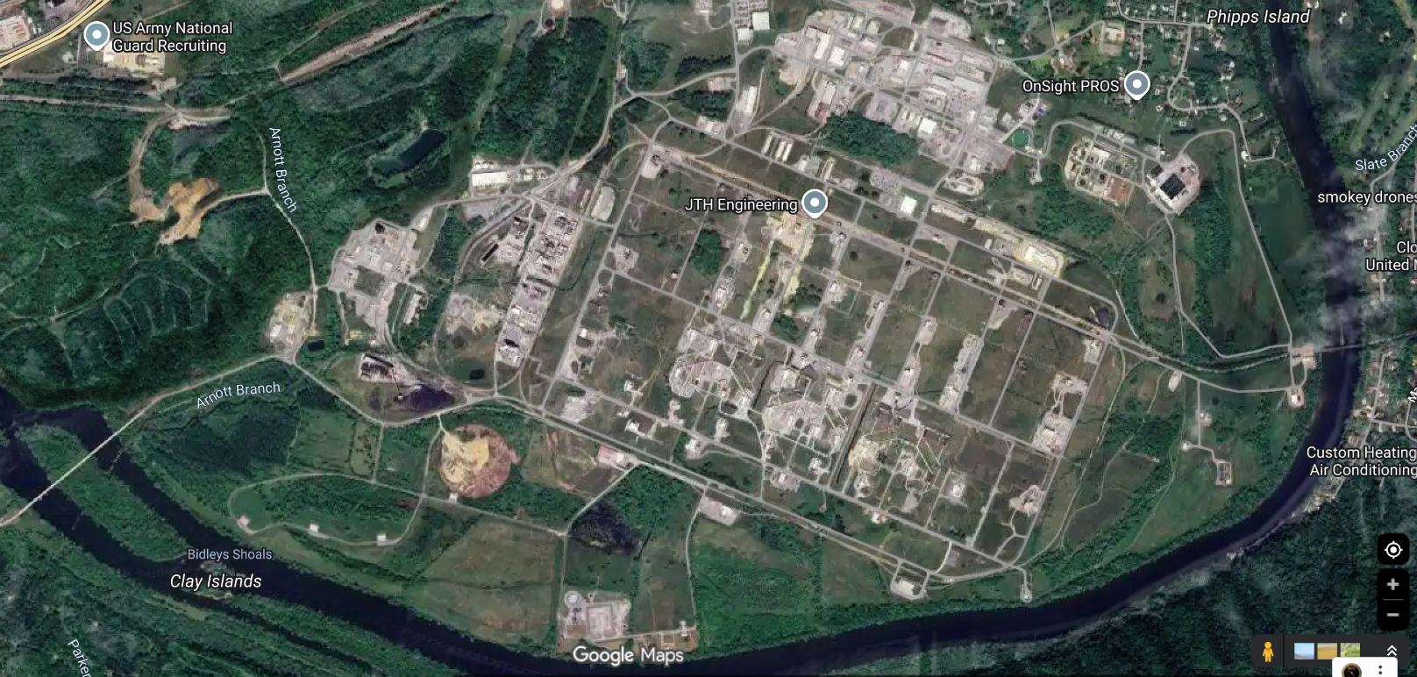

Working Group Slide Example
HD Working Group
Scenario: Military installation in TN has been attacked during the Natural Disaster and limited resources are available
Triggers/Artificialities/Simulation:
-Limited resources to Support MOU/MOAs triggers request for support through DCO/DCE which ultimately leads to Fed tasking state to support.
HAAP contact Local EMA, EMA contact TEMA, TEMA contact NG.
Test drone system.
Commander’s approval for Drone use
Participants | VICs/ Equipment | PAX
Holston | 0 | 3
State Guard | 5/4 | 10
JABS/J6 | 1 | 10
PAO | 1 | 1
Total | 15 | 24
Timeline:
13 MAY 2026 Attack begin 08:00
ADVON / establish ICP
14 May 2026 Main day
15 May half day and AAR
POC & Location Information:
Holston POC: Tony Armstrong, 423-341-5840, HAAP
State Guard Poc: COL Noah Roark 423-329-2620
Objectives:
-Exercise the TERP (Tennessee Emergency Response Plan) HD Annex
-Establish ICP
Coordinate with Holston EMA
-Test HAAP drone system and drone approval process.
-CSDA TTX
Perimeter security, parking lot security
Base entrance inject
Protection of Water way: Netherland Park.
Logistics & Resources:
Food/Water: All units are responsible for food and water for their personnel.
Lodging: All units are responsible for lodging for their personnel, if needed.
Role Players:?
Comms: TNNG: P: TACN; A: FirstNet ePTT; C: Cell Phone; E: Satellite Phone; JISCC
Admin: Provided by SG
Medical: Provided by SG

Slide 2
Inject Examples
INJECTS
5 W’s
-Who: EMA, HAAP, TEMA, RCC, TNNG
-What: HD scenerio
-When: 13-15 MAY 2026
-Where: Kingsport, TN
-Why: Execute HD crawl
Expected Player Action:
10 SG, 1 PAO, 3 HAAP, 2 NG
Measure of Performance/Effectiveness: TBD
Realism: mixture of FTX and TTX
Objectives:
-Exercise the TERP (Tennessee Emergency Response Plan) HD Annex
-Establish ICP (5 SG PAX)
Coordinate with Holston EMA (2 HAAP PAX)
-CSDA TTX
- Test HAAP drone system and drone approval process. (4 SG PAX)
Perimeter security, parking lot security (6 SG PAX)
Damage Assessment UAS (4 SG PAX – Duplicate Number)
Base entrance inject (3 SG PAX)
Protection of Water way (Waterway intrusion): Netherland Park. (2-4 SG PAX)
-Medical Support (2 SG PAX)
-Reporting Process
-JISCC Deployment (NG)
Total estimated SG support: 10 pax (this will trigger RFA through EPLO to DCO for Fed resources, fed resources are unavailable therefore we will reach out to TEMA for support (Executes CSDA)

Slide 3
Inject Examples
TIMELINE
TIMELINE:
13 May
0700 drone attack on Holston
0800 staff conducts TTX with maps in room 106
0900 State Guard (SG) given WARNORD to support the mission and establish ICP
1000hrs FRAGORD push to state Guard to execute movement of ADVON
1200 SG begins establishing ICP at MT Carmel Armory with ADVON
1600 ICP IOC
14 MAY
0900 HOLSTON EMA links up with SG at ICP to establish requirements for support
1000- UTC Perimeter Security
1200- Breach on restricted water way. SG must conduct Shore Security
1300- 2 pax try to enter HAAP with only ID card to test security of the entrance
1400- Drone Damage assessment and perimeter recon (also test drone detection system)
1430- HAAP request approval for Drone to enter restricted air space (test response capability for approval)
15 May: Recovery and AAR

