Slide 1

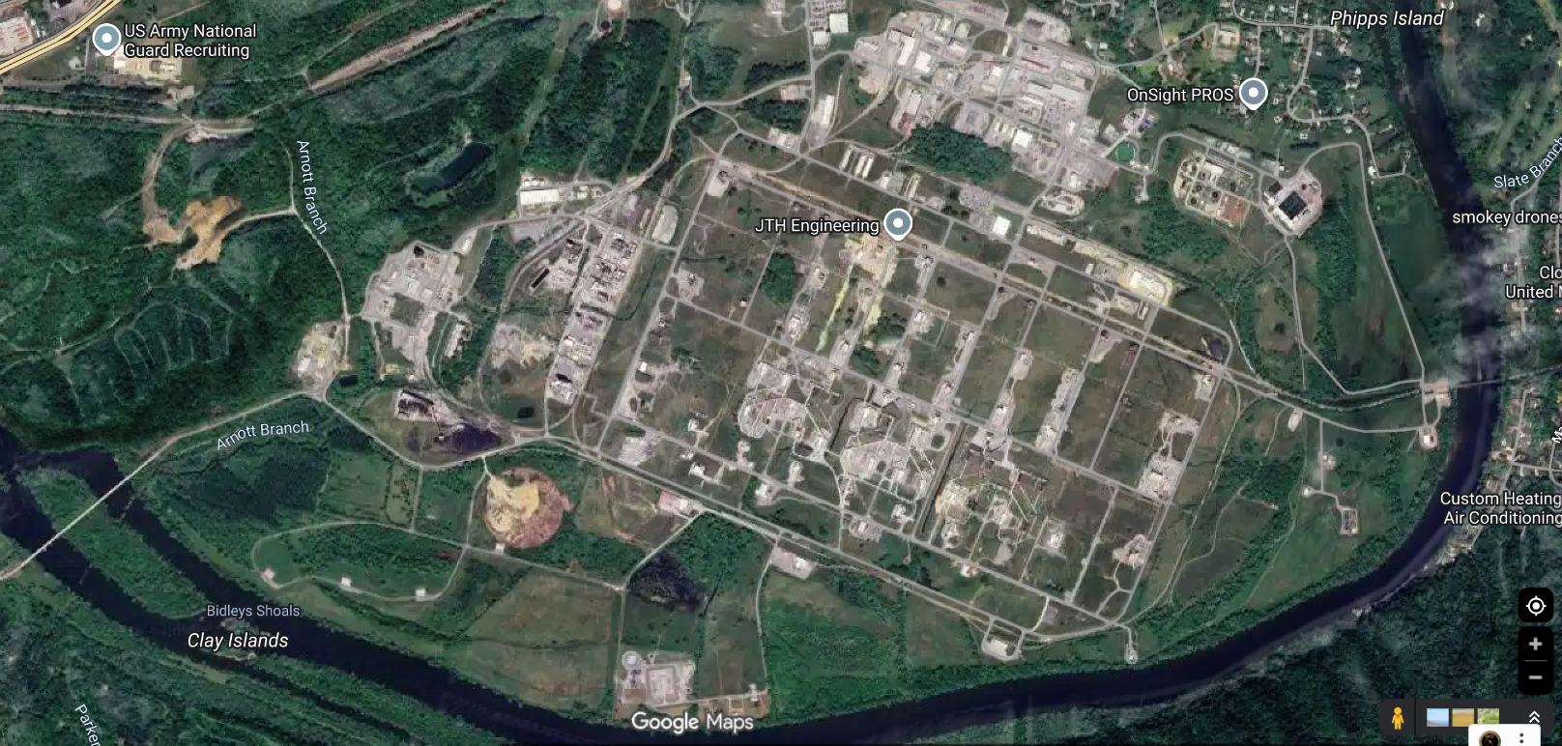

Working Group Slide Example
HD Working Group
Scenario: Military installation in TN has been attacked during the Natural Disaster and limited resources are available.
Triggers / Artificialities / Simulation:
- Limited resources to Support MOU / MOAs triggers request for support through DCO / DCE which ultimately leads to Fed tasking state to support.
- HAAP contact Local EMA, EMA contact TEMA, TEMA contact NG.
- Test drone system.
- Commander’s approval for Drone use.
Participants | VICs / Equipment | PAX
Holston | 0 | 3
State Guard | 5 / 4 | ??
JABS / J6 | 1 | 10
PAO | 1 | 1
Total | 15 | 24
Timeline:
13 MAY 2026 Attack begin HH:MM
ADVON / Establish ICP
14 May 2026 Main day
15 May 2026 Half day and AAR
POC & Location Information:
Holston POC:
State Guard POC:
Objectives:
Exercise the TERP (Tennessee Emergency Response Plan) HD Annex
Establish ICP
Coordinate with Holston EMA
Test HAAP drone system and drone approval process.
CSDA TTX
Perimeter security, parking lot security
Base entrance inject
Protection of Water way: Netherland Park.
Logistics & Resources:
Food/Water: All units are responsible for food and water for their personnel.
Lodging: All units are responsible for lodging for their personnel, if needed.
Role Players:?
Comms: TNNG: P: TACN; A: FirstNet ePTT; C: Cell Phone; E: Satellite Phone; JISCC
Admin: Provided by SG
Medical: Provided by SG

