Slide 1


Swift
Trey Rhodes

Slide 2


Slide 3
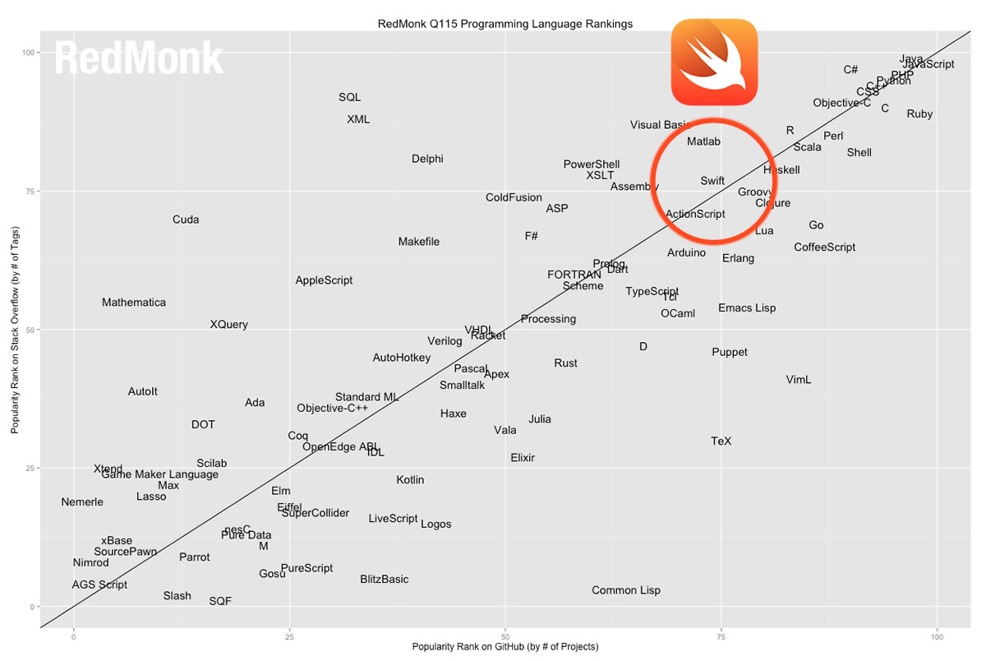
Swift
Designed to work with C languages
Apple based on Obj-C
Made to be similar
“Safer” (easier to catch bugs)

Slide 4

What is Swift?
Swift is a programming language used to code for iOS, watchOS, tvOS, and macOS.
It’s designed to replace C languages (C++, Obj-C)
Syntactic Sugar - “sweet”
Pyramid of doom

Slide 5
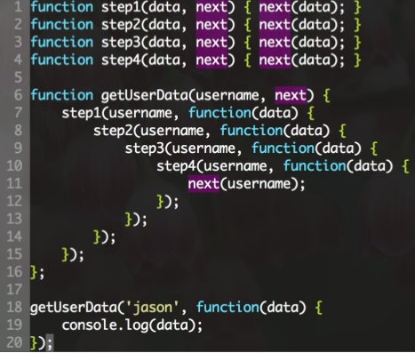
Syntactic Sugar & Pyramid of Doom
NSString *str = @"hello,"; str = [str stringByAppendingString:@" world"];
var str = "hello," str += " world"

Slide 6
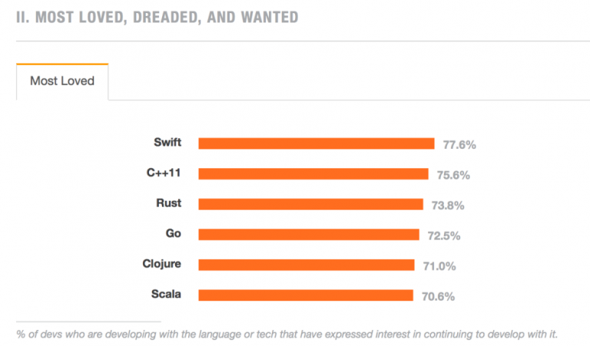
Why Swift?
Based on C
Language consistently updated for what works best
Strictly defined to avoid mistakes
Preferred by developers

Slide 7
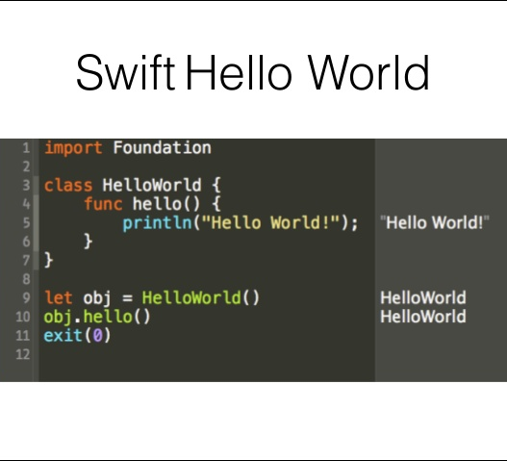
Benefits of Swift
Faster than C languages
Easier to use syntax
Memory auto-managed

Slide 8
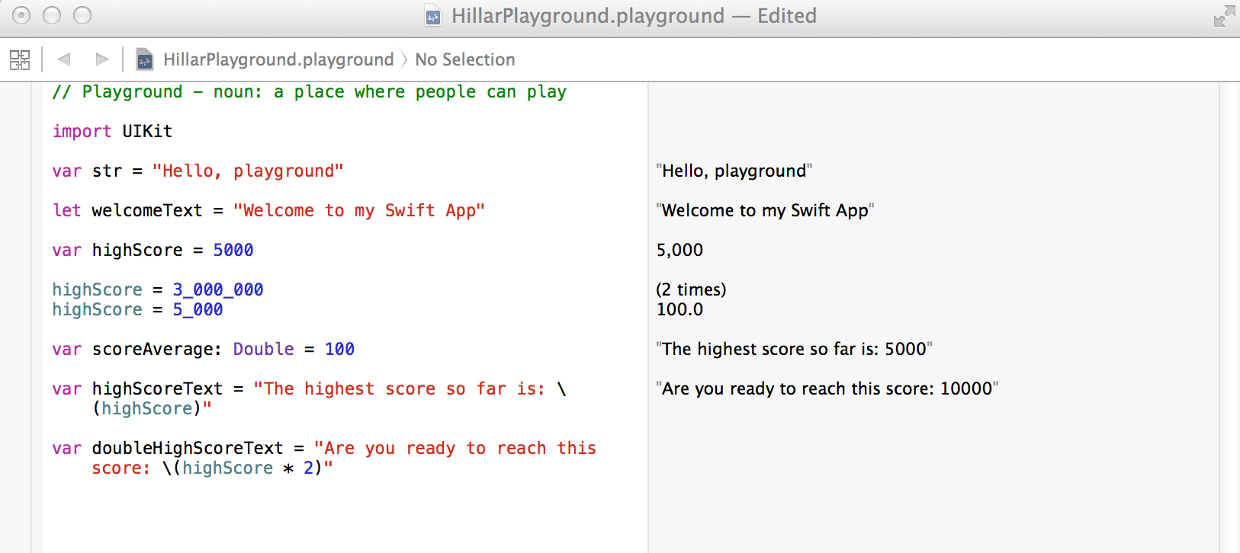
Disadvantages of Swift
Fairly new (2014)
“Moving target”
Major changes
Not backwards compatible

Slide 9
Works Cited
https://developer.apple.com/swift/
https://swift.org/
https://blog.novatec-gmbh.de/swift-2-introduction-comparison/
https://www.cultofmac.com/309156/apples-new-swift-language-experiences-meteoric-growth/
https://www.slideshare.net/wevtimoteo/swift-language-a-fast-overview
https://www.altexsoft.com/blog/engineering/the-good-and-the-bad-of-swift-programming-language/

