Slide 1
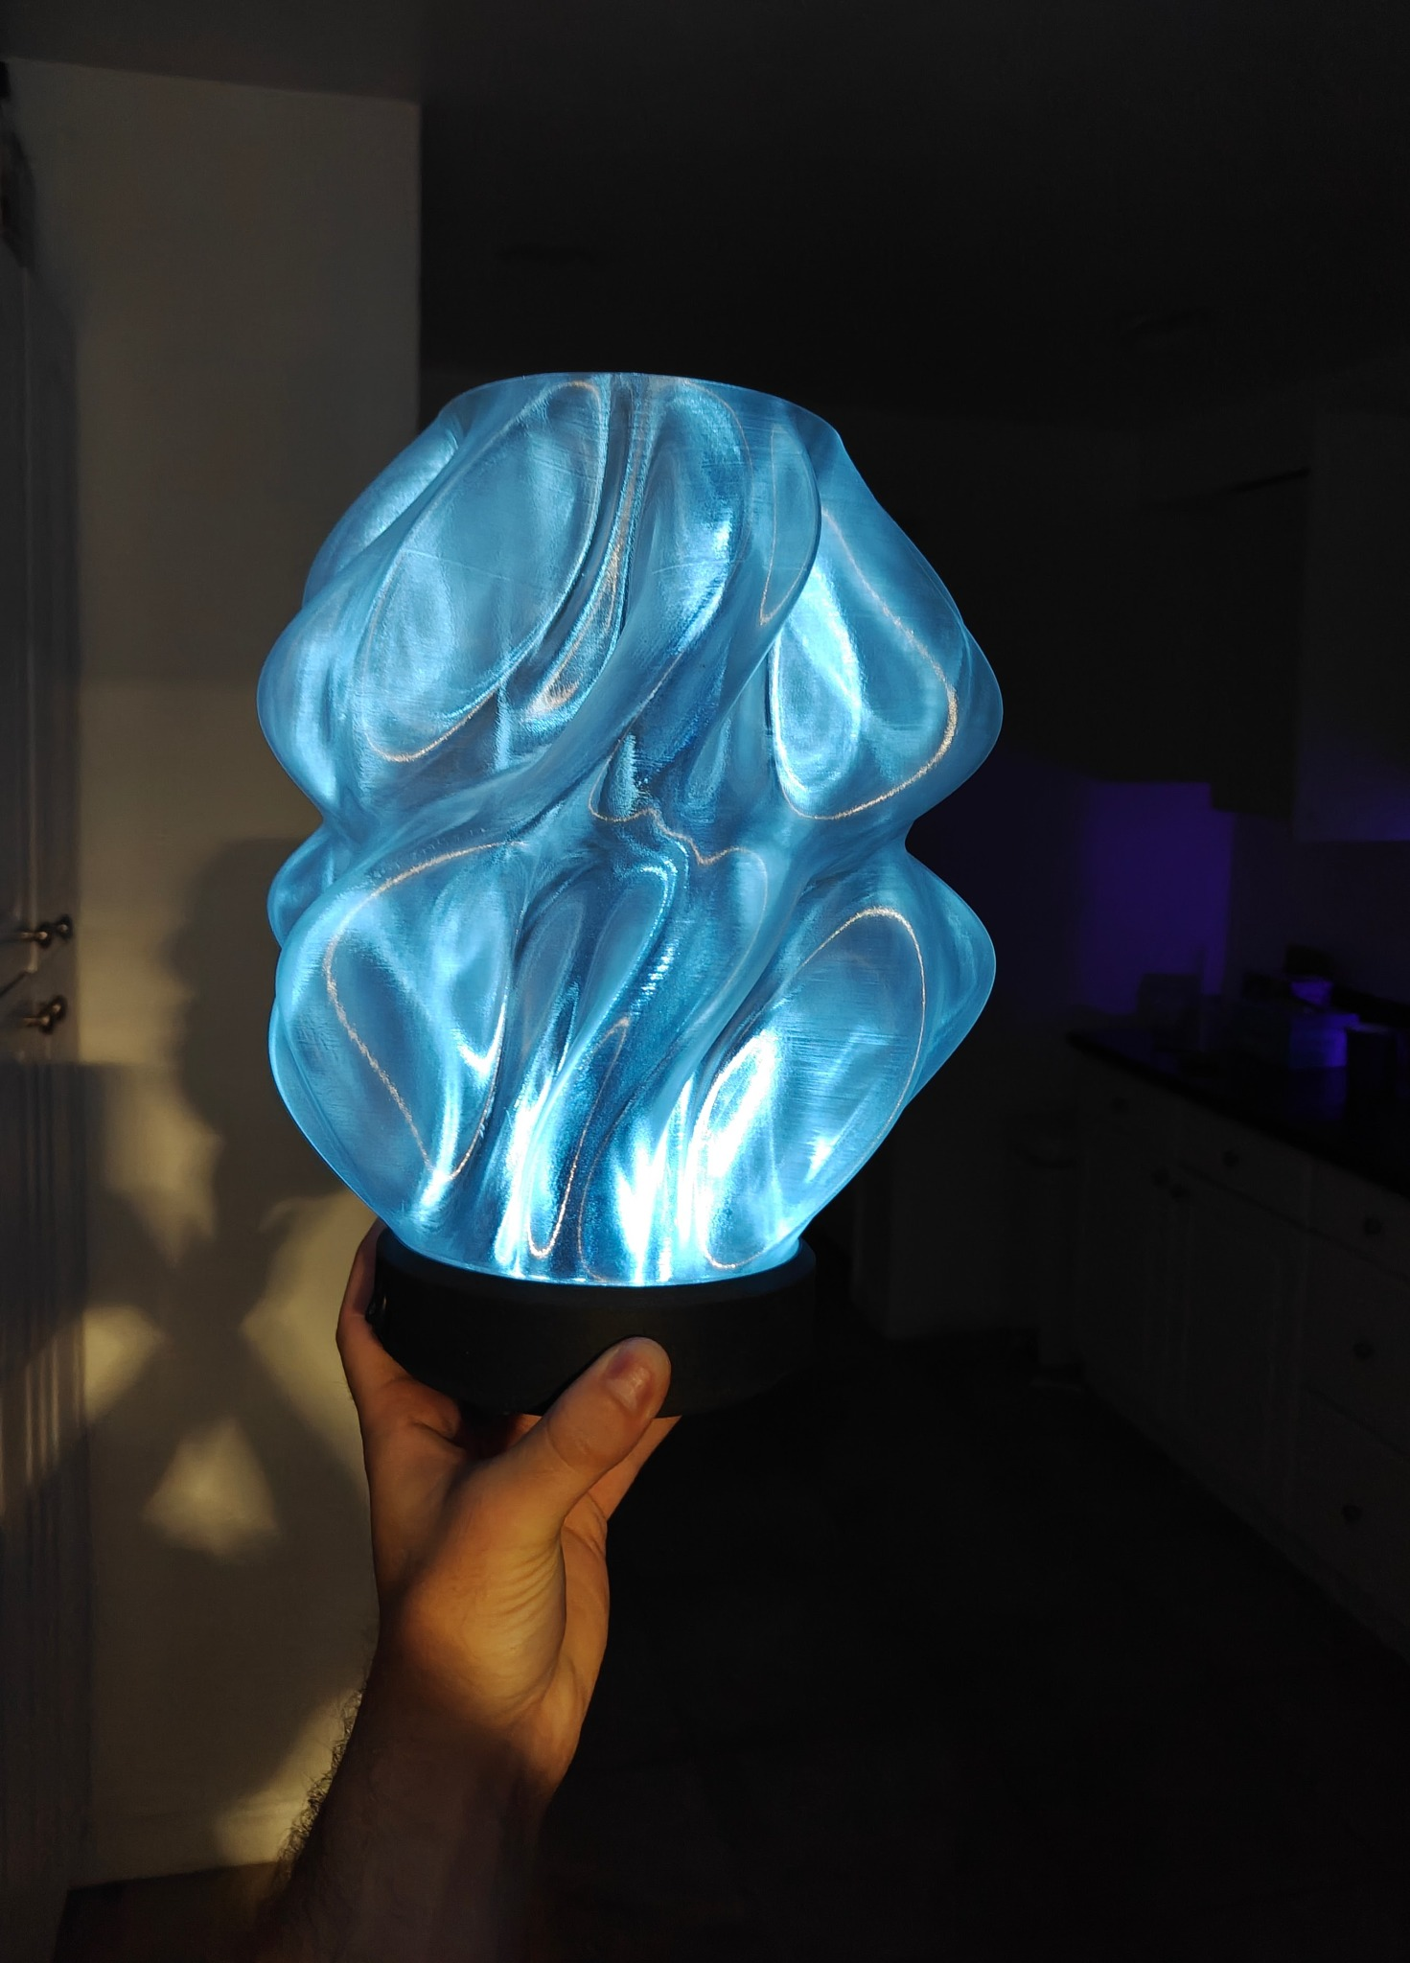
Design and Circuit Analysis
of an Automatic
Light-Controlled LED Circuit
ENGR 098 Final Project Resubmission
Treydon York
Thesis: the project is a circuit-analysis design first, then a custom PCB implementation.

Slide 2
Project Goal and Analytical Framing
Original build
Resubmission focus
An automatic night-light implemented using a custom KiCad layout, a 3D-printed PCB substrate, copper-tape traces, and a printed enclosure.
Explain why the circuit works using voltage division, Thévenin analysis, transistor switching, KVL/KCL, power checks, and fault modeling.
Key design question
How can a high-resistance light sensor reliably control a multi-LED load from a 9 V source?
Circuit analysis drives the redesign
ENGR 098 Final Project • Treydon York • 2

Slide 3
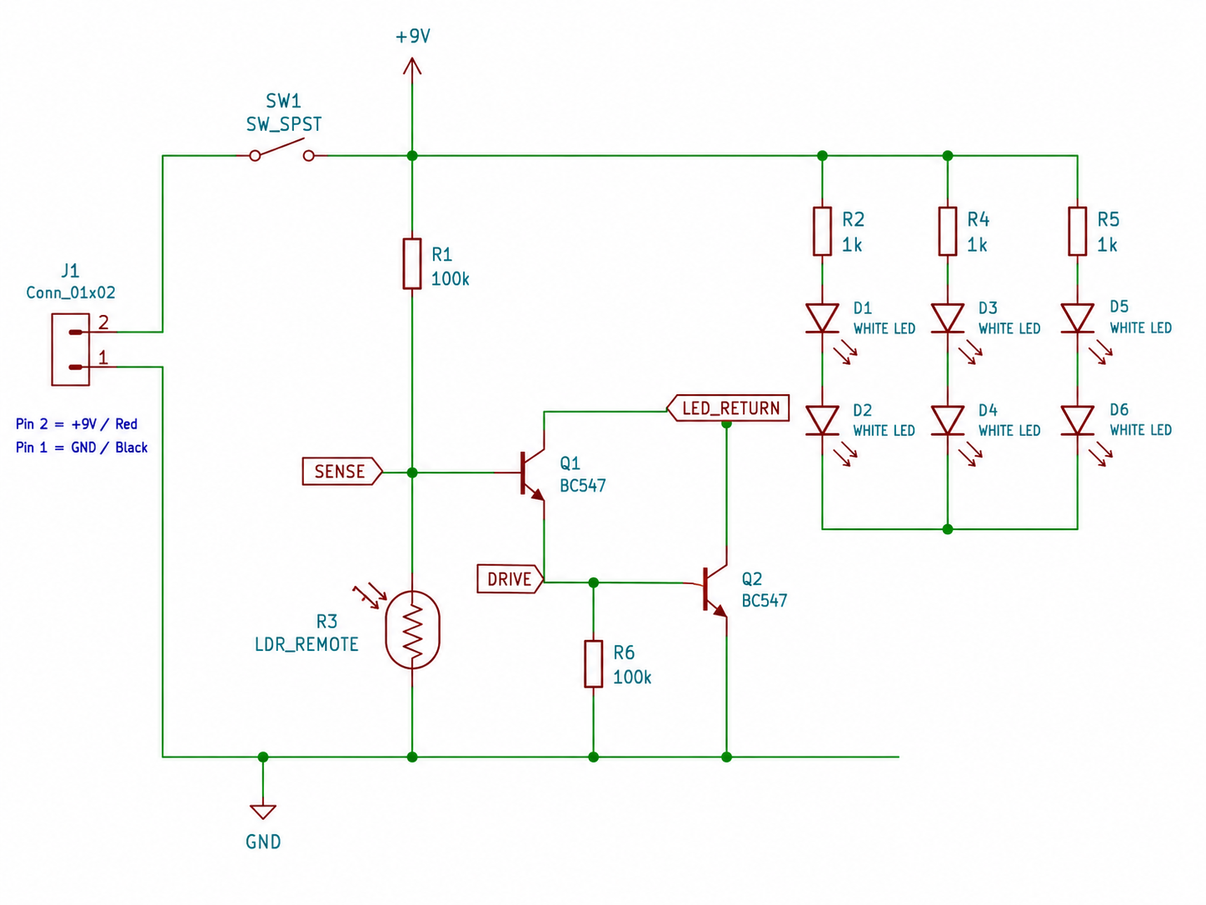
Complete As-Built Circuit
Functional blocks
1. LDR + 100 kΩ divider converts light into a control voltage.
2. Two BC547 NPN transistors form a Darlington-style low-side switch.
3. Three LED branches share the load current through individual 1 kΩ resistors.
The circuit is analyzed at three named nodes: SENSE, INTERSTAGE, and OUTPUT.
ENGR 098 Final Project • Treydon York • 3

Slide 4
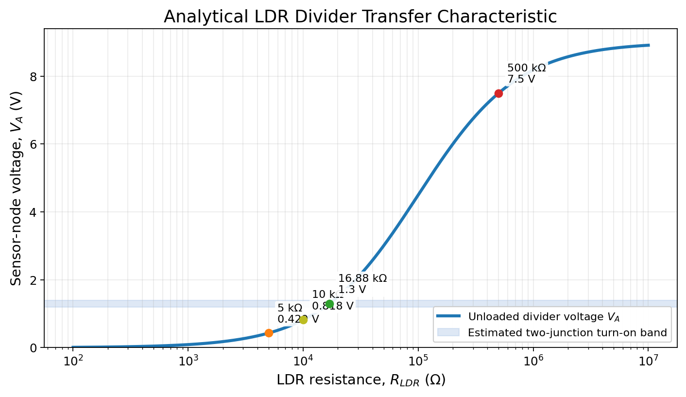
LDR Divider: Bright Versus Dark
Core equation
V_A = 9 · R_LDR / (100 kΩ + R_LDR)
Selected points from hand analysis
• 5 kΩ → V_A ≈ 0.429 V → transistor pair off
• 10 kΩ → V_A ≈ 0.818 V → below threshold
• 500 kΩ → V_A ≈ 7.50 V → transistor pair on
This orientation creates the desired dark-on behavior.
ENGR 098 Final Project • Treydon York • 4

Slide 5
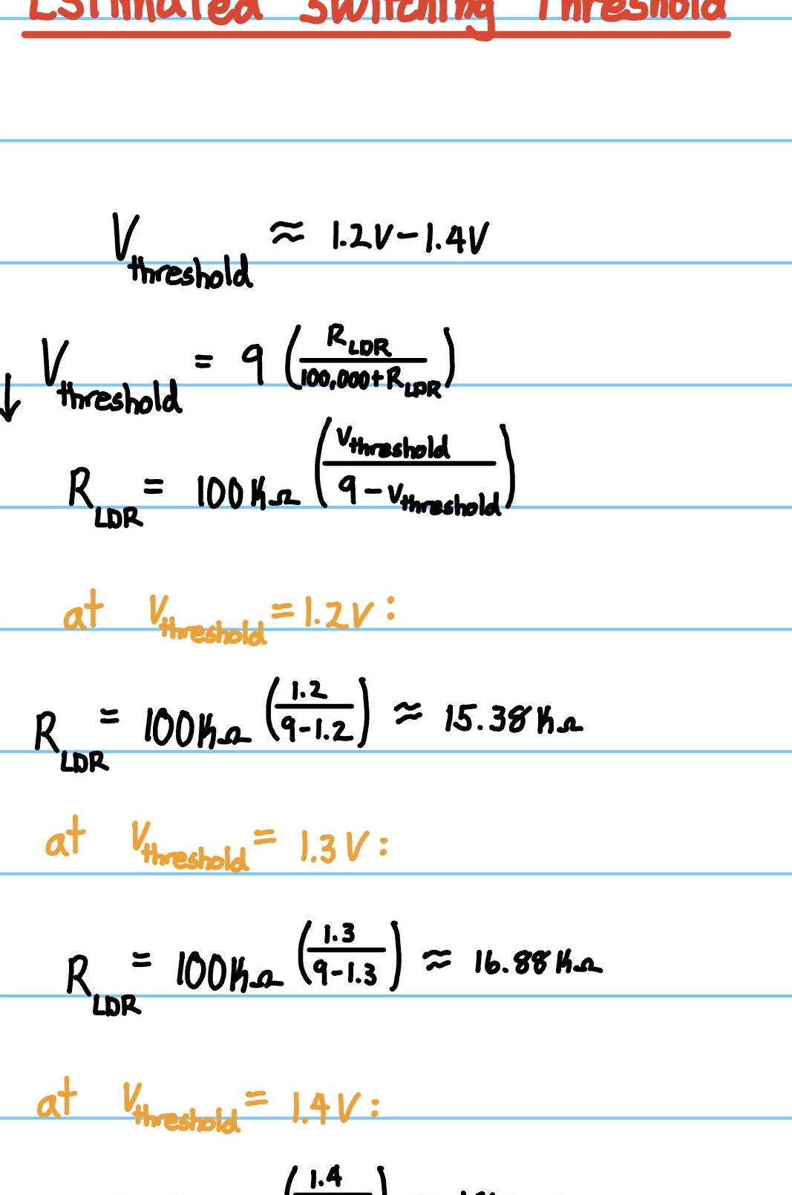
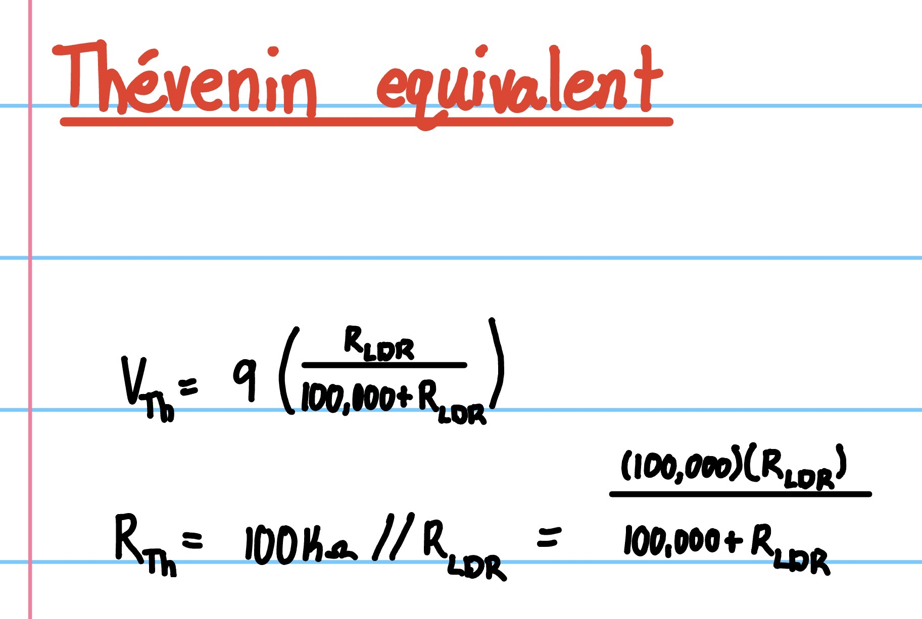
Thévenin and Switching Threshold
Estimated threshold
For a two-junction transistor input, the turn-on region is approximately:
V_threshold ≈ 1.2–1.4 V
Solving the divider equation gives:
R_LDR ≈ 15–18 kΩ
Why this matters: it predicts the resistance range where the lamp transitions from off to on, then allows simulation and hardware behavior to be checked against theory.
ENGR 098 Final Project • Treydon York • 5

Slide 6
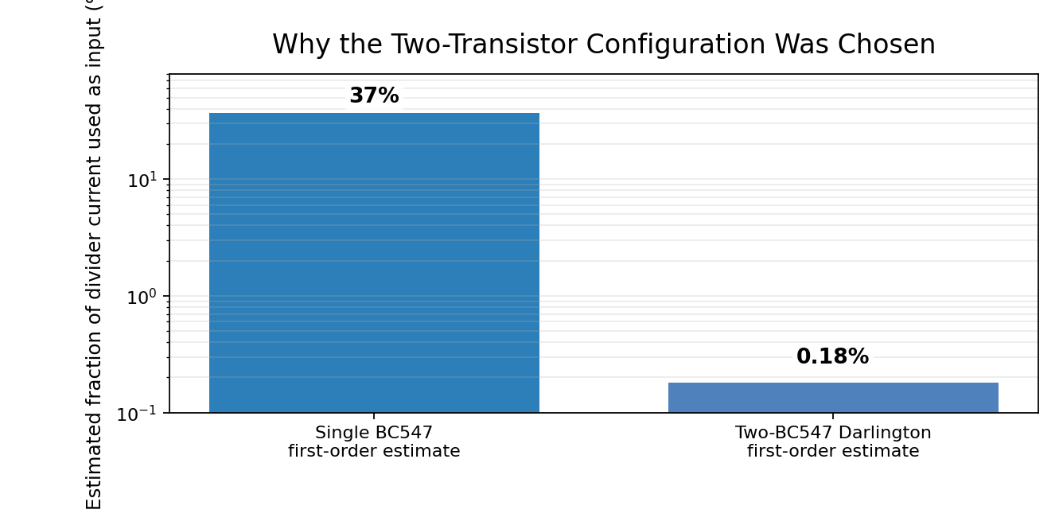
Why Two BC547 Transistors?
Design rationale
The LDR divider is a high-impedance source. A single BJT can draw enough base current to load that divider and shift the intended control voltage.
Darlington-style pair: much smaller first-stage input current
Trade-off: the two-transistor input requires a higher threshold and produces a larger on-state voltage drop than one saturated transistor.
BC547 margin: 9 V supply and <10 mA LED load are comfortably below representative device ratings.
ENGR 098 Final Project • Treydon York • 6

Slide 7
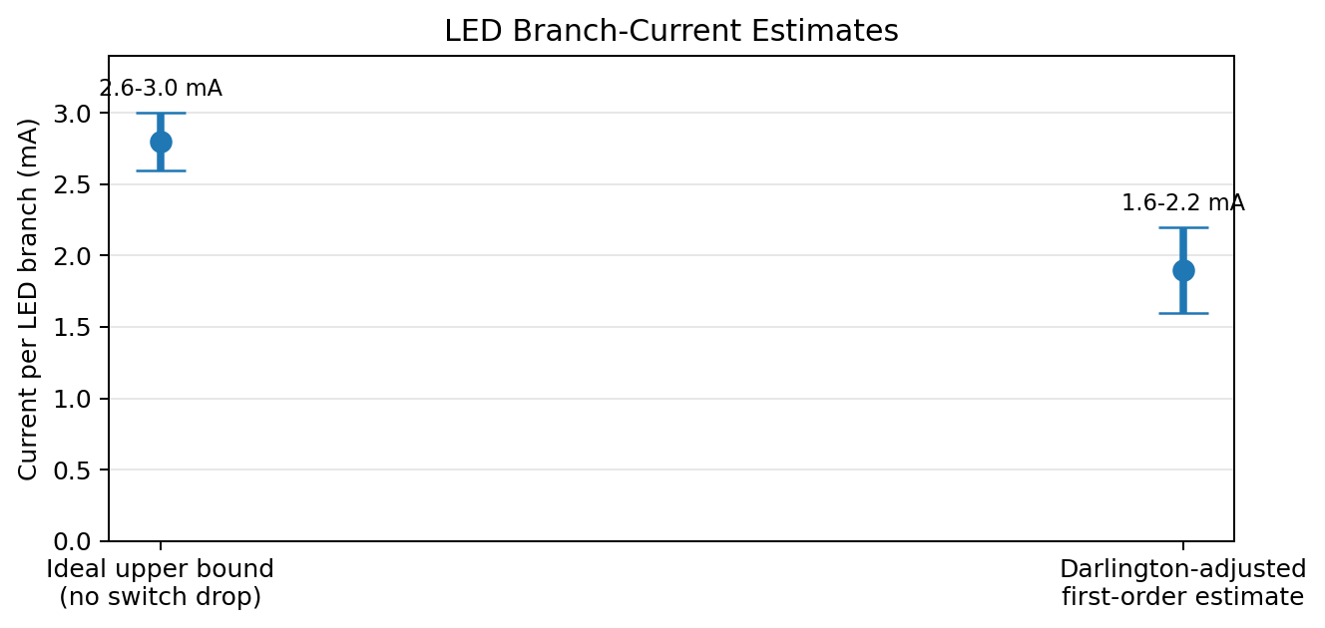
LED Network: KVL and KCL
Branch choice
Six white LEDs cannot all be placed in series from 9 V, because 6 × 3.0–3.2 V requires roughly 18.0–19.2 V.
Selected topology: 3 parallel branches, 2 LEDs per branch, 1 kΩ per branch
Hand estimate: I_branch ≈ 2.6–3.0 mA, so total LED current is approximately 7.8–9.0 mA before transistor-drop correction.
KCL combines the three branch currents at the transistor output node.
ENGR 098 Final Project • Treydon York • 7

Slide 8
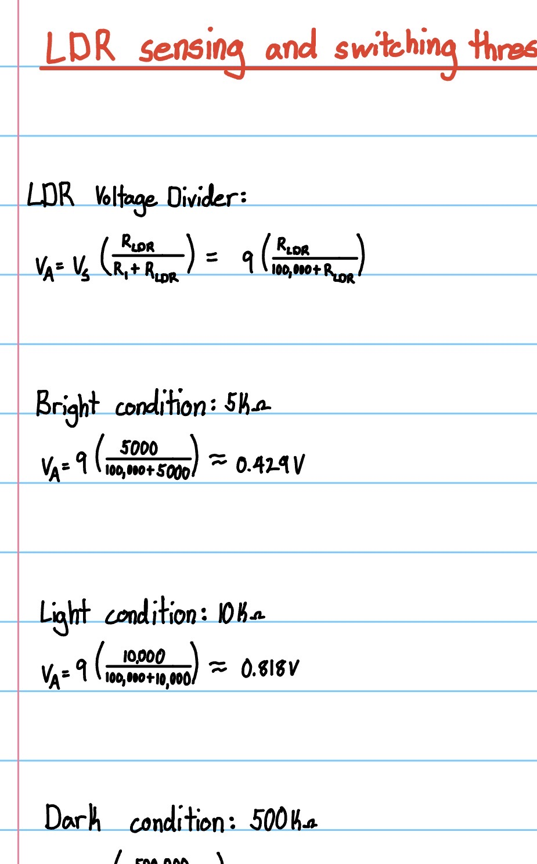
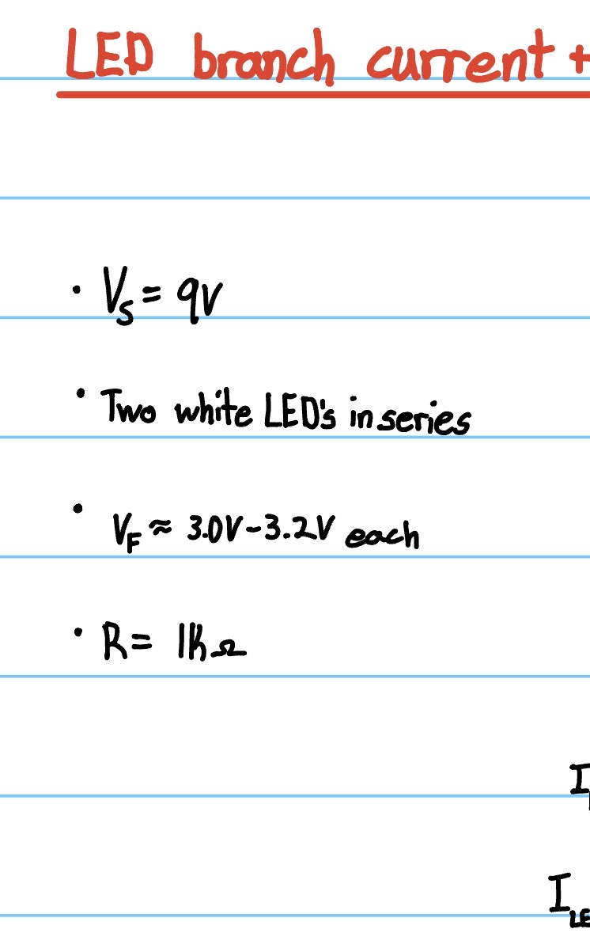
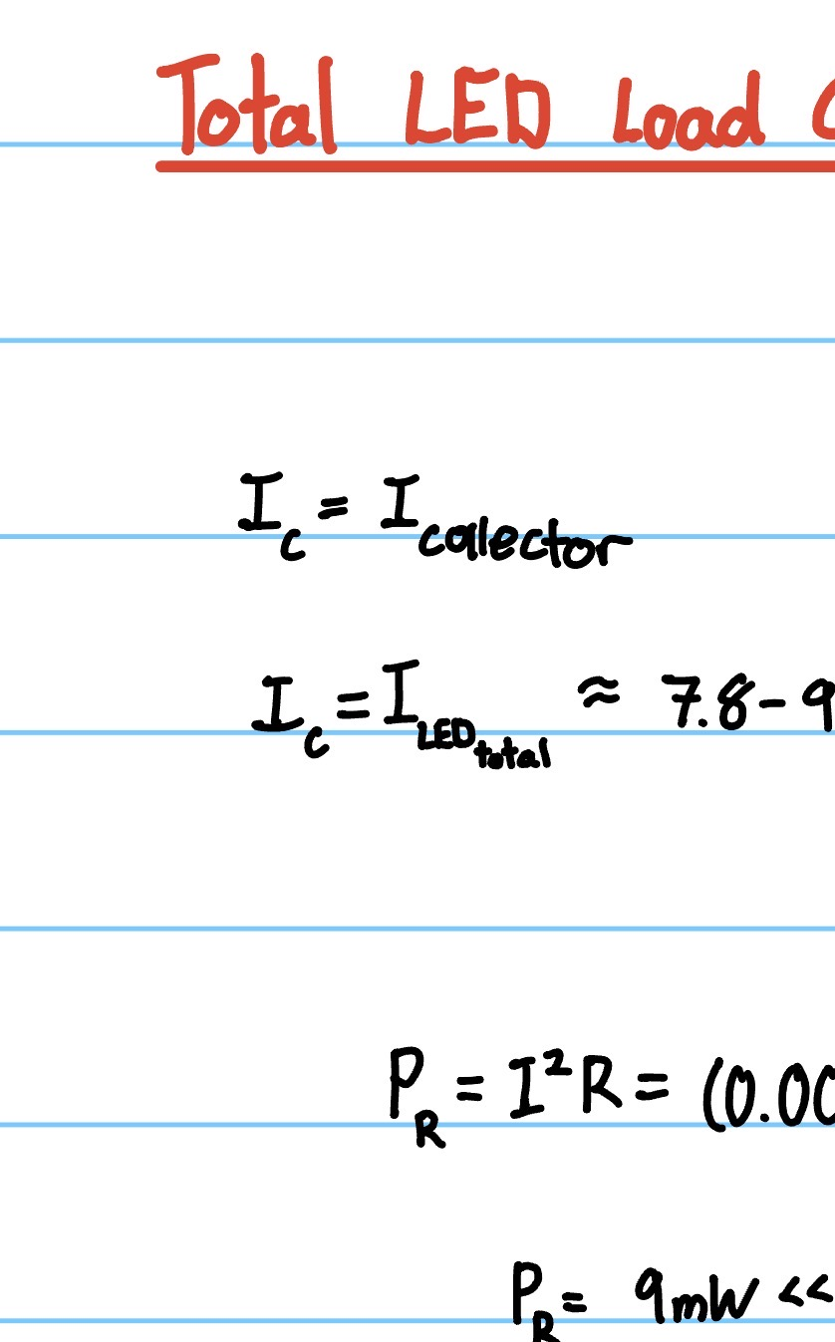
Handwritten Circuit-Analysis Evidence
These calculations are the analytical backbone of the resubmission.
Divider
LED KVL
Load current + power
ENGR 098 Final Project • Treydon York • 8

Slide 9
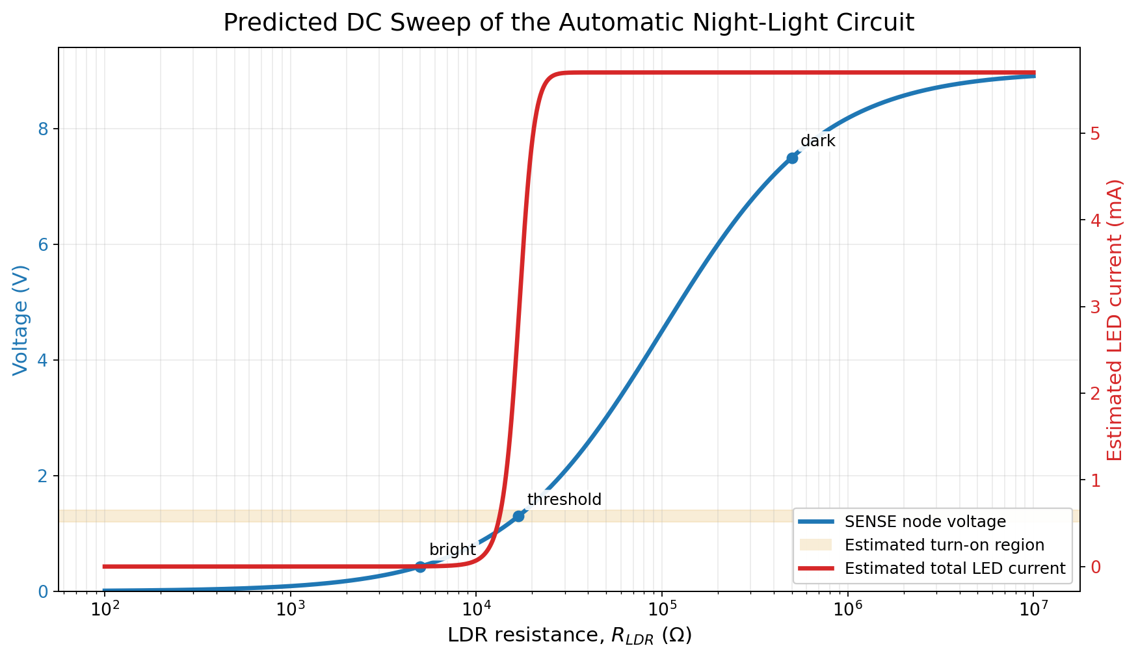
Modeled DC Sweep Response
Interpretation
As LDR resistance increases, the SENSE node rises toward the transistor-pair turn-on range.
After crossing the threshold region, LED current increases rapidly and approaches the dark-state current range.
The model follows the same trend predicted by the hand calculations.
ENGR 098 Final Project • Treydon York • 9

Slide 10
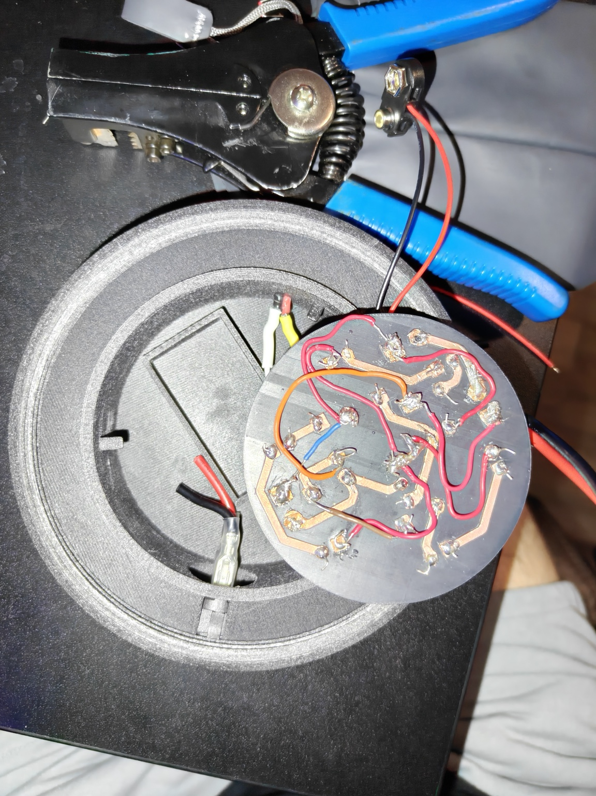
Fault Analysis: Why the Hardware Sometimes Became “Switch Only”
Observed issue
The photoresistor connection was intermittent. Around half of the time, the lamp behaved like a simple switched light instead of a light-controlled circuit.
Circuit explanation
• LDR open → SENSE approaches 9 V → transistors on
• LDR short → SENSE approaches 0 V → transistors off
• Extra contact resistance raises SENSE and can falsely imitate darkness
Failure mode explained using the voltage-divider equation
ENGR 098 Final Project • Treydon York • 10

Slide 11
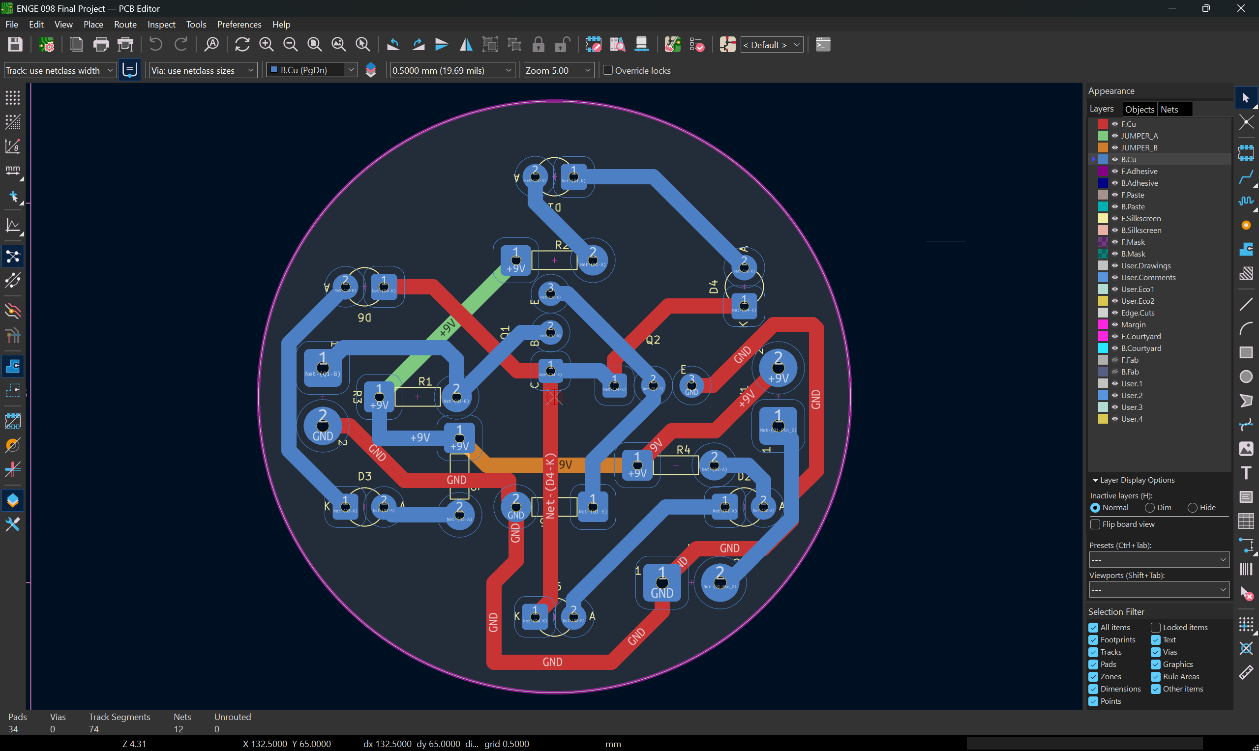
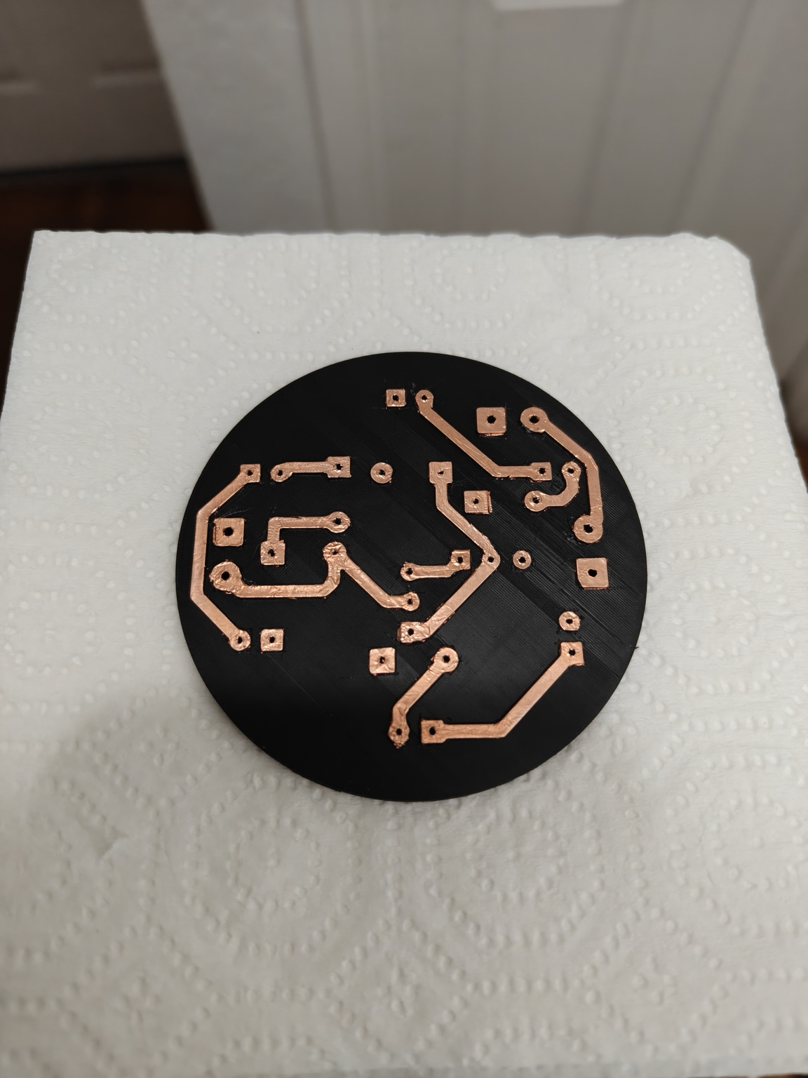
Implementation: From Circuit to Custom PCB
Fabrication was intentionally secondary in the resubmission: it demonstrates the circuit was physically realized.
Blue traces in the layout became copper tape on the board; short colored jumper wires completed routes on the same side.
KiCad DRC passed with zero errors before fabrication.
ENGR 098 Final Project • Treydon York • 11

Slide 12
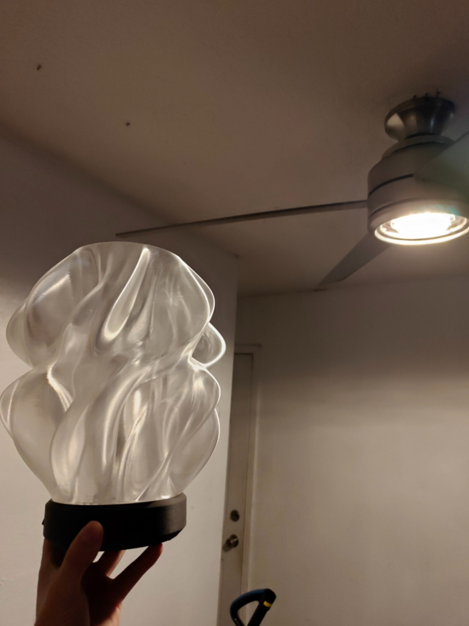
Working Hardware Verification
Dark condition: LEDs on
Bright condition: LEDs off
ENGR 098 Final Project • Treydon York • 12

Slide 13

What I Would Improve
Circuit reliability
Fabrication process
Optical design
Better insulate the LDR leads and photoresistor connections to prevent intermittent open-circuit behavior.
Use the flux pen from the start, make the PCB circle slightly larger, and add clearer service access for wiring.
Add a translucent internal LED cover to hide the circuit more fully and diffuse the light evenly.
ENGR 098 Final Project • Treydon York • 13

Slide 14
Conclusion
Primary references
• ENGR 098 Final Project Guidelines
• onsemi BC547 / BC548 transistor data
• Cadence PSpice A/D documentation
• KiCad PCB Editor documentation
• GL5516 photoresistor data
• Printables “Waves” Designer Lamp enclosure source
A simple automatic night-light can be explained using core circuit-analysis tools: voltage division, Thévenin modeling, transistor switching, KVL, KCL, power checks, and fault analysis.
Designing, fabricating, and testing a custom PCB can be cheaper and faster than expected — but the circuit analysis must drive the design.
Questions?

