Slide 1

HTTPS & Secure communication

Slide 2
Objectives
Introduction HTTPS
Install and Create SSL Certificate
How to implement https in node js
Introduction SSO, OAuth

Slide 3
Introduction HTTPS
HTTPS (Hypertext Transfer Protocol Secure) is the secure version of HTTP. It uses Transport Layer Security (TLS) to encrypt communication between a web browser and a web server.
If an attacker intercepts the transmitted data, they see encrypted information that they cannot read without the appropriate keys. TLS also helps verify the server’s identity and protects data from modification during transmission.
SSL (Secure Sockets Layer) is the older predecessor of TLS. Although the term “SSL” is still commonly used, modern HTTPS connections use TLS to protect sensitive information sent over the internet.

Slide 4
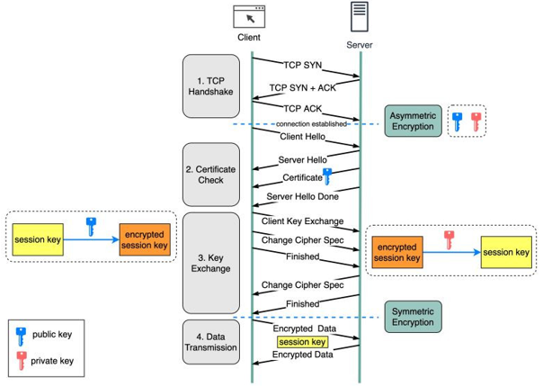
How does HTTPS work?

Slide 5
How is the data encrypted and decrypted?
Step 1 - The client (browser) and the server establish a TCP connection.
Step 2 - The client sends a “client hello” to the server. The message contains a set of necessary encryption algorithms (cipher suites) and the latest TLS version it can support. The server responds with a “server hello” so the browser knows whether it can support the algorithms and TLS version. The server then sends the SSL certificate to the client. The certificate contains the public key, host name, expiry dates, etc. The client validates the certificate.
Step 3 - After validating the SSL certificate, the client generates a session key and encrypts it using the public key. The server receives the encrypted session key and decrypts it with the private key.
Step 4 - Now that both the client and the server hold the same session key (symmetric encryption), the encrypted data is transmitted in a secure bi-directional channel.

Slide 6
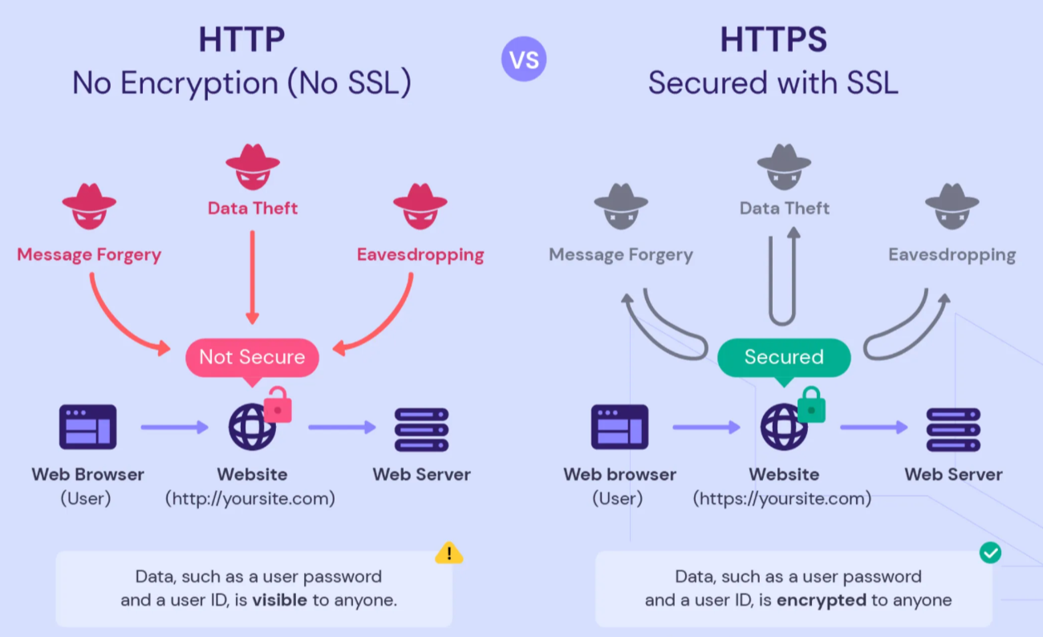
Why does HTTPS switch to symmetric encryption during data transmission?
Notes:
HTTPS has an overhead of SSL handshake and thus might be slower than HTTP. But the security benefits it offers outweighs these slight delays in performance.

Slide 7
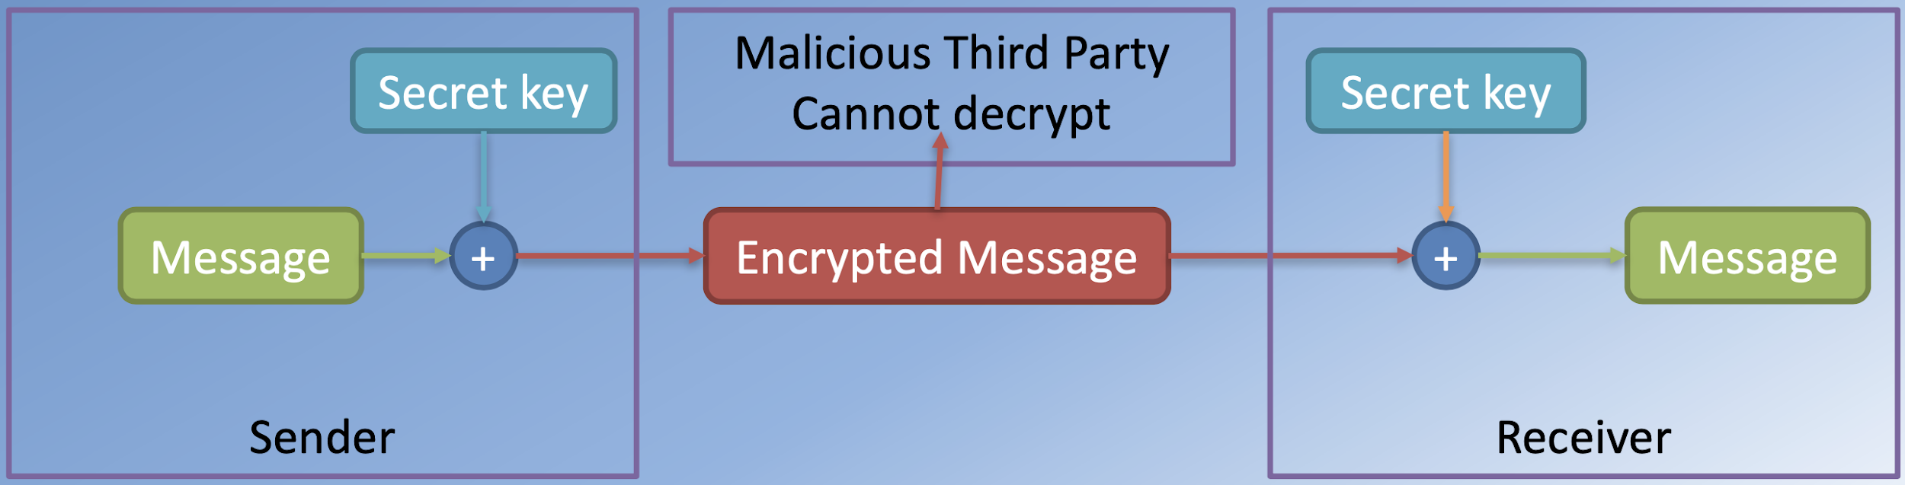
Symmetric Key Cryptography
Symmetric Encryption:
  Shared secret key between the two parties

Slide 8
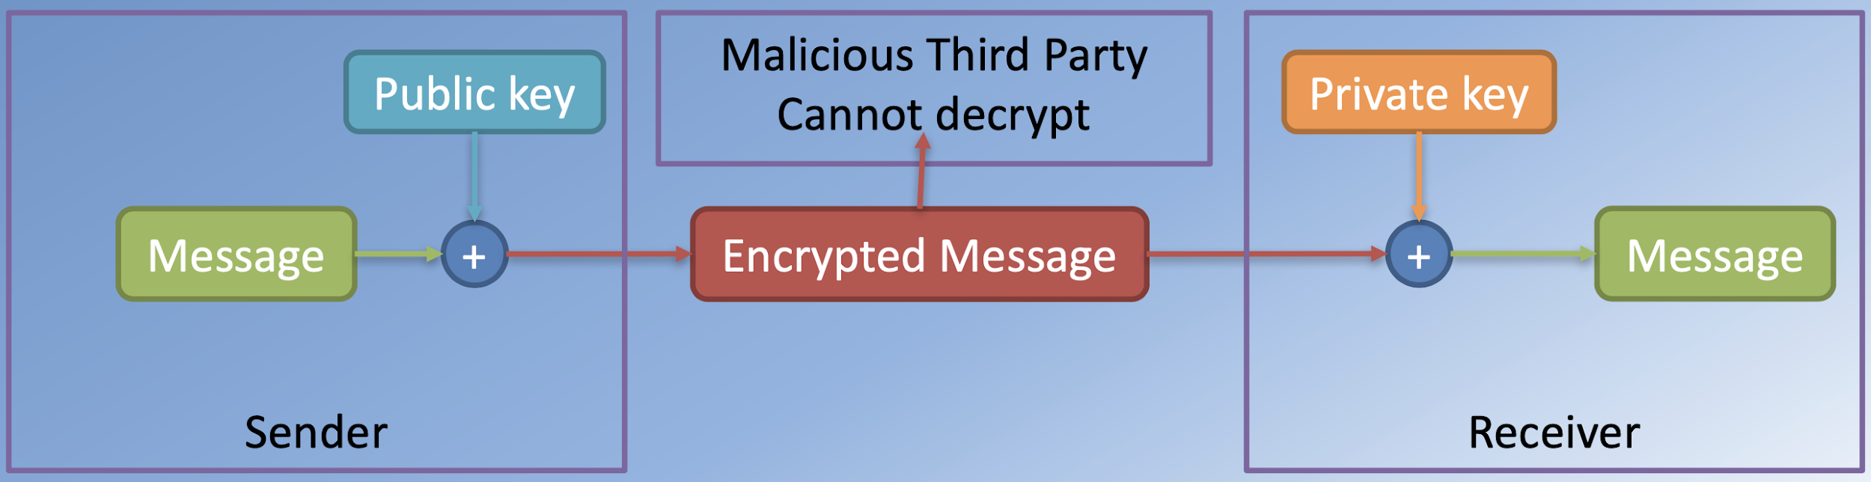
Public Key Cryptography
Asymmetric Encryption:
  Public key that can be widely distributed
  Private key that is only known to the receiver

Slide 9
Why does HTTPS switch to symmetric encryption during data transmission?
There are two main reasons:
  Security: The asymmetric encryption goes only one way. This means that if the server tries to send the encrypted data back to the client, anyone can decrypt the data using the public key.
  Server resources: The asymmetric encryption adds quite a lot of mathematical overhead. It is not suitable for data transmissions in long sessions.
Notes:
HTTPS has an overhead of SSL handshake and thus might be slower than HTTP. But the security benefits it offers outweighs these slight delays in performance.

Slide 10
Generate SSL certificates
The first step in enabling HTTPS for a Node.js application is to obtain a TLS certificate, commonly called an SSL certificate. Two common options are self-signed certificates and certificates issued by a Certificate Authority (CA).
Self-signed certificates can be generated at no cost and are useful for local development and testing. Browsers do not trust them by default, making them unsuitable for public production websites.
Certificates issued by a trusted CA are recognized by most browsers and are suitable for production websites. They may be available for free or purchased from a certificate provider.

Slide 11
Generate SSL certificates – MAC
brew install openssl@3
export PATH="$(brew --prefix openssl@3)/bin:$PATH”
openssl version

Slide 12
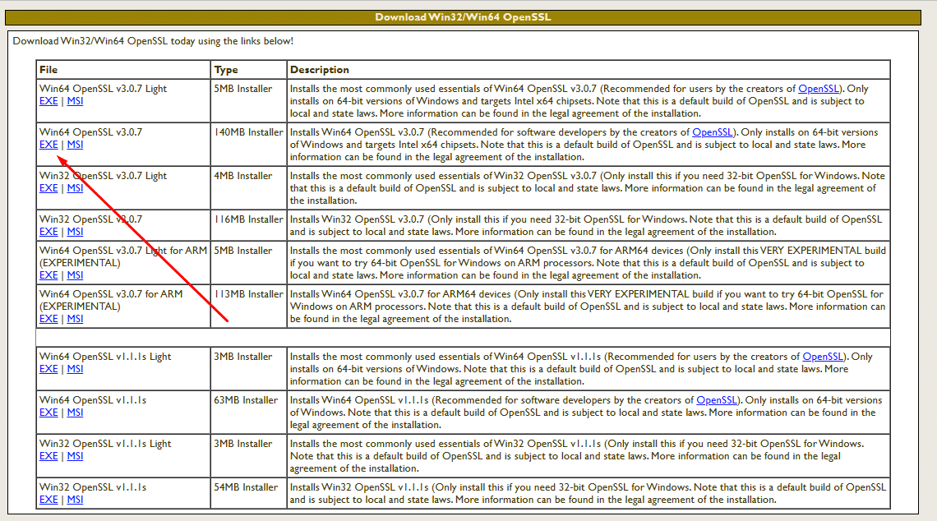
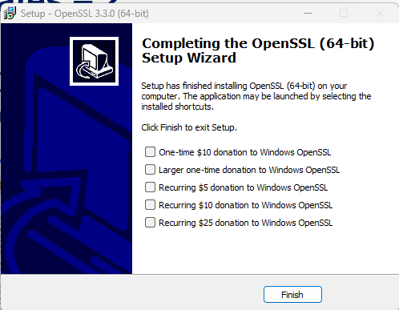
Generate SSL certificates
Download and Install OpenSSL from a reliable source. One commonly used build for Windows is available from Win32/Win64 OpenSSL.

Slide 13
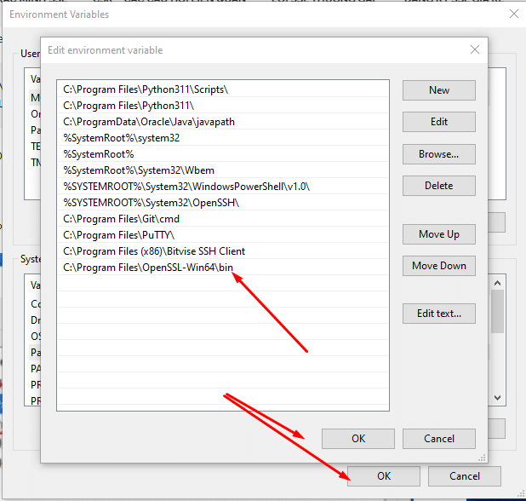
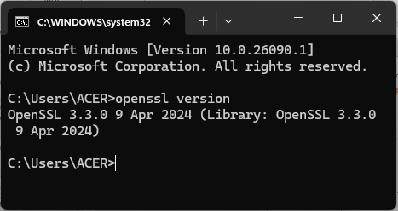
Generate SSL certificates
Add OpenSSL to the PATH Environment Variable: C:\Program Files\OpenSSL-Win64\bin

Slide 14
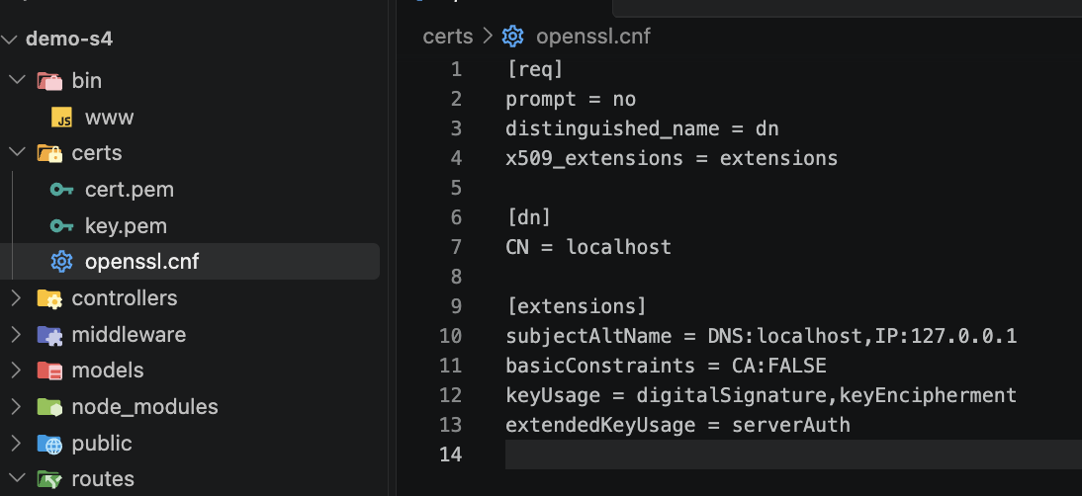
Generate SSL certificates – MAC
Creating the certs folder
[req] prompt = no
distinguished_name = dn
x509_extensions = extensions
[dn]
CN = localhost
[extensions]
subjectAltName = DNS:localhost,IP:127.0.0.1
basicConstraints = CA:FALSE
keyUsage = digitalSignature,keyEncipherment
extendedKeyUsage = serverAuth EOF

Slide 15
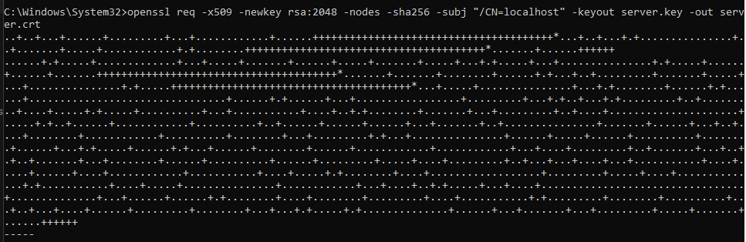
Generate SSL certificates
To generate a self-signed SSL certificate, you can use the OpenSSL command-line tool. Here ‘s now:
openssl req -x509 -newkey rsa:2048 -nodes -sha256 -subj "/CN=localhost" -keyout server.key -out server.crt
Notes:
This command generates an SSL certificate with a 2048-bit RSA key pair and a validity period of 365 days. The certificate is signed by its own private key (self-signed).

Slide 16
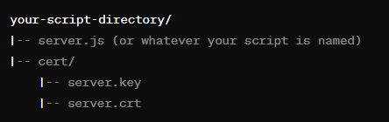
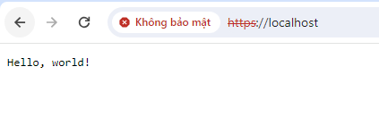
Set up HTTPS
How to set up HTTPS using the https module:
const https = require('https');
const fs = require('fs');
const path = require('path');
const options = {
key: fs.readFileSync(path.join(__dirname, 'cert', 'server.key')),
cert: fs.readFileSync(path.join(__dirname, 'cert', 'server.crt'))
};
https.createServer(options, (req, res) => {
res.writeHead(200);
res.end('Hello, world!');
}).listen(443);

Slide 17
Redirect HTTP traffic to HTTPS
To ensure that all traffic to your NodeJS app is encrypted, you should redirect all HTTP traffic to HTTPS.
const http = require('http');
const https = require('https');
const fs = require('fs');
const path = require('path');
const options = {
key: fs.readFileSync(path.join(__dirname, 'cert', 'server.key')),
cert: fs.readFileSync(path.join(__dirname, 'cert', 'server.crt'))
};
const httpsServer = https.createServer(options, (req, res) => {
res.writeHead(200);
res.end('Hello, world!');
});
const httpServer = http.createServer((req, res) => {
const host = req.headers.host.split(':')[0]; // Get hostname without port number
res.writeHead(301, { Location: `https://${host}:443${req.url}` }); //https://${req.headers.host}${req.url}
res.end();
});
httpServer.listen(3000);
httpsServer.listen(443);

Slide 18
Exercise: HTTPS and Secure Communication

Slide 19
Introduction SSO
Single Sign-On (SSO) is a tailored SSO solution made for applications that are built on Node. js.
The solution streamlines the integration of popular authentication protocols such as OAuth 2.0, JWT, and OpenID Connect into Node.

Slide 20
𝗞𝗲𝘆 𝗣𝗹𝗮𝘆𝗲𝗿𝘀 𝗶𝗻 𝗦𝗦𝗢
User - The individual seeking access to applications
Identity Provider (IDP) - Authenticates users (e.g. Google, Facebook)
Application - The software or service the user wants to access

Slide 21
𝗕𝗲𝗻𝗲𝗳𝗶𝘁𝘀 𝗼𝗳 𝗦𝗦𝗢
Simplifies access with one set of credentials
Enhances user experience
Reduces password fatigue
Centralizes security and access management
Improves security
Streamlines access control
Simplifies compliance reporting
Allows seamless integration

Slide 22
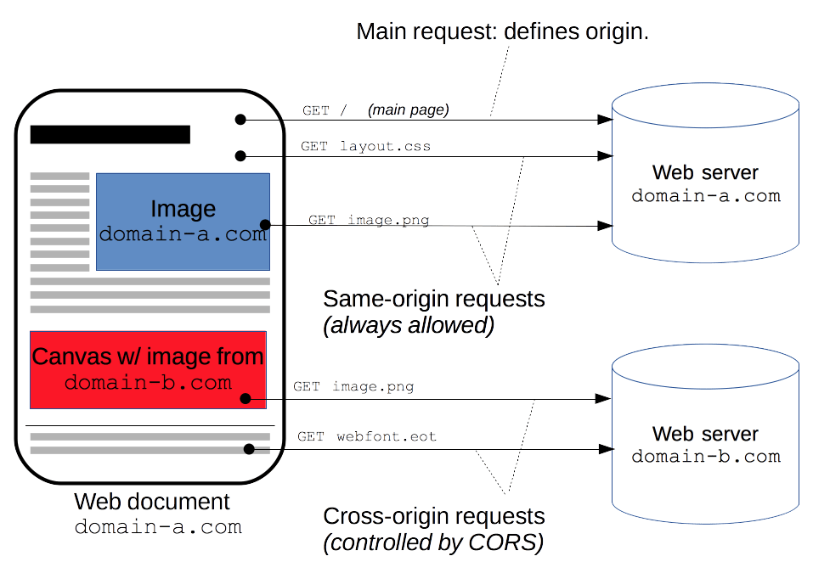
𝗛𝗼𝘄 𝗦𝗦𝗢 𝗪𝗼𝗿𝗸𝘀
User tries to log into an application
Application redirects user to SSO/IDP
IDP authenticates user
IDP issues authenticated token
Token sent back to browser
Browser presents token to application
Application grants access without re-entering credentials
This streamlined process enables single login access to multiple applications, improving convenience and security.

Slide 23
Understand OAuth 1.0
OAuth provides a method for clients to access server resources on behalf of a resource owner (such as a different client or an end- user).
It also provides a process for end-users to authorize third- party access to their server resources without sharing their credentials (typically, a username and password pair), using user- agent redirections.

Slide 24
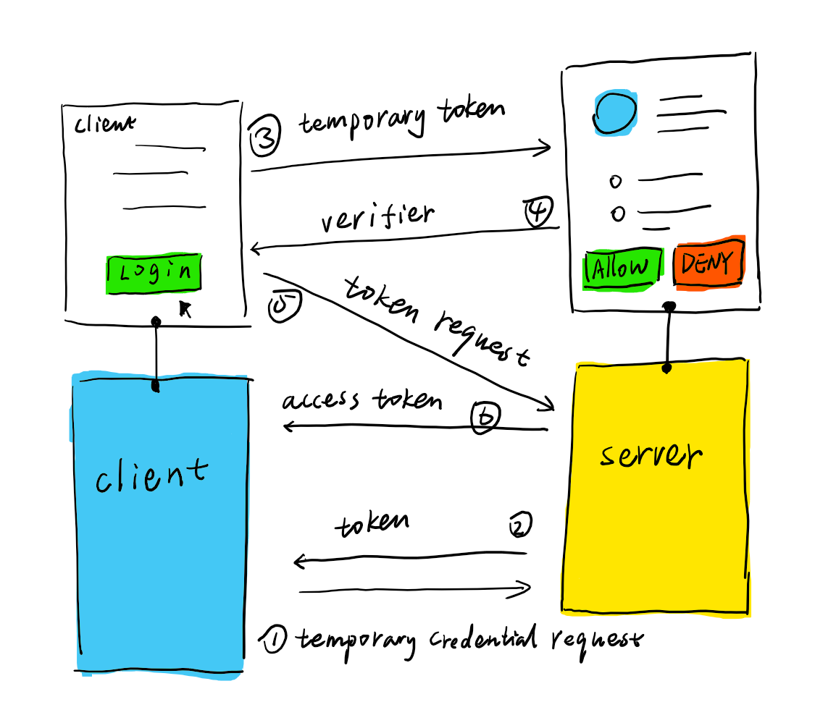
Understand OAuth 1.0 – cont’d
This section will help developers understand the concepts in OAuth 1.0, but not in deep. Here is an overview of a typical OAuth 1.0 flow
Client uses its client credentials to make a request to server, asking the server for a temporary credential.
Server responds with a temporary credential if it verified your client credential.
Client saves temporary credential for later use, then open a view for resource owner to grant the access.
When access is granted, Server responds with a verifier to client.
Client uses this verifier and temporary credential to make a request to the server asking for token credentials.
Server responds with access token if it verified everything.
And then Client can send tweets with the token credentials.

Slide 25
Understand OAuth 2.0
It is an open standard that allows users to grant limited access to their data on one site to other sites or applications without exposing their passwords.
It has become the backbone of secure authorization across the web and mobile apps.
OAuth connects three main players:
  The User who wants to grant access to their data without sharing login credentials
  The Server that hosts the user's data and provides access tokens
  The Identity Provider (IdP) that authenticates the user's identity and issues tokens
𝗛𝗼𝘄 𝗢𝗔𝘂𝘁𝗵 𝘄𝗼𝗿𝗸𝘀
  When a user tries to access their data through a third-party app, they are redirected to log in through the IdP.
  The IdP sends an access token to the app, which presents it to the server. Recognizing the valid token, the server grants access.

Slide 26
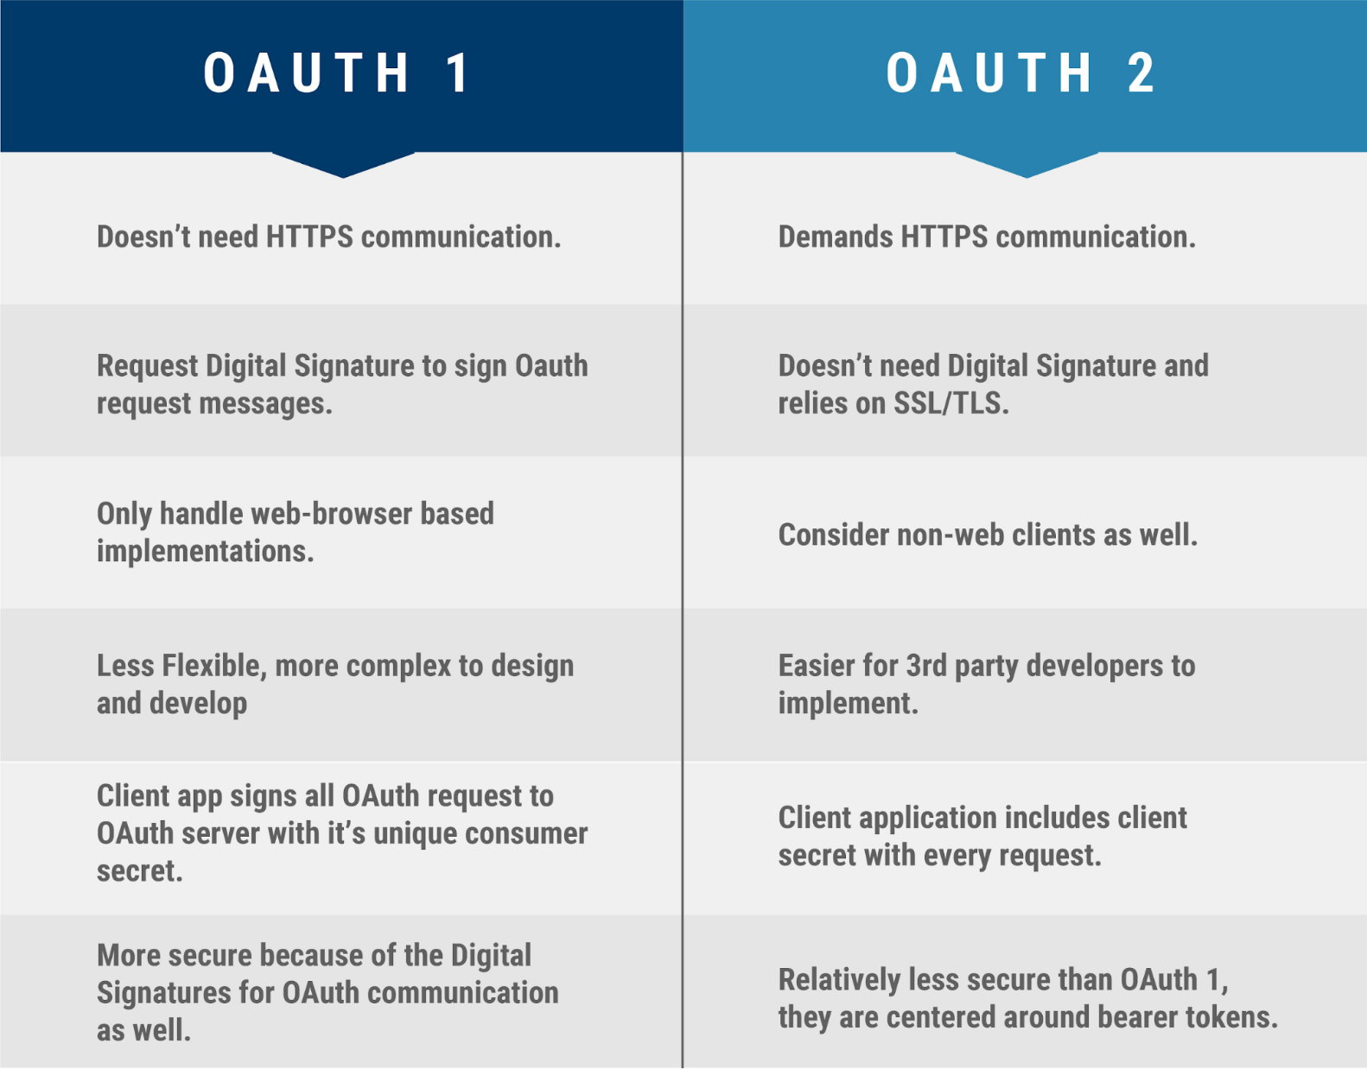
Compare between OAuth 1 and OAuth 2

Slide 27
Summary
Concepts were introduced:
  Introduction HTTPS
  Install and Create SSL Certificate
  How to implement https in node js
  Introduction SSO, OAuth

