Slide 1

HandleBars

Slide 2
Objectives
Introduction to Handlebars
Install and Using Handlebars in NodeJS
Basic Example about Handlebars
Introduction Helper, Conditional, Partial, Hook in Handlebars

Slide 3
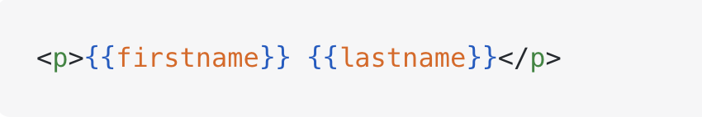
What is Handlebars?
Handlebars is a template engine that combines HTML templates with data to generate dynamic HTML. It uses expressions such as {{name}} to display data.

Slide 4
Key Features of Handlebars
Expressions: Display data in templates using double curly braces, such as {{name}}.
Helpers: Functions used in templates to format data or perform custom operations.
Partials: Reusable template sections, such as headers and footers, included using {{> footer}}.
Conditionals and Loops: Built-in helpers such as {{#if}} and {{#each}} for displaying content conditionally and iterating over data.

Slide 5
Why Use Handlebars?
Separation of Logic and Presentation: Keep business logic in JavaScript and focus templates on displaying data. Handlebars supports conditions, loops, and helpers, so “logic-less” does not mean no logic at all.
Simplicity: Its straightforward syntax, such as {{name}}, makes templates easy to learn and write.
Maintainability: Readable templates and reusable partials make interfaces easier to update.
Performance: Templates can be precompiled, reducing template compilation work during rendering.

Slide 6
Setting Up Handlebars with Node.js
Install dependencies:
npm install express express-handlebars
Set up an Express server: Configure the server to use Handlebars as the templating engine.

Slide 7
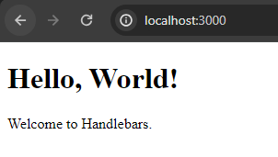
Basic Example
const express = require('express');
const exphbs = require('express-handlebars');
const app = express();
// Configure Handlebars
app.engine('handlebars', exphbs.engine({
layoutsDir: 'views/layouts/',
defaultLayout: 'index'
}));
app.set('view engine', 'handlebars');
app.set('views', './views');
app.get('/', (req, res) => {
res.render('home', {
title: 'Hello, World!',
body: 'Welcome to Handlebars.'
});
});
app.listen(3000, () => {
console.log('Server is running on port 3000');
});
{{!-- home.handlebars --}}
<html>
<body>
<h1>{{title}}</h1>
<p>{{body}}</p>
</body>
</html>

Slide 8
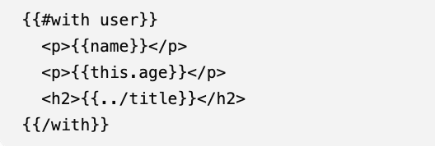
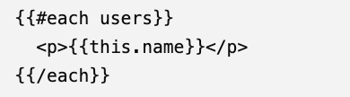
Evaluation context
The evaluation context in Handlebars is the current data object that the template uses to look up variable values.

Slide 9
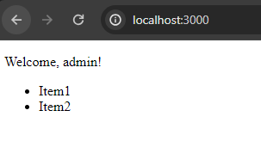
Conditionals and Loops
Highlight the use of {{#if}}, {{else}}, and {{#each}}.
Show a practical example:
app.engine('handlebars', exphbs.engine());
…
app.get('/', (req, res) => {
res.render('home', {
isAdmin: true,
items: ['Item1', 'Item2']
});
});
<html>
<body>
{{#if isAdmin}}
<p>Welcome, admin!</p>
{{else}}
<p>Welcome, user!</p>
{{/if}}
<ul>
{{#each items}}
<li>{{this}}</li>
{{/each}}
</ul>
</body>
</html>

Slide 10
Evaluation context
Expression | Meaning
{{name}} | Retrieves name from the current context (user).
{{this.age}} | Retrieves age from the current data object.
{{../title}} | Accesses the parent context to retrieve title.

Slide 11
Template comments
You can use comments in your handlebars code just as you would in your code. Since there is generally some level of logic, this is a good practice.
The comments will not be in the resulting output. If you'd like the comments to show up just use HTML comments, and they will be output.
Any comments that must contain }} or other handlebars tokens should use the {{!-- --}} syntax.

Slide 12
Template comments
Syntax | Meaning | Included in generated HTML?
{{! comment }} | Short Handlebars comment | No
<!-- comment --> | HTML comment | Yes, but not visibly displayed on the page
{{!-- comment --}} | Handlebars comment that can contain }} and span multiple lines | No

Slide 13
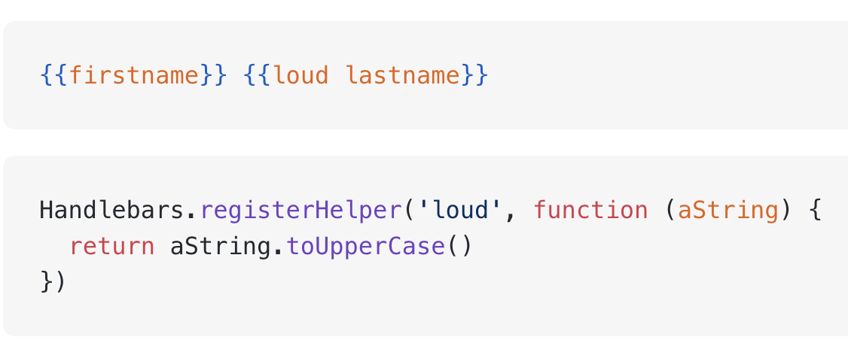
Helpers in Handlebars
Handlebars helpers can be accessed from any context in a template. You can register a helper with the Handlebars.registerHelper method.

Slide 14
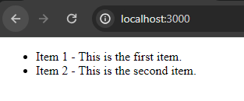
Using Partials
const express = require('express');
const exphbs = require('express-handlebars');
const app = express();
const hbs = exphbs.create({
layoutsDir: 'views/layouts/',
defaultLayout: 'index',
partialsDir: 'views/partials/'
});
app.engine('handlebars', hbs.engine);
app.set('view engine', 'handlebars');
app.set('views', './views');
app.get('/', (req, res) => {
res.render('home', {
title: 'Welcome to Handlebars',
items: [
{ name: 'Item 1', description: 'This is the first item.' },
{ name: 'Item 2', description: 'This is the second item.' }
]
});
});
app.listen(3000, () => {
console.log('Server is running on port 3000');
});
Partials are reusable template pieces.
{{!-- layout/home.handlebars --}}
<html>
<body>
<ul>
{{#each items}}
{{> item}}
{{/each}}
</ul>
</body>
</html>
{{!-- partials/item.handlebars --}}
<li>{{name}} - {{description}}</li>

Slide 15
Exercise: Using Handlebars and Express-Handlebars for building a news website

Slide 16
Summary
Concepts were introduced:
  Introduction to Handlebars
  Install and Using Handlebars in NodeJS
  Basic Example about Handlebars
  Introduction Helper, Conditional, Partial, Hook in Handlebars

