Slide 1

Embedded Javascript (EJS)

Slide 2
Objectives
Introduction to EJS
Understand What Ejs Does And How To Use It With Node And Express
Templating With EJS
Compare between EJS and JSX

Slide 3
What is EJS
EJS (Embedded JavaScript) is a template engine that lets you write HTML with JavaScript to display dynamic data.
In Express, the server combines an EJS template with data to generate HTML, then sends that HTML to the browser.

Slide 4
Features of EJS
Use plain JS
Fast Speed execution
Fast development time
Easy debugging
Simple syntax
Active development

Slide 5
Templating with EJS
A template engine combines data with an HTML template on the server side to generate HTML, which is then sent to the client’s browser.
The diagram illustrates the template rendering process: Template + Data → Generated HTML → Browser.

Slide 6
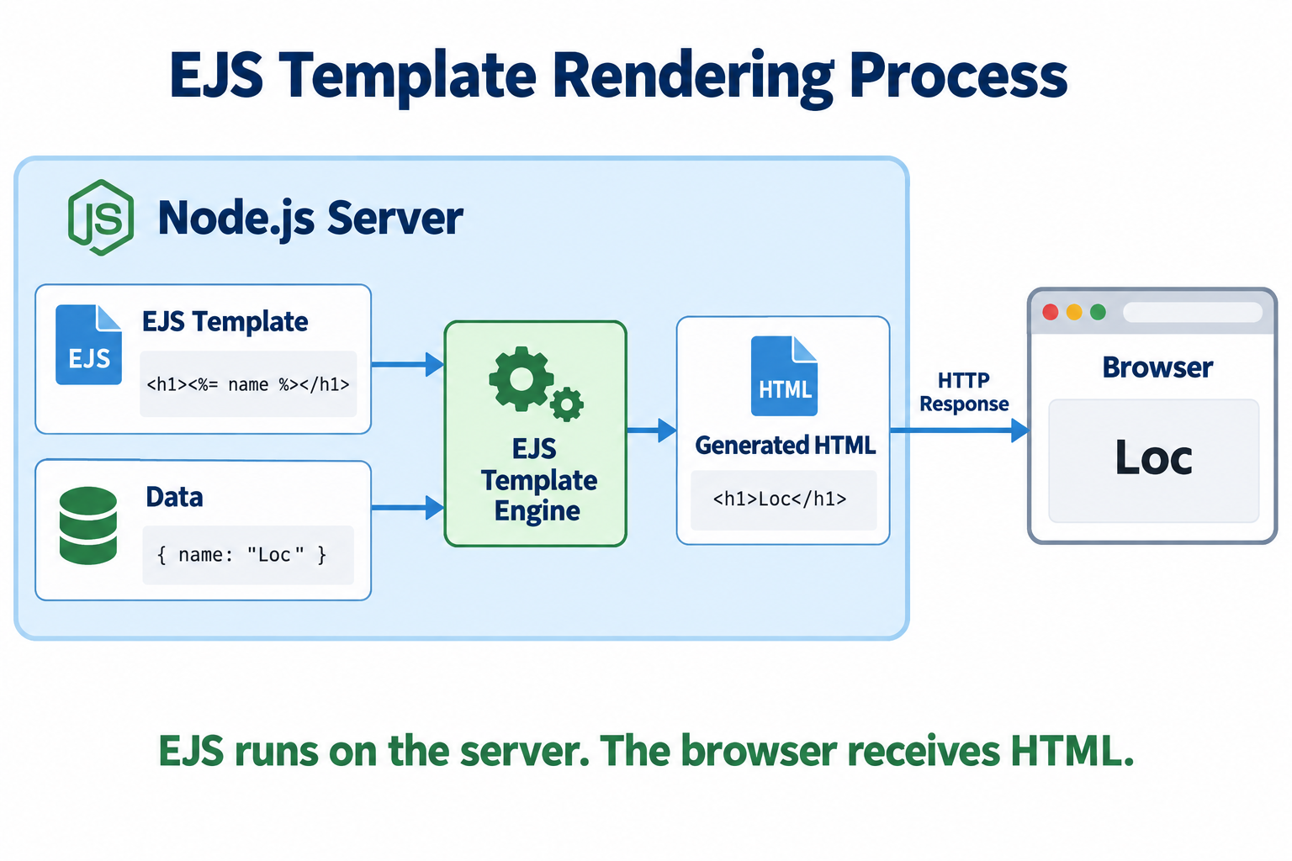

Slide 7
Using EJS
Install EJS with NPM:
npm install ejs
Configure Express to Use EJS
  Set up EJS as template engine
  Set up the directory containing EJS files
app.set('view engine', 'ejs');
app.set('views', './templates');

Slide 8
Using EJS
Create an EJS template file in the directory
  Create a file named index.ejs with the following content:
<!DOCTYPE html>
<html lang="en">
<head>
<meta charset="UTF-8" />
<meta name="viewport" content="width=device-width, initial-scale=1.0" />
<title>Home Page</title>
</head>
<body>
<h1>Hello, <%= name %>!</h1>
</body>
</html>

Slide 9
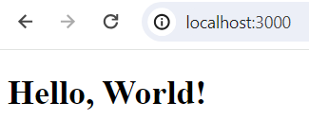
Using EJS – 2
Using Template in Route Handler
When accessing the path /, the browser displays "Hello, World!".
app.get('/', (req, res) => {
res.render('index', { name: 'World' });
});

Slide 10
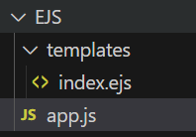
Using EJS – 3
// app.js
const express = require('express');
const app = express();
// Set up EJS as template engine
app.set('view engine', 'ejs');
// Set up the directory containing EJS files
app.set('views', './templates');
app.get('/', (req, res) => {
res.render('index', { name: 'World' });
});
// Start the server
const port = 3000;
app.listen(port, () => {
console.log(`Server running on port ${port}`);
});

Slide 11
Tags of EJS
<% | 'Scriptlet' tag, for control-flow, no output
<%_ | ‘Whitespace Slurping’ Scriptlet tag, strips all whitespace before it
<%= | Outputs the value into the template (HTML escaped)
<%- | Outputs the unescaped value into the template
<%# | Comment tag, no execution, no output
<%% | Outputs a literal '<%'
%> | Plain ending tag
-%> | Trim-mode ('newline slurp') tag, trims following newline
_%> | ‘Whitespace Slurping’ ending tag, removes all whitespace after it

Slide 12
Important tags
<% | 'Scriptlet' tag, for control-flow, no output
<%= | Outputs the value into the template (HTML escaped)
<%- | Outputs the unescaped value into the template
<%# | Comment tag, no execution, no output

Slide 13
Options of EJS
cache | Compiled functions are cached, requires filename
filename | Used by cache to key caches, and for includes
root | Set project root for includes with an absolute path (e.g, /file.ejs). Can be array to try to resolve include from multiple directories
views | An array of paths to use when resolving includes with relative paths.
context | Function execution context
compileDebug | When false no debug instrumentation is compiled
client | Returns standalone compiled function
delimiter | Character to use for inner delimiter, by default '%'
openDelimiter | Character to use for opening delimiter, by default '<'
closeDelimiter | Character to use for closing delimiter, by default '>'

Slide 14
Options of EJS – cont’d
debug | Outputs generated function body
strict | When set to `true`, generated function is in strict mode
_with | Whether or not to use with() {} constructs. If false then the locals will be stored in the locals object. (Implies `--strict`)
localsName | Name to use for the object storing local variables when not using with Defaults to locals
rmWhitespace | Remove all safe-to-remove whitespace, including leading and trailing whitespace. It also enables a safer version of -%> line slurping for all scriptlet tags (it does not strip new lines of tags in the middle of a line).
escape | The escaping function used with <%= construct. It is used in rendering and is .toString()ed in the generation of client functions. (By default escapes XML).
outputFunctionName | Set to a string (e.g., 'echo' or 'print') for a function to print output inside scriptlet tags.
async | When true, EJS will use an async function for rendering. (Depends on async/await support in the JS runtime.

Slide 15
Exercise: How To Use EJS to Template Your Node Application

Slide 16
Summary
Concepts were introduced:
  Introduction to EJS
  Understand What EJS Does And How To Use It With Node And Express
  Templating With EJS
  Compare between EJS and JSX

