Slide 1
Business View | 1. Frame the Problem
Payroll has multiple high-value AI use cases, but each agent can become a separate engineering effort.
Repeated Build Effort
Hard to Scale Across Payroll
Trust & Governance Matter
• Every use case needs agent setup, model configuration, tools and service integration.
• Summarizer, General Query and Anomaly Detection repeat the same foundational work.
• Agents need to be wired into Payrun pages and backend flows.
• One-off implementations create inconsistent deployment, ownership and maintenance.
• Payroll decisions depend on sensitive, high-trust data.
• Agents must use approved models, domain tools and controlled access—not ad-hoc integrations.
Business need: Create once, configure safely, and attach reusable agents to Payroll experiences.

Slide 2
Business View | 2. Show the Idea
Agent Template Studio + Agent Factory turns agent creation into a reusable platform capability for Payroll.
1
2
3
4
5
CREATE
CONFIGURE
ATTACH TOOLS
PUBLISH
USE IN PAYRUN
Start from an
Agent Template
Description • Model
Domain • Page
Approved Payroll APIs
& domain tools
Agent Factory creates
& registers agent
Agent Window in
Payroll experience
Business Value
Faster Time-to-Value
Governed AI
Scale Across Use Cases
Reusable templates reduce effort to launch new Payroll agents.
Models, tools and domains are controlled through a common configuration path.
One platform supports Summarizer, General Query, Anomaly Detection and future agents.

Slide 3
Think Big — One Foundation, Many Domains
Payrun is a reference implementation. The platform is designed from day one to support enterprise-wide agent creation.
AGENT TEMPLATE STUDIO
Reusable Agent Templates
Agent Factory
Model + Tool Catalog
Guardrails • Evaluation • Observability
PAYROLL
HR
BENEFITS
COMPLIANCE
FUTURE
Payrun is the first
reference use case
Configure templates
for HR workflows
Reuse foundation for
benefit experiences
Domain tools +
controlled workflows
New domains
without new platform
Build templates once → configure by domain → generate many purpose-built agents without rebuilding the foundation.

Slide 4
Agent Template Studio — Foundational Agent Platform
A shared enterprise capability for building domain-specific agents from reusable templates, configurations, models and tools.
1 TEMPLATE CATALOG
2 DOMAIN CONFIGURATION
3 AGENT FACTORY
4 DOMAIN AGENTS
Reusable agent patterns:
• Anomaly Detection
• Summarizer
• General Query
• Failure Investigation
• Future enterprise templates
Each domain configures:
• Agent purpose
• Domain / service
• Model
• Instructions
• Approved tools
• UI / workflow attachment
Shared backend foundation:
• Loads template + config
• Selects model
• Binds tools
• Applies guardrails
• Creates / registers agent
Purpose-built instances:
• Payroll / Payrun
• HR
• Benefits
• Compliance
• Other enterprise domains
Same foundation. Different domain context.
Platform owns the reusable foundation. Domains own their configuration, tools and business use cases.

Slide 5
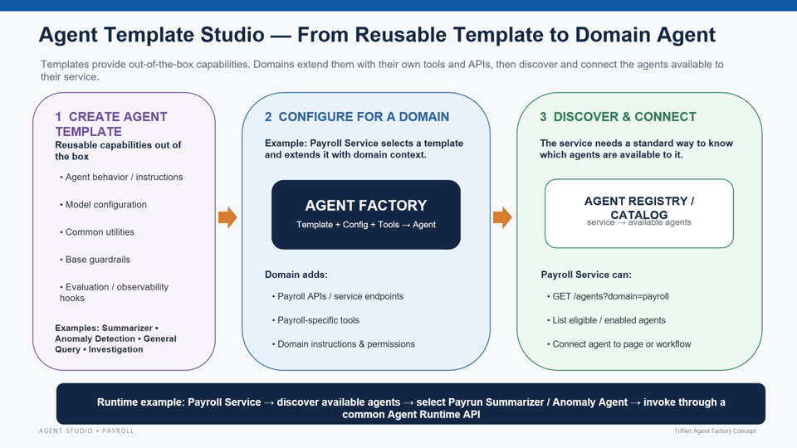
Agent Template Studio — From Reusable Template to Domain Agent
Templates provide out-of-the-box capabilities. Domains extend them with their own tools and APIs, then discover and connect the agents available to their service.
1 CREATE AGENT
TEMPLATE
2 CONFIGURE FOR A DOMAIN
3 DISCOVER & CONNECT
Reusable capabilities out of the box
Example: Payroll Service selects a template and extends it with domain context.
The service needs a standard way to know which agents are available to it.
• Agent behavior / instructions
AGENT FACTORY
AGENT REGISTRY /
CATALOG
• Model configuration
Template + Config + Tools → Agent
service → available agents
• Common utilities
• Base guardrails
Domain adds:
Payroll Service can:
• Payroll APIs / service endpoints
• GET /agents?domain=payroll
• Evaluation / observability hooks
• Payroll-specific tools
• List eligible / enabled agents
Examples: Summarizer • Anomaly Detection • General Query • Investigation
• Domain instructions & permissions
• Connect agent to page or workflow
Runtime example: Payroll Service → discover available agents → select Payrun Summarizer / Anomaly Agent → invoke through a common Agent Runtime API

Slide 6
Agent Template Studio — Template Marketplace
Select a reusable template, review its built-in capabilities and runtime pattern, then configure it for your domain.
AGENT STUDIO
Create Agent from Template
Search templates…
Choose a template that matches the runtime behavior you need.
Templates
My Agents
Anomaly Detection
Summarizer
General Query
Incident Generator
Tools & APIs
REAL-TIME
OFFLINE
INTERACTIVE
EVENT-DRIVEN
Models
• Streaming / event input
• On-demand / scheduled
• Question + context
• Failure / alert signal
Agent Registry
• History + rules utilities
• Context retrieval utilities
• Tool-calling pattern
• Evidence utilities
Evaluation
• Detect • score • alert
• Summarize • structure
• Reason • answer
• Create • enrich • route
Use Template
Use Template
Use Template
Use Template
Example: Configure Anomaly Detection
Domain
Runtime
Add Tools / APIs
Configure →
Payroll / Payrun
Real-time / long-running
History • Rules • Alert API
UI concept: templates feel like reusable products in a catalog; selecting one opens domain-specific configuration before the Agent Factory creates the agent.

Slide 7
Agent Factory APIs & Service Agent Discovery
Agent Factory manages reusable templates. Domain services discover the agents created for them and invoke those agents through service-level APIs.
Agent Studio
Templates
Agent Factory
Agent Registry
Service UI
Create / update
agent templates
Anomaly Detection
Summarizer
General Query
Builds agent using
template config
Agents created
for each service
List agents → open
Agent Window → invoke
Agent Factory APIs
Template Config
Service-Level Agent APIs
Template lifecycle and reusable capabilities
Example fields used by Agent Factory
Agents created for a service are discovered and invoked by that service
POST
/create-template/
template_id
anomaly_detection
GET
/<service-name>/list-agents
create a reusable agent template
model_id
approved model
list agents available to service
created_by_user_id
<user_id>
PUT
/update-template/
capabilities_attached
approved APIs/tools
GET
/<service-name>/get-agent/{agent-id}
update template config/capabilities
roles_access
role-based access
get selected agent metadata
GET
/get-template/
services_visibility
service/domain scope
POST
/<service-name>/{agent-id}/prompts
retrieve template definition
created_at
timestamp
{"prompt": data}
Template = out-of-box behavior + governed configuration
Flow: create/update template in Agent Factory → create service-visible agents → service lists available agents → UI Agent Window invokes the selected agent with prompts.

Slide 8
Page 4 — Service Discovers Available Agents & Opens Agent Window
A domain service does not hard-code agents. It asks which agents are visible to that service, retrieves the selected agent, then sends prompts through the service API.
PAYROLL SERVICE
Available Agents
AGENT WINDOW
Example service:
Payrun
Agents discovered dynamically for Payroll / Payrun
Selected: General Query Agent
Anomaly Detection
REAL-TIME
Open
Why is this employee's
net pay lower this run?
Monitor current Payrun and surface anomalies
GET /payrun/list-agents
Summarizer
OFFLINE / ON-DEMAND
Open
Returns only agents where
services_visibility includes Payrun
Generate employee or Payrun summary
POST /payrun/{agent-id}/prompts
General Query
INTERACTIVE
Open
{"prompt": data}
GET /payrun/get-agent/{id}
Ask contextual questions using approved tools
Agent Runtime
Loads selected agent metadata,
capabilities and UI configuration
Incident Generator
EVENT-DRIVEN
Open
Uses only approved capabilities
+ role-authorized APIs
Generate incident from failure evidence
Service owns discovery and UI integration; Agent Factory owns templates/configuration; the created agent owns governed runtime behavior.

Slide 9
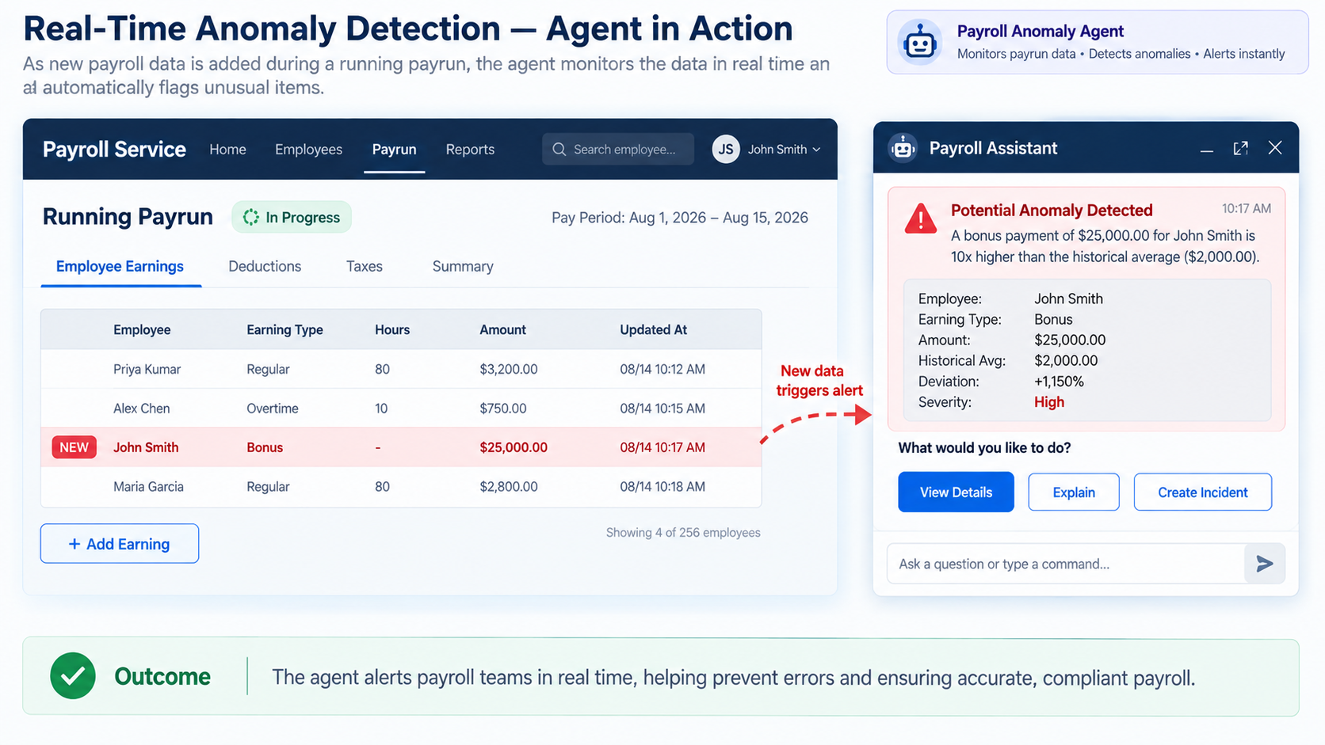
Real-Time Anomaly Detection — Agent in Action
🤖 Payroll Anomaly Agent • Monitors • Detects • Alerts
As new payroll data is added during a running payrun, the agent monitors the data in real time and automatically flags unusual items.
Payroll Service
Home Employees Payrun Reports
🤖 Payroll Assistant
Running Payrun
● In Progress
Pay Period: Aug 1, 2026 – Aug 15, 2026
⚠ Potential Anomaly Detected
Employee Earnings Deductions Taxes Summary
A bonus payment of $25,000.00 for John Smith is 10x higher than the historical average ($2,000.00).
Employee
Earning Type
Hours
Amount
Updated At
Employee:
John Smith
Earning Type:
Bonus
Priya Kumar
Regular
80
$3,200.00
08/14 10:12 AM
Amount:
$25,000.00
Alex Chen
Overtime
10
$750.00
08/14 10:15 AM
New data
triggers alert
Historical Avg:
$2,000.00
Deviation:
+1,150%
NEW
John Smith
Bonus
-
$25,000.00
08/14 10:17 AM
Severity:
High
Maria Garcia
Regular
80
$2,800.00
08/14 10:18 AM
What would you like to do?
View Details
Explain
Create Incident
+ Add Earning
Ask a question or type a command...
✓ Outcome
The agent alerts payroll teams in real time, helping prevent errors and ensuring accurate, compliant payroll.

Slide 10
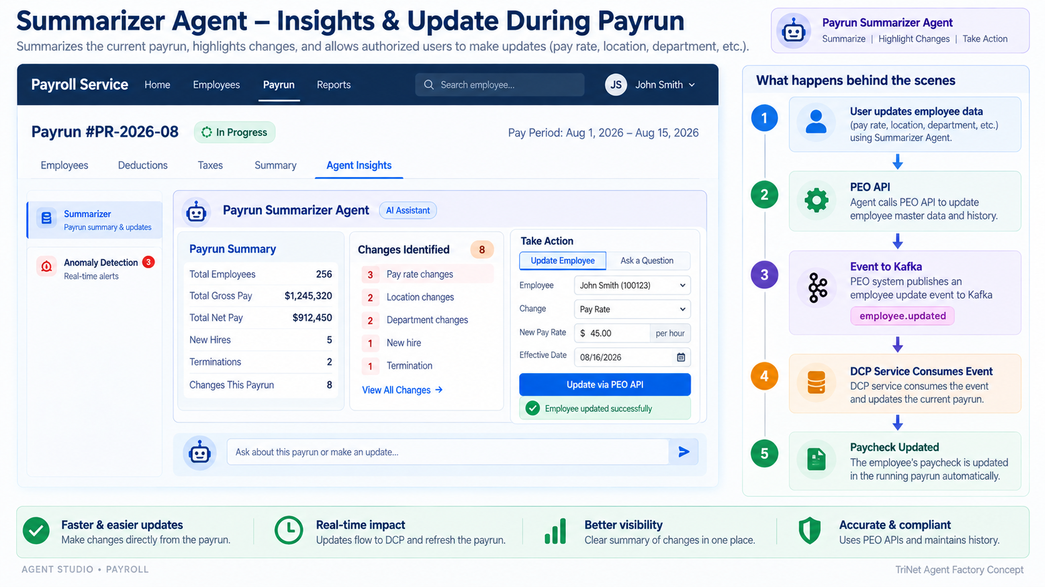
Summarizer Agent – Insights & Update During Payrun
🤖 Payrun Summarizer Agent
Summarizes the current payrun, highlights changes, and allows authorized users to make updates (pay rate, location, department, etc.).
Payroll Service
Home Employees Payrun Reports
What happens behind the scenes
● In Progress
1
User updates employee data
Payrun #PR-2026-08
Pay Period: Aug 1, 2026 – Aug 15, 2026
pay rate, location, department, etc.
Employees Deductions Taxes Summary Agent Insights
2
PEO API
AI Assistant
updates employee master data and history
▣ Summarizer
🤖 Payrun Summarizer Agent
Payrun summary & updates
3
Event to Kafka
Payrun Summary
Changes Identified
8
Take Action
employee.updated
◉ Anomaly Detection
Total Employees
256
Update Employee
Ask a Question
3
3 Pay rate changes
Real-time alerts
Total Gross Pay
$1,245,320
2 Location changes
Employee
John Smith (100123)
Total Net Pay
$912,450
2 Department changes
4
DCP Service Consumes Event
New Hires
5
Change
Pay Rate
updates the current payrun
1 New hire
New Pay Rate
$ 45.00 / hour
Terminations
2
1 Termination
Changes This Payrun
8
View All Changes →
Effective Date
08/16/2026
5
Paycheck Updated
Update via PEO API
running paycheck refreshes automatically
✓ Faster & easier updates
◷ Real-time impact
▥ Better visibility
⬟ Accurate & compliant
Make changes directly from the payrun.
Updates flow to DCP and refresh the payrun.
Clear summary of changes in one place.
Uses PEO APIs and maintains history.

Slide 11
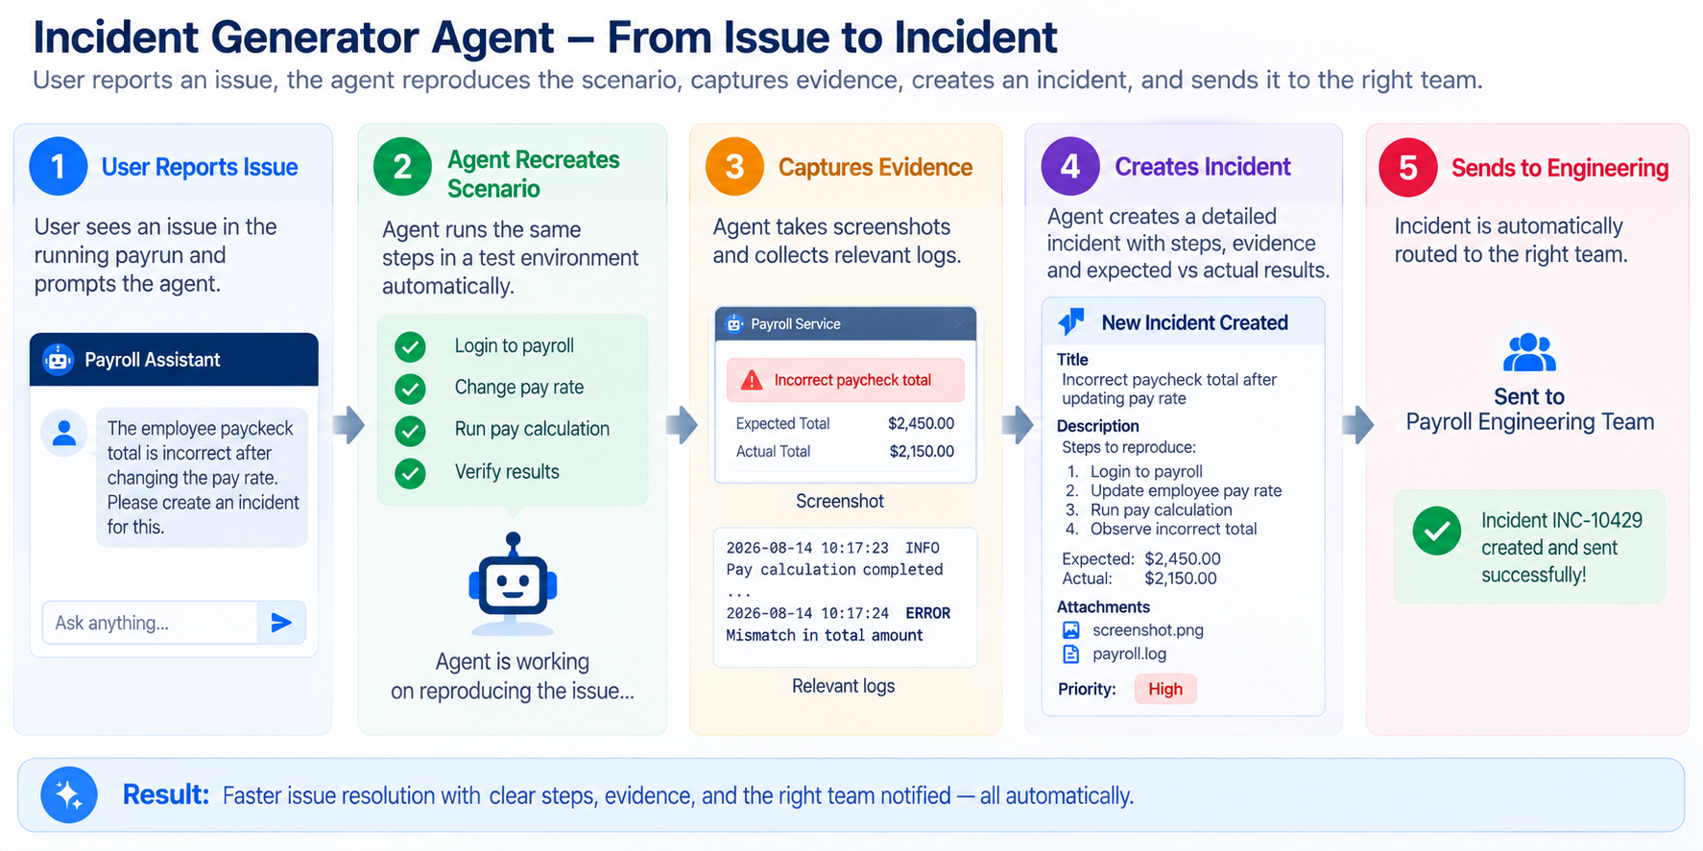
Incident Generator Agent – From Issue to Incident
User reports an issue, the agent reproduces the scenario, captures evidence, creates an incident, and sends it to the right team.
1
User Reports Issue
2
Agent Recreates
Scenario
3
Captures Evidence
4
Creates Incident
5
Sends to Engineering
User sees an issue in the running payrun and prompts the agent.
Agent runs the same steps in a test environment automatically.
Agent takes screenshots and collects relevant logs.
Agent creates a detailed incident with steps, evidence and expected vs actual results.
Incident is automatically routed to the right team.
🤖 Payroll Assistant
✓ Login to payroll
⚠ Incorrect paycheck total
⚑ New Incident Created
👥
Sent to
Payroll Engineering Team
The employee paycheck total is incorrect after changing the pay rate. Please create an incident for this.
✓ Change pay rate
Expected Total $2,450.00
Title
Incorrect paycheck total after updating pay rate
✓ Run pay calculation
Actual Total $2,150.00
Steps to reproduce:
1. Login to payroll
2. Update employee pay rate
3. Run pay calculation
4. Observe incorrect total
✓ Verify results
10:17:23 INFO Pay calculation completed
10:17:24 ERROR Mismatch in total amount
✓ Incident INC-10429
created and sent!
🤖
Agent is reproducing the issue…
Expected: $2,450.00
Actual: $2,150.00
High
✦ Result: Faster issue resolution with clear steps, evidence, and the right team notified — all automatically.

Slide 12
End-to-End Architecture
One control plane for agent configuration; multiple runtime agents attached to payroll microservices.
Agent Studio
UI
Agent Factory
API
Templates +
Model Config
Tool
Bindings
Agent
Registry
GitHub
RUNTIME / PAYROLL MICROSERVICE
Payrun Service
Anomaly Agent
General Query Agent
Summarizer Agent
Design principle: agent behavior is configuration-driven; payroll services remain the source of truth and tools provide controlled access.

