Slide 1
Business View | 1. Frame the Problem
Payroll has multiple high-value AI use cases, but each agent can become a separate engineering effort.
Repeated Build Effort
Hard to Scale Across Payroll
Trust & Governance Matter
• Every use case needs agent setup, model configuration, tools and service integration.
• Summarizer, General Query and Anomaly Detection repeat the same foundational work.
• Agents need to be wired into Payrun pages and backend flows.
• One-off implementations create inconsistent deployment, ownership and maintenance.
• Payroll decisions depend on sensitive, high-trust data.
• Agents must use approved models, domain tools and controlled access—not ad-hoc integrations.
Business need: Create once, configure safely, and attach reusable agents to Payroll experiences.

Slide 2
Business View | 2. Show the Idea
Agent Template Studio + Agent Factory turns agent creation into a reusable platform capability for Payroll.
1
2
3
4
5
CREATE
CONFIGURE
ATTACH TOOLS
PUBLISH
USE IN PAYRUN
Start from an
Agent Template
Description • Model
Domain • Page
Approved Payroll APIs
& domain tools
Agent Factory creates
& registers agent
Agent Window in
Payroll experience
Business Value
Faster Time-to-Value
Governed AI
Scale Across Use Cases
Reusable templates reduce effort to launch new Payroll agents.
Models, tools and domains are controlled through a common configuration path.
One platform supports Summarizer, General Query, Anomaly Detection and future agents.

Slide 3
Think Big — One Foundation, Many Domains
Payrun is a reference implementation. The platform is designed from day one to support enterprise-wide agent creation.
AGENT TEMPLATE STUDIO
Reusable Agent Templates
Agent Factory
Model + Tool Catalog
Guardrails • Evaluation • Observability
PAYROLL
HR
BENEFITS
COMPLIANCE
FUTURE
Payrun is the first
reference use case
Configure templates
for HR workflows
Reuse foundation for
benefit experiences
Domain tools +
controlled workflows
New domains
without new platform
Build templates once → configure by domain → generate many purpose-built agents without rebuilding the foundation.

Slide 4
Agent Template Studio — Foundational Agent Platform
A shared enterprise capability for building domain-specific agents from reusable templates, configurations, models and tools.
1 TEMPLATE CATALOG
2 DOMAIN CONFIGURATION
3 AGENT FACTORY
4 DOMAIN AGENTS
Reusable agent patterns:
• Anomaly Detection
• Summarizer
• General Query
• Failure Investigation
• Future enterprise templates
Each domain configures:
• Agent purpose
• Domain / service
• Model
• Instructions
• Approved tools
• UI / workflow attachment
Shared backend foundation:
• Loads template + config
• Selects model
• Binds tools
• Applies guardrails
• Creates / registers agent
Purpose-built instances:
• Payroll / Payrun
• HR
• Benefits
• Compliance
• Other enterprise domains
Same foundation. Different domain context.
Platform owns the reusable foundation. Domains own their configuration, tools and business use cases.

Slide 5
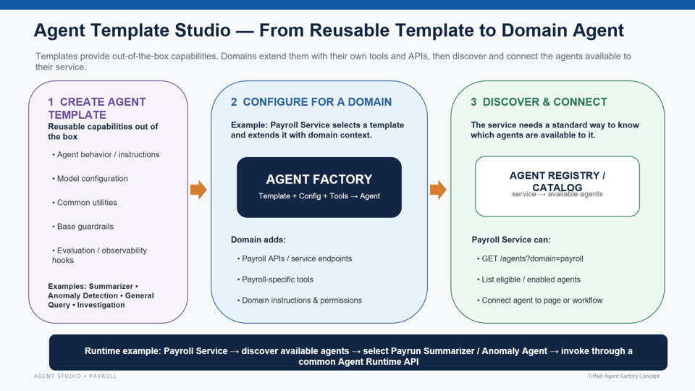

Slide 6
Agent Template Studio — Template Marketplace
Select a reusable template, review its built-in capabilities and runtime pattern, then configure it for your domain.
AGENT STUDIO
Create Agent from Template
Search templates…
Choose a template that matches the runtime behavior you need.
Templates
My Agents
Anomaly Detection
Summarizer
General Query
Incident Generator
Tools & APIs
REAL-TIME
OFFLINE
INTERACTIVE
EVENT-DRIVEN
Models
• Streaming / event input
• On-demand / scheduled
• Question + context
• Failure / alert signal
Agent Registry
• History + rules utilities
• Context retrieval utilities
• Tool-calling pattern
• Evidence utilities
Evaluation
• Detect • score • alert
• Summarize • structure
• Reason • answer
• Create • enrich • route
Use Template
Use Template
Use Template
Use Template
Example: Configure Anomaly Detection
Domain
Runtime
Add Tools / APIs
Configure →
Payroll / Payrun
Real-time / long-running
History • Rules • Alert API
UI concept: templates feel like reusable products in a catalog; selecting one opens domain-specific configuration before the Agent Factory creates the agent.

Slide 7
Agent Factory APIs & Service Agent Discovery
Agent Factory manages reusable templates. Domain services discover the agents created for them and invoke those agents through service-level APIs.
Agent Studio
Templates
Agent Factory
Agent Registry
Service UI
Create / update
agent templates
Anomaly Detection
Summarizer
General Query
Builds agent using
template config
Agents created
for each service
List agents → open
Agent Window → invoke
Agent Factory APIs
Template Config
Service-Level Agent APIs
Template lifecycle and reusable capabilities
Example fields used by Agent Factory
Agents created for a service are discovered and invoked by that service
POST
/create-template/
template_id
anomaly_detection
GET
/<service-name>/list-agents
create a reusable agent template
model_id
approved model
list agents available to service
created_by_user_id
<user_id>
PUT
/update-template/
capabilities_attached
approved APIs/tools
GET
/<service-name>/get-agent/{agent-id}
update template config/capabilities
roles_access
role-based access
get selected agent metadata
GET
/get-template/
services_visibility
service/domain scope
POST
/<service-name>/{agent-id}/prompts
retrieve template definition
created_at
timestamp
{"prompt": data}
Template = out-of-box behavior + governed configuration
Flow: create/update template in Agent Factory → create service-visible agents → service lists available agents → UI Agent Window invokes the selected agent with prompts.

Slide 8
Page 4 — Service Discovers Available Agents & Opens Agent Window
A domain service does not hard-code agents. It asks which agents are visible to that service, retrieves the selected agent, then sends prompts through the service API.
PAYROLL SERVICE
Available Agents
AGENT WINDOW
Example service:
Payrun
Agents discovered dynamically for Payroll / Payrun
Selected: General Query Agent
Anomaly Detection
REAL-TIME
Open
Why is this employee's
net pay lower this run?
Monitor current Payrun and surface anomalies
GET /payrun/list-agents
Summarizer
OFFLINE / ON-DEMAND
Open
Returns only agents where
services_visibility includes Payrun
Generate employee or Payrun summary
POST /payrun/{agent-id}/prompts
General Query
INTERACTIVE
Open
{"prompt": data}
GET /payrun/get-agent/{id}
Ask contextual questions using approved tools
Agent Runtime
Loads selected agent metadata,
capabilities and UI configuration
Incident Generator
EVENT-DRIVEN
Open
Uses only approved capabilities
+ role-authorized APIs
Generate incident from failure evidence
Service owns discovery and UI integration; Agent Factory owns templates/configuration; the created agent owns governed runtime behavior.

Slide 9
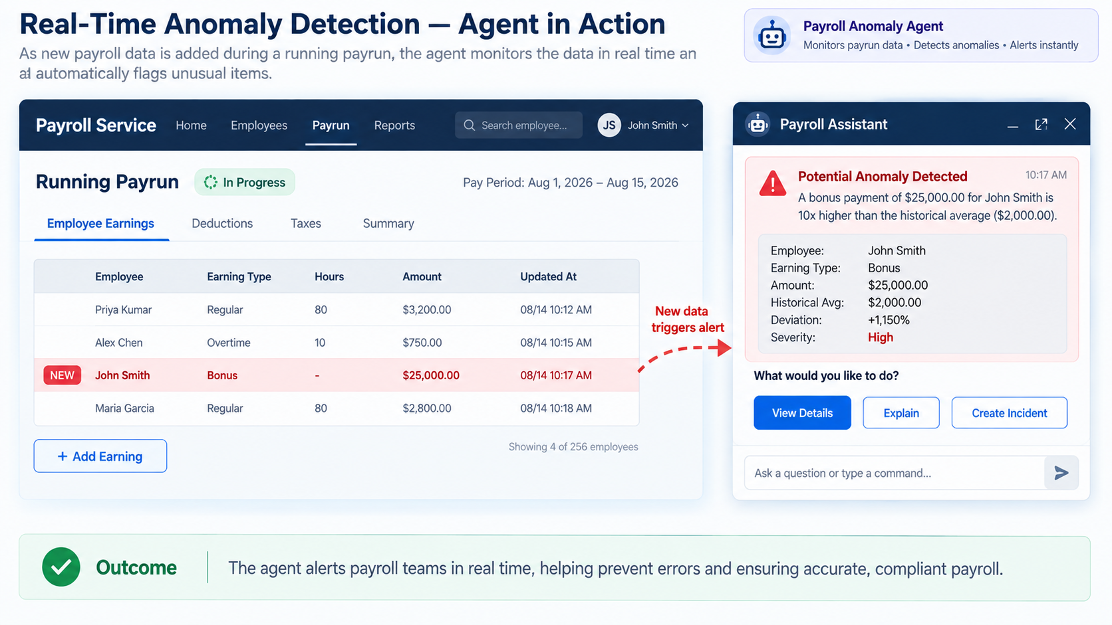

Slide 10
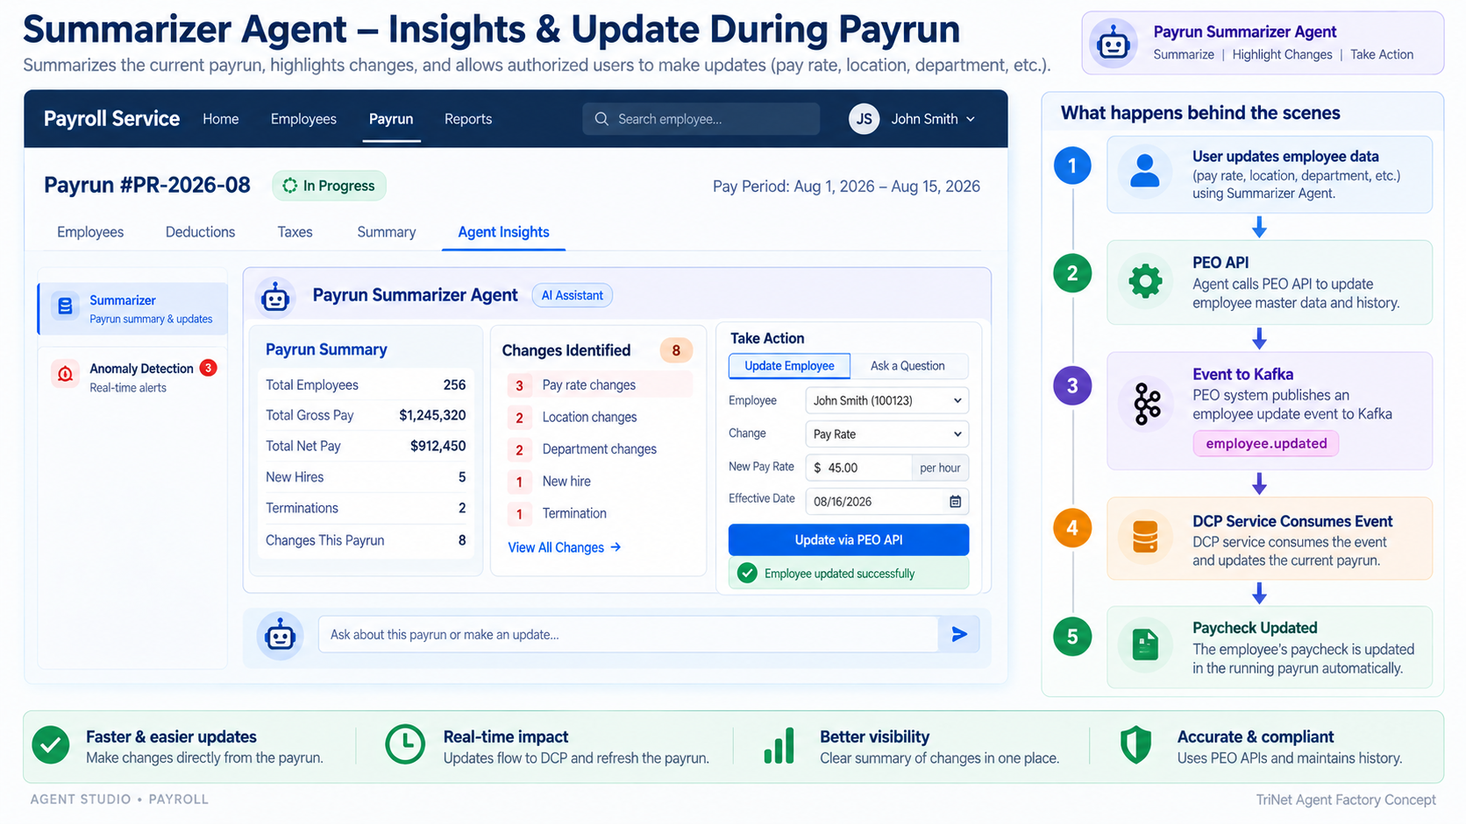

Slide 11
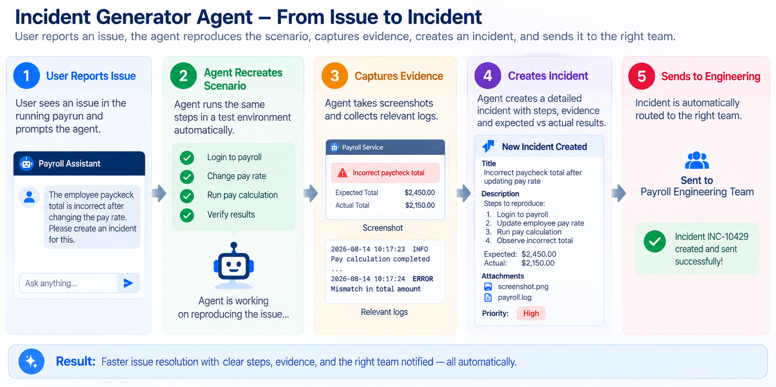

Slide 12
End-to-End Architecture
One control plane for agent configuration; multiple runtime agents attached to payroll microservices.
Agent Studio
UI
Agent Factory
API
Templates +
Model Config
Tool
Bindings
Agent
Registry
GitHub
RUNTIME / PAYROLL MICROSERVICE
Payrun Service
Anomaly Agent
General Query Agent
Summarizer Agent
Design principle: agent behavior is configuration-driven; payroll services remain the source of truth and tools provide controlled access.

