Slide 1
Text classification models
B. Malar
Associate Professor
Dept. of Applied Mathematics and Computational Sciences
PSG COLLEGE OF TECHNOLOGY
Coimbatore
1

Slide 2
Outline
Machine Learning
Optimization in ML
SVM
SVM for radiology reports classification
Conclusion

Slide 3

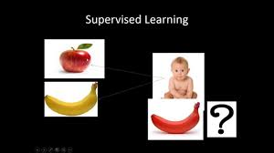
Learning
Notes:
the acquisition of knowledge or skills through study, experience, or being taught.

Slide 4
Machine Learning
Study of algorithms that
  Improve their performance P
  At some task T
  With experience E
Machine learning is programming computers to optimize a performance criterion using example data or past experience.

Slide 5

Deterministic data (Certain data)
Id | X | Y
P1 | 9 | 81
P2 | 1 | 1
P3 | 2 | 4
P4 | 5 | 25
P5 | 8 | 64
P6 | 10 | 100
P7 | 6 | 36
P8 | 3 | 9

Slide 6
Random data (Uncertain data)
Day | Temp | Humidity | Rain?
1 | 34 | 21 | No
2 | 25 | 20 | No
3 | 9 | 14 | Yes
4 | 32 | 25 | No
5 | 11 | 6 | Yes
6 | 10 | 10 | Yes
7 | 13 | 16 | Yes
8 | 12 | 9 | Yes

Slide 7
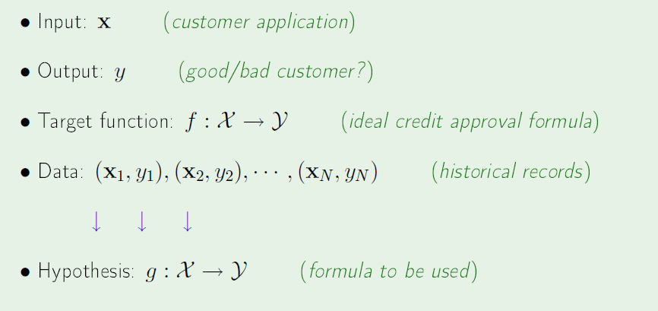
Components of ML

Slide 8
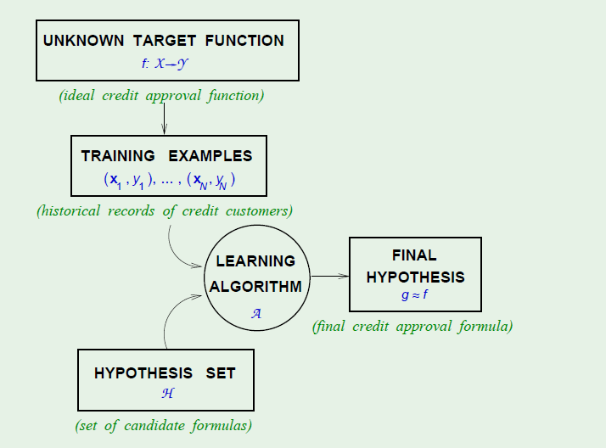
ML in a Nutshell –
Learning a function from data

Slide 9
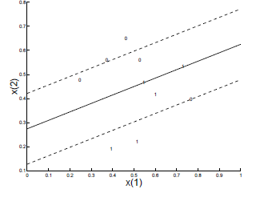
Model – Line (Y = WX+b)

Slide 10
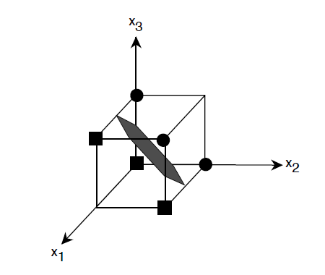
Model – Hyperplane

Slide 11
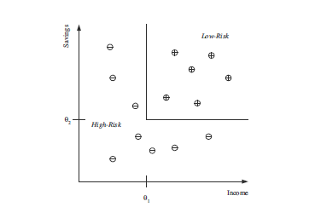
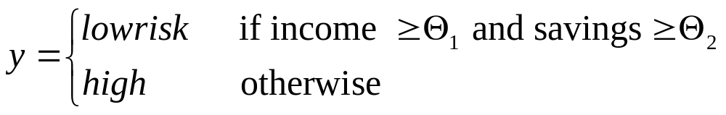
Model – Rule

Slide 12
Sigmoid function – Logistic Regression
Y
LP Model
1
Logit Model
0
X

Slide 13
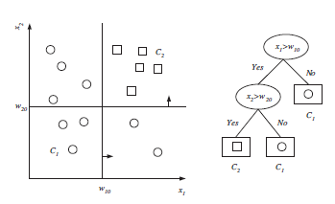
Model - Decision tree

Slide 14
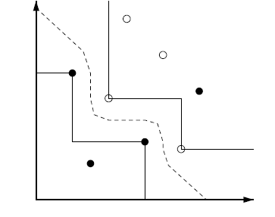
Model – data points
Training Set
Training
Boundary points
Test set
Class labels
Testing

Slide 15
SVM
m
d

Slide 16
Support Vector Machine

Slide 17
Support Vector Machines (SVM)
Supervised learning method for classification and regression
relatively new class of successful learning method
derived from statistical learning theory by Vapnik and Chervonenkis in 1992
Notes:
First introduced in COLT-92 by Boser, Guyon and Vapnik
COLT = computational learning theory

Slide 18
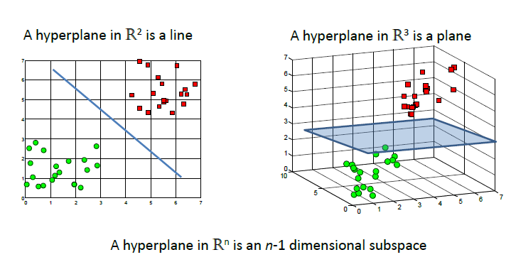
Basic idea - Linear SVM

Slide 19
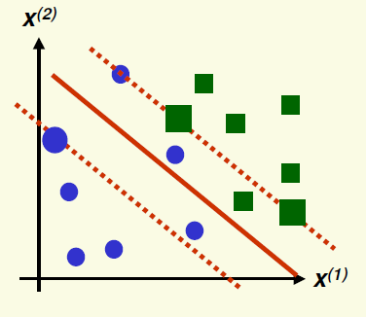
Linear SVM – Soft margin

Slide 20
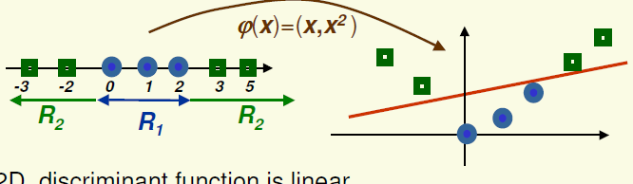
Basic idea – Non linear SVM

Slide 21
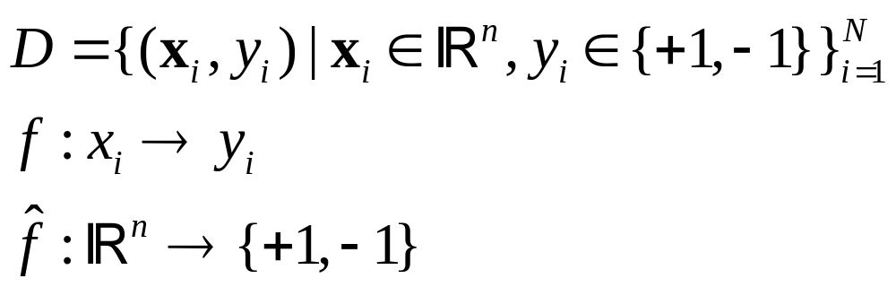
Problem Statement

Slide 22
Binary classification : Linear SVM
Many decision boundaries can separate these two classes
Which one should we choose?
Class +1
Class -1
Notes:
Perceptron learning rule can be used to find any decision boundary between class 1 and class 2

Slide 23
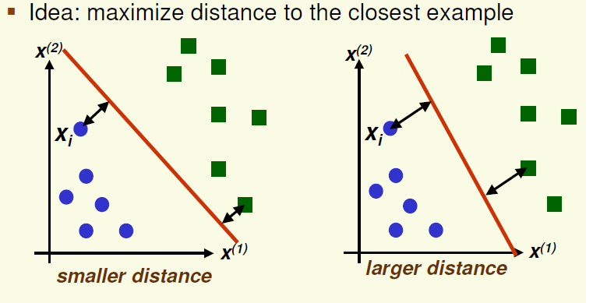
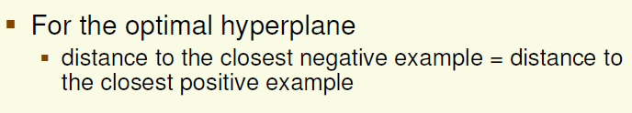
SVM

Slide 24
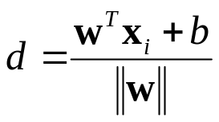
Margin and Support Vectors
Distance from example x_{i} to the separator is
Examples closest to the hyperplane are support vectors.
Margin m of the separator is the distance between support vectors.
m
d

Slide 25
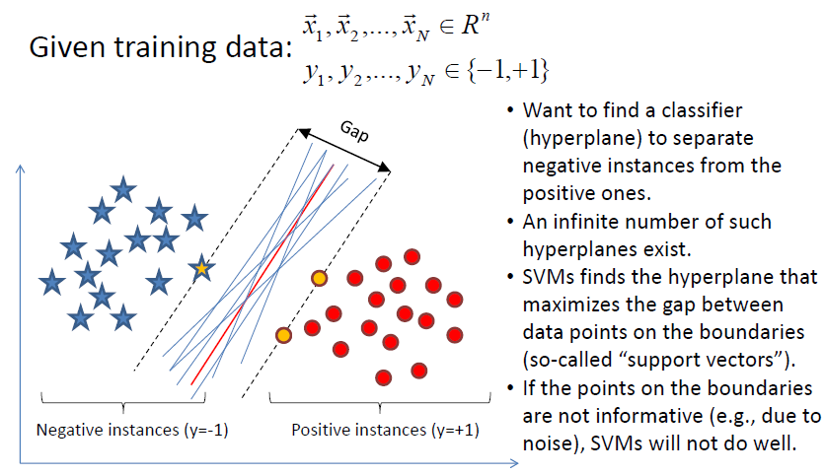
SVM

Slide 26
Model of SVM
wx +b > 1
denotes +1
denotes -1
wx +b > 1
x
X – Input Vector
W – Normal Vector
b – Scalar Value
W
wx +b = 0

Slide 27
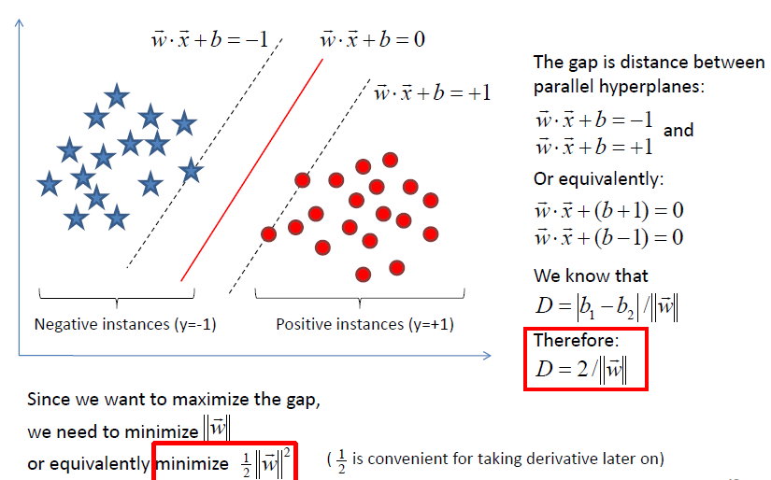
Margin of a hyperplane

Slide 28
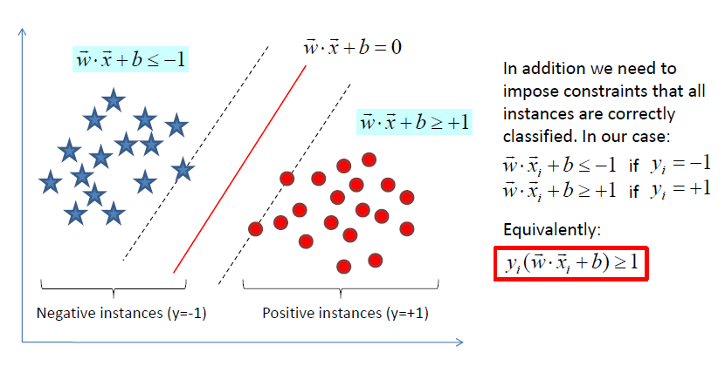
Constraints

Slide 29
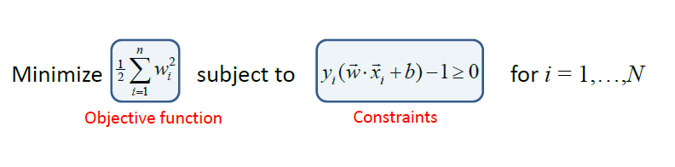
Problem Formulation

Slide 30
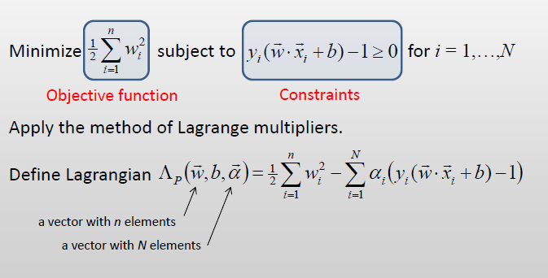
Lagrangian Problem

Slide 31
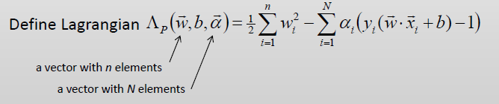
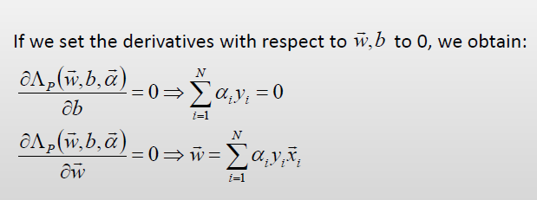
Partial derivatives

Slide 32
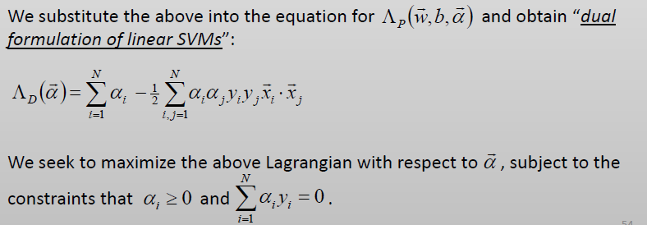
Dual formulation of Linear SVM

Slide 33
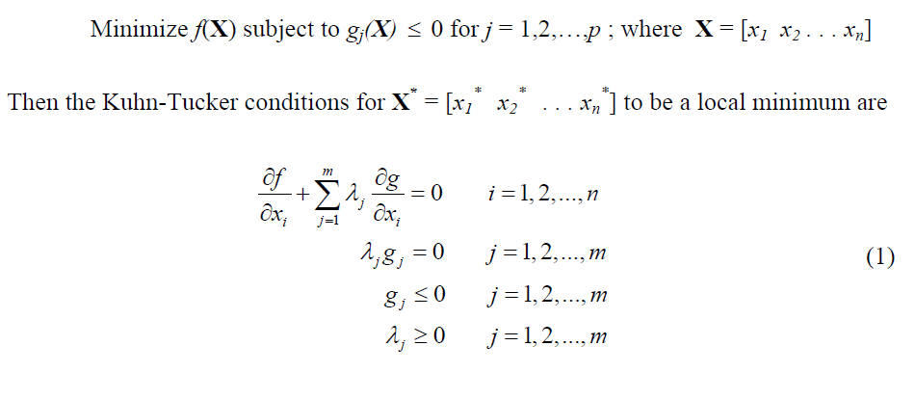
KKT Conditions

Slide 34




A Geometrical Interpretation
Class 2
Support vectors
→α’s with values
different from zero
(they hold up the
separating plane)!
α₁₀=0
α₈=0.6
α₇=0
α₂=0
α₅=0
α₁=0.8
α₄=0
α₆=1.4
α₉=0
α₃=0
Class 1
Notes:
So, if change internal points, no effect on the decision boundary

Slide 35
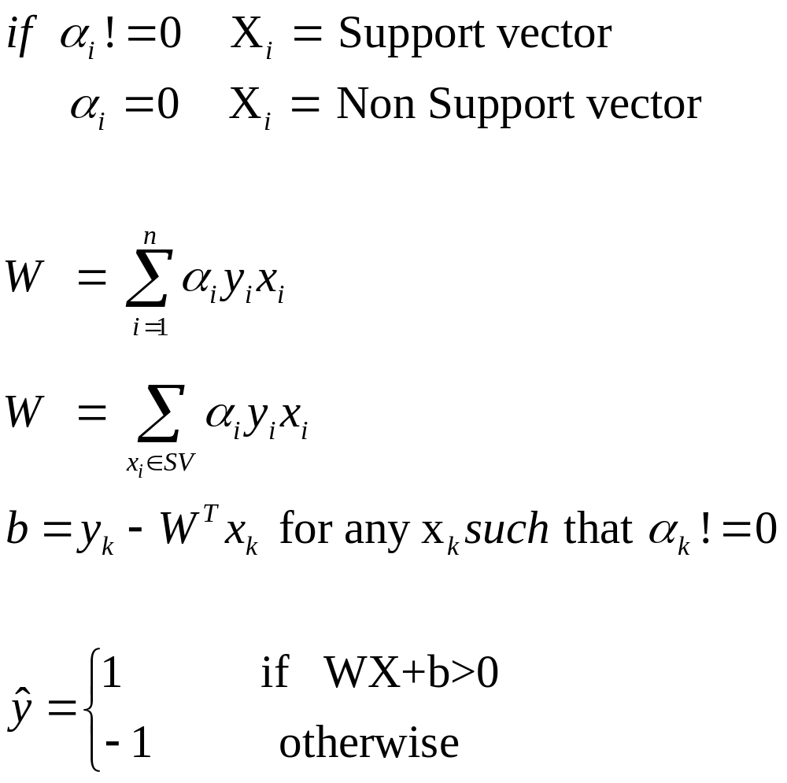
Prediction

Slide 36
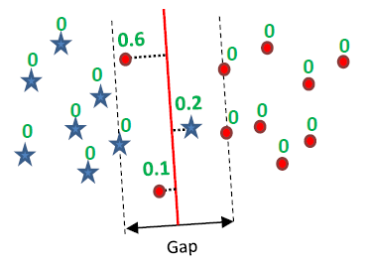
Linear SVM with soft margin

Slide 37
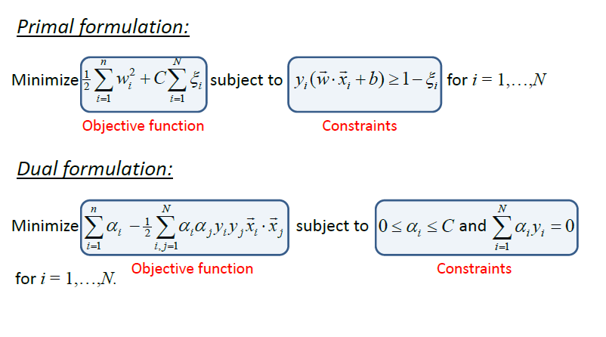
SVM with soft Margin

Slide 38
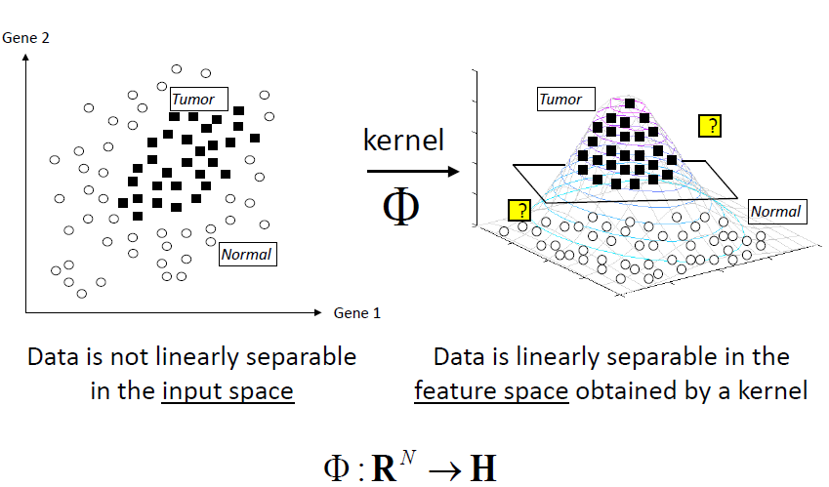
Non Linear SVM

Slide 39
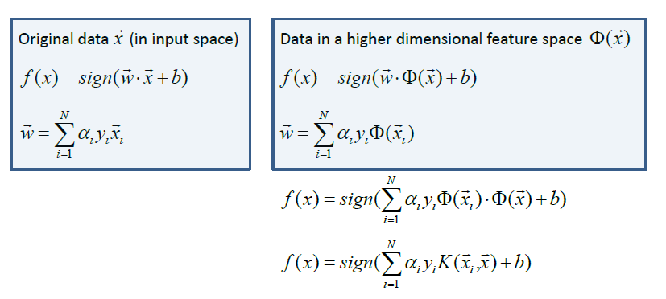
Prediction for Non-linear data

Slide 40
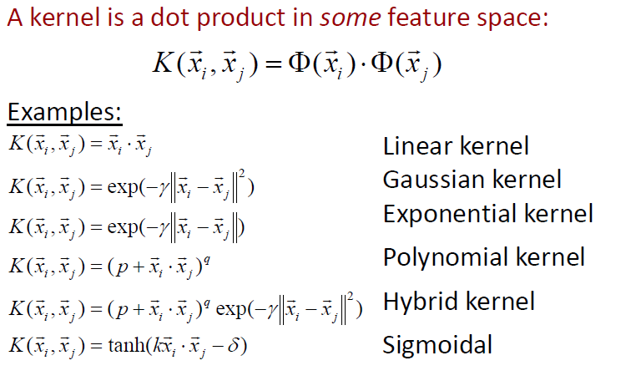
Popular Kernels

Slide 41
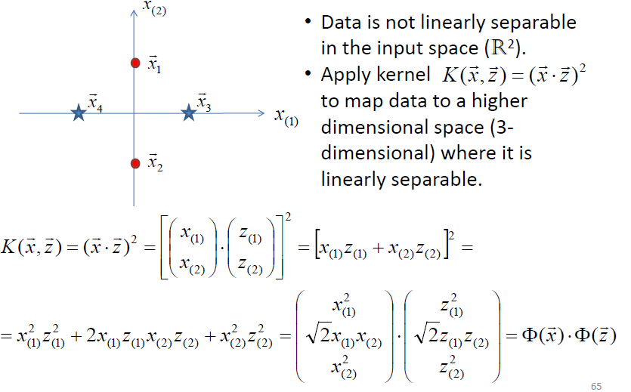
Kernel functions

Slide 42
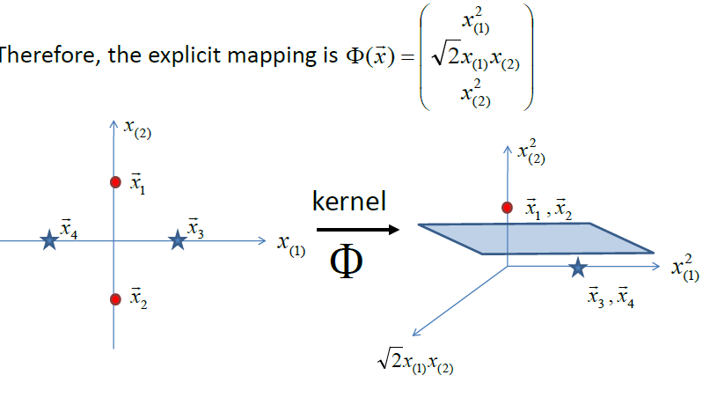

Slide 43
Recap of Steps in SVM
Prepare data matrix {(x_{i},y_{i})}
  x_{i} should be normalized
  Class labels Y_{i} should be changed to +1 and -1
Select a Kernel function
Select the error parameter C
“Train” the system (to find all α_{i})
New data can be classified using α_{i} and Support Vectors

Slide 44
Summary
Weaknesses
  Training (and Testing) is quite slow compared to ANN
    Because of Constrained Quadratic Programming
  Essentially a binary classifier
    However, there are some tricks to evade this.
  Very sensitive to noise
    A few off data points can completely throw off the algorithm
  Biggest Drawback: The choice of Kernel function.
    There is no “set-in-stone” theory for choosing a kernel function for any given problem (still in research...)
    Once a kernel function is chosen, there is only ONE modifiable parameter, the error penalty C.

Slide 45
Summary
Strengths
  Training is relatively easy
    We don’t have to deal with local minimum like in ANN
    SVM solution is always global and unique (check “Burges” paper for proof and justification).
  Unlike ANN, doesn’t suffer from “curse of dimensionality”.
    How? Why? We have infinite dimensions?!
    Maximum Margin Constraint: DOT-PRODUCTS!
  Less prone to overfitting
  Simple, easy to understand geometric interpretation.
    No large networks to mess around with.

Slide 46
Applications of SVMs
Bioinformatics
Machine Vision
Text Categorization
Ranking (e.g., Google searches)
Handwritten Character Recognition
Time series analysis
→Lots of very successful applications!!!

Slide 47
Text classification
Sentiment analysis
Document classification
Radiology reports classification

Slide 48
Mammogram reports classification
Dataset
https://drive.google.com/file/d/1O1rA0T-fpTf_bEMpz1dUEYz-QYeNzCq-/view?usp=sharing

Slide 49
Actual data

Slide 50
Preprocessing tasks
Lower case conversion
Tokenization
Stop words removal
Stemming / Lemmatization
Bag of words Generation

Slide 51
Preprocessed data
Parenchyma is predominantly fatty.No distinctly identifiable radio opaque mass. No parenchymal calcification.Vascular pattern appears normal.Pectoralis and retromammary space appear normal.Nipple-areolar outline, skin & subcutaneous fat plane are normal.No skin thickening or irregularity.Left axillary lymphnodes seen.Normal. No mass / cyst.Left axillary lymphadenopathy with preserved fatty hilum

Slide 52
Bag of words
{'soft': 177, 'tissue': 197, 'mass': 106, 'lesion': 93, 'mm': 114, 'spiculated': 182, 'margin': 105, 'note': 128, 'subareolar': 184, 'region': 157, 'clock': 22, 'position': 149, 'mild': 112, 'nipple': 120, 'retraction': 159, 'parenchyma': 140, 'predominantly': 151, 'distinctly': 39, 'identifiable': 70, 'radio': 155, 'opaque': 131, 'parenchymal': 141, 'pattern': 142, 'appear': 4, 'retromammary': 160, 'space': 179, 'outline': 136, 'skin': 175, 'subcutaneous': 186, 'fat': 54, 'plane': 145, 'thickening': 194, 'axillary': 9, 'lymphnodes': 102, 'lymphadenopathy': 100, 'preserved': 152, 'fatty': 55, 'hilum': 67, 'glandular': 66, 'calcification': 16, 'vascular': 203, 'normal': 127, 'pectoralis': 143, 'irregularity': 87, 'enlargement': 51, 'see': 165, 'bilateral': 12, 'ductal': 45, 'dilatation': 36, 'either': 49, 'side': 171, 'small': 176, 'fibroadenoma': 59, 'measure': 107, 'right': 161, 'breast': 15, 'subcentimeter': 185, 'nodular': 123, 'shadow': 168, 'scatter': 164, 'non': 125, 'specific': 180, 'well': 207, 'define': 32, 'radiopaque': 156, 'superior': 189, 'out': 134, 'quadrant': 154, 'mixed': 113, 'upper': 200, 'outer': 135, 'left': 92, 'evidence': 53, 'cyst': 29, 'leave': 91, 'obvious': 129, 'focal': 63, 'solid': 178, 'cystic': 30, 'alter': 2, 'echotecture': 47, 'simple': 173, 'tiny': 196, 'nodule': 124, 'within': 208, 'lipoma': 95, 'birads': 13, 'ii': 71, 'usg': 201, 'correlation': 28, 'do': 42, 'otherwise': 133, 'lymphnode': 101, 'vary': 202, 'size': 174, 'large': 89, 'one': 130, 'lymph': 98, 'node': 122, 'benign': 11, 'multiple': 116, 'complex': 26, 'internal': 81, 'component': 27, 'fibrocystic': 61, 'disease': 38, 'macro': 103, 'hypoechoic': 69, 'near': 118, 'areolar': 7, 'speck': 181, 'enlarge': 50, 'suggestive': 188, 'dense': 35, 'round': 162, 'defined': 33, 'show': 170, 'thick': 191, 'wall': 206, 'debris': 31, 'intramammary': 83, 'iii': 72, 'lobulated': 96, 'operative': 132, 'change': 19, 'area': 6, 'necrosis': 119, 'doppler': 43, 'study': 183, 'increase': 74, 'vascularity': 204, 'lymphadenopath': 99, 'pleft': 146, 'feature': 58, 'favor': 56, 'nonspecific': 126, 'infected': 76, 'dilate': 37, 'duct': 44, 'intra': 82, 'polypoid': 147, 'palpable': 139, 'oval': 137, 'shape': 169, 'macrocalcifications': 104, 'involuting': 84, 'braest': 14, 'iv': 88, 'benigh': 10, 'punctate': 153, 'inferior': 77, 'axilary': 8, 'medial': 108, 'two': 198, 'inner': 80, 'inflammation': 78, 'three': 195, 'respectively': 158, 'post': 150, 'another': 3, 'irregular': 86, 'septation': 167, 'layer': 90, 'cm': 24, 'volume': 205, 'cc': 18, 'infect': 75, 'periareolar': 144, 'favour': 57, 'huge': 68, 'involve': 85, 'entire': 52, 'degeneration': 34, 'significant': 172, 'abnormality': 0, 'echogenic': 46, 'focus': 64, 'cluster': 23, 'micro': 110, 'ill': 73, 'microcalcifications': 111, 'subtle': 187, 'adjacent': 1, 'rounded': 163, 'low': 97, 'fibroadenomas': 60, 'nocular': 121, 'ectasia': 48, 'thickened': 193, 'fluid': 62, 'surround': 190, 'architectural': 5, 'distortion': 40, 'likely': 94, 'galactocele': 65, 'distribute': 41, 'multifocal': 115, 'collection': 25, 'inflammatory': 79, 'thicken': 192, 'overlie': 138, 'poorly': 148, 'circumscribe': 21, 'seenwith': 166, 'underlie': 199, 'chest': 20, 'muscle': 117, 'metastatic': 109, 'calcified': 17}

Slide 53
Dataset formulation
(0, 4) 0.1002825695112369 (0, 9) 0.10311443634687989 (0, 15) 0.1401505563772833 (0, 16) 0.13874519001911678 (0, 32) 0.22291520954061128 (0, 49) 0.1187690095998007 (0, 51) 0.07224803580055394 (0, 54) 0.05108052826081885 (0, 66) 0.0922262945163657 (0, 87) 0.0653620172041886 (0, 100) 0.07151266840260619 (0, 102) 0.06472536003347226 (0, 105) 0.22636506223702832 (0, 127) 0.19608605161256581 (0, 134) 0.31154424546901305 (0, 136) 0.051557218173439945 (0, 140) 0.053513381886414954 (0, 141) 0.13464985646328953 (0, 142) 0.05060858161007134 (0, 143) 0.0653620172041886 (0, 145) 0.05108052826081885 (0, 151) 0.06600733664267906 (0, 154) 0.1679133405748244 (0, 156) 0.47325749186704136 (0, 160) 0.05060858161007134 (0, 161) 0.18673849468286002 (0, 165) 0.15467165452031983 (0, 168) 0.22636506223702832 (0, 171) 0.11145760477030564 (0, 175) 0.10121716322014268 (0, 176) 0.21637051165986626 (0, 179) 0.05060858161007134 (0, 182) 0.2336656246280111 (0, 186) 0.05108052826081885 (0, 189) 0.2760006397074813 (0, 194) 0.05060858161007134 (0, 203) 0.0653620172041886 (0, 207) 0.2132600528644208

Slide 55
References
Burges, C. “A Tutorial on Support Vector Machines for Pattern Recognition.” Bell Labs. 1998
Law, Martin. “A Simple Introduction to Support Vector Machines.” Michigan State University. 2006
Prabhakar, K. “An Introduction to Support Vector Machines”

Slide 56
Resources
http://www.kernel-machines.org
http://www.support-vector.net/
http://www.support-vector.net/icml-tutorial.pdf
http://www.kernel-machines.org/papers/tutorial-nips.ps.gz
http://www.clopinet.com/isabelle/Projects/SVM/applist.html
http://www.cs.cornell.edu/People/tj/
http://svmlight.joachims.org/

Slide 57
Thank You!!
Queries???

Slide 58
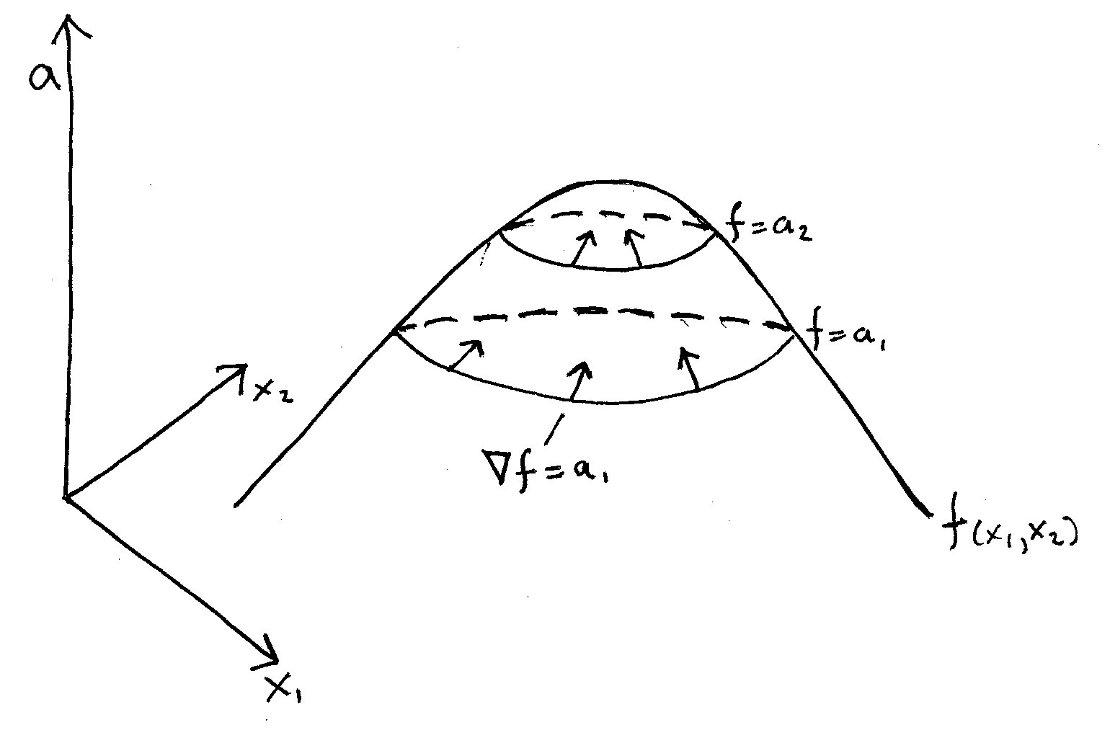
Maximum of a f(x1,x2)

Slide 59
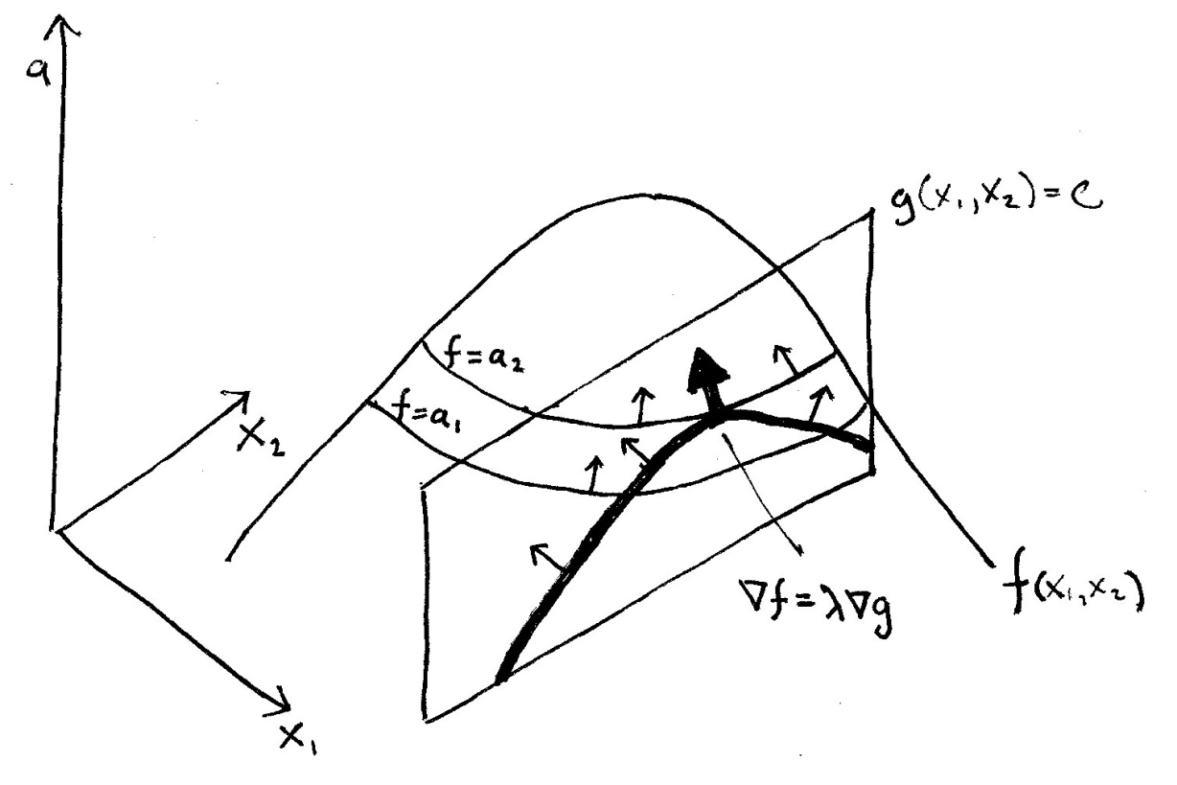
Max f(x1, x2) stc g(x1,x2) = c
the gradients of f and g both point in the same direction, and differ at most by a scalar. Let’s call that scalar “lambda.” Then we have,
Solving for zero, we get

