Slide 1
Modeling data Using SVM
1

Slide 2
Outline
Machine Learning
Support Vector Machine
Linear SVM
Linear SVM with Soft margin
Non-Linear SVM
References

Slide 3
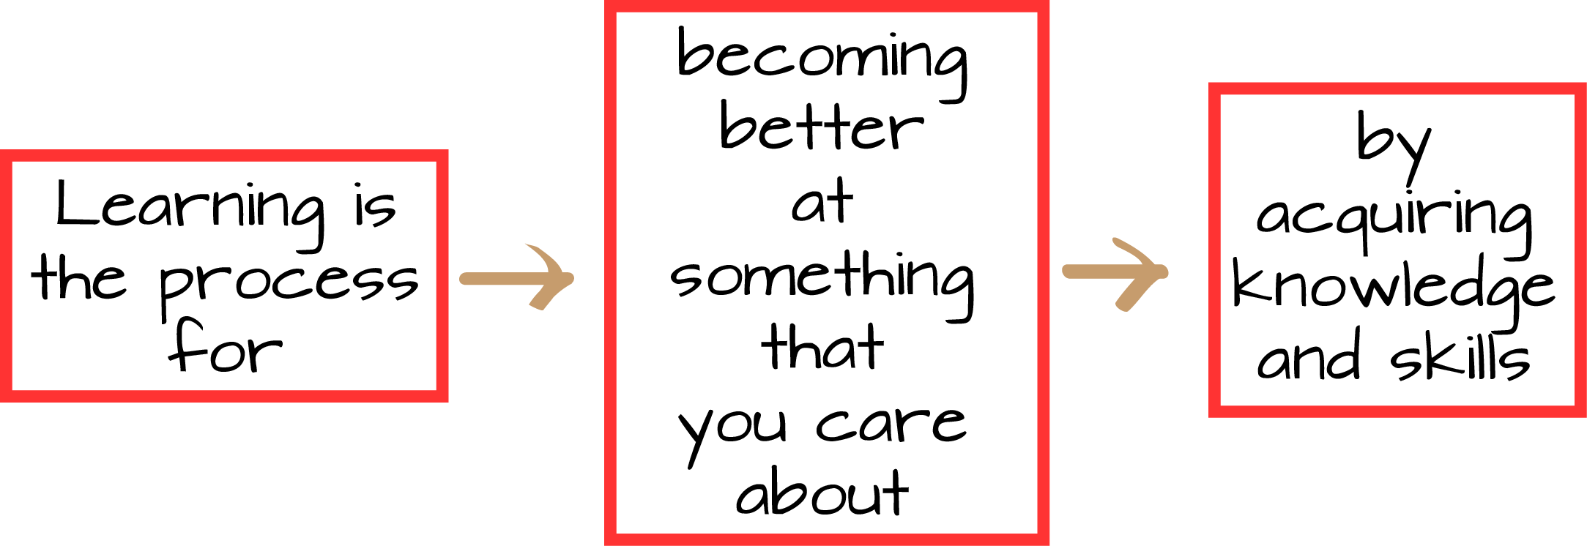
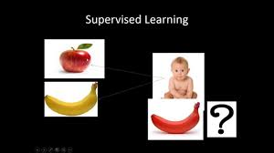
Learning
Notes:
the acquisition of knowledge or skills through study, experience, or being taught.

Slide 4
Machine Learning
Study of algorithms that
  Improve their performance P
  At some task T
  With experience E

Slide 5
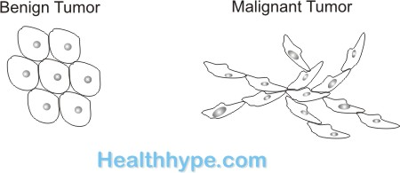
Cancer diagnosis
Task T – Classifying malignant(cancer) / benign (non cancer) tumors
Performance Measure P – Number of cancer patients correctly diagnosed
Training Experience E – a database of cancer and non-cancer patients

Slide 6
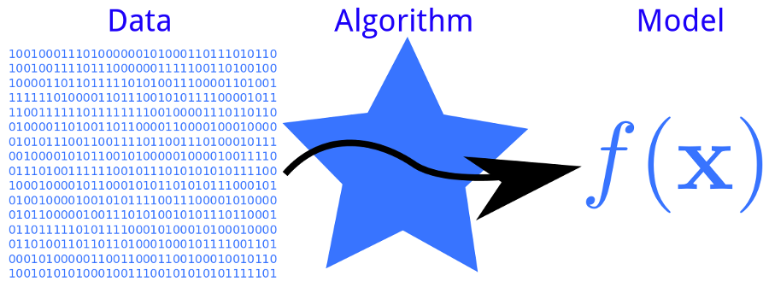
Learning

Slide 7
Machine Learning Paradigms
Supervised learning
Unsupervised Learning
Reinforcement Learning

Slide 8
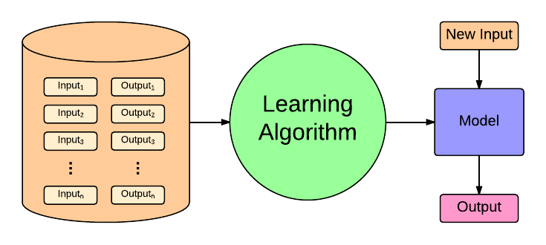
Supervised Learning

Slide 9
Supervised Learning
Supervised learning
  Classification
  Regression

Slide 10
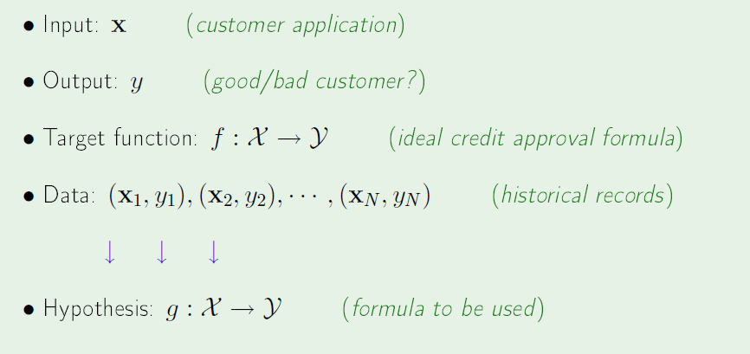
Components of Supervised Learning

Slide 11
Hypothesis - Line
Benign
Malignant
Notes:
Perceptron learning rule can be used to find any decision boundary between class 1 and class 2

Slide 12
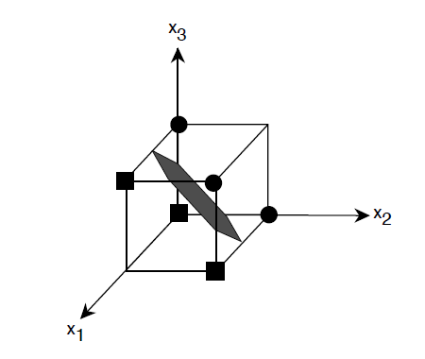
Model – Hyperplane

Slide 13
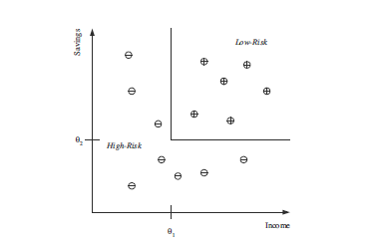
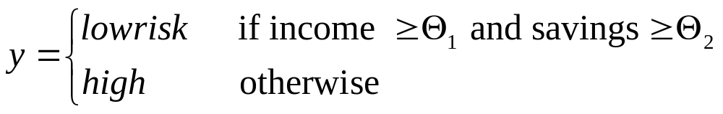
Model – Rule

Slide 14
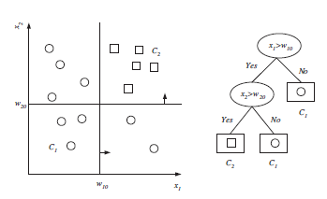
Model - Decision tree

Slide 15
Maximum Margin
denotes +1
denotes -1
wx +b = 0
x
W

Slide 16
SVM

Slide 17
Support Vector Machines (SVM)
Supervised learning method for classification and regression
relatively new class of successful learning method
derived from statistical learning theory by Vapnik and Chervonenkis in 1992
Notes:
First introduced in COLT-92 by Boser, Guyon and Vapnik
COLT = computational learning theory

Slide 18
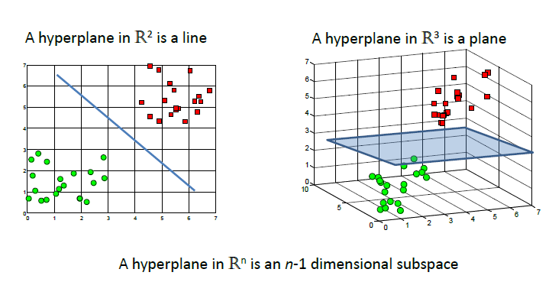

Slide 19
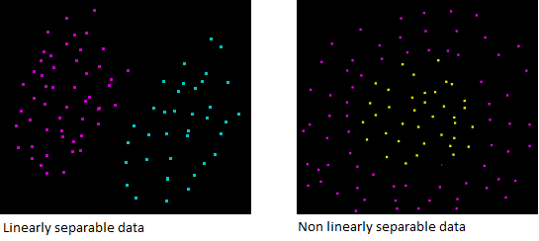

Slide 20
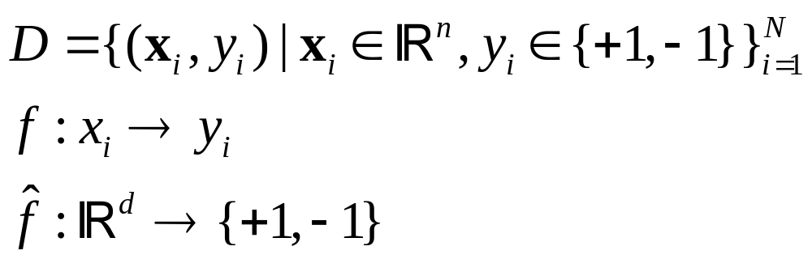
Problem Statement

Slide 21
Binary classification : Linear SVM
Many decision boundaries can separate these two classes
Which one should we choose?
Class +1
Class -1
Notes:
Perceptron learning rule can be used to find any decision boundary between class 1 and class 2

Slide 22
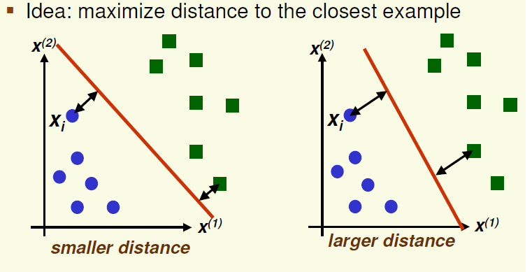
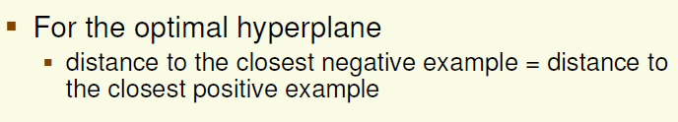
SVM

Slide 23
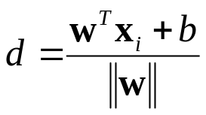
Bruteforce method
Distance from example x_{i} to the separator is
Examples closest to the hyperplane are support vectors.
Margin m of the separator is the distance between support vectors.
m
d

Slide 24
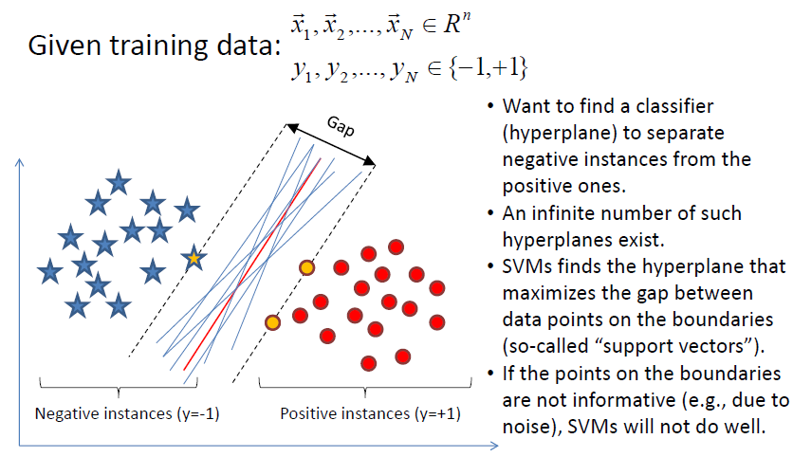
SVM

Slide 25
Estimate the Margin
wx +b > 1
denotes +1
denotes -1
wx +b > 1
x
X – Vector
W – Normal Vector
b – Scale Value
W
wx +b = 0

Slide 26
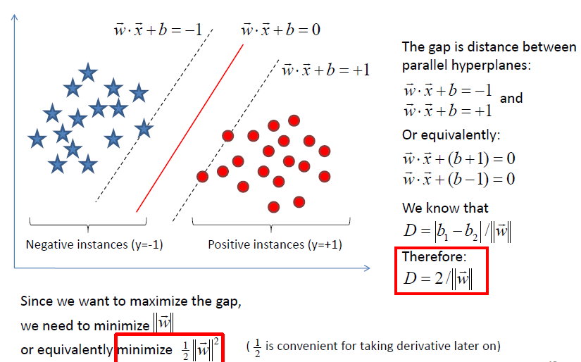
Margin of a hyperplane

Slide 27
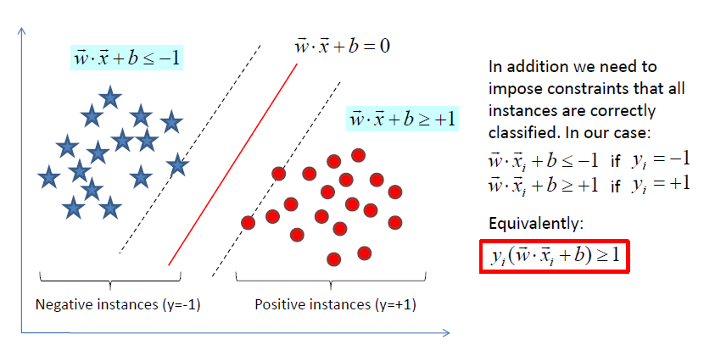

Slide 28
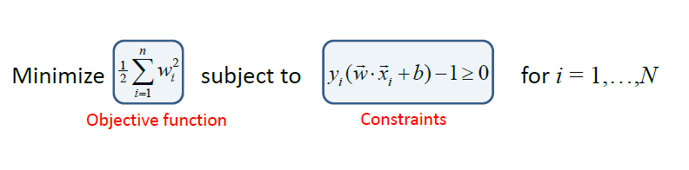
Primal Problem

Slide 29
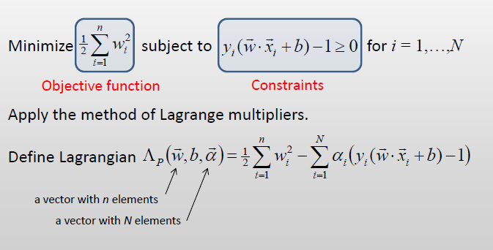
Lagrangian Problem

Slide 30
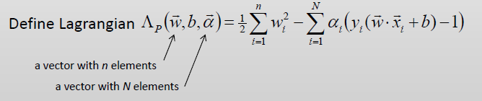
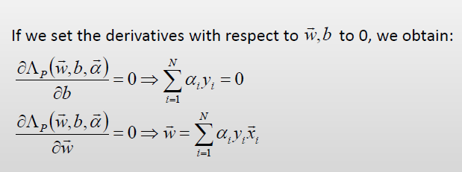

Slide 31
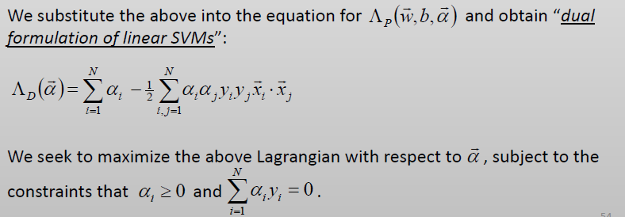
Dual formulation of Linear SVM

Slide 32
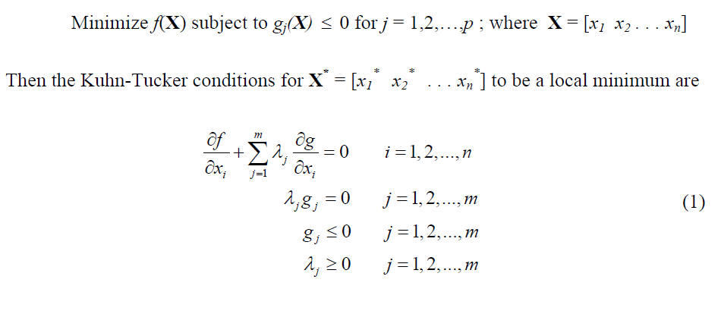
KKT Conditions

Slide 33

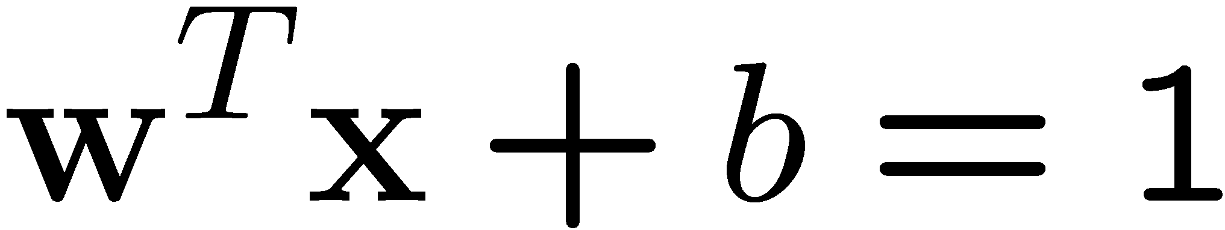
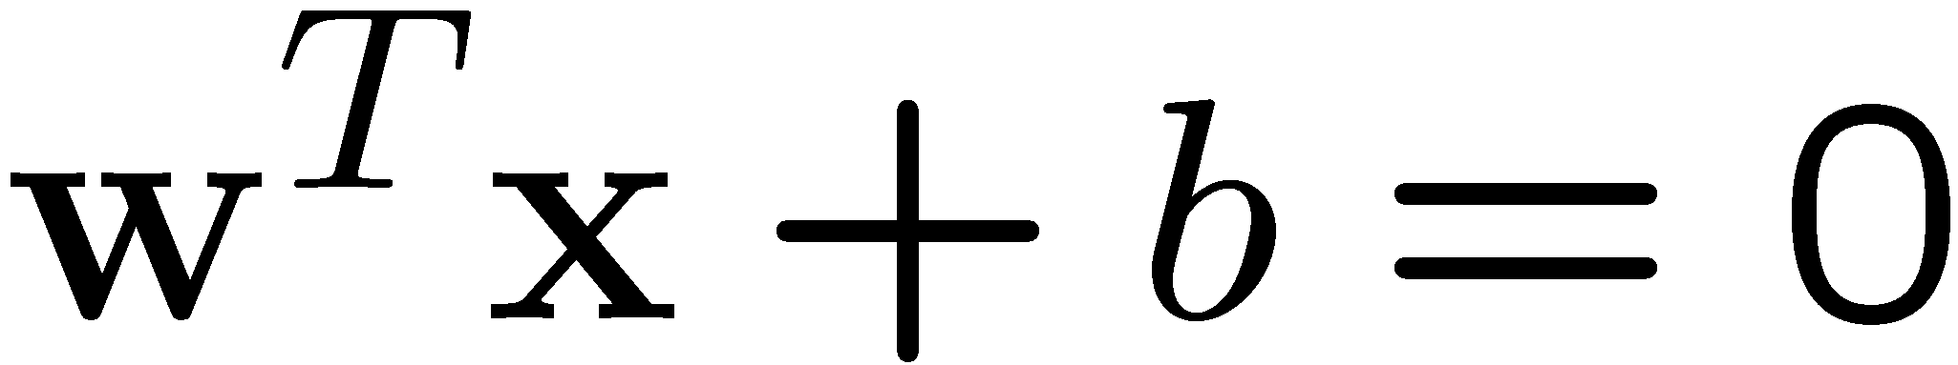
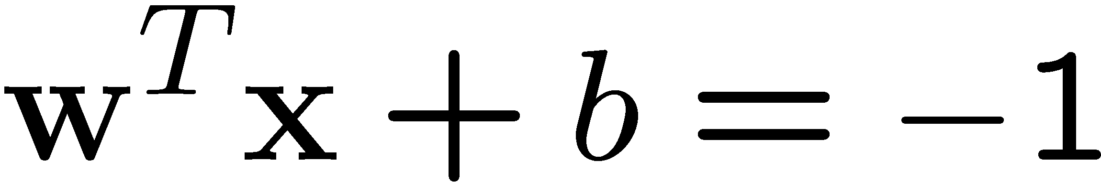
A Geometrical Interpretation
Class 2
Support vectors
→α’s with values
different from zero
(they hold up the
separating plane)!
α₁₀=0
α₈=0.6
α₇=0
α₂=0
α₅=0
α₁=0.8
α₄=0
α₆=1.4
α₉=0
α₃=0
Class 1
Notes:
So, if change internal points, no effect on the decision boundary

Slide 34
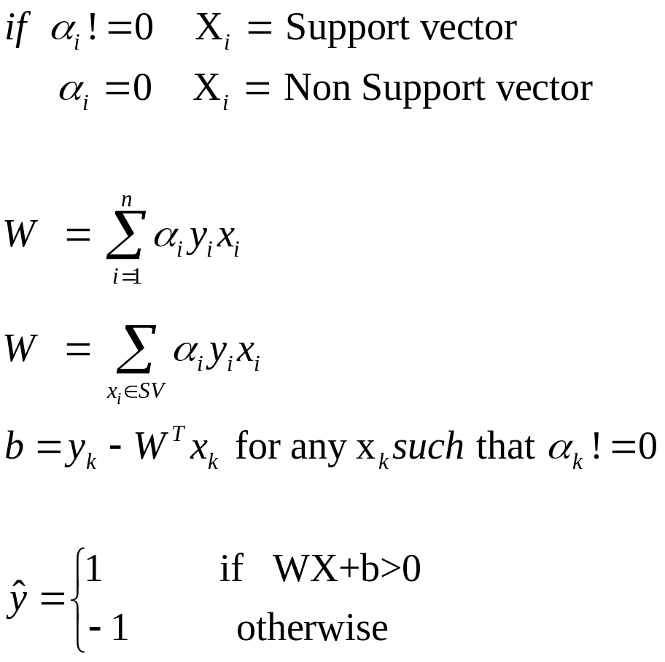
Prediction

Slide 35
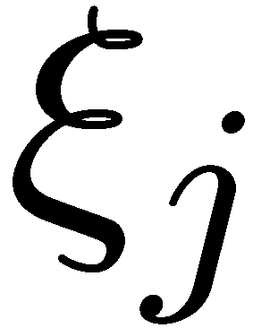
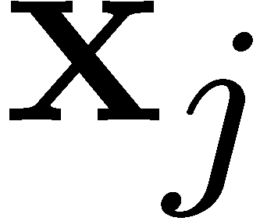
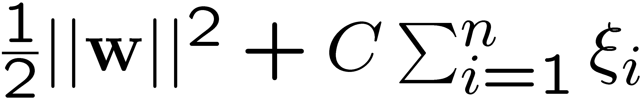
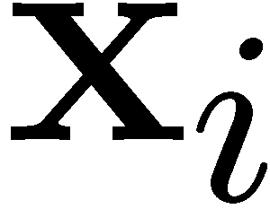
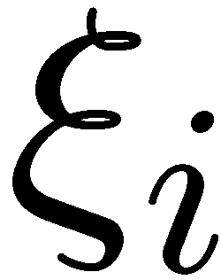
Non-linearly Separable Problems
We allow “error” ξ_{i} in classification; it is based on the output of the discriminant function w^{T}x+b
ξ_{i} approximates the number of misclassified samples
New objective function:
Class 2
  C : tradeoff parameter between
  error and margin;
  chosen by the user;
  large C means a higher
  penalty to errors
Class 1

Slide 36
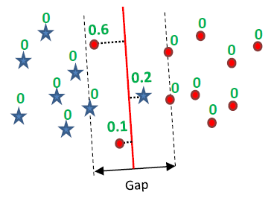

Slide 37
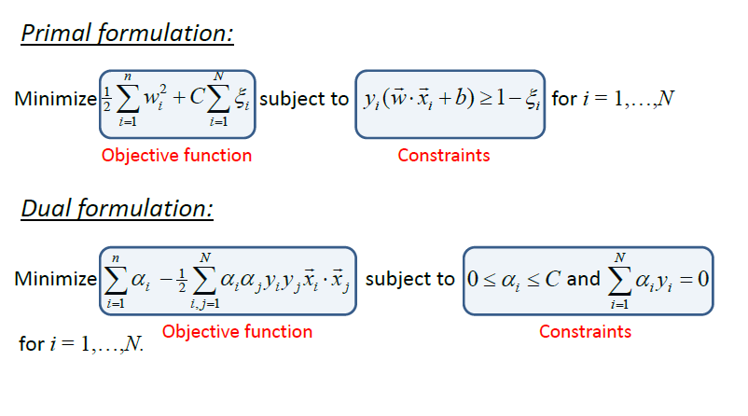
SVM with soft Margin

Slide 38
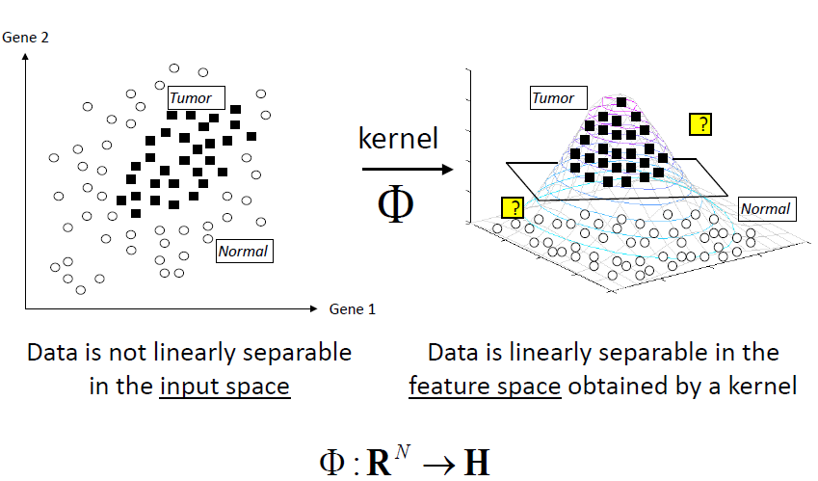
Non Linear SVM

Slide 39
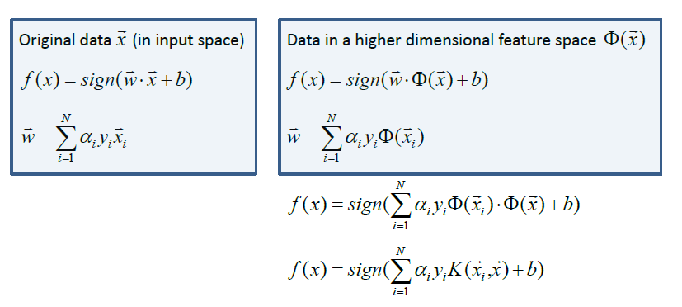
Prediction for Non-linear data

Slide 40
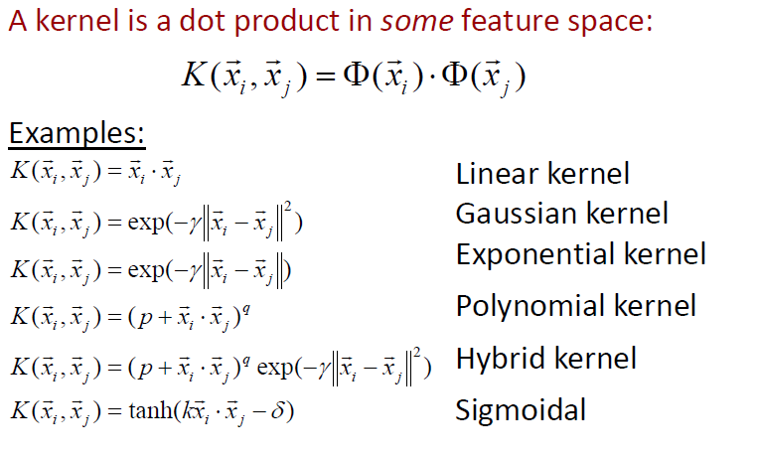
Popular Kernels

Slide 41
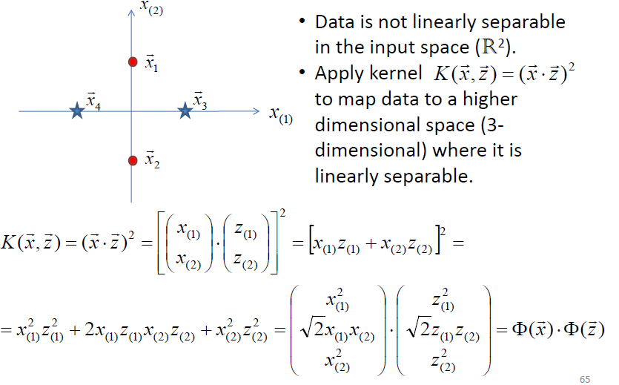
Kernel functions

Slide 42
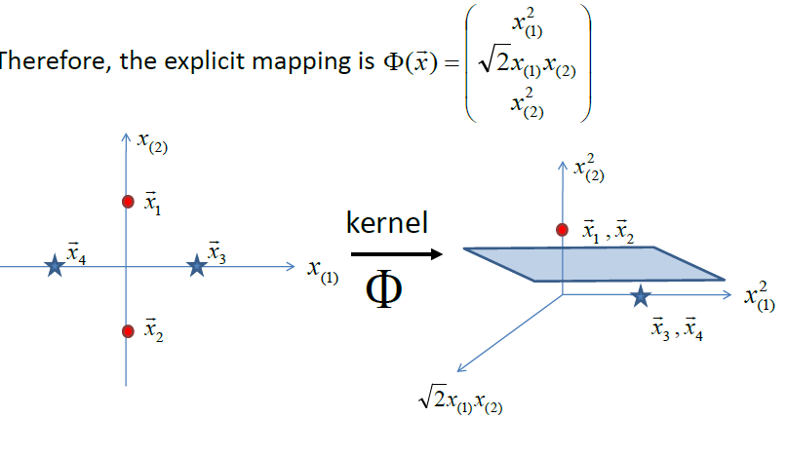

Slide 43
Recap of Steps in SVM
Prepare data matrix {(x_{i},y_{i})}
Select a Kernel function
Select the error parameter C
“Train” the system (to find all α_{i})
New data can be classified using α_{i} and Support Vectors

Slide 44
Summary
Weaknesses
  Training (and Testing) is quite slow compared to ANN
    Because of Constrained Quadratic Programming
  Essentially a binary classifier
    However, there are some tricks to evade this.
  Very sensitive to noise
    A few off data points can completely throw off the algorithm
  Biggest Drawback: The choice of Kernel function.
    There is no “set-in-stone” theory for choosing a kernel function for any given problem (still in research...)
    Once a kernel function is chosen, there is only ONE modifiable parameter, the error penalty C.

Slide 45
Summary
Strengths
  Training is relatively easy
    We don’t have to deal with local minimum like in ANN
    SVM solution is always global and unique (check “Burges” paper for proof and justification).
  Unlike ANN, doesn’t suffer from “curse of dimensionality”.
    How? Why? We have infinite dimensions?!
    Maximum Margin Constraint: DOT-PRODUCTS!
  Less prone to overfitting
  Simple, easy to understand geometric interpretation.
    No large networks to mess around with.

Slide 46
Applications of SVMs
Bioinformatics
Machine Vision
Text Categorization
Ranking (e.g., Google searches)
Handwritten Character Recognition
Time series analysis
→Lots of very successful applications!!!
Prof. Throsten Joachims

Slide 47
References
Burges, C. “A Tutorial on Support Vector Machines for Pattern Recognition.” Bell Labs. 1998
Law, Martin. “A Simple Introduction to Support Vector Machines.” Michigan State University. 2006
Prabhakar, K. “An Introduction to Support Vector Machines”

Slide 48
Resources
http://www.kernel-machines.org
http://www.support-vector.net/
http://www.support-vector.net/icml-tutorial.pdf
http://www.kernel-machines.org/papers/tutorial-nips.ps.gz
http://www.clopinet.com/isabelle/Projects/SVM/applist.html
http://www.cs.cornell.edu/People/tj/
http://svmlight.joachims.org/

Slide 49
Thank You!!
Queries???

