Slide 1
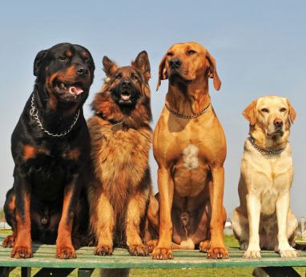
T09 - Hub Dawgs
Sam Bonafe, Cameron Connell, Tri Nguyen, and Evan Williams
“In order to improve your game, you must study the endgame before everything else. For whereas the endings can be studied and mastered by themselves, the middle game and opening must be studied in relation” - Jose Capablanca

Slide 2
Progress:
Finished:
Finished login page
Finished user registration on the client and server
Added chessboard on the frontend using react
Added test cases for classes
Added functionality to server-class skeletons:
Board fully initializes
MovePiece can validate moves
Smaller classes like Square, Position, and the Pieces are finished
To do:
Finish Game and Player classes & finalize User class functionality
Request to server to move piece

Slide 3
Process & Decisions:
Process:
Starting point was React-ChessBoard
Constructed skeleton classes
Finalized functionality in edge classes
Started to add main structural code to Board and Move classes
Decisions:
Bottom-up development:
Smaller, less detailed classes first; then larger, more complex classes
Use React libraries for the frontend:
Already tested & saved time

Slide 4
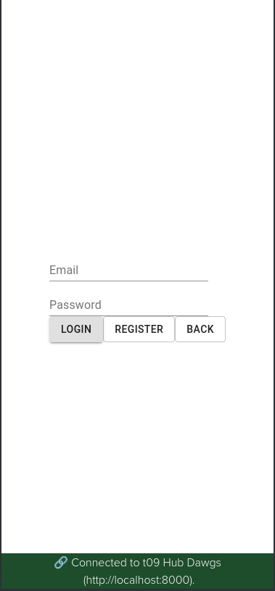
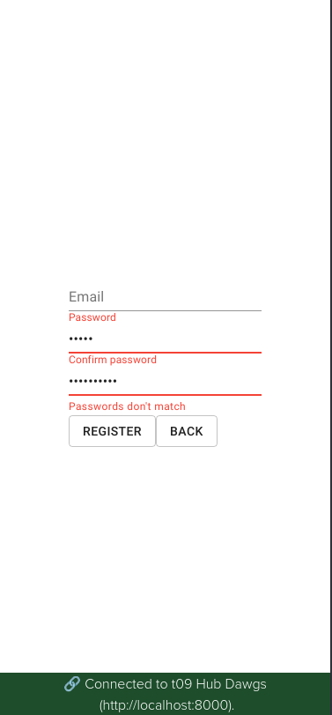
Login and Registration Pages:
Our login and registration pages were made using the React Material UI library. The most difficult part here by far was getting the “Passwords don’t match” alert and red underline working properly.

Slide 5
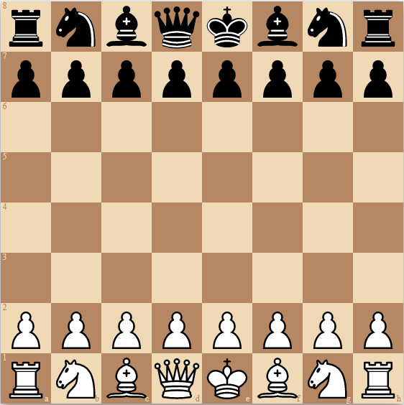
Game Board
Our client uses React - chessboard library.
This library provides a user friendly digital chessboard which is versatile and can be adapted to Extinction Chess.

Slide 6
Ceremonies:
Schedule:
2 Sprints during P2
Things that went well:
Active communication
Teamwork to problem-solve product code and github issues
Work was thoroughly reviewed
Things that we need to improve:
Updating artifacts regularly
Distributing work
Reviewing and merging PRs sooner
One thing we will change next time:
Assigning tasks to evenly distribute work and diminish confusion

