Slide 1


Tribal Build, Integrate, and Test System
TriBITS
Roscoe A. Bartlett
(bartlettra@ornl.gov) Computational Engineering and Energy Sciences Group, Oak Ridge National Laboratory

Slide 2
The Problem => Develop and Deploy Complex Software
Multiple software repositories and distributed development teams
Multiple compiled programming languages (C, C++, Fortran) and mixed-language programs
Multiple development and deployment platforms (Linux, Windows, Super-Computers, etc.)
Stringent software quality requirements
Solution Approach
=> TriBITS custom CMake build & test framework

Slide 3
Why CMake?
Why TriBITS?

Slide 4
Why CMake?
Open-source tools maintained and used by a large community and supported by a profession software development company (Kitware).
CMake:
Simplified build system, easier maintenance
Improved mechanism for extending capabilities (CMake language)
Support for all major C, C++, and Fortran compilers.
Automatic full dependency tracking (headers, src, mod, obj, libs, exec)
Faster configure times (e.g. > 10x faster than autotools)
Shared libraries on all platforms and compilers
Support for MS Windows (e.g. Visual Studio projects)
Portable support for cross-compiling
Good Fortran support (parallel builds with modules with src => mod => object tracking, C/Fortran interoperability, etc.)
CTest:
Parallel running and scheduling of tests and test time-outs
Memory testing (Valgrind)
Line coverage testing (GCC LCOV)
Better integration between the test system and the build system

Slide 5
Why CMake?
Open-source tools maintained and used by a large community and supported by a profession software development company (Kitware).
CMake:
Simplified build system, easier maintenance
Improved mechanism for extending capabilities (CMake language)
Support for all major C, C++, and Fortran compilers.
Automatic full dependency tracking (headers, src, mod, obj, libs, exec)
Faster configure times (e.g. > 10x faster than autotools)
Shared libraries on all platforms and compilers
Support for MS Windows (e.g. Visual Studio projects)
Portable support for cross-compiling
Good Fortran support (parallel builds with modules with src => mod => object tracking, C/Fortran interoperability, etc.)
CTest:
Parallel running and scheduling of tests and test time-outs
Memory testing (Valgrind)
Line coverage testing (GCC LCOV)
Better integration between the test system and the build system

Slide 6
Why TriBITS?
Framework for large, distributed multi-repository CMake projects
Reduce boiler-plate CMake code and enforce consistency across large distributed projects
Subproject dependencies and namespacing architecture (packages)
Automatic package dependency handling
Additional tools for agile software development processes (e.g. Continuous Integration (CI))
Additional functionality missing in raw CMake
Change default CMake behavior when necessary

Slide 7
Raw CMake vs. TriBITS

Slide 8
Raw CMakeLists.txt File
# Build and install library
SET(HEADERS hello_world_lib.hpp)
SET(SOURCES hello_world_lib.cpp)
ADD_LIBRARY(hello_world_lib ${SOURCES})
INSTALL(TARGETS hello_world_lib DESTINATION lib)
INSTALL(FILES ${HEADERS} DESTINATION include)
# Build and install user executable
ADD_EXECUTABLE(hello_world hello_world_main.cpp)
TARGET_LINK_LIBRARIES(hello_world hello_world_lib)
INSTALL(TARGETS hello_world DESTINATION bin)
# Test the executable
ADD_TEST(test ${CMAKE_CURRENT_BINARY_DIR}/hello_world)
SET_TESTS_PROPERTIES(test PROPERTIES PASS_REGULAR_EXPRESSION "Hello World")
# Build and run some unit tests
ADD_EXECUTABLE(unit_tests hello_world_unit_tests.cpp)
TARGET_LINK_LIBRARIES(unit_tests hello_world_lib)
ADD_TEST(unit_test ${CMAKE_CURRENT_BINARY_DIR}/unit_tests)
SET_TESTS_PROPERTIES(unit_test PROPERTIES PASS_REGULAR_EXPRESSION "All unit tests passed")

Slide 9
TriBITS Package CMakeList.txt File
TRIBITS_PACKAGE(HelloWorld)
TRIBITS_ADD_LIBRARY(hello_world_lib
HEADERS hello_world_lib.hpp SOURCES hello_world_lib.cpp)
TRIBITS_ADD_EXECUTABLE(hello_world NOEXEPREFIX SOURCES hello_world_main.cpp
INSTALLABLE)
TRIBITS_ADD_TEST(hello_world NOEXEPREFIX PASS_REGULAR_EXPRESSION "Hello World")
TRIBITS_ADD_EXECUTABLE_AND_TEST(unit_tests SOURCES hello_world_unit_tests.cpp
PASS_REGULAR_EXPRESSION "All unit tests passed")
TRIBITS_PACKAGE_POSTPROCESS()
Library linking automatically handled
Avoid duplication and boiler-plate code
Fewer commands
Install by default (most common)
Automatic namespacing of test & exec names

Slide 10
TriBITS Structural Units
and
Meta-Projects

Slide 11
TriBITS Structural Units
TriBITS Project:
Complete CMake “Project”
Overall projects settings
TriBITS Repository:
Collection of Packages and TPLs
Unit of distribution and integration
TriBITS Package:
Collection of related software & Tests
Lists dependencies on SE Packages & TPLs
Unit of testing, namespacing, documentation, and reuse
TriBITS Subpackage:
Partitioning of package software & tests
TriBITS TPLs (Third Party Libraries):
Specification of external dependency (libs)
Required or optional dependency
Single definition across all packages
Packages
+ Subpackages
=
Software Engineering (SE) Packages

Slide 12
Example: VERA Meta-Project, Repositories, Packages & Subpackages
VERA
PSSDriversExt
VERAInExt
Trilinos
VRIPSS
VERAIn
Teuchos
…
common
…
Core
Comm
cobra
Tiamat
Exnihilo
…
ParameterList
…
Nemesis
Shift
Insilico
LIMEExt
Epetra
NOX
Neutronics
LIME
…
…
VERA: Git repository and TriBITS meta-project (contains no packages)
Git repos and TriBITS repos: Trilinos, VERAInExt, LIMEExt, Exnihilo, …
TriBITS packages: Teuchos, Epetra, VERAIn, Insilico, LIME, VRIPSS, …
TriBITS subpackages: TeuchosCore, InsilicoNeutronics, VRIPSSTiamat, …
TriBITS SE (Software Eng.) packages: Teuchos, TeuchosCore, VERAIn, Insilico, InsilicNeutronics, …

Slide 13
Automated Package Dependency Handling

Slide 14
Package Dependency Structure (Example: Trilinos)
Thyra
RTOp
Triutils
EpetraExt
Teuchos
Epetra
Required Dependence
Optional Dependence

Slide 15
Package Dependencies.cmake Files
Teuchos
Epetra
TRIBITS_PACKAGE_DEFINE_DEPENDENCIES(
LIB_REQUIRED_TPLS BLAS LAPACK
LIB_OPTIONAL_TPLS Boost )
TRIBITS_PACKAGE_DEFINE_DEPENDENCIES(
LIB_REQUIRED_TPLS BLAS LAPACK )
RTOp
Triutils
TRIBITS_PACKAGE_DEFINE_DEPENDENCIES(
LIB_REQUIRED_PACKAGES Teuchos )
TRIBITS_PACKAGE_DEFINE_DEPENDENCIES(
LIB_REQUIRED_PACKAGES Epetra )
EpetraExt
Thyra
TRIBITS_PACKAGE_DEFINE_DEPENDENCIES(
LIB_REQUIRED_PACKAGES Epetra Teuchos
LIB_OPTIONAL_PACKAGES Triutils )
TRIBITS_PACKAGE_DEFINE_DEPENDENCIES(
LIB_REQUIRED_PACKAGES RTOp Teuchos
LIB_OPTIONAL_PACKAGES EpetraExt Epera )

Slide 16
Pre-Push Testing: Change Epetra
$ ./do-configure \
-D Trilinos_ENABLE_Epetra:BOOL=ON \
-D Trilinos_ENABLE_ALL_FORWARD_DEP_PACKAGES:BOOL=ON \
-D Trilinos_ENABLE_TESTS:BOOL=ON
Thyra
RTOp
Triutils
EpetraExt
Teuchos
Epetra

Slide 17
Pre-Push Testing: Change RTOp
$ ./do-configure \
-D Trilinos_ENABLE_RTOp:BOOL=ON \
-D Trilinos_ENABLE_ALL_FORWARD_DEP_PACKAGES:BOOL=ON \
-D Trilinos_ENABLE_TESTS:BOOL=ON
Thyra
Libs & Tests
RTOp
Triutils
EpetraExt
Lib Only
Teuchos
Epetra

Slide 18
Extended Testing Support

Slide 19
TriBITS Standard Testing Layers
Nightly Testing
Secondary Tested (ST)
CATEGORIES [BASIC CONTINUOUS NIGHTLY]
(more platforms, more TPLs)
Post-Push CI Testing
Secondary Tested (ST)
CATEGORIES [BASIC CONTINUOUS]
(post-push CTest/CDash, Linux/GCC)
Correctness Testing
Pre-Push CI Testing
Primary Tested (PT)
CATEGORIES [BASIC]
(pre-push checkin-test.py)
Coverage Testing
Memory (Valgrind) Testing

Slide 20
Pre-Push CI Testing: checkin-test.py
checkin-test.py --do-all --push
Integrates with latest version in remote git repositories
Figures out modified packages
Modified file: 'packages/teuchos/CMakeLists.txt'
=> Enabling 'Teuchos'!
Enables all forward/downstream packages & tests
Configures, builds, and runs tests
Does the push (if all builds/tests pass)
Sends notification emails
Fully customizable (enabled packages, build cases, etc.)
Documentation: checkin-test.py --help

Slide 21
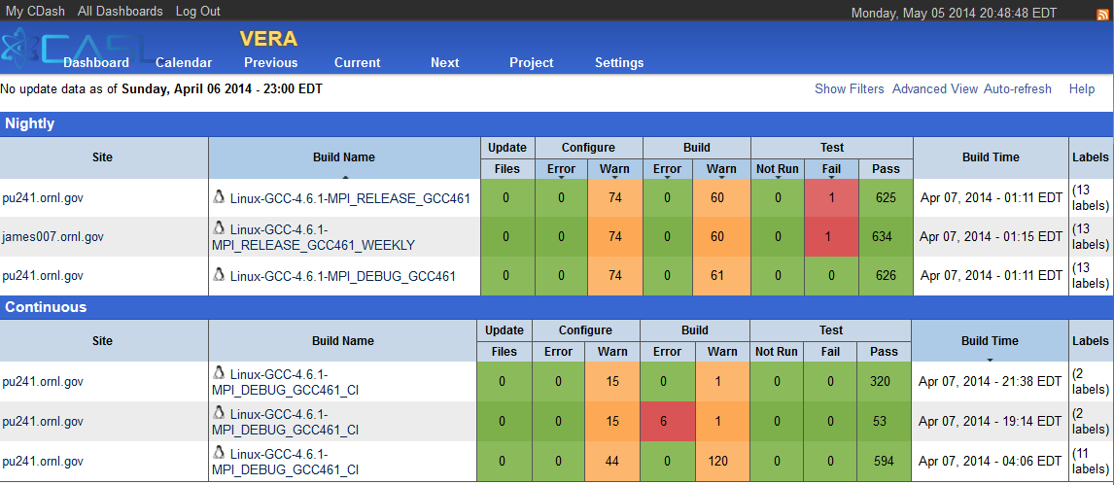
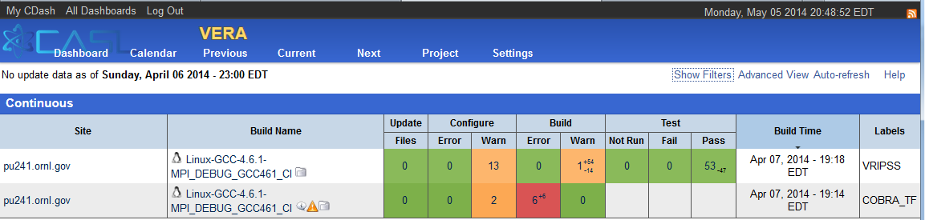
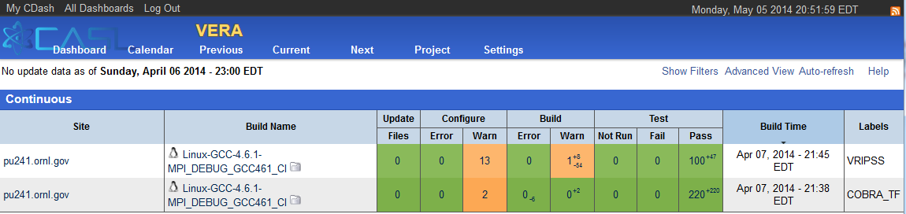
Post-Push Testing: TRIBITS_CTEST_DRIVER()
CDash Dashboard for 4/6/2014
Rolled-up summaries for each build case
Nightly, CI, Experimental build cases
CDash CI Iterations
Individual packages built in sequence
Targeted emails for failed package build & tests
Failed packages disabled in downstream packages
=> Don’t propagate failures!

Slide 22
TriBITS Miscellaneous Facts
TriBITS System Dependencies:
TriBITS Core: Basic configure, build, test & install
=> Only raw CMake (2.8.4+)
TriBITS Extra SE tools (checkin-test.py, …)
=> Git (1.7.0.4+) and Python 2.4
Usage of TriBITS:
Trilinos (SNL, originating project)
ORNL: SCALE, Exnihilo, DataTransferKit
Non-ORNL: MPACT (Univ. of Misc.), COBRA-TF (Penn. State)
CASL-Related: VERA
TriBITS Development & Distribution:
3-clause BSD-like license, Copyright SNL
Current: Trilinos (trilinos.sandia.gov), CASL (casl-dev)
Near future: Github (public repo, global pull)

Slide 23
Contact: bartlettra@ornl.gov
Sponsors:
CASL: Consortium for the Advanced Simulation of Lightwater reactors

