Slide 1
Introduce Angular 18 & 19

Slide 2
Overview:
What’s New in Angular 18?
What’s New in Angular 19?
Why These Updates Matter?
How These Features Work?

Slide 3
What’s New in Angular 18
Zoneless Change Detection (Experimental)
Faster Build Performance
Deferable Views and Built-in Control Flow

Slide 4
What’s New in Angular 19
Standalone Components by default
Stabilization of Core Reactivity Primitives
Event Replay Enabled by default (Related Hydration)
Incremental Hydration (Developer Preview)
Route-Level Render Mode (Developer Preview)
Hot Module Replacement (HMR) Support

Slide 5
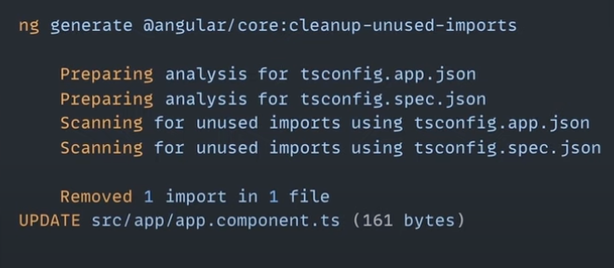
Angular CLI smarter
Clean all import not use

Slide 6
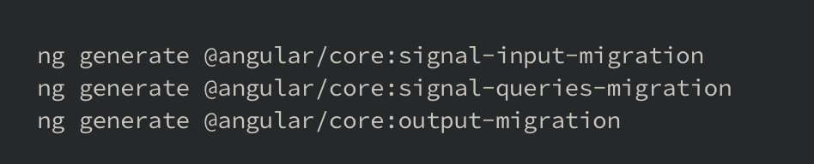
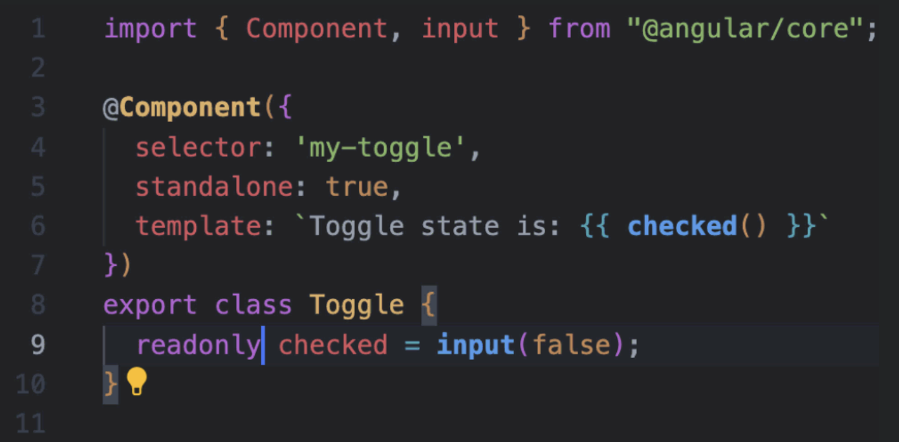

Angular CLI smarter
OR
Migrate traditional input/output to signal input

Slide 7
Why These Updates Matter?
Performance Improvements – Faster rendering, optimized hydration, and better build times.
Enhanced Developer Experience – Features like Hot Module Replacement (HMR) and component-first routing reduce development friction.
Better Reactivity & State Management – Stable reactivity APIs and linked signals make managing application state more efficient.
Security Enhancements – Every new version includes security patches and compliance updates.
Long-Term Support – Staying updated ensures compatibility with the latest ecosystem tools and best practices.
Improved Server-Side Rendering (SSR) & SEO – Incremental hydration optimizes how Angular handles SSR, leading to better page load times and SEO.

Slide 8
How These Features Work
Zoneless Change Detection: Reduces reliance on zones for better efficiency
Component-Based Routing: Define routes directly in components
Linked Signals: Manage state dependencies more efficiently
Incremental Hydration: Progressive rendering for better load times
Hot Module Replacement: Live updates without a full page reload

Slide 9
Q&A

Slide 10
Ref
https://blog.angular.dev/angular-v18-is-now-available-e79d5ac0affe
https://blog.angular.dev/meet-angular-v19-7b29dfd05b84
https://angular.dev/overview

Slide 11
Angular 18 & 19
Thank you for your attention!

