Slide 1
Introduce Angular 18 & 19

Slide 2
Overview:
What’s New in Angular 18?
What’s New in Angular 19?
Why These Updates Matter?
How These Features Work?

Slide 3
What’s New in Angular 18
Zoneless Change Detection (Experimental)
Deferable Views and Built-in Control Flow

Slide 4
Zoneless Change Detection (Experimental)
Traditional Angular and Zone.js:
Traditionally, Angular relies on a library called Zone.js to track asynchronous operations (like timeouts, network requests, and user events).
Zone.js "monkey-patches”(modifying or extending existing code at runtime) these operations, allowing Angular to automatically trigger change detection whenever they occur.
While this simplifies development, it can lead to unnecessary change detection cycles and performance overhead.

Slide 5
Zoneless Change Detection (Experimental)
Zoneless Change Detection:
Angular 18 introduces an experimental feature that allows developers to bypass Zone.js and take more manual control over change detection.
This approach aims to improve performance by reducing unnecessary change detection cycles.
It gives developers more precise control over when the UI updates.
Essentially, instead of Zone.js automatically triggering change detection, the developer must explicitly tell Angular when changes have occurred.

Slide 6
Deferable Views, Built-in Control Flow
Angular 17 introduced deferrable views and the new built-in control flow syntax.
Angular 18 graduates deferrable views and the new built-in control flow syntax to stable status.
Essentially, deferrable views help optimize our initial bundle size and improve the initial load of the application by allowing you to lazy load your templates until they are needed later.
The syntax: @defer, @for, @if, @switch, @let(*new)

Slide 7
What’s New in Angular 19
Standalone Components by default
Stabilization of Core Reactivity Primitives
Event Replay Enabled by default (Related Hydration)
Incremental Hydration (Developer Preview)
Route-Level Render Mode (Developer Preview)
Hot Module Replacement (HMR) Support

Slide 8
Stabilization of Core Reactivity Primitives
The stabilization of core reactivity primitives, such as signal-based inputs, outputs, and queries, which were introduced in previous versions, provides a more efficient and predictable reactivity model.
A core theme of Angular over the past two years has been the development of the reactivity system.
In version 19, it shares some additional new APIs, namely linkedSignal and resource.

Slide 9
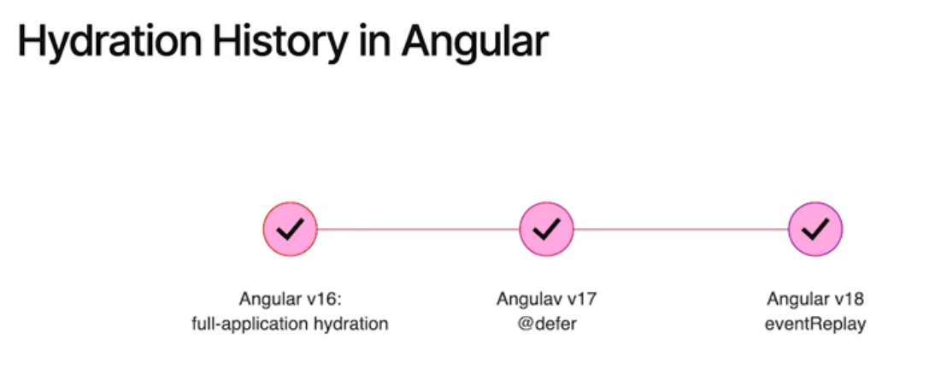
Incremental Hydration (Developer Preview)

Slide 10
Incremental Hydration (Developer Preview)
Incremental Hydration history
Full Application Hydration: This ensures that server-rendered HTML is reused when the app bootstraps on the client side.
Defer: To delay the loading of app chunks.
eventReplay: To ensure that no user interactions are lost when hydration finishes.

Slide 11
Incremental Hydration (Developer Preview)
Define
Hydration is the process of restoring a server-rendered application on the client. This process involves reusing the DOM structures rendered from the server, maintaining the application's state, transferring pre-fetched application data from the server, and other procedures.
Incremental hydration allows developers to specify which parts of the server-rendered template to load and hydrate lazily, which improves performance for complex applications

Slide 12
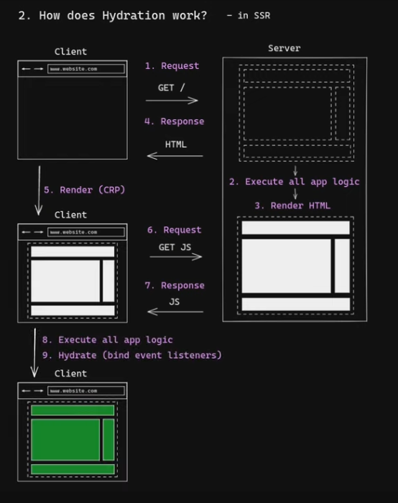

Slide 13
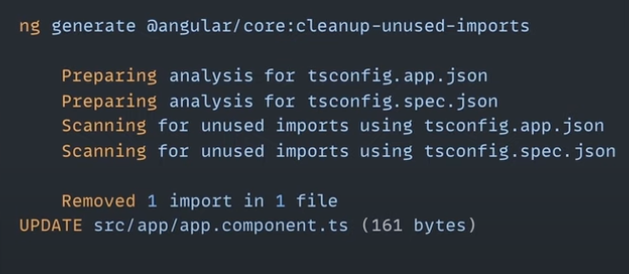
Angular CLI smarter
Clean all import not use

Slide 14
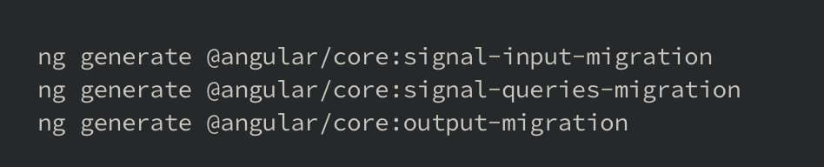
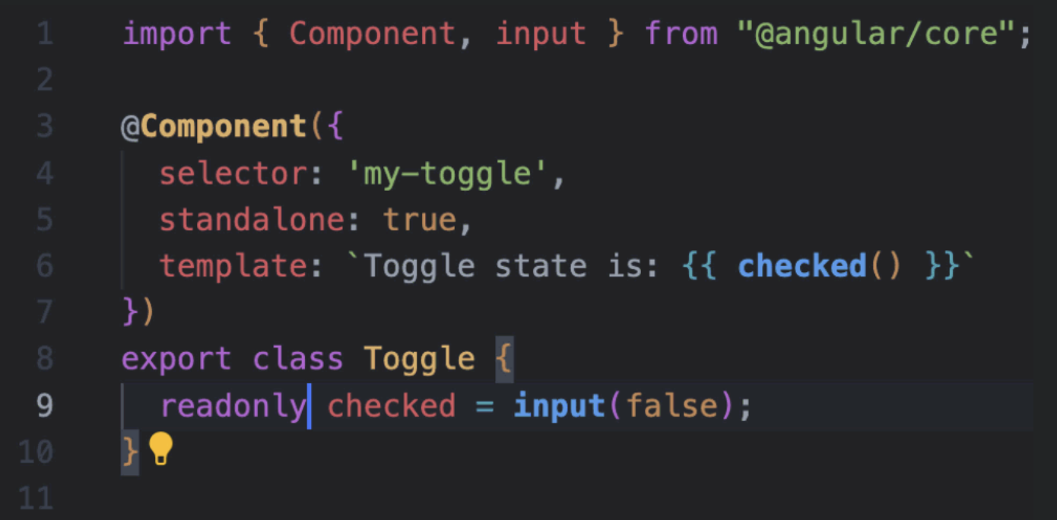

Angular CLI smarter
OR
Migrate traditional input/output to signal input

Slide 15
Why These Updates Matter?
Performance Improvements – Faster rendering, optimized hydration, and better build times.
Enhanced Developer Experience – Features like Hot Module Replacement (HMR) and component-first routing reduce development friction.
Better Reactivity & State Management – Stable reactivity APIs and linked signals make managing application state more efficient.
Security Enhancements – Every new version includes security patches and compliance updates.
Long-Term Support – Staying updated ensures compatibility with the latest ecosystem tools and best practices.
Improved Server-Side Rendering (SSR) & SEO – Incremental hydration optimizes how Angular handles SSR, leading to better page load times and SEO.

Slide 16
How These Features Work
Zoneless Change Detection: Reduces reliance on zones for better efficiency
Component-Based Routing: Define routes directly in components
Linked Signals: Manage state dependencies more efficiently
Incremental Hydration: Progressive rendering for better load times
Hot Module Replacement: Live updates without a full page reload

Slide 17
Q&A

Slide 18
Ref
https://blog.angular.dev/angular-v18-is-now-available-e79d5ac0affe
https://blog.angular.dev/meet-angular-v19-7b29dfd05b84
https://angular.dev/overview
Youtube angular channel.
https://github.com/TriBuiQuang/demo_angular_19

Slide 19
Angular 18 & 19
Thank you for your attention!

