Slide 1
Emotion-Aware, Fact-Grounded LLM-Augmented Contrastive Learning for Misinformation Detection in Social Networks
Authors
Faishal Abrar (12O23OO2O29O5O)
Kislay Bhardwaj (12023OO2O29042)
Debrup Chakraborty (12023002029041)
Adrija Pal (12023002029008)
Gairick Purakayastha (12O23OO2O29127)
Subhradwip Das(12023002029147)
Supervisor: Prof. Sangita Dutta & Prof. Dr. Arijit Ghosh
Group - 9 3rd Year
Batch 2023 - 2027
Department of Computer Science and Engineering
(Internet of Things, Cyber Security, Blockchain Technology)
University of Engineering & Management, Kolkata

Slide 2
Table of contents
01 Introduction | 06 | Technical architecture
02 Motivation | 07 | Results & analysis
03 Research gap | 08 | Conclusion
04 Literature survey | 09 | Future scope
05 Proposed methodology | 10 | References

Slide 3

Why detection matters
Misinformation is spreading faster than we can track it.
Social media has made it trivially easy to amplify false or misleading content. Driven by emotional appeal and rapid sharing, misinformation shapes public perception and causes measurable harm in healthcare, politics, and public safety.
LLM-Augmented Contrastive Learning (LACL) offers a promising path for automated detection - but current approaches carry two critical flaws:
            Emotional inconsistency: LLM-generated augmentations retain semantic meaning while stripping emotional tone, a key signal for spotting misleading content.
  No factual grounding: Systems relying on text patterns alone are vulnerable to hallucinations and factually wrong predictions.
EAFG-LACL addresses both. Our framework integrates emotion-aware filtering with external fact verification into a single contrastive learning pipeline - uniting semantic understanding, emotional consistency, and factual validation.

Slide 4
Why misinformation detection is challenging
Semantic Complexity of Misinformation
Misinformation often blends truth with deception using nuanced language, sarcasm, or partial facts, making it difficult for models to reliably distinguish misleading content from genuine information.
Emotional Manipulation & Virality
False information exploits strong emotions such as fear, anger, and urgency, which accelerate its spread and reduce critical reasoning, making detection both time-sensitive and challenging.
Unimodal Blind Spots
Text-only models fail to capture deeper contextual and emotional cues, limiting their ability to detect deceptive intent, especially when misinformation relies heavily on tone and implicit signals.
Degraded Training Signal (Augmentation Noise)
LLM-based augmentation can produce emotionally inconsistent samples, leading to poor-quality contrastive pairs and weakening the model's ability to learn robust representations.
Lack of External Fact Grounding
Without verification against real-world knowledge sources, models rely purely on linguistic patterns, making them vulnerable to hallucinations and factually incorrect predictions
Dynamic & Evolving Nature of Information
Misinformation evolves rapidly across domains and time, requiring systems to continuously adapt to new topics, narratives, and emerging patterns.

Slide 5

Critical gaps in current LALC Frameworks
Gap 1— Emotional inconsistency
Gap 2 — No factual grounding
LLMs preserve semantic meaning but neutralize emotional tone during rewriting, creating emotionally dissimilar pairs treated as positive in contrastive learning.
A fear laden post becomes a neutral rewrite same meaning, broken emotional signal.
Result: Degraded representations, weakened detection of emotionally driven misinformation.
Frameworks rely solely on linguistic patterns and LLM outputs. LLMs hallucinate producing II uent but factually wrong content with no mechanism to verify claims.
Proposed fix: emotion-preserving filtering via cosine similarity and dynamic thresholding.
Result: Predictions lack reliability for high- stakes moderation decisions.

Slide 6
Literature Survey
2017
Fake News Detection
Shu et al., ACM SIGKDD
Social context as key signal
No LLM-scale reasoning
2018
Propagation Path
Liu et al., AAAI
RNNs on propagation trees
Needs real-time metadata
2020
SimCLR
Chen et al., ICML
Contrastive representation learning
Augmentation quality is key
2022
Graph Contrastive
Feng et al., ICDM
Structural propagation patterns
Misses semantic and emotion
2026
LACL
Shen et al., IEEE TCSS
LLM augmentation + contrastive
Gaps: emotion + fact-check

Slide 7
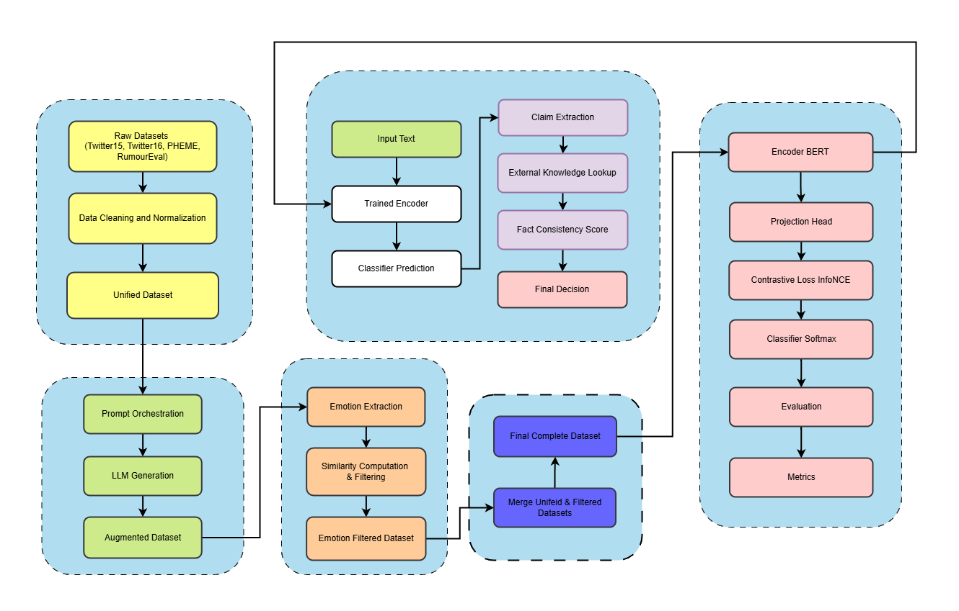
Proposed Methodology
EAFG-LACL framework
Master pipeline overview
The high-level master pipeline begins with data preprocessing, where multiple social media datasets are cleaned, normalized, and unified into a consistent format for downstream tasks. This unified data is then enhanced through LLM-based augmentation, generating semantically similar candidate samples to improve data diversity. To ensure quality, an emotion-aware filtering module retains only those augmented samples that preserve the original emotional tone, eliminating noisy or misleading pairs. The refined dataset is then used to train a contrastive learning model that learns robust textual representations and performs classification . During inference, a fact verification module evaluates extracted claims against external knowledge sources to compute factual consistency. Finally, the system combines learned representations with factual grounding to produce reliable and interpretable misinformation detection outcomes.

Slide 8
Phase 1: Data Preprocessing and Unification
1
Label normalization
Map disparate labeling schemes to a unified four-class space: true, false, unverified, non-rumor.
2
Schema conversion
Convert thread structures into standardized JSONL; ingest source posts only to isolate the primary claim.
3
Shuffling
Apply deterministic seeded shuffling to ensure diversity across downstream training batches.
Output
Produces unified_records.jsonl - a clean, normalized dataset across Twitter15, Twitter16, RumourEval, and PHEME.
4

Slide 9
Phase 2: LLM-augmented data generation
01
Candidate generation
Gemini rewrites each unified record into multiple candidates preserving core meaning - used as positive pairs in contrastive training.
02
Adaptive flow control
A rolling-window gating mechanism respects API rate limits, dynamically reducing batch sizes when token estimates exceed RPM or TPM capacity.
03
Key insight
Augmentations can inadvertently neutralize emotional tone - a critical limitation that Phase 3's emotion-preserving filter directly addresses.
04
Output
Augmented records written to augmented_records.jsonl, ready for emotion-aware filtering in the next phase.

Slide 10
Emotion extraction
Phase 3: Emotion Aware Filtering
01
Anchor and candidate texts run through distilroberta-base, producing multi-dimensional emotion vectors: anger, fear, joy, sadness, and more.
02
Dynamic thresholding
High-intensity texts (score >0.85) require strict cosine similarity (0.90-0.95). Low-intensity texts (score <0.40) apply a relaxed threshold (0.50-0.70).
03
Filtration
Candidates that fall below the threshold are discarded. Only emotion-consistent pairs advance to contrastive training.
Output
Produces filtered_augmented_data.jsonl - high-quality, emotion-preserving contrastive training pairs ready for Phase 4.
04

Slide 11
Phase 4: Contrastive representation learning
01
Contrastive pre-training
BERT encoder with lnfoNCE loss. Pulls emotion-consistent augmentations closer; pushes unrelated samples apart.
02
Supervised classification
Encoder frozen post pre-training. Classifier head trained over four labels: true, false, unverified, non-rumor.
03
Latent space objective
Semantically and emotionally similar pairs cluster together. Dissimilar pairs are pushed apart in the embedding space.
04
Evaluation metrics
Performance measured via accuracy, macro F1, and weighted F1 across all four rumor classes.

Slide 12
Phase 5: Inference and Fact Verification
01
Baseline prediction
Contrastive classifier generates an initial predicted label for the input text.
02
Verification routing
Rumor-class predictions route to the fact verification module. Non-rumor predictions bypass it to preserve efficiency.
03
Fact consistency scoring
Gemini extracts claims and cross-references Wikipedia, producing a scalar fact_score between 0 and 1.
04
Label re-assignment
Score> 0.66 ➔true.Score< 0.34 ➔ false. Grounded fact label overrides the baseline to yield the final_label.
Made with <;,- Chronicle

Slide 13
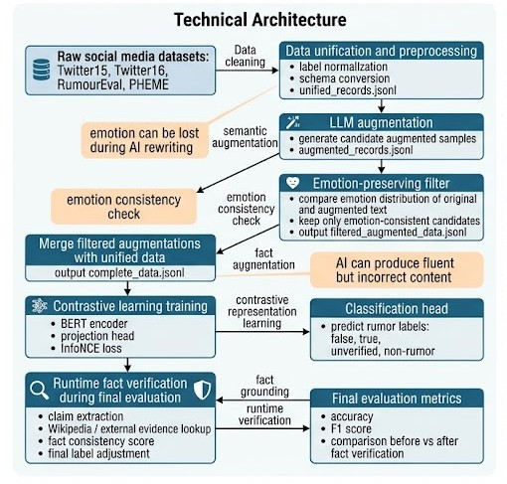
Technical Architecture
Five modules interact across the full pipeline: Data Preprocessing, LLM Augmentation, Emotion-Preserving Filter, Contrastive Learning, and Runtime Fact Verification.
Key design decisions:
Emotion consistency check preserves contrastive learning quality
Fact grounding at inference guards against hallucinations
Classification head predicts four labels: false, true, unverified, non-rumor
Final evaluation validates fact verification module impact

Slide 14
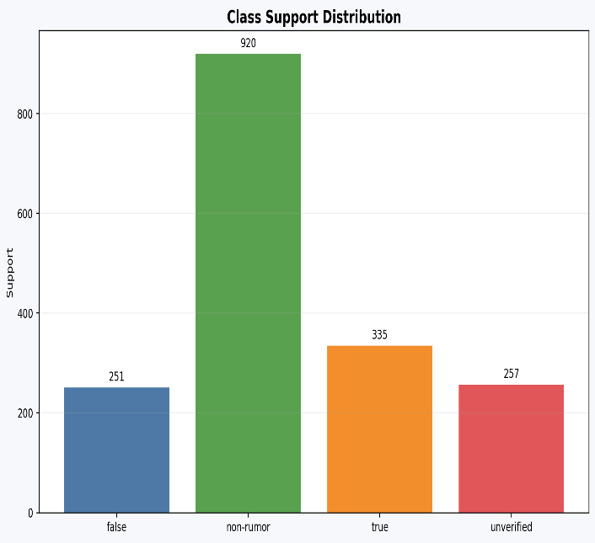
Class distribution across evaluation set
RESULT & ANALYSIS
1,763 samples — reflecting real-world social media imbalance
Natural imbalance means accuracy alone is insufficient. Macro F1 is the critical benchmark, weighting all classes equally regardless of support.

Slide 15
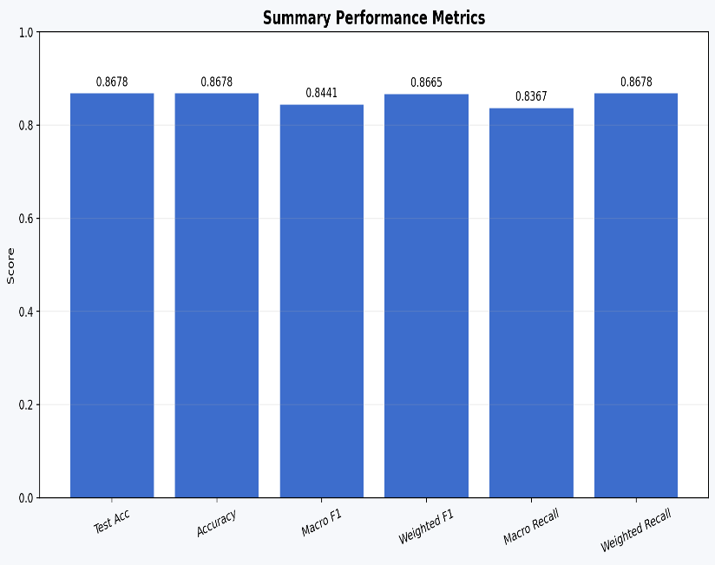
Overall Summary Performance Metrics
EAFG-LACL achieves strong, balanced performance - handling minority rumor classes as effectively as the majority class.
Test Accuracy: 86.78%
Weighted F1 Score: 0.8665
Micro F1 Score: 0.8441

Slide 16
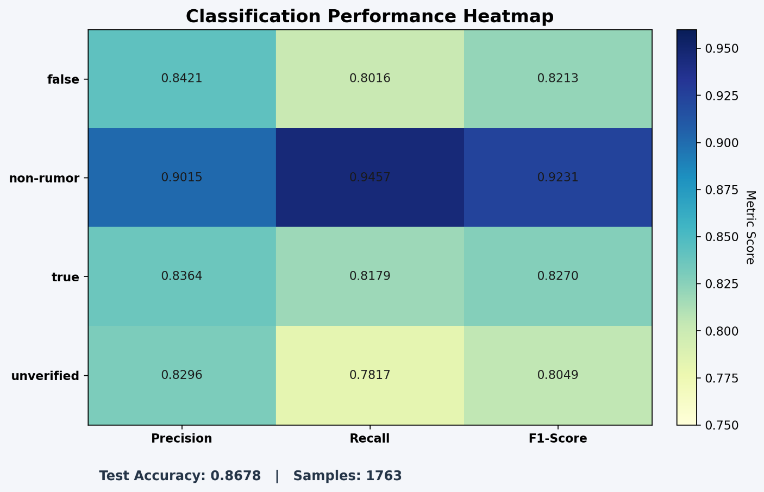
Classification performance Heatmap
Per-class precision, recall and Fl-score
Non-Rumor F1: 0.9231 Largest class, lTlost stable cluster.
True F1: 0.8270 - Fact- erification reinforces correct predictions.
False F1: 0.8213 - High precision; emotion filtering is ke}.
Unverified F1: 008049 Strong
despite inherent ambiguity}.
All minority class F1 scores exceed
0.80. Test Accuracy: 86.78% 1,763 samples.

Slide 17

CONCLUSION
86.78% accuracy: 0.8665 weighted F1 on a
1,763-sample evaluation set.
Minority class F1 >0.80: Robust handling of natural class imbalance throughout.
Emotion-preserving filter: Retains emotional characteristics in augmented data via cosine similarity.
Fact verification: Grounds predictions in Wikipedia knowledge, reducing false-positive flags.

Slide 18
Future scope
Six directions to extend this framework
Multi-lingual models
Extend to non-English languages using multilingual BERT and cross-lingual emotion models.
Multimodal data
Incorporate images, video, and audio to detect misinformation in mixed-media formats.
LLM fine-tuning
Train dedicated LLMs on misinformation corpora for healthcare and political domains.
Real-time fact checks
Integrate live knowledge bases and fact-checking APIs beyond Wikipedia.
Explainability (XAI)
Surface human understandable reasoning to support transparent content moderation.
Cross-platform reach
Adapt the framework beyond Twitter and Reddit for broader real -world generalization.

Slide 19



University of Engineering & Management, Kolkata

