Slide 1
Acadela: A Domain Specific Language for Definition of Integrated Care Pathway
Tri Huynh

Slide 2
Integrated Care Pathway
A patient-centric, multidisciplinary care plan
containing crucial steps
for treating a particular health issue ^{[1]}
[1] https://www.bmj.com/content/316/7125/133

Slide 3
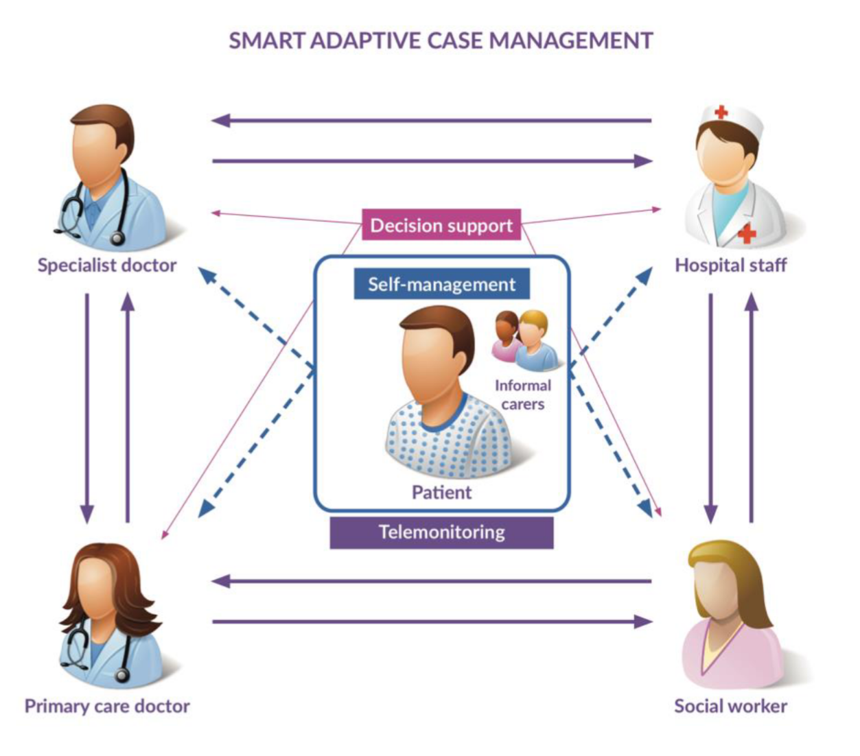


Care Plan Elements
A patient-centric, multidisciplinary care plan
containing crucial steps
for treating a particular health issue ^{[1]}
2
1
4
Data
3
Treatment Stages
Name
Age
Email
…
Personal
Info
Questionnaire
Medical
Data
Blood Pressure, questionnaire by amy morgan, Tatiana from the Noun Project

Slide 4
Care Plan Elements
A patient-centric, multidisciplinary care plan
containing crucial steps
for treating a particular health issue ^{[1]}
Patient Care Plan
Patient
Treatment Process Definition
Responsible Members
Personal & Medical Data
Medical Department
Data Visualization
Blood Pressure, questionnaire by amy morgan, Tatiana from the Noun Project

Slide 5
Care Plan Elements
A patient-centric, multidisciplinary care plan
containing crucial steps
for treating a particular health issue ^{[1]}
Patient Care Plan
XML
Admin
Acadela
Doctor
Patient
Treatment Process Definition
Responsible Members
Personal & Medical Data
Medical Department
Data Visualization
Blood Pressure, questionnaire by amy morgan, Tatiana from the Noun Project

Slide 6
Care Plan Elements
A patient-centric, multidisciplinary care plan
containing crucial steps
for treating a particular health issue ^{[1]}
Patient Care Plan
Patient
Process & Task Definition
Responsible Groups
Personal & Medical Data
Medical Department
Data Visualization
Blood Pressure, questionnaire by amy morgan, Tatiana from the Noun Project

Slide 7




Personal Data
Define user information in a customizable, type-restriction way
Usually contain personal information such as name, phone, email, etc.
Definition of personal data is done by Admins
Input of personal data is done by Medical Staff
First Name: Alex
First Name: John
First Name: Lily
First Name: Paul
Age: 25
Age: 50
Age: 29
Age: 45
…
…
…
…
ID: PA23053
ID: PS40152
ID: NS00713
ID: AD72839

Slide 8
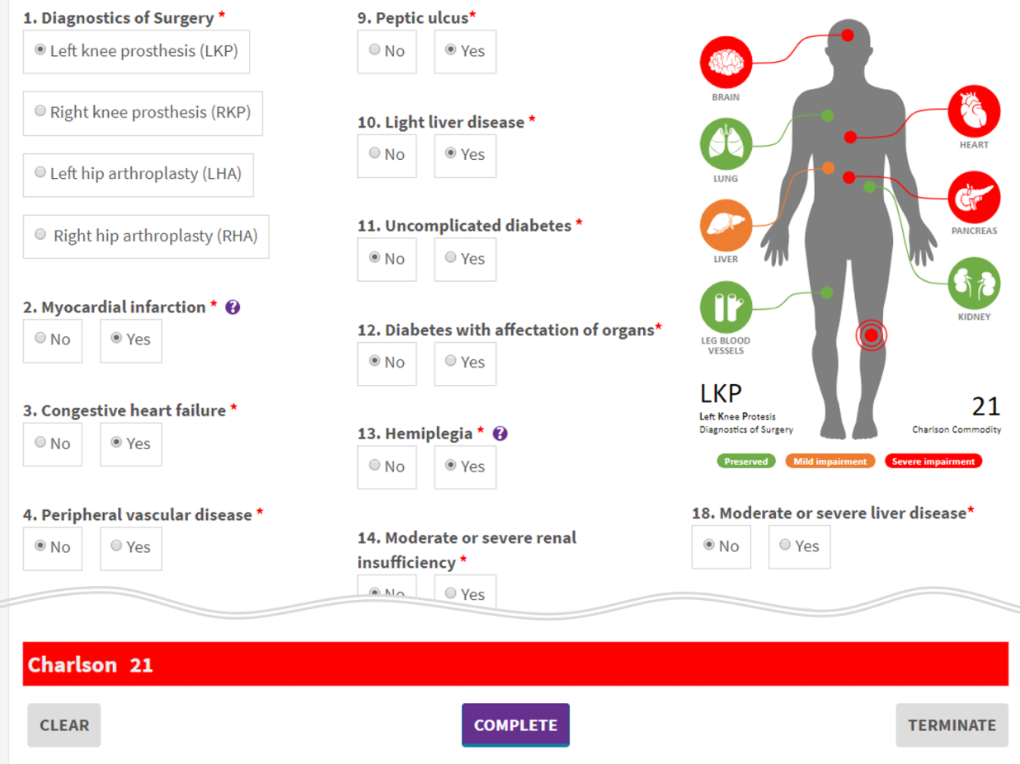
Medical Data – Include Medical Info
Include relevant medical information for the treatment process:
Vital signs: blood pressure, body temperature, sugar blood, etc.
Medical measurement index: Charlson Cormobidity Index (CCI), BMI index
entity Charlson
description = 'Charlson Cormobidity Index Form'
attribute ch1
type = ‘valueselection’
description = 'Myocardial Infarction:'
option value = ‘0’ description = ’No’
option value = ‘1’ description = ’Yes’
…
attribute ch20
type = ‘valueselection’
description = 'Age:'
option value = ‘1’ description = ’50-59’
…
option value = ‘5’ description = ‘90-99’

Slide 9
Medical Data – Computation Method
Define computation method for health indicator metrics:
Charlson Cormobidity Index: weighted sum of 19 metrics
Body Mass Index: weight / height²
entity Charlson
description = 'Charlson Cormobidity Index Form'
attribute ch1
…
attribute ch20
…
derivedattribute ch21
description = ‘Charlson Cormobidity Index (age adjusted)’
expression = ‘number(ch1, 0) + number(ch2, 0) + … number(ch19, 0) * 6 + number(ch20, 0))
derivedattribute ch22
description = ‘Charlson Cormobidity Index (unadjusted)’
expression = ‘number(ch1, 0) + number(ch2, 0) + … number(ch19, 0) * 6)

Slide 10
Medical Data – Define Severity
Define the level of severity:
Blood pressure (systolis): <=120 is normal | … | >=180 is highly critical
CCI: 0 is no disease burden | … | 4-29 is high disease burden
entity Charlson
description = 'Charlson Cormobidity Index Form'
attribute ch1
…
attribute ch20
…
derivedattribute ch21
description = ‘Charlson Cormobidity Index (unadjusted)’
expression = ‘number(ch1, 0) + number(ch2, 0) + … number(ch19, 0) * 6)
uiReference = ‘colors(1<=green<=2<orange<=4<red<100)’
derivedattribute ch22
description = ‘Charlson Cormobidity Index (age adjusted)’
expression = ‘number(ch1, 0) + number(ch2, 0) + … number(ch19, 0) * 6 + number(ch20, 0))

Slide 11
Medical Data – Visualization
Do doctors have to
program this visualization?
<svg xmlns='http://www.w3.org/2000/svg' viewBox='0 0 567.85828 845.26141' version='1'><style>.organ .circle,.organ .symbol{fill-opacity:1;fill-rule:evenodd;stroke:none}.organ .symbol{fill:#fff}.organ .label{font-style:normal;font-variant:normal;font-weight:700;font-size:18.75px;line-height:125%;font-family:Calibri;text-align:start;letter-spacing:0;word-spacing:0;text-anchor:start;fill-opacity:1;stroke:none;fill:#7f7f7f}.organ .line{fill:none;stroke-width:2.08014441px;stroke-linecap:butt;stroke-linejoin:miter;stroke-miterlimit:8;stroke-dasharray:none;stroke-opacity:1 stroke:red}.diagnostics .point .core{ fill:#ff0000; fill-opacity:1; fill-rule:evenodd; stroke:none; }

Slide 12
Medical Data – Visualization
Do doctors have to
program this visualization?
No ☺
Developers program medical visualization
Doctors provide relevant data (medical condition, severity level, etc.), then choose which medical visualization to display these data.

Slide 13
When to Collect/Process Medical Data?
Medical data are collected at a specific stage in a clinical pathway.
Example: A clinical pathway contains 4 stages: Identification, Evaluation, Workplan and Discharge
Each stage has its own task list
Create a task of collecting/processing medical data, and put it in a certain stage
Evaluation
Set Evaluation Due Date
Compute Charlson Comorbidity Index
…
Identification
Workplan
Discharge
Select Patients
Get Patient Consent
...
Give Advice
Prescribe
…
Fill Discharge Form

Slide 14
Define When to Collect Medical Data
Goal: Collect Charlson Comorbidity Index score in the Evaluation Stage.
How:
1. Create a Task to collect the CCI score from the defined CCI Form
2. Store the Task’s result (CCI score) in the Evaluation Stage
Evaluation
Set Evaluation Due Date
Compute Charlson Comorbidity Index
…
Identification
Workplan
Discharge
Select Patients
Get Patient Consent
...
Give Advice
Prescribe
…
Fill Discharge Form

Slide 15
Create a Medical Task Example
Define an action of collecting certain medical data in a Stage
Task: collect Charlson Comorbidity Index
Stage: Evaluation
HumanTaskDefinition ComputeCharlsonComorbidityIndex
description = 'Comorbidity - Charlson'
footnote = 'Pending authorization'
ownerPath = 'Settings.CaseManager'
isMandatory = 'true'
repeatable = 'ONCE'
entityDefinitionId = 'Charlson'
entityAttachPath = 'EvaluationEntity.CharlsonValue'
taskParamList isReadOnly = ‘false’ isMandatory = ‘true’
param path = ‘EvaluationEntity.Charlson.ch1’
..
param path = ‘EvaluationEntity.Charlson.ch20’
param path = ‘EvaluationEntity.Charlson.ch21’
param path = ‘EvaluationEntity.Charlson.ch22’
Inputs to be collected by medical staff
Outputs (automatically computed and recognized)

Slide 16
Create Medical Care Plan Template
A Care Plan comprises of Stages. In SACM, each Stage:
Has Stage Definition and Storage Object (Entity) Definition
May have entry precondition (predecessor Stage, technical/medical condition)
Identification
Identification.PatientConsent = yes
Evaluation
Identification StageDefinition
Identification EntityDefinition
EvaluationStage StageDefinition
EvaluationEntity EntityDefinition
 GetPatientConsent
…
 PatientConsent
 …
 ComputeCharlson
 …
 Charlson
 …

Slide 17
Create Stage in Medical Care Plan
Identification
Identification.PatientConsent = yes
Evaluation
EvaluationStage StageDefinition
EvaluationEntity EntityDefinition
 ComputeCharlson
 …
 Charlson
 …

Slide 18
Create Entity Definition of the Stage
entity EvaluationEntity
description = ‘Evaluation Stage Template’
attributeList
entity Charlson
description = ‘Charlson Cormobidity Index Form’
attribute ch1
type = ‘valueselection’
description = 'Myocardial Infarction:'
option value = ‘0’ description = ’No’
option value = ‘1’ description = ’Yes’
…
derivedattribute ch22
description = ‘Charlson Cormobidity Index (unadjusted)’
expression = …
entity Spirometry
description = ‘Spirometry Result Form’
attribute s1
…
entity Conclusion
…
endAttributeList
Identification
Identification.PatientConsent = yes
Evaluation
EvaluationStage StageDefinition
EvaluationEntity EntityDefinition
 ComputeCharlson
 …
 Charlson
Spirometry
…
Conclusion

Slide 19
Create Entity Definition of the Stage
entity EvaluationEntity
description = ‘Evaluation Stage Template’
attributeList
entity Charlson
description = ‘Charlson Cormobidity Index Form’
attribute ch1
type = ‘valueselection’
description = 'Myocardial Infarction:'
option value = ‘0’ description = ’No’
option value = ‘1’ description = ’Yes’
…
derivedattribute ch22
description = ‘Charlson Cormobidity Index (unadjusted)’
expression = …
…
entity Spirometry
description = ‘Spirometry Result Form’
attribute s1
endAttributeList
Identification
Identification.PatientConsent = yes
Evaluation
EvaluationStage StageDefinition
EvaluationEntity EntityDefinition
 ComputeCharlson
 …
 Charlson
…
Spirometry

Slide 20
Create Stage Definition of the Stage
stage EvaluationStage
description = ‘Stage Evaluation’
isMandatory= ‘true’
repeatable= ‘SERIAL’
entityDefinitionId = ‘EvaluationEntity’
entityAttachPath = ‘EvaluationEntity’
precondition
expression = ‘Identification.PatientConsent = 1’
processDefinitionId = ‘Identification’
Identification
Identification.PatientConsent = yes
Evaluation
EvaluationStage StageDefinition
EvaluationEntity EntityDefinition
 ComputeCharlson
 …
 Charlson
Spirometry
…
Conclusion

Slide 21
Create Stage Definition of the Stage
stage EvaluationStage
description = ‘Stage Evaluation’
isMandatory= ‘true’
repeatable= ‘SERIAL’
entityDefinitionId = ‘EvaluationEntity’
entityAttachPath = ‘EvaluationEntity’
precondition
expression = ‘Identification.PatientConsent = 1’
processDefinitionId = ‘Identification’
HumanTaskDefinition ComputeCharlsonComorbidityIndex
entityDefinitionId = 'Charlson'
entityAttachPath = ' EvaluationEntity.CharlsonValue'
taskParamList isReadOnly = ‘false’ isMandatory = ‘true’
param path = ‘Evaluation.Charlson.ch1’
...
param path = ‘Evaluation.Charlson.ch22’
Identification
Identification.PatientConsent = yes
Evaluation
EvaluationStage StageDefinition
EvaluationEntity EntityDefinition
 ComputeCharlson…
 …
 Charlson
Spirometry
…
Conclusion

Slide 22
Care Plan Definition
A Care Plan has its own Treatment Process. It consists of:
★ Stages
★ Configuration (Operations, Case Summary, etc.)
DiseasesACarePlan
Evaluation
 Set Evaluation Due Date
 Compute Charlson Comorbidity Index
…
Identification
Workplan
Discharge
 Select Patients
 Get Patient Consent
...
 Give Advice
 Prescribe
…
 Fill Discharge Form

Slide 23
Care Plan Template Definition
A Care Plan Template comprises of Stage Template (Entity Definition)
DiseasesACarePlan
Evaluation
EntityDefinition
Identification
EntityDefinition
Workplan
EntityDefinition
Discharge
EntityDefinition

Slide 24
Define Stages in a Care Plan Templates
Create a Care Plan Entity, which stores all the Entity Definition of Stages
entity DiseasesACarePlan
description = ‘Care Plan for disease A’
attributeList
entity Identification
type = ‘Link.EntityDefinition.Identification’
…
entity EvaluationEntity
type = ‘Link.EntityDefinition.EvaluationEntity’
attributeList
entity Charlson …
…
entity Conclusion …
endAttributeList
entity Workplan
…
endAttributeList
 Charlson
Spirometry
…
Conclusion
DiseasesACarePlan
Evaluation
EntityDefinition
Identification
EntityDefinition
Workplan
EntityDefinition
Discharge
EntityDefinition

Slide 25
Define Care Plan Configuration
case DiseasesACaseDefinition
ownerPath = 'Settings.CaseOwner‚
entityDefinitionId = 'DiseasesACarePlan'
newEntityDefinitionId = 'Settings'
newEntityAttachPath = 'Settings'
stage IdentificationStage
…
stage EvaluationStage
description = ‘Stage Evaluation’
entityDefinitionId = ‘EvaluationEntity’
entityAttachPath = ‘EvaluationEntity’
HumanTaskDefinition ComputeCharlsonComorbidityIndex
entityDefinitionId = 'Charlson'
entityAttachPath = 'EvaluationEntity.Charlson'
…
…
DiseasesACarePlan
Configuration
 ComputeCharlson…
 SetEvaluationDueDate
 …
Evaluation
StageDefinition
Identification
StageDefinition
Workplan
StageDefinition
Discharge
StageDefinition

Slide 26
Define Care Plan Operations
Define links to digital healthcare system, which handles activation, deletion and completion of the Case
case DiseasesACaseDefinition
ownerPath = 'Settings.CaseOwner‚
entityDefinitionId = 'DiseasesACarePlan'
newEntityDefinitionId = 'Settings'
newEntityAttachPath = 'Settings'
onActiveUrl = activateUrl
onCompleteUrl = completeUrl
onDeleteUrl = deleteUrl
stage IdentificationStage
…
stage EvaluationStage
…
 ComputeCharlson…
 SetEvaluationDueDate
 …
DiseasesACarePlan
Configuration
Evaluation
StageDefinition
Identification
StageDefinition
Workplan
StageDefinition
Discharge
StageDefinition

Slide 27
Patient-centric, Multidisciplinary Care Plan
Mobilizing human resources
from various disciplines for the patient treatment
Create Users, Groups with specific Privileges in Workspaces (Clinics, Hospitals)
Patient
Healthcare Staff
Admin

Slide 28
Membership
Privileges
Authentication: who can access a patient’s case?
Authorization: among authenticated users, who can read/write which information in the case?
Patient
Healthcare Staff
Admin
Only Admin creates Workspaces, Users, Groups, Privileges
Doctors only refer to Workspace, Users and Groups
in a case template definition

Slide 29
User
Represent a participant in the care plan
First Name: Alex
First Name: John
First Name: Lily
First Name: Paul
Age: 25
Age: 50
Age: 29
Age: 45
…
…
…
…
ID: PA23053
ID: PS40152
ID: NS00713
ID: AD72839

Slide 30
Group Definition
Group of Users and Group of Groups
Group of Users: contains users of the same category
Group of Groups: contains groups of different domains
Every group must have at least one admin

Slide 31
Group Examples
Group of Users
Group of Groups
Patient
Group
Physician
Group
Healthcare
Professional
Group
Physician
Group
Nurse
Group

Slide 32
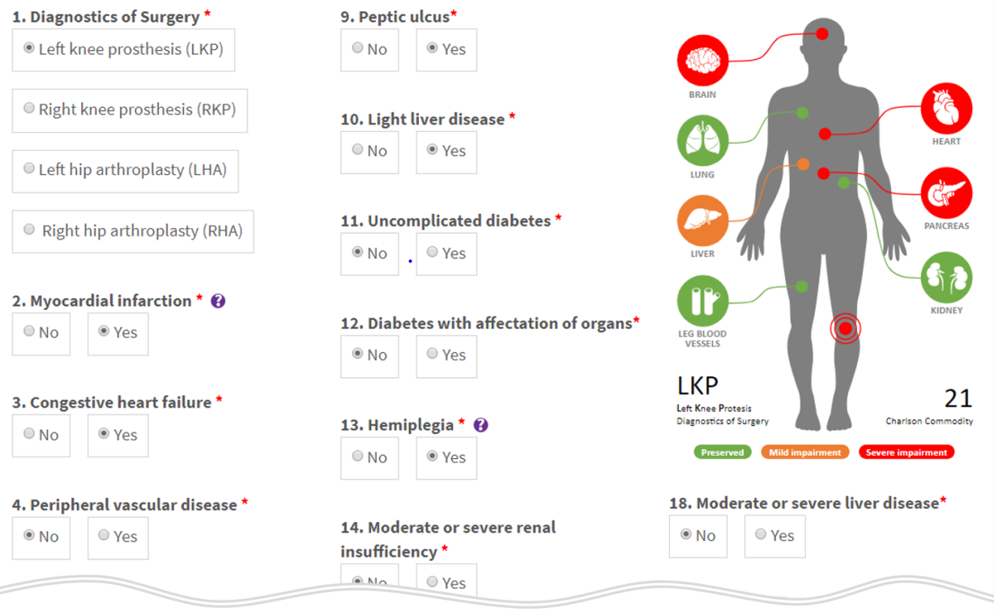
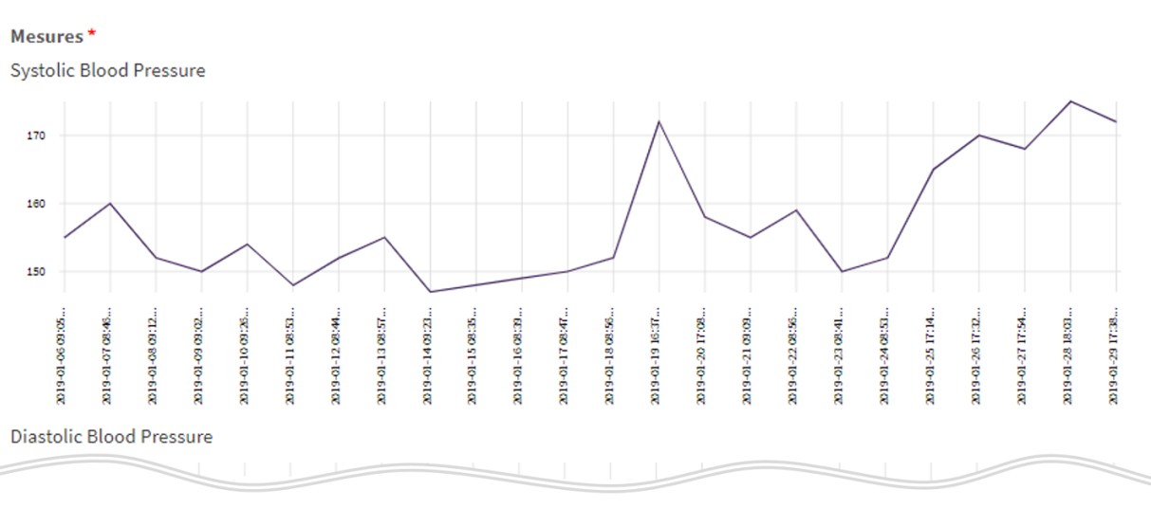
Workspace
Represent a hospital/clinic ➔ contains patients, staffs, groups, patient cases and treatment plan
Workspace
Patient
Group
2
1
4
3
Physician
Group
Name
Age
Email
…
Healthcare
Professional
Group
Nurse
Group

Slide 33
(Salutation)
Full Name
17132
student_email@in.tum.de

