Slide 1
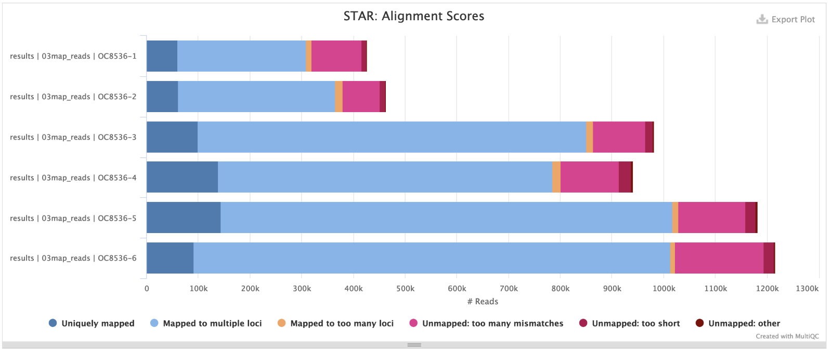
Paired trimmed reads were then mapped to the yeast genome with STAR (Fig. 2). Between 50%-60% of the fragments mapped to a single locus, while ~10% mapped to a few loci and ~30% to many loci (likely repetitive sequences).

Slide 2
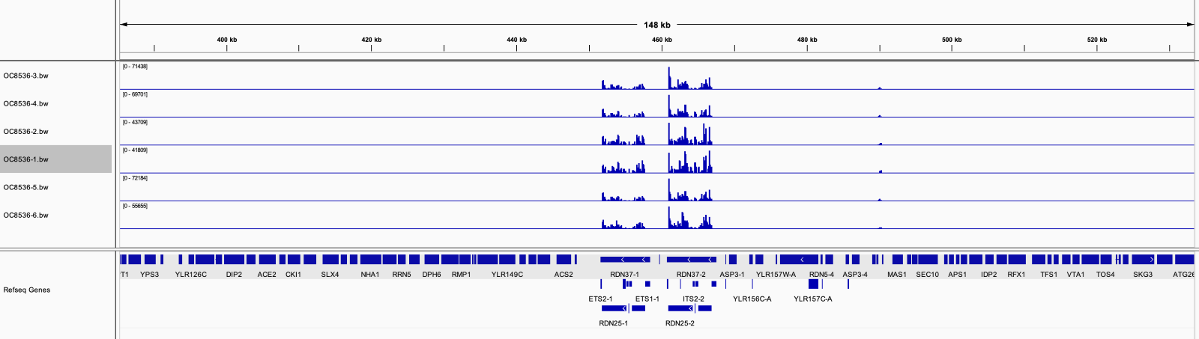
Most of the reads mapped to the yeast reference genome. However, only 15% of those reads mapped to a single location (Figure 3, light blue bar). A more in-depth analysis showed that more than 93% of the mapped reads mapped to the rRNA locus on chromosome XII (Fig. 3).

