Slide 1

Mastering Kubernetes Development with

Slide 2
Why more technolgy?
Problem statement: Kubernetes can be painful
  Lots of work goes into automating deployments
  Many *cloud* services needing to interacting with each other for the whole system to work
Pain points for development teams:
  Compile → Edit Config → Deploy → Test → Teardown?
  Keeping track of environment variables
  Deploying and remote debugging changes is annoying

Slide 3
How to get the best of both worlds
Meet Skaffold!
  An open-source command-line tool for continuous development on Kubernetes clusters. (Built and maintained by Google)
  Fast deployments while getting a consistent environment to work in that matches production is the dream of Kubernetes
  Simplifies the build, push, and deploy cycle. So your devs and qas can focus on writing and testing code

Slide 4
Why Skaffold stands out
Rapid Development Feedback
  Watch mode: Detects file changes, rebuilds images, and redeploys.
  Eliminates the need to manually rebuild and apply changes.
Environment-Agnostic Consistency
  Works across local, dev, staging, and production environments.
  Uses Kubernetes manifests or Helm charts.
Plug-and-Play with CI/CD
  Integrates easily with Jenkins, GitHub Actions, and other CI/CD tools.
  Currently in use as our main CI pipline at my works current project

Slide 5
Why Skaffold stands out
Faster Iteration Times
  Save hours of repetitive build/deploy/test steps.
Simplified Onboarding
  New developers can get started with minimal Kubernetes expertise.
  Don’t need to understand every part of the project to know it built and deployed for making a small change
Improved Collaboration
  Consistent workflows reduce errors and surprises.

Slide 6
How Skaffold works
Define your skaffold.yaml configuration once. Lives in source control along with the rest of your app at the top level directory
Integrate with Dockerfiles, Kubernetes manifests, and your dev cluster. This pulls the exact files you will use when you go to deploy with another kubernetes tool

Slide 7
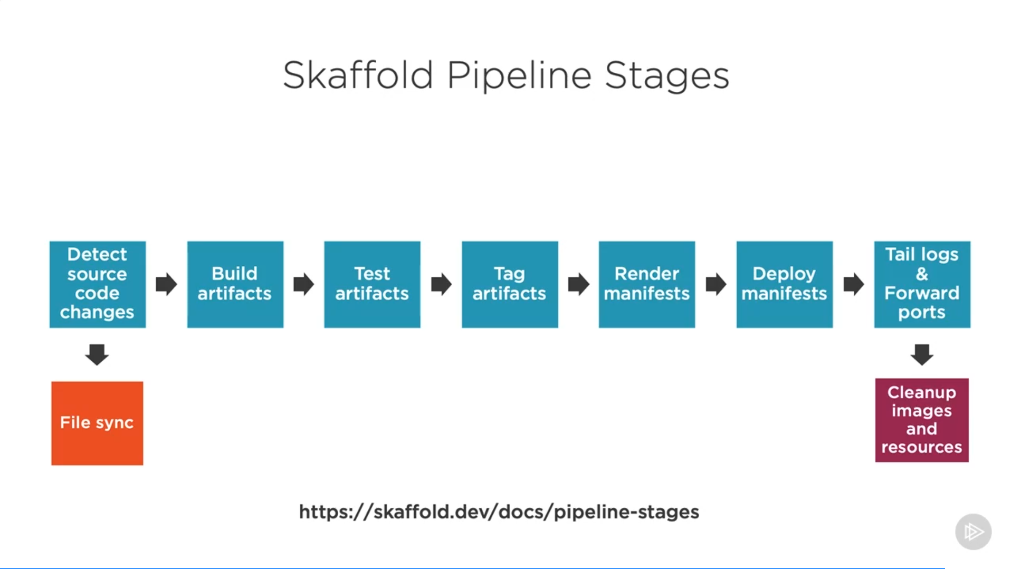

Slide 8
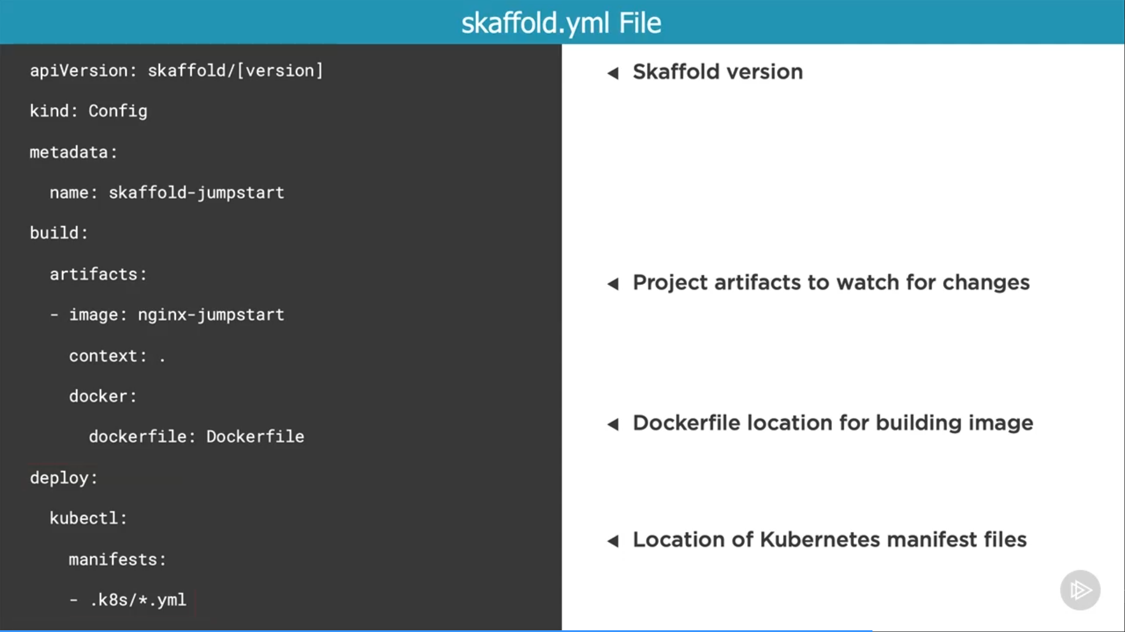
Skaffold yaml

Slide 9
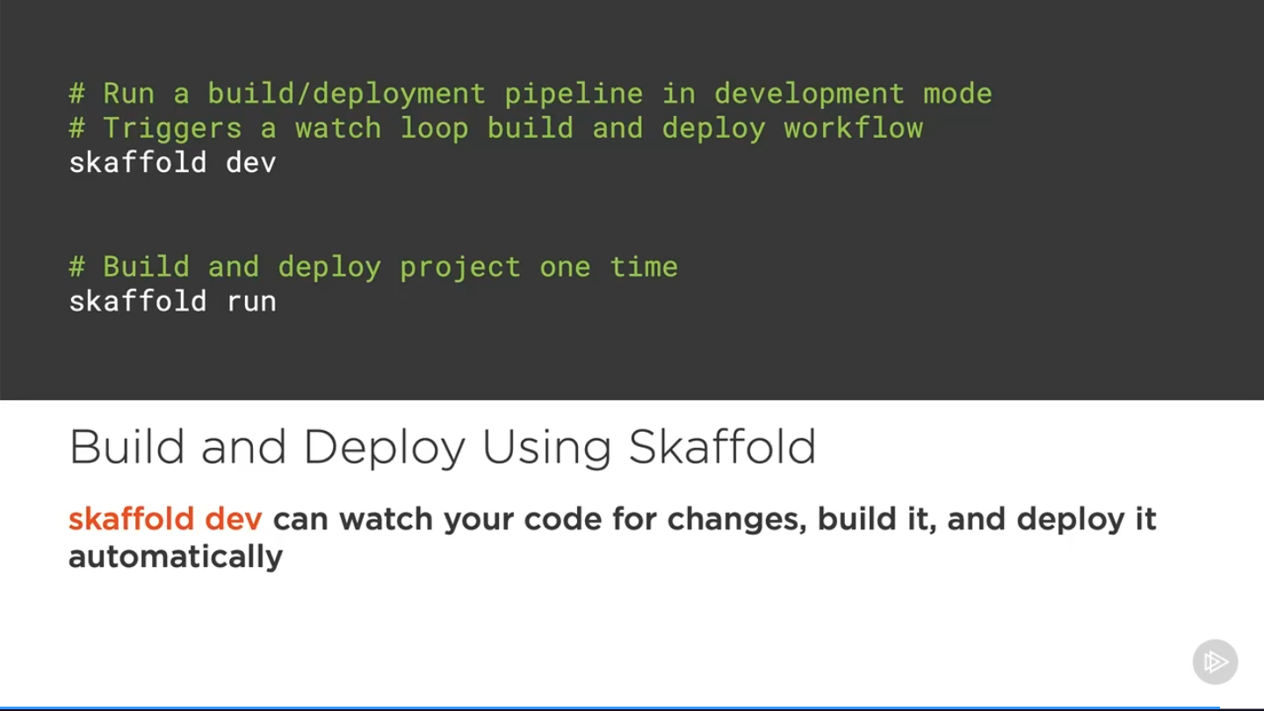

Slide 10
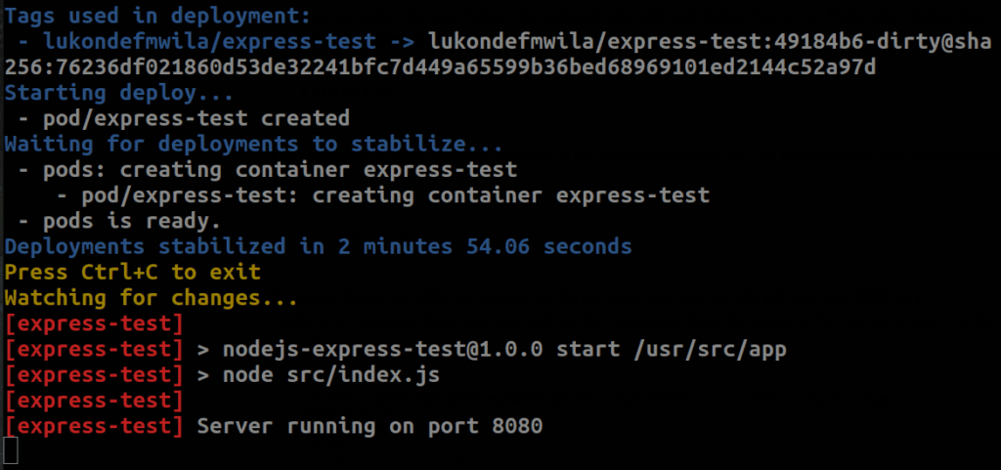
Time For A Demo!

Slide 11
Questions?

