Slide 1






November 2025
VOLTSWAP
Supervisor
Team Member
ĐỖ TẤN NHÀN
LÊ NHẬT NAM (Leader)
NGUYỄN ĐỨC ANH TÀI
PHẠM ĐĂNG KHOA
LÊ NGỌC TRÍ TÍN
TRẦN ANH KIỆT

Slide 2






Overview
Project Introduction
01
System Architecture Overview
02
Actors & Features
03
Demonstrations
04
Outcomes
05
Q&A
06

Slide 3



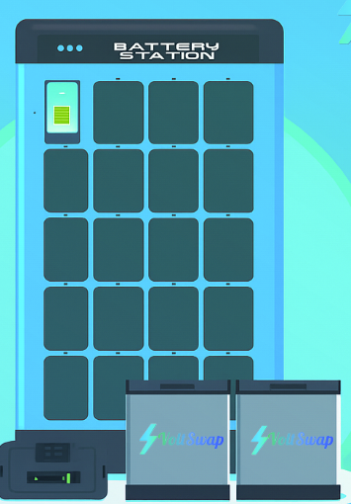

Project Introduction
A web app to allow customer to:
Send requests for rental plans and battery swaps
Order / book a battery swap appointment
View available stations and number battery in station
Manage their vehicles
Make online payments and view transaction history

Slide 4

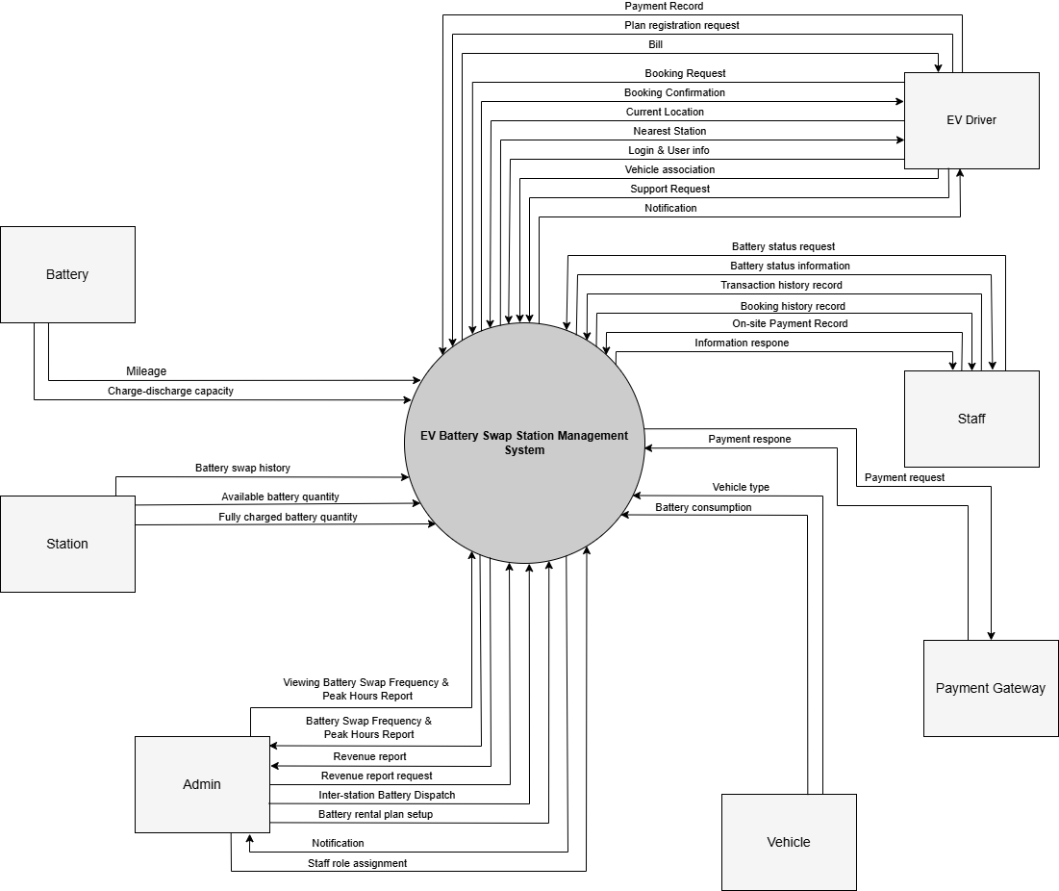
Project Introduction

Slide 5










System Architecture Overview
Back - End
Front - End
API Layer
Business Logic Layer
Data Access Layer
RestControler
Web App
Database
Payment
Gateway

Slide 6







System Architecture Overview
Tech Stack:
Back-end:
Front-end:
Project management:
.NET Core
SQL Server
JWT
VnPay
GitHub
Jira
React/js
Tailwindcss
Javascript

Slide 7

























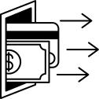
Actors & Features
EV Drivers
Staffs
Administration
Register a plan
Link vehicles
Find station
Booking
Swap battery
Payment
Dashboard
Booking management
Battery swap history management
Battery swap assistance
Battery inventory management
Interact with battery pillars
Dashboard
Customer management
Staff management
Rental plan management
Station management
Report management
View transactions
Initiate transaction

Slide 8
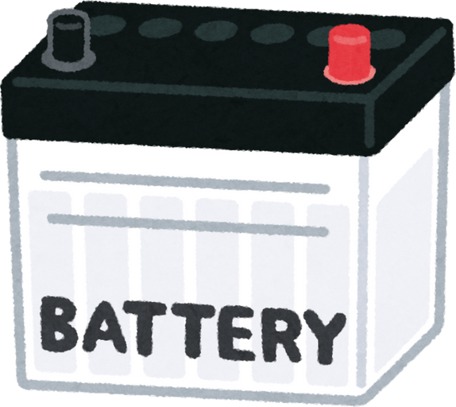












Actors & Features
Batteries
Vehicles
Stations
Payment Gateway
Record sessions
Record usage percentage
Battery information
Fully charged batteries
Batteries charging
Batteries under maintenance
Batteries in stock
Payment support
Notify transaction result
Vehicle information
Batteries in use

Slide 9








Demonstrations
Scenario #1: User registers and takes batteries
Login
2. View plan
3. Add to cart
Driver
Service Page
Plans
Payment
4. Choose station
7. User rating
6. Take battery
5. Go to station
Rating
Battery
Checkin
Battery station

Slide 10

Demonstrations
Scenario #2: User swaps batteries
3. Choose subscription
Login
2. Choose station
Driver
Service Page
Battery station
Subscriptions
4. Go to station
7. User rating
6. Take battery
5. Put in battery
Rating
Battery selection
Insertion
Checkin

Slide 11

Demonstrations
Scenario #3: User bookings
Login
2. Booking
3. Choose station
4. Booking
Driver
Service Page
Booking
Battery station
Subscriptions
5. Go to station
8. User rating
7. Take battery
6. Put in battery
Rating
Battery selection
Insertion
Checkin

Slide 12

Demonstrations
Scenario #3: User cancels subscription
4. Choose subscription
Login
2. Booking
3. Choose station
Driver
Service Page
Booking
Battery station
Subscription
5. Go to station
8. Staff confirm
7. Add to cart
6. Put in battery
Confirm
Payment
Insertion
Checkin

Slide 13





Outcomes
Lessons Learned:
Application Achievements:
A platform for managing battery swap stations.
Customer features: Register plan, Find station, Booking slot, Swap battery, Payment,...
Staff features: Support customers, Manage inventory & pillars,.....
Admin features: Manage customers, staff, plans, stations,......
Teamwork
New techs
Time Management
SDLC
Project Management

Slide 14


Outcomes
Project Deliverables:
Limitations:
Source code
Project management
Document
Multiple payment gateway (VnPay only)
Multiple language supporting

Slide 15


November 2025
Thank you for your attention
Q&A

