Slide 1
Data Structure with Scratch
Bob Freitas
And
Alex Freitas

Slide 2
What is a Data Structure
In computer science, a data structure is a particular way of storing and organizing data in a computer so that it can be used efficiently.
Definition from Wikipedia

Slide 3
Common Data Structure Types
Arrays
One dimensional
Two dimensional
Lists
Queues
Stacks

Slide 4
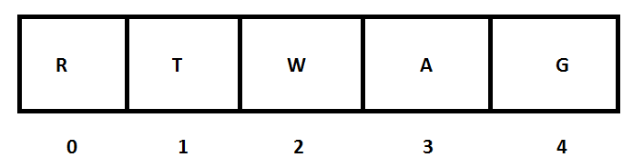
One Dimensional Array
A fixed size group of items that are stored and used with an index. These are good for things that you know a lot about. How many you will have and what they are. They will allow for quick and easy access.

Slide 5

Lists
Your data is in a node, which has your data and a link to other nodes. They are dynamic and can be increased/decreased as needed. These are good for things that will need to be added, deleted and accessed at the ends. They are not very good for searching.

Slide 6
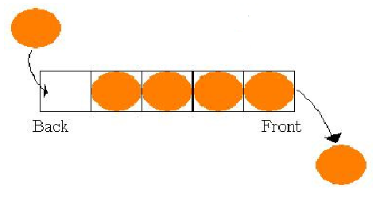
Queues
Items are stored and used in the order that they were received, often referred to as First-In-First-Out (FIFO). An example would be standing in line at the grocery store.

Slide 7
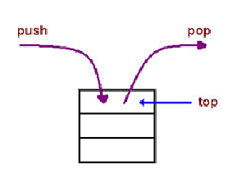
Stacks
Items are stored and used from the top of a stack, often referred to as Last-In-First-Out (LIFO). An example would be a stack of dishes at an all you can eat buffet.

Slide 8
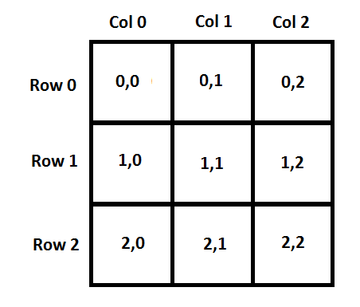
Two Dimensional Array
A fixed size group of items that are stored and used with two indexes. The first index is used to identify the row, and the second is for the column.

Slide 9
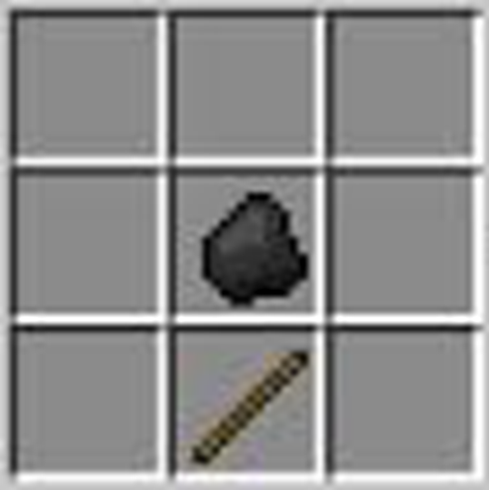
Two Dimensional Array
table[1][1] = coalStack;
table[2][1] = stickStack;
ItemStack itemStack;
for (int i=0; i < 3;i++){
for (int j=0; j < 3; j++){
itemStack = table[i][j];
// do something
}
}

Slide 10
Problem to Solve
We want to write a program that will allow Scratchy find his way home. However, to make sure he can always get home he needs to follow the exact path he took when he left.
Questions to ask
What should we use as home?
What should be the destination?
Which data structure should we use?

Slide 11
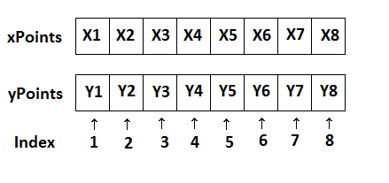
Selected Data Structure
Uses a pair of parallel stacks to store the X & Y coordinates

Slide 12
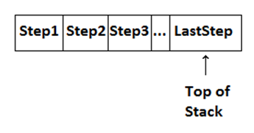
Tracking Each Step
Stack will keep track of the steps taken and then allow for them to be reversed

Slide 13
Computer Algorithm
Start Sratchy from home
Loop until Scratchy reaches his destination
If Scratchy takes a step
Keep track of that step
Endif
Endloop
Loop until Scratchy gets home
Get the next backward step to take
Endloop

Slide 14
On to the Project
Some URL here

