Slide 1


2nd Trial and Error Award 2025

Slide 2
History of the award

Slide 3
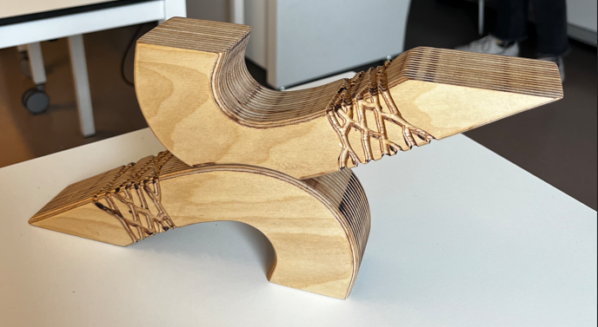


Slide 4
Nominations

Slide 5
Selected 4 which best fit spirit of the award

Slide 6
“AI-based virtual assistant and transformational leadership in social cognitive theory perspective: a study of team innovation in construction industry”
Authors: Zhang HUI, Naseer Abbas Khan, Maria akhtar

Slide 7
AI-based virtual assistant and transformational leadership in social cognitive theory perspective: a study of team innovation in construction industry.
They investigated how AI-powered virtual assistants and transformational leadership interact to influence team innovation, focusing on the construction industry through a social cognitive theory (SCT) lens
Initial hypothesis predicted a positive correlation of AI tools and leadership on innovation outcomes.
Pilot tests revealed methodological challenges, failed causal verification, and participant resistance to AI adoption.
The team revised the theory several times and finally settled for a complicated interpretation based on SCT.

Slide 8
No support for a causal role of primary motor cortex in construing meaning from language: An rTMS study
Authors: PABlo solana, Omar escamus, Daniel Casasanto, Ana B. Chica, julio santiago

Slide 9
No support for a causal role of primary motor cortex in construing meaning from language: An rTMS study
The study tested whether the primary motor cortex causally contributes to understanding action-related language, finding no support for this hypothesized role.
Despite the null result, methodological rigor was ensured by confirming the experimental manipulation worked and validating the measurement tools.
Sensitivity power analyses demonstrated sufficient sample size to detect even small effects, strengthening the reliability of the null finding.
The study was also preregistered prior to data collection

Slide 10
Proactive and retroactive effects of novelty and rest on memory.
Authors: Sumaiyah Raza, JUDITH SCHOMAKER, RICHARD N HENSON

Slide 11
Proactive and retroactive effects of novelty and rest on memory
This registered report planned to replicate work that has suggested that exploration of a novel environment and wakeful rest can promote memory.
It tested proactive and retroactive effects of novel exploration and of wakeful rest.
This study involved an elaborate multiple-day design to address these questions and prior to data collection a stopping rule was defined based on Bayesian unpaired t-tests and 10,000 simulations.
The final sample included 887 participants and convincingly showed that novelty did not induce a proactive or retroactive beneficial effect on memory, while wakeful rest was demonstrated to have a proactive benefit on immediate recall.

Slide 12
Limited data prevent assessment of role of climate change in deadly floods affecting highly vulnerable communities around Lake Kivu
Authors: Joyce Kimutai, Gerbrand koren

Slide 13
Limited data prevent assessment of role of climate change in deadly floods affecting highly vulnerable communities around Lake Kivu
The study aimed to determine whether the deadly 2023 floods around Lake Kivu were influenced by climate change using statistical attribution methods.
They found that due to insufficient, poor-quality, and sparse meteorological data in the region, conclusive attribution to climate change was impossible.
The authors decided to publish it to highlight the critical need for improved observational capacity and data accessibility in vulnerable, neglected regions.
The transparent reporting aligned with the important perspective by Perkins-Kirkpatrick et al. on climate data gaps.

Slide 14
Spin that wheel!

Slide 15
Interested in hosting the trial and error award next year?

