Slide 1
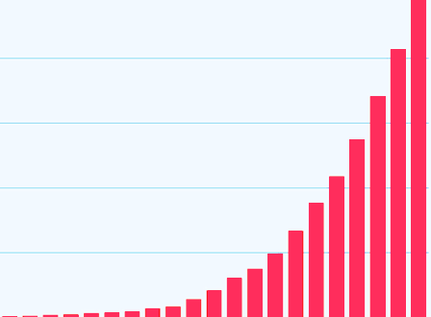
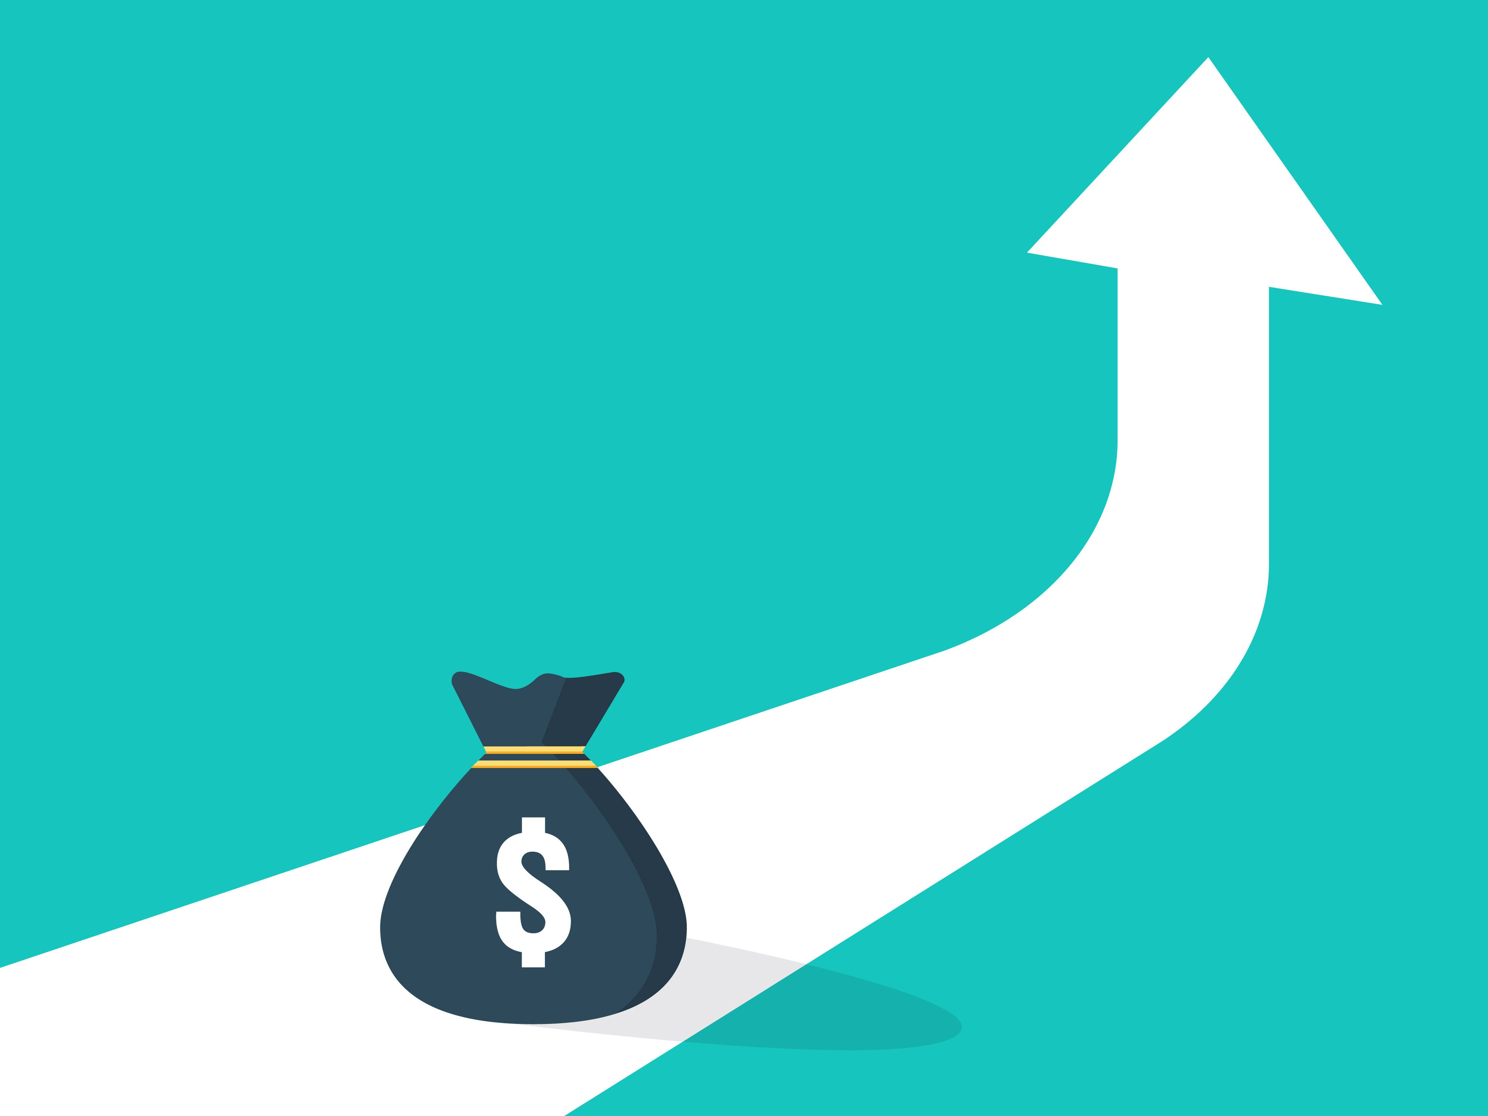
Uncertainty
Understanding
Lucie White | Utrecht University
l.a.white@uu.nl

Slide 2
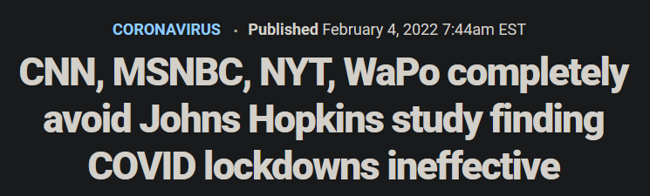
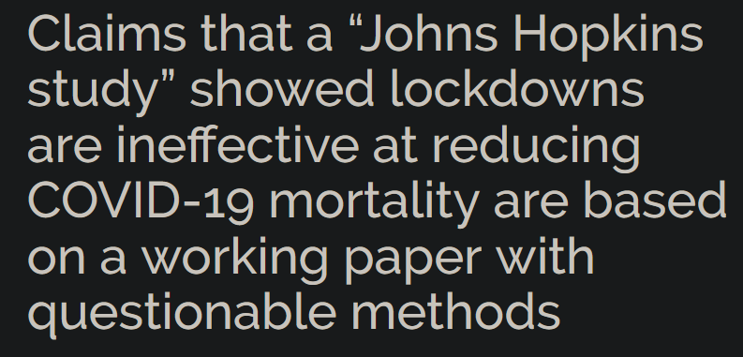
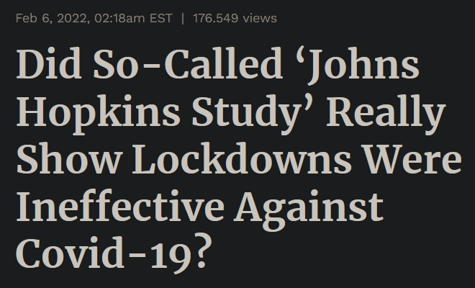
Enduring
Uncertainty

Slide 3
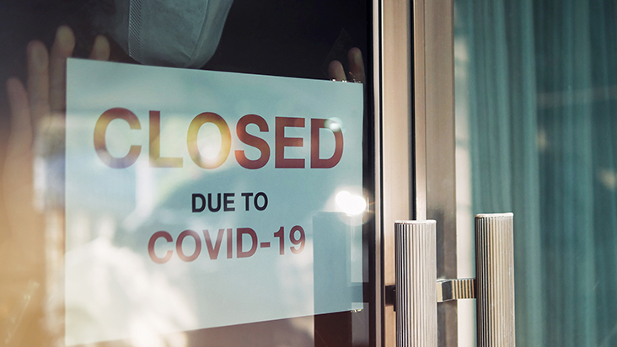
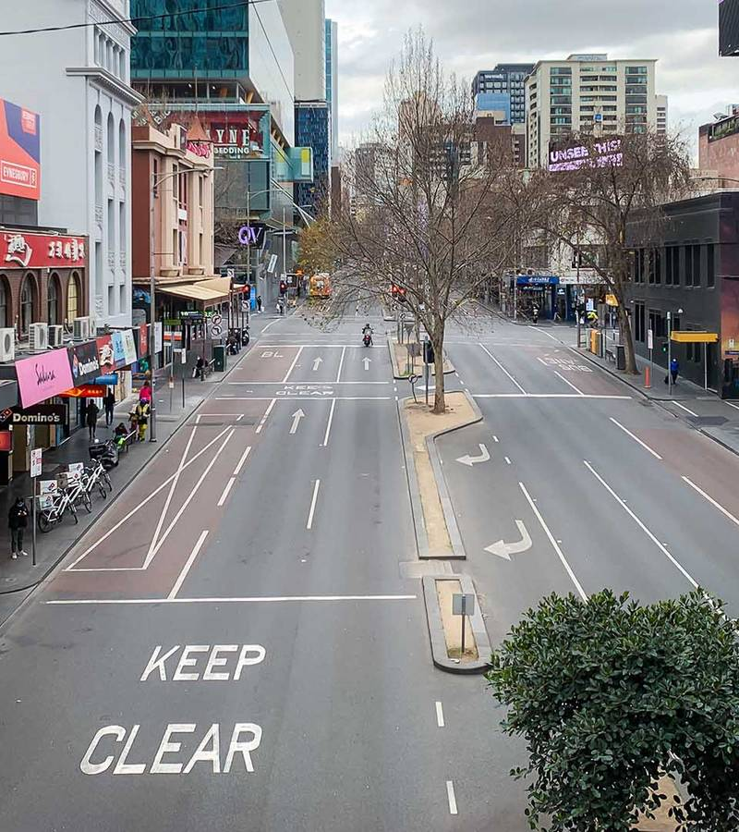
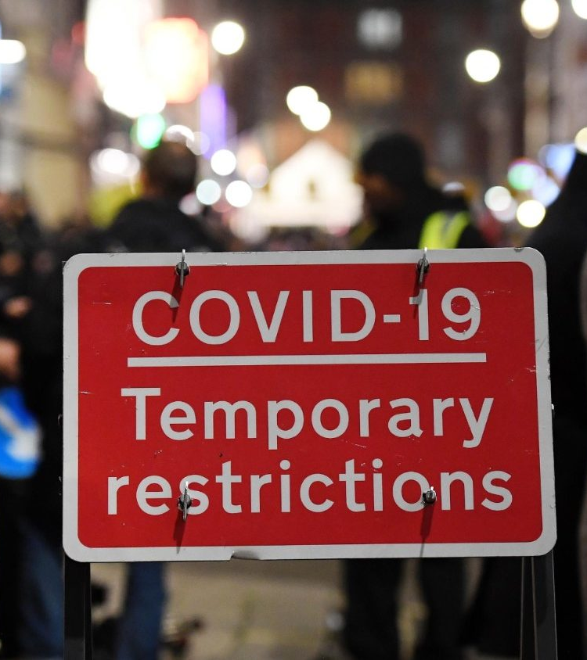
lockdowns

Slide 4
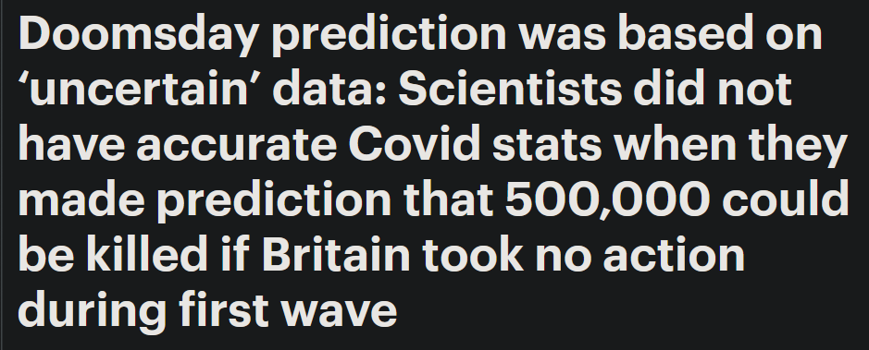
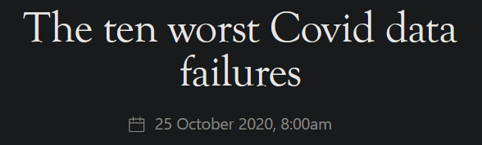
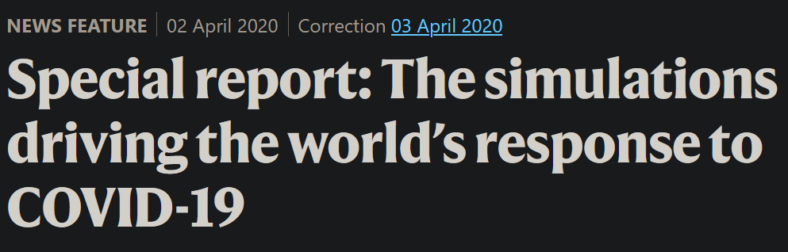
The
Early
Debate

Slide 5
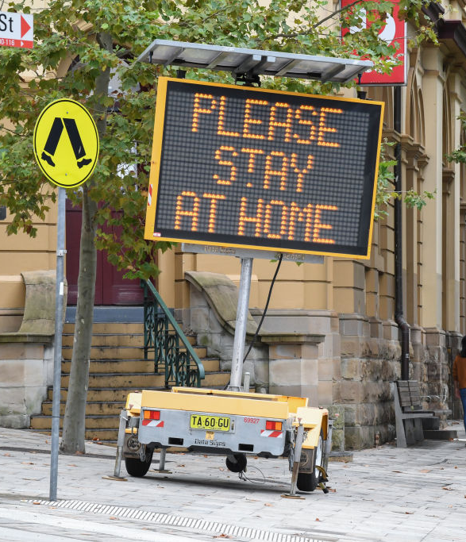
Predictions or projections?
Models provide projections: not what will happen, but what would happen.
500,000 dead in UK – if no-one changed their behaviour in any way.
We can treat a projection as a prediction – if we take the scenario to be sufficiently realistic.

Slide 6
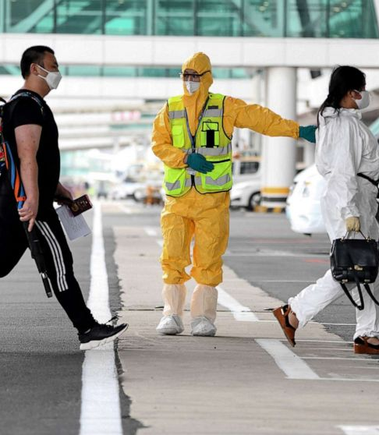
Behavioural change, and
“Looping effects”
Predictions can be self-fulfilling or self- defeating.
Very hard for models to incorporate this.
Can make models look untrustworthy.

Slide 7
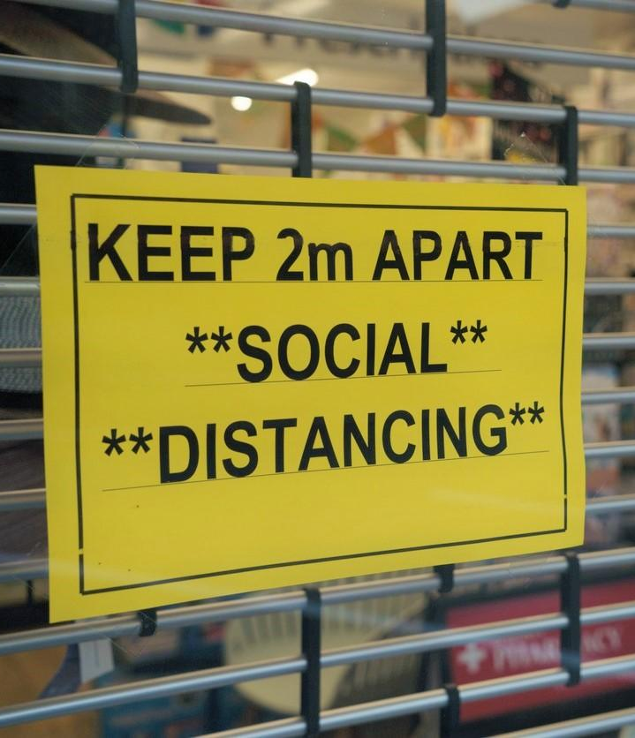
Uncertain data
Projections only as good as the data input into the model.
Model needs assumptions about, e.g.
  Infection hospitalization rate
  How long until an infected patient becomes infectious
  Effectiveness of social distancing

Slide 8
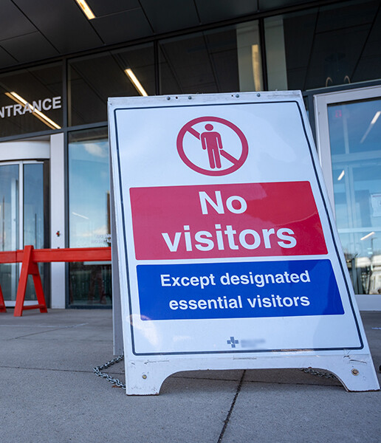
WHAt can models tell us?
When employing uncertain data, we can use model for some things but not others.
Can’t use them for pinpoint predictions.
But might use them for indication of the general trajectory of a pandemic, if we implement certain policies.

Slide 9
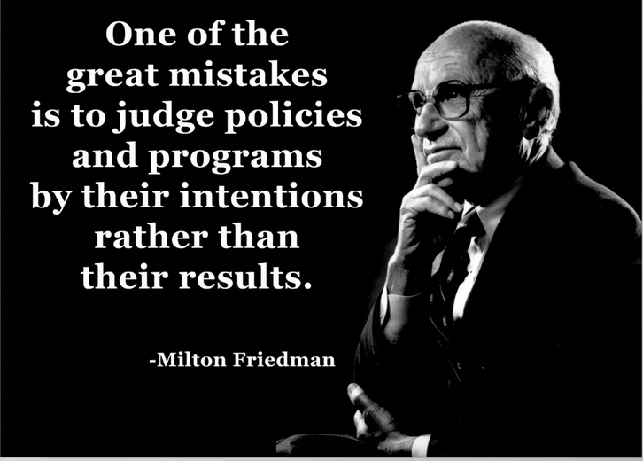
Models are Tricky…
But surely the availability of evidence can lead us to an answer?

Slide 10
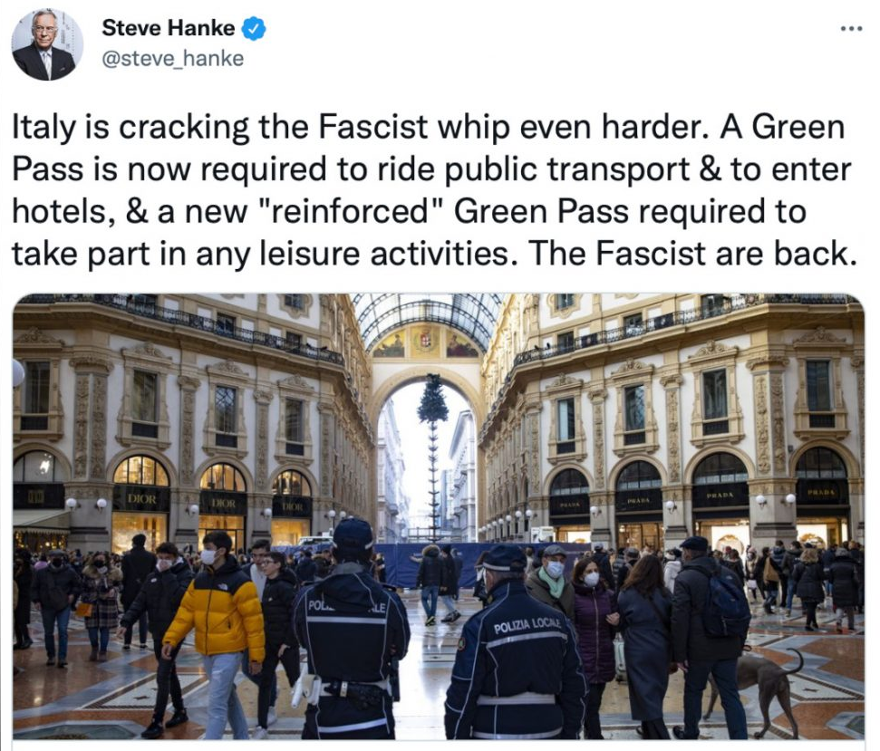
Three Complications
1. Ideological disagreements remain
Minimum wage findings challenged central economic orthodoxy – and thus met with a lot of resistance.
Similarly, deep ethical disagreements about the legitimacy of lockdowns coloured judgements about their efficacy.

Slide 11
Three Complications
2. Specifics are important
Cannot study effect of minimum wage in controlled environment.
Hard to determine effect of particular policy, or to extrapolate.
Lockdowns similarly complicated, involving multiple measures, different in different countries.
Other factors – age, enforcement, new variants – can have a profound effect.

Slide 12
Three Complications
3. We need to know what would have happened
E.g. introduce a minimum wage, no drop in unemployment.
But maybe without it, the company would have hired even more employees!
Similarly, introduce a lockdown, and deaths decrease.
But maybe people would have changed their behaviour anyway!

Slide 13
Understanding and
COMMUNICATING UNCERTAINTY
We can’t separate these debates from, and resolve them prior to, our ethical disagreements.
We might not be able to come to a satisfying general answer.
Not a simple “matter of fact”.

