Slide 1
A bit about me.
Notes:
Applied Mathematics degree.
Land surveyed 3.5 yrs.
Drafted civil engineering firm. Railroad crossings. 4 yrs.
The Iron Yard September 2017.

Slide 2
Version Control
aka Source Control
and Revision Control
Notes:
Comments, corrections, & questions.
High level demonstration. Reach out to me later - contact page.
Anyone not aware of version control?
Who’s used some sort of version control?
Who’s aware of it but hasn’t used it?

Slide 3
What is version control?

Slide 4
What is version control?
Task of organizing software versions
& organizing software configurations.
Source: https://www.google.com/search?q=definition+of+version+control&oq=definition+of+version+control&aqs=chrome..69i57.3440j0j7&sourceid=chrome&ie=UTF-8

Slide 5
Why have version control?

Slide 6

Example

Slide 7

Example

Slide 8
Example
Notes:
Because the software will break.
‘bird running gif’ https://media.giphy.com/media/ceHKRKMR6Ojao/giphy.gif

Slide 9
What are the tools?

Slide 10
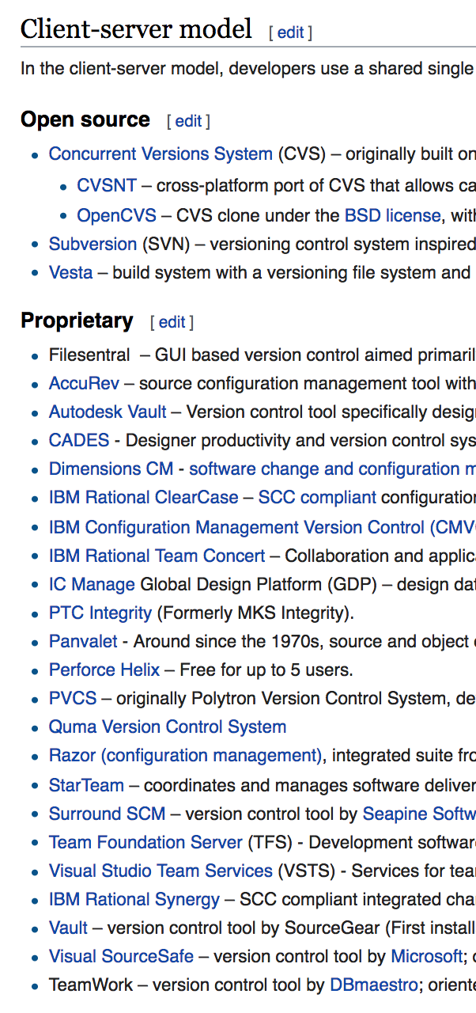
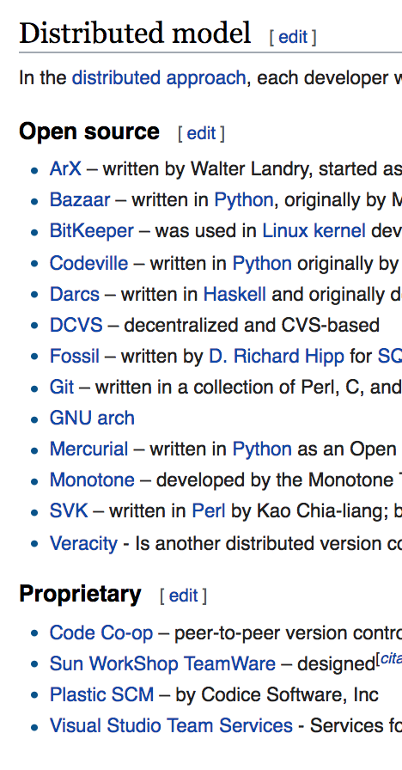
What are the tools?
source: https://en.wikipedia.org/wiki/List_of_version_control_software

Slide 11
What are the tools?
source: https://en.wikipedia.org/wiki/List_of_version_control_software
Notes:
Git is what I am familiar with.
Etymology: https://en.wikipedia.org/wiki/Git#History and https://github.com/progit/progit/issues/769

Slide 12




What are the tools?
Git Repositories
Notes:
Show you a diagram explaining what is happening. When I learned I didn’t know what I was doing. I was just told to do this. And then this. And then this.

Slide 13
Simple Git Diagram Example
‘Master Branch’

Slide 14
Simple Git Diagram Example
Create a branch
‘Master Branch’

Slide 15
Simple Git Diagram Example
‘Bug Fixing Branch’
Create a branch
‘Master Branch’
Notes:
Naming convention.

Slide 16
Simple Git Diagram Example
‘Bug Fixing Branch’
Create a branch
Merge
‘Master Branch’

Slide 17
Simple Git Diagram Example
‘Bug Fixing Branch’
2
Create a branch
Merge
1
‘Master Branch’
1
2
Files at point are the same as at point .

Slide 18
Simple Git Diagram Example
‘Bug Fixing Branch’
2
3
Create a branch
Merge
1
4
‘Master Branch’
1
2
3
4
Files at point are the same as at point .
Files at point are the same as at point .

Slide 19
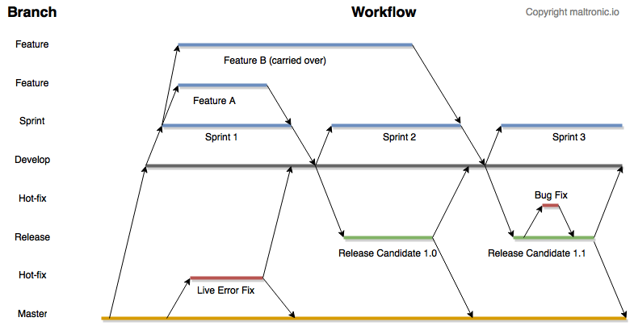

Slide 20
Time

Slide 21
Create Branch
Time

Slide 22
Merge
Create Branch
Time
Notes:
Walk through github’s site.
Command line.
Atom.

Slide 23
a
a
c
d
a
a
c
d
e
c
d
e
Create Branch
b
b
a
Time

Slide 24
a
d
a
c
Merge
c
d
a
c
d
d
a
f
c
c
g
d
i
e
h
c
g
d
e
i
Create Branch
h
b
f
b
f
a
g
i
Time

Slide 25
Walk through github

Slide 26
How to use the tools?
Walk through the process of pulling down, modifying, and then pushing back up again using terminal. Also merging. And then again using the website.
Notes:
Git is what I have experience with; specifically github.
Not going to go into setting up your account.
https://github.com/JamieBort/GitHubExample
Pull request.
Look at ‘files changed’ tab.

Slide 27
Homework
Look up the following terms:
fork
clone
remote
local
checkout
branch
rebase
head
write access
origin
pull request
commit
repository
upstream

Slide 28
Resources
URL to these slides: http://goo.gl/GzjrMi
A little bit about various git repositories: https://medium.com/flow-ci/github-vs-bitbucket-vs-gitlab-vs-coding-7cf2b43888a1
Git documentation. https://git-scm.com/documentation
Github documentation: https://guides.github.com
Git Practice. https://learngitbranching.js.org/
Github practice. https://try.github.io/levels/1/challenges/1
Me. But the answer is out there. Try to find it yourself first.

Slide 29






My contact info.
Jamie Bort
jamiebort@gmail.com
github.com/jamiebort
twitter.com/jamiebort
medium.com/@jamiebort
goo.gl/23Rtsw
[website - under construction]

