Slide 1
function:
00000500 <function>:
...
507: e8 12 00 00 00 call 51e <__x86.get_pc_thunk.ax>
50c: 05 f4 1a 00 00 add $0x1af4,%eax
511: 89 c3 mov %eax,%ebx
513: e8 98 fe ff ff call 3b0 <foo@plt>
...
int foo();
int function()
{
return foo();
}
①
foo@plt
000003b0 <foo@plt>:
3b0: ff a3 0c 00 00 00 jmp *0xc(%ebx)
3b6: 68 00 00 00 00 push $0x0
3bb: e9 e0 ff ff ff jmp 3a0 <_init+0x28>
GOT
GOT[0]:
GOT[1]:
GOT[2]: dynamic linker
GOT[3]: 0x3b6
......
②
③
⑤
PLT[0]
000003a0 <foo@plt-0x10>:
3a0: ff b3 04 00 00 00 pushl 0x4(%ebx)
3a6: ff a3 08 00 00 00 jmp *0x8(%ebx)
3ac: 00 00
④
dynamic linker

Slide 2
function:
00000500 <function>:
...
507: e8 12 00 00 00 call 51e <__x86.get_pc_thunk.ax>
50c: 05 f4 1a 00 00 add $0x1af4,%eax
511: 89 c3 mov %eax,%ebx
513: e8 98 fe ff ff call 3b0 <foo@plt>
...
int foo();
int function()
{
return foo();
}
①
foo@plt
000003b0 <foo@plt>:
3b0: ff a3 0c 00 00 00 jmp *0xc(%ebx)
3b6: 68 00 00 00 00 push $0x0
3bb: e9 e0 ff ff ff jmp 3a0 <_init+0x28>
GOT
GOT[0]:
GOT[1]:
GOT[2]: dynamic linker
GOT[3]: address of foo
......
②

Slide 3
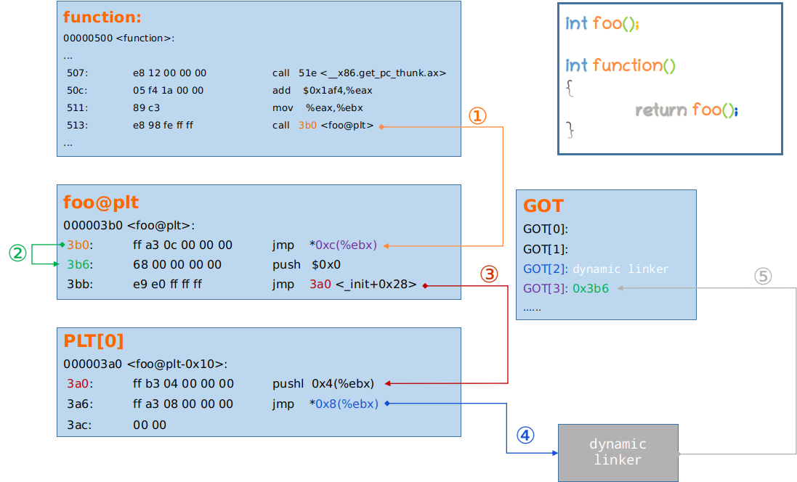

Slide 4
