Slide 1

Australian Economy Analysis
Monash FinTech Bootcamp 07/2021
Michelle
michelleqiaox@gmail.com
Scott
core3dsport@gmail.com
Jenny
jenny.tnguyen76@gmail.com
Trib
tthapa3@gmail.com

Slide 2


How did we do during the Pandemic…

Slide 3




Summary
Michelle (Strategy Consultant)
Introduction
Scott (Quality Assurance Manager)
Data cleanup and explorations: Foundation of any project
Jenny (Project Engineer)
Graphs and findings: Australia has done well
Trib (Project Manager)
Dashboard and App: Powerful Interactive resource available to anyone

Slide 4

Data Cleanup & Exploration
1. Data Cost
Realestate Market - Corelogic
2. Data Reliability
Domain.com data based on listings, false indication
ASX200-Yahoo finance API
3. Resources
ASX200-Yahoo finance API
SP-500- API
World Bank- API
Australian Bureau of Statistics

Slide 5
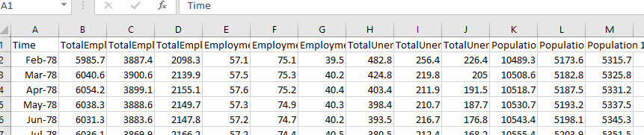
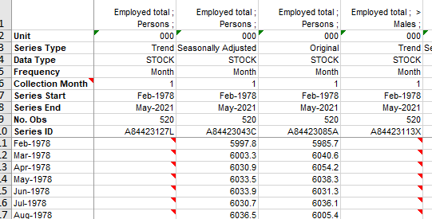
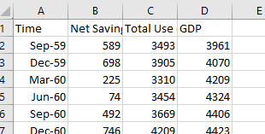
Data Cleanup & Exploration
4. Data Interpretation
Employment- Unit Metrics
Populations-Value Vs. Percentage -Millions Vs. Thousands
Naming Values – Stocks
Converting XLS to CSV
Converting Dates
Converting from Monthly to Yearly
Yearly to 5 years
Renaming Indexes
Global GDP

Slide 6

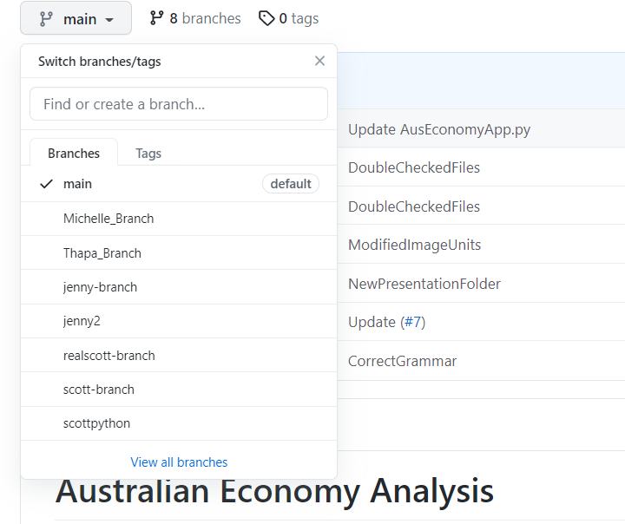
Data Cleanup & Exploration
5. Data Management
Naming System(Original-Raw-Processed )
Backup Data – back up every process
Create separate folders
Never delete files
GitHub-Merge
Working out of branches
Communication
Build master

Slide 7
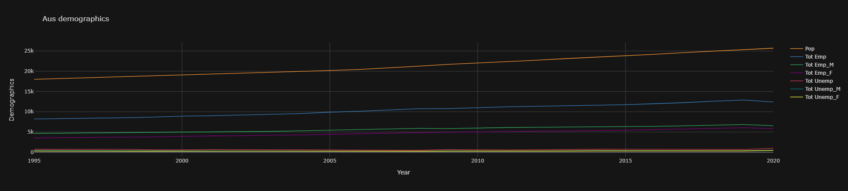
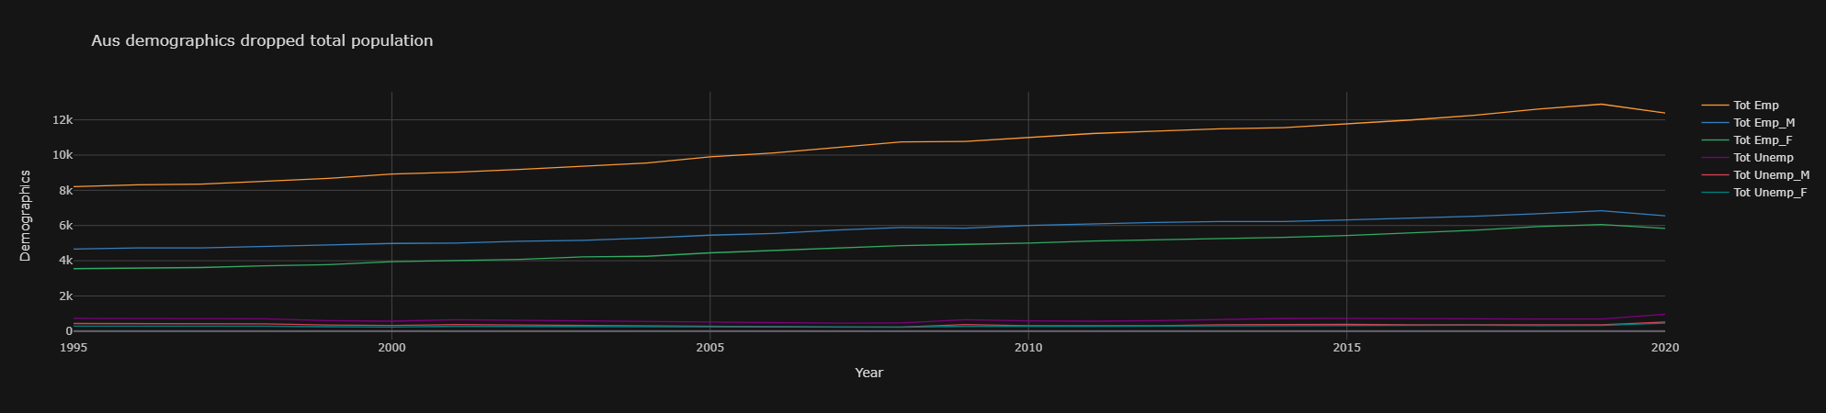
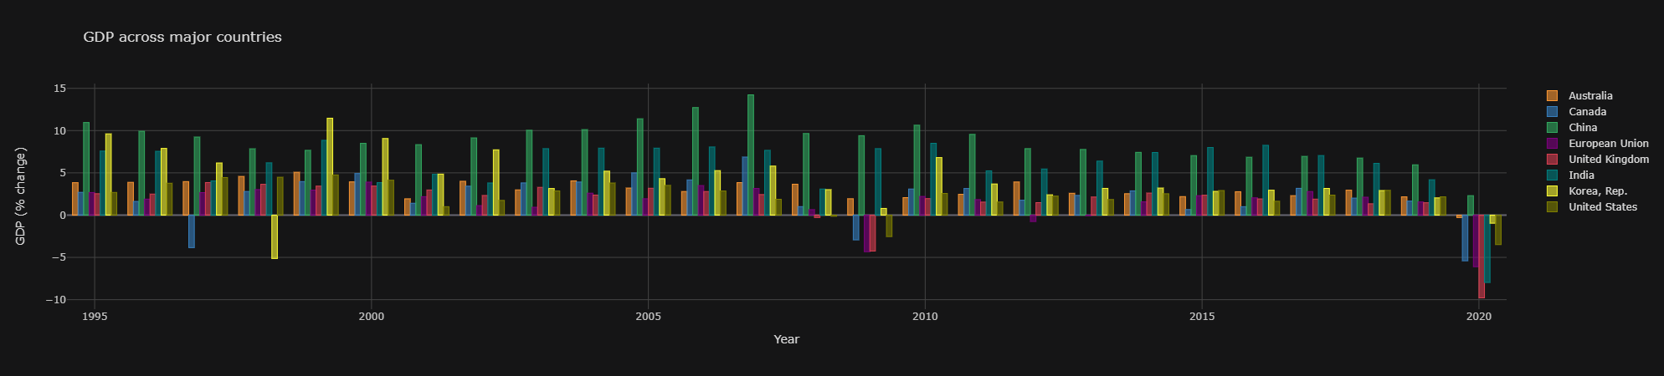
Australia Demographic Data

Slide 8
Australia Demographic Data

Slide 9
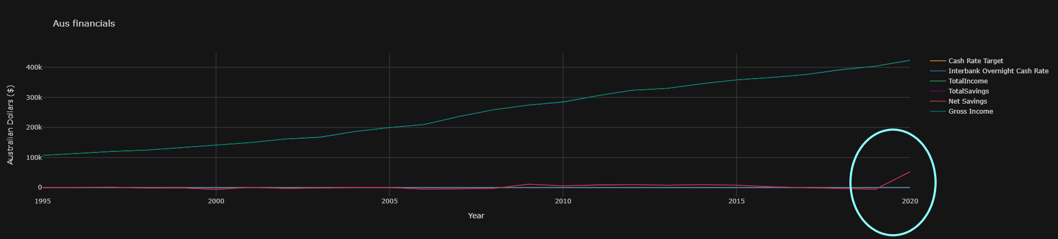
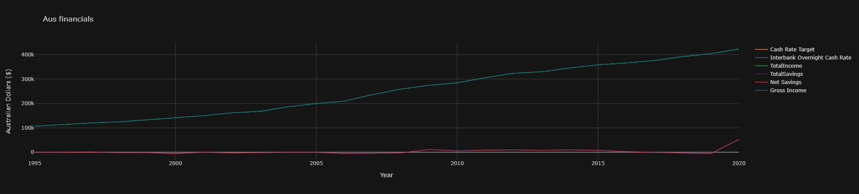
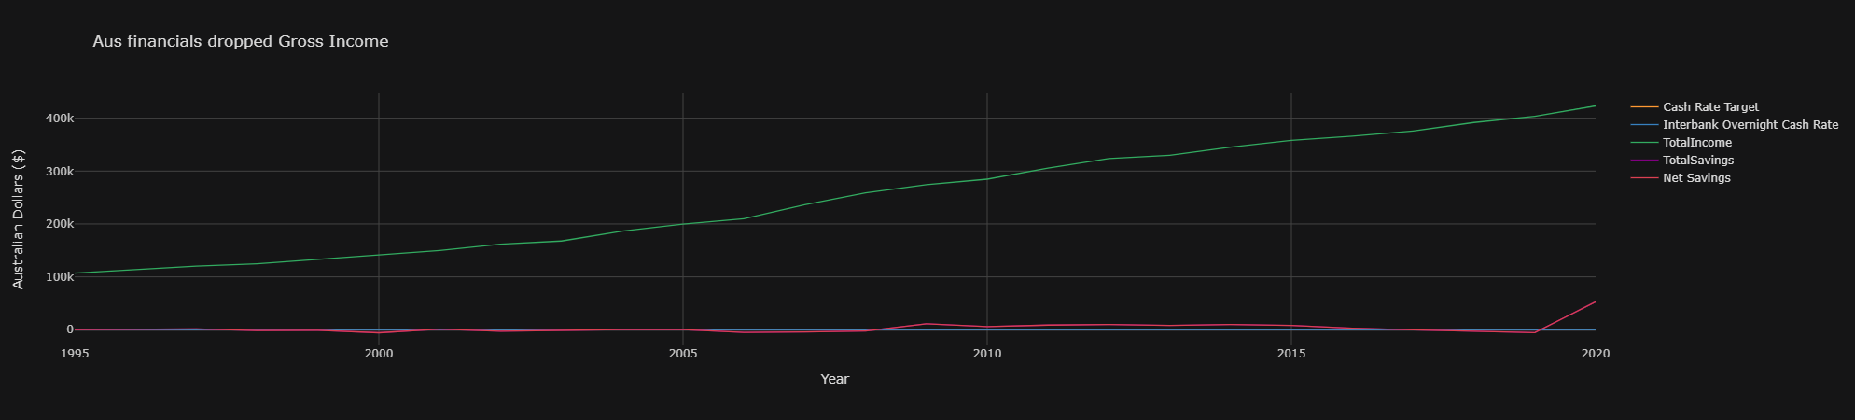
Australia’s Financials

Slide 10
Australia’s Financials

Slide 11
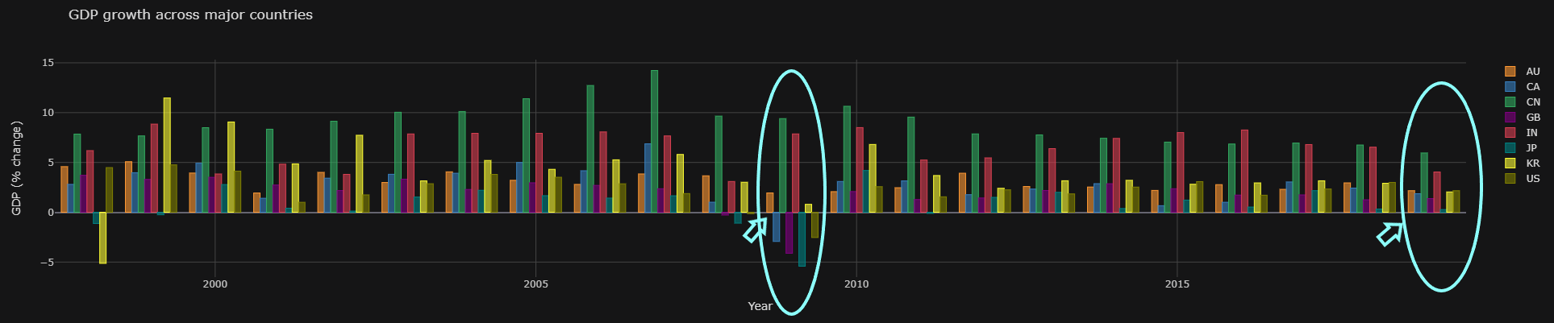
Australia's GDP VS The World

Slide 12
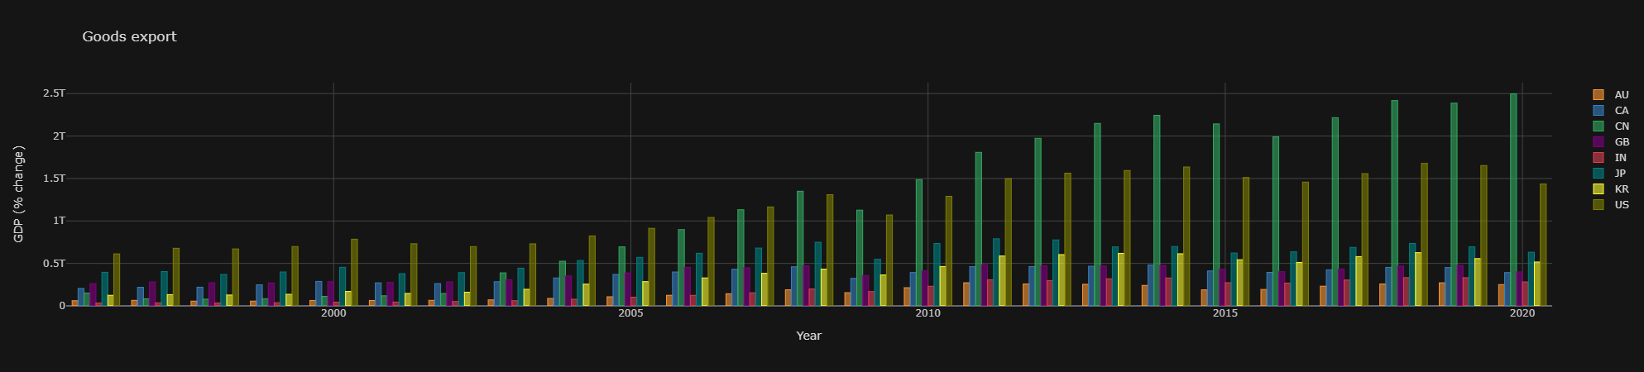
Goods Export

Slide 13
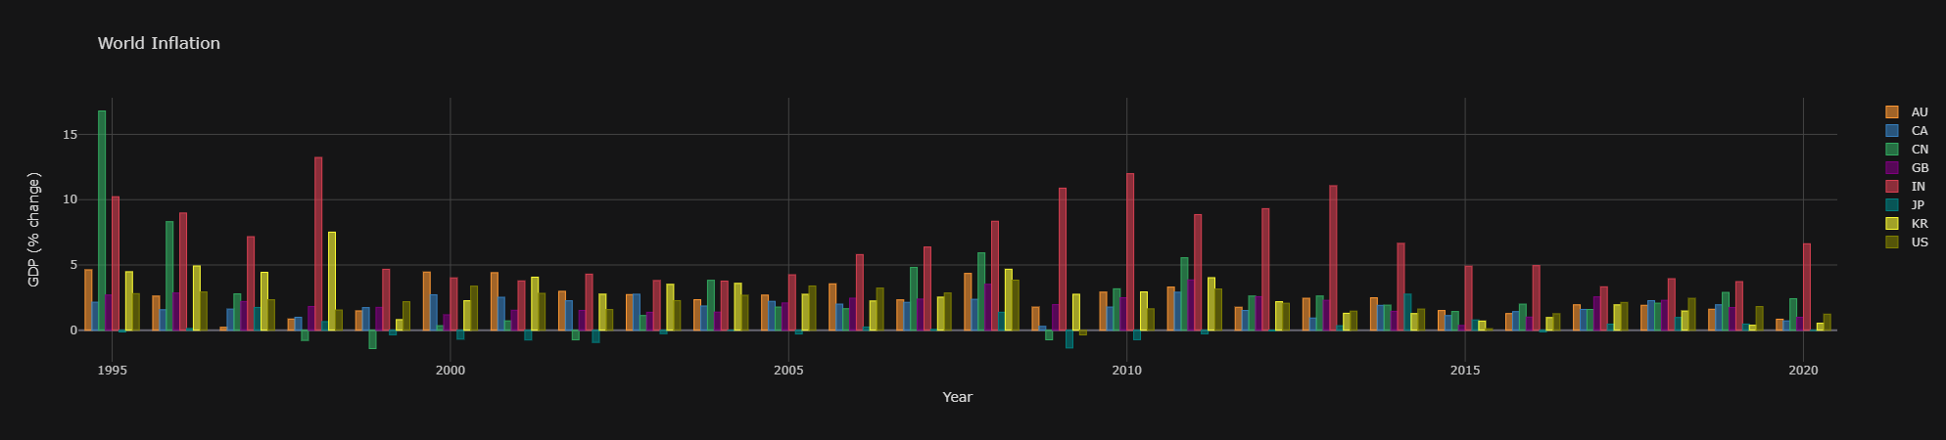
World Inflation

Slide 14
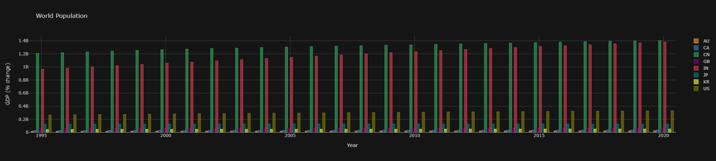
World Population

Slide 15
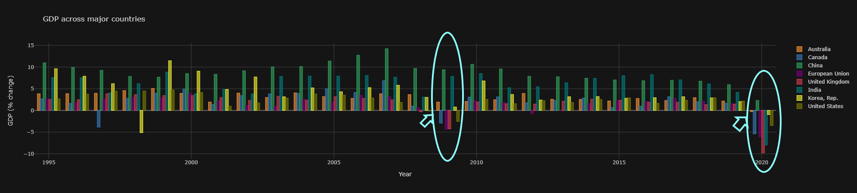
Australia VS The World 's GDP

Slide 16
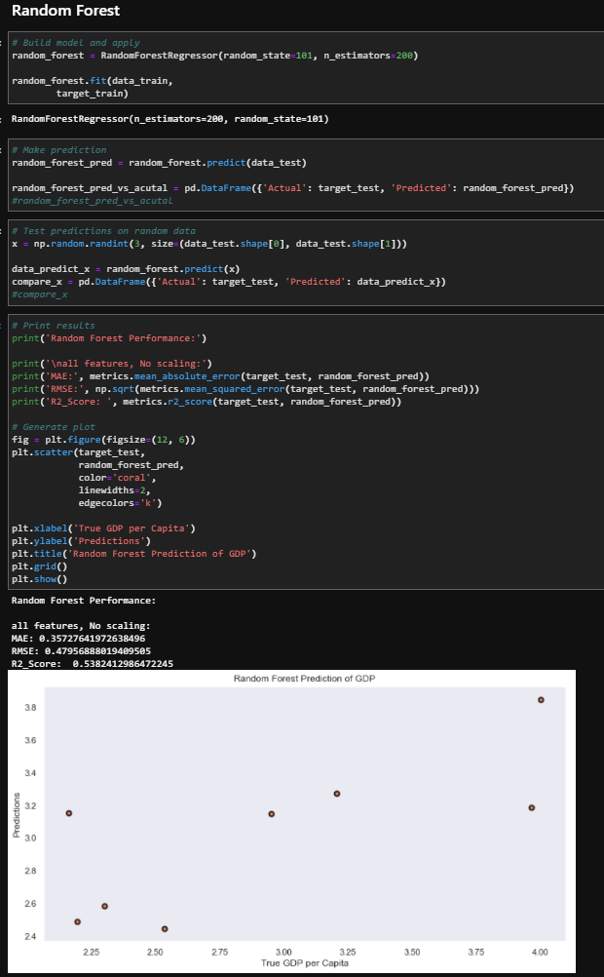
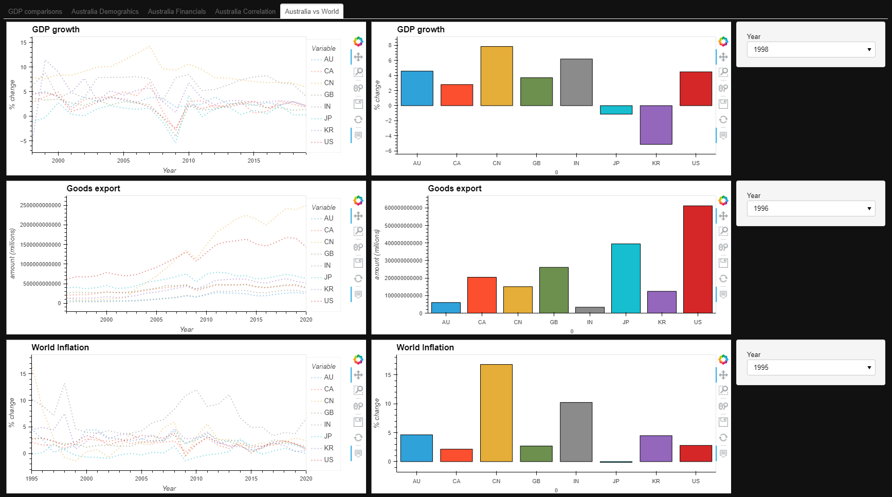
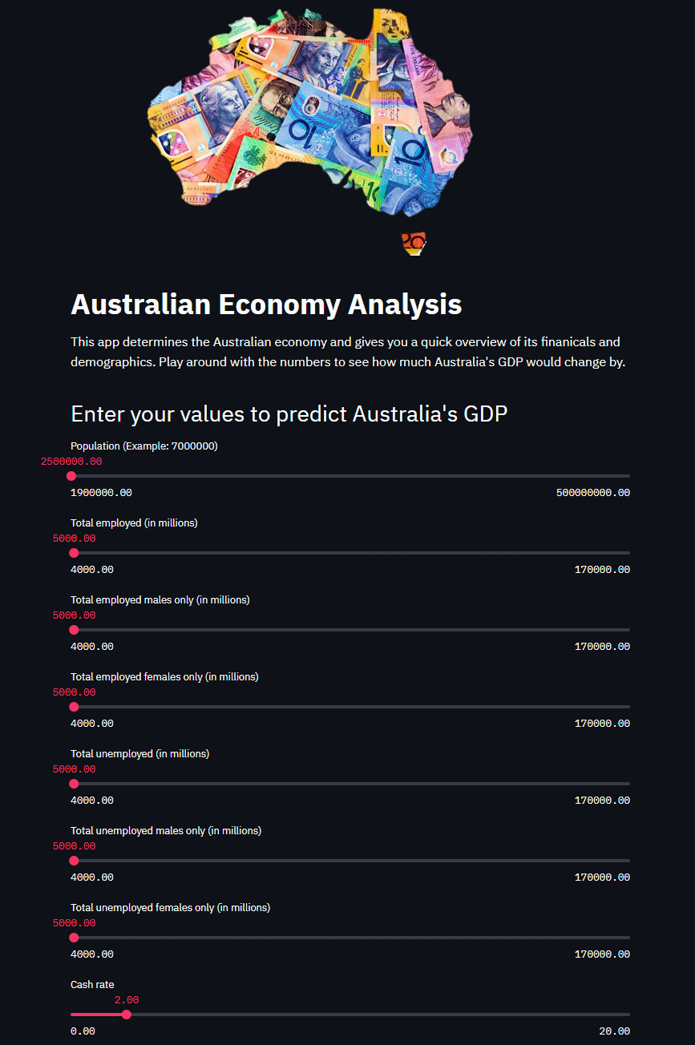
DashBoard & App

Slide 17
Difficulties arose…
Data obtained
GitHub collaboration-Scott
Conflicting issues-Jenny

Slide 18
If we have 2 more weeks…
Discuss any additional questions that arose, which couldn't be answered due to time constraints
-
What would you research next if you had two more weeks?
-

Slide 19




Any Questions…

Slide 20
References
Australia Bureau of Statistics
WorldBank
CuffLinks
Plotly
Machine Learning Classifiers
StreamLit
CoreLogic

