Slide 1
Ballot Paper
Computer Vision

Slide 2
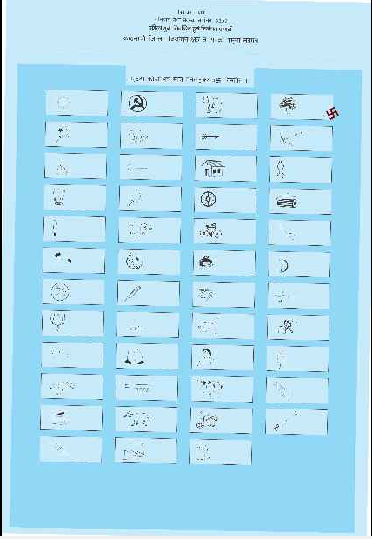
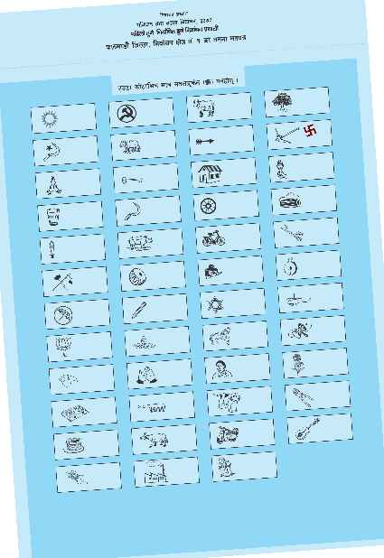
Datasets
Invalid
Valid

Slide 3
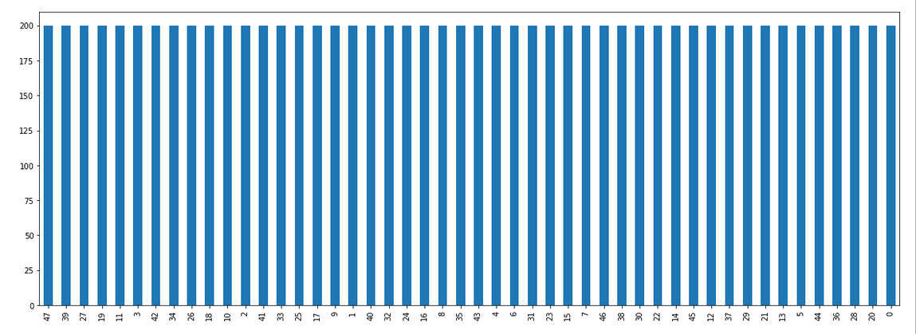
Data Statistics
Total class : 47+1 (Valid + Invalid)

Slide 4
Problem:
Classification
Solutions:
Simple Image processing
Deep Learning

Slide 5
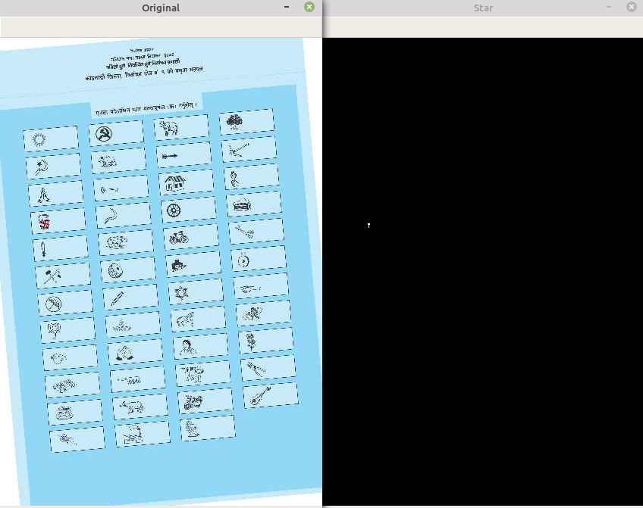
Simple image processing
Red spot location detection

Slide 6

Simple image processing
Red spot for invalid data

Slide 7
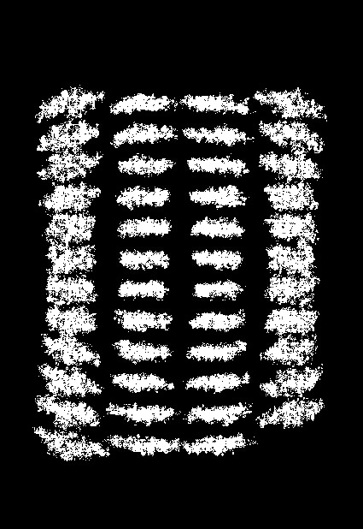
Simple image processing
Red spot for other classes

Slide 8
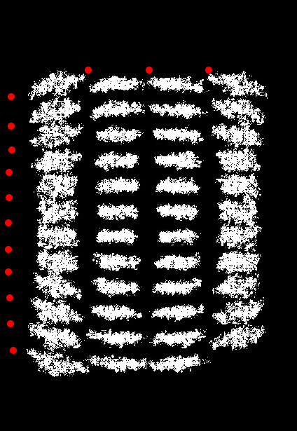
Simple image processing
Coordinate mapping

Slide 9
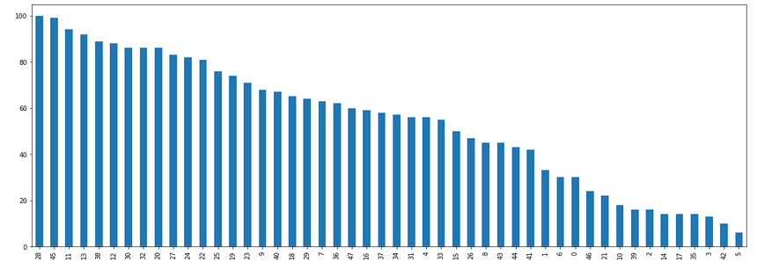
Simple image processing: Test distribution
Data are unevenly distributed

Slide 10
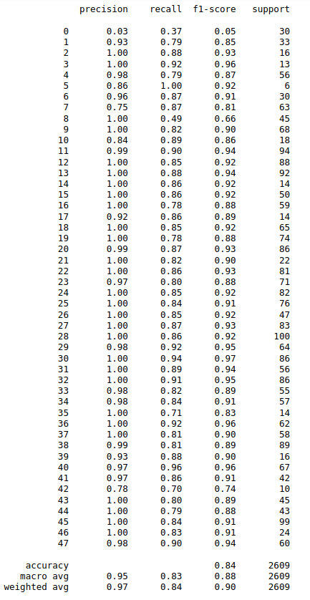
Simple Image processing: Result
Micro F1-score: 0.90
Can be improved by careful and fine location mapping

Slide 11
Deep learning
Approach: Transfer learning
Model: Resnet50

Slide 12
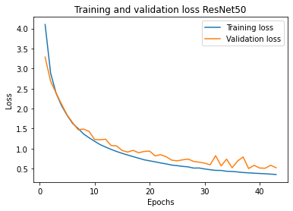
Deep learning: Learning curve
Training and validation loss plot

Slide 13
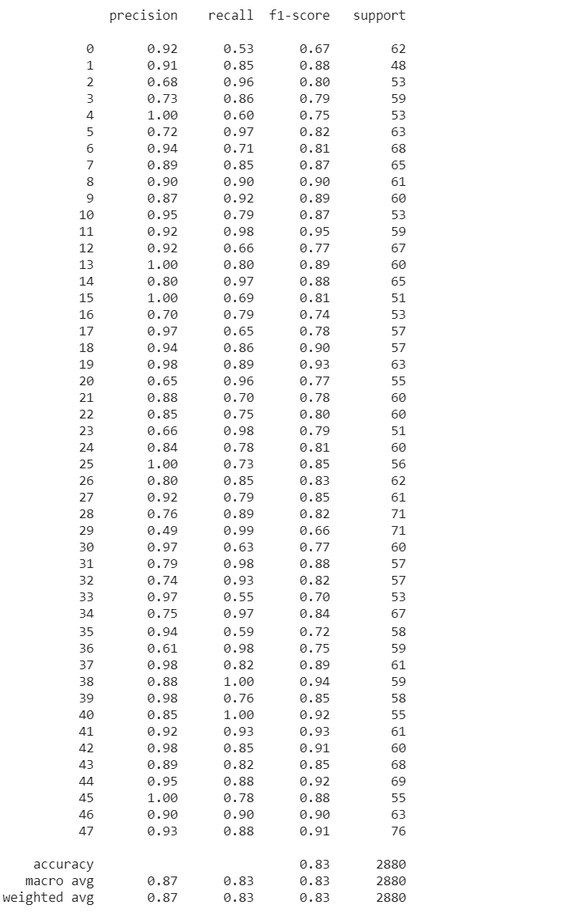
2. Deep learning: Result
F1-score: 0.83

Slide 14
Future Possibility
Image processing + Deep learning

Slide 15
App Demo

