Slide 1
Seek datasets
Data analytics insights

Slide 2
Agenda
Introduction
Data cleaning
Data visualization

Slide 3
Data Introduction
summary of the original datasets
How many documents
Formats of the excel docs
Challenges

Slide 4
What is done about the datasets
Data cleaning
Functionalization
Merge

Slide 5
Use cases of the datasets
Salaries
locations
Classification

Slide 6
Data Visualization

Slide 7
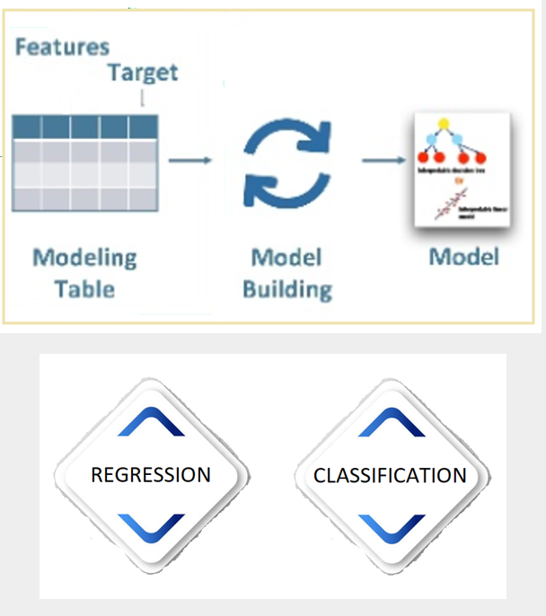
Model Development Options
Feature engineering: the best representation of the sample data
Model Building:
Regression:
Linear regression
Classification:
Logistic regression
Decision Tree
Random forest
SVM…

Slide 8
Thank You!

